Slide 1


Sponsored Programs Administration Resource & Knowledge Series
AWARD NOTIFICATION
& NEGOTIATION
Presented by:
Brion Berman, Sandra Sovinski,
Justo Torres, Laurianne Torres

Slide 2
General Business
Last session was chock-full of information that
we will refer to today and in later sessions!
AWARD NOTIFICATION & NEGOTIATION

Slide 3
General Business
LOCATION CHANGE!
The following sessions will be held in
Partnership I, room 102:
July 6 & July 20
AWARD NOTIFICATION & NEGOTIATION

Slide 4
General Business
Interested in Certification?
Want to Be a Certified Research Administrator?
http://www.cra-cert.org/
Email Doshie Walker to let her know that you are interested in a CRA REVIEW SESSION!
AWARD NOTIFICATION & NEGOTIATION

Slide 5
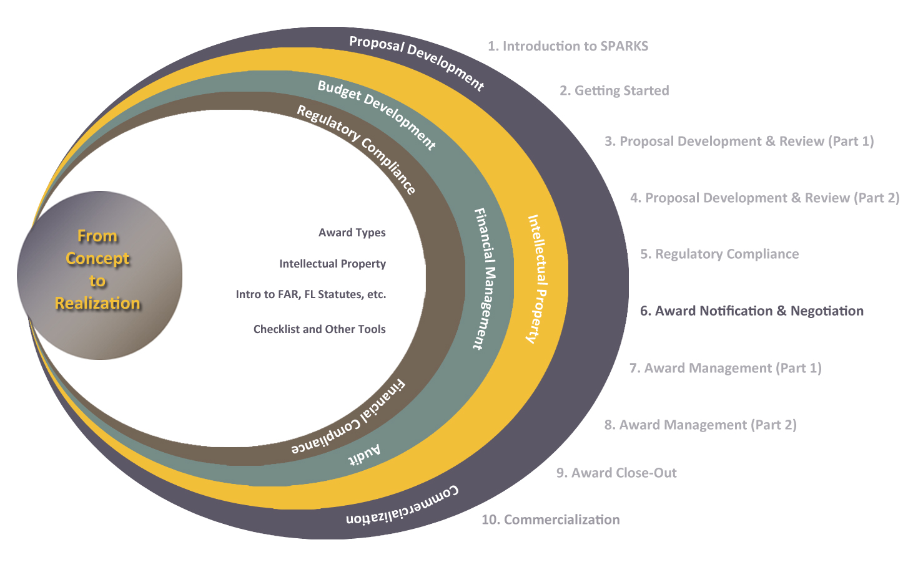
Exploring Research Administration from Concept to Commercialization

Slide 6
Exploring Research Administration from Concept to Commercialization
AWARD NOTIFICATION
Award Receipt
Is it a GIFT or a GRANT?
Awardee: UCF or UCF RF?
Funding Mechanisms
Justo Torres & Laurianne Torres

Slide 7
AWARD NOTIFICATION
Award Receipt
Notification of Award
How is it received?
By mail, by email
To ORC, to faculty member
Who is responsible?
ORC is authorized to bind the University contractually
AWARD NOTIFICATION & NEGOTIATION

Slide 8
AWARD NOTIFICATION
Is it a GIFT or a GRANT?
No single indicator: one vs. the other
Grants are reciprocal
each party giving/receiving
Gifts are contributions
with no expectation in return
Federal funds should never be treated as a gift
AWARD NOTIFICATION & NEGOTIATION

Slide 9
AWARD NOTIFICATION
Is it a GIFT or a GRANT?
CHARACTERISTIC | GIFT | GRANT
Defined Scope of Work? | NO | YES
Revocability? | NO | YES
Award Terms (Publication, IP, Royalty Sharing, etc.)? | NO | YES
Cost & Budget Information Required? | NO | YES
Detailed Reporting? | NO | YES
Performance Period / Milestones? | NO | YES
Return of Unexpended Funds? | NO | YES
Unrestricted Funds (no contract terms)? | YES | NO
Report of Accomplishments (Impact of Support) | YES | NO
No specified performance period? | YES | NO
AWARD NOTIFICATION & NEGOTIATION

Slide 10
AWARD NOTIFICATION
Awardee: UCF or UCF RF?
The UCF RF does not accept federal funding
ORC’s C&G staff handle proposal and award administration for both UCF and UCF RF projects
The UCF RF limits the receipt of state funding to <$500K per year
C&G projects funded by industry can be accepted by either UCF or the UCF RF
AWARD NOTIFICATION & NEGOTIATION

Slide 11

THINK ABOUT IT…
Benefit(s) of using the UCF RF is/are?
a. Some agencies can only fund 501(c)(3) organizations.
b. UCF RF can accept contractual language that UCF cannot.
c. UCF RF can pay for items that UCF cannot, if the sponsor’s terms allow.
d. All of the above.
AWARD NOTIFICATION & NEGOTIATION

Slide 12
AWARD NOTIFICATION
Funding Mechanisms - Federal
Grant
Contract
Cooperative Agreement
Assistance to accomplish a public purpose
Legally binding document
Award to accomplish a public purpose, but with substantial sponsor involvement in design and execution
Idea originates with the recipient
Federal procurement to acquire property or services for direct benefit or use of the Sponsor Government
Fellowship
Award generally made to an individual, not through the institution
AWARD NOTIFICATION & NEGOTIATION

Slide 13
AWARD NOTIFICATION
Funding Mechanisms - Other
Purchase Order
Used to request goods or services in return for payment
Master Task Order
Authorizes work and appropriates funds in increments/supplements
IDIQ
Delivery order requesting an indefinite delivery and indefinite quantity
Any award instrument that includes financial consideration
Subaward
Transfers a portion of a larger award to another institution
Letter Agreement
Basic agreement for goods or services with specific terms and conditions
AWARD NOTIFICATION & NEGOTIATION

Slide 14
THINK ABOUT IT…
Which of the following is true about a Cooperative Agreement?
a. The sponsor’s staff WILL be actively involved in the proposal preparation.
b. The sponsor’s staff will NOT be actively involved in the proposal preparation.
c. The sponsor’s staff will be actively involved in the proposal audit.
d. None of the above.
AWARD NOTIFICATION & NEGOTIATION

Slide 15
Exploring Research Administration from Concept to Commercialization
AWARD NEGOTIATION
Applicable Regulations
Negotiation Process
Negotiating Terms
Justo Torres & Laurianne Torres

Slide 16

AWARD NEGOTIATION
Applicable Regulations
What regulations apply to an award depends largely on 3 things:
UCF or UCF RF policies and procedures always apply.
Who the awardee is (UCF or UCF RF)
Type of Sponsor
Type of Award (Funding Mechanism)
AWARD NOTIFICATION & NEGOTIATION

Slide 17
AWARD NEGOTIATION
Applicable Regulations
The compass that guides our decision-making:
Federal
OMB Circulars
A-21 – Cost Principles for Educational Institutions (UCF)
A-122 – Cost Principles for Nonprofit Organizations (RF)
A-110 – Administrative Requirements
A-133 – Audit
Federal Acquisition Regulations
AWARD NOTIFICATION & NEGOTIATION

Slide 18
AWARD NEGOTIATION
Applicable Regulations
The compass that guides our decision-making:
State
Florida Statutes
Florida Administrative Code
Internal
UCF Policies & Procedures
RF Guidelines and Business Manual
Sponsor-specific terms & conditions
AWARD NOTIFICATION & NEGOTIATION

Slide 19
THINK ABOUT IT…
True or False?
The Federal Acquisition Regulations (FAR) apply to all types of federal funding mechanisms
(contracts, grants, cooperative agreements).
AWARD NOTIFICATION & NEGOTIATION

Slide 20
AWARD NEGOTIATION
Applicable Regulations
 | Federal Grant | Federal Contract | Federal Cooperative Agreement | Federal Flow-Thru | State Grant or Contract | Private/NonProfit/Industry Grant or Contract
Florida Statutes | X | X | X | X | X | X
Florida Administrative Code | X | X | X | X | X | X
UCF Policies & Procedures | X | X | X | X | X | X
UCF RF Policies & Procedures |  |  |  |  | X (if award is run through UCF RF) | X (if award is run through UCF RF)
Federal Acquisition Regulations |  | X |  | X (if prime is a Federal Contract)
OMB Circulars | X | X | X | X | X | X
Sponsor-specific Terms & Conditions | X | X | X | X | X | X
AWARD NOTIFICATION & NEGOTIATION

Slide 21
AWARD NEGOTIATION
Negotiation Process
Not all award types require negotiation!
Who is responsible for negotiation?
What is involved in the process?
AWARD NOTIFICATION & NEGOTIATION

Slide 22
THINK ABOUT IT…
True or False?
If UCF is able to successfully negotiate out a troublesome clause that would restrict the faculty member’s ability to publish, it means that the project work is not subject to Export Control laws.
AWARD NOTIFICATION & NEGOTIATION

Slide 23
AWARD NEGOTIATION
Negotiating Terms
Goal is to protect the University and the PI’s interests
Troublesome clauses
Negotiable vs. Deal-breakers
Each award is unique
AWARD NOTIFICATION & NEGOTIATION

Slide 24
THINK ABOUT IT…
True or False?
The UCF RF has sovereign immunity.
AWARD NOTIFICATION & NEGOTIATION

Slide 25
AWARD NEGOTIATION
Negotiating Terms
Indemnification
Governing Law
Publication
Deliverables
Administrative Issues
Equipment Vesting
Revenue Collection
Liability/Risk Assessment
Warranties
IP and Data Rights
TERMS TO CONSIDER
AWARD NOTIFICATION & NEGOTIATION

Slide 26
Exploring Research Administration from Concept to Commercialization
INTELLECTUAL PROPERTY OVERVIEW
Forms of Intellectual Property
Patents: Types of Patents & Patent Protection
Trademarks & Service Marks
Copyrights
Trade Secrets
Protecting Your IP from Within
Sandra Sovinski

Slide 27

INTELLECTUAL PROPERTY OVERVIEW
Four Forms of Intellectual Property
Patents
Trademarks
Copyrights
Trade Secrets
AWARD NOTIFICATION & NEGOTIATION

Slide 28



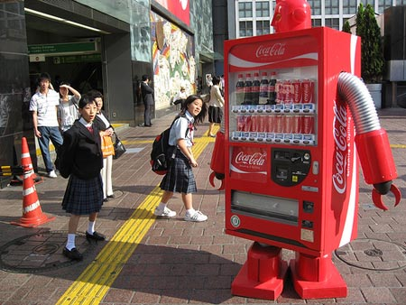





INTELLECTUAL PROPERTY OVERVIEW
Coca-Cola ®
An Example of Effective IP Usage
Bottle Shape
The word: COKE
Logo
TV Commercial
Machine Look
The Formula
Print Ads
Bottling System
Packaging
Can’s Artwork
AWARD NOTIFICATION & NEGOTIATION

Slide 29

INTELLECTUAL PROPERTY OVERVIEW
Types of Patents
UTILITY 20 Year Term
New, Useful & Non-Obvious Process, Machine, Manufactured Good, Composition of Material, or Improvement Thereof
DESIGN 14 Year Term
PLANT 20 Year Term
New Original Ornamental Design for a Product
New Variety of Asexually Reproduced Plant
AWARD NOTIFICATION & NEGOTIATION

Slide 30
THINK ABOUT IT…
True or False?
A Patent is a grant from the Federal Government of the right to EXCLUDE others from making, using or selling an invention for the term of the patent.
AWARD NOTIFICATION & NEGOTIATION

Slide 31

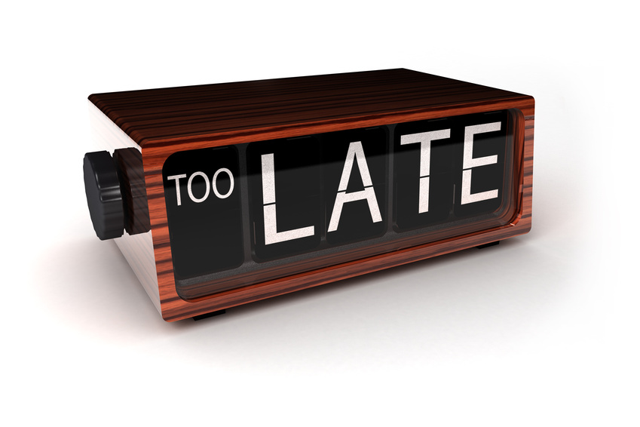
INTELLECTUAL PROPERTY OVERVIEW
Patent Protection
U.S. patent protection is unavailable if…
Another Party Invented/Filed First
Published >1 Year Prior
Offered For Sale > 1 Year Prior
Public Use > 1 Year Prior
Not Useful/”Ready” for Practice
AWARD NOTIFICATION & NEGOTIATION

Slide 32
INTELLECTUAL PROPERTY OVERVIEW
Patent Protection
NO grace period in MOST foreign countries.
Without an agreement to the contrary,
each Co-Inventor may license or use the patent without any duty of accounting of the proceeds
AWARD NOTIFICATION & NEGOTIATION

Slide 33
INTELLECTUAL PROPERTY OVERVIEW
Patent Protection – Design & Utility
Bottle Shape
The word: COKE
Logo
TV Commercial
Machine Look
The Formula
Print Ads
Bottling System
Packaging
Can’s Artwork
AWARD NOTIFICATION & NEGOTIATION

Slide 34



INTELLECTUAL PROPERTY OVERVIEW
Trademarks & Service Marks
IDENTIFY the SOURCE of goods/services
Continue for life of business, are transferrable
Prevent others from using similar mark
Trademarks for goods /
Service marks for services
Trademark
Nike ®
Service Mark
FedEx®
Can be a word, device, symbol, color, sound, or combination
Trademarks for packaging / Service marks for advertising
® is ONLY for a
registered mark
Brand names, packaging, unique color schemes, slogans
TM
non-registered rights (state law)
Renewable every 10 years
Others can make/sell same goods/ services under different mark
Can last forever
AWARD NOTIFICATION & NEGOTIATION

Slide 35

INTELLECTUAL PROPERTY OVERVIEW
Trademarks
Illustration of the Multifaceted Nature of Trademark Protection
Name is a trademark
Symbol/Logo is a trademark
Slogan is a trademark
AWARD NOTIFICATION & NEGOTIATION

Slide 36
INTELLECTUAL PROPERTY OVERVIEW
Trademark & Trade Dress Protection
Bottle Shape
The word: COKE
Logo
TV Commercial
Machine Look
The Formula
Print Ads
Bottling System
Packaging
Can’s Artwork
AWARD NOTIFICATION & NEGOTIATION

Slide 37
INTELLECTUAL PROPERTY OVERVIEW
Copyrights
Copyright protection is automatic upon creation on an original work
Protect property of creator against unauthorized copying/derivative use
Good for the life of the author + additional 70 years
Whether registered or not, include notice:
© or the word “copyright”
First year of publication
Name of owner or institution
Example: © 2011 John Doe. All rights reserved.
Literary, musical, software, dramatic, choreographic, pictorial, graphic, sculptural, audiovisual, architectural works all covered
Allow limited “Fair Use” of materials by others for criticism, comment, news reporting, teaching, scholarship and research
Why register? $ damages, attorney fees, stronger position (lower burden of proof)
AWARD NOTIFICATION & NEGOTIATION

Slide 38
THINK ABOUT IT…
True or False?
Without an agreement to the contrary,
each Co-Author of a Copyrighted Material
may license or use the Copyright Material
but WITH a duty of accounting and sharing the proceeds.
AWARD NOTIFICATION & NEGOTIATION

Slide 39
INTELLECTUAL PROPERTY OVERVIEW
Copyright Protection
Bottle Shape
The word: COKE
Logo
TV Commercial
Machine Look
The Formula
Print Ads
Bottling System
Packaging
Can’s Artwork
AWARD NOTIFICATION & NEGOTIATION

Slide 40


INTELLECTUAL PROPERTY OVERVIEW
Trade Secrets
Provides the owner with a competitive advantage in the marketplace
Must NOT be easily duplicated, reverse engineered, or discovered
Not known outside of the institution
Trade secrets can include pattern, marketing plans, physical device, idea, product formulas, financial forecasts, employee rosters, logs of sales calls, laboratory notebooks, and similar types of proprietary information
Only shared inside the institution on “need to know” basis
Safeguarded by stringent efforts to keep it confidential
Valuable and provides institution with key competitive advantage
Was developed at great time, cost and effort
AWARD NOTIFICATION & NEGOTIATION

Slide 41
INTELLECTUAL PROPERTY OVERVIEW
Trade Secret Protection
Bottle Shape
The word: COKE
Logo
TV Commercial
Machine Look
The Formula
Print Ads
Bottling System
Packaging
Can’s Artwork
AWARD NOTIFICATION & NEGOTIATION

Slide 42
INTELLECTUAL PROPERTY OVERVIEW
Protecting Your IP from Within
“Employee” agreements
NDA to not share confidential info
Non-compete agreement to not solicit other employees to leave
Assign rights of all work, inventions, etc. to institution
Limit Access to Proprietary Information
Identify and label all confidential information
Secure information and have clear employee policy
Have visitors sign-in and escorted in confidential areas
Limit information to public – approve all publications, website content, presentation materials, etc.
Provide Notice
of Rights:
©
Patent Pending
TM
®
AWARD NOTIFICATION & NEGOTIATION

Slide 43
Exploring Research Administration from Concept to Commercialization
IMPORTANCE OF & NEGOTIATING IP
Origins of IP Law & How UCF Acquires Rights
Why do we want to protect IP?
When to Look Out for IP
Negotiating IP
Brion Berman

Slide 44
IMPORTANCE OF & NEGOTIATING IP
Origins of IP Law
Article 1, Section 8 of the Constitution states:
"Congress shall have the power to...promote the progress of science and useful arts, by securing for limited times to authors and inventors the exclusive right to their respective writings and discoveries." (US Const., art I. sec. 8, cl. 8.)
The Bayh-Dole Act
allows universities, small businesses and non-profits to own IP resulting from federal funding. (35 U.S.C. § 200-212)
Data Rights
FAR 27.401 and 52.227-14
AWARD NOTIFICATION & NEGOTIATION

Slide 45
IMPORTANCE OF & NEGOTIATING IP
How UCF Acquires Rights
Florida Statute 1004.23
Authorizes FL universities to Secure, License, Enforce IP
UCF Policies
UCF-2.029 Copyrights and Patents; Faculty and Graduate Handbooks and Collective Bargaining Agreement—requires UCF Faculty/Staff/Grad. Students to disclose inventions and assign rights to UCF.
AWARD NOTIFICATION & NEGOTIATION

Slide 46
IMPORTANCE OF & NEGOTIATING IP
Why do we want to protect IP?
Social, Cultural, and Economic Development
Drives industrial growth
Protects key technology
Creates a barrier to others
Generates value
Incentivizes commercialization
Helps raise living standards
AWARD NOTIFICATION & NEGOTIATION

Slide 47
IMPORTANCE OF & NEGOTIATING IP
Why do we want to protect IP?
Licensing Revenue
IBM (software) | $1.1B (annual)
Qualcomm* (3G tech) | $10.4B (annual)
Gatorade | $150M+ (cumulative)
Loss to China | $48B (annual)
*annual revenue for 2009; source: Bloomberg Businessweek
AWARD NOTIFICATION & NEGOTIATION

Slide 48
IMPORTANCE OF & NEGOTIATING IP
Why do we want to protect IP?
Cumulative net income (gross royalties minus direct costs of patenting, licensing, legal and other related expenses) resulting from inventions is distributed as follows:
UCF Royalty Distribution
RECIPIENT | $1-$100K | $101K-$199K | >$200K
Inventors | 50% | 40% | 30%
Inventors’ College | 20% | 24% | 28%
Inventors’ Department | 20% | 24% | 28%
UCF Research Foundation | 10% | 12% | 14%
AWARD NOTIFICATION & NEGOTIATION

Slide 49
THINK ABOUT IT…
When is the best time to ask the PI if IP has been developed?
a. At the time of project close-out.
b. Prior to proposal submission.
c. Upon completion of the research project.
d. Before submitting results of the research for publication or to the Sponsor
e. All of the above.
AWARD NOTIFICATION & NEGOTIATION

Slide 50
IMPORTANCE OF & NEGOTIATING IP
When to Look Out for IP
IP can be generated at any time:
Proposals
Contracts and Grants
Presentations
Manuscripts, Thesis, Dissertations
Collaborations
Sponsored Research
AWARD NOTIFICATION & NEGOTIATION

Slide 51
IMPORTANCE OF & NEGOTIATING IP
Negotiating IP: A Starting Point
Background Intellectual Property
All inventions, improvements and/or discoveries…which were in existence, prior to the execution date of the Agreement.
UCF Default Position on Background Intellectual Property:
Existing Background Intellectual Property of any party existing prior to the Agreement is separate property and not affected.
Neither party acquires rights in any Background Intellectual Property of the other that exists prior to the execution date of the Agreement.
AWARD NOTIFICATION & NEGOTIATION

Slide 52
IMPORTANCE OF & NEGOTIATING IP
Negotiating IP: A Starting Point
Mutual (Neutral) IP Language
UCF shall own all IP developed solely by UCF employees.
Company shall own all IP developed solely by Company’s employees.
IP jointly developed by UCF and Company
shall be jointly owned by UCF and Company
AWARD NOTIFICATION & NEGOTIATION

Slide 53
THINK ABOUT IT…
Is it always appropriate to use the mutual IP language?
AWARD NOTIFICATION & NEGOTIATION

Slide 54
IMPORTANCE OF & NEGOTIATING IP
Negotiating IP: A Starting Point
Maybe YES:
Both UCF and Company are equally contributing
Language does not hurt UCF’s position
Good, ongoing relationship with Company
Delays negotiations until later
Maybe NO:
UCF or the Company may want more…
AWARD NOTIFICATION & NEGOTIATION

Slide 55
IMPORTANCE OF & NEGOTIATING IP
Negotiating IP: UCF May Want More
What about when:
Contracts (UCF Prime)
Sponsored Research is conducted at UCF
UCF has all the expertise
UCF provides unique materials
In these cases, more than likely, UCF wants to own more.
Limited rights for Subcontractor to use Background IP for a specific purpose
Flow back rights of New IP to UCF
UCF’s ability to use New IP
UCF owns, solely or jointly, new IP
AWARD NOTIFICATION & NEGOTIATION

Slide 56
IMPORTANCE OF & NEGOTIATING IP
Negotiating IP: What Companies Want
But companies want:
Assignment of IP Rights
Exclusive rights to Background IP
Exclusive rights to New IP
Right of First Refusal to New IP
Upfront License terms for New IP
UCF may be willing to consider alternatives:
License Background IP separately
Option for New IP
AWARD NOTIFICATION & NEGOTIATION

Slide 57
THINK ABOUT IT…
True or False?
In a legal agreement,
when granting to a Company a future right to UCF’s IP,
the grant of a right of first refusal to license the IP
is identical to
the grant of a first option to license the IP.
AWARD NOTIFICATION & NEGOTIATION

Slide 58
IMPORTANCE OF & NEGOTIATING IP
Negotiating IP: Alternatives
But what about when:
Contracts (UCF Sub)
Collaborations
UCF does not have all the expertise
UCF receives unique materials
In these cases, UCF usually wants to own more, but cannot negotiate for more
UCF needs to consider:
Right for UCF to use Background IP of Contractor
Right for UCF to own IP created under subcontract
Reservation of right for continued research after the contract
AWARD NOTIFICATION & NEGOTIATION

Slide 59
IMPORTANCE OF & NEGOTIATING IP
Impacts of Negotiating IP
Regardless, you always have to consider the current and future impact of IP terms to UCF and the PI:
Future research
Funding
Collaborations
Publications
Graduate Students
Tenure
AWARD NOTIFICATION & NEGOTIATION

Slide 60

QUESTIONS or COMMENTS?

Slide 61
THANKS FOR JOINING US!
Please come to the next session:
AWARD MANAGEMENT (PART I)
July 6, 2011
10:00 am to 12:00 pm
Sponsored Programs Administration Resource & Knowledge Series

