Slide 1


Sponsored Programs Administration Resource & Knowledge Series
Commercialization
Presented by:
Dr. Tom O’Neal and Dr. Svetlana Shtrom

Slide 2
ORC Efforts to Accelerate the Knowledge-based Economy by a Strong Coupling to the Academic Enterprise
Tom O’Neal
Associate Vice President for Research and Commercialization
Notes:
We are committed to our region and state’s efforts to attract, retain, and grow tech-based industry. We are already a great big university.
Our only hope for being a great university is to prove to our state that we can have a major impact in developing its wealth producing industries. The three key components of our strategy for doing this are shown on the next slide.

Slide 3
Building quality programs in focused areas that impact the region’s high tech industry
Incentivize faculty engagement with regional industry (FHTCC)
Commitment to development of our region’s innovation ecosystem through entrepreneurship education, incubation, tech transfer, & active support high value economic growth
Notes:
•
1. Our strategy starts with building quality programs in areas that impact existing and emerging industry clusters in our region and in the state, e.g., prusue excellence in key areas of research and graduate education.
2. Next we provide incentives to encourage faculty engagement with regional industry. Our prime way of doing this is through the FHTCC, e.g., be America’s leading partnership university.
3. The third leg of our economic engagement strategy is new company creation. We are committed to the development of our region’s innovation ecosystem through tech transfer, entrepreneurship education, incubation of new companies, and we actively support high-value economic growth. In general we try to put the same energy and creativity in commercialization of technology as used to create it.
At another time we can talk about development of centers and institutes and other focus on key areas of research and graduate education and about the FHTCC project. Today we wand to concentrate on the third bullet. Tom will describe those activities centered around building the innovation ecosystem for our region.
Our objective to day is to give you a taste of these activities and to solicit your input about what we are doing and your support in selling these activities to our other bosses.

Slide 4
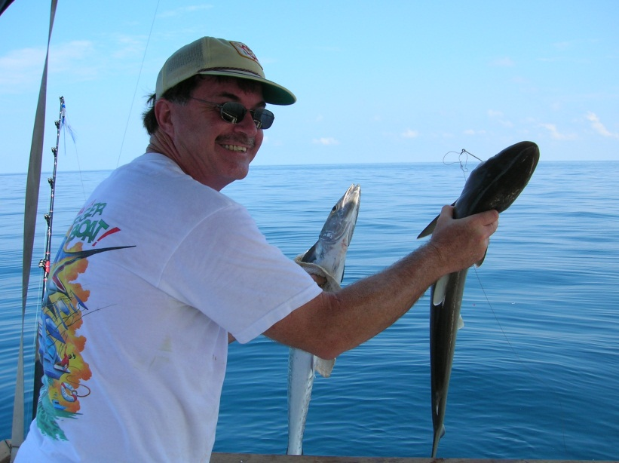
Why listen to me?
1970’s
1980’s
1990’s
2000’s
2010’s
Entrepreneur
BSEE
Engineer
Associate Director @ CREOL
Entrepreneur
Founding Director UCFTI now UCFBIP
MSEM, MBA, PhD
Associate VP
Dr. Thomas O’Neal
Associate VP for Research and Commercialization
Executive Director UCF Business Incubation Program
Executive Director GrowFL
12201 Research Parkway
Orlando, FL 32826
oneal@mail.ucf.edu
www.research.ucf.edu
Faculty
Mgmt/IEMS
Exec. Direc.
GrowFL

Slide 5
ORC’s Organizational Structure

Slide 6
Focus on Key Areas
Match university assets to industry clusters
CREOL – Optics Industry
IST – Large presence in Central Florida and CFRP
AMPAC – Created to serve semiconductor fab
FSEC -- We did energy before energy was cool
FSI – Space industry and NASA
NANO – Growing field locally
BMS -- Leading cluster development

Slide 7
Focus on Key Areas
Traditional Colleges, units
Engineering
Physics
Sciences
Chemistry
Math
Humanities
Psychology
etc

Slide 8
Economic Development Eco System UCF’s Approach to Accelerate Innovation
Notes:
Good starting point for SPaRKS presentation

Slide 9






Entrepreneurial Ecosystem
Economic Gardening
Universities, & Colleges
Volunteer Mentors
Ecosystem Funding Sources
Peer Networking groups
New IP & Technology
Intellectual
Capital
Resource
Providers/
Support
Incubators and Accelerators
Non-profit Research Institutions & Hospitals
SBDC SCORE
Early-stage Execs & C-level Mgrs
Service Providers
Talent
Pool
Entrepreneurs
Workforce
Chambers
Angels, VCs, Private Equity
Policy Makers, Government
Philanthropy
Advocates
& Champions
Economic Development Organizations
Financial
Capital
Banks
Government grant/loan programs
State & Local Government Foundations & Individuals Businesses
Trade Assns
Corporate Partners

Slide 10
Taxes
USA: LAB TO MARKET
ECONOMIC PYRAMID
Jobs
Research Park
Product
Incubation
Company
Technology and Graduates
Funding for Labs
World Class Researchers/Faculty

Slide 11
Path to Success
Success
Startup
Copyright © O’Neal 2011

Slide 12
How does one get there?
A
Success
Startup
Copyright © O’Neal 2011

Slide 13

How do they get there?
B
Success
Startup
Copyright © O’Neal 2011

Slide 14
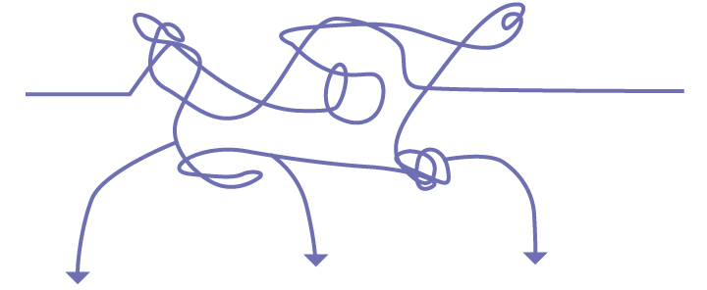
Central Florida’s Ecosystem
Ecosystem Funding Sources
Intellectual
Capital
Resource
Providers/
Support
Funding
Talent
Pool
Entrepreneurs
Financial
Capital
Advocates
& Champions
Resources
Copyright © O’Neal 2011

Slide 15
Big picture goals
Expand high tech industry
Engage the community
Facilitate tech transfer
Collaboration
Economic development in the society

Slide 16



Economic Development in the Innovation Economy
Economic Development
Commercialization Incubation
Strategy Development
Assessment / Marketing/
Technology Maturation
Sponsored
Research
IP Creation &
Management
Top Students
World class research
Business services
Tech Savvy Entrepreneurs
Industry Clusters
Political Support
Workforce Development
IP Training / Awareness
State of the art facilities
Top Faculty
Must reach a critical mass of specialized supporting infrastructure
Notes:
This is a complicated slide; please draw the audience’s attention to where they, as Research Administrators, fit in and how they facilitate Economic Development.

Slide 17
University Commercialization & Incubation
Idea Basic Research Applied Research Prototype Products
Influence
Secondary effect
Core Activities
Contribution
Licenses
High-paying
jobs
Partnerships
Economic
development
Diversified
economy
Quality &
Relevant
Research
Proactive
Technology
transfer
Commercialization
New companies
Stronger
existing
companies
UCF
Spin-offs
Rich
Academic
Programs
Leaders
to create
new
companies
Entrepre-
neurship

Slide 18
Innovation Support Infrastructure here at UCF
FHTCC
Venture Lab in Research Park, RP
Disney Entrepreneur Center (DT)
Incubator Program (9 sites)
Entrepreneurship Center in COB
Technology Transfer Office, RP
Research & Com. Office, RP
GrowFL RP
Notes:
Please describe the FHTCC in more detail; this will be new to them. Please consider labeling the ORC programs as “ORC” instead of “RP” for clarity for this audience.

Slide 19

FHTCC matching grants program
Matching Funds to promote industry research partnerships
Leverage university resources / expertise
Access to top students
Over 1000 projects
$55M FHTCC, 300 companies

Slide 20
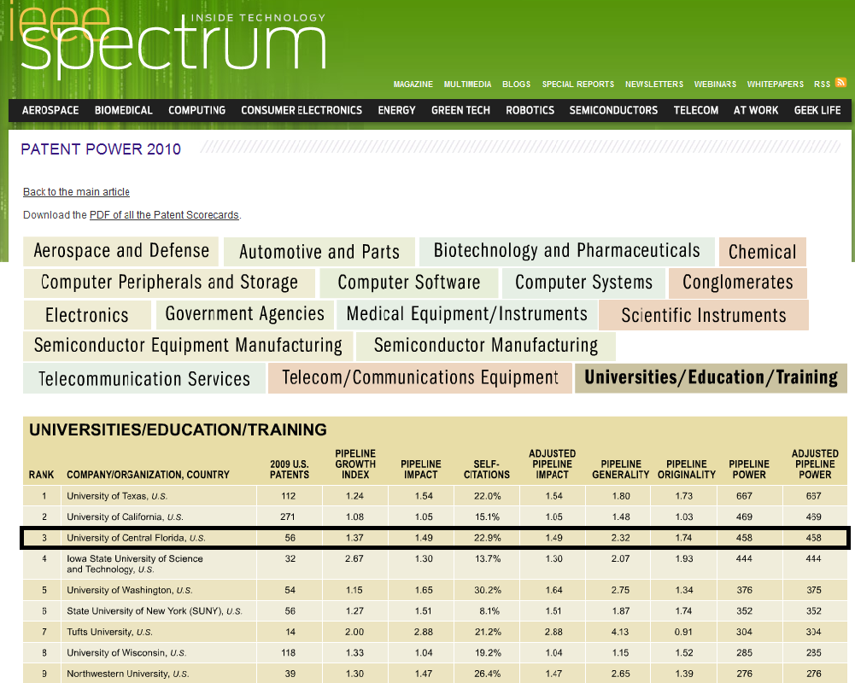
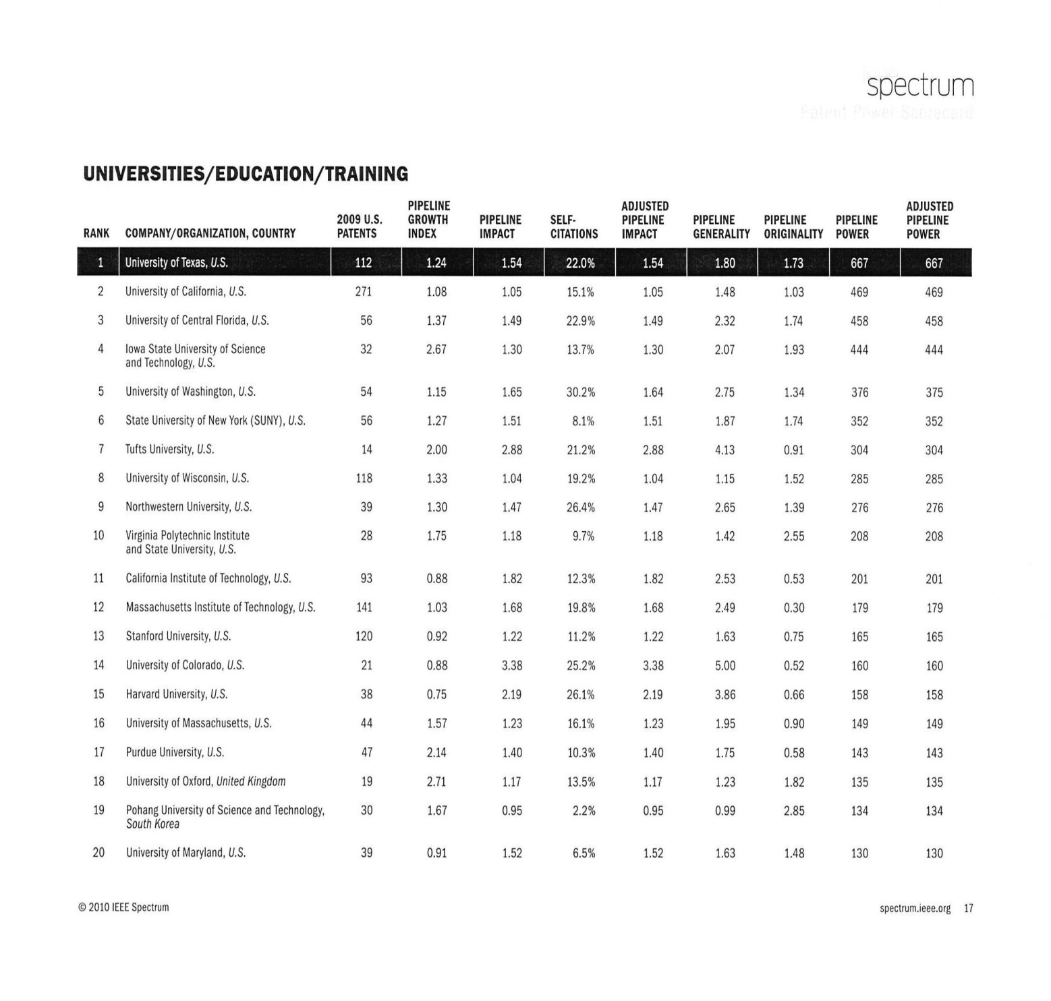
Ranking – 2010 US Patent Power

Slide 21
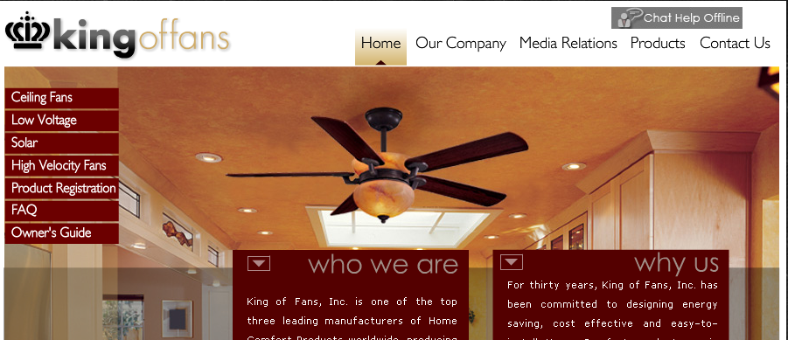
Tech Transfer Examples
King of Fans (established OEM) – licensed series of ceiling fan patents, established Energy Star std for entire product category
Notes:
1.7 million fans sold since in the past 10 years.

Slide 22

Tech Transfer Examples
Petra Solar
(startup co, raised $14M in 1st round VC investment) – licensed series of power supply patents, can store & release energy per panel versus end panel only

Slide 23
Tech Transfer Side Benefits
Petra Solar example:
Hired six alums as full time employees (“high paying” jobs)
Hired additional students as interns
Contracted for $900,000 in sponsored research
Matched with $450,000 from FHTCC Program
Located company’s R&D headquarters in UCF Research Park
Multiplier Effect = economic development

Slide 24
UCF Tech Transfer
Portfolio of approx. 553 issued patents
Staff consists of Dir, 4 LA’s & assistants
Receive avg of 120 inv disclosures/year (disclosure rate exceeds US avg by 3x)
Licensing revenues just starting to grow
Goal is NOT short term income maximization, rather to get good tech from UCF into marketplace, invest in region
Notes:
I updated the number of issued patents and changed the number of LA’s from 3.5 to 4, since Sandra Sovinski is full-time now. Although John and Andrea are Assoc. Directors, they function as Licensing Associates, so I did not make this distinction in adding up LA’s to 4.

Slide 25

Venture Lab’s Mission
To provide early-stage entrepreneurs with access to experienced business coaches that can assist them in the business steps that are critical for the successful launch of technology firms.

Slide 26
What the Venture Lab Does
The Venture Lab provides expertise and resources to technology entrepreneurs in a variety of areas including:
business plan & financial statement creation
market research assistance
company, investor and product pitches
product validation & competitive analysis
financing guidance & intros to investors
business strategy mentorship
SBIR and Kauffman educational workshops
online templates for BP, financials, pitches, etc.

Slide 27
Business Incubation
Smart place to start
Increase chances of success
87 % of incubator graduates still in business 5 years later
Home grown companies
84 % of graduates stay in the community they were incubated in
Good investment
Low cost per job
generates more tax revenue than it costs

Slide 28
Incubation Program - UCFIP
The UCF Incubation Program opened in December, 1999, with the Technology Incubator. The Program now consists of eight facilities in Metro Orlando (one coming)
Facilities in total cover 106,000 sq. feet
The Program is a partnership between UCF and the local government / community.
Notes:
Did you change Business Incubation Program to just Incubation Program? That is why I was confused by UCFIP when you first showed these slides to me. I was expecting UCFBIP. UCFIP may be confusing to the audience who are used to IP referring to Intellectual Property.

Slide 29
What does the UCFIP do?
Graduate companies poised for success
New Client
Identify and strengthen the weak spots
Add Value
Marketing
Sales
Distribution
Financial
Technical
IP
Cash
Management
Manufacturing
Contacts
Incubator staff
Community political support
Technical expertise
Business expertise
Networking
Regional professional service providers
University resources
Marketing
Sales
Distribution
Financial
Technical
IP
Cash
Management
Manufacturing
Contacts
Focus
Tactics
Strategy
Connectivity

Slide 30
UCFIP Services
On-site business coaching and mentoring (including from the Venture Lab)
Entrepreneurship curriculum, seminars
Access to community leaders and advisory board
Shared resources
Reception, conference rooms, high speed internet access, work / break rooms, office equipment
Networking, close proximity to UCF technology, expertise and the UCF Campus or Downtown Orlando resources
Access to interns and graduate student support
Adaptable space, flexible leases

Slide 31
Current Results from the UCFIP Clients
Companies currently serving | 108
Companies graduated | 65, 60 still in Region
Companies assisted in total | 200
Jobs created in community / total | > 1,600 / >3,000
Average salary | $60,000
Investment raised | $190 M
Generated revenue | > $300M
Patents held by UCFTI clients | 286
Copyrights held by UCFTI clients | 75
Trademarks held by UCFTI clients | 47
Trade secrets held by UCFTI clients | 64

Slide 32
Growth of the UCFIP
UCFIP
Research
Park
Downtown
Winter
Springs
OBDC
Photonics
Osceola
County (2)
Volusia
County
(Q1 2011)
Lake
County

Slide 33

Central Florida Research Park
Established in 1981
7th largest research park in the US
Over 120 firms
10,000+ employees
1100 acres adjacent to UCF.

Slide 34
Central Florida Research Park
Examples of UCF spinoffs or Incubator graduates
in the Park:
AVT Simulation
Productivity Apex
Raydiance
Petra Solar
HN Burns Engineering

Slide 35
Evolution
Central Florida Research Park 1981
UCF Research Foundation 1991
Technology Transfer Program 1992
Emerging Business Network 1996
Technology Incubator 1999
Excellence in Entrepreneurship 2000
Industry matching grants program 2000
Boot-camps for Entrepreneurs 2000
Office of Economic Development 2002
Entrepreneurship graduate course 2003
Business Plan Competition 2004
Venture Lab 2004
Center for Entrepreneurship and Innovation 2005
Incubation Program expansion currently 8 facilities 2010

Slide 36
Questions
What does this have to do with me?
Are we rich yet?
Where do I sign up?
Notes:
36

Slide 37

Notes:
This slide is to remind us not to talk too much and go kick some tires. But Tom and I are faculty and therefore we have a quiz question. What does the sign say and in what language?

Slide 38
Exploring Research Administration from Concept to Commercialization
Research Administration Cycle
Research Cycle
Award Cycle
Economic Development Cycle
Dr. Svetlana Shtrom

Slide 39
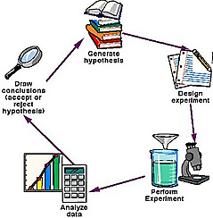
RESEARCH CYCLE
Adapted from: http://www.ucsd.tv/greymatters/images/GreyMatters_BasicScienceSM.jpg
COMMERCIALIZATION

Slide 40
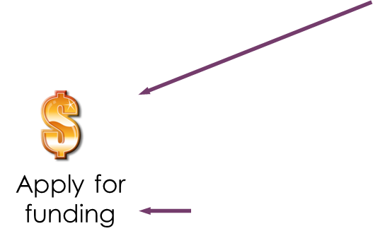
AWARD CYCLE
Adapted from: http://www.ucsd.tv/greymatters/images/GreyMatters_BasicScienceSM.jpg
COMMERCIALIZATION

Slide 41
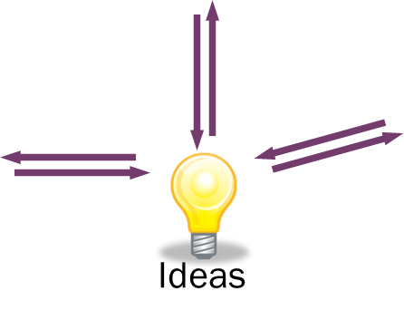
RESEARCH CYCLE: ideas
Adapted from: http://www.ucsd.tv/greymatters/images/GreyMatters_BasicScienceSM.jpg
COMMERCIALIZATION

Slide 42




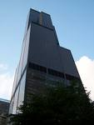
PATH TO COMMERCIALIZATION
Invention
Invention Assessment/ Patent Strategy
Technology Commercialization Committee
Market and Business Analysis
Commercialization Strategy
Coaching
Incubation
Start-Up
External Company
Economic Gardening
COMMERCIALIZATION

Slide 43
Taxes
USA: LAB TO MARKET
ECONOMIC PYRAMID
Jobs
Research Park
Product
Incubation
Company
Technology and Graduates
Funding for Labs
World Class Researchers/Faculty

Slide 44
ECONOMIC development cycle
Invention
Research funding
Salaries
Jobs
Start-Up
External Company
COMMERCIALIZATION

Slide 45
Exploring Research Administration from Concept to Commercialization
Research Administration Cycle

Slide 46
Sponsored Programs Administration Resource & Knowledge Series
Series Wrap-up
Nancy Nisbett

Slide 47
General Business
TEAM PROJECTS
August 24th
Contact your mentor if you have questions or need guidance:
Nancy Nisbett Justo Torres
407.882.2223 phone 407-882-1131 phone
nancy.nisbett@ucf.edu justo.torres@ucf.edu
Svetlana Shtrom Laurianne Torres
407-823-5150 phone 407-882-0113 phone
svetlana.shtrom@ucf.edu laurianne.torres@ucf.edu
COMMERCIALIZATION

Slide 48
General Business
TEAM PROJECTS
Schedule
Morning Afternoon
Team 1: 9:00 Team 5: 12:45
Team 2: 9:45 Team 6: 1:30
Team 3: 10:30 Team 7: 2:15
Team 4: 11:15
COMMERCIALIZATION

Slide 49
General Business
TEAM PROJECTS
Poster (tri-fold display board)
Team Information
Problem Statement
Key Stakeholders
Project Description
Project Benefits
Implementation
COMMERCIALIZATION

Slide 50

General Business
TEAM PROJECTS
PowerPoint Slides (optional)
Email PPT slides to Doshie Walker (doshie.walker@ucf.edu) by Tuesday, August 23, no later than noon
COMMERCIALIZATION

Slide 51

General Business
TEAM PROJECTS
Presentation:
20 minutes
Abstract (no more than one page)
Feedback from Research Administration Training Council
COMMERCIALIZATION

Slide 52


General Business
TEAM PROJECTS
copies of all handouts
Have fun!
COMMERCIALIZATION

Slide 53
General Business
CERTIFICATE CEREMONY
August 31
COMMERCIALIZATION

