Slide 1


Sponsored Programs Administration Resource & Knowledge Series
PROPOSAL DEVELOPMENT
& REVIEW (PART I)
Presented by:
Laurianne Torres, Joan Jarvis

Slide 2
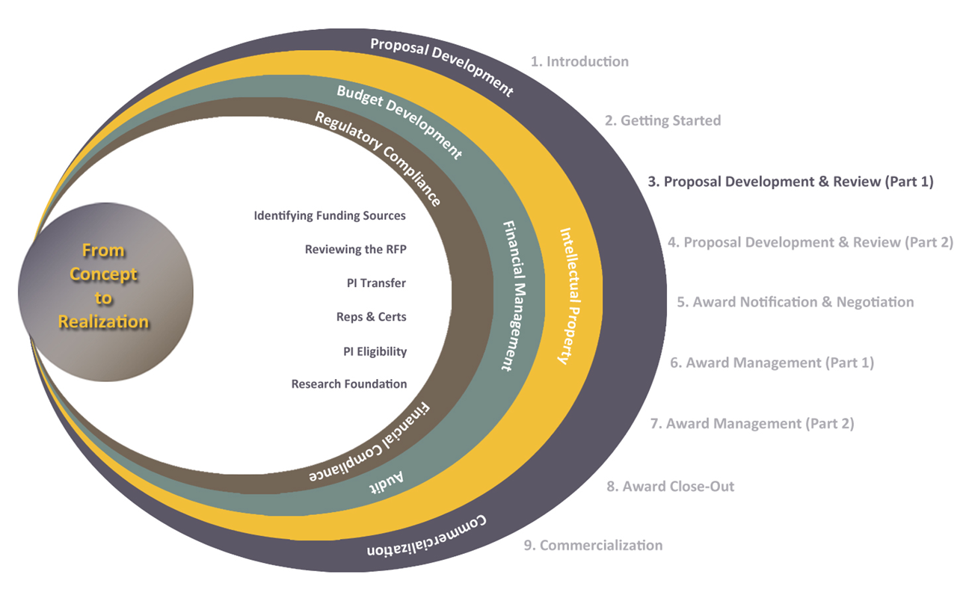
Exploring Research Administration from Concept to Commercialization

Slide 3
Exploring Research Administration from Concept to Commercialization
THE FUNDING PROCESS
Federal Funding Cycle
Federal Priorities – Who sets them?
The Federal Budget – an Overview
Earmarks – Why are they significant?
Laurianne Torres

Slide 4

THE FUNDING PROCESS
Federal Funding Cycle
Based on Federal Fiscal Year (FY) Oct 1 to Sep 30
October 1
Federal FY begins
October 1 – mid January
Sponsors release awards for current FY and prepare budget proposals for next FY
Late January – Early February
President submits budget to Congress for the next FY
February – April
Congress (House and Senate) engage in budget resolution process that specifies spending levels for all Federal agencies
May – September
Congress appropriates funds for Federal agencies and programs via a series of budget bills
FINANCIAL
PROGRAMMATIC
Early October
Federal agencies begin releasing preliminary guidelines for appropriated funds
December
- January
After 60-90 day comment period, Federal agencies release final guidelines
February
- May
Peak period for publication of final RFPs, deadlines for applications peak 30-90 days later
March - July
Peak period for proposal submissions
Prior to September 30
Proposal review process completed within 60-90 days so that awards can be made in time for projects to begin October 1
PROPOSAL DEVELOPMENT & REVIEW (PART I)

Slide 5
THE FUNDING PROCESS
Federal Priorities – Who Sets Them?
The President, with advice from:
Federal agencies (ex. NSF, DHHS, US Dept of Ed, etc.)
The Office of Science and Technology Policy (OSTP)
Office of Management & Budget (OMB)
Congress, not required to pass budget proposal
As part of the Congressional Budget and Impoundment Control Act of 1974, the budget resolution process was established
Allows Congress some control over the appropriations process
PROPOSAL DEVELOPMENT & REVIEW (PART I)

Slide 6
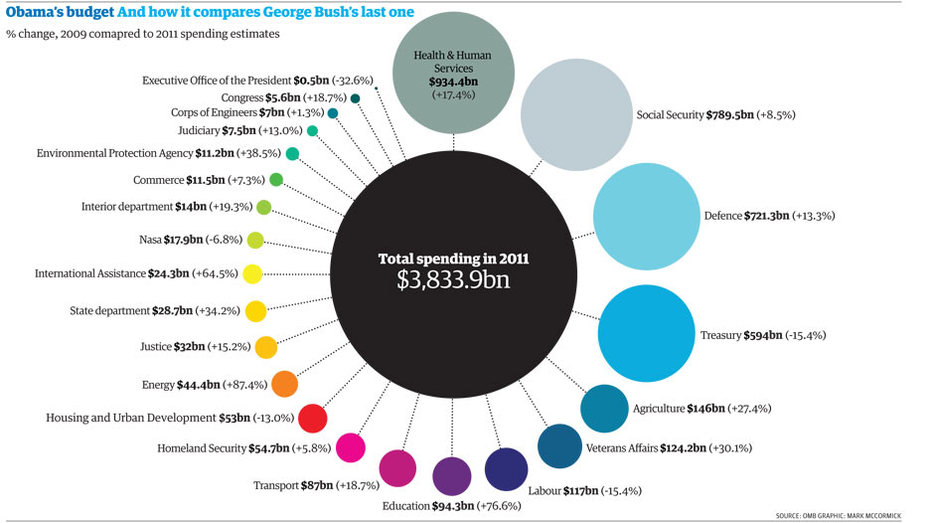
THE FUNDING PROCESS
Federal Priorities – Who Sets Them?
PROPOSAL DEVELOPMENT & REVIEW (PART I)

Slide 7
THE FUNDING PROCESS
The Federal Budget
Discretionary
Levels set every year by Congress in the Budget process
Mandatory
Earmarks
Payments the U.S. Government is obligated to make
Funds for projects where congressional direction circumvents the merit-based, competitive allocation process
PROPOSAL DEVELOPMENT & REVIEW (PART I)

Slide 8
THE FUNDING PROCESS
Earmarks – Why are they significant?
For you, the taxpayer:
gives Congress the power to allocate funds to specific named projects
circumvents the Executive Branch’s competitive allocation process
directs funds without any public hearing or review
reduces/eliminates transparency in the system, though policy reform is changing that
PROPOSAL DEVELOPMENT & REVIEW (PART I)

Slide 9
THE FUNDING PROCESS
Earmarks – Why are they significant?
For you, the research administrator:
threaten University research
Some universities refuse to accept earmarks, citing that it “undermines national excellence in research by diverting resources” from competitive research funding
Faculty earmark requests often must be reviewed/approved by VP
PROPOSAL DEVELOPMENT & REVIEW (PART I)

Slide 10
THE FUNDING PROCESS
Earmarks – Why are they significant?
For you, the researcher:
Merit, value and quality of research may be questioned
Integrity may be compromised
PROPOSAL DEVELOPMENT & REVIEW (PART I)

Slide 11
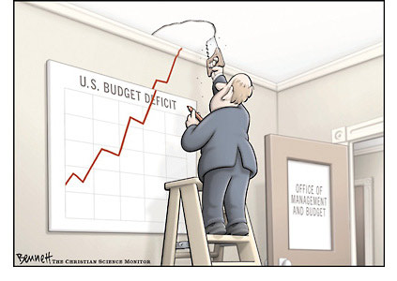
THE FUNDING PROCESS
PROPOSAL DEVELOPMENT & REVIEW (PART I)

Slide 12
Exploring Research Administration from Concept to Commercialization
RESEARCHING FUNDING SOURCES
Federal Announcements
Proposal Types
Sources of Funding
How to Spot the Right Opportunity
Laurianne Torres

Slide 13
RESEARCHING FUNDING SOURCES
Federal Announcements
Federal Register
Published daily by the Government Printing Office
Informs citizens of their rights and obligations, and provides access to Federal benefits and funding opportunities
Organized into 4 categories
Presidential Documents
Rules and Regulations
Proposed Rules
Notices
PROPOSAL DEVELOPMENT & REVIEW (PART I)

Slide 14
RESEARCHING FUNDING SOURCES
Federal Announcements
Catalog of Federal Domestic Assistance (CFDA)
A standardized system for categorizing federal grant programs.
A unique 2-digit number assigned to each federal agency
A unique 3-digit number assigned to each program
12.101 – Beach Erosion Control Projects (funded by U.S. Department of Defense)
PROPOSAL DEVELOPMENT & REVIEW (PART I)

Slide 15
RESEARCHING FUNDING SOURCES
Proposal Types
Grants.gov
Sponsor websites/publications
Federal Register
FedBizOpps.gov
Proprietary databases/newsletters
FedBizOpps.gov
State procurement lists
Sponsor websites/publications
Community of Science
Unsolicited
Solicited
PROPOSAL DEVELOPMENT & REVIEW (PART I)

Slide 16
RESEARCHING FUNDING SOURCES
Proposal Types
Early Stage
Concept Paper
White Paper
Contract
Solicitation
Grant or Cooperative Agreement
Program Announcement
Preliminary Proposal
Letter of Intent
Request for Proposal (RFP)
Request for Quotes (RFQ)
Request for Bid (RFB)
Proposal Guidelines
Call for Proposals
Broad Agency Announcement (BAA)
PROPOSAL DEVELOPMENT & REVIEW (PART I)

Slide 17
RESEARCHING FUNDING SOURCES
Sources of Funding
Federal Government
State Government
Foundations
Other Non-profit Organizations
Private/Commercial/Industry
PROPOSAL DEVELOPMENT & REVIEW (PART I)

Slide 18
RESEARCHING FUNDING SOURCES
UCF Resources
Funding Opportunities Databases (offered at UCF)
Community of Science (COS)
www.cos.com
Automated funding alerts
Funding Opportunities (over 400,000)
Expertise (500,000 researcher profiles)
Illinois Research Information Service (IRIS)
www.library.uiuc.edu/iris/
Serves the arts, humanities and private foundation
Foundation Search Database (limited access)
www.foundationsearch.com
Private, corporate and government grant opportunities
Profiles of each Foundation
Not available to faculty, staff, students
PROPOSAL DEVELOPMENT & REVIEW (PART I)

Slide 19
RESEARCHING FUNDING SOURCES
UCF Resources
Agency Websites
Grants.gov
Agency-specific (ex. NIH, NSF, etc.)
UCF Internal Funding Programs
In-House Research Grants
Undergraduate Research Initiative (URI)
UCF Research Incentives
Matching Funds for Federal Agencies (MFFA)
Florida High Tech Corridor (FHTC) Industry Matching
PROPOSAL DEVELOPMENT & REVIEW (PART I)

Slide 20
RESEARCHING FUNDING SOURCES
How to Spot the Right Opportunity
Do your Homework, Ask Questions:
Who is the PI?
Type of project or activities
Amount of funding needed
Timeframe to receive funding
Proposal submission deadline
Timeframe to conduct activity
Competitiveness
History of funding source
History of UCF
Find a sponsor whose mission and purpose match the project
Be sure eligibility requirements are met
PROPOSAL DEVELOPMENT & REVIEW (PART I)

Slide 21

THINK ABOUT IT…
Which of the following refers to an announcement of a federal agency’s general research interests?
BAA
BCC
BEA
BRC
PROPOSAL DEVELOPMENT & REVIEW (PART I)

Slide 22
THINK ABOUT IT…
Proposals submitted that are not in response to a specific RFP, RFA or program announcement are referred to as
______________ proposals.
unsolicited
PROPOSAL DEVELOPMENT & REVIEW (PART I)

Slide 23
Exploring Research Administration from Concept to Commercialization
REVIEWING THE RFP
What is an RFP?
Overview of RFP Requirements
Dissecting the RFP
Considerations
Common Errors to Avoid
Good Practice: The Ella Fitzgerald Approach
Resources
Joan Jarvis

Slide 24
WHAT IS AN RFP?
Is an RFP a Box of Chocolates?
A Request for Proposal (RFP) is a document generated by a sponsoring agency for access by interested entities to submit a proposal to provide services or goods or to conduct research efforts. An RFP is either:
sent directly to a specific entity to invite it
or
is made available to the public through the sponsoring agency’s funding opportunities website
PROPOSAL DEVELOPMENT & REVIEW (PART I)

Slide 25
WHAT IS AN RFP?
Why Do Agencies Use an RFP?
WHEN:
cost is not the sole evaluative criteria
a project is so complex that it warrants a proposal from a provider
creativity and innovative approaches are needed
PROPOSAL DEVELOPMENT & REVIEW (PART I)

Slide 26
WHAT IS AN RFP?
Other Mechanisms/Terms:
Most frequently used:
RFA - Request for Applications
RFI - Request for Information
RFQ - Request for Quotation
LOI- Letter of Intent
Less frequently used:
EOI - Expression of Interest
RFD - Request for Documentation
RFO - Request for Offer
ROI - Registration of Interest
PROPOSAL DEVELOPMENT & REVIEW (PART I)

Slide 27
OVERVIEW OF RFP REQUIREMENTS
Common Elements of the RFP
overview of agency/program
description of research/services required
detailed requirements
other information
cost requirements
proposal format
due date(s)
selection criteria
time line
questions
how to respond
point of contact
PROPOSAL DEVELOPMENT & REVIEW (PART I)

Slide 28
OVERVIEW OF RFP REQUIREMENTS
Common Federal RFP Sections
Part I
Section B: Supplies/Services & Prices/Costs
Section C: Descriptions, Specifications, Scope of Work
Section D: Packaging and Marking
Section E: Inspection and Acceptance
Section F: Deliveries or Performance
Section G: Contract Administration Data
Section H: Special Contract Requirements
Section A: Cover Page
PROPOSAL DEVELOPMENT & REVIEW (PART I)

Slide 29
OVERVIEW OF RFP REQUIREMENTS
Common Federal RFP Sections
Part II
Section J: List of Attachments
Section K: Representations/Certifications
Section L: Instructions, Attachments
Section M: Evaluation Factors for Award
Section I: Contract Clauses
Part III
Part IV
PROPOSAL DEVELOPMENT & REVIEW (PART I)

Slide 30
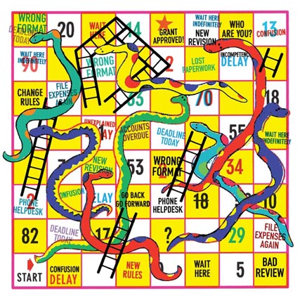
DISSECTING THE RFP
Sometimes it seems like this:
PROPOSAL DEVELOPMENT & REVIEW (PART I)

Slide 31
DISSECTING THE RFP
What’s in this thing?
Summary of Program Requirements
Eligibility Information
Limit of number of Proposals
Proposal Preparation Instructions
Budgetary Information/Limitations
Matching/Cost Share Requirements
Submission Requirements and Due Date
Considerations
PROPOSAL DEVELOPMENT & REVIEW (PART I)

Slide 32
DISSECTING THE RFP
Summary of Program Requirements
Provides a brief description of the projects or services that are needed, being requested, or available.
In some RFPs, the needs are complex and may be difficult to describe in detail.
A good description of these needs assists responders in developing an excellent and highly targeted proposal.
Agency contact
PROPOSAL DEVELOPMENT & REVIEW (PART I)

Slide 33
DISSECTING THE RFP
Eligibility and Proposal Limits
Eligibility criteria
Is UCF eligible?
Is the PI eligible?
Organization Limit ?
If yes, contact ORC Funding Opportunities Section
PI Limit
PROPOSAL DEVELOPMENT & REVIEW (PART I)

Slide 34
DISSECTING THE RFP
Proposal Preparation Instructions
Most RFPs provide the guidelines to be followed relating to format and content:
Format:
Type font & size
Page numbering and limitation requirements
Page size & margins
Line spacing
Graphic resolution, etc.
PROPOSAL DEVELOPMENT & REVIEW (PART I)

Slide 35
DISSECTING THE RFP
Proposal Preparation Instructions
Content:
Agency required forms
Cover Page
Summary
Table of Contents
Project Narrative
Biosketches
PROPOSAL DEVELOPMENT & REVIEW (PART I)

Slide 36
DISSECTING THE RFP
Proposal Preparation Instructions
Content (continued):
Budget & Budget Justification
Current & Pending Support
Facilities & Equipment
Letter of Support (if applicable)
Appendices (if applicable)
PROPOSAL DEVELOPMENT & REVIEW (PART I)

Slide 37
DISSECTING THE RFP
Budgetary Information/Limits
Budget = the proposal in dollars
Check for:
Number of years allowed & timeframe
Budget range
(minimum-maximum; per year, total)
Any special limitations
(no equipment is allowed; no salaries can be charged, etc)
Budget format (if any)
Cost Share/matching requirements
PROPOSAL DEVELOPMENT & REVIEW (PART I)

Slide 38
DISSECTING THE RFP
Cost Share/Matching
Is it required?
Ratio
Type of cost share allowed
Source
Documentation/Commitments
PROPOSAL DEVELOPMENT & REVIEW (PART I)

Slide 39
DISSECTING THE RFP
Submission Requirements
Instructions for proposal submission
Hard copy
E-mail
Electronic
i.e., Grants.gov; Fastlane; NSPIRES, etc.
Electronic with follow-up hard copy
could include CDs, separate reference letters), or with
follow-up e-mail with specific files of the proposal
Fax
PROPOSAL DEVELOPMENT & REVIEW (PART I)

Slide 40

DISSECTING THE RFP
Due Date & Time
May have letter of intent due date (required or optional)
Preliminary Proposal due date with option to invite only those selected for full submission
Should be clearly stated near the beginning of the RFP and in other relevant places.
PROPOSAL DEVELOPMENT & REVIEW (PART I)

Slide 41
CONSIDERATIONS
Intergovernmental Review
Compliance Requirements (IRB, IACUC, Biohazards, Export Control, COI, RCR)
Certifications and Representations
Sample contract/contracting language
Reporting requirements
PROPOSAL DEVELOPMENT & REVIEW (PART I)

Slide 42
COMMON ERRORS TO AVOID
Not reading the RFP (assuming format & content)
Selecting the incorrect solicitation
Postmarked vs. actual receipt
Use of incorrect agency forms
Not checking that CDs are readable on other computers
Not contacting agency reps when requested
in the RFP
PROPOSAL DEVELOPMENT & REVIEW (PART I)

Slide 43
How do I remember everything?
I’ve got 10 proposals due this week
I read the RFP two weeks ago
I’m in a panic!
PROPOSAL DEVELOPMENT & REVIEW (PART I)

Slide 44
GOOD PRACTICE
The Ella Fitzgerald Approach
a-tisket a-tasket...
A green-and-yellow basket…
I bought a basket for my mommy…
On the way I dropped it. - Ella Fitzgerald
Only it’s a green and yellow MARKER
And some sticky notes
PROPOSAL DEVELOPMENT & REVIEW (PART I)

Slide 45
QUESTIONS?
The RFP should clearly specify the mechanism by which respondents can ask questions.
RFPs may set a time period during which questions can be submitted
Agencies will usually display the questions and answers on website and make them a part of the RFP as an amendment.
PROPOSAL DEVELOPMENT & REVIEW (PART I)

Slide 46
THINK ABOUT IT…
The Federal Government invites proposals and specifies general award terms and conditions using what instrument?
RFP
RFQ
RFO
BAA
PROPOSAL DEVELOPMENT & REVIEW (PART I)

Slide 47
THINK ABOUT IT…
What is the purpose of the
federal proposal review process?
Assures that the highest quality proposals are selected for funding in an equitable manner
PROPOSAL DEVELOPMENT & REVIEW (PART I)

Slide 48
THINK ABOUT IT…
When reviewing the proposal guidelines, you notice that awards may only be made to a nonprofit organization, is UCF eligible to submit a proposal and receive an award?
No, UCF is not a 501(c)(3) (nonprofit) organization.
PROPOSAL DEVELOPMENT & REVIEW (PART I)

Slide 49

QUESTIONS or COMMENTS?

Slide 50
THANKS FOR JOINING US!
Please come to the next session:
PROPOSAL DEVELOPMENT & REVIEW (PART II)
May 25, 2011
10:00 am to 12:00 pm
Sponsored Programs Administration Resource & Knowledge Series

