Slide 1


Sponsored Programs Administration Resource & Knowledge Series
PROPOSAL DEVELOPMENT
& REVIEW (PART II)
Presented by:
Justo Torres, Laurianne Torres, Terri Vallery

Slide 2


General Business
Cell Phones Off
Sign In
PROPOSAL DEVELOPMENT & REVIEW (PART II)

Slide 3
General Business
New Syllabus
Regulatory Compliance – June 8th
Presentations – August 24th
Certificate Ceremony – August 31st
PROPOSAL DEVELOPMENT & REVIEW (PART II)

Slide 4
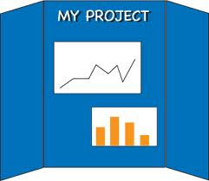
General Business
Changes to Team Projects
Presentations – 20 minutes long
Evaluation completed immediately following presentations
Mentor will provide feedback prior to Certificate Ceremony
PROPOSAL DEVELOPMENT & REVIEW (PART II)

Slide 5
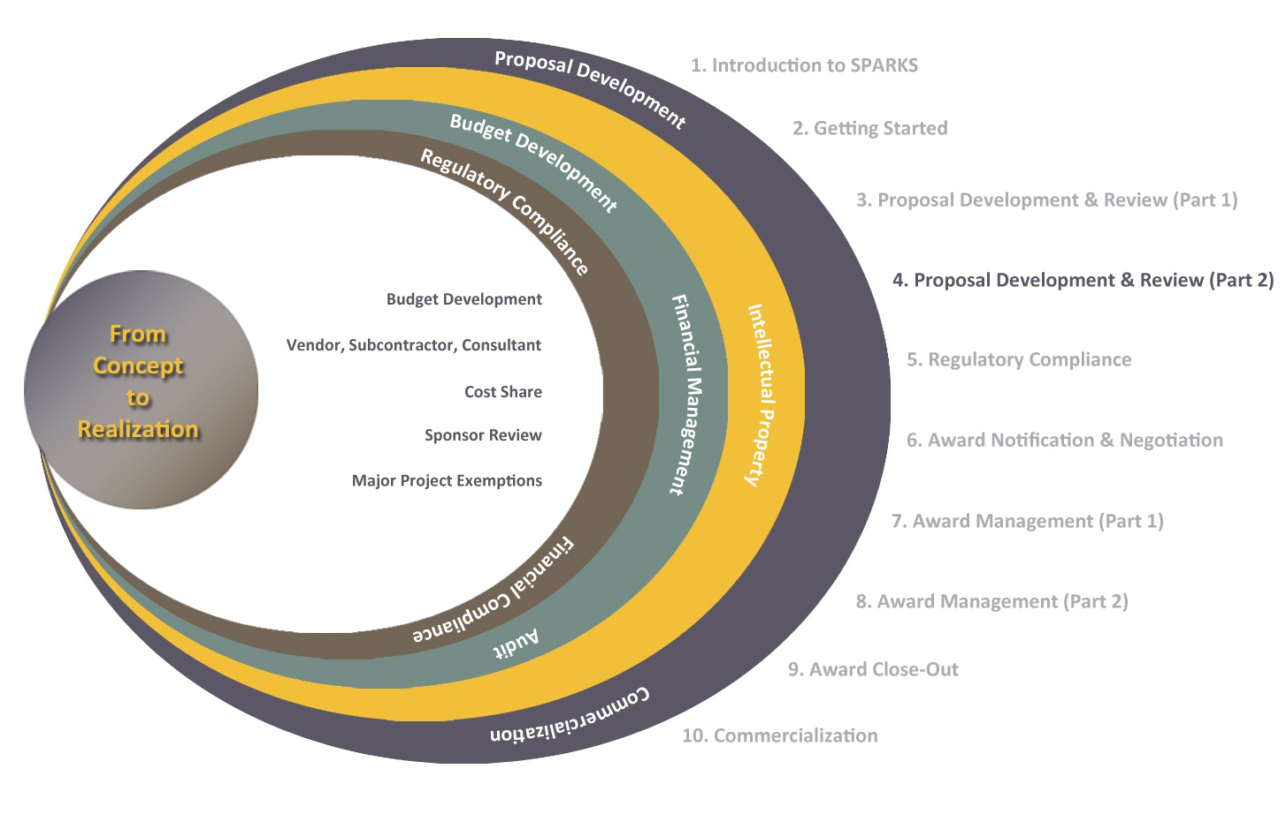
Exploring Research Administration from Concept to Commercialization

Slide 6
Exploring Research Administration from Concept to Commercialization
BUDGET DEVELOPMENT OVERVIEW
Cost Principles
Cost Accounting Standards
Cues from the Proposal Guidelines
The Budget Draft
Justo Torres

Slide 7
BUDGET DEVELOPMENT OVERVIEW
Your mission:
to build a winning budget
But what does that mean?
It means developing a budget that is:
Reasonable
Appropriate
Allowable
Consistent
Cost Principles
PROPOSAL DEVELOPMENT & REVIEW (PART II)

Slide 8

BUDGET DEVELOPMENT OVERVIEW
Cost Principles
Cost principles address cost allowability.
Reasonable
Appropriate
Allowable
Consistent
PROPOSAL DEVELOPMENT & REVIEW (PART II)

Slide 9

BUDGET DEVELOPMENT OVERVIEW
Cost Accounting Standards (CAS)
Cost Accounting Standards were designed for uniformity and consistency in the estimating, allocating and reporting of costs
Estimating
Allocating
Reporting
process of forecasting costs based upon information available at the time.
process of assigning a cost only once (direct or indirect) and on only one basis (UCF’s DS-2).
process of disseminating cost information to others.
PROPOSAL DEVELOPMENT & REVIEW (PART II)

Slide 10

BUDGET DEVELOPMENT OVERVIEW
Cost Accounting Standards (CAS)
For Educational Institutions,
the Cost Accounting Standards (CAS) are outlined in the
Office of Management & Budget’s (OMB) guiding document:
OMB Circular A-21
Appendix A
http://www.whitehouse.gov/omb/circulars_a021_2004
PROPOSAL DEVELOPMENT & REVIEW (PART II)

Slide 11
BUDGET DEVELOPMENT OVERVIEW
Cues from the Proposal Guidelines
Is there a cap on the amount that may be requested?
Are there salary limitations?
Is there a cap on Facilities & Administrative cost recovery?
Is there a mandatory cost share requirement?
Are there costs that the sponsor will not allow?
PROPOSAL DEVELOPMENT & REVIEW (PART II)

Slide 12
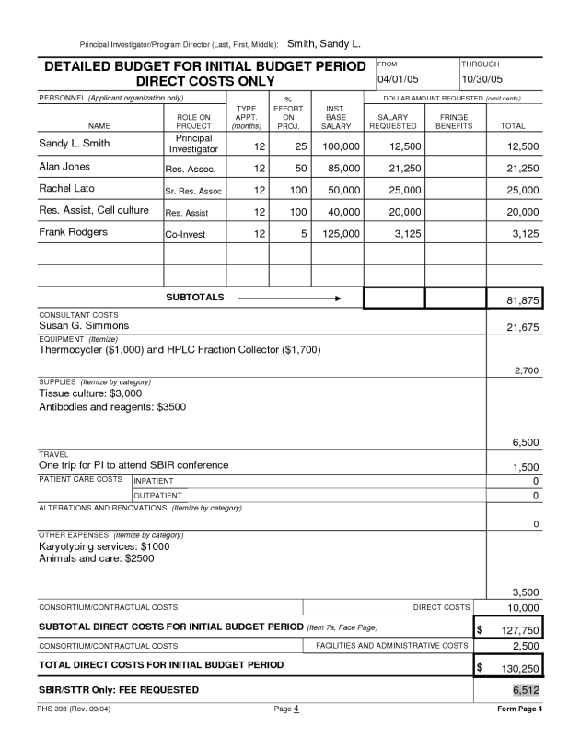
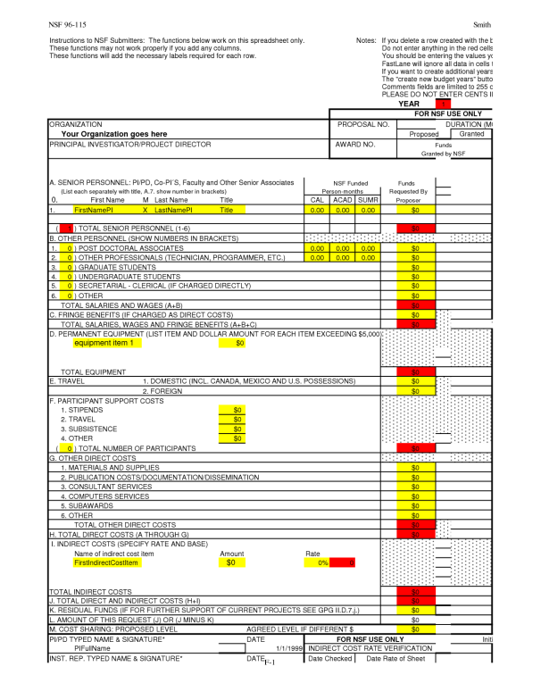
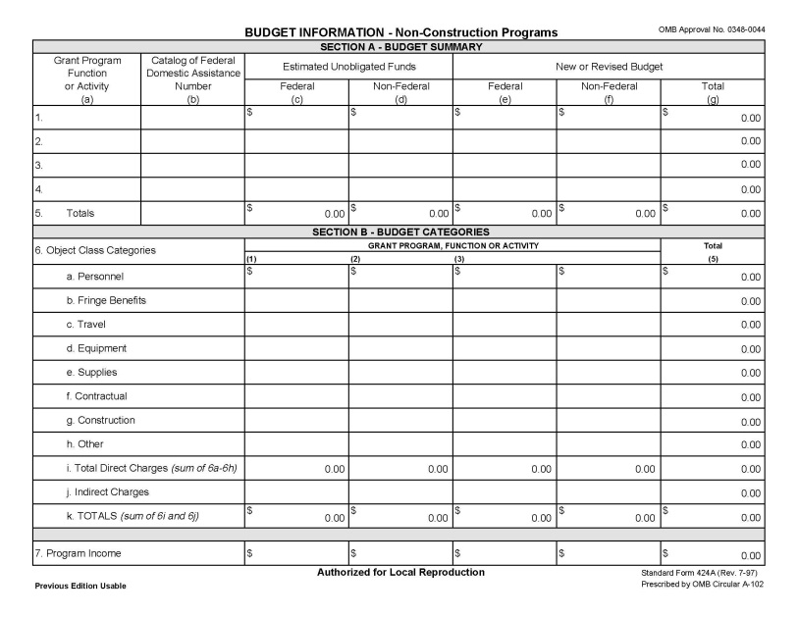
BUDGET DEVELOPMENT OVERVIEW
The Budget Draft
Before drafting the budget, locate and work from the sponsor’s budget template.
PROPOSAL DEVELOPMENT & REVIEW (PART II)

Slide 13

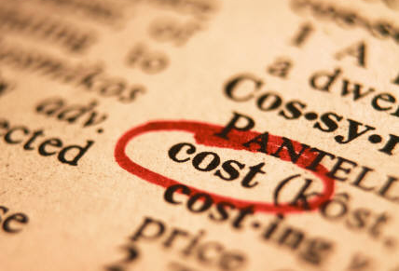

BUDGET DEVELOPMENT OVERVIEW
The Budget Draft
Draft a rough budget FIRST, even before writing the proposal.
Consider all possible costs.
Don’t forget the cost share and any reduced F&A rate, which may require approval time.
PROPOSAL DEVELOPMENT & REVIEW (PART II)

Slide 14
Exploring Research Administration from Concept to Commercialization
BUILDING THE BUDGET
Direct Costs
Facilities & Administrative Costs
Cost Share
Budget Narrative
CAS Exemptions
Justo Torres
Laurianne Torres
Terri Vallery

Slide 15
BUDGET DEVELOPMENT OVERVIEW
Direct vs. Indirect (or F&A) Costs
A proposal budget consists of 2 categories of costs:
Direct Costs
Costs which can be easily/readily identified with a specific project relatively easily with a high degree of accuracy
Facilities & Administrative Costs
Costs which can NOT be specifically identified with a particular project or activity, but the University incurs as a result of the project
PROPOSAL DEVELOPMENT & REVIEW (PART II)

Slide 16
BUDGET DEVELOPMENT OVERVIEW
Direct Costs
Salaries & Wages
Fringe Benefits
Consultants
Subcontracts
Equipment
Travel
Tuition
Materials & Supplies
Publication
Participant Support Costs
Examples
Of
Direct Costs
PROPOSAL DEVELOPMENT & REVIEW (PART II)

Slide 17
BUDGET DEVELOPMENT OVERVIEW
Salaries & Wages
Usually the largest portion of the budget
Project year vs. Salary (Academic) year
% Effort vs. Hourly
Limited AY salary recovery & sponsor salary caps
vs. Stipends
Clerical support generally unallowable
Salary increases (like cost-of-living and merit)
Effort reporting
Summer salary (AY salary sometimes unallowable)
PROPOSAL DEVELOPMENT & REVIEW (PART II)

Slide 18
BUDGET DEVELOPMENT OVERVIEW
Fringe Benefits
Regardless of the classification - if compensating through payroll, there is a fringe rate associated¹
Consultants
vs. Employee
Work for hire
IRS Independent Contractor Test²
Letter of commitment
Sponsor cap
PROPOSAL DEVELOPMENT & REVIEW (PART II)

Slide 19
BUDGET DEVELOPMENT OVERVIEW
Maximum Consultant Rates on Federal Grants
AGENCY | MAXIMUM RATE
U.S. Dept. of Education | No Specific Limit except $513/day for Rehabilitation Training Program grants
U.S. Dept. of Energy | None Specified
U.S. Dept. of Justice, Office of Justice Programs | $450/day
National Aeronautics & Space Administration (NASA) | Up to Level IV of the Executive Schedule (exclusive of expenses and indirect costs )
National Institute of Health (NIH) | None Specified Note: The NIH salary cap does not apply to payments made to consultants.
National Science Foundation (NSF) | $537/day
PROPOSAL DEVELOPMENT & REVIEW (PART II)

Slide 20
BUDGET DEVELOPMENT OVERVIEW
Subcontracts
Portion of the programmatic work assigned elsewhere
vs. Vendor Services
ORC requirements (Commitment Letter, SOW, Budget)
>$1,000,000 = UCF President approval
>$50,000 = require bid
>50% of the total project = ORC VP approval
PROPOSAL DEVELOPMENT & REVIEW (PART II)

Slide 21
BUDGET DEVELOPMENT OVERVIEW
Subcontracts
When subcontracting an outside entity (3rd party), ORC will need:
A Letter of Commitment (with authorized signature)
Detailed Statement of Work (to include deliverables)
Itemized budget (helpful to include a detailed budget narrative)
PROPOSAL DEVELOPMENT & REVIEW (PART II)

Slide 22
BUDGET DEVELOPMENT OVERVIEW
Equipment
Also known as OCO or “Operating Capital Outlay”
Institutional Definition vs. Sponsor Definition
Vesting
Vendor quotes-shipping, installation & maintenance costs
Budget early in the project timeline
PROPOSAL DEVELOPMENT & REVIEW (PART II)

Slide 23
BUDGET DEVELOPMENT OVERVIEW
Travel
Example costs: mileage, airfare, ground transportation, registration, per diem and lodging
Applicable travel rates
Proper identification of Domestic vs. Foreign
Fly America Act³
Tuition
If charging grad student salary (assistantship), must charge tuition⁴
Current rate + average 15% escalation⁵ for out-years
PROPOSAL DEVELOPMENT & REVIEW (PART II)

Slide 24
BUDGET DEVELOPMENT OVERVIEW
Materials & Supplies
For technical work not administration thereof
Publication
Dissemination of research findings/results
If publication restrictions exist, budget accordingly
May not be budgeted for administrative printing costs
PROPOSAL DEVELOPMENT & REVIEW (PART II)

Slide 25
BUDGET DEVELOPMENT OVERVIEW
Participant Support Costs
Calculate cost per participant (there may be a limit)
Pay attention to sponsor definition
Typical costs include:
Training
Tuition
Books
Materials
Per Diem
Meals
Lodging
Payments
Honoraria
Travel
Stipends
PROPOSAL DEVELOPMENT & REVIEW (PART II)

Slide 26
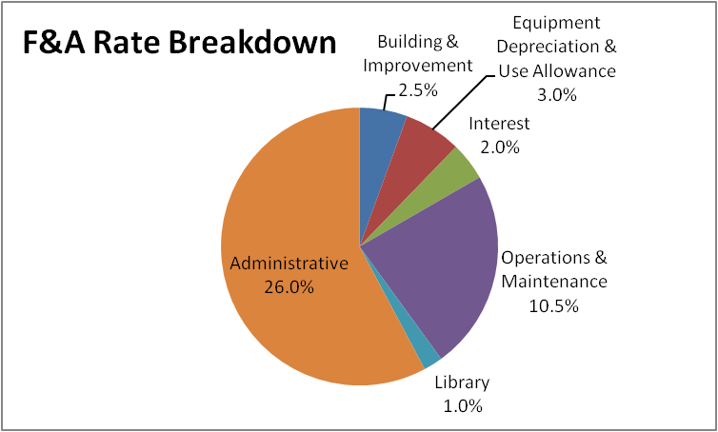
BUDGET DEVELOPMENT OVERVIEW
Facilities & Administrative Costs
the operating costs necessary to maintain the research infrastructure
tangible costs to the University for doing research
PROPOSAL DEVELOPMENT & REVIEW (PART II)

Slide 27

BUDGET DEVELOPMENT OVERVIEW
Facilities and Administrative Costs⁶
Formerly known as Overhead or Indirect Costs
Could change as frequently as ~ 3 years
Charged on a portion (MTDC) or all (TDC) direct costs – BASE
On vs. Off campus activities
F&A recovery can be a significant cost
TIP: Estimate these costs first!
$100,000 ÷ 1.45 = $68,966 (available for direct costs)
$31,034 (available for F&A costs)
PROPOSAL DEVELOPMENT & REVIEW (PART II)

Slide 28

BUDGET DEVELOPMENT OVERVIEW
Facilities & Administrative Costs
F&A rate in effect at time of initial award
is locked in for the life of that project⁷
/l·ife/: each competitive segment of a project
/com·pet·i·tive seg·ment/: a period of years
approved by the Federal funding agency
at the time of award
PROPOSAL DEVELOPMENT & REVIEW (PART II)

Slide 29
BUDGET DEVELOPMENT OVERVIEW
Cost Share
Definition
That portion of the total project costs not borne by the sponsor
Sources
Cash or In-kind
Internal UCF or Third-party
Foregone F&A
Approvals
Requires approval from someone authorized to commit funds
PROPOSAL DEVELOPMENT & REVIEW (PART II)

Slide 30



BUDGET DEVELOPMENT OVERVIEW
Cost Share
Verifiable from recipient records (companion account)
Allowable under per OMB A-21
Necessary and reasonable
Using Federal to match Federal = unallowable
Foregone F&A costs
Auditable for 3 years from close-out (or longer if sponsor requirement)
General rule: if allowable as a direct cost, allowable as cost share
BE CREATIVE
(and careful)
Consider internal sources
PROPOSAL DEVELOPMENT & REVIEW (PART II)

Slide 31
BUDGET DEVELOPMENT OVERVIEW
Cost Share
Is it Required?
Mandatory
Required by sponsor
Must be tracked and reported to sponsor
Voluntary Committed
Not required by sponsor, but promised in proposal
Must be tracked and reported to sponsor
Voluntary Uncommitted
NOT required by sponsor
NOT required to be tracked or reported to sponsor
PROPOSAL DEVELOPMENT & REVIEW (PART II)

Slide 32
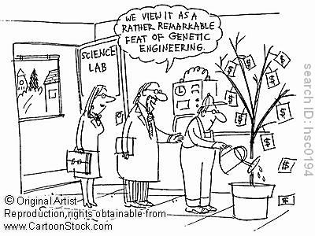
BUDGET DEVELOPMENT OVERVIEW
Budget Narrative
PROPOSAL DEVELOPMENT & REVIEW (PART II)

Slide 33
BUDGET DEVELOPMENT OVERVIEW
Budget Narrative
Sponsor’s way of verifying that all costs are appropriate, reasonable and necessary for the project work.
Explains the itemized financial budget in narrative form
TIP: Be sure the budget narrative is consistent with the project narrative
PROPOSAL DEVELOPMENT & REVIEW (PART II)

Slide 34
BUDGET DEVELOPMENT OVERVIEW
Budget Narrative
An opportunity to make the case that the budget is
reasonable, appropriate, adequate to complete the proposed work.
Indicate policies that govern the budgetary decisions.
Include sufficient detail regarding tuition requirements, salary increases.
Provide detail about items to be purchased.
Where appropriate, include vendor quotes.
Specify how costs were calculated.
Describe escalation rates, per item costs (tuition credit hours).
PROPOSAL DEVELOPMENT & REVIEW (PART II)

Slide 35

BUDGET DEVELOPMENT OVERVIEW
Cost Accounting Standards (CAS) Exemptions
Sometimes it is necessary to direct-charge F&A costs.
When this happens, there are some steps to take:
Review Exhibit C of OMB Circular A-21 to determine if project meets the criteria of a major project⁸
Complete the CAS Exemption Form located on ORC’s website⁹
Include the written justification and route for approval
NOTE: Applies to all project costs, including cost share.
PROPOSAL DEVELOPMENT & REVIEW (PART II)

Slide 36
BUDGET DEVELOPMENT OVERVIEW
Cost Accounting Standards (CAS) Exemptions
Sometimes it is necessary to direct-charge F&A costs.
When this happens, there are some steps to take:
Review Exhibit C of A-21 to determine if project may be considered a “major project”⁸
If so, complete the CAS Exemption Form located on ORC’s website⁹
Include the written justification and route for approval
1
2
3
PROPOSAL DEVELOPMENT & REVIEW (PART II)

Slide 37

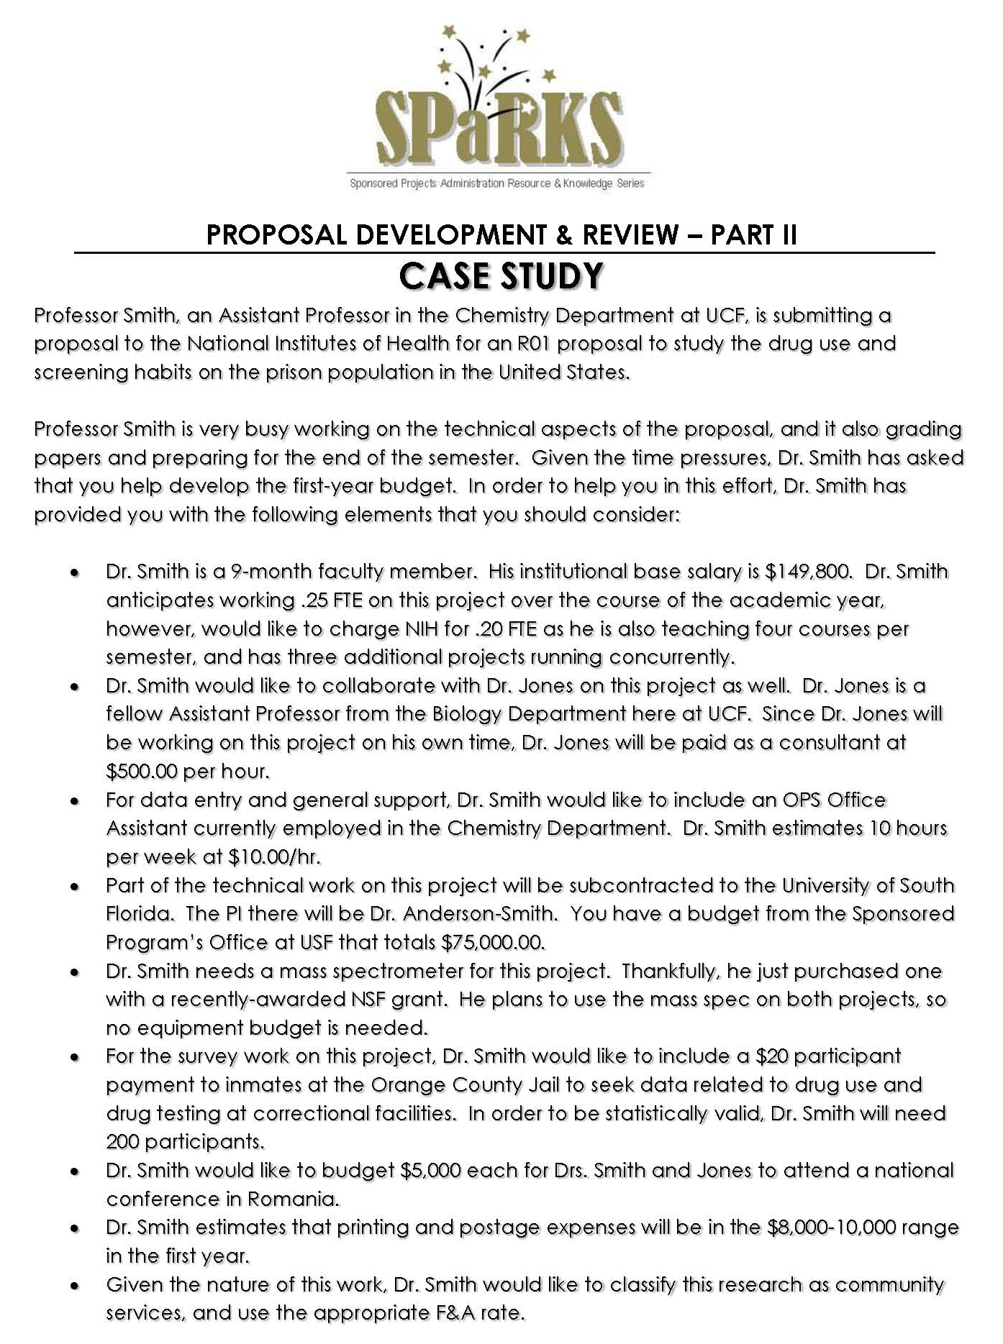
CASE STUDY
PROPOSAL DEVELOPMENT & REVIEW (PART II)

Slide 38

QUESTIONS or COMMENTS?

Slide 39
THANKS FOR JOINING US!
Please come to the next session:
REGULATORY COMPLIANCE
June 8, 2011
10:00 am to 12:00 pm
Sponsored Programs Administration Resource & Knowledge Series

