Slide 1
Normadica
Sophie Tony, Paul Anderson, Fuchee Young, Ilyas Ibrahim

Slide 2
Table of Content
Introduction
Vision and Scope
Business Value
Feasibility Studies
Software Development Methodology
Proposed System Functionalities
Hardware and Software Requirements
Interface Design
Use Case
Use Case and Actors
Initial use case diagram
Proposed System Architectural Design
Project Risks

Slide 3
Introduction
Normadica is a self-driving car concept similar to Uber, but privately owned. Imagine you own an electric self-driving car. While you’re at work, your car doesn’t sit idle. Instead, it operates as a rideshare vehicle, picking up and dropping off passengers who book it according to your availability. Once it’s done for the day, the car returns to you. This concept makes transportation more efficient, creates a passive source of income for vehicle owners, and contributes to boosting the economy by reducing wasted resources and increasing ride availability.

Slide 4
Vision: An app that lets users easily schedule and manage self-driving car rides.
Scope: A prototype with booking updates, ride management and payment.
Vision and Scope

Slide 5
Normadica makes electric car ownership useful by letting people earn money with their cars when they aren't using them. This gives riders more rides, shorter wait times, and possibly cheaper prices. It helps the business earn money through small fees or subscriptions and helps society by reducing traffic,encouraging electric car use, and putting more money back into people’s pockets instead of big companies.
Business Value

Slide 6
Feasibility
Long-term, normadica has a lot of promise, but it is difficult to put into effect right away due to a number of issues. Being in the early stages of self-driving technology is one of the primary problems. Self- Driving cars are still in the testing and development stages and are not yet generally accessible to the general public. It also means that the system would not be able to run on a big scale until the technology became more dependable and widespread. The price aspect of self-driving electric vehicles adds another challenge. In the short run, the majority of people might not be able to purchase one, which would make it more difficult to get enough automobile owners to sign up for the platform initially. Despite these challenges, Normadica has a feasible future if implemented gradually. Starting with studies in areas or towns where rules allowing self-driving cars are already in place would be a smart strategy.

Slide 7
Software Development Methodology
For this project we will be using the Agile methodology, it allows us to work in small leaps, and test each part and adjust errors quickly. This makes it easier to build a reliable system for normadica and keep improving it based on user feedback.

Slide 8
Proposed System functionalities
The proposed Normadica system will function as a platform that connects drivers who want to get the most out of their self-driving electric cars with passengers who are looking for easy transportation. Key features of the platform will include the following:
Account Management: Users will be able to register, log in, and log out securely.
Ride Booking: Passengers can enter their destination, view cost, and confirm their ride.
Ride Cancellation: Users have the option to cancel a ride, and the system will apply cancellation policies and issue refunds as necessary.
Car Availability Management: Owners can set their car to “Start” or “Stop” availability, deciding when the car can accept ride requests.
Work Hour Scheduling: Owners can set up regular schedules, such as 9 to 5 on weekdays and all day on weekends, during which the vehicle will function as a rideshare vehicle automatically.

Slide 9
Hardware and Software Requirements
Software Requirements: Python, HTML, Css, PHP will be the main technologies used to develop the application.
Hardware Requirement: Any person with a mobile device will be able to access the application without needing to download it. The vehicles self driving system will be used to deliver the passenger to their destination while displaying route information, estimated time, and map on the infotainment display.

Slide 10
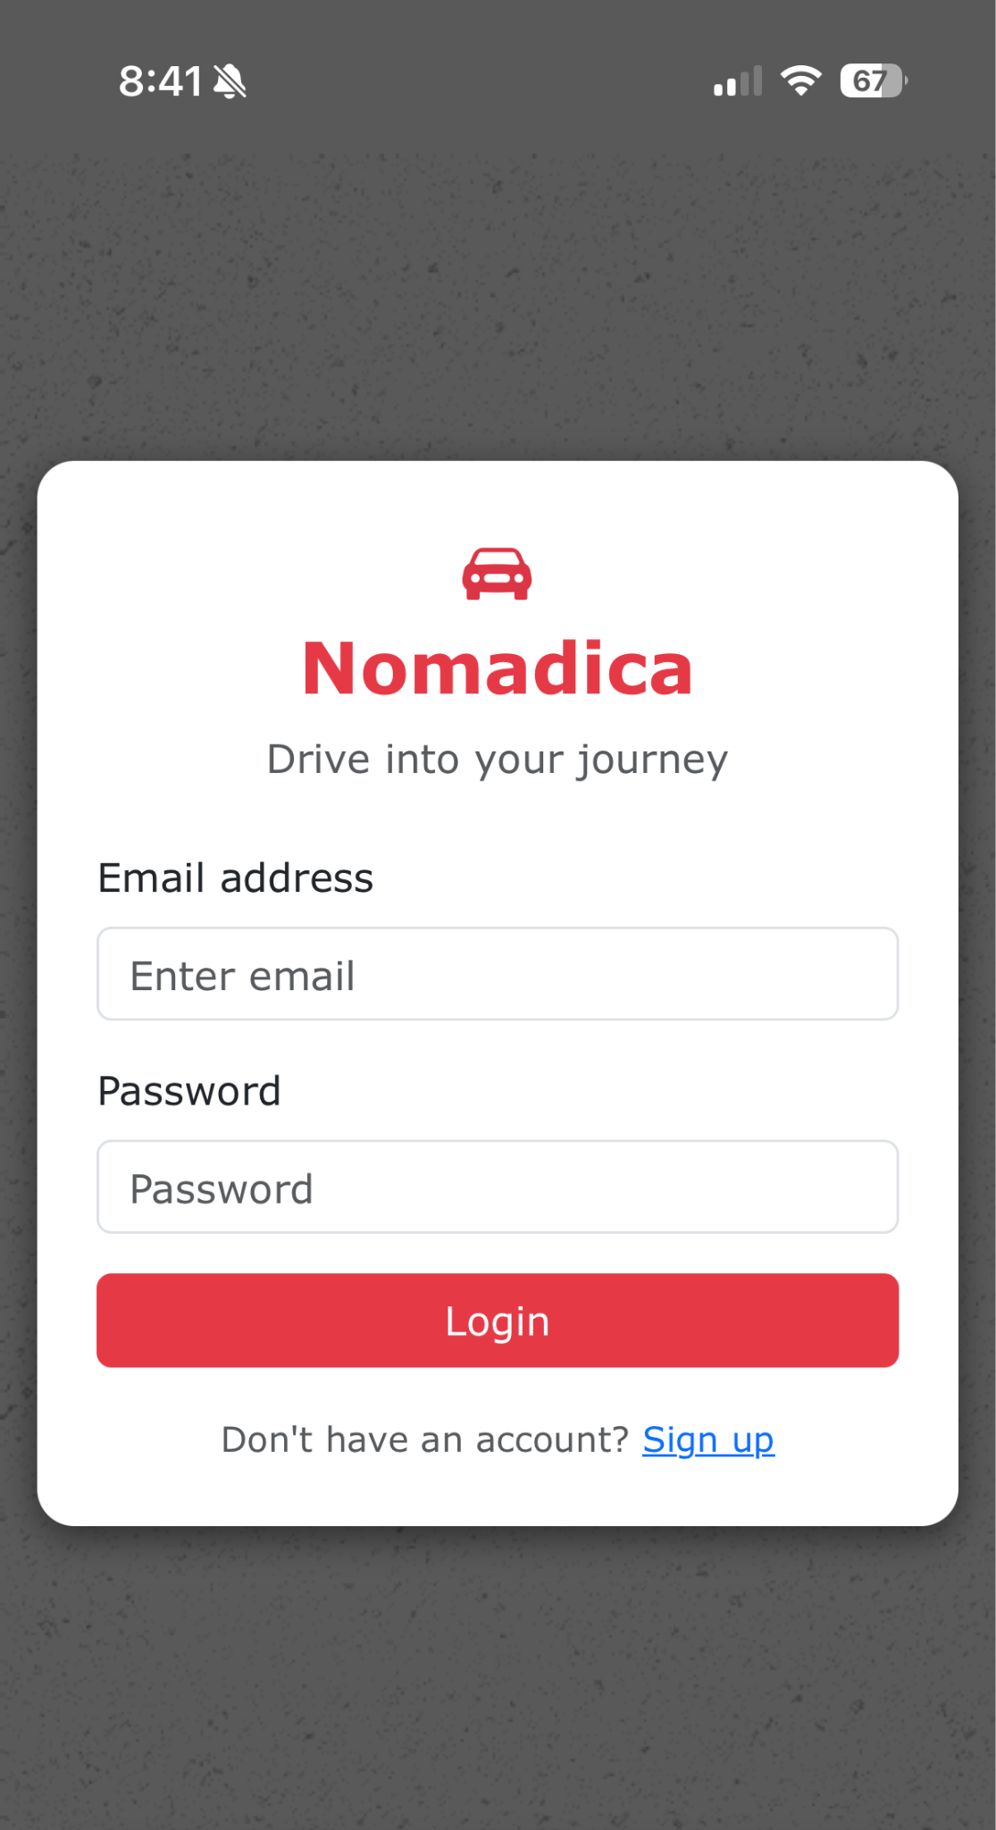
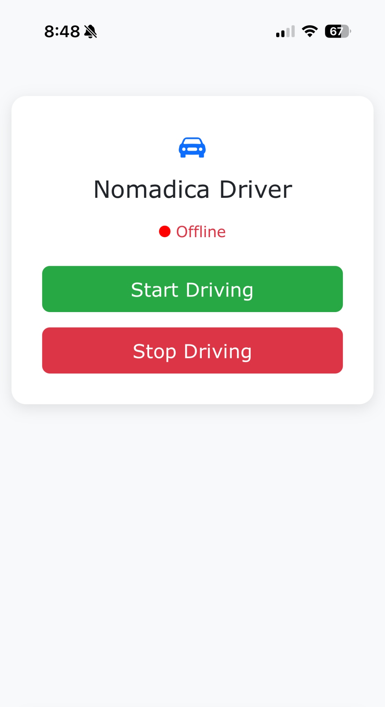
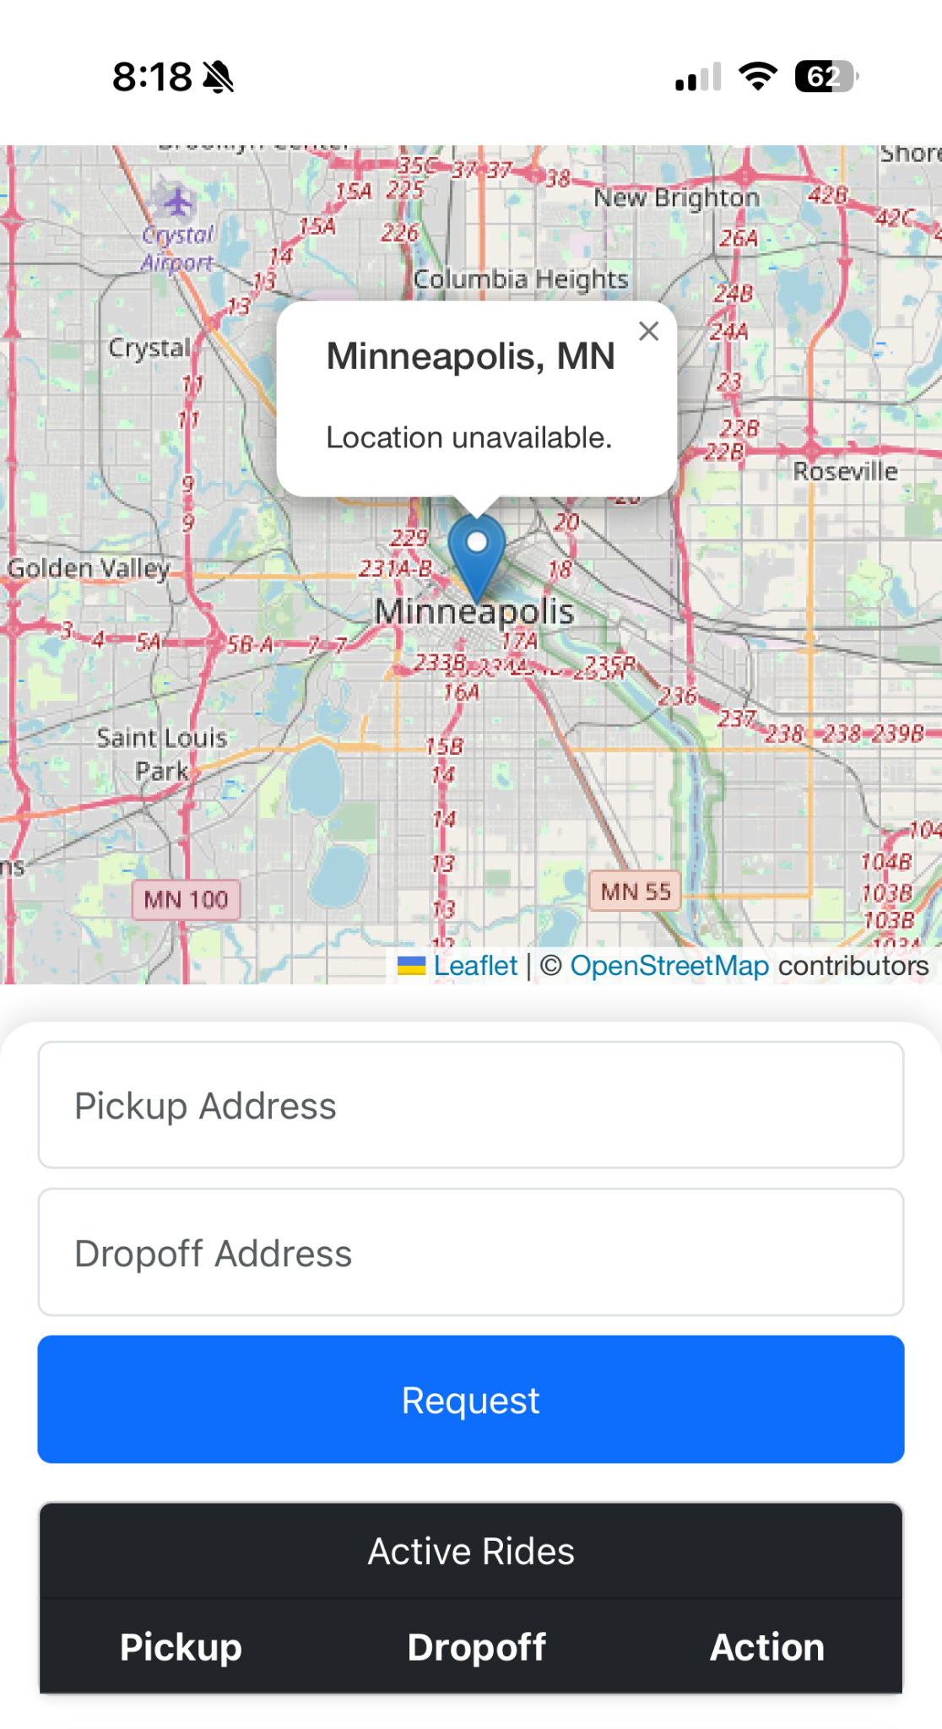
Interface Design
Login Screen
Owner operations
User Ride request

Slide 11
Use Case:
Car Owner Sets Car Availability:
Car owner uses the app to set the hours their self-driving vehicle is available for ride-sharing. System updates the schedule and makes the vehicle available for bookings during that time.
Rider Books a Ride:
Rider opens the app, enters pickup and drop-off locations. The app calculates the optimal route and assigns an available self-driving car. Rider confirms and receives estimated fare and arrival time.

Slide 12
Use Case and Actors
Actors: Rider, Car Owner, System Admin, GPS/Mapping System.
In the Normadica system, riders can book rides by entering their pickup and destination into the app, where the GPS calculates the optimal route and requests a nearby available self-driving car. Car owners manage their vehicles by setting availability through the app, allowing the system to update the schedule accordingly. Once a request is made, the system assigns the trip to the nearest available car and sends confirmation to both the rider and the vehicle. During the trip, the GPS system continuously provides real time navigation and adjusts routes if traffic or roadblocks occur. Meanwhile, system administrators oversee the platform by managing fleet data, adding new cars, updating software, and monitoring ride transactions.

Slide 13
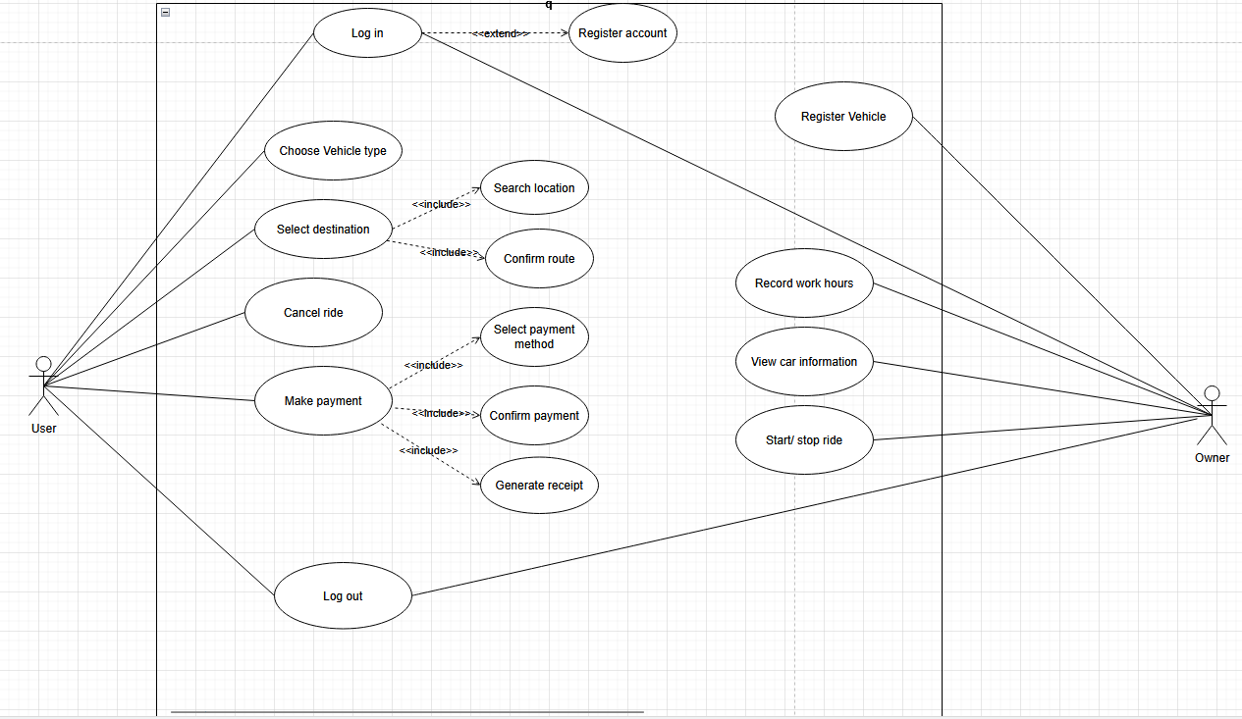
Use Case Diagram:

Slide 14
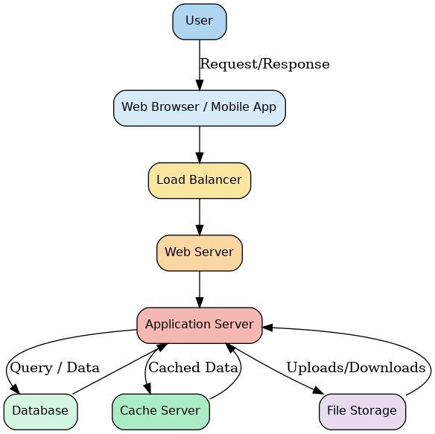
System Architecture

Slide 15
Project Risks
Vehicle software incompatibility
Uncooperative vehicle manufactures
Legislation restricting or limiting services
Owners and the potential for Vehicle damage and soiling.
Insurance

