Slide 1
Training NTUC employees to work
Wei Lun, Jun Long, Nigel, Caleb

Slide 2
Issue of NTUC Fairprice
Have to allocate resource & manpower to train new staff

Slide 3
Solution
Software solution - help to train new employees
Reduce amount of resources & manpower to train new employees
Resources and manpower - allocated to other areas

Slide 4
Business needs
NTUC FairPrice requires convenient and low-maintenance software
Employees can use this anywhere
Brandon-Hall study states that learning through e-learning typically requires 40% to 60% less employee time
Employees who are using this have much more control over how they learn
The Research Institute of America found that e-Learning increases retention rates by 25% to 60%, while retention rates for face-to-face training are much lower: 8% to 10%
This allows companies to reduce the money allocated to training staff to other areas
IBM found that participants learned more than 4 times more material while not increasing the time spent in training
Notes:
that aids in the training of employees to reduce the burden of training new employees.
Which mean removing travel cost, (after brandon hall) learning the staff things compared to, for example, training in a classroom
as the employees who are using this have much more control over how they learn, while having the ability to revisit this software again and again
This allows companies to reduce the money allocated to training staff to other areas, as a result of e-learning being more efficient compared to traditional training/on-the-job training.

Slide 5

Layout of our game

Slide 6
Introduction (Wei Lun)
Why?
The first impression for new employees
Intrigue the employees to try out the game
Consists of: Title, Start and Instructions buttons
Title: NTUC Works
Benefits:
Can easily locate the buttons
Get a rough understanding of the game

Slide 7
Wireframe for Introduction
NTUC Works
Start
Instructions
Navigation bar

Slide 8
Wireframe for Introduction
Instructions
Users must….
After the games….
There will be…..
NTUC Works
Start
Instructions

Slide 9
NTUC Training Game (Jun Long)
Why?
More efficient
Safer
Faster

Slide 10
Benefits
Accessible anytime, anywhere
Motivation
No risk of mistakes
Reduces costs on trainers and onboarding sessions
Less variation of service quality in different stores
Feedback - easier to interpret

Slide 11



Game consists of

Slide 12
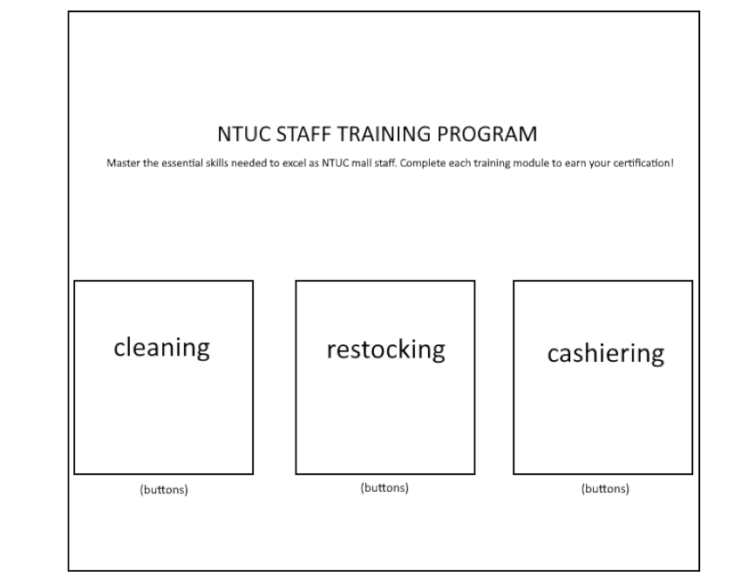
Wireframe for Game (Starting Page)

Slide 13
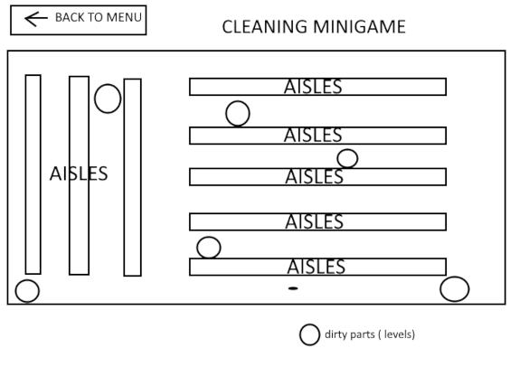
Wireframe for Game (Cleaning)

Slide 14
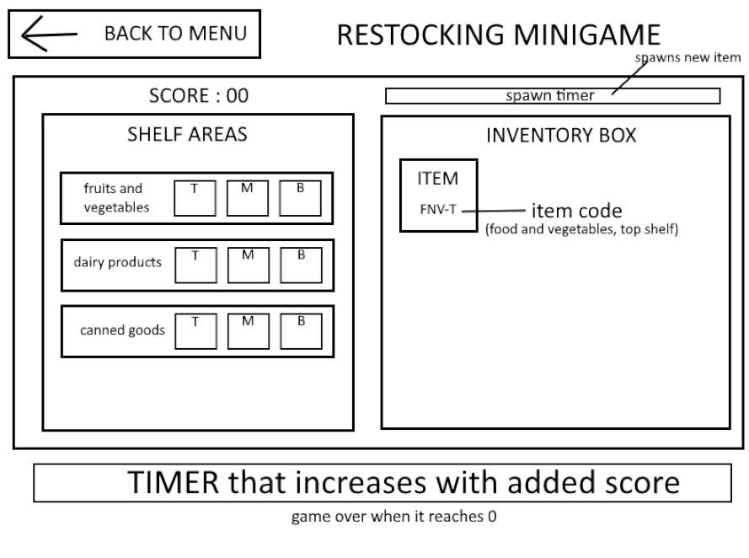
Wireframe for Game (Restocking)

Slide 15
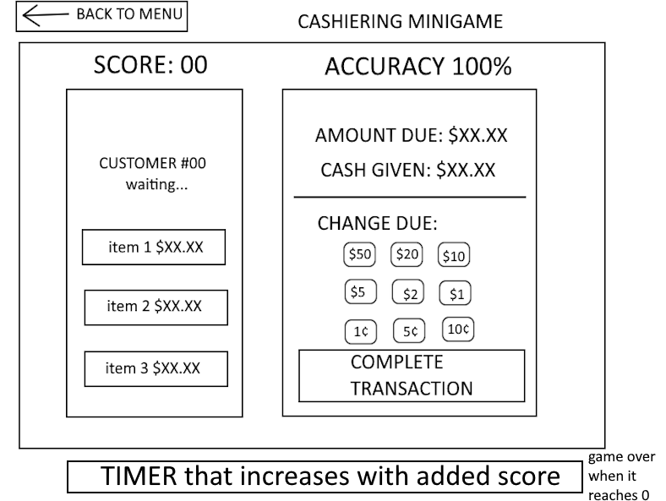
Wireframe for Game (Cashiering)

Slide 16

E-learning (Nigel)
Preparing staff
Notes:
Allows part-timers that the company wouldn’t want to spend a lot of resources to train, be ready/prepared for their first day on the job without didn't much resources
Read up on the staff that they are going to do inside the store. Some tips
Getting a better sense of idea of what to expect / do

Slide 17

Notes:
Eg: showing them the cash you received from them when giving them their item

Slide 18
Wireframe for E-Learning
Description
Flip card
Flip card
Flip card
Navigation bar

Slide 19

Illustration for E-Learning

Slide 20
Caleb (Quiz)
NTUC Supermarket Game Quiz
Focuses on quiz-based training to test new NTUC staff
3 main learning points - Cleaning, Re-stocking and Cashiering
→ essential to supermarket businesses

Slide 21
Purpose
Basic supermarket operations
Mistakes affect safety, hygiene and customer experience
Quiz ensures that new hires are able to carry out their work professionally
Covers 3 roles - cleaning, Stocking and cashiering

Slide 22
Example
What are you supposed to do before mopping the floor?
Use a toothbrush to mop the floor without putting the wet floor caution sign
Use the appropriate equipment such as a mop, floor cleaner, etc. for the respective situation and alert all customers nearby that a cleaning process is going on

Slide 23
Format of Quiz
Multiple-choice format
Answer selection via buttons
Immediate feedback
Score tracking

Slide 24
Benefits & Conclusion
Standardised training assessment
Improves staff readiness
Reduces training errors
Expandable for more roles
More room for error instead of a real life situation

Slide 25
Wireframe for Quiz
Question 1) Does restocking…
Option 1
Option 2
Option 3
Next Question

Slide 26
Wireframe for Quiz
Your marks is ……
Failed/Passed
Retry
Exit

Slide 27
References( Business needs)
Gutierrez, K. (n.d.). Facts and Stats That Reveal The Power Of eLearning [Infographic]. SH!FT.
https://www.shiftelearning.com/blog/bid/301248/15-facts-and-stats-that-reveal-the-power-of-elearning

