Slide 1
Employee Data Analysis using Excel
STUDENT NAME:R.Sophiya
REGISTER NO:122201784
DEPARTMENT:B.com(corporate secreraryship)
COLLEGE:chellammal womens college

Slide 2
PROJECT TITLE
Employee Performance Analysis using Excel

Slide 3


AGENDA
Problem Statement
Project Overview
End Users
Our Solution and Proposition
Dataset Description
Modelling Approach
Results and Discussion
Conclusion
3/21/2024 Annual Review

Slide 4

PROBLEM STATEMENT
STATEMENT •Detection of face masks in public spaces has become critical for ensuring public health and safety. Traditional methods of manual monitoring are inefficient and prone to errors. An automated system for face mask detection is needed to enforce mask-wearing policies effectively.

Slide 5

PROJECT OVERVIEW
.
PROJECT OVERVIEW Our project aims to develop a CNN-based system for automatic face mask detection. Leveraging deep learning techniques, we seek to accurately identify whether individuals are wearing masks in images or video streams. The system will serve as a tool for authorities to monitor compliance with mask-wearing regulations in various settings.

Slide 6

WHO ARE THE END USERS?
Health authorities •Law enforcement agencies •Business owners (e.g., retail stores, restaurants) •Public transportation operators

Slide 7

OUR SOLUTION AND ITS VALUE PROPOSITION
•We propose a CNN architecture trained on a dataset of labeled images containing people with and without masks. The model will be capable of real-time detection and can be deployed in various scenarios, including CCTV surveillance, mobile applications, and public kiosks. Our solution aims to provide a reliable and efficient method for enforcing mask-wearing policies and promoting public safety.

Slide 8
Dataset Description
Dataset Description Employee dataset-Kaggle 26 features 9 features Emp id Name-text Rating-numeri Performance-text Gender-m Business unit-text Business type-text

Slide 9

THE "WOW" IN OUR SOLUTION
Real-time detection capabilities High accuracy in identifying mask-wearing behavior Scalability for deployment in diverse environments •Potential for integration with existing surveillance systems
3/21/2024 Annual Review
9

Slide 10
MODELLING
1.Convolutional Neural Network (CNN) Architecture: 1. CNNs are ideal for image classification due to their ability to capture spatial dependencies. 2. We've chosen a CNN architecture optimized for image classification tasks, ensuring efficient processing of input images. 2.Data Preprocessing: 1. Prior to training, our dataset undergoes preprocessing steps. 2. Techniques such as resizing, augmentation, and normalization are applied to ensure data quality and model robustness. 3. Training Process: 1. The dataset is split into training, validation, and testing sets. 2. We initiate the model parameters and select an optimization algorithm. 3. Training iterations and batch sizes are adjusted to optimize model performance.
10

Slide 11
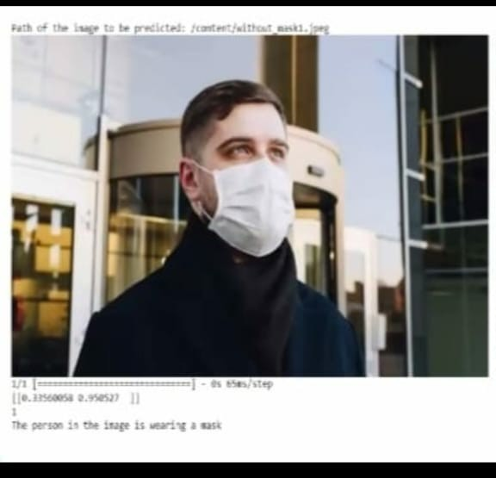
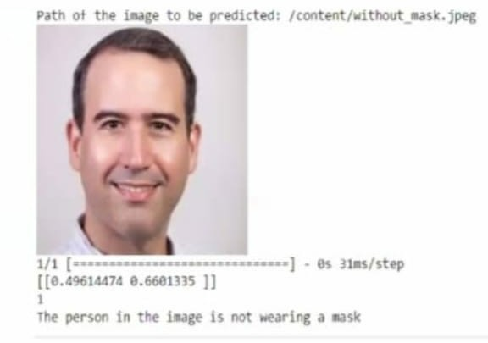
RESULTS
11

Slide 12
conclusion
conclusion Our project successfully developed a Convolutional Neural Network (CNN)-based system for face mask detection. •Through meticulous data preprocessing and model training, we achieved promising results in accurately identifying individuals wearing face masks.

