Slide 1
TLS ATTACKS : ORACLE PADDING
Presented by: JiaRui XIE
Imad HAMDACHE
Yassine EL AMRAOUI

Slide 2

Introduction:
Information became very important
People try to secure their data
But others try to break this security

Slide 3
Plan:
Introduction
I- SSL/TLS Attacks
II- Cipher Block Chaining ( CBC )
III- Oracle Padding
Conclusion

Slide 4
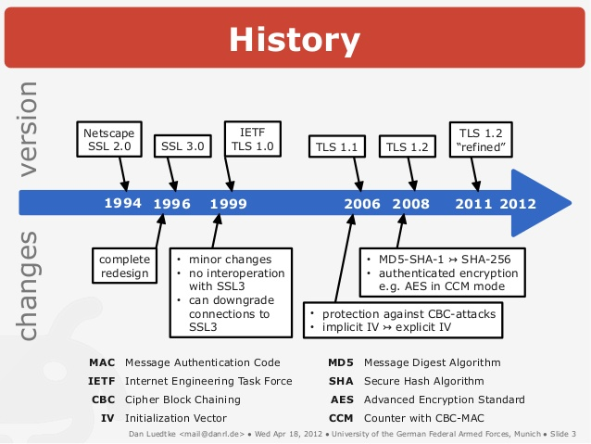
I- SSL/TLS ATTACKS

Slide 5
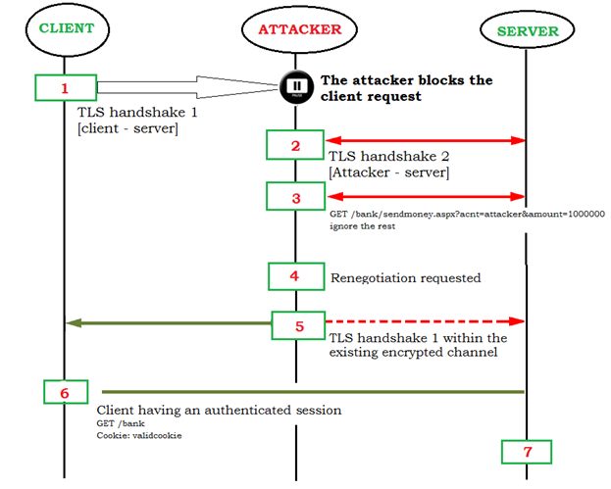

Slide 6
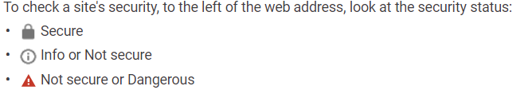

Slide 7
Cipher Block Chaining ( CBC ):
It is a symmetric key algorithm.
It divides the plaintext into blocks of equal length then
encrypts and decrypts each group separately using a
determined algorithm.

Slide 8
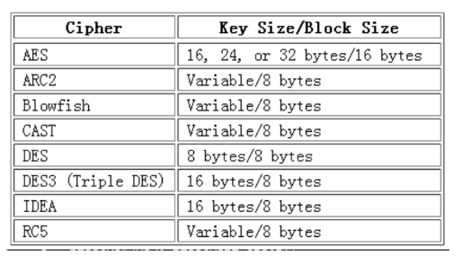
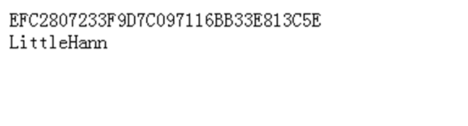
Split:
If the plain message is 10 bytes with DES how many blocks will we get?

Slide 9
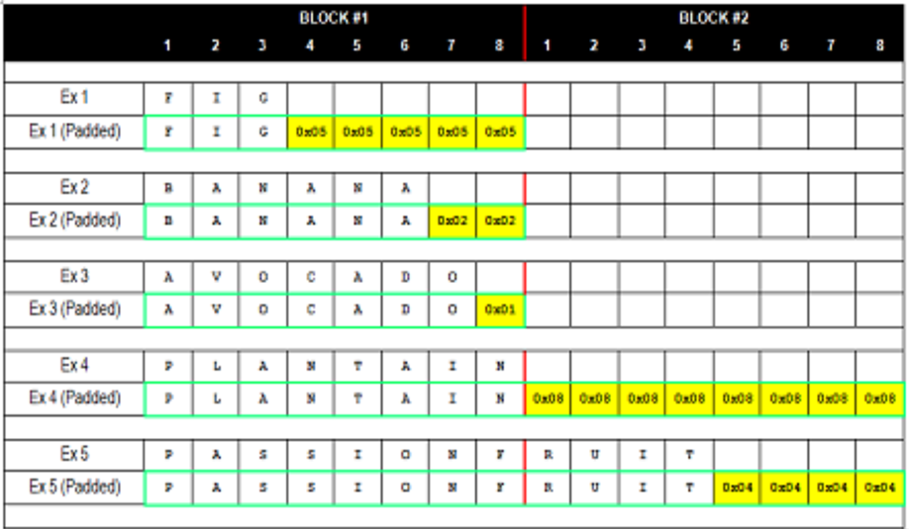
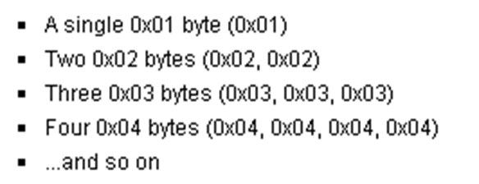
Padding:

Slide 10
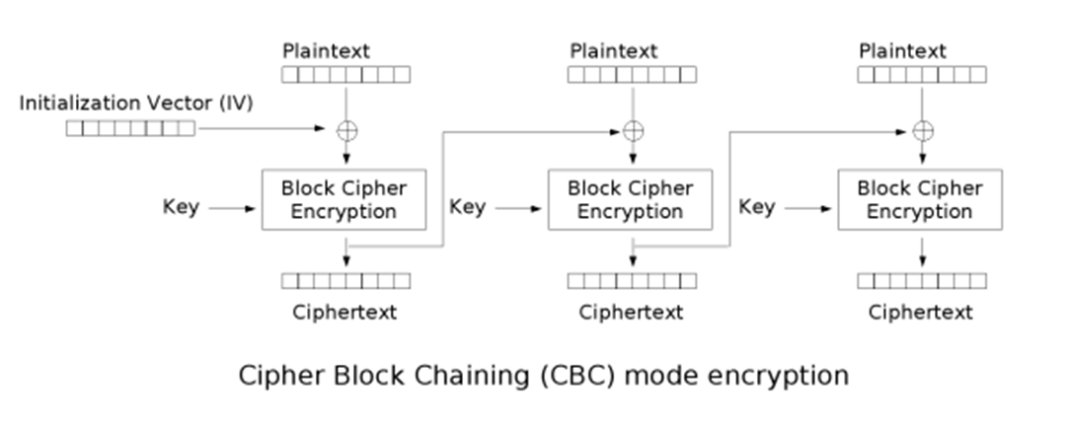
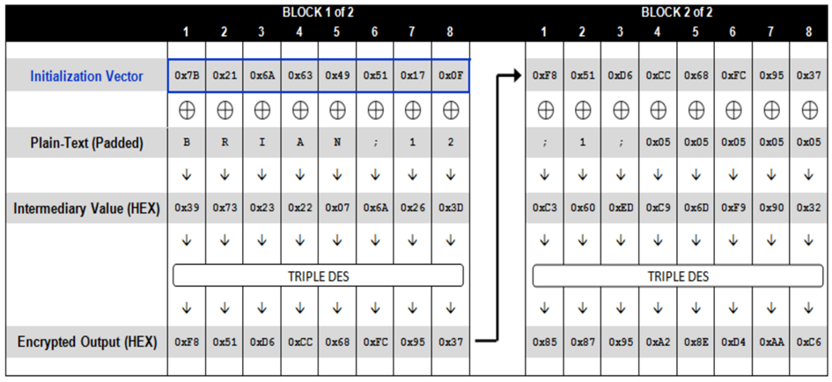
Encryption:

Slide 11
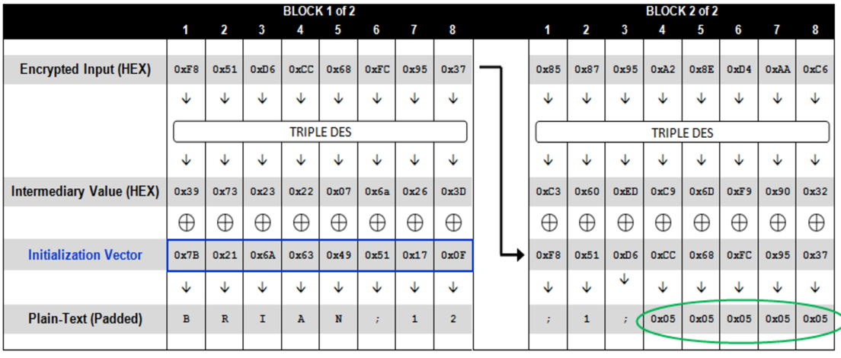
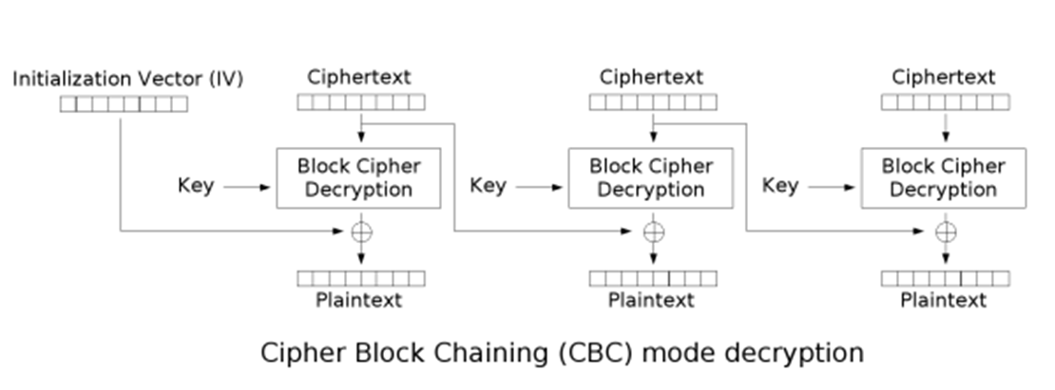
Decryption:

Slide 12
Advantages:
(1) To some extent, CBC can prevent data from tampering.
(2) Can be decrypted in parallel.

Slide 13
Disadvatanges:
(1) Unable to encrypt in parallel. Because the encryption of each data block depends on the cipher of the previous data block.
(2) Encrypted messages must be padded to an integer multiple of the block size.
(3) Error propagation. When a bit in one block is wrong, if the cipher length does not change, then two blocks are affected. Else if the cipher length changes, all blocks are affected.

Slide 14
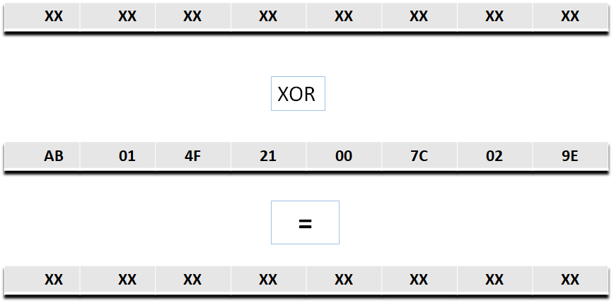
III - Oracle Padding:

Slide 15
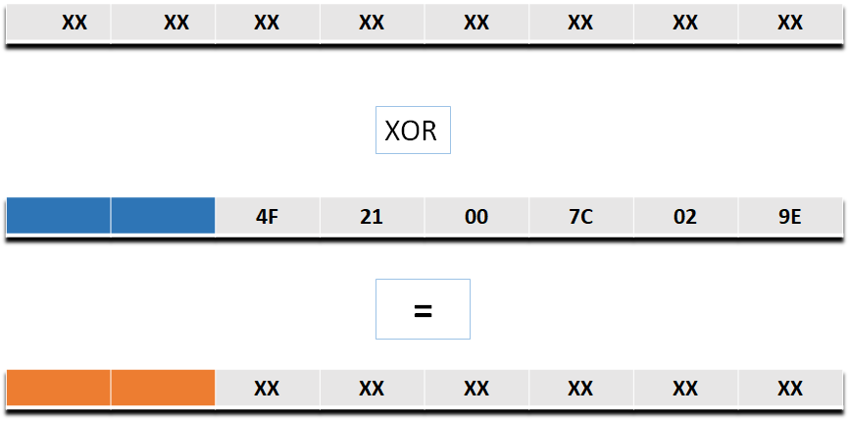


Slide 16
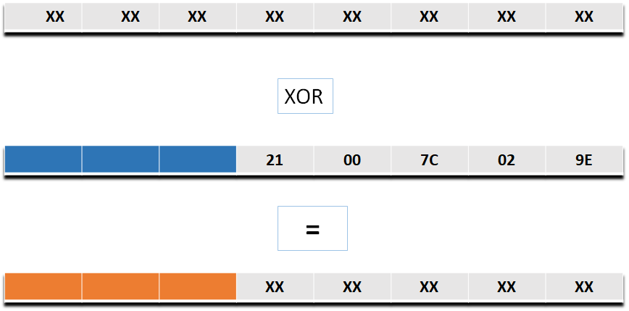
Padding error !!

Slide 18
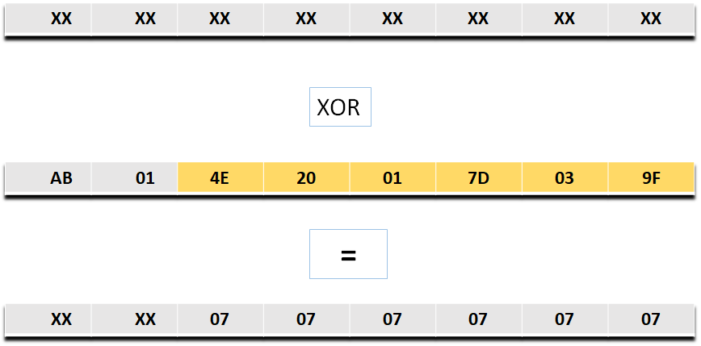

Slide 19
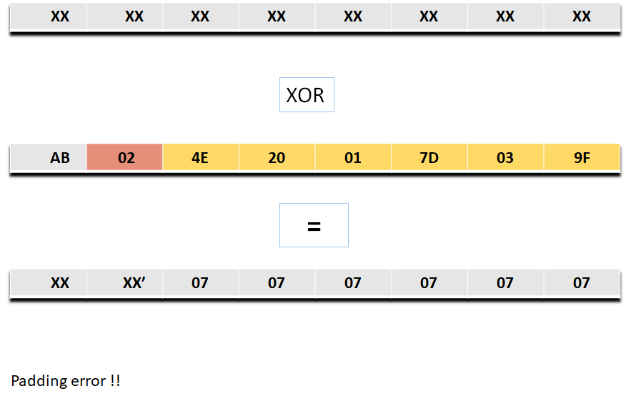

Slide 20
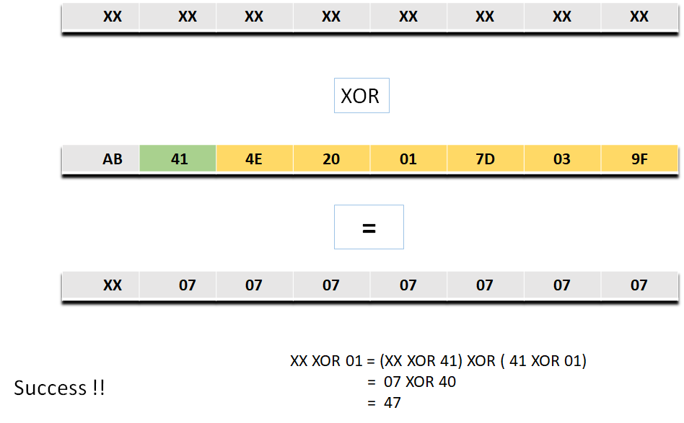

Slide 21
Complexity of the attack :

Slide 22
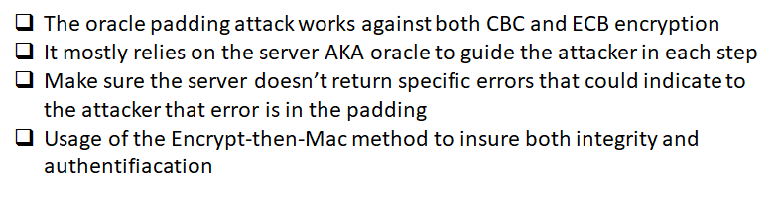
Conclusion

Slide 23
Thanks for your attention!

