Slide 1
What is CBC
It is a symmetric key algorithm.
It divides the plaintext into blocks of equal length then encrypts and decrypts each group separately using a determined algorithm.

Slide 2
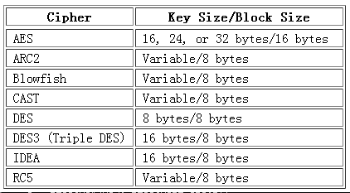
How is it Work -Split
If the plain message is 10 bytes with DES how many blocks will we get?
2. Because 8¹ < 10 < 8²

Slide 3
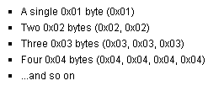
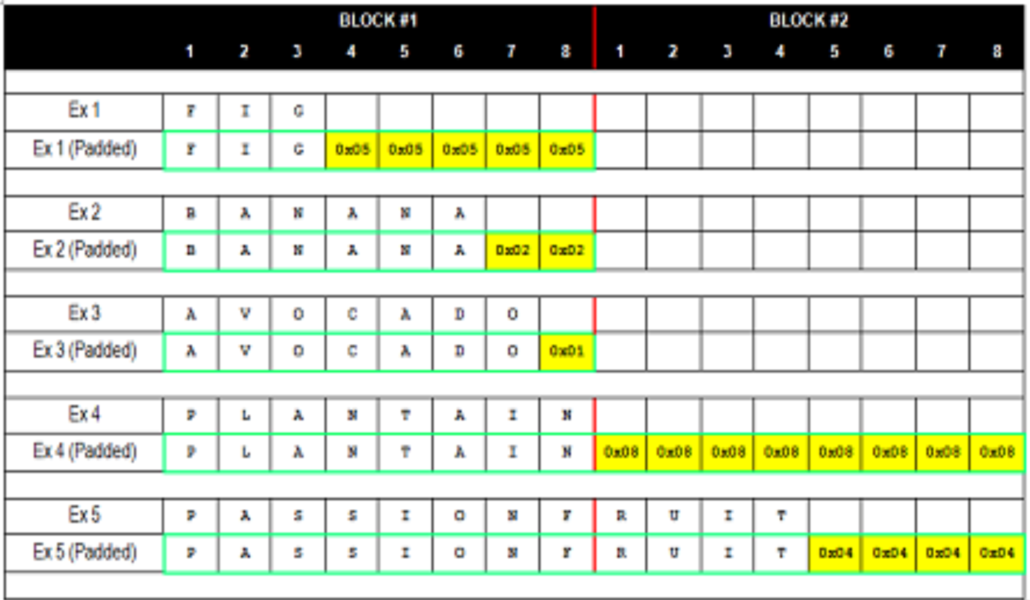
How is it Work -Padding

Slide 4
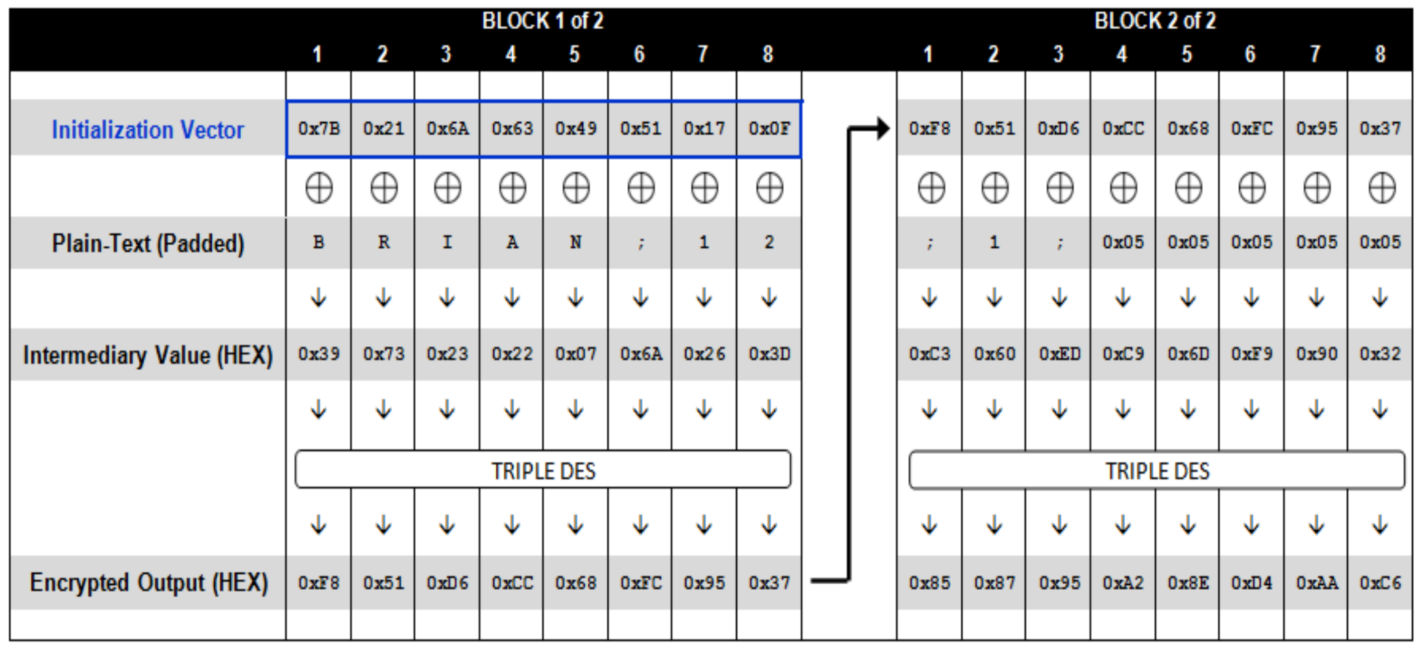
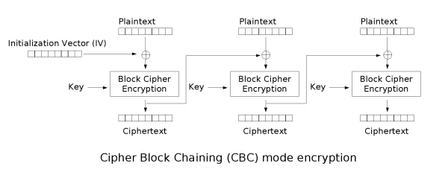
How is it Work -Encrypt

Slide 5
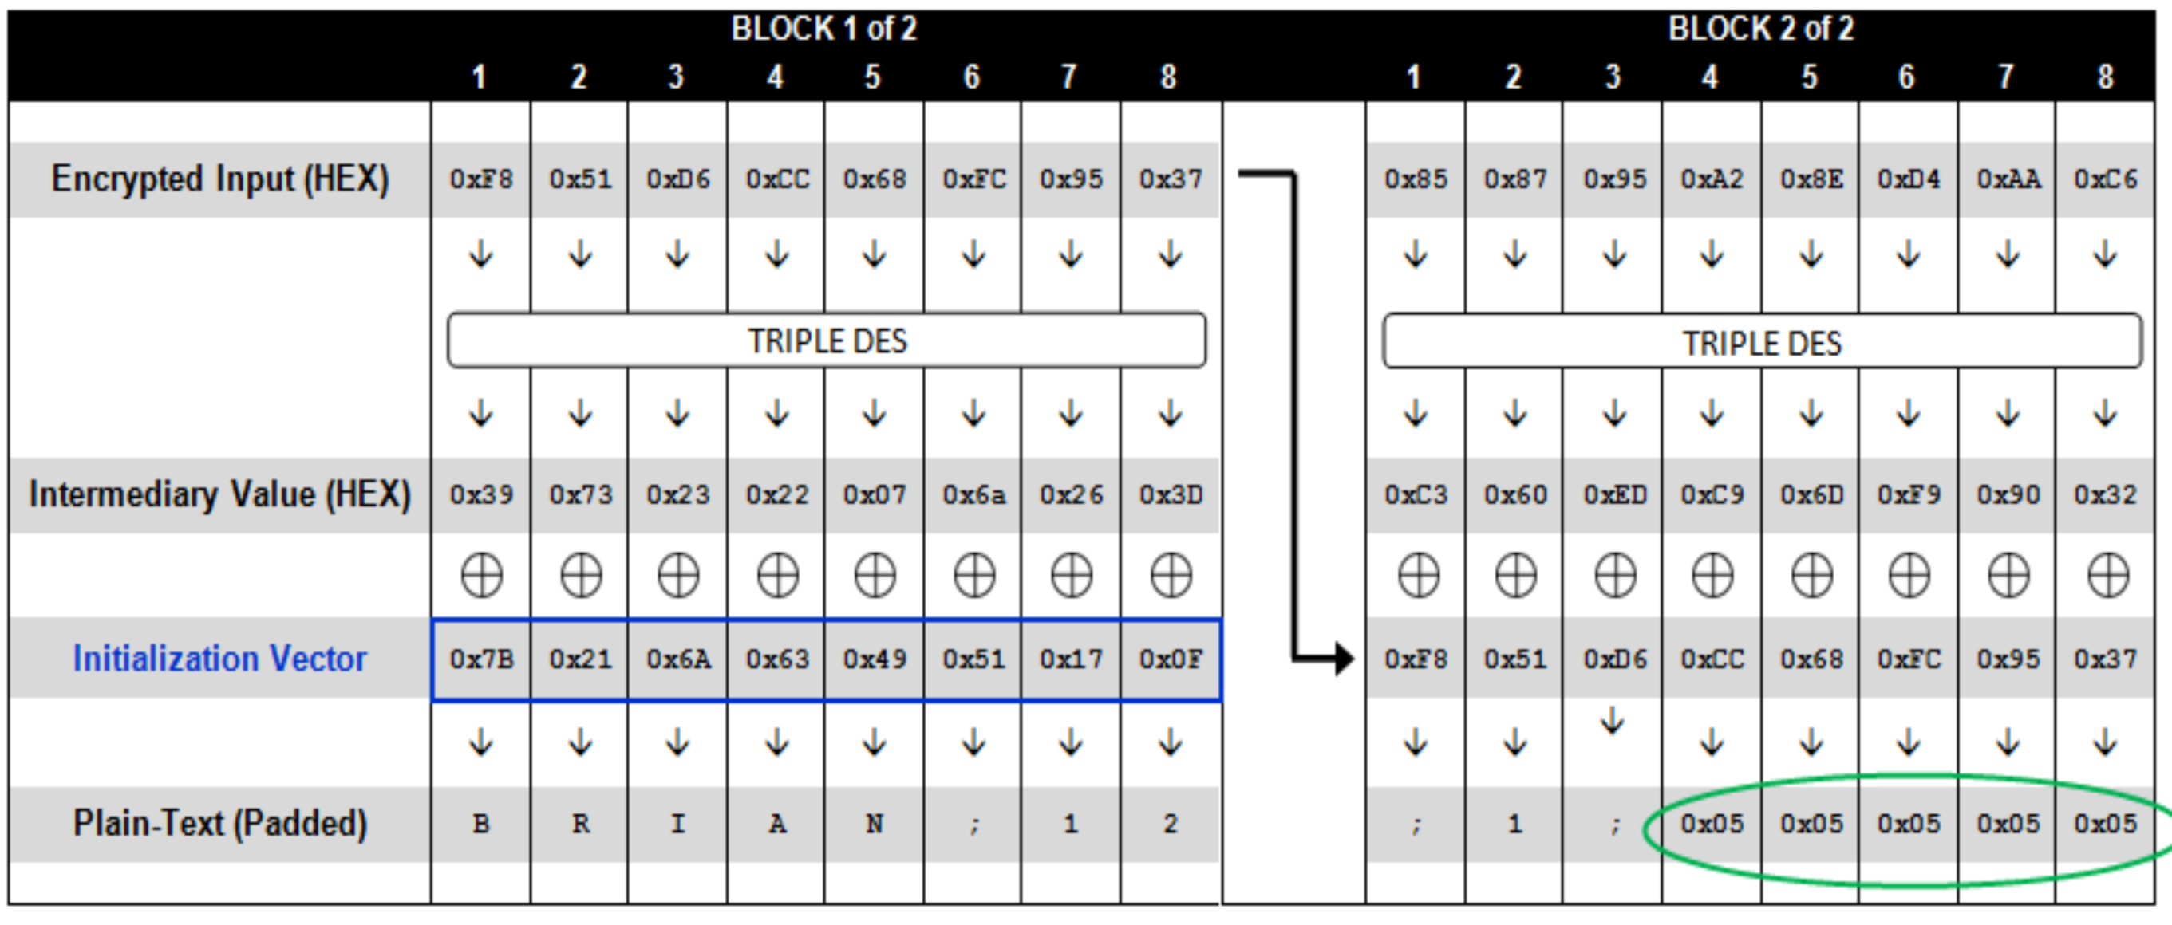
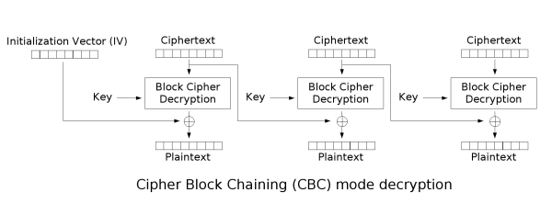
How is it Work -Decrypt

Slide 6
Advantages & Disadvantages
Advantages：
(1) To some extent, CBC can prevent data from tampering.
(2) Can be decrypted in parallel.
Disadvantages：
(1) Unable to encrypt in parallel. Because the encryption of each data block depends on the cipher of the previous data block.
(2) Encrypted messages must be padded to an integer multiple of the block size.
(3) Error propagation. When a bit in one block is wrong, if the cipher length does not change, then two blocks are affected. Else if the cipher length changes, all blocks are affected.

