Slide 1

Dash \ Streamlit
Data Dashboard

Slide 2
Github
https://github.com/Soplicow/streamlit-dash

Slide 3
Dash

Slide 4


What is Dash?
Open source framework created by Plotly in 2017.
Used for web data apps in Python.
It is based on Plotly.js, React and Flask.
Knowledge of HTML and JS is not necessary but can be helpful.

Slide 5
https://dash.gallery/Portal/
https://plotly.com/examples

Slide 6
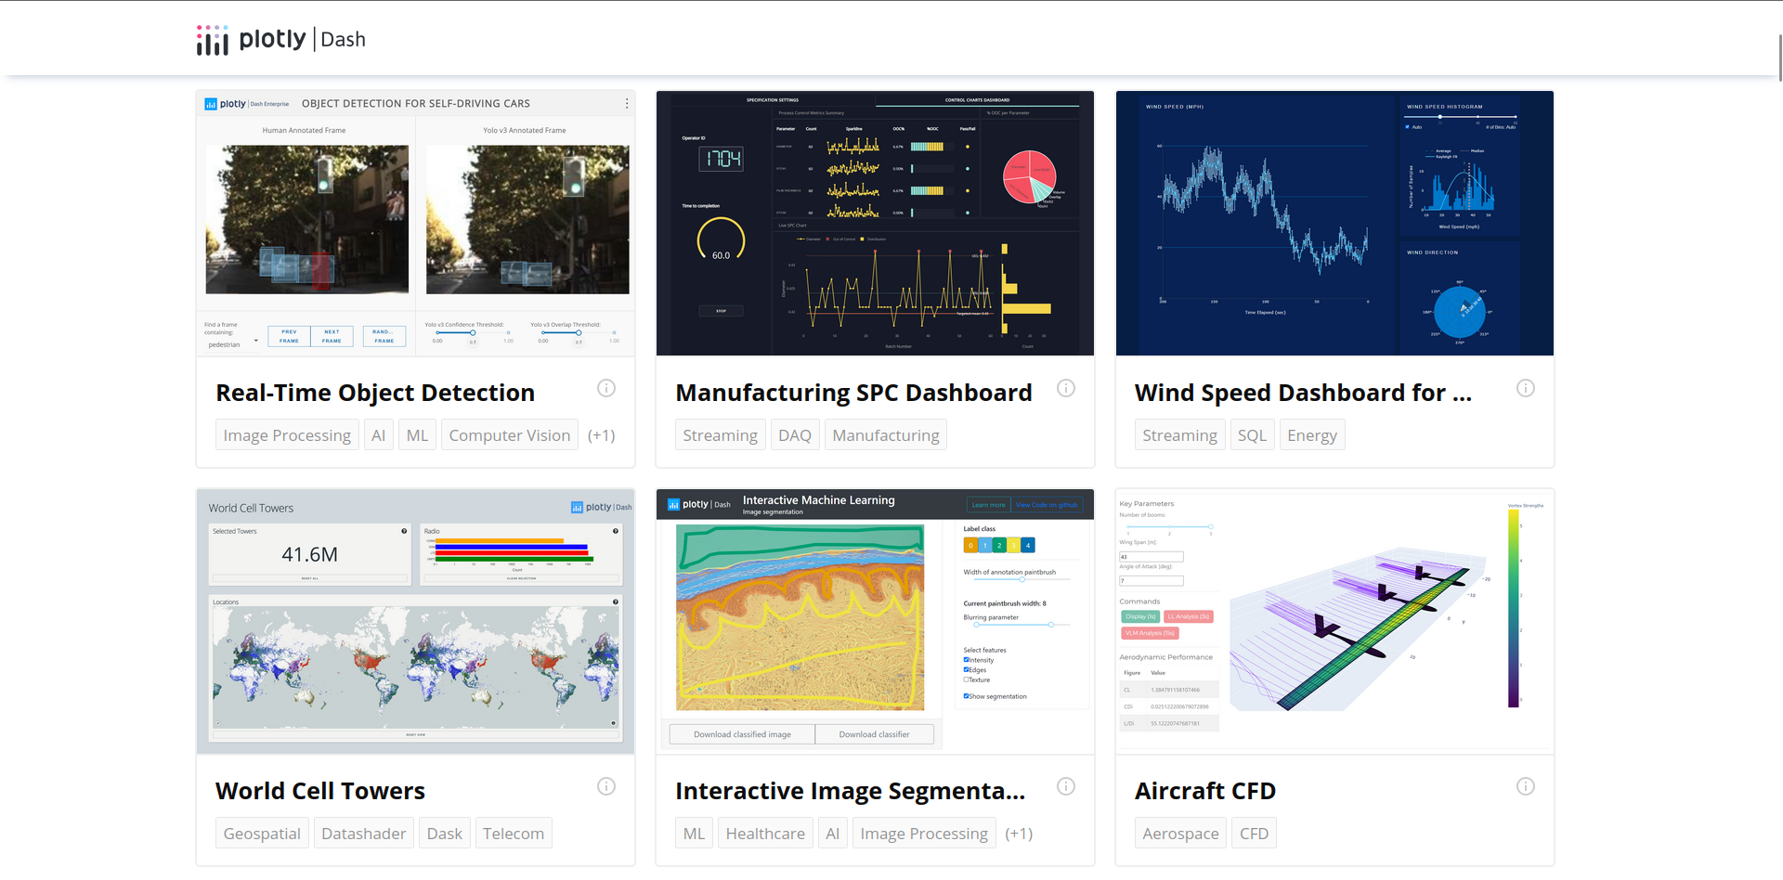

Slide 7
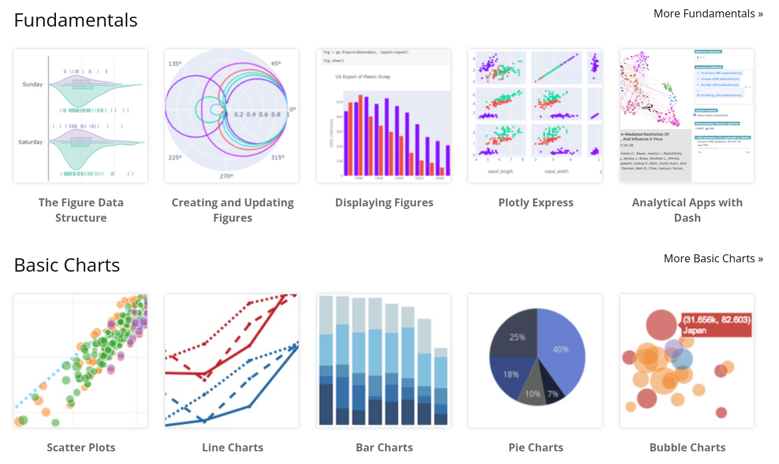
https://plotly.com/python

Slide 8
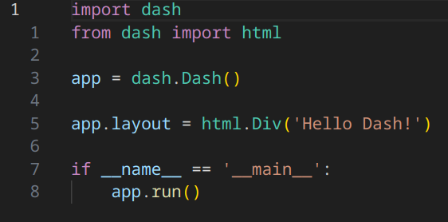
Hello Dash!
Install dash with pip:
pip install dash
Run the app with:
python3 app.py

Slide 9
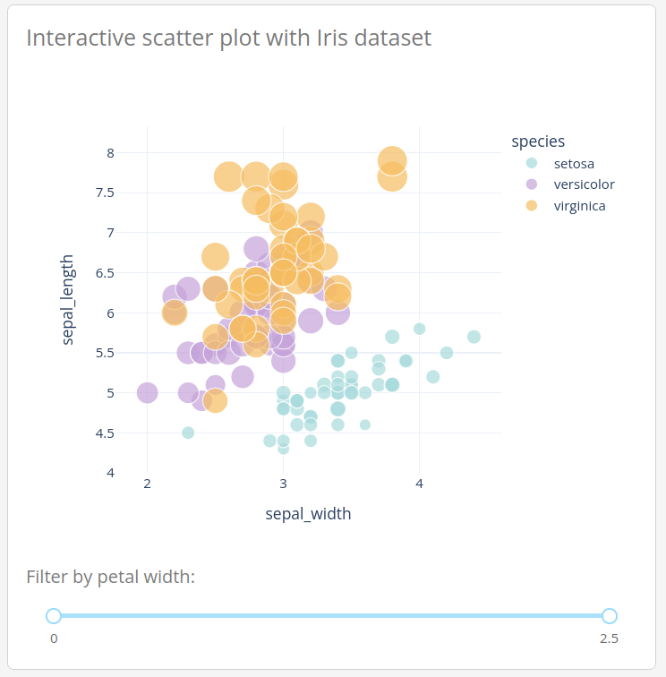
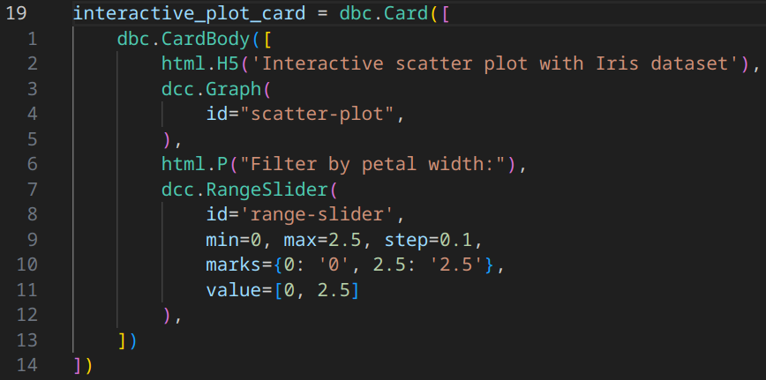
Dash components:

Slide 10
Callbacks
Callbacks are Python functions that are automatically called by Dash whenever an input component’s property changes. https://dash.plotly.com/basic-callbacks

Slide 11
Callbacks contd.
You can get callbacks from:
Button clicks
Dropdown lists
Graph hover/click on value
Period timers, URL address change
From callbacks you can:
Update input values
Generate new HTML elements
Update CSS styling
Generate plotly graphs

Slide 12
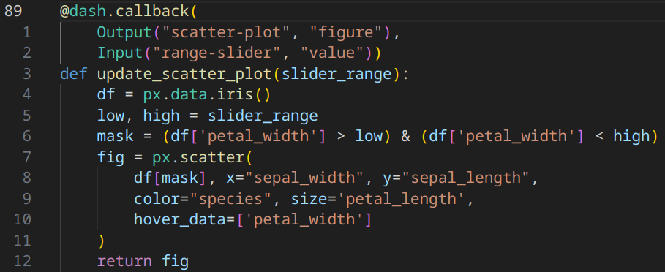
Callbacks – example

Slide 13
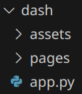
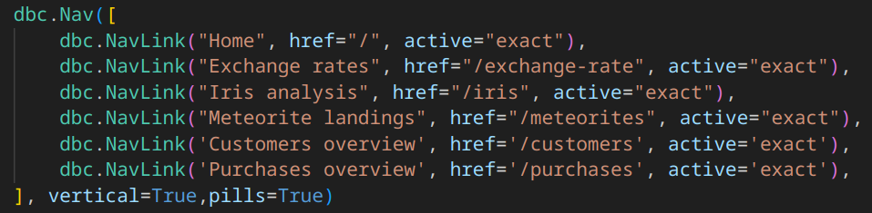
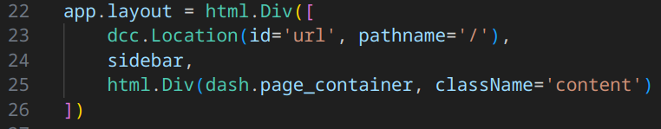
Multipage apps

Slide 14
Streamlit

Slide 15

What is Streamlit?
An open-source Python framework
Used to build interactive data apps
Intuitive syntax
Minimal experience required

Slide 16
Streamlit links
https://streamlit.io/
https://streamlit.io/gallery

Slide 17
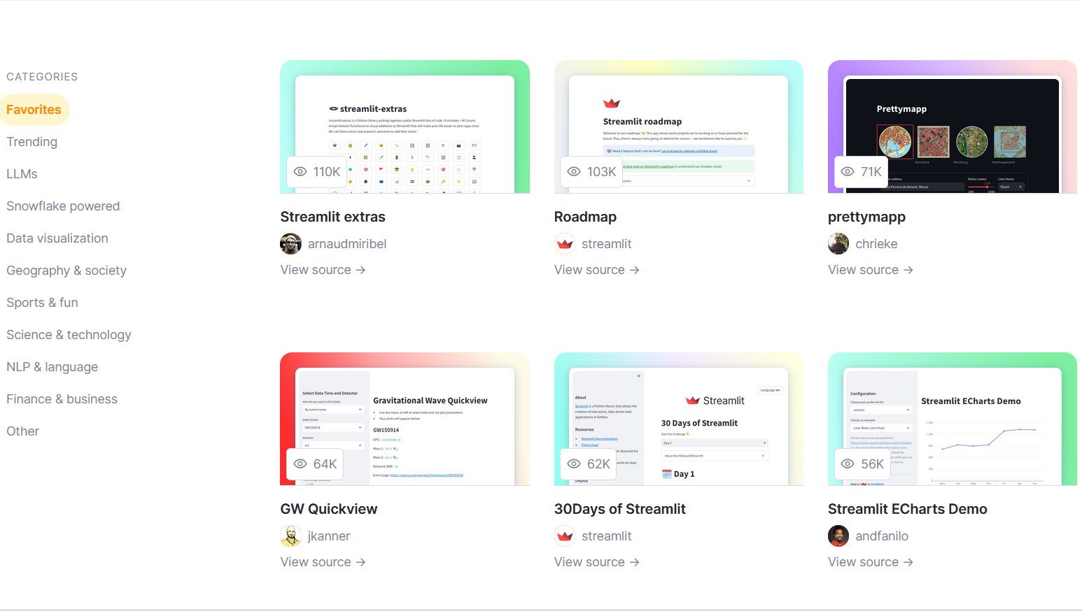

Slide 18
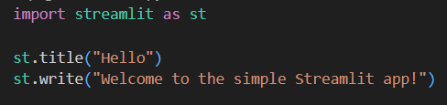
Hello Streamlit!
Create and activate venv:
python –m venv .venv
.venv/Scripts/Activate.ps1 (Windows)
OR
.venv/bin/activate (Linux/MacOS)
Install streamlit with pip:
pip install streamlit
Run the app with:
streamlit run hello.py

Slide 19
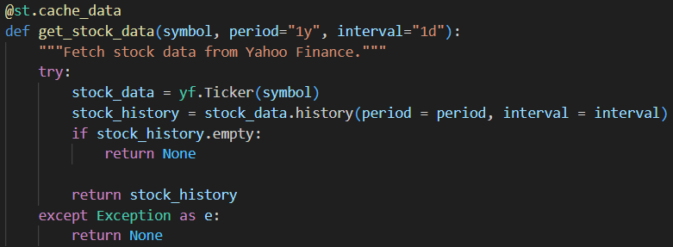
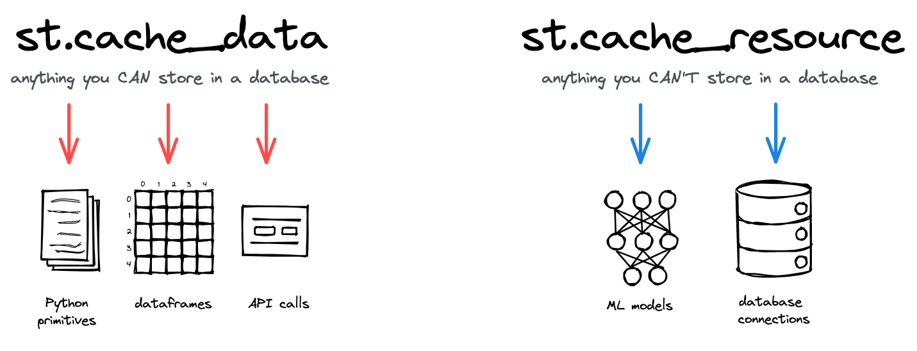
Data/Resource caching
Data caching:
@st.cache_data
Saves expensive function and API calls
Helps reduce loading Times
Resource caching:
@st.cache_resource
Useful for saving database connections and ML models
Ensures resources are created only once and shared globally

Slide 20

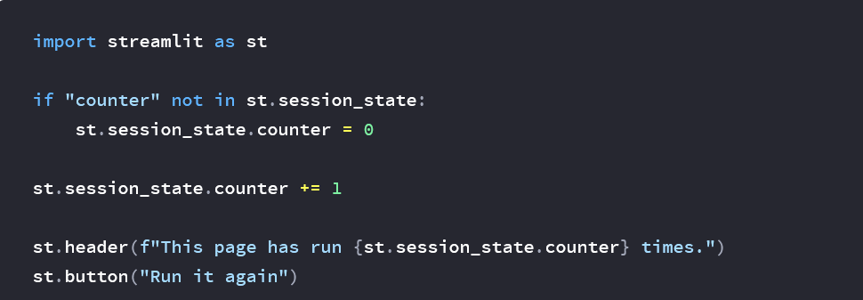
Session state
Session state:
Presists data across user interactions and reruns
Useful for storing variables like counters, user inputs, or intermediate results
Helps avoid unnecessary recalculations and maintains app state

Slide 21
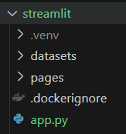
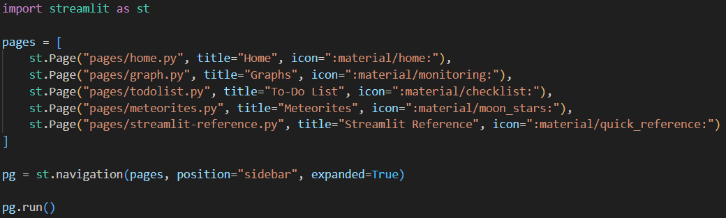
Multipage apps

