Slide 1
8086 REGISTRI E FLAGS

Slide 2
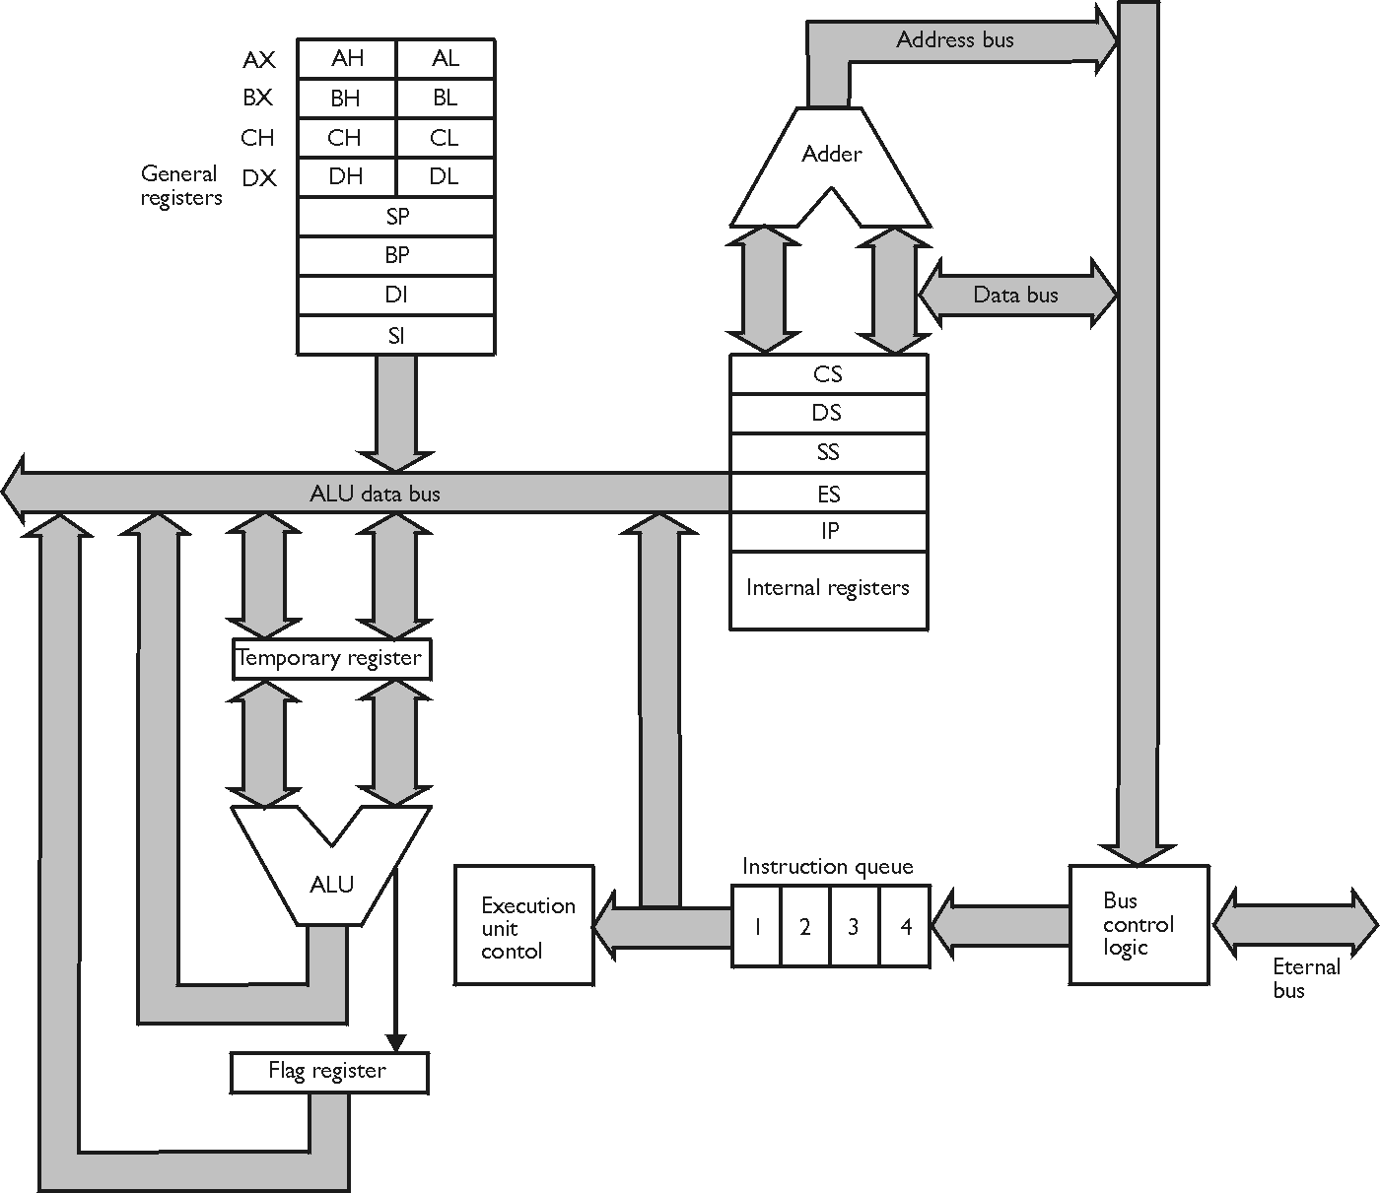

Slide 3
Flag Description
1) S-Sign Flag: This flag is set, when the result of any computation is negative, the sign flag equals the MSB of the result for signed computations.
2) Z-Zero Flag: This flag is set, if the result of the computation orcomparison performed by the earlierinstruction/instructions is 0.
3) P-Parity Flag: This flag is set to 1, if the lower byte of the result contains even number of 1's.
4) C-Carry Flag: This flag is set, when there is perform of MSB in case of addition or borrow in case of subtraction. i.e. when 2 numbers are added, a carry can be generated out of the most significant bit position. In this case the carry flag will be set to '1'. In case, no carry is generated, it will be'0'. Some other instructions also affect or use this flag and will be discussed later in this text.
5) T-Trap Flag: If this flag is set, then the processor enters the single step execution mode. In the other words, a trap interrupt is generated after execution of every specificinstruction. The processor executes the current instruction and the control is transferred to the Trap interrupt service routine.
6) 1-lnterrupt Flag: If this flag is set, the mask able interrupts are recognised by the CPU, otherwise, they are ignored.
7) D-Direction Flag: This is used by string manipulation instructions. If this flag bit is '0', the string is processed starting from the lowest address to the highest address, for example autoincrementing mode. Or else, the string is processed from the highest address towards the lowest address, for example. Autodecrementing mode. We will discuss string manipulations later in chapter 2 in more details.
8) Ac-Auxiliary Carry Flag: This is set, if there is a carry from the lowest nibble, for instance. Bit 3, during addition or borrow for the lowest nibble, for example bit 3, during subtraction.
9) O-Overflow Flag: This flag is set, if an overflow occurs, for example if the result of a signed operation is large enough to be accommodated in a destination register. For example, in case of the addition of 2 signed numbers, if the outcome overflows into the sign bit, for example the result is of more than 7-bits in size in case of 8-bit signed operations and more than 15-bits in size in case of 16-bit signed operations, and then the overflow flag shall be set up.

Slide 4
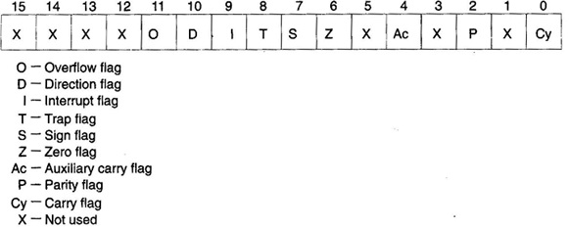
Flag Register

Slide 5

DosBox
DOSBox è un completo emulatore di CPU
È dotato di una interfaccia a riga di comando
Sono implementati solo alcuni dei comandi, ma sufficienti per lanciare un programma.

Slide 6
DosBox
DOSBox emulates an Intel x86 PC
DOSBox works in both Vista 32 bit and Vista 64 bit.
DOSBox also works on Windows 7 32bit and 64bit.
http://www.dosbox.com/wiki/Basic_Setup_and_Installation_of_DosBox

Slide 7
TASM TLINK TD
Tasm/l/zi file (.asm)
Tlink/v file (.obj)
Td file (.exe)

