Slide 1


Institute of Technology of Cambodia Department of Information Technology and Communication
Subject: TP-Internet Programming
Lecturer: Hok Tin
Name: SOR Sopheak
ID: e20191066
Group: I4GIC – C
Assignment: TP-01 HTML & CSS

Slide 2
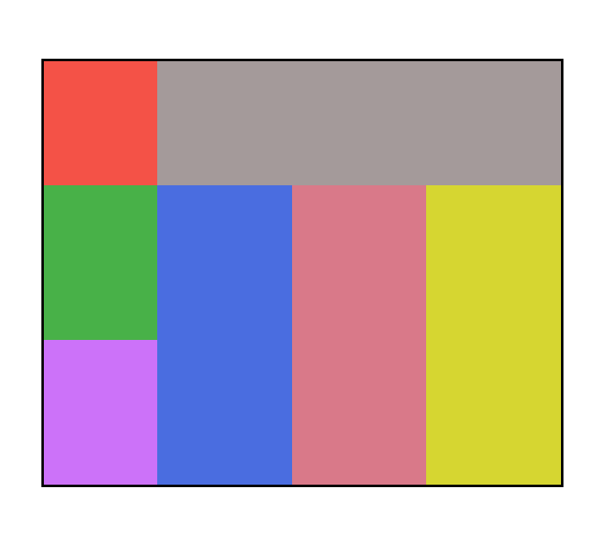
Ex1. Basic Layout

Slide 3

Ex2. Centering a “div” in a container

Slide 4

Ex3. Centering a “div” in a container

Slide 5
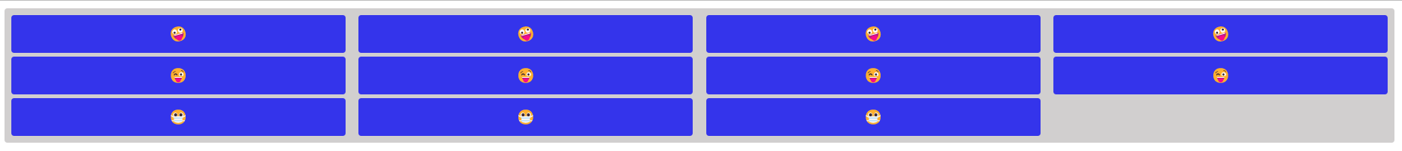
Ex4. Column and Row

Slide 6
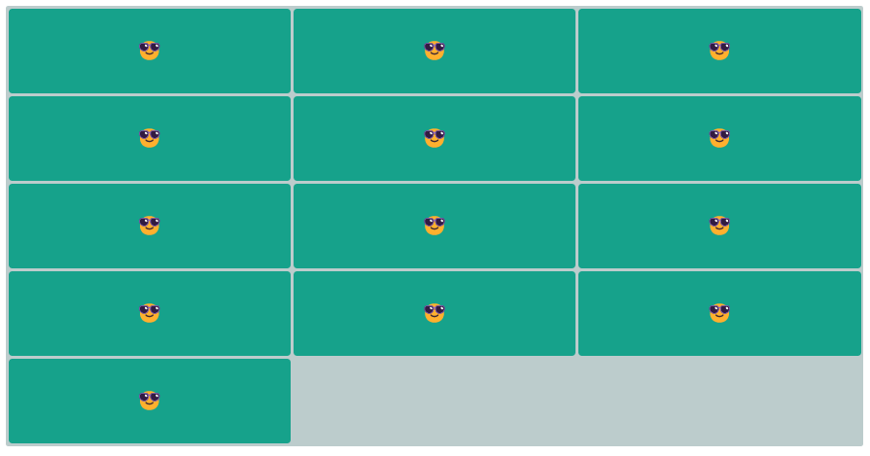
Ex5. Column and Row

Slide 7

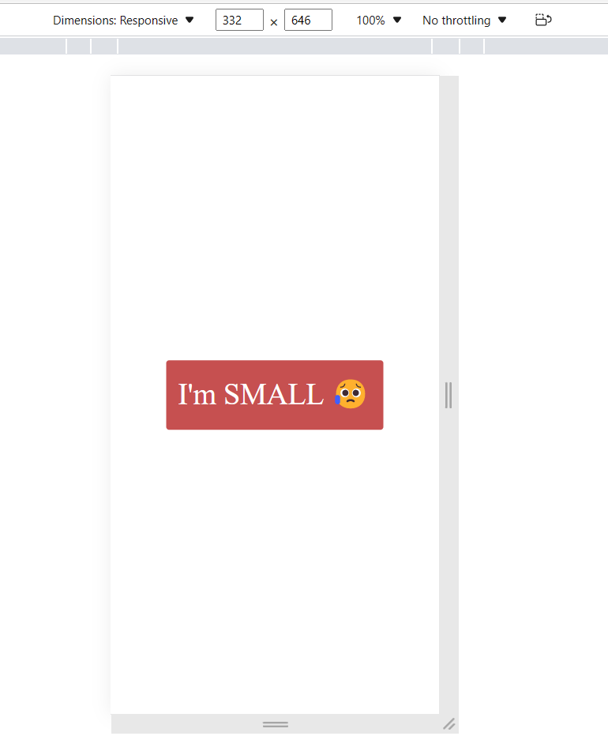
Ex6. Responsive

Slide 8
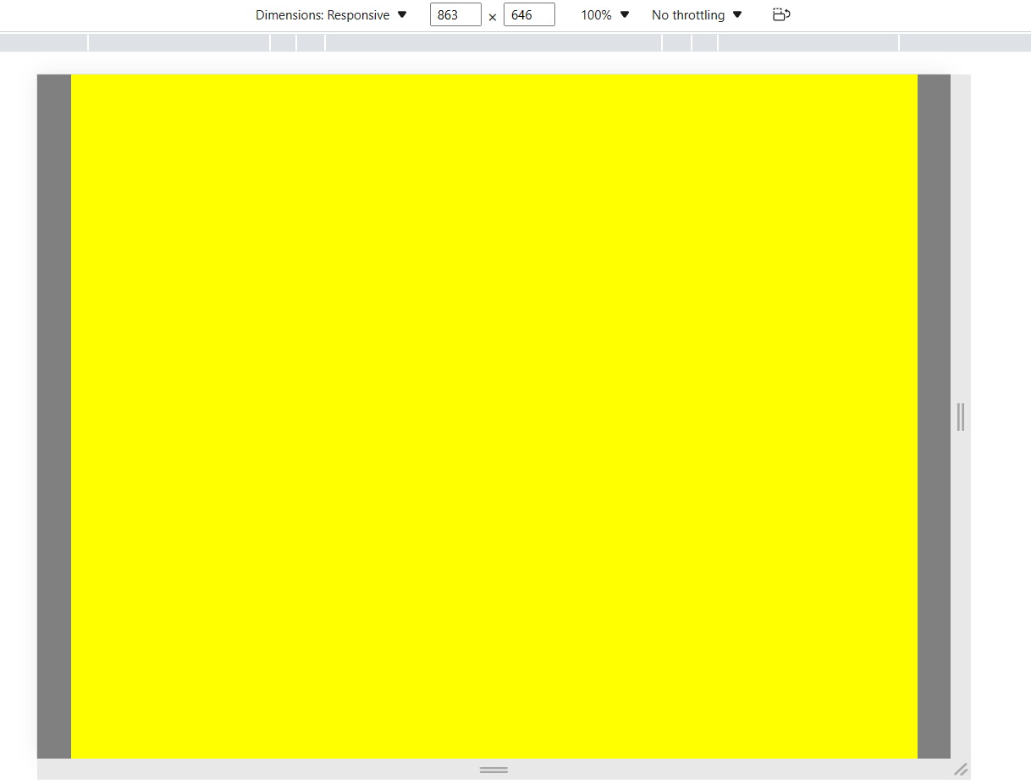
Ex7. Responsive

Slide 9


Ex8. Animation & variable

Slide 10
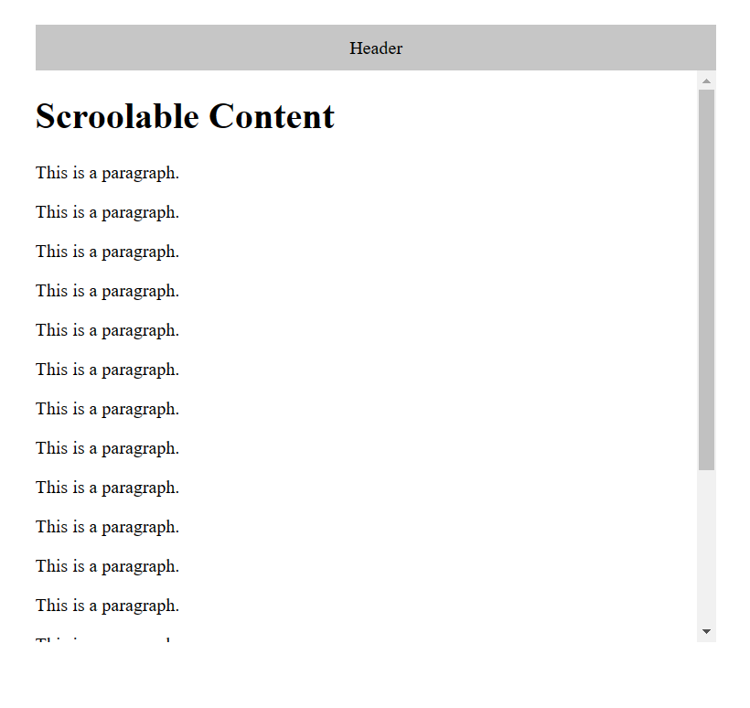
Ex9. Scrollable content

Slide 11
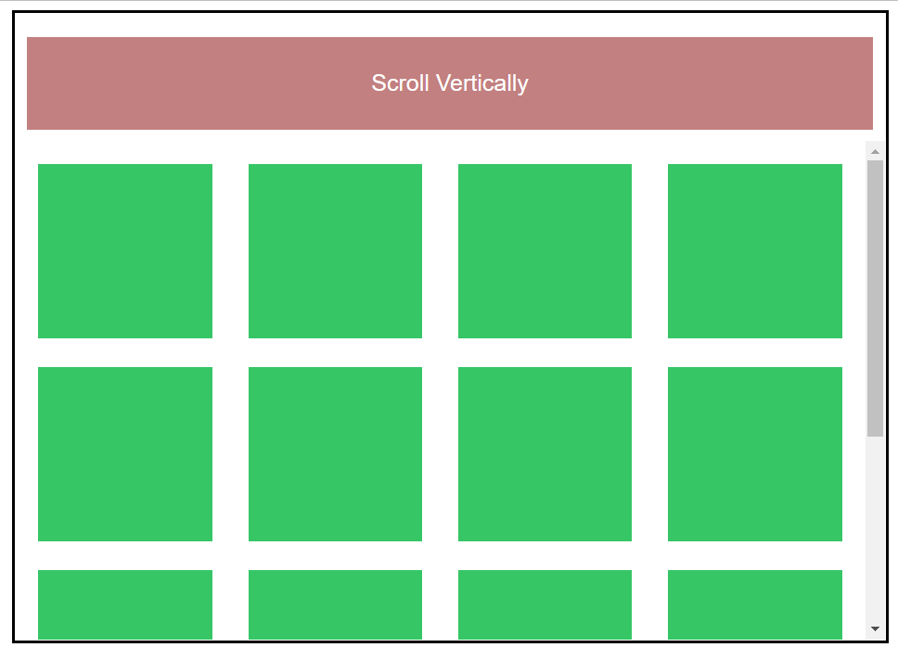
Ex10. Scrollable content

Slide 12
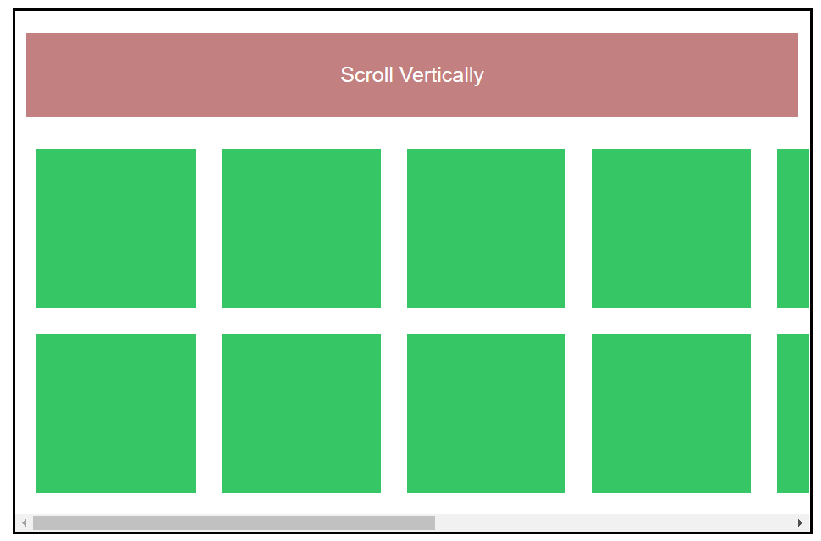
Ex11. Scrollable content

Slide 13

Ex12. Scrollable content

