Slide 1
Chapter 4 Multiple Feedforward Neural Network
4.1 Error Backpropagation Algorithm
4.2 Improving on BP Algorithm
4.3 Practical aspects of neural computing
4.4 Introduction to special neural network architectures
4.5 Applications

Slide 2
4.1 Error Backpropagation Algorithm
Error Back-Propagation
-
+
Desired
output
Input
layer
Output
layer
Hidden layer

Slide 3
Y_{j,desired}
Error
x₁
w_{1j}
Y_{j} = g(h_{j})
x₂
w_{2j}
Neuron j
Σw_{ij}x_{i}
☞
x_{j}
w_{ij}
Transfer function
u_{i}^{k-1} i v_{i}^{k-1}
w_{ij}
u_{j}^{k} j v_{j}^{k}
w_{jl}
u_{l}^{k+1} l v_{l}^{k+1}
Assumption:
Transfer function : Sigmoid
Input sample (x_{k}, y_{k}) , k=1,2,…,N
u_{j}^{k} : Total input to j^{th} neuron on the k^{th} layer
v_{j}^{k} : Output from j^{th} neuron on the k^{th} layer
w_{ij} : interconnecting weight between the i^{th} node of layer k-1
and the j^{th} node of layer k

Slide 4
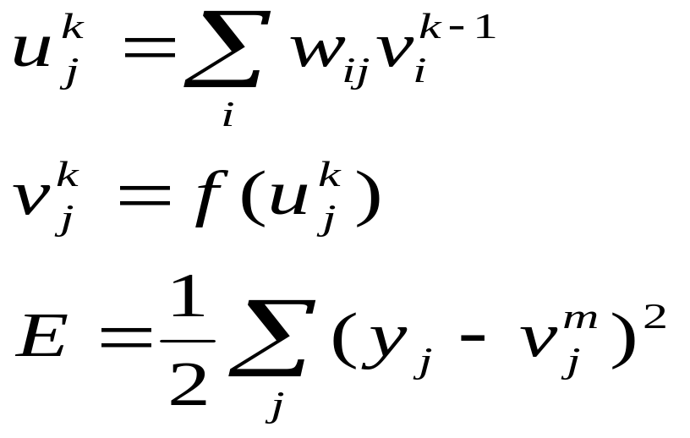
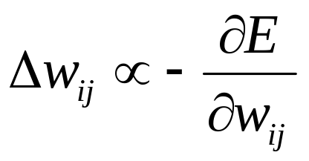
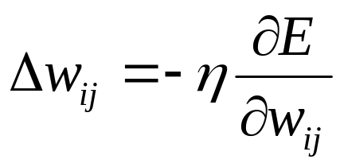
u_{i}^{k-1} i v_{i}^{k-1}
w_{ij}
u_{j}^{k} j v_{j}^{k}
w_{jl}
u_{l}^{k+1} l v_{l}^{k+1}
Where, y_{j} is the desired output
min E(w, x)
η is the learning rate

Slide 5
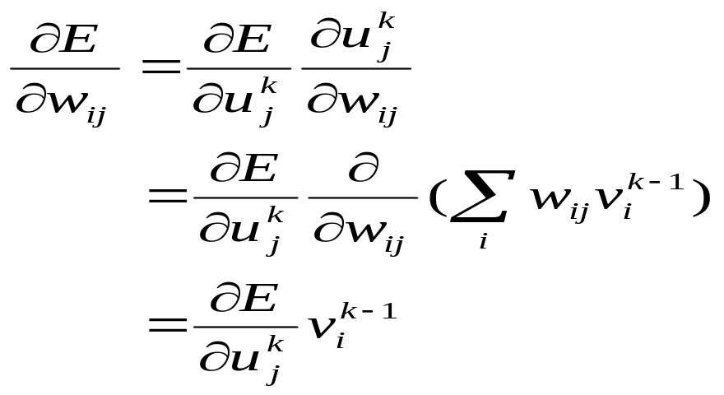
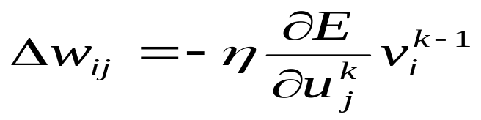
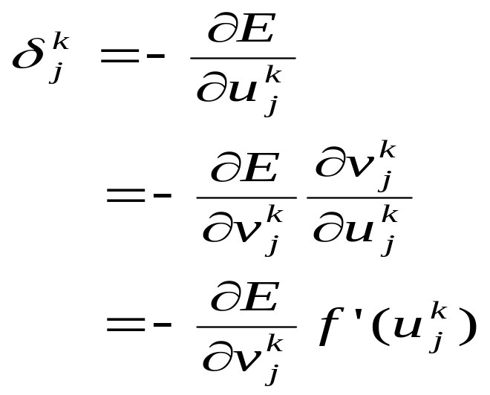
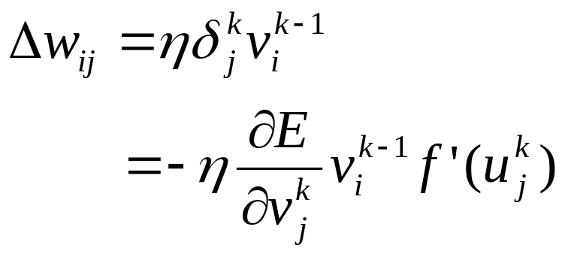
w_{ij}
u_{j}^{k} j v_{j}^{k}
Assuming:
Learning formula

Slide 6
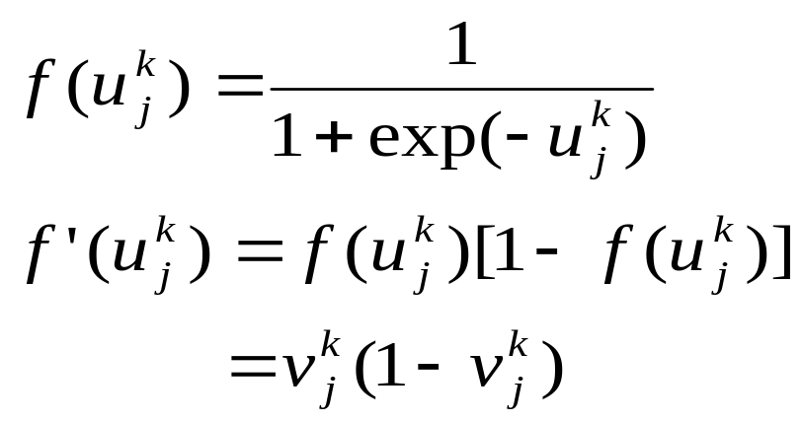
Learning formula
Sigmoid function:

Slide 7
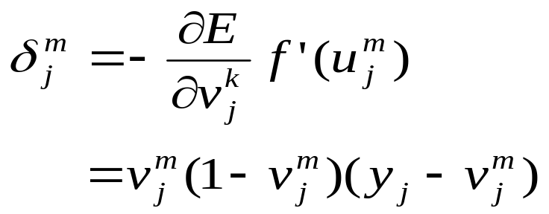
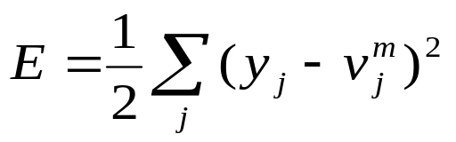
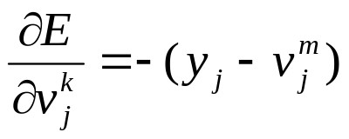
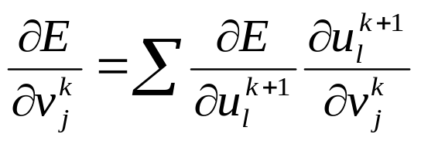
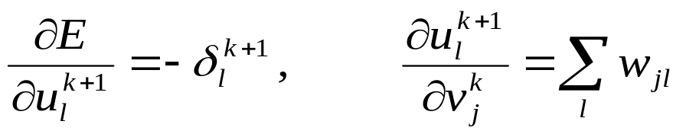
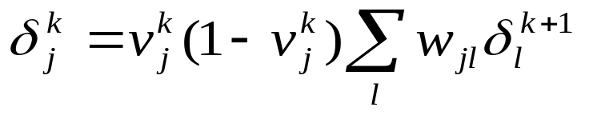
u_{i}^{k-1} i v_{i}^{k-1}
w_{ij}
u_{j}^{k} j v_{j}^{k}
w_{jl}
u_{l}^{k+1} l v_{l}^{k+1}
1. j^{th} node on the output layer m
2. j^{th} node on the hidden layer k

Slide 8
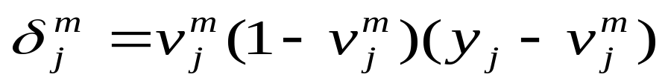
BP algorithm:
w_{ij,new}= w_{ij,old}+Δw_{ij}
New weight
factor
=
Old weight
factor
+
Learning
rate
×
Gradient-descent
correction term
×
Input
term

Slide 9

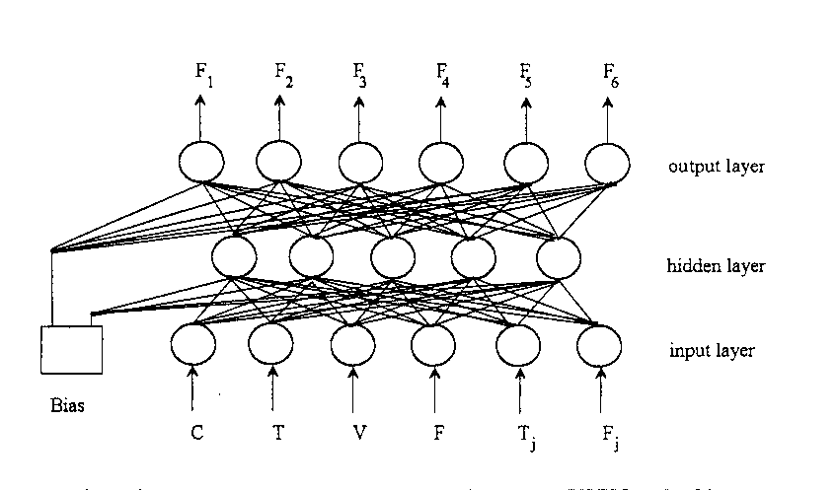
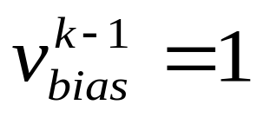
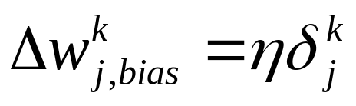
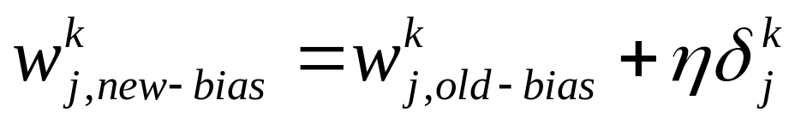
NN with thresholds

Slide 10
Calculating steps of BP algorithm
1. Randomly assign values for weights w_{ij}
2. Repeat the following procedures until the NN is converged
(1) forward activation flow to calculate v_{j}^{k} on each layer
backward error flow to calculate δ_{j}^{k} through the network
Adjust weight factors
w_{ij,new}= w_{ij,old}+Δw_{ij}

Slide 11
An illustrative example: fault diagnosis
Input and output for fault-diagnosis network
Input vector | Output vector
I₁: reactor inlet temperature, ⁰F | c₁ : low conversion
I₂: reactor inlet pressure, psia | c₂ : low catalyst selectivity
I₃: feed flow rate, 1b/min | c₃ : catalyst sintering
The desired output,d_{k} from the neural network is Boolean:
0 indicates that no operational fault exist,
1 indicates that a fault does exist.
The actual output from the neural network is a numeric value between 0 and 1, and can be viewed almost the “probability” that a given input produce the operational fault.
0 = the fault definitely will not occur,
1 = the fault definitely will occur.

Slide 12
Specific conditions:
Input: | I₁=300/1000 ⁰F=0.3 | Output: | d₁=1 (low conversion)
 | I₂=100/1000 psia=0.1 |  | d₂=0 (no problem)
 | I₃=200/1000 lb/min=0.2 |  | d₃=0 (no problem)
In neural network training, we recommend normalizing the input and output values to a finite range, such as [0,1] or [-1,1].

Slide 13
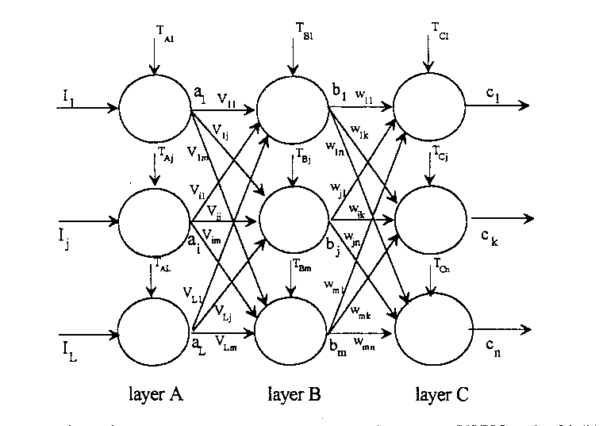
A three-layer perceptron neural network

Slide 14
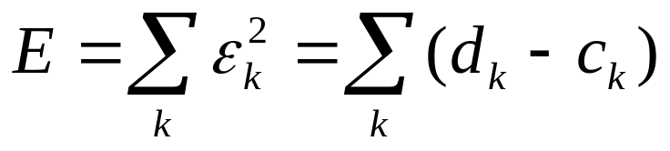
Attempts to properly map given inputs with desired outputs by minimizing an error function.
The total mean-square error function:
here,
ε_{k} is the output error vector from the k^{th} node on the output layer
d_{k} is the desired output value
c_{k} is the calculated value

Slide 15
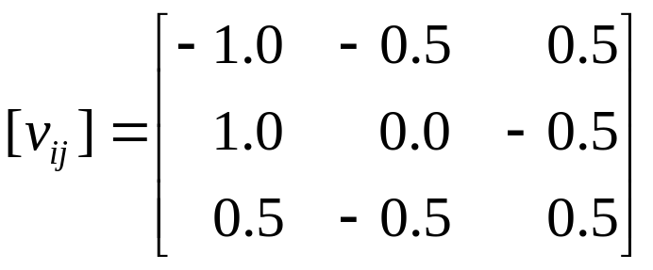
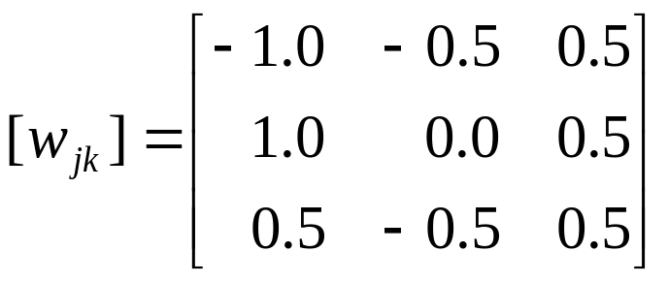
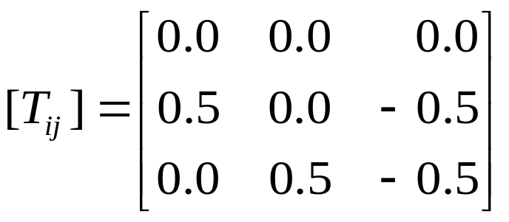
Step 1:
Randomly specify numerical values for all weight factors (v_{ij}’s and w_{ik}’s) within the interval [-1,+1]. Likewise, assign internal threshold values (T_{ai}, T_{Bj}, T_{Ck}) for every node, also between –1 and +1.
Example:
To use computer, let layer A=layer 1, layer B=layer 2, and layer C=layer 3.
For the internal threshold values (T_{1i}, T_{2j}, T_{3k}), we set T_{1i}=0 because usually there is no threshold for every node on the first layer

Slide 16
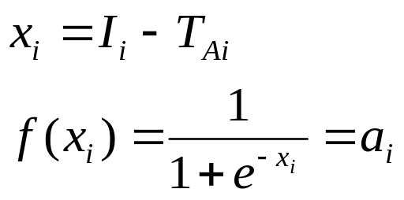
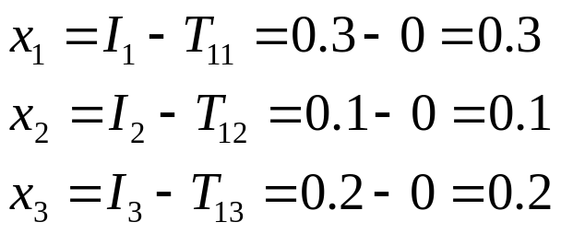
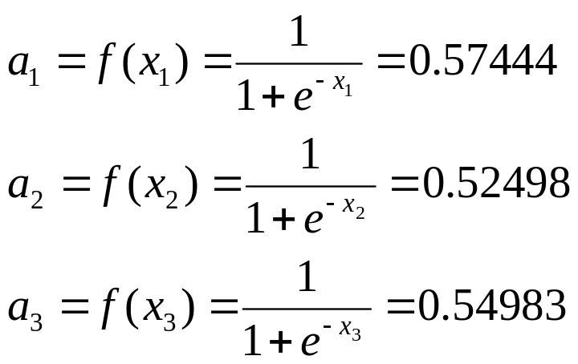
Step 2:
Introduce the input I_{i} into the neural network and calculate all outputs from the first layer, using the standard sigmoid function.
Example:
We introduce the input vector into the neural network and calculate outputs from layer 1:

Slide 17
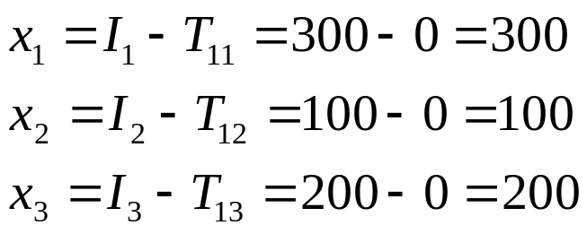
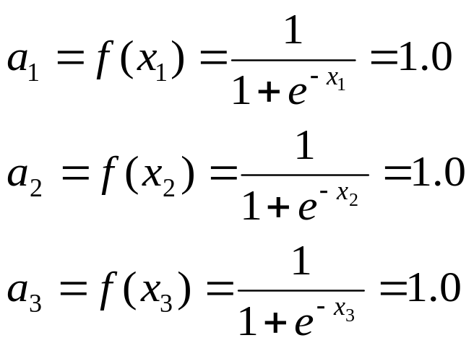
Note that had we not normalized our input values to the ranger [0,1], we would have the following results:
If I₁=300 ⁰F, then a₁=1. If I₁=150 ⁰F, then a₁=1 again.
That is, the sigmoid transfer function is insenstitive to changes in the input when I₁>2.

Slide 18
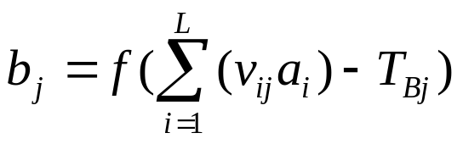
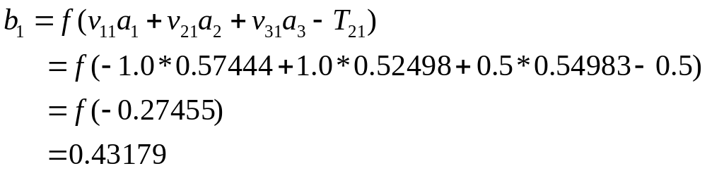
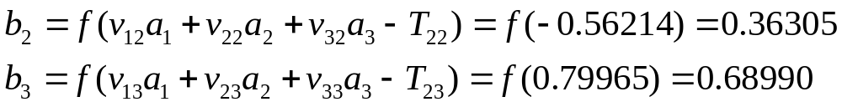
Step 3:
Given the output layer A, calculate the output from layer B, using the equation:
where f ( ) is the same sigmoid function.
Example:
We calculate the output from each node in layer 2:

Slide 19
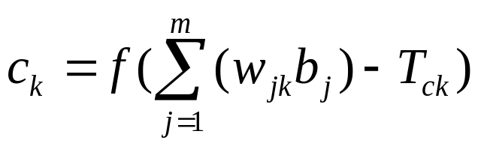
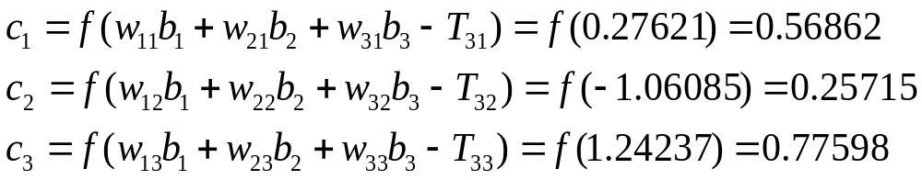
Step 4:
Given the output from layer B, calculate the output from layer C, using the equation:
Where f ( ) is the same sigmoid function
Example:
We calculate the output from each node in layer 3:
Step 1 to 4 represent the forward activation flow.
Obviously, the actual output values c_{k} deviate from the desired output values (d₁=1, d₂=0, and d₃=0).
The next few steps of the backpropagation algorithm represent the backward error flow in which we propagate the error between the desired d_{k} (k=1 to 3) and the actual output c_{k} backward through the network, and try to find the best set of network parameters (v_{ij}, w_{ij}, and T_{ij}).

Slide 20
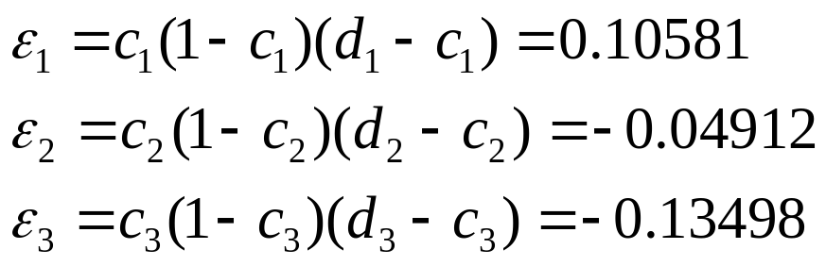
Step 5:
Now backpropagate the error through the network, starting at the output and moving backward toward the input.
Calculate the k^{th} component of the output error, ε_{k}, for each node in layer C, according to the equation:
ε_{k}=c_{k} (1-c_{k}) (d_{k}-c_{k})
Example:
We backpropagate, first calculating the error for each node in layer 3:

Slide 21
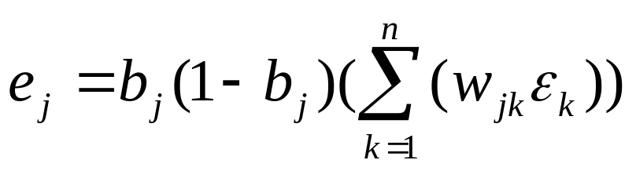
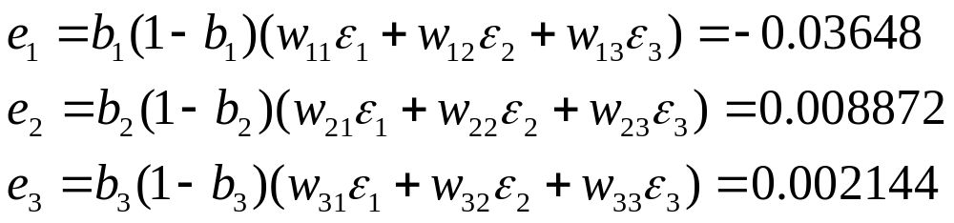
Step 6:
Continue backpropagation, moving to layer B.
Calculate the j^{th} component of the error vector, e_{j}, of layer B relative to each ε_{k}, using the equation:
Example:
We calculate the errors associated with layer 2, the hidden layer:

Slide 22
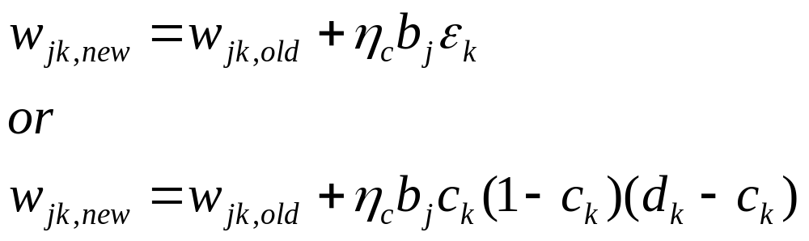
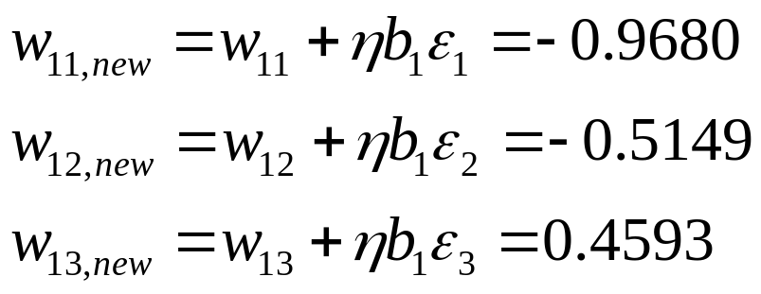
Step 7:
Adjust weight factors, calculating the new w_{jk}, i.e., w_{jk,new}, as:
New weight
factor
=
Old weight
factor
+
Learning
rate
×
Input
term
×
Gradient-descent
Correction term
Example:
We adjust weight factors for interconnections between layer 2 and 3.
For simplicity, we assume that η=0.7 for all values of η.
We continue these adjustments for the rest of the w_{jk}’s.

Slide 23
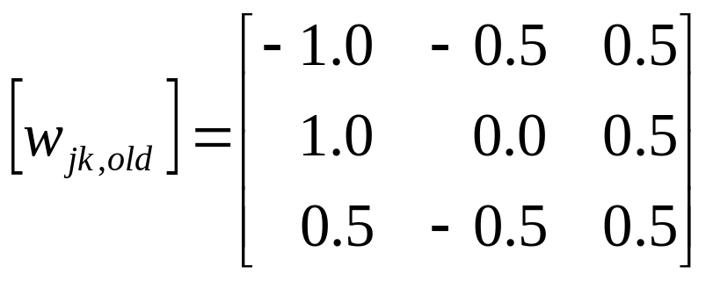
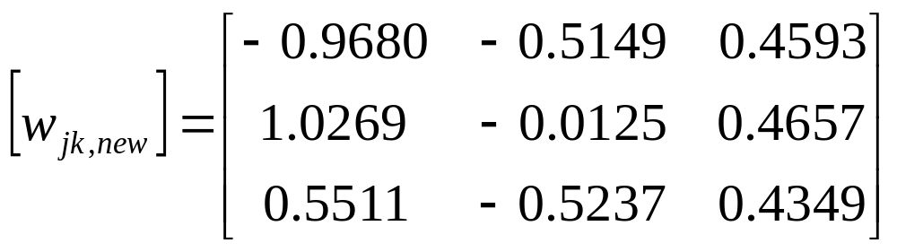
A comparison of the old and new weight factors shows:

Slide 24
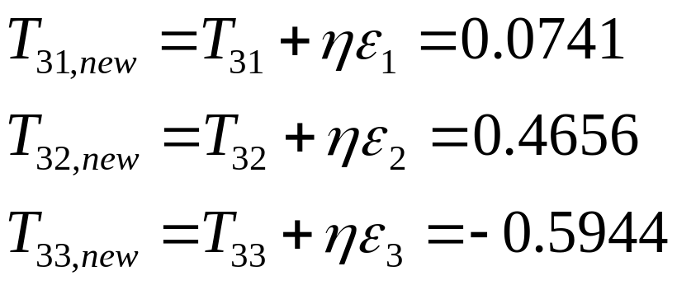
Step 8:
Adjust the thresholds T_{ck} (k=1 to n) in layer C,
according to the equation:
T_{ck,new}=T_{ck}+η_{c}ε_{k}
Example:
We adjust the internal thresholds for layer three:
Thus, new and old threshold values are:
old : T₃₁=0.0 T₃₂=0.5 T₃₃=-0.5
new: T₃₁=0.0741 T₃₂=0.4656 T₃₃=-0.5944

Slide 25
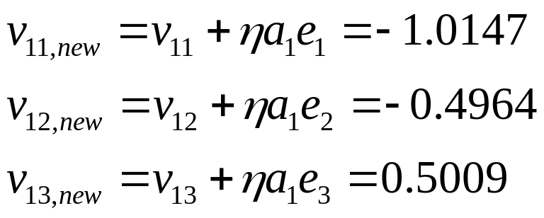
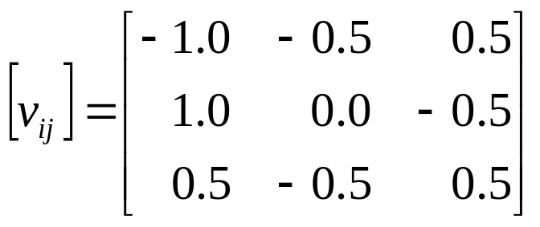
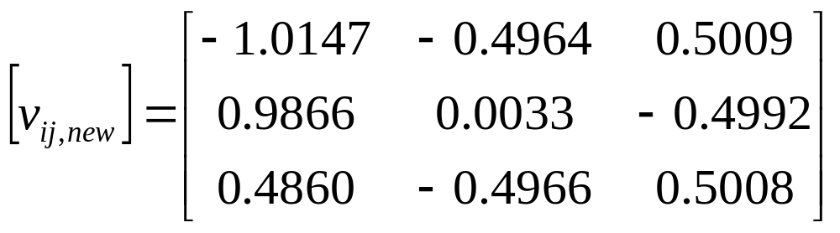
Step 9:
Adjust weight factors v_{ij} for interconnections between layer 1 and 2, according to the equation:
v_{ij,new}= v_{ij} + η_{B}a_{i}e_{j}
Example:
Again, η=0.7.
We continue these adjustments for the rest of the v_{ij}’s,
and the old and new weight factors are:

Slide 26
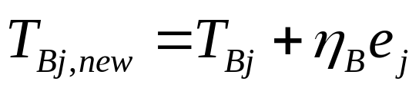
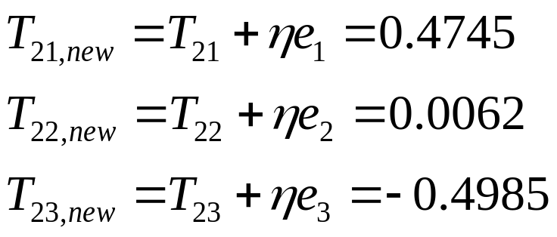
Step 10:
Adjust the thresholds T_{Bj} (j=1 to m) in layer B,
according to the equation:
Example:
We adjust the internal thresholds for layer three:
Thus, new and old internal threshold values are:
Old : T₂₁=0.5 T₂₂=0.0 T₂₃=-0.5
New : T₂₁=0.4745 T₂₂=0.0062 T₂₃=-0.4985

Slide 27
Step 11:
Repeat steps 2-10 until the squared error, E, or the output-error vector, ε, is zero or sufficiently small.
Example:
This problem requires 3860 time steps to get results less than 2% error on variable d_{k}.
Number of time steps: 3860
Desired values: d₁=1 d₂=0 d₃=0
Actual values: c₁=0.9900 c₂=0.0156 c₃=0.0098
Percent error: e₁=1.00% e₂=1.56% e₃=0.98%

Slide 28
4.2 Improving on BP Algorithm
4.2.1 Generalized Delta-Rule Algorithm and Its Application to Fault Diagnosis
A. Adding momentum term
The delta rule uses a technique known as momentum to speed up the training.
Momentum is an extra weight added onto the weight factors when they are adjusted.
By accelerating the change in the weight factors, we improve the training rate.

Slide 29
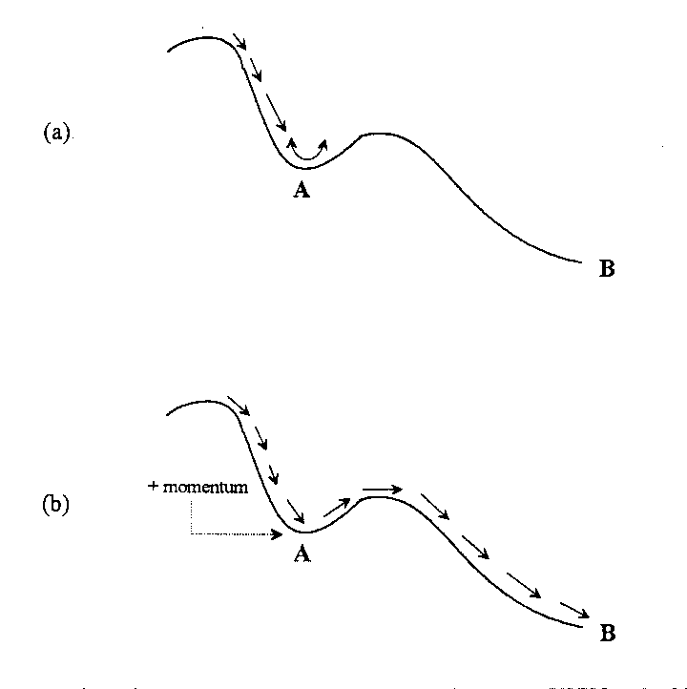
+ momentum

Slide 30
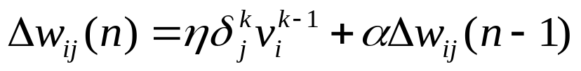
New weight
factor
=
Old weight
factor
+
Learning
rate
×
Input
term
×
Gradient-descent
correction term
+
Momentum
coefficient
×
Previous
weight change
w_{ij,new}= w_{ij,old}+Δw_{ij}
Here, the momentum coefficient, α, is restricted such that 0< α<1.

Slide 31
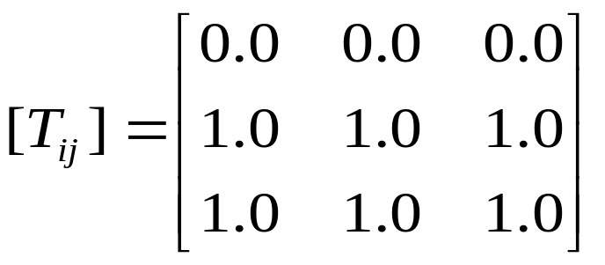
To see the comparison, we will apply the delta rule for the three-layer-feedforward perceptron to the fault-diagnosis problem of section 4.1.
Step 1:
Randomly assign values between 0 and 1 to weights v_{ij} and w_{jk}.
All input-layer thresholds must equal zero, i.e. T_{li}=0;
All hidden- and output-layer thresholds must equal one, i.e., T_{2j}=T_{3j}=1.
Example:
i到j的权值
j到k的权值
This T-matrix serves as a bias function.

Slide 32


Step 2:
Introduce the input I_{i} into the neural network, and calculate all outputs from the first layer according to the equations:.
Note that f( ) here is again the sigmoid function
Example:
We introduce the input vector into the neural network and calculate outputs from layer 1:

Slide 33




Knowing the output from the first layer, calculate outputs from the second layer, using the equation:
Step 3:
Example:
We calculate the output from each node in layer 2:
Step 4:
Knowing the output from layer B, calculate the output from layer C, using the equation:
Where f ( ) is the same sigmoid function
Example:
We calculate the output from each node in layer 3:

Slide 34


Step 5:
Continue steps 1-4 for P number of training patterns presented to the input layer. Calculate the mean-squared error, E, according to the following equation:
Where
P is the number of training patterns presented to the input layer,
n is the number of nodes on the output layer,
d_{k}^{p} is the desired output value from the k^{th} node in the p^{th} training pattern, c_{k}^{p} is the actual output value from the k^{th} node in the p^{th} training pattern.
Example:
We are training the network with just one input pattern (P=1). With desired output values d₁=1, d₂=0, and d₃=0, our total mean-squared error is:

Slide 35




Step 6:
Knowing the p^{th} pattern, calculate δ_{3k}^{p}, the gradient-descent term for the k^{th} node in the output layer for training pattern p.
use the following equation:
Where
The partial derivative of the sigmoid function is:
Note that x_{k} is the sum of the weighted inputs to the k^{th} node on the output layer plus the bias function(i.e., for the p^{th} training session):
Where for training pattern p, b_{j}^{p} is the output value of the j^{th} node in the hidden layer and T_{3k}^{p} is the threshold value on the output layer.

Slide 36


Example:
We calculate δ_{3k}, the gradient-descent term for layer 3. To obtain δ_{3k}, we must first calculate the gradients by setting x₁=c₁, x₂=c₂, and x₃=c₃:
Knowing the gradients, we calculate the δ_{3k}’s:

Slide 37



Step 7:
Again knowing the p^{th} pattern, calculate δ_{2k}^{p}, the gradient-descent term for the j^{th} node on the hidden layer (layer 2). use the equation:
Where the subscript k denotes a node in the output layer.
Recall that x_{j} is defined by:
and the partial derivative of the sigmoid function, again, is

Slide 38


Example:
We calculate δ_{2j}, the gradient-descent term for layer 2. Again, we must first calculate the gradients by setting x₁=b₁, x₂=b₂, and x₃=b₃:
Then, the δ_{2j}’s are:

Slide 39

Step 8:
Knowing δ_{2j}^{p} for the hidden layer and δ_{3k}^{p} for the output layer, calculate the weight changes using the equations:
Where η is the learning rate, and α is the momentum coefficient.

Slide 40


Example:
We calculate the changes in weights, Δv_{ij,new}, and Δw_{jk,new}. We arbitrarily set the learning rate, η, to 0.9, and the momentum coefficient, α, to 0.7. Thus, for v_{ij,new}:
On this first time step, Δv_{ij} (from the “previous step”) is zero, since no previous step exists. We continue this procedure for all Δv_{ij,new}’s, and end up with:

Slide 41


We also calculate the weight change Δw_{jk,new} using the same learning rate (η=0.9) and momentum coefficient (α=0.7):
Again, on this first time step, Δw_{ij}=0, since no previous time step exists.
We continue this procedure for all w_{ij,new}’s to yield:

Slide 42

Step 9:
Knowing the weight changes, update the weights according to the equations:
Where
v_{ij}^{p} is the connection weight between the i^{th} element in the input layer and j^{th} element in the hidden layer,
w_{jk}^{p} is the connection weight between the j^{th} element in the hidden layer and k^{th} element in the output layer,
both for the p^{th} training pattern.
Repeat steps 2-9 for all training patterns until the squared error is zero or sufficiently low.

Slide 43


Example:
Knowing the weight changes, we update the weights.
The old and new weights are:
The results are:
Number of time steps:784
Desired values: | d₁=1 | d₂=0 | d₃=0
Actual values: | c₁=0.9900 | c₂=0.0099 | c₃=0.0099
Percent error: | e₁=1.00% | e₂=0.99% | e₃=0.99%

Slide 44
B. Comparing two results:
Using standard BP algorithm
Number of time steps: 3860
Desired values: d₁=1 d₂=0 d₃=0
Actual values: c₁=0.9900 c₂=0.0156 c₃=0.0098
Percent error: e₁=1.00% e₂=1.56% e₃=0.98%
Using modified BP algorithm (with a momentum term)
Number of time steps:784
Desired values: | d₁=1 | d₂=0 | d₃=0
Actual values: | c₁=0.9900 | c₂=0.0099 | c₃=0.0099
Percent error: | e₁=1.00% | e₂=0.99% | e₃=0.99%
Note that above, we used only one data point (input pattern).

Slide 45

C. Alternative Formulation of Backpropagation Learning
A simplified three-layer feedforward network

Slide 46
Output from the hidden layer :
Output from the output layer :
i=1 to 3 (=L)
j=1 to 3 (=m)
k=1 to 3 (=n)

Slide 47

An alternative architecture of the three-layer feedforward network
with a basis input and weight factors v_{oj} and w_{ok} replacing internal thresholds T_{ij}

Slide 48


This bias input a₀ is fed to all nodes in the hidden and output layers with weight factors v_{oj} and w_{ok} (j=1 to 3;k=1 to 3),and the resulting weighted biases replace the internal thresholds T_{2j} and T_{3k} (j=1 to 3;k=1 to 3).
output from the hidden layer:
output from the output layer:
a_{o}=1.0
b_{o}=1.0
The internal thresholds T_{2j} and T_{3k} in the original neural network become the weight factors between the bias node and the nodes in the hidden and output layers.

Slide 49
大作业：
编写BP算法程序（不限语言种类）
图示计算过程与结果
多入单出或多入多出实例验证
数据格式：
x1 x2 x3 ……xn y1 y2 ym
……………………………….
.………………………………

Slide 50


4.2.2 overview of special modified methods
A. Learning rate
Where η(0) is the initial learning rate, E(n) is the n^{th} mean-squared error.
If E(n) > E(n-1) Then e^{-E(n)} < e^{-E(n-1)} , η(n) < η(n-1)
T is the simulated annealing temperature

Slide 51



u=1.1~1.3, d=0.7~0.9

Slide 52

See page 79~92

Slide 53



New
η(t)=η_{max}-∆η(t)= η_{max}- (η_{max}- η_{min})*t / t_{max}
t—number of iteration, η_{max}=0.9， η_{min}=0.1
New

Slide 54
B. Activation functions
New activation function
Combination of activation function
Different node uses different activation function.
Each node uses the same “combination” activation function.
Choose activation function for each node based on the leaning case.
Example
MSE (structure 2:26:1)
MSE (structure 2:15:11:1)
Iteration Function | 5000 | 10000
Sin(x)-TanH(x) | 0.16 | 0.11
Sin(x) | 0.19 | 0.16
TanH(x) | 0.33 | 0.23
Iteration Function | 5000 | 10000
TanH(x)-sin(x) | 0.23 | 0.07
Sin(x)-TanH(x) | 0.37 | 0.09
Sin(x) | 0.57 | 0.13
TanH(x) | 0.47 | 0.15

Slide 55
4.3 Practical aspects of neural computing
A. Design for input and output layers
B. Selecting the number of hidden layers and theirs nodes
single hidden layer is sufficient for identifying process faults or feature categories;
double hidden layer is sufficient for prediction,
using 30:15 hidden-layer configuration as the initial architecture for most networks.
Example:
3 input
1 output
Number of nodes in specified layer |  | Average error Reaction rate
Hidden layer 1 | Hidden layer 2
3 5 10 20 30 | 0 0 0 0 0 | 0.205 0.165 0.128 0.134 0.157
6 10 20 30 | 3 5 10 15 | 0.126 0.109 0.089 0.074

Slide 56


Slide 57
C. Normalizing input and output data sets
Problem 1: data distribution
Problem 2: if input variable 1 has a value of 10000 and input variable 2 has a value of 10, the assigned weight for the second variable going into a node of hidden layer 1 must be much greater than that of the first variable to have any significance.
Problem 3: using the sigmoid function,
we find x_{i}=5, f(x_{i})=0.993;
x_{i}=50, f(x_{i})=1.00;
x_{i}=500, f(x_{i})=1.00;
Three main types of normalization procedures will be introduced here.

Slide 58


Method 1
0.62

Slide 59


Method 2

Slide 60


Method 3

Slide 61
D. Initializing the weight-factor distribution
Weight-factor distribution | PH Average error 1 | PH Average error 2
Gaussian : [-0.50 to 0.50] Gaussian : [-0.75 to 0.75] Gaussian : [-1.00 to 1.00] Gaussian : [-1.25 to 1.25] Gaussian : [-1.75 to 1.75] Gaussian : [-2.50 to 2.50] | 0.136 0.130 0.104 0.098 0.108 0.136 | 0.333 0.294 0.253 0.214 0.276 0.333

Slide 62

E. Setting the learning rate and momentum coefficient

Slide 63

With a low learning rate, training may be trapped in a locaal minimum

Slide 64
Adding momentum term
Learning rate | Momentum coefficient
 | 0.00 | 0.20 | 0.40 | 0.60 | 0.80
0.01 0.10 0.30 0.50 0.70 1.00 2.00 3.00 4.00 | 0.137 0.100 0.075 0.057 0.043 0.040 0.030 0.191 >0.3 | 0.139 0.095 0.062 0.045 0.035 0.026 0.140 >0.3 >0.3 | 0.139 0.082 0.054 0.037 0.035 0.034 >0.3 >0.3 >0.3 | 0.138 0.063 0.038 0.034 >0.3 >0.3 >0.3 >0.3 >0.3 | 0.130 0.093 >0.3 >0.3 >0.3 >0.3 >0.3 >0.3 >0.3

Slide 65

A typical learning schedule for a 3-hidden-layer BP network

Slide 66

F. Selecting the proper transfer function

Slide 67

A comparison of the effectiveness of the hyperbolic tangent
and sigmoid transfer function in training a prediction network

Slide 68
G. Generating a network learning curve
A general procedure for generating a learning curve below:
1. Divide all variable training examples into selected groups(t1,t2,…,t7).
2. Use one group to train the network.
3. Test the network for both recall of the training data set and generalization of
the remaining data groups not used in network training.
4. Add one randomly selected generalization data group to the training data set.
5. Retrain the network using the new training data set, reducing the learning rates
and momentum coefficients.
(this is done to maintain some of the integrity of the previously trained network.)
6. Repeat steps 2-5 until there are no more groups remaining in the generalization
data set.

Slide 69


Slide 70
Hidden-layer configuration 30:15
Training |  |  | Recall | Generalization
Group numbers in training set | Experiments in training set | Experiments in testing set | Avg error reaction rate | Avg error reaction rate
1 1,6 1,3,6 1,3,5,6 1,2,3,5,6 | 4 8 12 16 20 | 20 16 12 8 4 | <0.001 0.022 0.015 0.059 0.073 | 2.002 0.887 0.763 0.498 0.555
Hidden-layer configuration 15:5
Training |  |  | Recall | Generalization
Group numbers in training set | Experiments in training set | Experiments in testing set | Avg error reaction rate | Avg error reaction rate
1 1,6 1,3,6 1,3,5,6 1,2,3,5,6 | 4 8 12 16 20 | 20 16 12 8 4 | <0.001 0.027 0.029 0.069 0.111 | 2.100 0.720 0.699 0.564 0.509

Slide 71
Hidden-layer configuration 0:10
Training |  |  | Recall | Generalization
Group numbers in training set | Experiments in training set | Experiments in testing set | Avg error reaction rate | Avg error reaction rate
1 1,6 1,3,6 1,3,5,6 1,2,3,5,6 | 4 8 12 16 20 | 20 16 12 8 4 | <0.001 0.013 0.050 0.102 0.109 | 2.613 0.912 0.644 0.552 0.562

Slide 72


Slide 73

H. Discussion
1. MSE：mean square error criterion:
where p is the training samples
2. stability
3. convergence
4. overtraining
5. overfitting

Slide 74
作业1
编写BP算法程序。要求：
1、选择训练与泛化数据文件，数据格式为：
x1 x2……xn y1 y2……ym
并选择自变量与因变量数目；
2、选择网络结构；
3、选择学习速率、动量因子；
4、选择训练结束判据：训练误差、最大迭代次数；
5、动态画出训练误差曲线；
6、分别给出训练和泛化数据与网络计算结果比较图，并给出各自的相对误差。

