Slide 1
4.4 Introduction to special neural network architectures
4.4.1 Determining the optimal Structure
◆ Empirical Formula
The number of nodes in the hidden layer:
s: No. of nodes in the input layer
n: No. of nodes in the output layer
❖ Identifying redundant node
δ_{I}=E_{without node I} - E_{with node i}

Slide 2
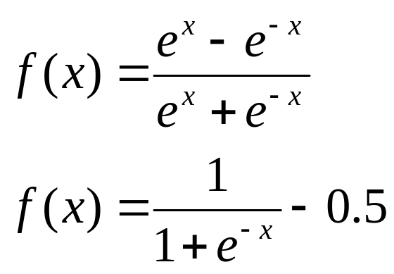
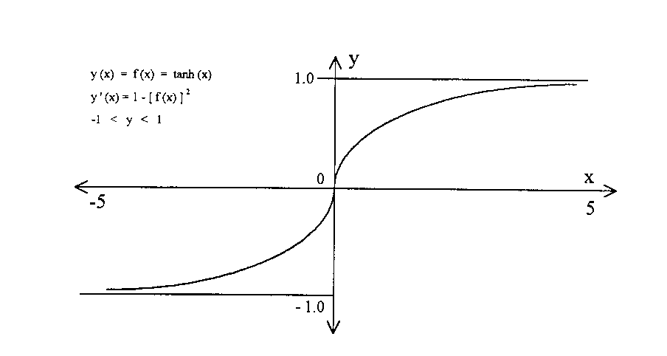
⬥ Structure optimization
1. Selecting transfer function

Slide 3
Redundant nodes and connections
v=0.0
0.0
0.0
0.0
0.0
0.0
w=0.0
0.0
0.0
0.0

Slide 4
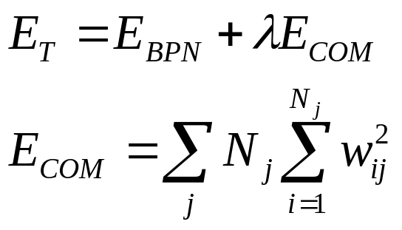
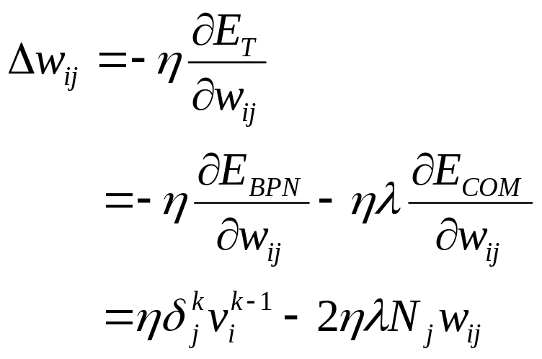
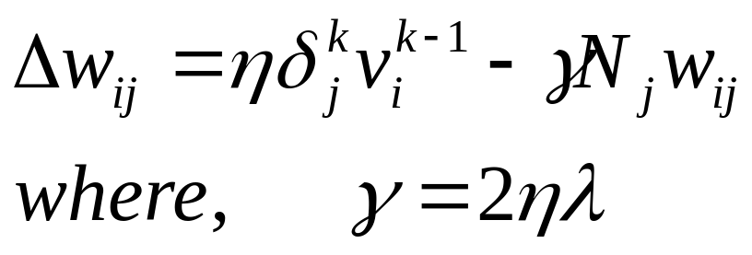
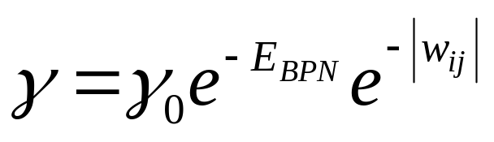
2. Objective function
i
N_{j}
i
j
i
Adding momentum item

Slide 5
Example 1
x₁=0.5x+4.57
x₂=2.5x+1.23
y=x₁+x₂
① Structure 2-20-1
x₁
y
x₂

Slide 6
Record of deleting the redundant node
Iterations | 900 | 901 | 912 | 913 | 918 | 920 | 924 | 996
The number of nodes in hidden layer | 20 | 18 | 17 | 16 | 14 | 13 | 11 | 10
No. of deleted nodes |  | Mid 19,20 | Mid 13 | Mid 4 | Mid 14,17 | Mid 18 | Mid 15,16 | Mid 7
Iterations | 1273 | 1747 | 2183 | 2269 | 2406 | 2900 | 3507
The number of nodes in hidden layer | 9 | 8 | 7 | 6 | 5 | 3 | 2
No. of deleted nodes | Mid 8 | Mid 12 | Mid 11 | Mid 10 | Mid 9 | Mid 1,6 | Mid 2

Slide 7
② Structure 2-10-1
x₁
y
x₂
Record of deleting the redundant node
Iterations | 500 | 528 | 554 | 724 | 756 | 953 | 1075 | 1839 | 3618
The number of nodes in hidden layer | 10 | 9 | 8 | 7 | 6 | 5 | 4 | 3 | 2
No. of deleted nodes |  | Mid 8 | Mid 9 | Mid 6 | Mid 5 | Mid 7 | Mid 3 | Mid 10 | Mid 4

Slide 8
③ Structure 2-7-1
x₁
y
x₂
Record of deleting the redundant node
Iterations | 1000 | 1042 | 1105 | 1114 | 1143 | 1159
The number of nodes in hidden layer | 7 | 6 | 5 | 4 | 3 | 2
No. of deleted nodes |  | Mid 5 | Mid 4 | Mid 6 | Mid 7 | Mid 2

Slide 9
④ Structure 2-5-1
x₁
y
x₂
Record of deleting the redundant node
Iterations | 500 | 582 | 680 | 992
The number of nodes in hidden layer | 5 | 4 | 3 | 2
No. of deleted nodes |  | Mid 3 | Mid 5 | Mid 4

Slide 10
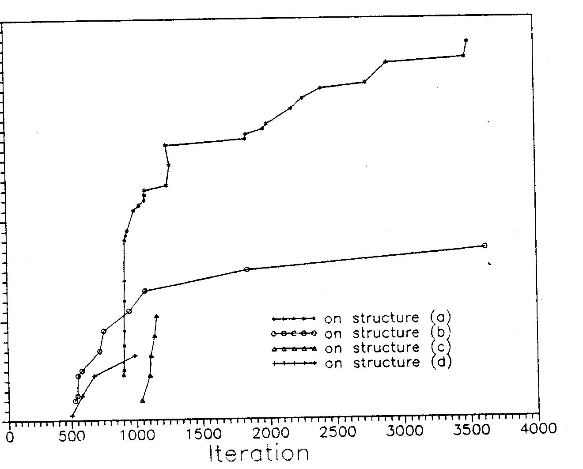
Weights deleted for four structures
Weights deleted

Slide 11
Compare results with three structures (2-1-1, 2-2-1, 2-3-1)
No. of nodes in hidden layer |  | 1 | 2 | 3
Iteration |  | 8000 | 4000 | 4000
Training set | MSE | 0.000578 | 0.000240 | 0.000404
 | Relative error | 0.1143 | 0.0693 | 0.0885
 | Absolute error | 0.0736 | 0.0449 | 0.0571
Testing set | MSE | 0.000744 | 0.000211 | 0.000483
 | Relative error | 0.1364 | 0.0721 | 0.1023
 | Absolute error | 0.0872 | 0.0463 | 0.0655

Slide 12
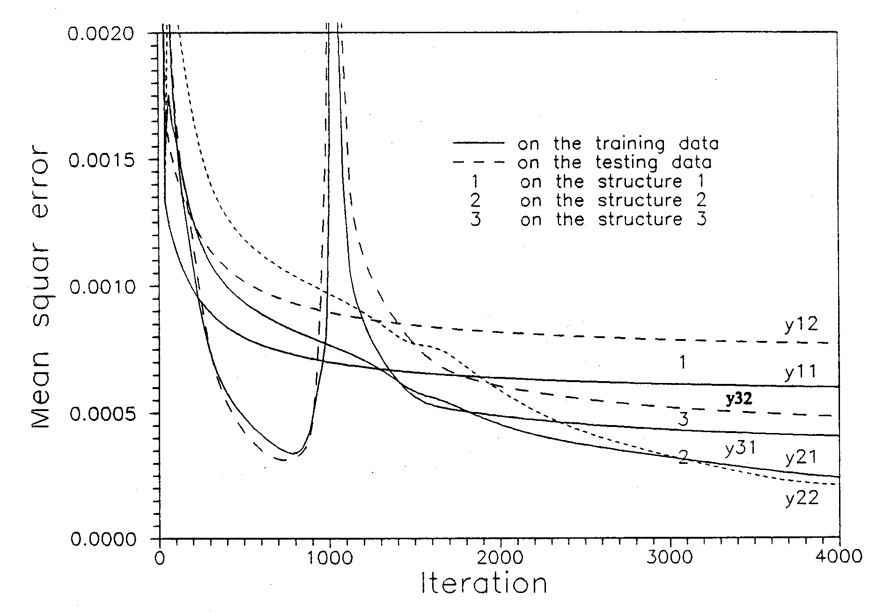
Training process

Slide 13
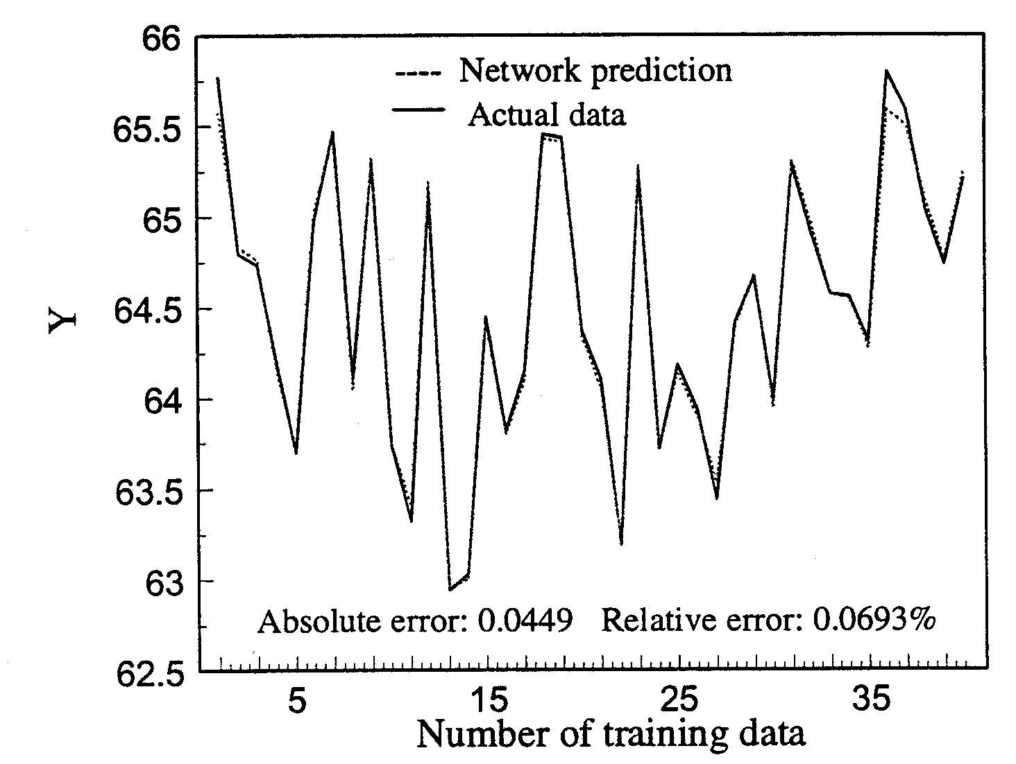

Slide 14
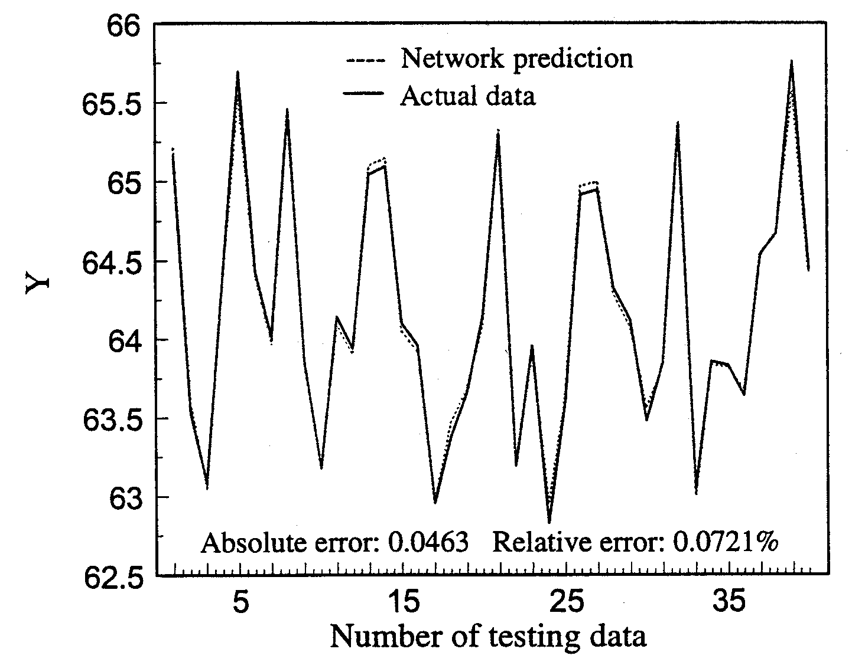

Slide 15
Example 2
x₁=0.5x+4.57
x₂=2.5x+1.23
x₃= noise (random value)
y=x₁+x₂
x₁
x₂
y
x₃
x₁
x₁
x₂
y
x₂
y
x₃
x₃
x₁
x₂
y
x₃

Slide 16
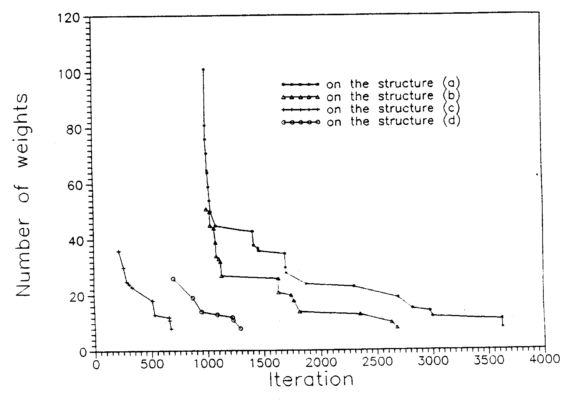
Weights deleted for four structures

Slide 17
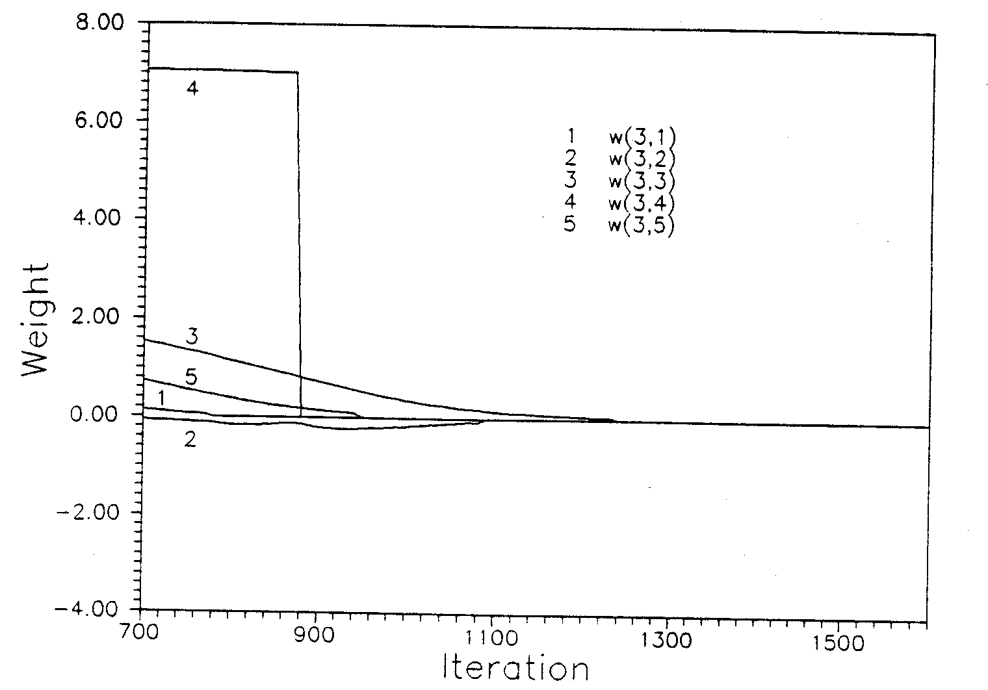
Changing of the weights connected to input node 3 (structure 3-5-1)

Slide 18
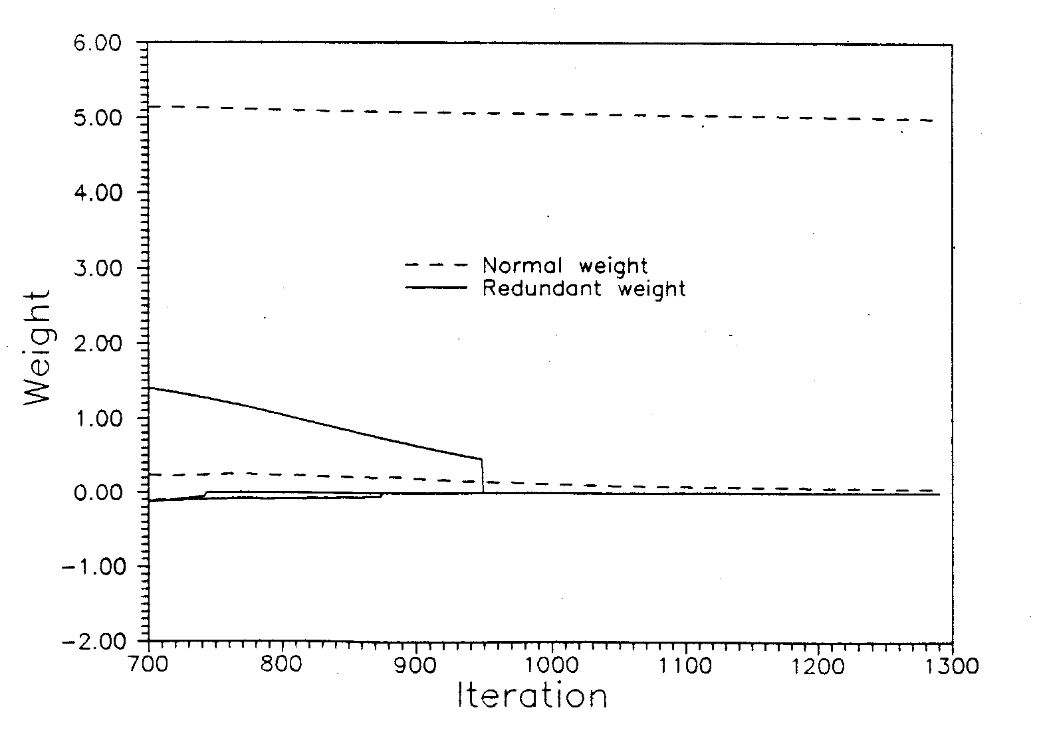
Weights changing curve

Slide 19
Example
Final structure 1
x₁
x₂
y
x₃

Slide 20
Record for redundant weights deleted with different weight deadlines
W₀=±0.001 |  | W₀=±0.005 |  | W₀=±0.01 |  | W₀=±0.05 |  | W₀=±0.1
Iteration | Weights deleted | Iteration | Weights deleted | Iteration | Weights deleted | Iteration | Weights deleted | Iteration | Weights deleted
771 904 956 1292 1339 1378 1460 1523 1532 | 1 2 3 4 5 8 9 14 18 | 768 886 953 1083 1167 1206 1223 1410 1440 1515 | 1 2 3 4 5 6 9 10 14 18 | 765 866 949 1027 1109 1147 1150 1287 1372 1492 | 1 2 3 4 5 6 9 13 14 18 | 742 775 874 948 1088 1223 1231 1290 | 1 2 7 12 13 14 15 18 | 700 716 723 780 855 1002 | 1 2 3 8 13 18

Slide 21
Record for redundant weights deleted with different γ₀
γ₀ =0.005 |  | γ₀ =0.0005 |  | γ₀ =0.0001 |  | γ₀ =0.00005
Iteration | Weights deleted | Iteration | Weights deleted | Iteration | Weights deleted | Iteration | Weights deleted
700 701 703 1922 2880 2883 3305 | 1 8 14 15 16 17 18 | 704 713 738 740 901 1480 1509 2082 2517 3064 | 1 3 8 9 10 11 12 15 16 18 | 742 775 874 948 1088 1223 1231 1290 | 1 2 7 12 13 14 15 18 | 766 901 1097 1114 1281 1629 1654 5083 | 1 2 7 12 13 14 15 18

Slide 22
Record for redundant weights deleted with different E₀
E₀ =0.005 |  | E₀ =0.0005 |  | E₀ =0.0001 |  | E₀ =0.00005
Iteration | Weights deleted | Iteration | Weights deleted | Iteration | Weights deleted | Iteration | Weights deleted
765 866 949 1140 1231 1533 3020 3166 3968 4127 6422 6597 | 1 2 3 4 5 6 7 8 9 11 14 18 | 765 866 949 1027 1109 1147 1887 1903 1904 1981 2025 | 1 2 3 4 5 6 9 10 11 14 18 | 765 866 949 1027 1109 1147 1150 1287 1372 1492 | 1 2 3 4 5 6 9 13 14 18 | 765 866 949 1027 1109 1147 1150 1287 1372 1492 | 1 2 3 4 5 6 9 13 14 18
10000 | 18 | 4000 | 18 | 4000 | 18 | 4000 | 18

Slide 23
4.4.2 Autoassociative Networks
Two main applications:
Data compression and filtering
Dimensionality reduction of an input vector
Two main categories:
Signal-processing networks
Image-processing networks
The most commonly used NN for signal processing is the autoassociative backpropagation network
 reduce the amount of random noise in the input signal
 filter gross errors in data resulting from sensor-malfunctions,
drift and bias.

Slide 24
The input signal has three distinct components:
A pure signal (p)
Measurement noise (n)
Measurement error (e)
Thus, we may represent the input vector as a linear combination of the three components:
In(m)=In_{p}(m)+In_{n}(m)+In_{e}(m)
The objective of filtering a process signal is to map only the pure signal (In_{p}(m)) onto the output vector, while removing all measurement noise (In_{n}(m)) and measurement errors (In_{e}(m)).
In(m)=Out(m)

Slide 25
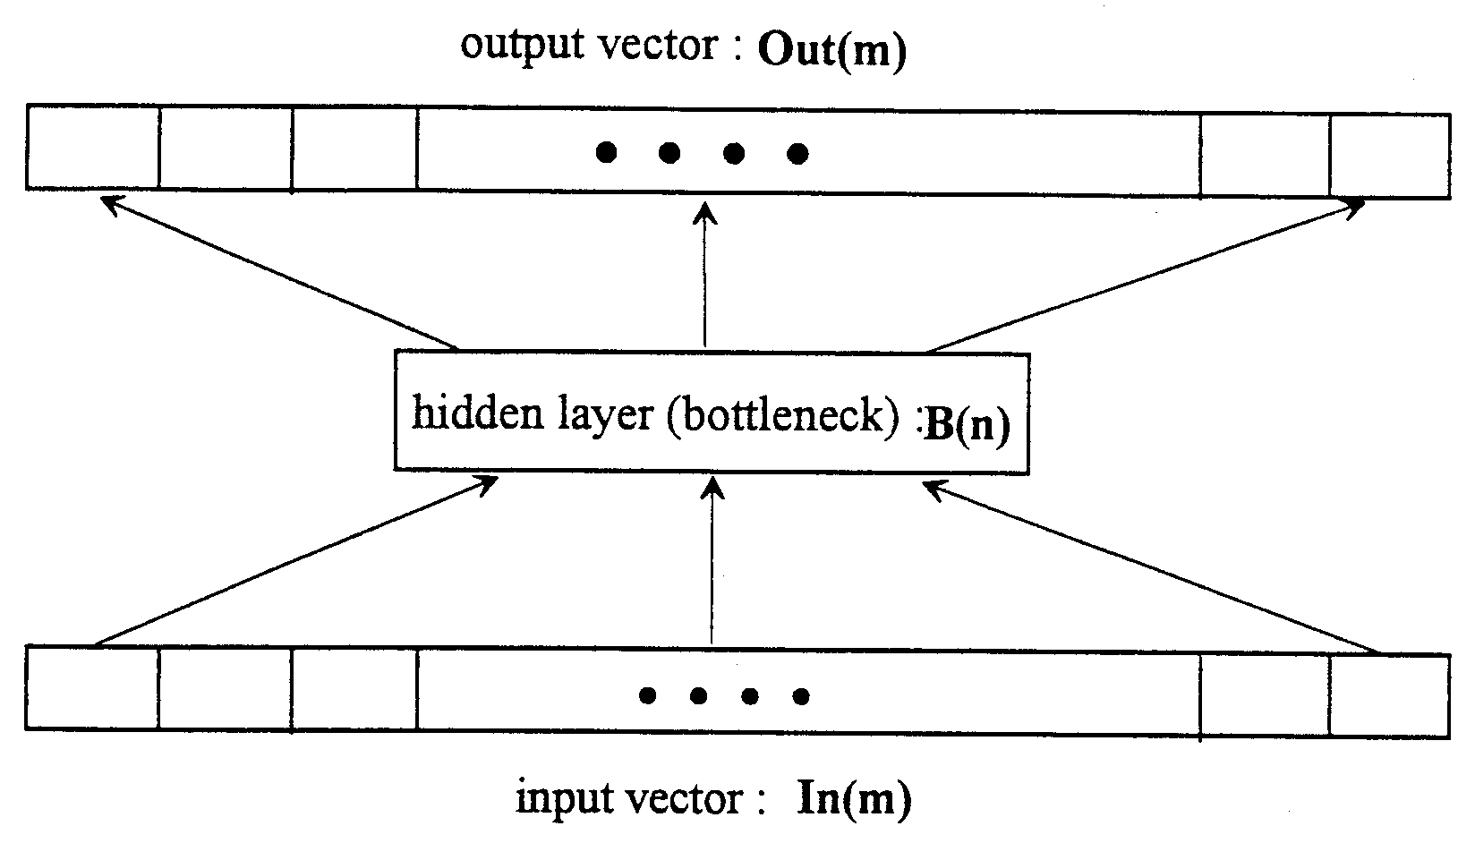

A three-layer autoassociative network
Compression ratio =

Slide 26
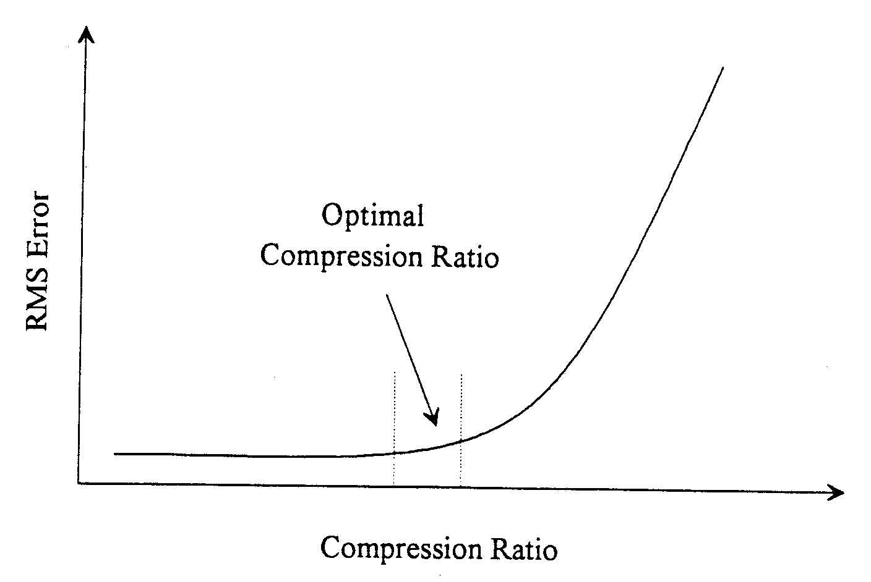
Typical ratios are normally set between 2 and 8, depending on the signal type and noise in the system

Slide 27
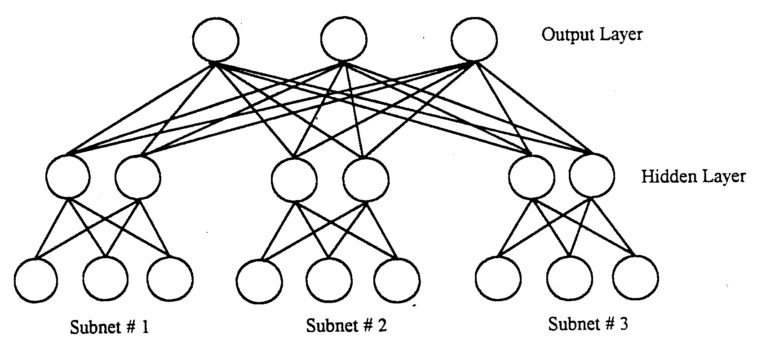
4.4.3 Hierarchical Neural Networks
The input vector is divided into groups that have similar effects on the output responses
A hierarchical NN architecture

Slide 28
Advantages:
use more nodes with fewer weight factors, improving efficiency. Therefore, network training requires fewer examples and less time.
well-defined subnetworks of related variables provides hints that help the network learn in the right direction.
isomorphic to expert systems or model-based algorithms for the same task. We can map each useful subnetwork to a rule (or small set of rules) or a model-based local analysis.
The following sections describe two significant types of hierarchical networks used in process system engineering.
moving-window networks for time-dependent processes
input-compression networks for working with large input variable sets

Slide 29
1: Moving-Window Networks
… VAR1(t-3) VAR1(t-2) VAR1(t-1) VAR1(t) VAR1(t+1) VAR1(t+2) …
… VAR2(t-3) VAR2(t-2) VAR2(t-1) VAR2(t) VAR2(t+1) VAR2(t+2) …
… VAR3(t-3) VAR3(t-2) VAR3(t-1) VAR3(t) VAR3(t+1) VAR3(t+2) …
: : : : : :
: : : : : :
: : : : : :
… VARn(t-3) VARn(t-2) VARn(t-1) VARn(t) VARn(t+1) VARn(t+2) …
Moving Window
Moving Window
Moving Window
two types of applications:
model dynamic systems
model unsteady-state processes

Slide 30
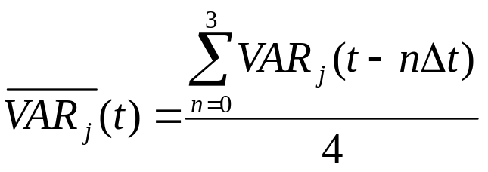
Key challenge problems:
(1) Choose the “ time-window width ”
(2) Choose the time between data sampling point
(3) Use average moving-window values as input to the network

Slide 31
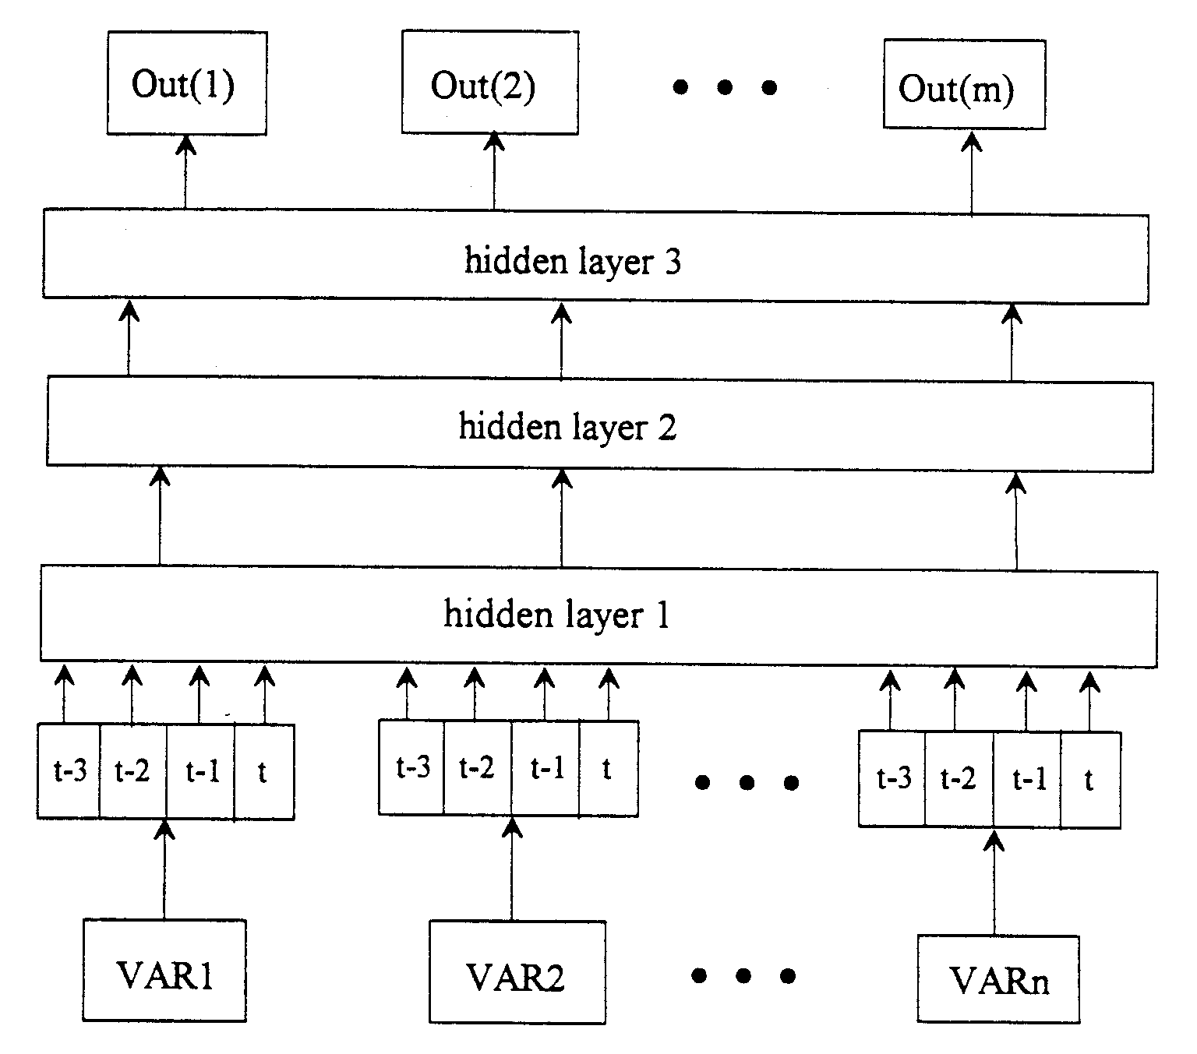
A moving-window network with a process-trend scanning window including 4 time increments

Slide 32
2: Input-Compression Networks
Neural networks can become very large and difficult to train if they have a large number of input variables that influence the output responses.
Auto-assoicate hierarchical neural network
The input layer in the input-compression network consists of n property groups, where each group includes input variables with similar effects on the output responses. Each property group is compressed into a corresponding subnetwork to create a more compact representation of the input variables without losing any essential information.

Slide 33
A input-compression network
…
Out(1)
Out(2)
Out(m)
hidden layer 3
hidden layer 2
hidden layer 1
…
subnet 1
subnet n
…
subgroup (1)
subgroup (n)

Slide 34
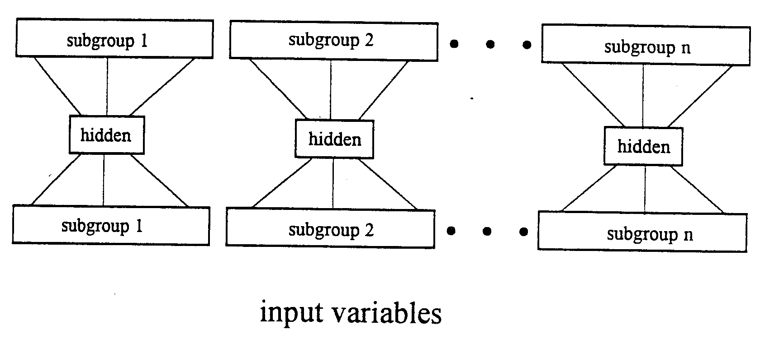
An input-compression network divided into a lower section containing a dimensionality-reduction network and an upper section containing a standard backpropagation network.
* Attaching a Dimensionality-Reduction Network to
a Backpropagation Network

Slide 35
Developing an input-compression network involving two steps.
use an autoassociative network to reduce the dimensionality of the input vector.
attach the input and hidden layers of the dimensionality-reduction network to a standard backpropagation network.
* Dimensionality Reduction of Input Vector
…
subgroup 1
subgroup 2
subgroup n
detach
hidden
hidden
hidden
fixed
weights
fixed
weights
…
fixed
weights
subgroup 1
subgroup 2
subgroup n
input variables

Slide 36
…
Out(1)
Out(2)
Out(m)
…
Subnet-1
Subnet-2
Subnet-j
recurrent
self-feedback
Hidden layer
Dimensionality-reduction
…
Subnetwork
fixed
weights
fixed
weights
fixed
weights
Subgroup 1
Subgroup 2
Subgroup n
…
t-3
t-2
t-1
t
t-3
t-2
t-1
t
…
t-3
t-2
t-1
t
Moving-Window
Var group-1
Var group-2
Var group-i

Slide 37
Example:
Feature Clustering-FC
Feature Target Correlation -FTC
Data Attributes Decompostion method
Datasets from UCI Respository and Production
Dataset Name | Dataset Character Quality
 | Instances | Attributes | Outputs | Default Task
Ionosphere | 351 | 34 | 1 | Classification
Breast Cancers | 569 | 30 | 1 | Regression /Classification
PTA | 260 | 17 | 1 | Regression

Slide 38
Feature Sets Ensembles from Test Data Sets
Dataset Name | Feature Sets Ensemble Steps
 | Feature Target Correlation | Feature Clustering
Ionosphere | {22,27,30,32,34} {1,2…20,21,23,24,25,26,28,29,31,33} | {2,18,20,24,26,28} {1,3,5,7,9,29,31} {22,27,30,32,34} {4,6,8,10,12,14,16,33} {11,13,15,17,19,21,23,25}
Breast Cancers | {10,12,15,19} {1,2,3,4,5,6,7,8,9,11,13,14,16,17,18,20…30} | {3,23} {4,24} {10,12,15,19} {1,2,5,7,8…22,25…30}
PTA | {3,4,8,10,13} {1,2,5,6,7,9,11,12,14,15,16,17} | {7,9,11,12,14} {15,16,17} {1,2,5,6} {3,4,8,10,13}

Slide 39
Comparison results
Dataset Name | Methods Comparison(Err/Sta)
 | BP | DAD-AHNN | DAD-THNN
Ionosphere | 8.1468 | 3.9423 | 4.4179
 | 0.2669 | 0.1239 | 0.1168
Breast Cancers | 5.1059 | 2.4075 | 4.0621
 | 0.1665 | 0.1348 | 0.1568
PTA | 0.4426 | 0.4247 | 0.3609
 | 0.0037 | 0.0033 | 0.0030
AHNN--Auto-assoicate Hierarchical Neural Network
THNN--Treetyped Hierarchical Neural Network

Slide 40
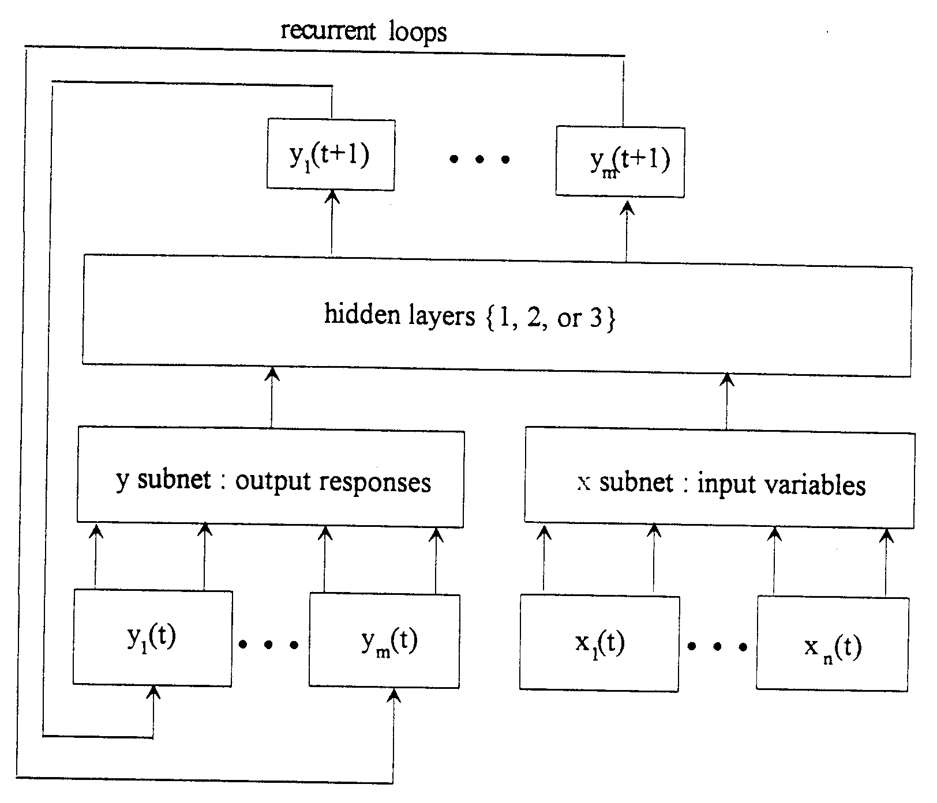
4.4.4 Recurrent Networks

Slide 41
Definition:
A recurrent network combines the feedback and feedforward connections of neural networks. It is simply a neural network with loops connecting the output responses to the input layer.
Applications:
The recurrent network provides a modeling technique that can be used for process optimization and adaptive process control of time-dependent processes.

Slide 42
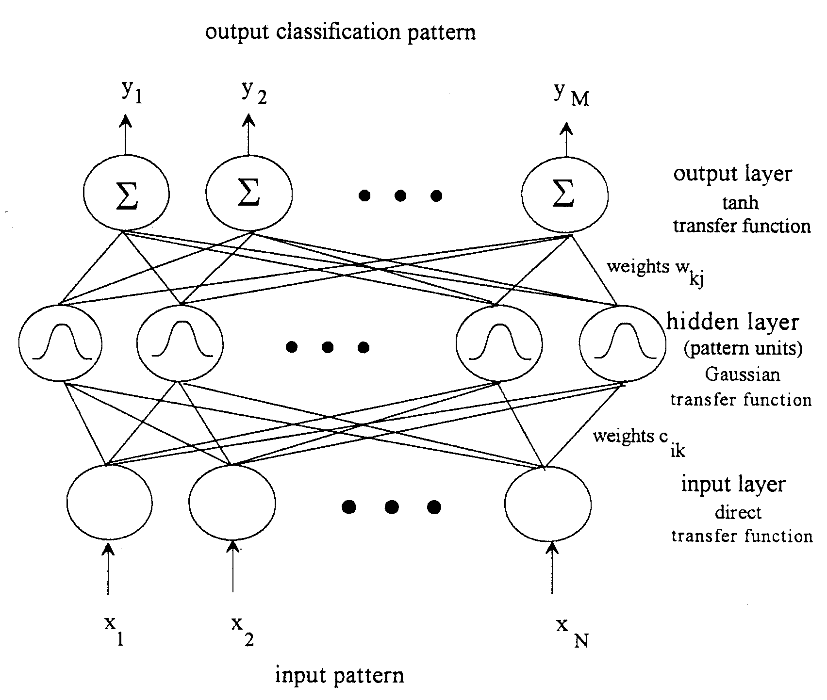
4.4.5 Radial-Basis-Function Networks
1. Network Architecture

Slide 43
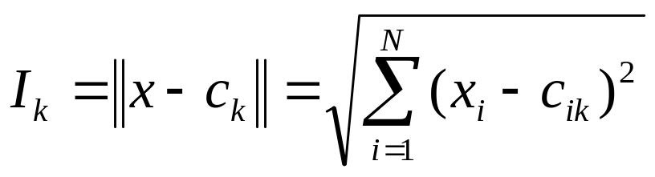
(1) Input Layer
The output of the node equals the input.
(2) Hidden Layer
Its nodes satisfy the unique property of being radially symmetric.
A center vector c_{k} in the input space, made up of cluster center, with elements c_{ik}(i=1 to N). The vector is typically stored as the weight factors from the input layer to the hidden layer.
A distance measure to determine how far an input vector x, with elements x_{i}(i=1 to N), is from the center vector c_{k}.
We use the standard Euclidean distance measure between x and c_{k} to define a Euclidean summation, I_{k}(k=1 to L), where L is the number of nodes in hidden layer.

Slide 44
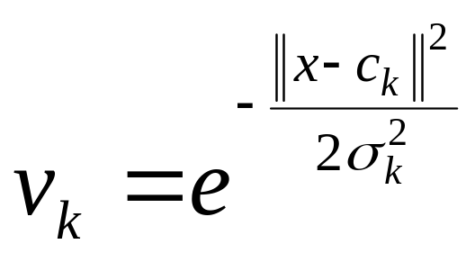
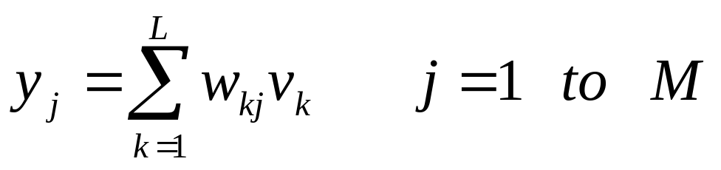
(c) A transfer function which transforms the Euclidean summation I_{k} (k=1 to L) to give an output for each node.
Where Sigma σ_{k} is a width of the Gaussian function
(3) Output Layer
There are weight factors w_{kj} (k=1 to L; j=1 to M) between the k^{th} node in the hidden layer and the j^{th} node in the output layer.

Slide 45
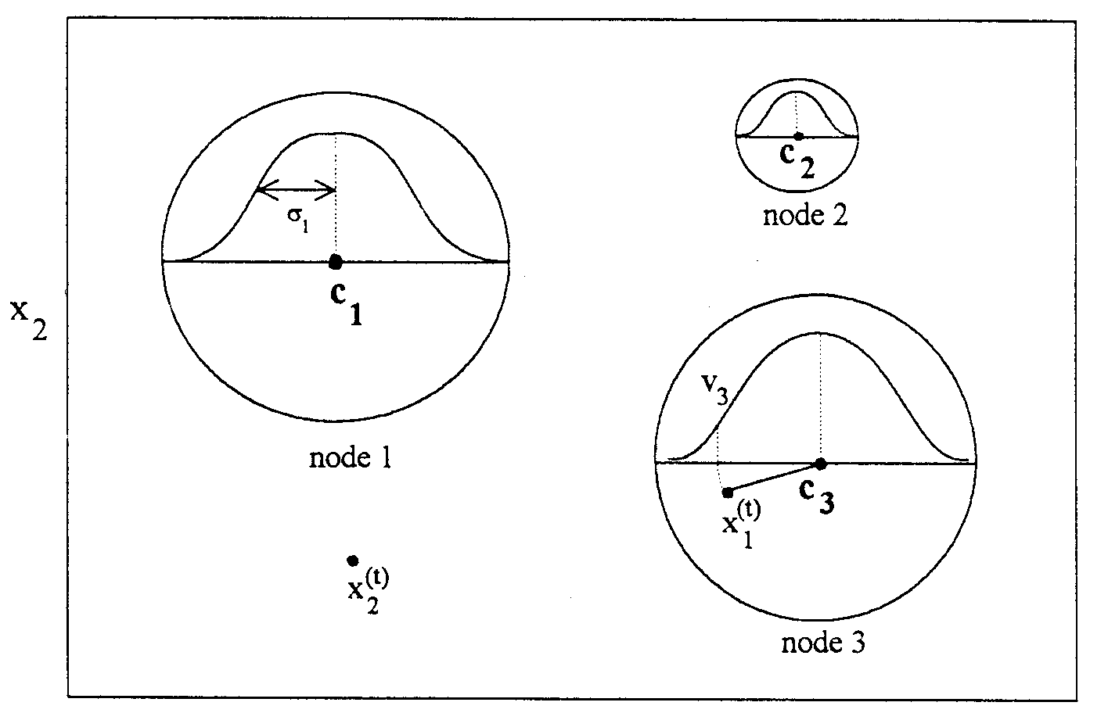
2. Network Development
(1) Cluster Centers c_{k}
x₁

Slide 46
Using K-means clustering algorithm
We start by assuming an initial set of L cluster centers, i.e.,center vector c_{k}, which corresponds to the L nodes in the hidden layer.
The elements, c_{ik}(i=1 to N; k=1 to L) of c_{k} are stored as the weight factors between the input and hidden layers.
Assume that there are T training examples available to the input layer with N nodes, and represent them by training vectors x^{(t)} with x_{i}^{(t)} (i=1 to N; t=1 to T).
The adaptive K-means clustering algorithm then iteratively finds a desirable set of L center vectors c_{k} that will minimize the sum of the squares of the distance between T training vectors x^{(t)} and their nearest L centers c_{k}(k=1 to L).

Slide 47
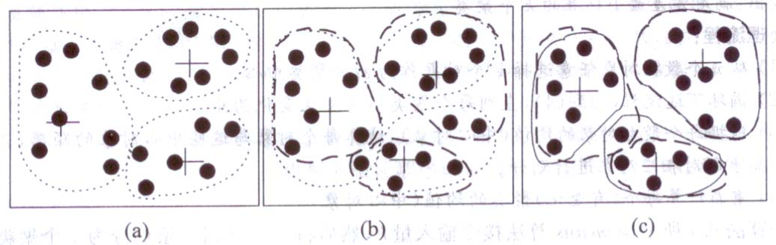
Example of K-means clustering algorithm
a. We arbitrily choose three objects as the three initial cluster centers, where clusters are marked by a “+”. Each object is distributed to a cluster based on the cluster center to which it is the nearest.
b. The mean value of each cluster is recalculated based on the objects in the cluster. Relative to these new centers, objects are redistributed to the cluster domains based on which cluster center is the nearest.
c. This process iterate, leading to Figure ©. Eventually, no redistribution of the objects in any cluster occurs and so the process terminates.

Slide 48
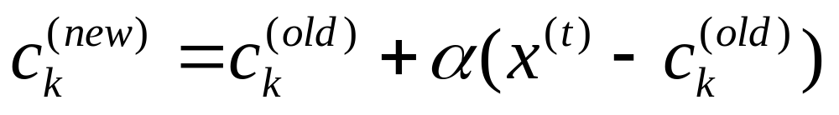
(a) Initialization step
Assume a set of cluster centers, c_{k}, for the L nodes in the hidden
layer, with the elements c_{ik} (i=1 to N; k=1 to L) stored as the
weight factors between the input and hidden layers.
(b) Iterative Steps:
Read the next training vector x^{(t)} with elements x_{i}^{(t)} (i=1 to N) into
the input layer as t increases from 1 to T.
Modify only the cluster center c_{k} (k=1 to L) closest to the training
vector x^{(t)} in the Euclidean distance:
where α is a learning rate which decreases as t increases from 1 to T.
Continue this process for a fixed number of iterations.

Slide 49
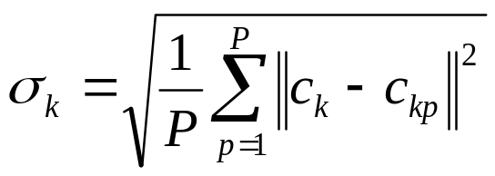
(2) Gaussian Function, Sigma σ_{k}
Using P-nearest neighboring heuristic.
consider a given center vector c_{k} (k=1 to L)
assume that c_{k1}, c_{k2}, …, c_{kp}(1≤k₁, k₂ ,… k_{p} ≤L) are the P nearest
neighboring centers.
(3) The resulting output from the k^{th} node in the hidden layer, v_{k}, is:

Slide 50
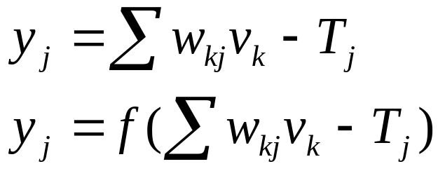
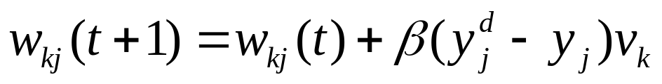
(4) Weight factors, w_{kj}
Using BP algorithm:
(5) Network training
First, do not use any desired output to train the input connects to the hidden layer.
Second, for any given training example expressed by the t^{th} training vector x^{(t)} with elements x_{i}^{(t)} (i=1 to N), we iteratively modify only one cluster center c_{k} (k=1,2,…, or L) closest to the t^{th} training vector x^{(t)} in the Euclidean distance.
Over this same time period, no training of the weight factors, w_{kj} , from hidden layer to output layer, occurs. We call this initial period the data-clustering phase.

Slide 51
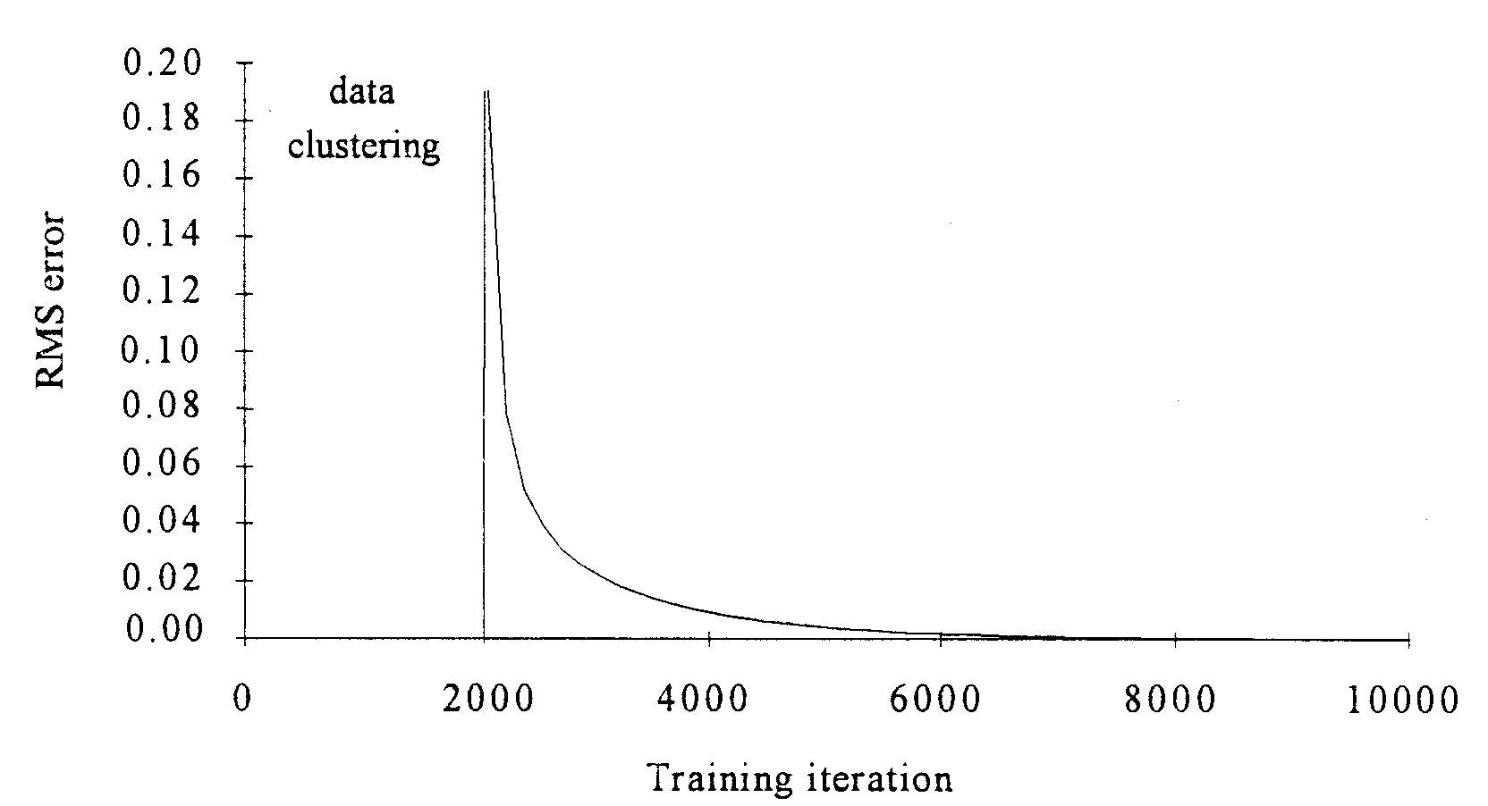
For example, after the 2000th iteration, the weight factors, c_{ik}, are fixed for the remainder of the training procedure. The weight factors w_{kj} are then trained using a conventional backpropagation algorithm.

Slide 52
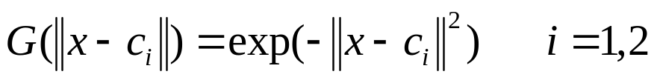
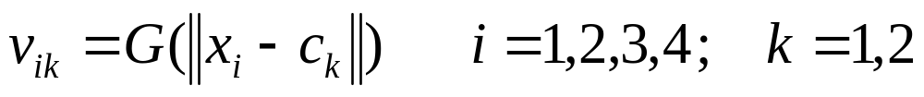
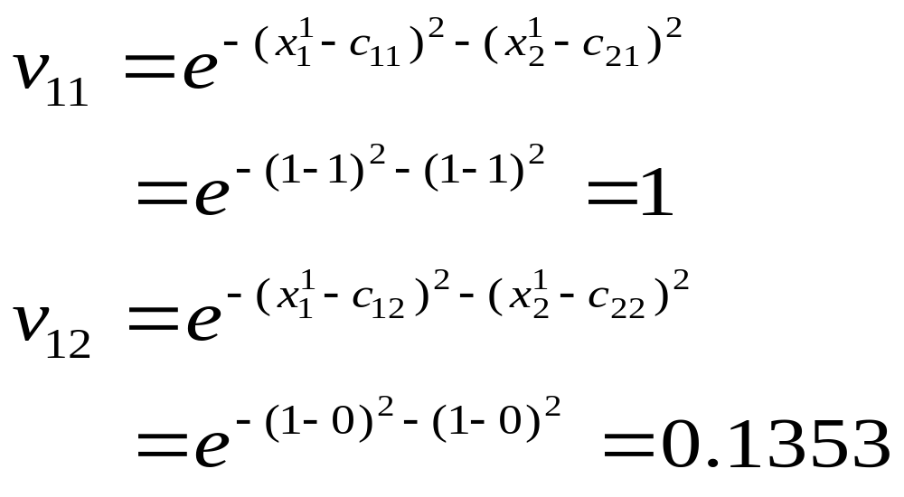
XOR Problem
X₀=1
x₁
G
B (bias)
Gaussian Function
w
y
x₂
G
Input | Desired output
(1,1) (0,1) (0,0) (1,0) | 1 0 1 0
Assuming c₁=[1,1]^{T}, c₂=[0,0]^{T}, b=1

Slide 53
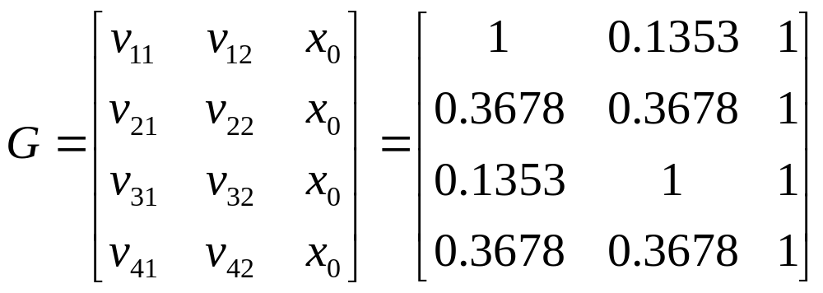
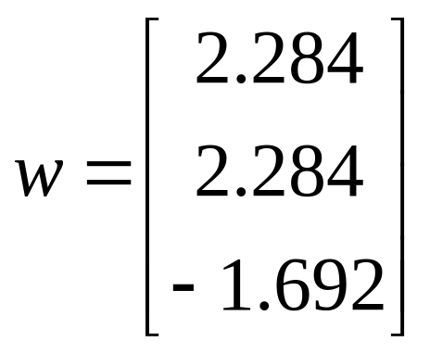
Assuming w=[w,w,b]^{T}
Gw=d
d=[1,0,1,0]^{T}
Input | Desired output
(1,1) (0,1) (0,0) (1,0) | 1 0 1 0
Network output
0.901 0.01 0.901 -0.01

Slide 54
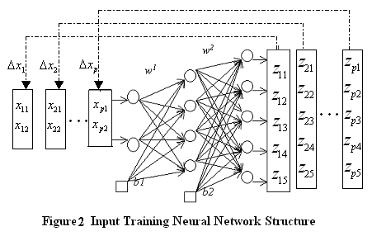


4.4.6 Input Training Neural Network
Let: t_{pk} is the value of the kth observed variable in the pth sample,
z_{pk} is the corresponding output of IT-NN.

Slide 55
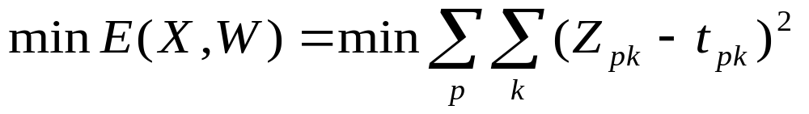
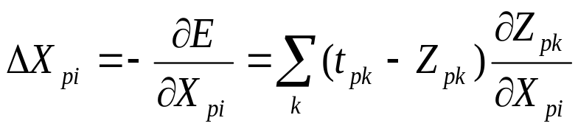
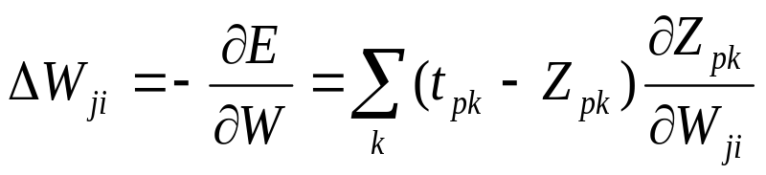
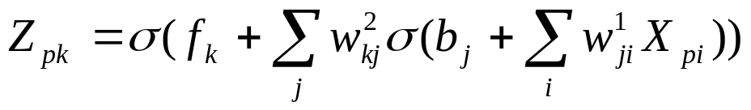
The aim of training IT-NN is to minimize the following objective function:
The steepest descent direction for optimizing network inputs ΔX_{pi}
The steepest descent direction for optimizing network weights ΔW_{ji} is
The network output is given by
where σ(.) is sigmoidal function,
b_{j}, f_{k} are the bias of the jth hidden node and kth output node,
w_{kj}, w_{ji} are the weights of IT-NN.

Slide 56
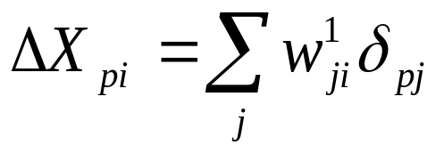
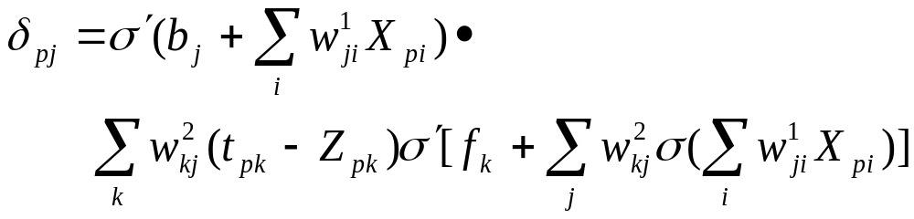
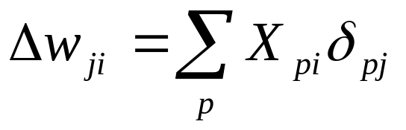
The steepest descent direction for training network is
where δ_{pj}is the propagated error at the hidden layer.
Weight adjusting is given by

Slide 57
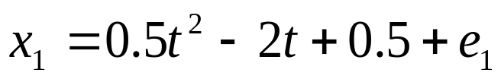
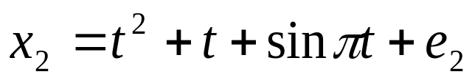
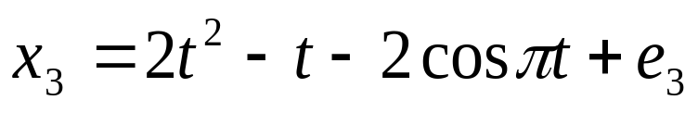
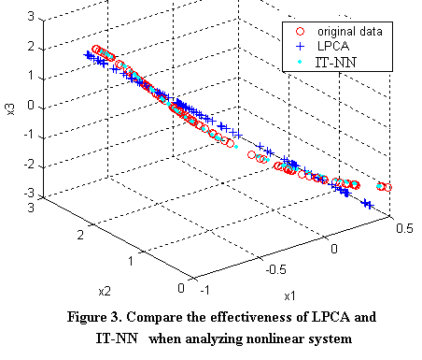
Effectiveness of IT-NN
Consider a nonlinear system of flowing,
网络结构为1-7-3

Slide 58
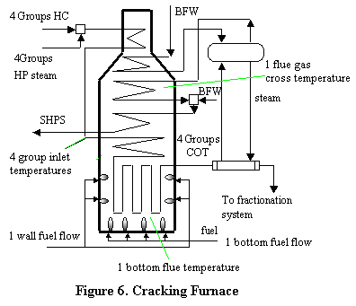
Nonlinear System Modeling with IT-NN & RBF-NN
There are 20 factors that directly or indirectly affect the yields of ethylene and propylene

Slide 59
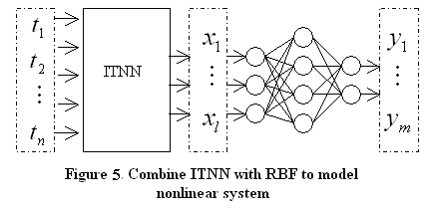
Combining IT-NN with RBF

Slide 60
Results
Num. Of Input nodes
10
9
8
7
6
5
e_{max} (%)
2.1432
3.4599
2.7845
3.6290
4.3221
5.8745
e_{min} (%)
0.0007
0.0030
0.0051
0.0033
0.0065
0.0103
e_{mse}(%)
0.0923
0.1065
0.1565
0.1903
0.5329
1.3785
Table 1. Reconstruction errors with different input layer nodes of IT-NN but same hidden layer nodes

Slide 61
Num. of nonlinear PCs
10
9
8
7
6
5
Training
period
C₂H₄
e_{max}
0.1055
0.1771
0.1730
0.2036
0.7814
0.9631
e_{min}
0.0000
0.0001
0.0007
0.0010
0.0105
0.0489
e_{mse}
0.0106
0.0130
0.0144
0.0555
0.1001
0.3901
C₃H₆
e_{max}
0.2373
0.3672
0.3829
0.6300
0.8100
1.485
e_{min}
0.0002
0.0001
0.0005
0.0023
0.0090
0.1068
e_{mse}
0.0835
0.0902
0.0995
0.1300
0.1689
0.2155
Predicting
period
C₂H₄
e_{max}
2.7501
2.2456
2.3780
2.4998
2.7599
5.1613
e_{min}
0.0095
0.0092
0.0089
0.0104
0.0196
0.1079
e_{mse}
0.5933
0.6318
0.6770
0.8317
0.8965
1.4086
C₃H₆
e_{max}
3.0477
3.7034
3.9861
4.1960
4.3435
6.7936
e_{min}
0.0104
0.0108
0.0153
0.0230
0.0267
0.023
e_{mse}
0.6053
0.6539
0.6900
0.90
1.09
1.7540
Table 2. Training and predicting errors with different PCs in IT-NN+RBF-NN model

Slide 62

We can see that the IT-NN with 8 nonlinear PCs will be the best choice. Fewer PCs (7, 6 and 5) cause information lost, and more PCs (10 and 9) increase the input nodes of RBF.

Slide 63



4.4.7 other Networks
1. Neural-Fuzzy Networks
2. Stacked neural network
Neural Network Ensemble
…
…

Slide 64

Diversity measurement using network Weight based Selective ENsemble
Network structure of DWSEN

Slide 65



Weight Vector
=（w_{i1}，w_{i2}，…，w_{iH}）
All weights in the ith network
Distance between Ni and Nj:
Weight Matrix

Slide 66


Definition of the diversity
（0≤c≤1）
Diversity Matrix

Slide 67



UCI Standard Data
Freidman#1

Slide 68

数据集 |  | Bagging | Boosting | ALL-ENN | SEL-ENN | DWSEN
Freidman#1 | 泛化误差(%) | 12.31 | 11.51 | 13.84 | 11.16 | 10.83
 | 标准偏差 | 0.1217 | 0.1264 | 0.1362 | 0.1073 | 0.0922

Slide 69
4.5 Applications
4.5.1 Classification
Two major areas:
Identification of process faults based on the operating conditions of given process
Prediction of the most likely categorical group for a given input pattern
Two basic types of pattern classifiers:
Parametric and nonparametric

Slide 70
A standard neural network architecture for pattern-classification network
…
class 1
[1,0,0,…,0]
class 2
[0,1,0,…,0]
class n
[0,0,0,…,1]
output
Class
y
hidden layer
input pattern (x)

Slide 71

An illustration of a two-dimensional input space,decision regions, decision boundaries, and transition regions for a classification problem

Slide 72

A classification network’s predictions moving from the class I decision region (y=[1,0,0]) to the II decision (y=[0,1,0]).

Slide 73
The two most commonly used network architectures for classification problems are the BP network and the RBF network.
Illustrative example of fault diagnosis of a chemical reactor
low conversion
[1,0,0]
low catalyst selectivity
[0,1,0]
catalyst sintering
[0,0,1]
Hidden layer
reactor inlet
temperature, ⁰F
reactor inlet
pressure, psia
feed flow
rate, 1b/min
Next, we use a example to compare the BP network with the RBF network. In addition, we compare different transfer functions(e.g. sigmoid and hyperbolic tangent) and network training rules(e.g., delta rule and normalized cumulative delta rule, nc-delta).

Slide 74

Using BP network

Slide 75

Using BP network with delta-learning rule and the hyperbolic tangent transfer function and 5 nodes in the hidden layer

Slide 76

Using the RBF network

Slide 77
Comparison of the BP network and RBF network
RBF networks perform better than BP networks for classification problems
The RBF network’s RMS error approaches 0 as the number of nodes increases, while the BP network has a much larger RMS error of 0.037.
BP network has a much more compact system representation than the RBF network, and has significantly lower RMS error for smaller networks(e.g. less than 5 nodes).
The RBF network also trains faster requiring only 7000 iterations, versus 30000 for the BP network.

Slide 78

4.5.2 Data compression
Using four simulated cell-growth curves spanning the entire range of possible cell-growth profiles, having maximum normalized cell concentrations of 0.2, 0.4, 0.6, and 0.8,respectively.

Slide 79

Each curve consist of 675 data points, divided into 45 training examples consisting of 15 data points each, producing a total training set of 180 examples(45*4).

Slide 80

A plot of RMS error versus compression ratio used for the determination of the optimal compression ratio.

Slide 81

Select a 3:1 compression ratio(I.e. 15 nodes in both the input and output layers being compressed to 5 nodes in the hidden layer) for the network.

Slide 82
Following figure shows the four cell-growth curves predicted.
The average error of the normalized cell concentration for the training examples is 0.0027.

Slide 83

To demonstrate using the network to reduce noise in the cell-growth signal, we now add random noise to the four signals used for training.

Slide 84

The four cell-growth curves with noise

Slide 85

corresponding cell-growth curves after data compression with a 3:1 compression ratio.

Slide 86
4.5.3 Identification
1. Forward modelling
d
d⁺
u
P
y^{p}
y^{m}
+
-
M
Learning
Algorithm

Slide 87
2. Inverse modelling
Direct method
s_{s}
r
u
y^{p}
P
-
+
C
Learning
Algorithm

Slide 88
Specialized method
r
u
P
y^{p}
C
Learning
Algorithm
y^{m}
M

Slide 89
4.5.4 Control
1. A simplified block diagram for a process control system
disturbance
Input
d
feedward
manipulated
input
feedforward
control
G_{c,ff}
original
Disturbance
model
G_{L}
m_{ff}
setpoint
y_{d}
₊
feedback
manipulated
input
total
manipulated
input
+
Final
control
element
G_{v}
controller
output
original
process
model
G_{p}
+
process
output
feedback
controller
G_{c,fb}
+
m_{fb}
+
m
u
y
-
measured output
measurement
model
G_{m}
y
y_{m}

Slide 90




2. Basic Digital PID control Algorithm

Slide 91



Digital PID Block diagram
E(z)
+
U(z)
e(kT)
+
u(kT)
+

Slide 92
3. Neural Networks for Process Control
(1) Direct Network Control
training a neural network as the controller determining the controller output directly
neural
controller output
ε
neural controller
u_{nn}
ε_{nn}
network
error signal
Measured
output
setpoint
+
ε
feedback controller
u
process model
y_{d}
output
error
signal
feedback
controller
output
y_{m}
–

Slide 93
Neural controller emulator
controller
output u(t+1)
existing
controller
Controller
outputs
u(t) and u(t-1)
Measured
outputs
y(t) and y(t-1)
neural
controller
output
neural
controller
emulator
+
-
u_{nn}(t+1)
network
error signal
ε_{nn}
Neural process emulator
Controller
outputs
u(t) and u(t-1)
Measured
outputs
y(t) and y(t-1)
measured
outputs y(t+1)
actual
process
neural
process
emulator
output
neural
process
emulator
+
controller
outputs
u(t+1)
-
y_{nn}(t+1)
network
error signal
ε_{nn}

Slide 94
Integrated Neural Controller/Process System
Controller
outputs
u(t) and u(t-1)
Measured
outputs
y(t) and y(t-1)
neural
controller
emulator
desired
process
output
y_{d}(t+1)
neural
controller
output
u_{nn}(t+1)
neural
process
emulator
output
+
neural
process
emulator
y_{nn}(t+1)
-
network
error
signal
ε(t+1)

Slide 95
(2) Inverse Network Control
training a neural network as an “inverse” model of a process, predicting the process input necessary to produce the desired process outputs(setpoints).
u_{nn}(t+1)=g[u(t),u(t-1),y_{d}(t+1),y(t),y(t-1)]
process inputs
u(t) and u(t-1)
measured outputs y(t) and y(t-1)
predicted process inputs
neural inverse
Process model
u_{nn}(t+1)
+
Network error signal
y_{d}(t+1)
–
ε_{nn}(t+1)
process
inputs
Desired process outputs
process model
u(t+1)
y_{d}(t+1)
y(t+1)=f [u(t+1),u(t),u(t-1),y(t),y(t-1)]

Slide 96
(3) Internal Model Control (IMC)
y^{s}
e
signal
filter
r
u
process
model
y^{p}
+
-
C
neural inverse
model(controller)
+
-
y^{m}
M
neural forward model
(internal process model)

Slide 97
(4) Model Reference Control
reference
model
y^{m}(t)
e_{c}(t)
-
+
r(t)
+
e(t)
u(t)
process
model
y(t)
-
C

Slide 98

(5) Neural Network Nonlinear Predictive Control based upon Tent-map Chaos Optimization
The neural network is used as multi-step predictive model and the TCOA is applied to performing the nonlinear rolling optimization to enhance the convergence and accuracy in the NNPC.

Slide 99










Example 1
The process control input is calculated to minimize a criterion at each sampling instant

Slide 100

Example 2

Slide 101


Slide 102


