Slide 1
5.2 BAM Network
Bidirectional Associative Memory
W₁
Layer A
x₁
1
1
y₁
x(t)=f_{y}(f_{x}(x(t-1)W₁)W₂)
y(t)=f_{x}(f_{y}(y(t-1)W₂)W₁)
x₂
2
2
y₂
…
…
x_{n}
n
m
y_{m}
W₂
Layer B

Slide 2
Calculating process
x(t-1)
w₁
f_{x}(x(t-1)w₁)
y(t-1)
x(t)
f_{y}(y(t-1)w₂)
w₂
y(t)
w₁
f_{x}(x(t-1)w₁)
x(t-1)
f_{y}(y(t-1)w₂)
w₂
y(t-1)

Slide 3
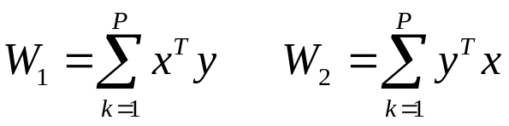
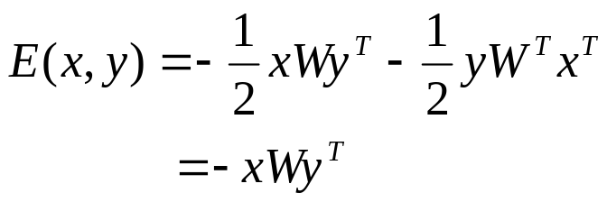
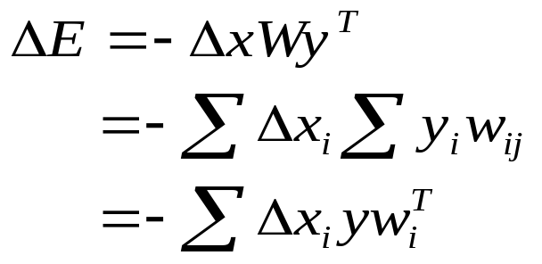
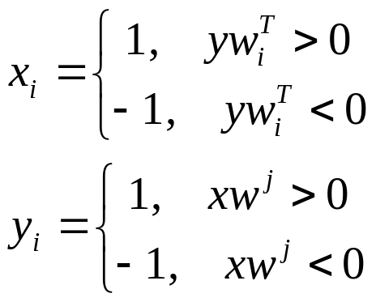
(x_{i} , y_{i}), i=1,2,…,P
Learning rule
Assuming: x∈{-1,+1}^{N}, y ∈{-1,+1}^{M}
Hebb learning formular
W₁=W₂^{T}
Definition of energy function:
If Δx_{i}>0 then yw_{i}^{T}>0
If Δx_{i}<0 then yw_{i}^{T}<0
Therefore, ΔE<0
w_{i} is the i^{th} row weight factors in the W
w^{j} is the j^{th} column weight factors in the W

Slide 4
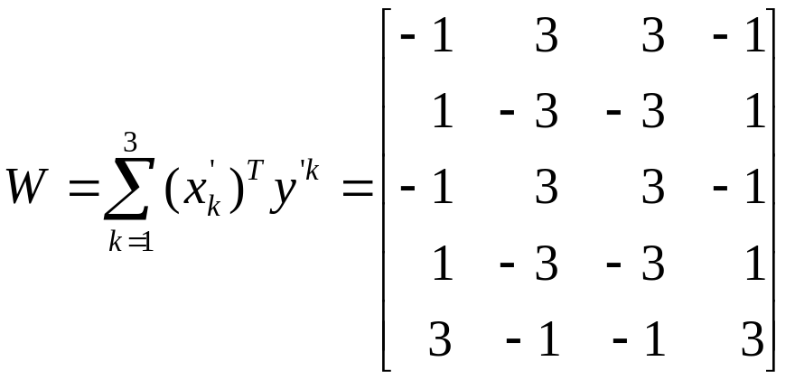
Example 1
x₁(1 0 1 0 1) , y₁(1 1 1 1)
x₂(1 0 1 0 0) , y₂(0 1 1 0)
x₃(0 1 0 1 1) , y₃(1 0 0 1)
sgn(x₁W)=sgn(1 5 5 1)=y₁
sgn(y₁W^{T})=sgn(4 –4 4 –4 4)
=(1 –1 1 –1 1)
Change the vectors to {-1,+1}
change to binary
sgn(y₁W^{T})=(1 0 1 0 1)=x₁
x₁’(1 -1 1 -1 1) , y₁’(1 1 1 1)
x₂’(1 -1 1 -1 -1) , y₂’(-1 1 1 -1)
x₃’(-1 1 -1 1 1) , y₃’(1 -1 -1 1)
δ=(0 1 0 0 0)
x₁+ δ=(1 1 1 0 1)
sgn[(x₁+ δ)W]=sgn[2 2 2 2]
=y₁

Slide 5
Chapter 6 ANN Hybrid System
6.1 Fuzzy Neural Network
6.2 Evolutionary Computation and Genetic Algorithm
6.3 A Hybrid System of Expert Systems and Neural Networks

Slide 6
6.1 Fuzzy Neural Network
Neural-fuzzy networks implements fuzz-logic inferencing through neural networks.
1. Fuzzy-logic Systems
Fuzzy logic grew out of a desire to quantify rule-based systems. It provides a way to quantify certain quantifiers such as approximately, often, rarely, several, few, and very.
Relationship of fuzzy-logic systems to the two main areas of AI
knowledge type
Information framework
symbolic
numerical
expert system
fuzzy-logic system
structured
(based on rules)
————
neural network
unstructured

Slide 7
A. Fuzzy set
quantify the degree of membership with values between 0 (not a member) and 1 (definitely a member).
The following figure shows a representation of energy requirement in fuzzy terms.
very low
low
moderate
high
very high
1
Fuzzy value
0
Numeric value

Slide 8
B. Conversion Between Numeric and Fuzzy-Logic Variables
How to convert a numeric variable to a fuzzy-logic variable through fuzzifier, and to convert the fuzzy-logic variable back to a numeric variable through a defuzzifier.
very low
low
moderate
high
very high
1
Fuzzy value
0.5
0
50
70
80
100
Numeric value
The numeric variable are denoted numeric(x) and the fuzzy-logic variables are denoted fuzzy(e.g., 50 to 70 for low,and 80 to 100 for moderate).
numeric(60)=fuzzy(0, 1, 0, 0, 0)
numeric(90)=fuzzy(0, 0, 1, 0, 0)

Slide 9
For numeric values in the transition regions, we use a linear interpolation between the beginning and ending values of the region.
very low
low
moderate
high
very high
1
Fuzzy value
0.5
0
50
70
80
100
Numeric value
Similarly, we can convert the fuzzy-logic variable back to a numeric variable using the exact opposite process.
x₁=77 x₂=77

Slide 10
C. Union and Intersection of Fuzzy sets
Define two fuzzy sets:
I={i₁/x₁, i₂/x₂, …,i_{n}/x_{n},}
J={j₁/x₁, j₂/x₂, …,j_{p}/x_{p},}
where x₁,x₂,…are members of the set with degrees of membership i₁,i₂,…(for set I) and j₁,j₂,…(for set J).
Union of two fuzzy sets:
Intersection of two fuzzy sets:

Slide 11
D. Fuzzy Control
Fuzzy Controller
Knowledge-base
r
Fuzzy logic Inference
y
Fuzzification
Defuzzification
plant

Slide 12
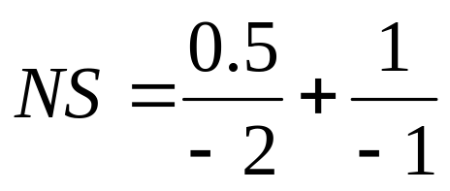
Fuzzy-logic variable (e,u)
 | -3 | -2 | -1 | 0 | 1 | 2 | 3
PB | 0 | 0 | 0 | 0 | 0 | 0.5 | 1
PS | 0 | 0 | 0 | 0 | 1 | 0.5 | 0
0 | 0 | 0 | 0.5 | 1 | 0.5 | 0 | 0
NS | 0 | 0.5 | 1 | 0 | 0 | 0 | 0
NB | 1 | 0.5 | 0 | 0 | 0 | 0 | 0
NB
NS
PS
PB
0
e
u
-3
-2
-1
0
1
2
3

Slide 13
Control rule table
e | NB | NS | 0 | PS | PB
u | PB | PS | 0 | NS | NB
R=(NB_{e}*PB_{u})+ (NS_{e}*PS_{u})+ (0_{e}*0_{u})+ (PS_{e}*NS_{u})+ (PB_{e}*NB_{u})
u=e ° R

Slide 14
2. Neural-Fuzzy Networks
A. Neural-Fuzzy Networks for Expert Systems
neural network
expert system
fuzzifier
defuzzifier
Numeric values
Fuzzy values
Fuzzy values
Numeric values
B. The architecture of the neural-fuzzy controller
setpoint
fuzzy controller
plant
+
_
Regulation of membership functions
Neural network 1
Neural network 2

Slide 15
3. Fuzzy Neural Network
O₁
output layer
…
N₁
N₂
N_{k}
hidden layer 3
(backpropagation)
R₁₁
…
R_{1M}
R_{N1}
…
R_{NM}
hidden layer 2
(product)
hidden layer 1
(Gaussian function)
A₁
…
A_{N}
B₁
…
B_{M}
x₁
x₂
input layer

Slide 16
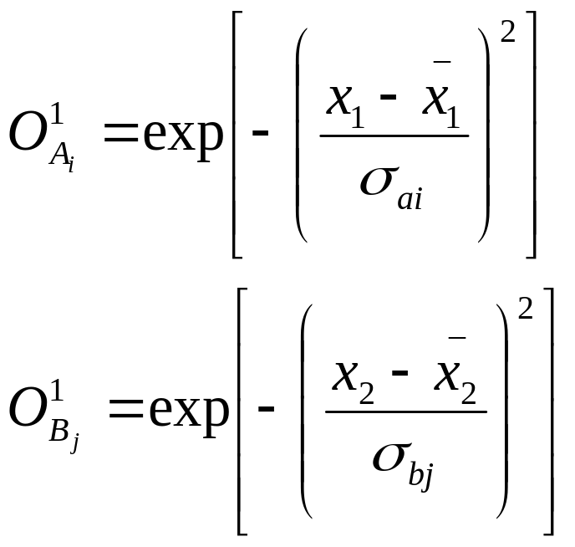

Fuzzy Network
membership function
(hidden layer 1)
fuzzy rules(hidden layer 2)
BP learning(hidden layer 3)
Input
Output
Hidden layer 1:
represents a radially symmetric (Gaussian) membership functions of A₁(i=1 to N) and B_{j}(j=1 to M) for the normalized input variables x₁ and x₂, respectively.
is the center and σ is the standard derviation of a Gaussian membership function.

Slide 17
A common representation of the Gaussian membership function stored in hidden layer 1 of a fuzzy network.
node A₁
NL
node A₂
NM
node A₃
ZE
node A₄
PM
node A₅
PL
-1
0
1
Normalized input variable, x_{l}
Hidden layer 2:
Taking the dot product of the outputs of the membership functions(hidden layer 1) O¹_{Ai} and O¹_{Bi}.
For example, the output of the first node(R₁₁) in the hidden layer 2 reflects whether the rule of A₁(x₁ is negative large) and B₁(x₂ is negative large) should be applied.

Slide 18
Hidden layer 3:
operates the same as a standard backpropagation network, having weight factors (w_{ij}) and a sigmoid transfer function. The weight factors are adjusted to map the firing strength of the fuzzy rules onto the desired output variable.
Hidden layer 4:
operate the same as a standard backpropagation network, as in layer 3.

Slide 19
6.2 Evolutionary Computation and Genetic Algorithm
Genetic Algorithm
Evolutionary Algorithm
Evolutionary Programming
Evolutionary Strategy
Genetics
Biology Evolutionary Process
Mutation
Selection

Slide 20
GA basic operation
Step 1: Initiation
Step 2: Selection (reproduction)
e.g. using fitness function
Step 3: Crossover
Example 1
A
B
1 0 0 1 1 1 1
0 0 1 1 0 0 0
1 0 0 1 0 0 0
0 0 1 1 1 1 1
C
D
⇒
A: 0 0 1 1 1 1
B: 1 1 1 1 0 0
Shield 0 1 0 1 0 1
Example 2
0→A，1→B
►A’
A’: 0 1 1 1 1 0
B’: 1 0 1 1 0 1
Step 4 : Mutation
0→1
1→0

Slide 21
Practice
Max{ f(x)=x² }, x=0 ~ 31
1. Initiation ( binary code)
标号 | 串 | X | 适配值 | 占整体百分数
1 2 3 4 | 01101 11000 01000 10011 | 13 24 8 19 | 169 576 64 361 | 14.4 49.2 5.5 30.9
总计（初始种群整体） |  |  | 1170 | 100

Slide 22
2. Selection(reproduction)
第一代群体的选择（复制）
标号 | 初始群体 | X | f(x)=x² | 选择复制的概率 | 期望复制数 | 实际得到复制数
1 2 3 4 | 01101 11000 01000 10011 | 13 24 8 19 | 169 576 64 361 | 0.14 0.49 0.06 0.31 | 0.58 1.97 0.22 1.23 | 1 2 0 1
总计 |  |  | 1170 | 1.0 | 4.0 | 4
平均 |  |  | 293 | 0.25 | 1.0 | 1
最大值 |  |  | 576 | 0.49 | 1.97 | 2
169/1170=0.14
169/293=0.58

Slide 23
3. Crossover
复制交叉后的各项数据
新标号 | 复制后的匹配池 | 匹配对象 （随机选取） | 交叉点 （随机取） | 新种群 | X值 | f(x)=x²
1 | 01101 | 2 | 4 | 01100 | 12 | 144
2 | 11000 | 1 | 4 | 11001 | 25 | 625
3 | 11000 | 4 | 2 | 11011 | 27 | 729
4 | 10011 | 3 | 2 | 10000 | 16 | 256
总 计 |  |  |  |  |  | 1754
平 均 |  |  |  |  |  | 439
最大值 |  |  |  |  |  | 729
平均值 293 → 439
最大值 576 →729

Slide 24
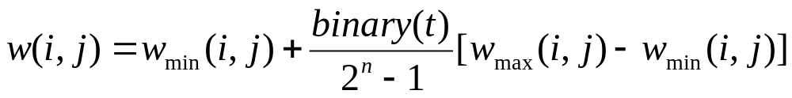
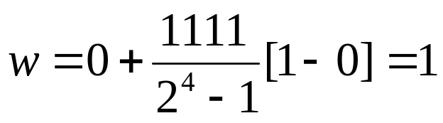
4. Mutation
取变异概率0.001， 种群共有4*5=20位，20*0.001=0.02位，所以本例无串位值的改变。至此，完成一代遗传。
Application in ANN
用遗传算法学习神经网络权值w_{ij}
1. 二进制编码
W字符串表示的值和实际数值间的关系：
如w在1~0间，4位二进制：
W学习过程：交叉、变异，产生下一代网络。

Slide 25
2. Real number code
0.4
2.1
* code （0.4, -0.3, 2.1, 1.3, 0.9, -0.6, 4.5, -0.1, 0.7)
-0.3
4.5
-0.1
* estimate function f=1/Σe_{i}²
1.3
0.9
0.7
* Initiation
determine the weight factors at random
-0.6
(0.4, -0.3, 2.1, 1.3, 0.9, -0.6, 4.5, -0.1, 0.7)
(0.7, -0.9, 1.2, 0.8, 1.4, 0.1, -1.1, 0.2, -1.1)
* crossover (0.4, -0.9, 1.2, 1.3, 1.4, 0.1, 4.5, 0.2, -1.1)
* mutation (0.4, -0.3, 2.1, 1.3, 0.9, -0.6, 4.5, -0.1, 0.7)
stochastic value -1.1
stochastic value -0.7
(0.4, -0.3, 1.0, 1.3, 0.9, -0.6, 4.5, -0.8, 0.7)

Slide 26
6.3 A Hybrid System of Expert Systems and Neural Networks
1. The structure of an expert system
knowledge
base
inference
engine
user
interface
shell
knowledge in expert systems
Knowledge = facts + rules +heuristics
shell
Explains how the system reaches a conclusion
Explains why it needs certain information
Adds information to the knowledge base

Slide 27
2. Neural networks versus expert systems
Neural networks | Expert systems
example-based domain-free finds rules little programming easy to maintain fault-tolerant needs a database fuzzy logic adaptive system | rule-based domain-specific needs rules much programming difficult to maintain not fault-tolerant needs a human expert rigid logic requires reprogramming

Slide 28
3. Advantages and limitations of expert systems and neural networks
 | Expert systems | Neural networks
very effective | In applying a fixed set of facts, rules and heuristic(i.e., knowledge) to a domain-specific problem, typically involving only simple mathematics. | In organizing and detecting patterns from unpredictable and/or imprecise input data, in learning by examples, and in generalizing to new situations.
less effective | In processing raw sensory data from the real, unpredictable world. | In providing in-depth solutions and full understanding of each problem as well as the reasoning behind its solution(i.e., no explanation capability).

Slide 29
4. An illustration of an expert network
numerical
results
input data
(normalized vector)
neural network
(predictor)
classifier
(data structuring)
fuzzy results
solution
user
interface
inference
engine
Knowledge base
shell
expert system

