Slide 1
Artificial Neural Network Technology
Zhu Qunxiong
朱群雄
College of Information Science and Technology

Slide 2


Slide 3
Course Description:
This course introduces the fundamental principles and practical aspects of neural networks, focusing on the feedforward neural network, feedback neural network, hybrid intelligent system based on fuzzy-logic systems and genetic algorithm, and applications in modeling, simulation, control, fault diagnosis, information processing, associative memory and optimization computing.

Slide 4
Reference
1. Zurada Jacek M．Introduction to Artificial Neural System．
West Publishing Company, New York, 1992
2. D. R. Baughman, Y. A. Liu． Neural Networks in Bioprocessing and Chemical Engineering． Virginia Polytechnic Institute and State University, Blacksburg, 1992
3. Nils J. Nilsson(Staford University). Artificial Intelligence: A New Synthesis. Morgan Kaufmann, 1998
Martin T. Hagan(Oklahoma State University). Neural Network Design. Mark H. Beale(MHB, Inc.) ITP, 1996
Simon Haykin(McMaster University). Neural Network: A Comprehensive Foundation, 2E. Prentice Hall, 1999
Jiawei Han, Micheline Kamber. Data Mining: Concepts and Techniques. Morgan Kaufmann, 2000
7. 袁曾任．人工神经元网络及其应用，清华大学出版社，2000
8. 孙增圻. 智能控制理论与技术，清华大学出版社，1997
9. 李士勇. 模糊控制-神经控制和智能控制论，哈尔滨工业大学出版社，1998

Slide 5
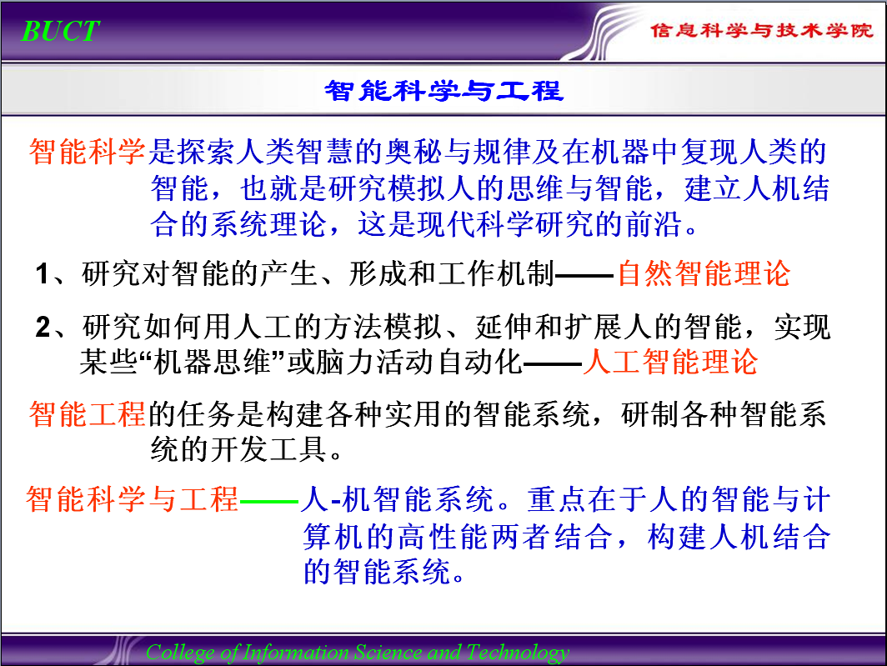

Slide 6
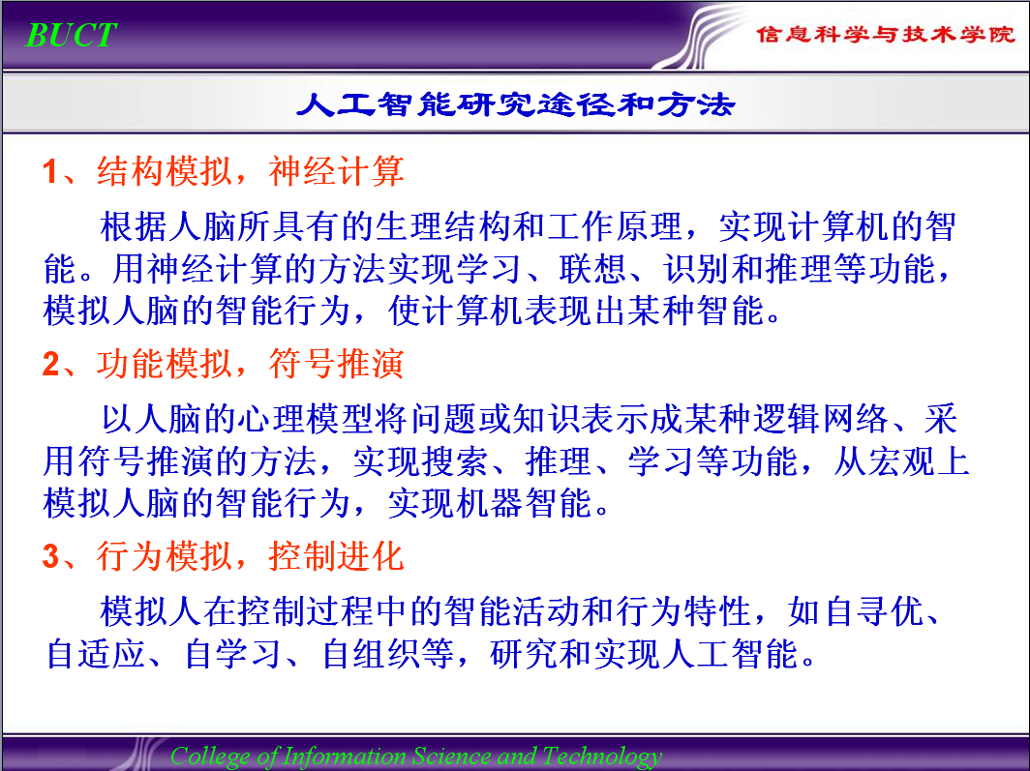

Slide 7
Introduction to Intelligent System
Intelligent System
Bio-Intelligence
Machine Intelligence
Artificial Intelligence
Expert System
Computation Intelligence
Artificial Neural Network
Fuzzy System
Evolutionary Computation
Rough Set
Extension Theory
Genetic Algorithm
Evolutionary Strategy
Evolutionary Programming

Slide 8
Ａ. Artificial Intelligent
Definition of AI
Artificial intelligence is the part of computer science concerned with designing intelligent computer systems, that is, systems that exhibit characteristics we associate with intelligence in human behavior.
The goal of AI from the definition
to make computers “think”,
to make computers solve problems requiring human intelligence.

Slide 9
Another definition of AI
Artificial intelligence is the branch of computer science dealing with symbolic, non-algorithm methods of problem solving.
Two aspects of AI-based methods for problem-solving
1. AI does not use an algorithm.
2. AI involves symbolic processing.
major AI-based technologies
New
Expert system
Genetic Algorithms
Neural networks
Rough Set
Fuzzy-logic systems
Extension Theory

Slide 10
B. Expert System, Neural Networks, and Fuzzy-Logic System
A expert system is a computer program that uses high-quality, in-depth, knowledge to solve complex and advanced problems typically requiring human experts.
Expert systems operate symbolically, on a macroscopic scale, processing non-numerical symbols and names.
A neural network is a computing system made up of a number of simple, highly interconnected nodes or processing elements, which process information by its dynamic state response to external inputs.
The goal of a neural network is to map a set of input patterns onto a corresponding set of output patterns.
Neural networks use subsymbolic processing, characterized by microscopic interaction that eventually manifest themselves as macroscopic, symbolic, intelligent behavior.

Slide 11
Fuzzy-Logic allows us to mesh a quantitative approach with the qualitative representation. It provides a way to quantify certain qualifiers such as approximately, often, rarely, several, few, and very.
To use fuzzy logic, we first need a fuzzy set. In a fuzzy set, the transition from membership to non-membership is not well-defined. We quantify the degree of membership with values between 0(not a member) and 1(definitely a member).
Expert Network
Fuzzy Network
Neural-Fuzzy Networks for Expert Systems
neural network
expert system
fuzzifier
defuzzifier
Numeric values
Fuzzy values
Fuzzy values
Numeric values

Slide 12
AI Methods
AI Features or Functions
Heuristic Programming
Expert System
Knowledge Engineering
Pattern Recognition
Natural Language Understanding
Theorem Providing
Machine Learning
Artificial Neural Network
Fuzzy Logic
Intelligent Robot
Self – Adaptation
Self – Learning
Self –Recognition
Self – Stabilization
Self – Turning
Self – Coordination
Self – Organization
Self – Diagnosis
Self – Repairing
Self – Reproduction
Rough Set
Extension Engineering

Slide 13

Natural
Language
processing
Genetic
algorithm
Automatic
programming
Speech
understanding
Intelligent
tutor
Machine
learning
Expert
systems
Robotics
Fuzzy
logic
Computer
vision
Neural
networks
The
AI
Tree
Game
playing
A B C
D L N P
E F G H
I J K
M O
Psychology
Philosophy
Electrical engineering
Management science
A Psycholinguistics
B Sociolinguistics
C Computational
linguistics
D Adaptive systems
E Cognitive psychology
F Philosophy
G Philosophy of
language
H Logic
I Robotics
J Image processing
K Pattern recognition
L Management
M Mathematics/statistics
N Operations research
O Management
information System
P Biology

Slide 14
Intelligent Applications
Intelligent Control
Intelligent Regulation
Intelligent Management
Intelligent Decision-Making
Intelligent Instrument
Intelligent Machine
Intelligent Communication
Intelligent Network
Intelligent Interface
Intelligent Monitor
Intelligent Diagnosis
Intelligent Dispatch
Intelligent Operation
Intelligent Software
Intelligent Robot
Intelligent Automation
Intelligent Computer
Intelligent Database
Intelligent Agent
Intelligent Housing Colony

Slide 15
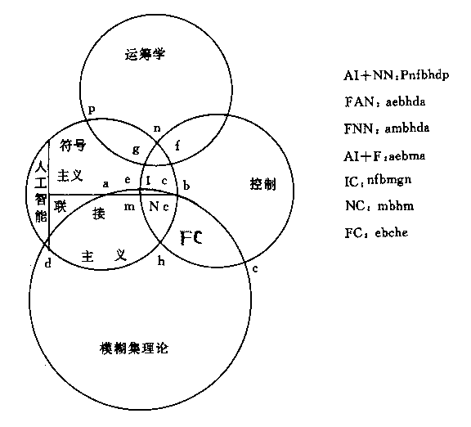
Intelligent Control
Operational Research
Symbolism
Control
Connectionism
FC
Rough Set Fuzzy Set

Slide 16
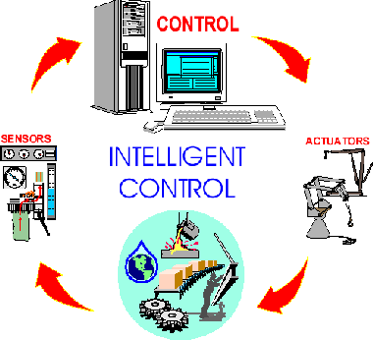
Intelligent Control

Slide 17
Chapter 1 Introduction
1.1 ANN Development History
1.2 Basic Principle of ANN
1.3 Properties of Neural Networks
1.4 Potential Applications of Neural Networks

Slide 18
1.1 ANN Development History
1943 MP model ( McCulloch and Pitts)
1944 Hebb learning rule
ΔW_{ij}=aS_{i}S_{j} a>0
1957 Perceptron (Rosenblatt)
1962 Adaline (Adaptive linear element) (Widrow)
1969 Book “Perceptron” (Minsky and Papert)
1982 Hopfield network
1988 First China neural network conference in Beijing
1992 IEEE neural network conference in China

Slide 19
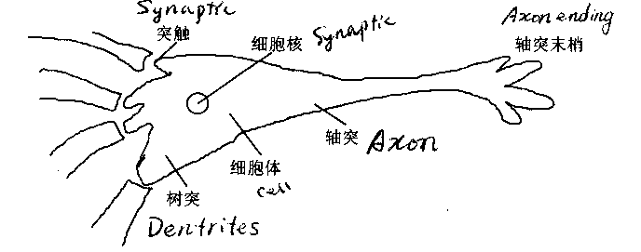
1.2 Basic Principle of ANN
A. Bio-neuron Model
脑神经元由细胞体、树突和轴突构成。
神经元之间通过轴突末梢（输出）与树突（输入）相互联结,其接口称为突触.
(Synapse)
(Axon ending)
(Nucleus)
(Axon)
轴突：传导信息
(Cell)
(Dendrites)
树突是神经元的主要接受器。

Slide 20
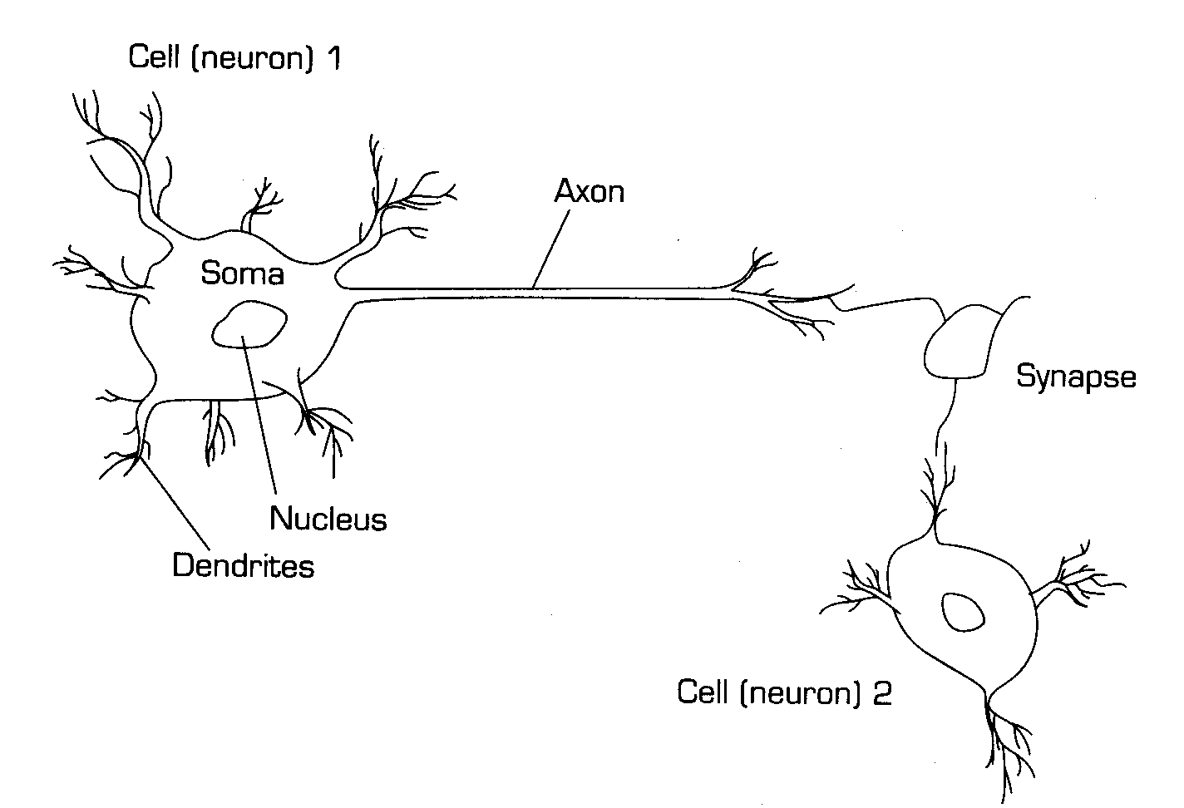

Slide 21
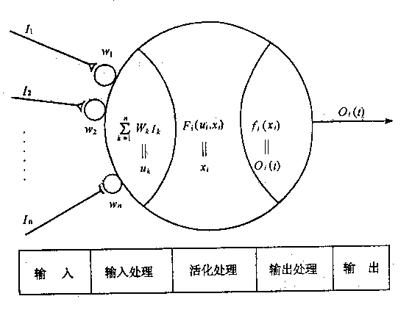
B. Neuron Model
Input
Input
processing
Activity
processing
Output
processing
output

Slide 22
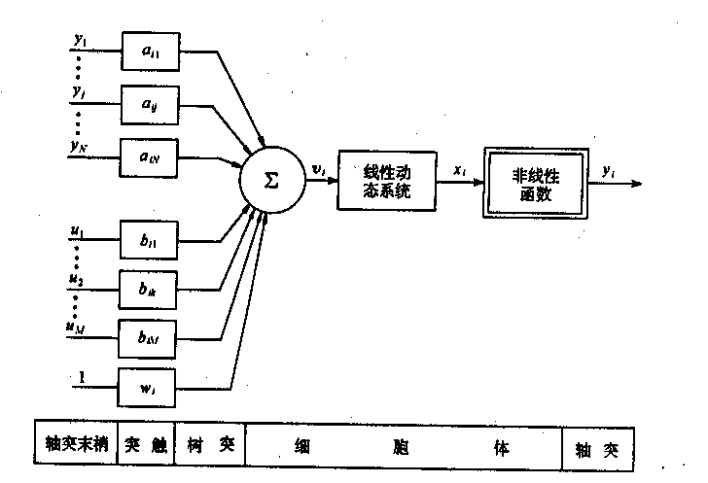
C. Neuron Model Structure

Slide 23
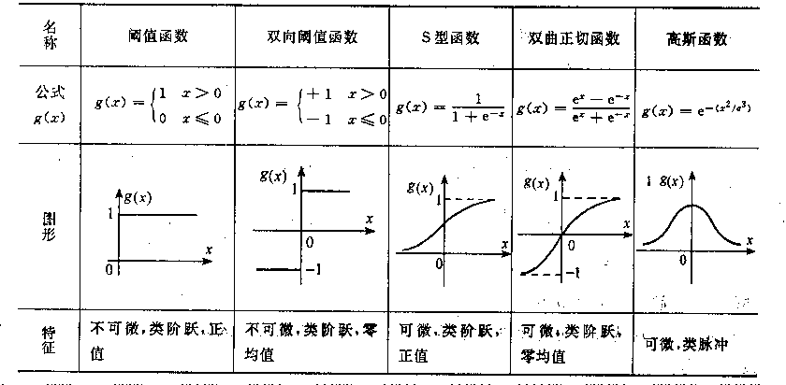
D. Nonlinear Function in a Neuron Model

Slide 24
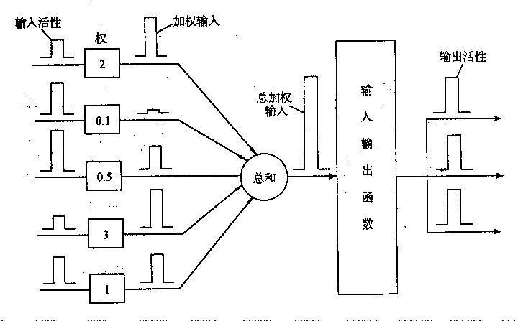
E. Idea Pattern

Slide 25
F. MP Model
Excitement Input
E
x1
E
y=x1x2
Y{0,1}
2
T
x2
I
Output
Inhibitory Input
I
T-Threshold
x1
y=x1+x2
1
输入条件 输出
_________________________
∑E≥T, ∑I=0 Y=1
∑E≥T, ∑I>0 Y=0
∑E<T, ∑I=0 Y=0
∑E<T, ∑I≤0 Y=0
x2
Binary Boolean logic operation by using MP model

Slide 26
Ternary Boole logic operation by using MP model
x1
0 0 0
x2
1
0
y=x1x2x3
x3
x1
x3
0 0 1
x2
1
1
y=x1x2x3
x1
x2
0 1 0
x3
1
1
y=x1x2x3
x1
0 1 1
x2
2
y=x1x2x3
x3
x2
x1
1 0 0
x3
1
1
y=x1x2x3
x1
1 0 1
x2
2
y=x1x2x3
x3
x1
1 1 0
x2
2
y=x1x2x3
x3
x1
1 1 1
x2
3
y=x1x2x3
x3

Slide 27
Modified M-P Model:
linear weight neural model
Excitement Input
E
E
Y{0,1}
T
I
Output
Inhibitory Input
I
T-Threshold
Input Condition Output
∑E - ∑I≥T Y=1
∑E - ∑I＜T Y=0

Slide 28

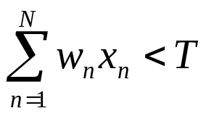
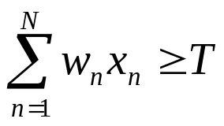
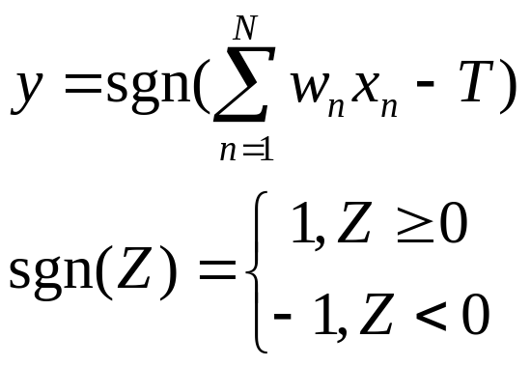
Typical MP Model
x₁
w₁
y
y=0, If
x₂
w₂
T
y=1, If
x _{n}
w_{n}

Slide 29
1.3 Properties of Neural Networks
A. Strengths of Neural Networks
(1) Information is distributed over a field of nodes.
(2) Neural networks have the ability to learn.
(3) Neural networks allow extensive knowledge indexing.
(4) Neural networks are better suited for processing noisy,
incomplete, or inconsistent data.
(5) Neural networks mimic human learning processes.
(6) Automated abstraction.
(7) Potential for online use.

Slide 30
B. Comparison of Neural Networks to Empirical Modeling
First, neural networks have a better filtering capacity than
empirical models because of the micro-feature concept.
Second, neural network are more adaptive than empirical models
because of having specified training algorithms.
Third, neural networks are truly MIMO systems.

Slide 31
C. Limitations of Neural Networks
(1) Long training times
(2) Large amount of training data
(3) No guarantee of optimal results
(4) No guarantee of 100% reliability

Slide 32
1.4 Potential Applications of Neural Networks
(1) Classification
(2) Predication and Optimization
(3) Process - Forecasting, Monitoring, Diagnosis,
Modeling and Control
(4) Data - Filtering
(5) Expert System
……

Slide 33
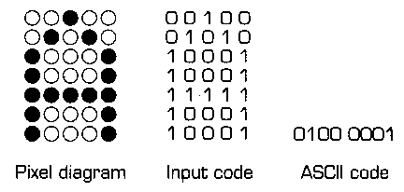
Processing Information in the Network

Slide 34
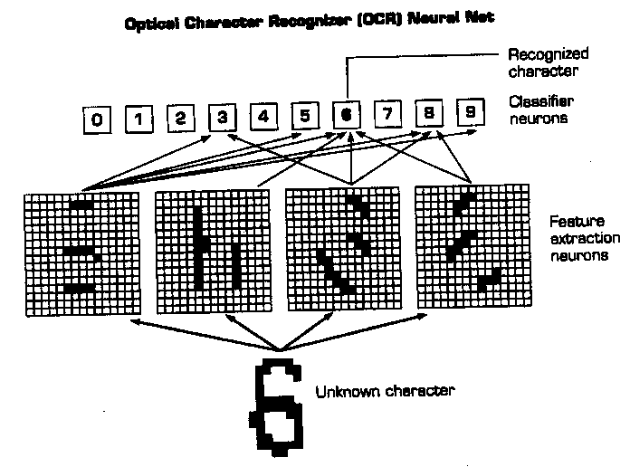
Optical Character Recognizer (OCR) Neural Net
Recognized
character
6
Classifier
neurons
Feature
Extraction
neurons
Unknown Character

Slide 35
Chapter 2 Perceptron Network
2.1 Single-layer Perceptron Network
2.2 Multi-layers Perceptron Network

Slide 36
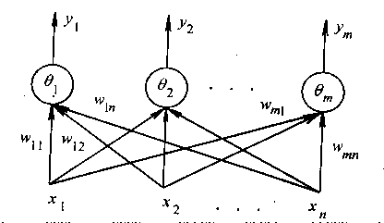
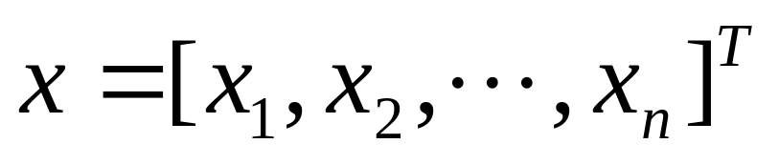
2.1 Single-layer Perceptron Network
Input Vector
w_{ji} weight factor from x_{i} to y_{j}
y_{j} (j=1,2,…,m) output

Slide 37
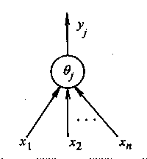
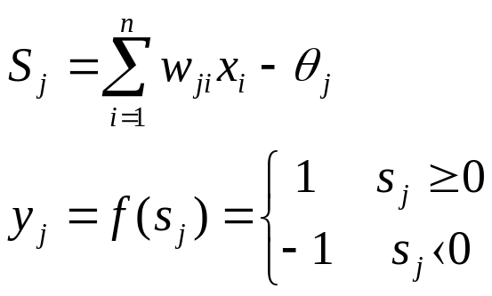
A. A Neuron
X^{p} (p=1,2,….,p) ,
P point in the n dimension space
Perceptron Separates P point into two classes

Slide 38
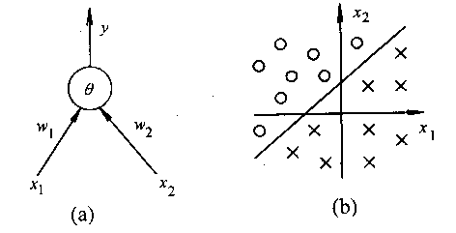
B. Two Dimension Space
AND Problem
(0,1)
(1,1)
0 1
0 0
(0,0)
(1,0)
OR Problem
(0,1)
(1,1)
Neuron
Sample space
1
0 1
Linear equation
(0,0)
(1,0)
w₁x₁+w₂x₂-θ=0

Slide 39
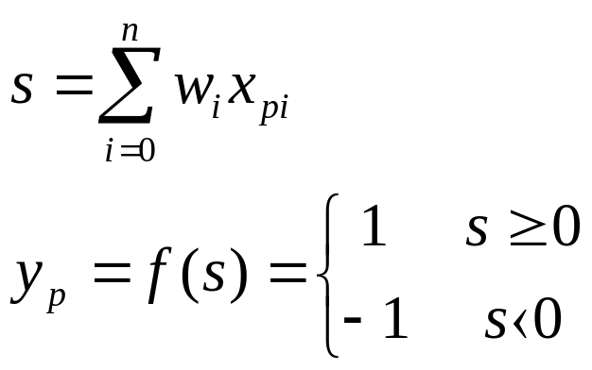
C. Learning Algorithm
1. Initial weight w_{i}(0), k=0, select at random
2. Select a group of sample, x_{p} and d_{p}(desired output)
Calculate:
Assume:
x_{p0}=1, w₀=-θ
3. Adjusting weight
w_{i}(k+1)=w_{i}(k)+η(d_{p}-y_{p}) x_{pi} i=1,2,…,n
η Learning rate
4. Select next sample, and k=k+1
If w_{i}(k+1)=w_{i}(k) Then
end
Else
goto 2
End if
i=1,2,…,n

Slide 40
Learning Process of an Artificial Neural Network
Compute
output
Is
desired
output
achieved
No
Adjust
weights
Yes
Stop

Slide 41
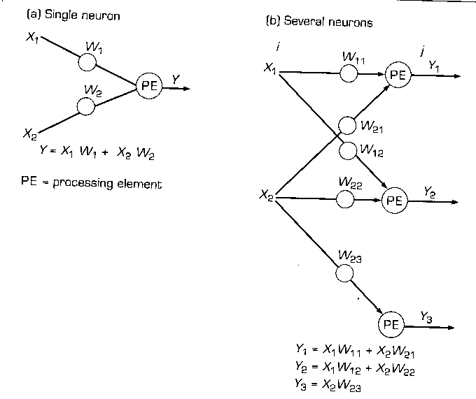

Slide 42
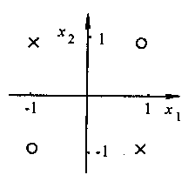
D. Limitation of Simple Perceptron
XOR relation is linear impartibility
x1 x2 y
0 0 0
0 1 1
1 0 1
1 1 0
0 × w1 + 0 × w2 < θ → 0 < θ
0 × w1 + 1 × w2 > θ → w2 > θ
1 × w1 + 0 × w2 > θ → w1 > θ
1 × w1 + 1 × w2 < θ → w1+w2 < θ

Slide 43
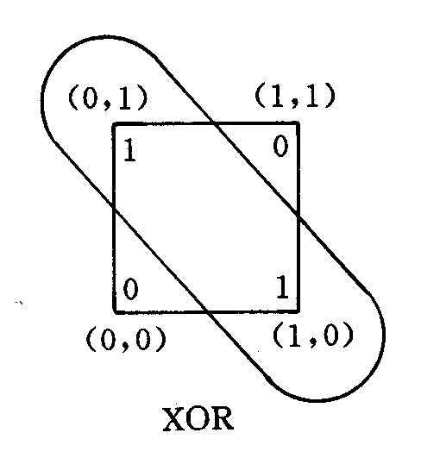
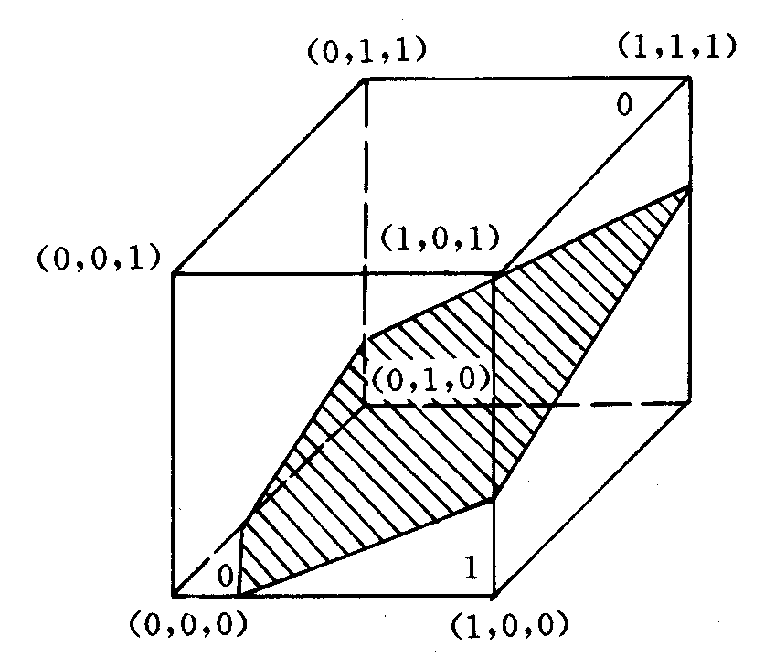
Input pattern | Output pattern
0 0 0 0 1 0 1 0 0 1 1 1 | 0 1 1 0

Slide 44
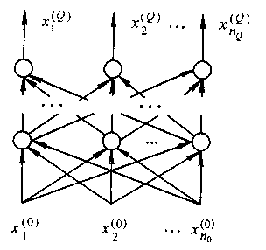
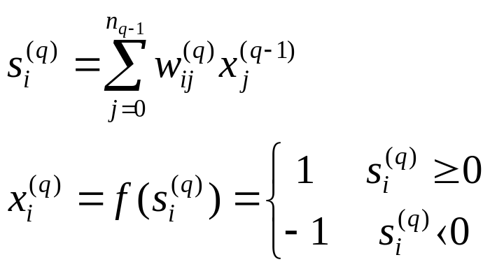

2.2 Multi-layers Perceptron Network
Output layer
Hidden layer
Input layer
i=1,2,…,n_{q} j=1,2,…,n_{q-1} q=1,2,…,q

Slide 45
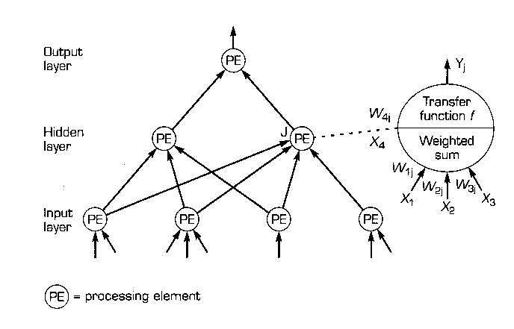

Slide 46
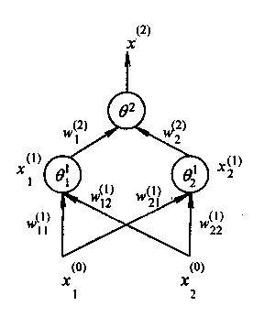
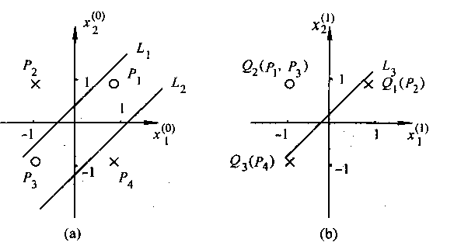
XOR Problem
1.design w₁₁⁽¹⁾, w₁₂⁽¹⁾ to get line L₁
L₁ equation:
w₁₁⁽¹⁾ x₁⁽⁰⁾+w₁₂⁽¹⁾ x₂⁽⁰⁾ - θ₁⁽¹⁾=0
p2 1, p1,p3,p4 -1
2. design w₂₁⁽¹⁾, w₂₂⁽¹⁾ to get line L₂
p4 -1 p1, p2, p3 1
3. There are 3 point q1,q2,q3 in Fig. (b)
Design w₁⁽²⁾, w₂⁽²⁾
to get line L₃

Slide 47
XOR Solution 2
x1
Input pattern | Output pattern
0 0 0 0 1 0 1 0 0 1 1 1 | 0 1 1 0
x3
y
x2

Slide 48
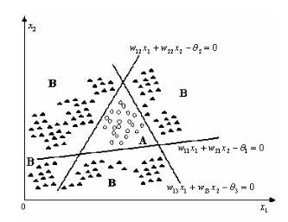
Structure 2-3-1

Slide 49
Chapter Highlights
1. The goal of artificial intelligence is to make computers “think” and to make computers solve problems requiring human intelligence.
2. The goal of a neural network is to map a set of input patterns onto a corresponding set of output patterns.
3. An artificial neural network can be organized in many different ways, but the major elements are the processing elements, the connections among the processing elements,the inputs,the outputs,and the weights.
4. Weights express the relative strength (or importance) given to input data.
5. An activation value is translated to an output by going through a transfer function. The output can be related in a linear or nonlinear manner or via a threshold value.
6. ANNs lend themselves to parallel processing. However, most current ANNs are solved on standard computers where multiprocessing is simulated on a single processor (such as simulated ANNs).

Slide 50
Questions for Review
What is an artificial neural network?
2. How do weights function in an artificial neural network?
3. Describe the role of the transfer function.
4. List the major benefits of neural computing.
5. List the major limitations of neural computing.
Questions for Discussion
Compare neural computing and conventional computing.
2. Explain the combined effects of the summation and transformation functions.
3. Discuss the relationship between a transfer function and a threshold value.
4. Discuss the major advantages of ANNs.
5. What related applications can you think of for using neural computing.
6. Explain the difference between MP model and Perceptron.

Slide 51
Chapter 3 Topology and Learning Algorithm of NN
3.1 Components of a Node
3.2 Topology of a Neural Network
3.3 Introduction to learning and Training with NNs

Slide 52
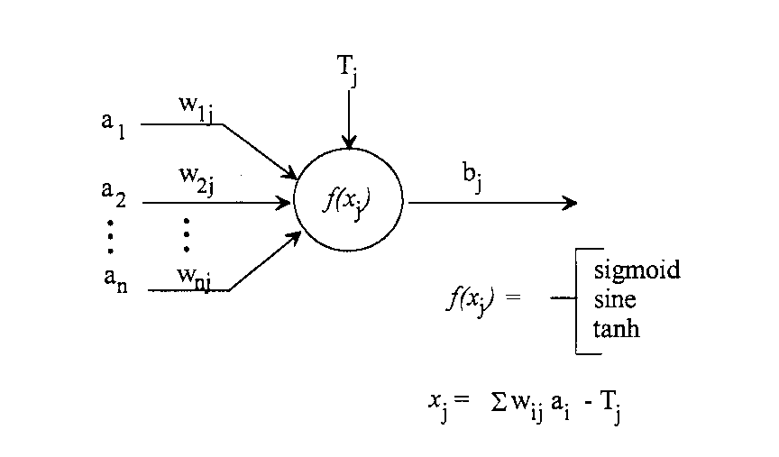
3.1 Components of a Node
A. Anatomy of j^{th} Node
Total Activation

Slide 53
B. Transfer Functions
The complete node calculation is :
f ( x_{j} ) = f ( Σ (w_{ij} a_{i}) – T_{j} )
What function form do we choose for f( ) ?

Slide 54
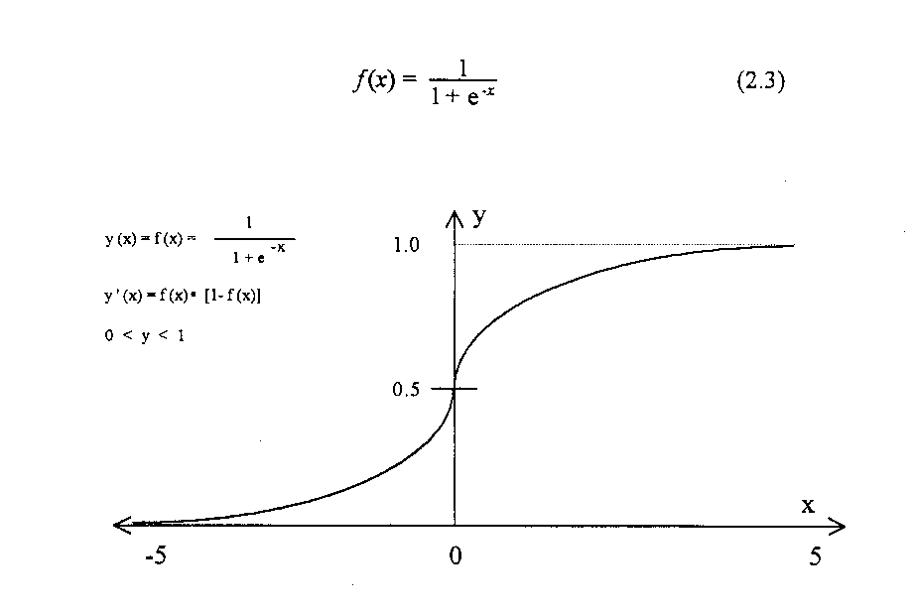
A sigmoid ( S-shaped ) function

Slide 55
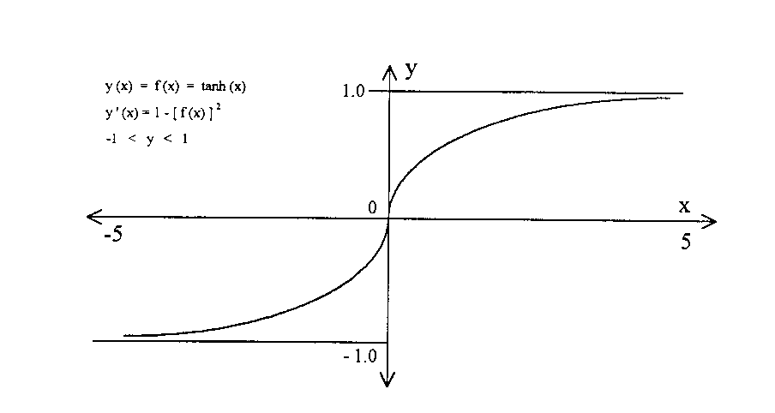
A hyperbolic tangent transfer function
e^{x} – e^{-x}
f ( x) = tanh( x ) =
e^{x} + e^{-x}

Slide 56
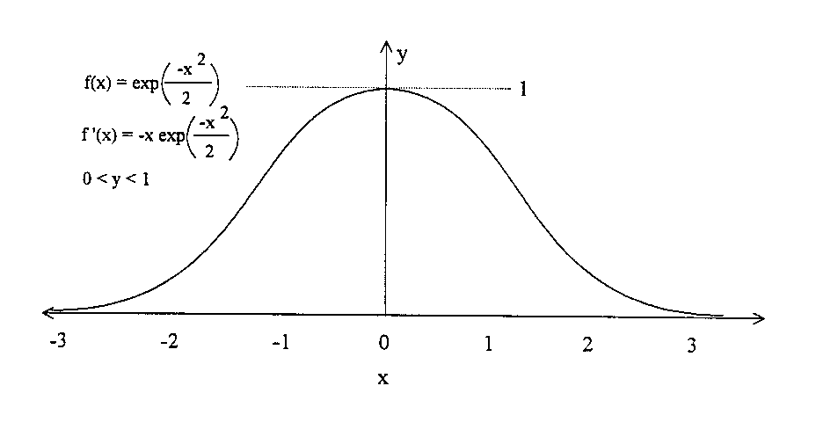
A Gaussian transfer function
[-x²/2]
f ( x ) = e

Slide 57
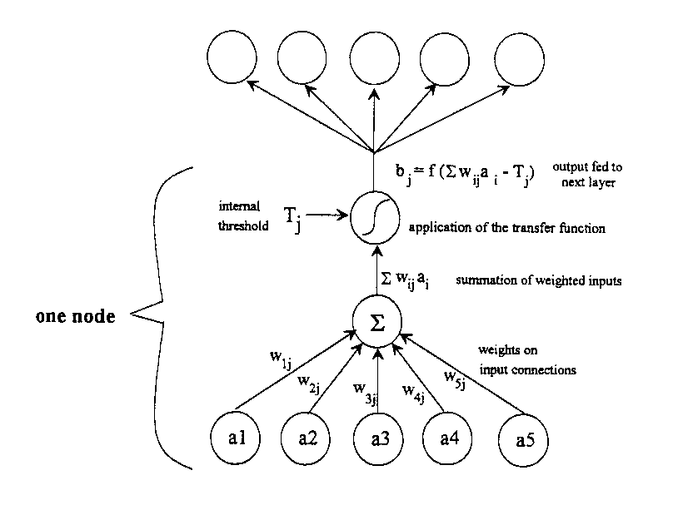
C. Summary of Node Anatomy

Slide 58
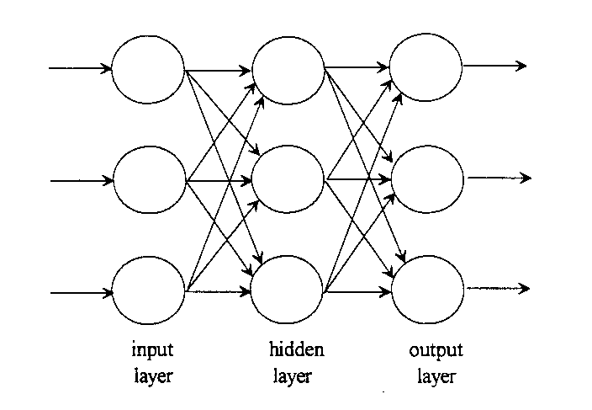
3.2 Topology of a Neural Network
A neural network with one hidden layer

Slide 59
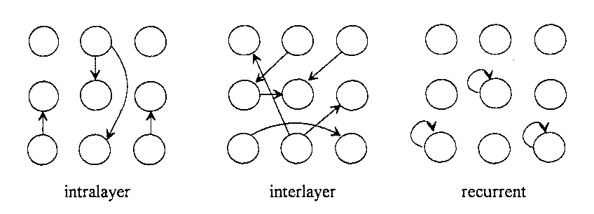
A. Inhibitory or Excitatory Connections
B. Connection Options
Three connection options in a neural network

Slide 60
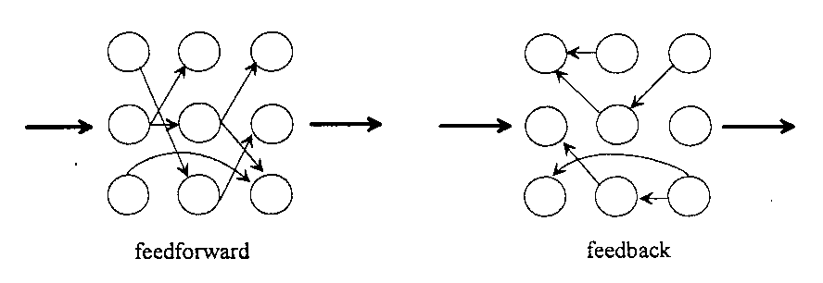
Within the interlayer topology, we have two options:
Feedback connections and feedforward connections

Slide 61
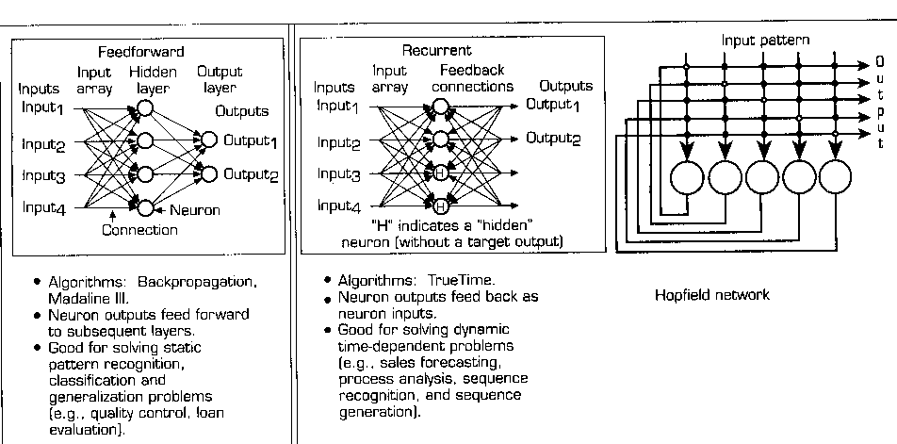

Slide 62
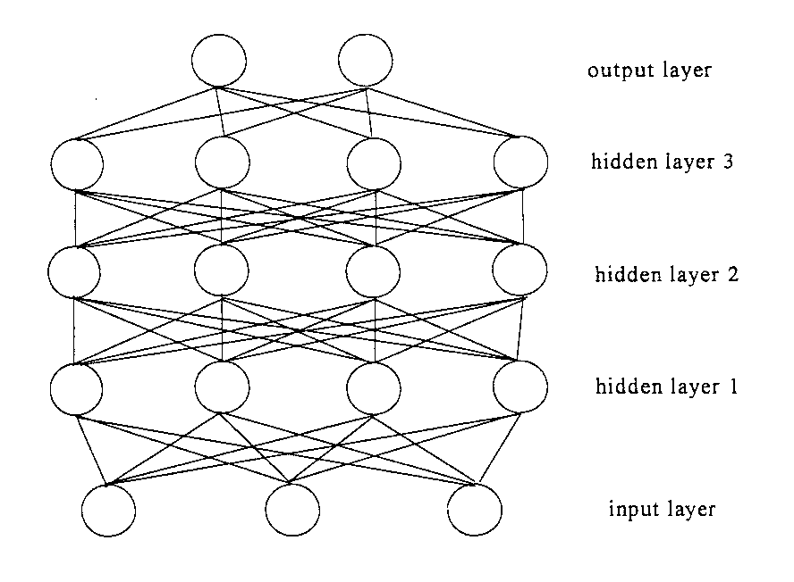
C. Multiple Hidden Layers

Slide 63
3.3 Developing a neural networks
Developing a neural network requires three phases:
* the training or learning phase,
* the recall phase, and
* the generalization phase.
Learning is the actual process of adjusting weight factors based on trial-and-error
A. Stability and Convergence
A globally stable neural network maps any set of inputs to a fixed output.
A convergent neural network produces accurate input-output relations.

Slide 64
B. Types of Learning
Two major categories based on the input format:
binary-valued input (0s and 1s) or continuous-valued input
Each of these can be further divided into two basic categories:
supervised learning and unsupervised learning
Supervised learning – An external teacher controls the learning
and incorporates global information.
Unsupervised learning – No external teacher is used and instead the neural network relies upon both internal control and local information.

Slide 65
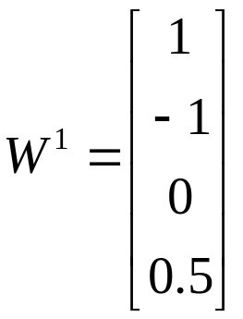
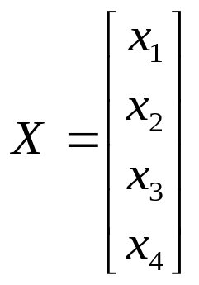
1. Hebb Learning Rule (unsupervised learning )
x₁
w_{i1}
Δw_{ij} = w_{ij}(n+1) - w_{ij}(n)
= ηy_{i}x_{j} j=1, 2, …, n
η >0 Learning rate
Δw_{ij} = ηf (w_{i}^{T}X) x_{j}
x₂
y_{i}
w_{ij}
i
x_{j}
x_{n}
w_{in}
Example 1
Initial weight vector
Input vector

Slide 66
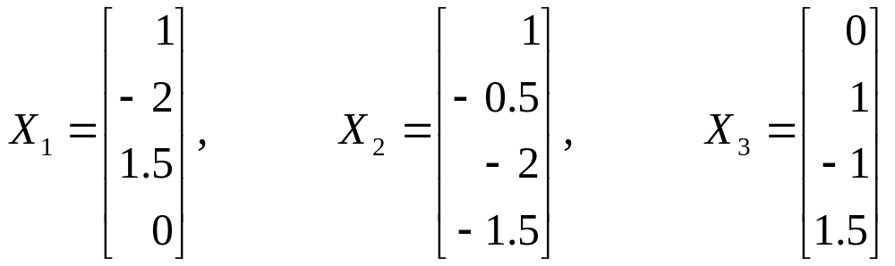
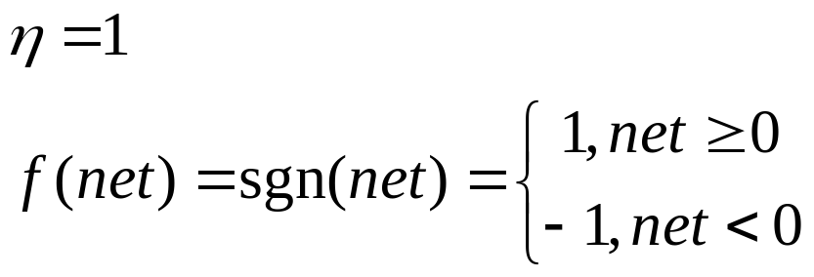
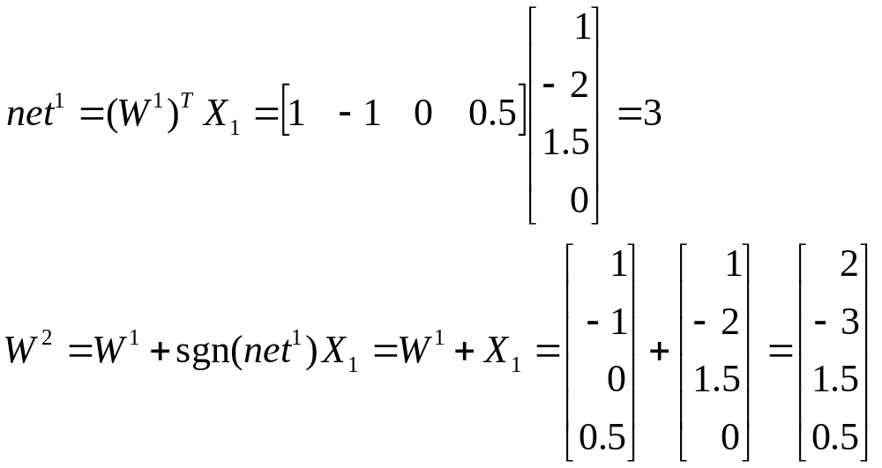
Training sample
Assumption 1
Step 1
f(net)=1

Slide 67
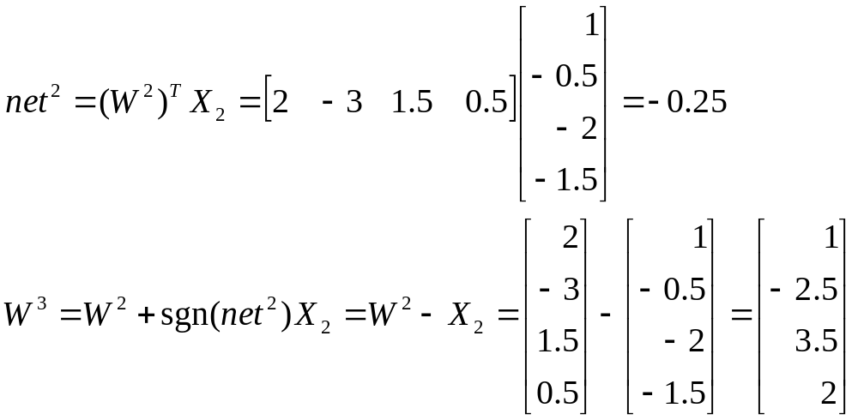
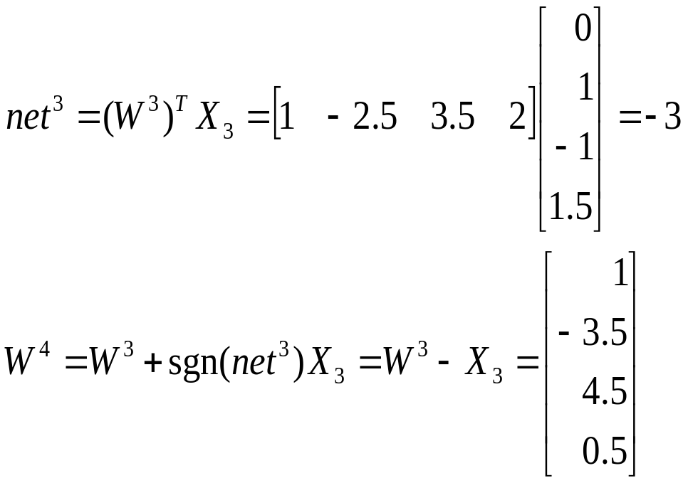
Step 2
f(net)=-1
Step 3
f(net)=-1

Slide 68
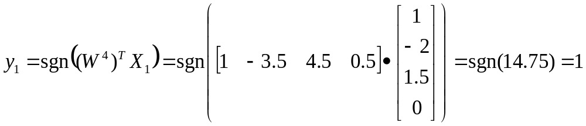
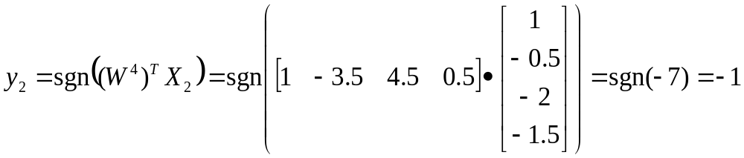


Slide 69








Assumption 2
Step 1
Step 2
Step 3

Slide 70


Slide 71

2. Perceptron Learning Rule (supervised learning )
Learning signal r = d_{i} – y_{i} d_{i} desired output
Δw_{ij} = η(d_{i}-sgn ( w_{i}^{T}X )) x_{j} j=1,2,…,n
Example 1
A group of training input vectors:
Desired output
d₁= -1 d₂= -1 d₃=1

Slide 72


Assumption η=0.1
Initial weight vector
Step 1
Select sample X₁ and d₁

Slide 73


Step 2
Select sample X₂ and d₂
∵ d₂= y₂= sgn(-1.6)= -1 ∴ W³ = W²
Step 3
Select sample X₃ and d₃

Slide 74


Let W¹ = W⁴ , Recycle to step 1
From 2.5 reduced to 0.9

Slide 75





3. δ Learning Rule , LMS Rule (supervised learning )
d_{i} desired output
y_{i} NN output
Square Error
j=1,2,…,n

Slide 76
Example 1
A group of training input vectors:
Desired output
d₁= -1 d₂= -1 d₃=1
Assumption η=0.1
Initial weight vector

Slide 77


Transfer function
Step 1
Select sample X₁ and d₁

Slide 78


Step 2
Select sample X₂ and d₂
Step 3
Select sample X₃ and d₃

Slide 79


4. Widrow-Hoff Learning Rule (supervised learning )
Special δ Learning Rule ( f ( W_{i}^{T}X ) = W_{i}^{T}X )
j=1,2,…,n
5. Correlation Learning Rule (supervised learning )
Special Hebb Learning Rule ( binary function and y_{i}=d_{i} )

Slide 80

6. Winner-Take-All Learning Rule (unsupervised learning )
Δw_{mj}=α(x_{j}-W_{mj}) j=1,2,…,n ; α>0 learning constant
7. Star Learning Rule (supervised learning )
x2
x3
w3
w2
w1
x1
y1
w1
y2
w2
w4
w_{N}
w₃
w_{N}
x4
x_{N}
y_{N}
y₄
Inner-Star Training Algorithm
Outer-Star Training Algorithm
w_{i}(n+1)=w_{i}(n)+η[x_{i}-w_{i}(n)]
η Training rate coefficient
w_{i}(n+1)=w_{i}(n)+β[y_{i}-w_{i}(n)]
β Training rate coefficient

Slide 81

8. Gradient Descent Algorithm (supervised learning )
E is the error function
η is the learning rate
9. Stochastic Training Algorithm
We accept a random weight change if it reduces the output error vector,ε. If the change increases ε, we generally reject the change.
10. Simulated Annealing Algorithm
Gauss Function : G_{g}(x) ≈ exp[ -x²/T(t)]
T(t+1)=T(0) / ln(t+1)

Slide 82
C. Checking the Performance of the Neural Network
Two main steps:
1. Recall step
How well does the neural network recall the predicted responses (output vector) from data sets used to train the network.
A well-trained network should be able to produce an output with very little error from the desired output.
2. Generalization step
How well does the network predict responses from data sets that were not used in training.
A well-trained network should provides input-output mapping with good generalization capability.

Slide 83

An illustration of good and bad generalizations by a trained neural network

Slide 84

An typical learning curve for a well-trained neural network

Slide 85
Chapter Highlights
1. The basic network component is the node ( processing element) that has an n-dimensional input vector, an internal threshold value, and n weight factors, which multiply all inputs.
2. The node transfers the input to the output through the weight factors and a transfer function.
3. The topology of a neural network refers to how its nodes are interconnected. (by organizing the nodes into layers, connecting them, and weighting the interconnections.)
4. Developing a neural network requires three phases: the training or learning phase, the recall phase, and the generalization phase.
5. Learning is the actual process of adjusting weight factors based on trial-and-error. “given enough parameters, you can fit an elephant’s back.”

Slide 86
Questions for Review
1. What determines the output from a node?
2. What functional form do we choose for transfer function?
3. List the three options for connecting nodes to one another.
4. Describe the two basic approaches to training neural networks.
5. Analyze the inhibitory and excitatory connections.
Questions for Discussion
1. Why are learning algorithms important to an ANN?
2. Explain how ANN’s learn in a supervised and in an unsupervised mode.
3. Explain the difference between a training set and a testing set. Can the same set be used for both purposes? Why or why not?
4. Discuss the relationship between stability and convergence of the neural network.
5. Compare the learning algorithms and explain how learning (training) is executed.

