Slide 1

设计模式
——经验的复用

Slide 2
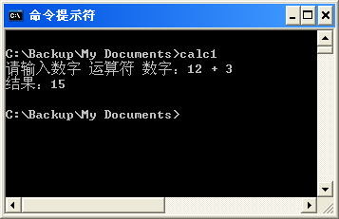
设计模式示例分析
示例01
请选用一种面向对象程序设计语言，如C++或Java或C#，实现一个计算器控制台程序，要求输入两个运算符和一个运算符，得到结果。

Slide 3
#include <iostream>
#include <string>
using namespace std;
int main()
{
double A;
string B;
double C;
cout << "请输入数字 运算符 数字：";
cin >> A >> B >> C;
double D;
if (B=="+") D = A + C;
if (B=="-") D = A - C;
if (B=="*") D = A * C;
if (B=="/") D = A / C;
cout << "结果：" << D << endl;
return 1;
}
不规范的命名
重复的条件判断
可能出现错误

Slide 4
#include <iostream>
#include <string>
using namespace std;
int main()
{
try
{
double fData1;
string sOp;
double fData2;
cout << "请输入数字 运算符 数字：";
cin >> fData1 >> sOp >> fData2;
double fResult;
if (sOp == "+")
fResult = fData1 + fData2;
else if (sOp == "-")
fResult = fData1 - fData2;
else if (sOp == "*")
fResult = fData1 * fData2;
else if (sOp == "/")
{
if (fData2==0.) throw string("除数不能为零！");
fResult = fData1 / fData2;
}
else
throw string("不可识别的运算符！");
cout << "结果：" << fResult << endl;
}
catch (string sInfo)
{
cout << sInfo << endl;
}
catch(...)
{
cout << "发生错误！" << endl;
}
return 1;
}
如何复用？

Slide 5
double Calc(double fData1, string sOp, double fData2)
{
double fResult;
if (sOp == "+")
fResult = fData1 + fData2;
else if (sOp == "-")
fResult = fData1 - fData2;
else if (sOp == "*")
fResult = fData1 * fData2;
else if (sOp == "/")
{
if (fData2==0.) throw string("除数不能为零！");
fResult = fData1 / fData2;
}
else
throw string("不可识别的运算符！");
return fResult;
}
int main()
{
try
{
double fData1;
string sOp;
double fData2;
cout << "请输入数字 运算符 数字：";
cin >> fData1 >> sOp >> fData2;
cout << "结果：" << Calc(fData1, sOp, fData2) << endl;
}
catch (string sInfo)
{
cout << sInfo << endl;
}
catch(...)
{
cout << "发生错误！" << endl;
}
return 1;
}
如果需要扩展功能呢？

Slide 6
class Calculator
{
public:
Calculator() : m_fData1(0.), m_fData2(0.)
{
}
Calculator(double fData1, double fData2)
: m_fData1(fData1), m_fData2(fData2)
{
}
public:
double Data1() const { return m_fData1; }
void SetData1(double fData1) { m_fData1 = fData1; }
double Data2() const { return m_fData2; }
void SetData2(double fData2) { m_fData2 = fData2; }
virtual double Result() const = 0;
private:
double m_fData1, m_fData2;
};
double Calc(double fData1, string sOp, double fData2)
{
Calculator *pCalc = NULL;
if (sOp == "+")
pCalc = new Calculator_Add();
else if (sOp == "-")
pCalc = new Calculator_Sub();
else if (sOp == "*")
pCalc = new Calculator_Mul();
else if (sOp == "/")
pCalc = new Calculator_Div();
else
throw string("不可识别的运算符！");
pCalc->SetData1(fData1);
pCalc->SetData2(fData2);
double fResult = pCalc->Result();
delete pCalc;
return fResult;
}
class Calculator_Add : public Calculator
{
public:
Calculator_Add(double fData1=0., double fData2=0.)
: Calculator(fData1, fData2)
{
}
double Result() const
{
return Data1() + Data2();
}
};
class Calculator_Sub : public Calculator
{
public:
Calculator_Sub(double fData1=0., double fData2=0.)
: Calculator(fData1, fData2)
{
}
double Result() const
{
return Data1() - Data2();
}
};
class Calculator_Mul : public Calculator
{
public:
Calculator_Mul(double fData1=0., double fData2=0.)
: Calculator(fData1, fData2)
{
}
double Result() const
{
return Data1() * Data2();
}
};
class Calculator_Div : public Calculator
{
public:
Calculator_Div(double fData1=0., double fData2=0.)
: Calculator(fData1, fData2)
{
}
double Result() const
{
if (IsZero(Data2())) throw string("除数不能为零！");
return Data1() / Data2();
}
};

Slide 7
double Calc(double fData1, string sOp, double fData2)
{
Calculator *pCalc = NULL;
try
{
pCalc = CreateCalculator(fData1, sOp, fData2);
double fResult = pCalc->Result();
delete pCalc;
return fResult;
}
catch (string aInfo)
{
delete pCalc;
throw aInfo;
}
catch (...)
{
delete pCalc;
throw;
}
}
Calculator *CreateCalculator(double fData1, string sOp, double fData2)
{
Calculator *pCalc = NULL;
if (sOp == "+")
pCalc = new Calculator_Add();
else if (sOp == "-")
pCalc = new Calculator_Sub();
else if (sOp == "*")
pCalc = new Calculator_Mul();
else if (sOp == "/")
pCalc = new Calculator_Div();
else
throw string("不可识别的运算符！");
pCalc->SetData1(fData1);
pCalc->SetData2(fData2);
return pCalc;
}

Slide 8
class Calculator
{
public:
virtual string Operator() const = 0;
virtual double Calc(double data1, double data2) const = 0;
};
class Calculator_Add : public Calculator
{
public:
string Operator() const
{
return "+";
}
double Calc(double data1, double data2) const
{
return data1 + data2;
}
};
class Calculators
{
public:
void Registe(Calculator *aCalculator)
{
if (aCalculator==NULL) return;
m_Calculators.push_back(aCalculator);
}
virtual void RegisteCalculators();
Calculator *GetCalculator(string aOperator) const;
private:
vector<Calculator *> m_Calculators;
};
Calculator *Calculators::GetCalculator(string aOperator) const
{
for (vector<Calculator *>::const_iterator it = m_Calculators.begin(); it!=m_Calculators.end(); it++)
{
if ((*it)->Operator()==aOperator) return *it;
}
return NULL;
}
void Calculators::RegisteCalculators()
{
Registe(new Calculator_Add());
Registe(new Calculator_Sub());
Registe(new Calculator_Mul());
Registe(new Calculator_Div());
}

Slide 9
class Calculate
{
public:
Calculate(Calculators &aCalculators)
:_Calculators(aCalculators)
{
}
double Calc(double fData1, string sOp, double fData2)
{
Calculator *aCalculator = _Calculators.GetCalculator(sOp);
if (aCalculator==NULL) throw string("不可识别的运算符！");
return aCalculator->Calc(fData1, fData2);
}
private:
Calculators &_Calculators;
};

Slide 10
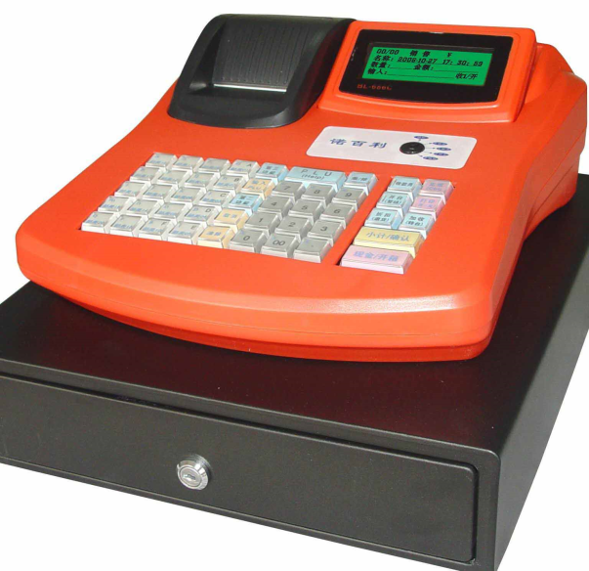
设计模式示例分析
示例02
请设计一个商场收银系统（POS机系统）的模拟程序。

Slide 11
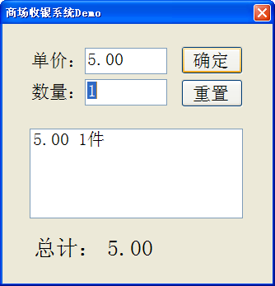
double total = 0.0d;
private void cmdOk_Click(object sender, EventArgs e)
{
double totalPrices = Convert.ToDouble(txtPrice.Text) * Convert.ToDouble(txtNumber.Text);
total += totalPrices;
lstList.Items.Add(string.Format("单价：{0} 数量：{1} 合计：{2}", txtPrice.Text, txtNumber.Text, totalPrices));
lblSum.Text = total.ToString();
}

Slide 12
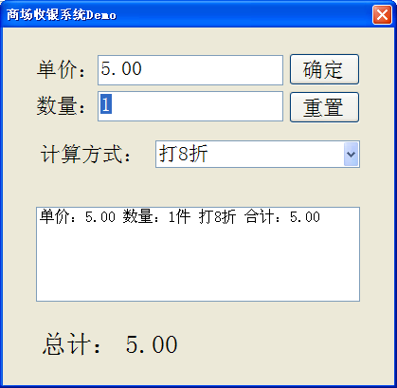
switch (cboPolicy.SelectedIndex)
{
case 0:
totalPrice = Convert.ToDouble(txtPrice.Text) * Convert.ToDouble(txtNum.Text);
break;
case 1:
totalPrice = Convert.ToDouble(txtPrice.Text) * Convert.ToDouble(txtNum.Text) * 0.8;
break;
case 2:
totalPrice = Convert.ToDouble(txtPrice.Text) * Convert.ToDouble(txtNum.Text) * 0.7;
break;
case 3:
totalPrice = Convert.ToDouble(txtPrice.Text) * Convert.ToDouble(txtNum.Text) * 0.5;
break;
}

Slide 13
abstract class CashSuper
{
public abstract double AcceptCash(double aMoney);
}
private void cmdOk_Click(object sender, EventArgs e)
{
CashSuper aCashSuper = CashFactory.CreateCashAccept(cboPolicy.Text);
double totalPrices = 0.0d;
totalPrices = aCashSuper.AcceptCash(Convert.ToDouble(txtPrice.Text) * Convert.ToDouble(txtNumber.Text));
total += totalPrices;
...
}
class CashNormal : CashSuper
{
public override double AcceptCash(double aMoney)
{
return aMoney;
}
}
class CashRebate : CashSuper
{
private double m_Rebate = 1.0d;
public CashRebate(double aRebate)
{
m_Rebate = aRebate;
}
public override double AcceptCash(double aMoney)
{
return aMoney * m_Rebate;
}
}

Slide 14
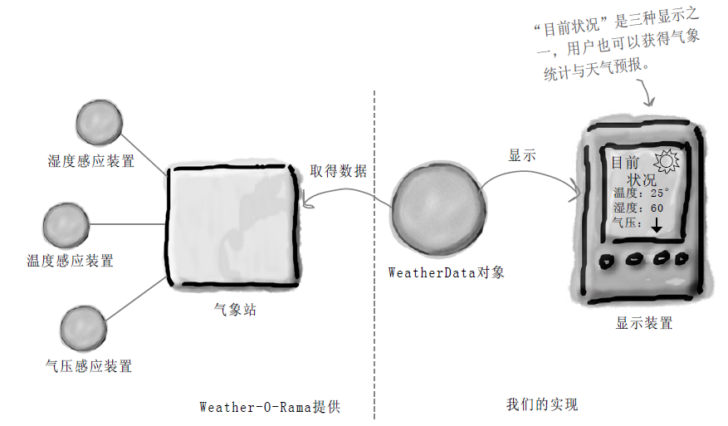
设计模式示例分析
示例03
在Weather-O-Rama公司提供的WeatherData类的基础上开发气象观测应用，为客户提供气象布告板的服务。有三种布告板，显示目前状况的布告板；显示气象统计信息的布告板；显示气象预报的布告板。当WeatherData的数据更新时，各布告板必须实时更新。
期望该应用系统具有良好的可扩展性。

Slide 15
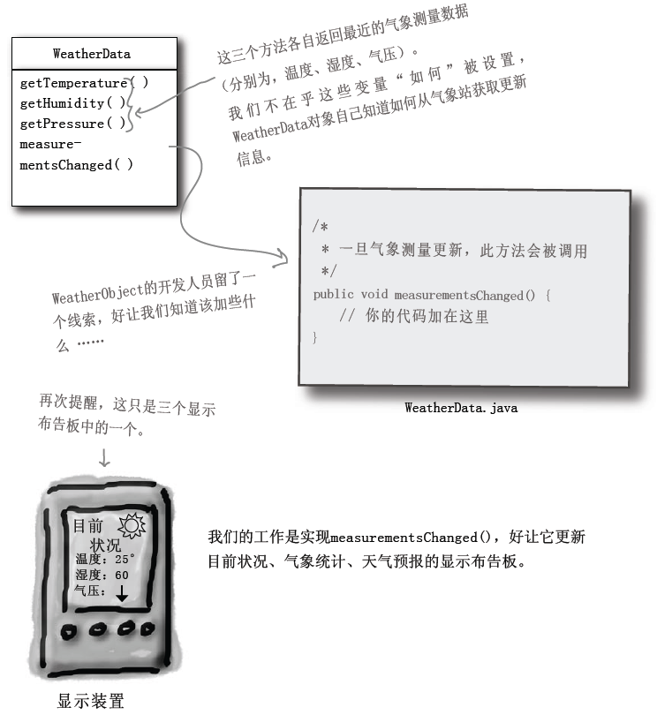

Slide 16
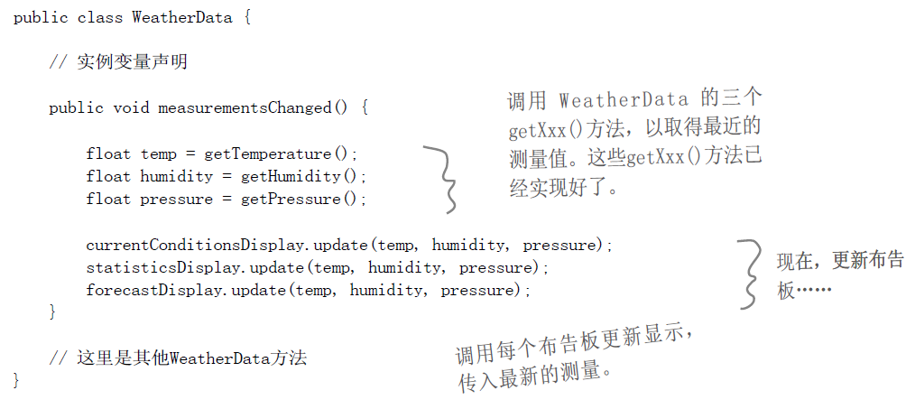
缺乏扩展性的实现

Slide 17
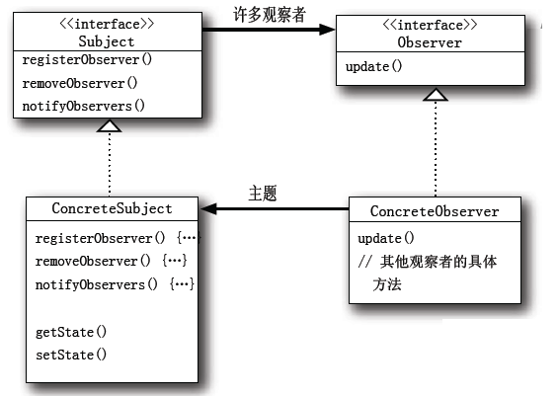
public interface Subject
{
public void registerObserver(Observer o);
public void removeObserver(Observer o);
public void notifyObservers();
}
public interface Observer
{
public void update(float temp, float humidity, float pressure);
}

Slide 18
public class CurrentConditionsDisplay implements Observer, DisplayElement
{
private float m_temperature;
private float m_humidity;
private Subject m_weatherData;
public CurrentCoditionsDisplay(Subject aWeatherData)
{
m_weatherData = aWeatherData;
m_weatherData.registerObserver(this);
}
public void update(float temp, float humi, float pres)
{
m_temperature = temp;
m_humidity = humi;
display();
}
...
}

Slide 19
public class WeatherData implements Subject
{
private ArrayList m_observers;
private float m_temperature;
private float m_humidity;
private float m_pressure;
public WeatherData() { observers = new ArrayList(); }
public void registerObserver(Observer o) { observers.add(o); }
public void removeObserver(Observer o)
{
int i = observers.indexOf(o);
if (i>=0) obsesrvers.remove(i);
}
public void notifyObservers()
{
for (int i=0; i<observers.size(); i++)
{
Observer aObserver = (Observer)observers.get(i);
aObserver.update(m_temperature, m_humidity, m_pressure);
}
}
public void mesurementsChanged()
{
notifyObservers();
}
}
public static void main(String[] args)
{
WeatherData aWeatherData = new WeatherData();
CurrentConditionsDisplay aCurrentDisplay =
new CurrentConditionDisplay(aWeatherData);
...
}

Slide 20
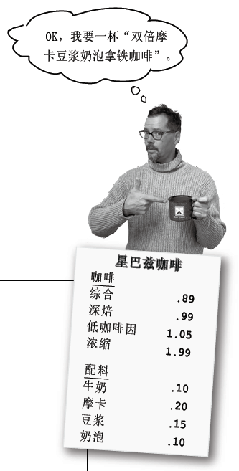
设计模式示例分析
示例04
某个咖啡连锁店需要设计订单系统，能够接受客户点单，并统计出客户订单的总价。

Slide 21
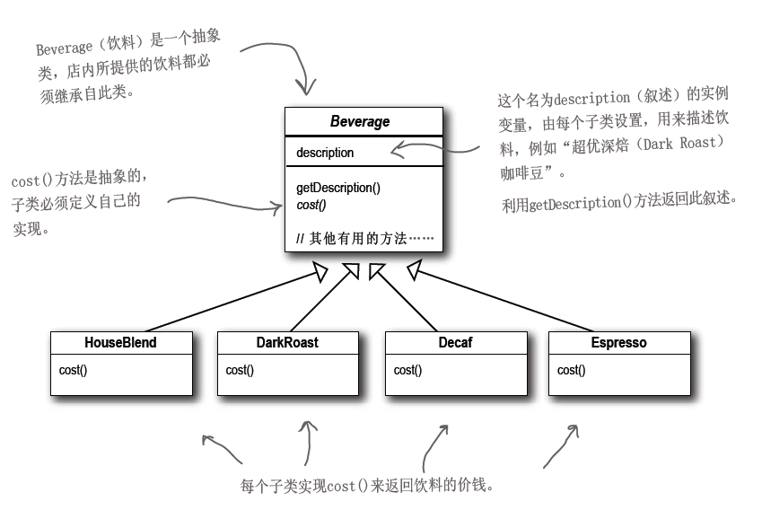
实现方案一

Slide 22
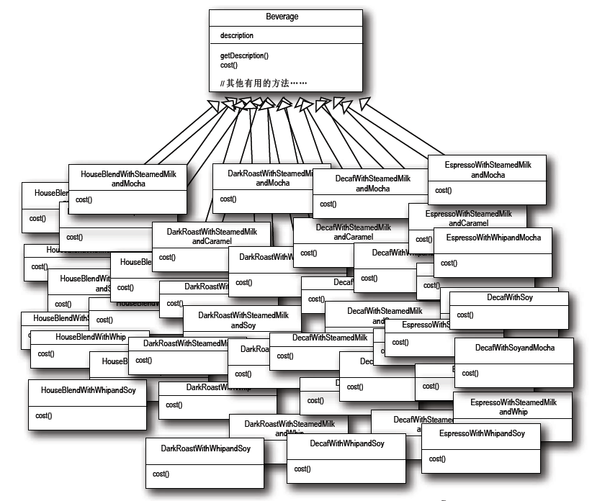
子类大爆炸！

Slide 23
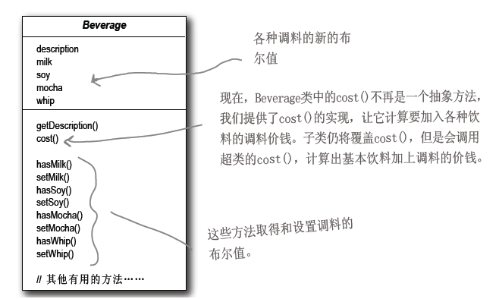
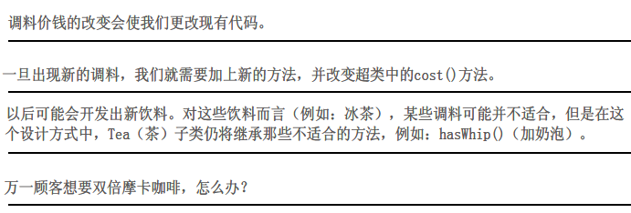
实现方案二

Slide 24
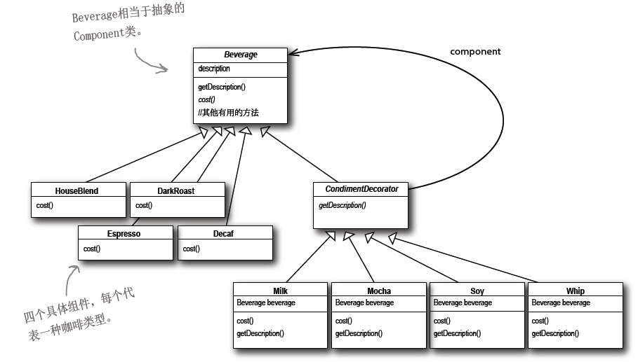
实现方案三

Slide 25
public abstract class Beverage
{
String description = "Unknown Beverage";
public String getDescription()
{
return description;
}
public abstrat double cost();
}
public class Espresso extends Beverage
{
public Espresso()
{
description = "Espresso";
}
public double const()
{
return 1.99;
}
}

Slide 26
public abstract class CondimentDecorator extends Beverage
{
public abstract String getDescription();
}
public class Mocha extends CondimentDecorator
{
Beverage m_beverage;
public Mocha(Beverage aBeverage)
{
m_beverage = aBeverage;
}
public String getDescription()
{
return m_beverage.getDescription() + ", Mocha";
}
public double cost()
{
return .20 + m_beverage.cost();
}
}

Slide 27
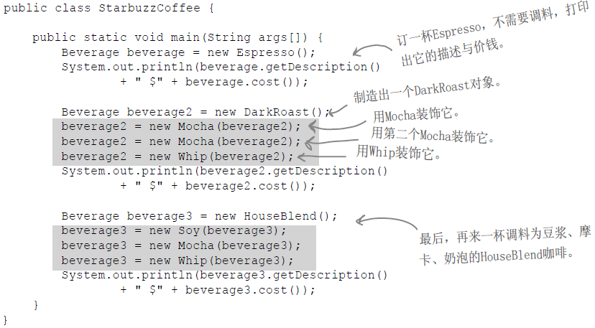

Slide 28
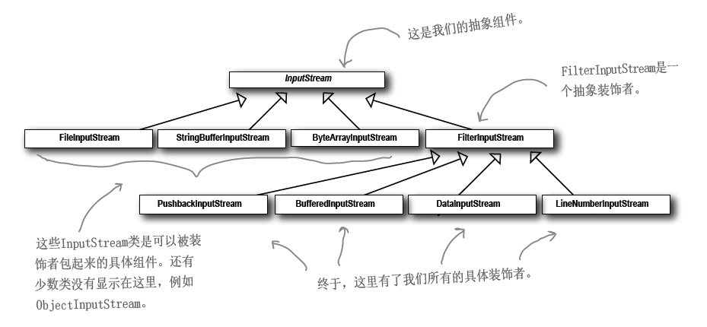
Java类库中的装饰模式

Slide 29
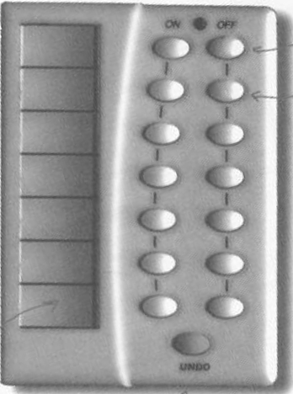
设计模式示例分析
示例05
为一个遥控器设计控制程序。

Slide 30
需要控制的设备的控制类
ApplianceControl
on
()
off
()
Stereo
on
()
off
()
setCd
()
TV
setDvd
()
setRadio
()
on
()
setVolume
()
off
()
setInputhannel
setVolume
()
()
CeiingLight
on
()
off
()
OutdoorLight
dim
()
on
()
CeilingFan
off
()
high
()
medium
low
()
()
off
()
Sprinkler
getSpeed
()
waterOn
()
waterOff
()

Slide 31
if (slot==Light)
{
light.on();
}
else if (slot==Hottub)
{
hottob.jetsOn();
}
...
方案一

Slide 32
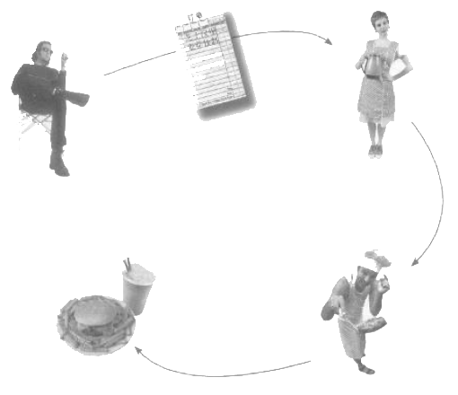
订单
服务生
顾客
考虑餐厅的工作模式
餐点
厨师

Slide 33
public interface Command
{
public void execute();
}
public class LightOnCommand implements Command
{
Light m_light;
public LightOnCommand(Light aLight)
{
m_light = aLight;
}
public void execute()
{
m_light.on();
}
}
public class LightOffCommand implements Command
{
Light m_light;
public LightOffCommand(Light aLight)
{
m_light = aLight;
}
public void execute()
{
light.off();
}
}
方案二

Slide 34
public class RemoteControl
{
Command[] m_onCommands;
Command[] m_offCommands;
public RemoteControl()
{
m_onCommands = new Command[7];
m_offCommands = new Command[7];
Command noCommand = new NoCommand();
for (int i = 0; i < 7; i++)
{
m_onCommands[i] = noCommand;
offCommands[i] = noCommand;
}
}
public void setCommand(int slot, Command aonCommand, Command aoffCommand)
{
m_onCommands[slot] = aonCommand;
m_offCommands[slot] = aoffCommand;
}
public void onButtonWasPushed(int slot)
{
m_onCommands[slot].execute();
}
public void offButtonWasPushed(int slot)
{
m_offCommands[slot].execute();
}
}
思考：undo功能如何实现？

Slide 35
设计模式示例分析
示例06
共性操作的抽象。
咖啡冲泡法
————————
把水煮沸
用沸水冲泡咖啡
把咖啡倒进杯子
加糖和牛奶
茶冲泡法
————————
把水煮沸
用沸水浸泡茶叶
把茶倒进杯子
加柠檬

Slide 36
public class Coffee
{
void prepareRecipd()
{
boilWater();
brewCoffeeGrinds();
pourInCup();
addSugarAndMilk();
}
public void boilWater();
public void brewCoffeeGrinds();
public void pourInCup();
public void addSugarAndMilk();
}
public class Tea
{
void prepareRecipd()
{
boilWater();
steepTeaBag();
pourInCup();
addLemon();
}
public void boilWater();
public void steepTeaBag();
public void pourInCup();
public void addLemon();
}

Slide 37
public abstract class caffeineBeverage
{
abstract void prepareRecipe()
void boilWater();
void pourInCup();
}
public class Tea extends CaffeineBeverage
{
public void prepareRecipe()
{
boilWater();
steepTeaBag();
pourInCup();
addLemon();
}
public void steepTeaBag(); // 泡茶
public void addLemon(); // 加柠檬
}
public class Coffee extends CaffeineBeverage
{
public void prepareRecipe()
{
boilWater();
brewCoffeeGrinds();
pourInCup();
addSugarAndMilk();
}
public void brewCoffeeGrinds(); // 泡咖啡
public void addSugarAndMilk(); // 加糖和奶
}
将明显的共性操作提取到基类中由子类共用
方案一

Slide 38
public abstract class caffeineBeverage
{
final void prepareRecipe()
{
boilWater();
brew();
pourInCup();
addComdiments();
}
abstract void brew();
abstract void addComdiments();
void boilWater();
void pourInCup();
}
public class Tea extends CaffeineBeverage
{
public void brew(); // 泡茶
public void addComdiments(); // 加柠檬
}
public class Coffee extends CaffeineBeverage
{
public void brew(); // 泡咖啡
public void addComdiments(); // 加糖和奶
}
抽象公共算法
思考：如果茶里是不是要加柠檬是可选的，如何处理？
方案二

Slide 39
设计模式示例分析
示例07
菜单系统的合并。
O餐厅和O煎饼屋合并后，原有的菜单系统需要整合。
public class PancakeHouseMenu
{
ArrayList menuItems;
public PancakeHouseMenu()
{
menuItems = new ArrayList();
addItem("K&B's Pancake Breakfast", "Pancakes with scrambled eggs, and toast", true, 2.99);
...
}
...
}
public class DinerMenu
{
static final int MAX_ITEMS = 6;
int numberOfItems = 0;
MenuItem[] menuItems;
public DinerMenu()
{
menuItems = new MenuItem[MAX_ITEMS];
addItem("Vegetarian BLT", "(Fakin') Bacon with lettuce & tomato on whole wheat", true, 2.99);
...
}
...

Slide 40
以打印菜单为例，考虑如何操作这两套不同实现的菜单。
void printMenu()
{
PancakeHouseMenu pancakeHouseMenu = new PancakeHouseMenu();
ArrayList breakfastItems = pancakeHouseMenu.getMenuItems();
DinerMenu dinerMenu = new DinerMenu();
MenuItem[] lunchItems = dinerMenu.getMenuItems();
for (int i=0; i<breakfastItems.size(); i++)
{
MenuItem menuItem = (MenuItem)breakfastItems.get(i);
Print(menuItem);
}
for (int i=0; i<lunchItems.length; i++)
{
MenuItem menuItem = lunchItems[i];
Print(menuItem);
}
}
方案一

Slide 41
抽象操作中的共性
public interface Iterator
{
boolean hasNext();
Object next();
}
public class DinerMenuIterator implements Iterator
{
MenuItem[] m_items;
int position = 0;
public DinerMenuIterator(MenuItem[] aItems)
{
m_items = aItems;
position = 0;
}
public Object next()
{
MenuItem menuItem = items[position];
position++;
return menuItem;
}
public boolean hasNext()
{
if (position >= items.length || m_items[position]==null)
return false;
else
return true;
}
}
public class DinerMenu
{
...
public Iterator createIterator()
{
return new DinerMenuIterator(menuItems);
}
}
方案二

Slide 42
整合两个菜单系统之后的示例
public class Waitress
{
PancakeHouseMenu pancakeHouseMenu;
DinerMenu dinerMenu;
public Waitress(PancakeHouseMenu apancakeHouseMenu, DinerMenu adinerMenu)
{
pancakeHouseMenu = apancakeHouseMenu;
dinerMenu = adinerMenu;
}
public void PrintMenu()
{
PrintMenu(pancakeHouseMenu.createIterator());
PrintMenu(dinerMenu.createIterator());
}
public void printMenu(Iterator aIterator)
{
while (aIterator.hasNext())
{
MenuItem menuItem = (MenuItem)aIterator.next();
Print(menuItem);
}
}
}
思考：如果再引入新的菜单系统如何处理？

Slide 43
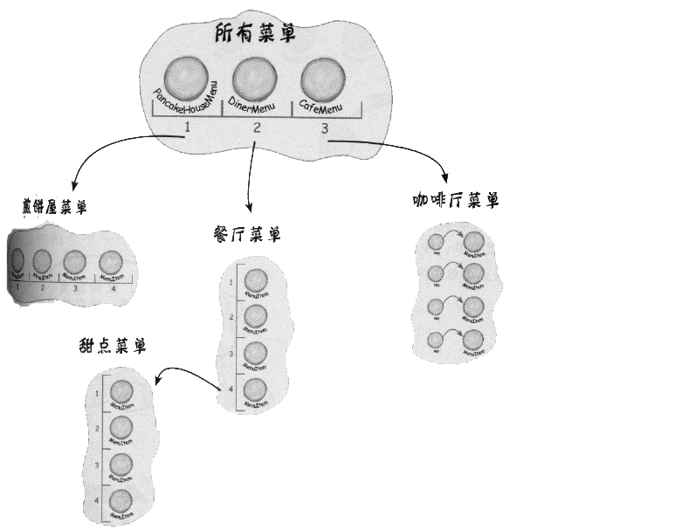
设计模式示例分析
示例08
在上例菜单系统中，如果需要增加二级菜单，如何处理？

Slide 44
