Slide 1
DHT11_TempHumidity_Sens-LCD_IRremote

Slide 2
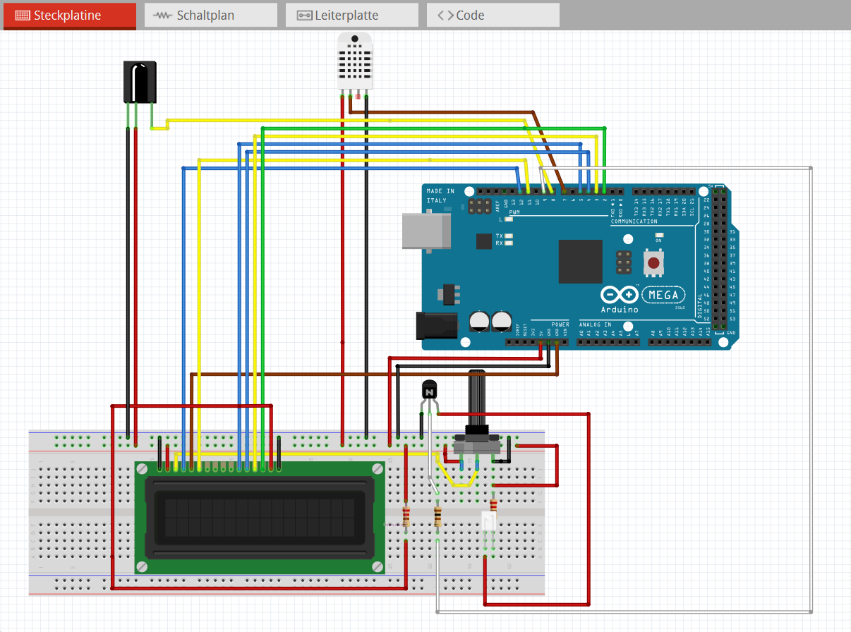

Slide 3
