Slide 1
DHT11_TempHumidity_Sens-LCD_IRremote

Slide 2
Short description
This Arduino project measures temperature and humidity using a DHT11 sensor and displays the values on a 16x2 LCD.
Additionally, it can control an air conditioner using an IR LED driven by a 2N2222 transistor.
Components
Arduino Mega 2560
DHT11 temperature & humidity sensor
LCD 16x2 with potentiometer for contrast
IR LED + 2N2222 transistor
Resistors and breadboard
Functions
Read temperature and humidity data from DHT11
Display values on LCD in real time
Send infrared signals to control an AC (ON/OFF)

Slide 3
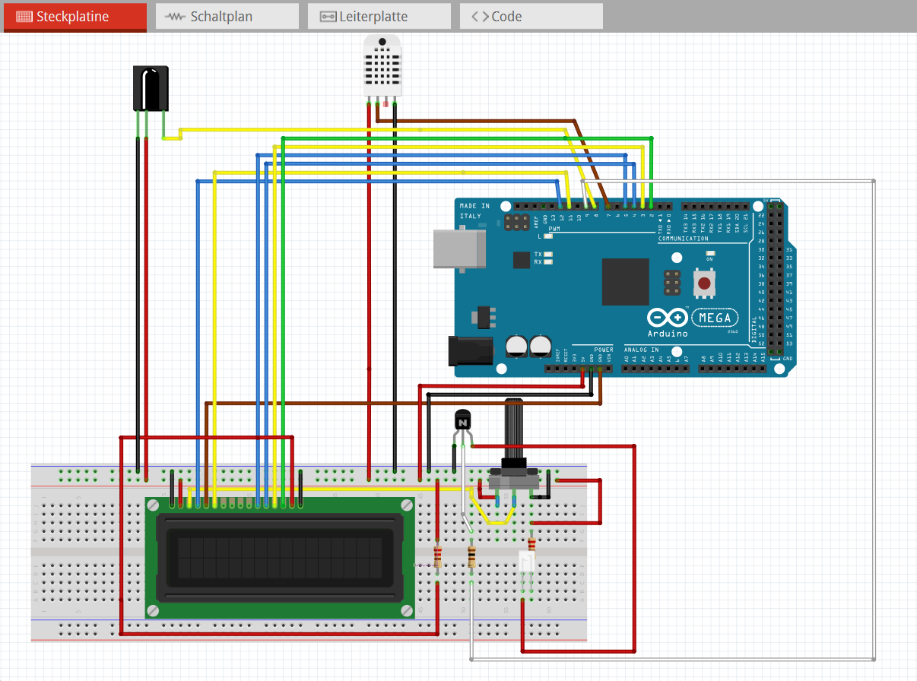

Slide 4
