Slide 1
DHT11_TempHumidity_Sens-LCD_IRremote

Slide 2
Short description
This Arduino project measures temperature and humidity using a DHT11 sensor and displays the values on a 16x2 LCD.
Additionally, it can control an air conditioner using an IR LED driven by a 2N2222 transistor.
Components
Arduino Mega 2560
DHT11 temperature & humidity sensor
LCD 16x2 with potentiometer for contrast
IR LED + 2N2222 transistor
Resistors and breadboard
Functions
Read temperature and humidity data from DHT11
Display values on LCD in real time
Send infrared signals to control an AC (ON/OFF)

Slide 3
Details
Purpose
This project demonstrates the integration of sensors, display, and actuator control with Arduino.
- Measure temperature and humidity using the DHT11 sensor.
- Display the measured values on a 16×2 LCD screen.
- Automatically control an air conditioner using an IR LED driven by a 2N2222 transistor.
- Implement a simple hysteresis rule (prevents rapid switching around the threshold) :
- If T ≥ 22 °C → AC ON
- If T ≤ 21 °C → AC OFF
Functionality
1. The DHT11 sensor is read every 2 seconds.
2. Temperature and humidity values are displayed on the LCD.
3. The Arduino checks the hysteresis condition:
- If AC is OFF and temperature ≥ 22 °C → send IR ON command.
- If AC is ON and temperature ≤ 21 °C → send IR OFF command.
4. The IR LED transmits the ON/OFF commands at 38 kHz carrier frequency.
5. The 2N2222 transistor ensures enough current flows through the IR LED for reliable range.

Slide 4
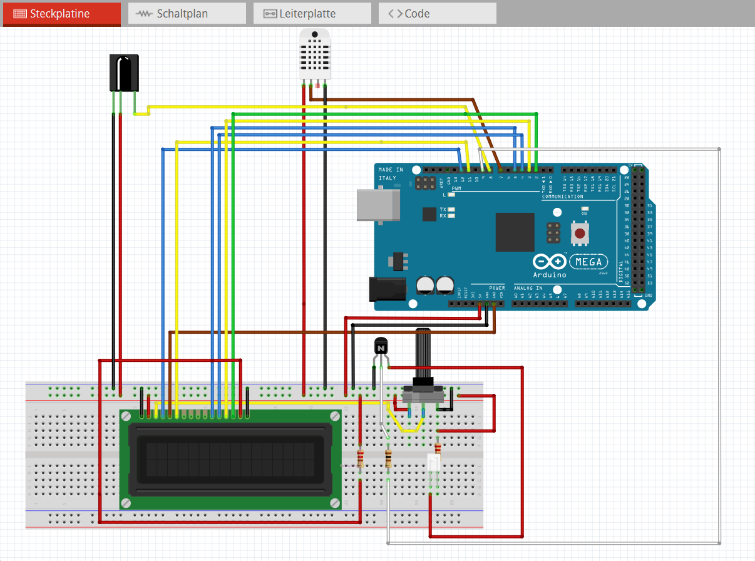

Slide 5
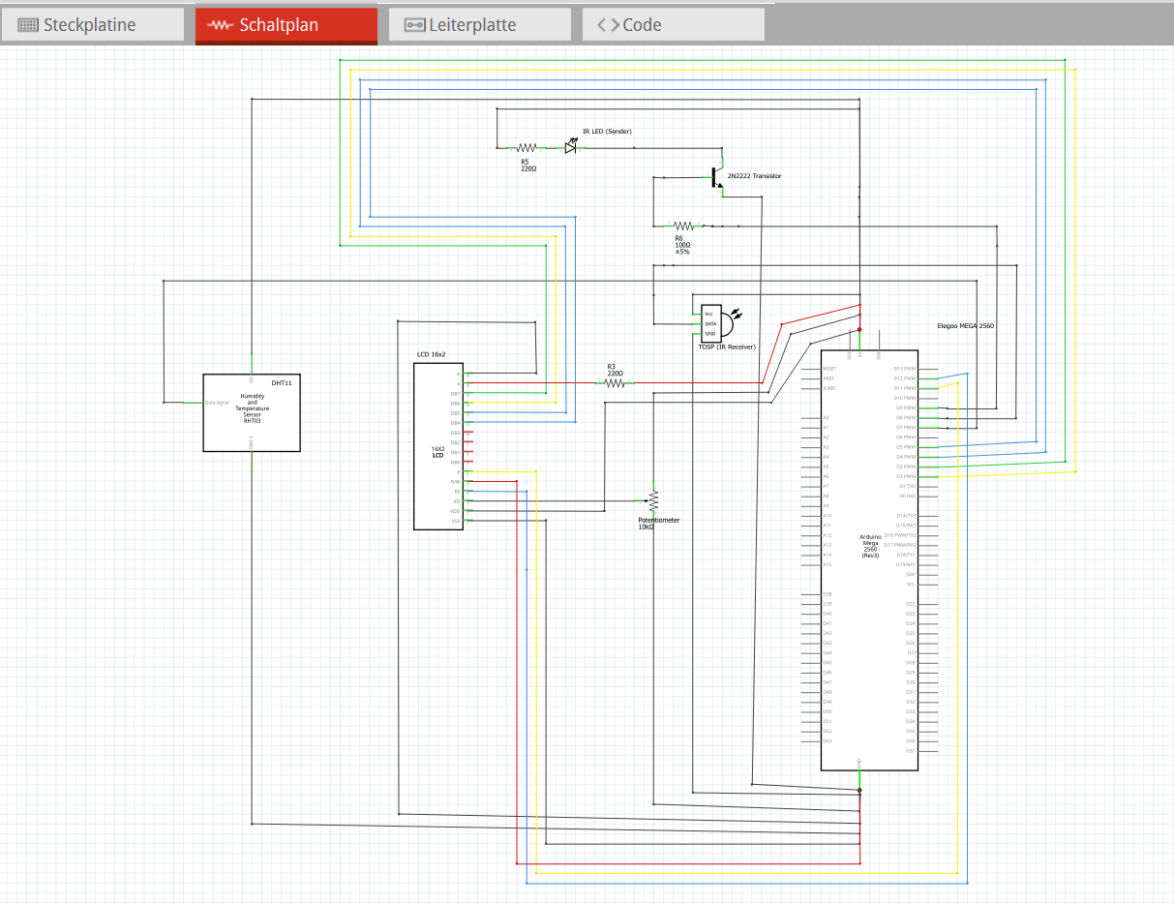

Slide 6
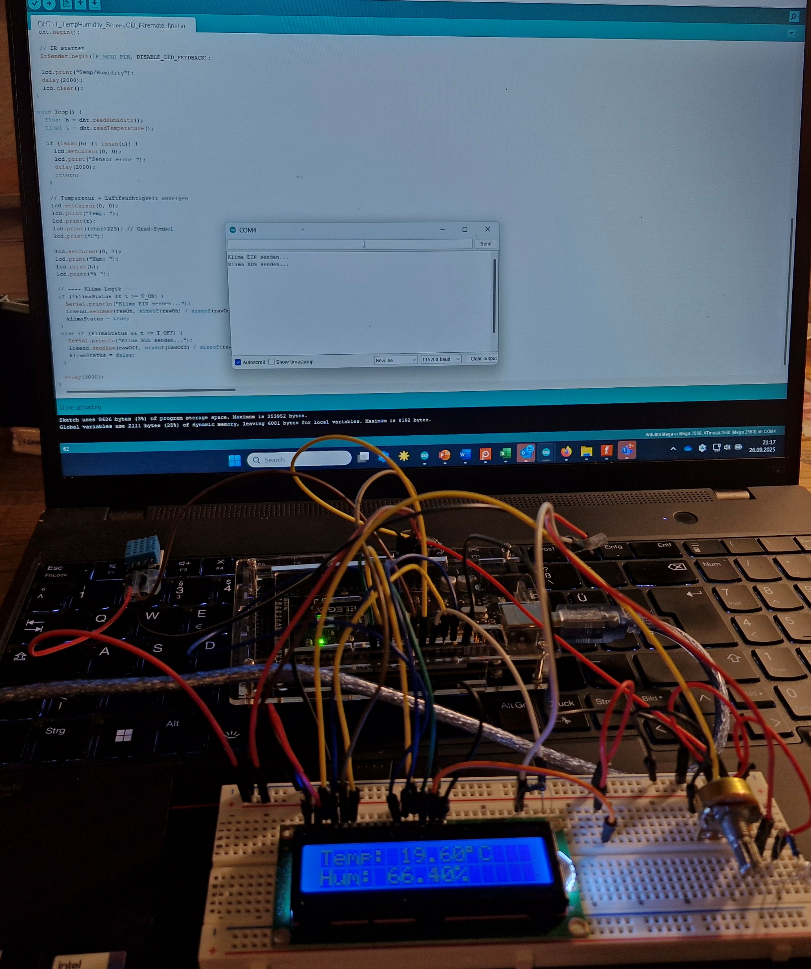
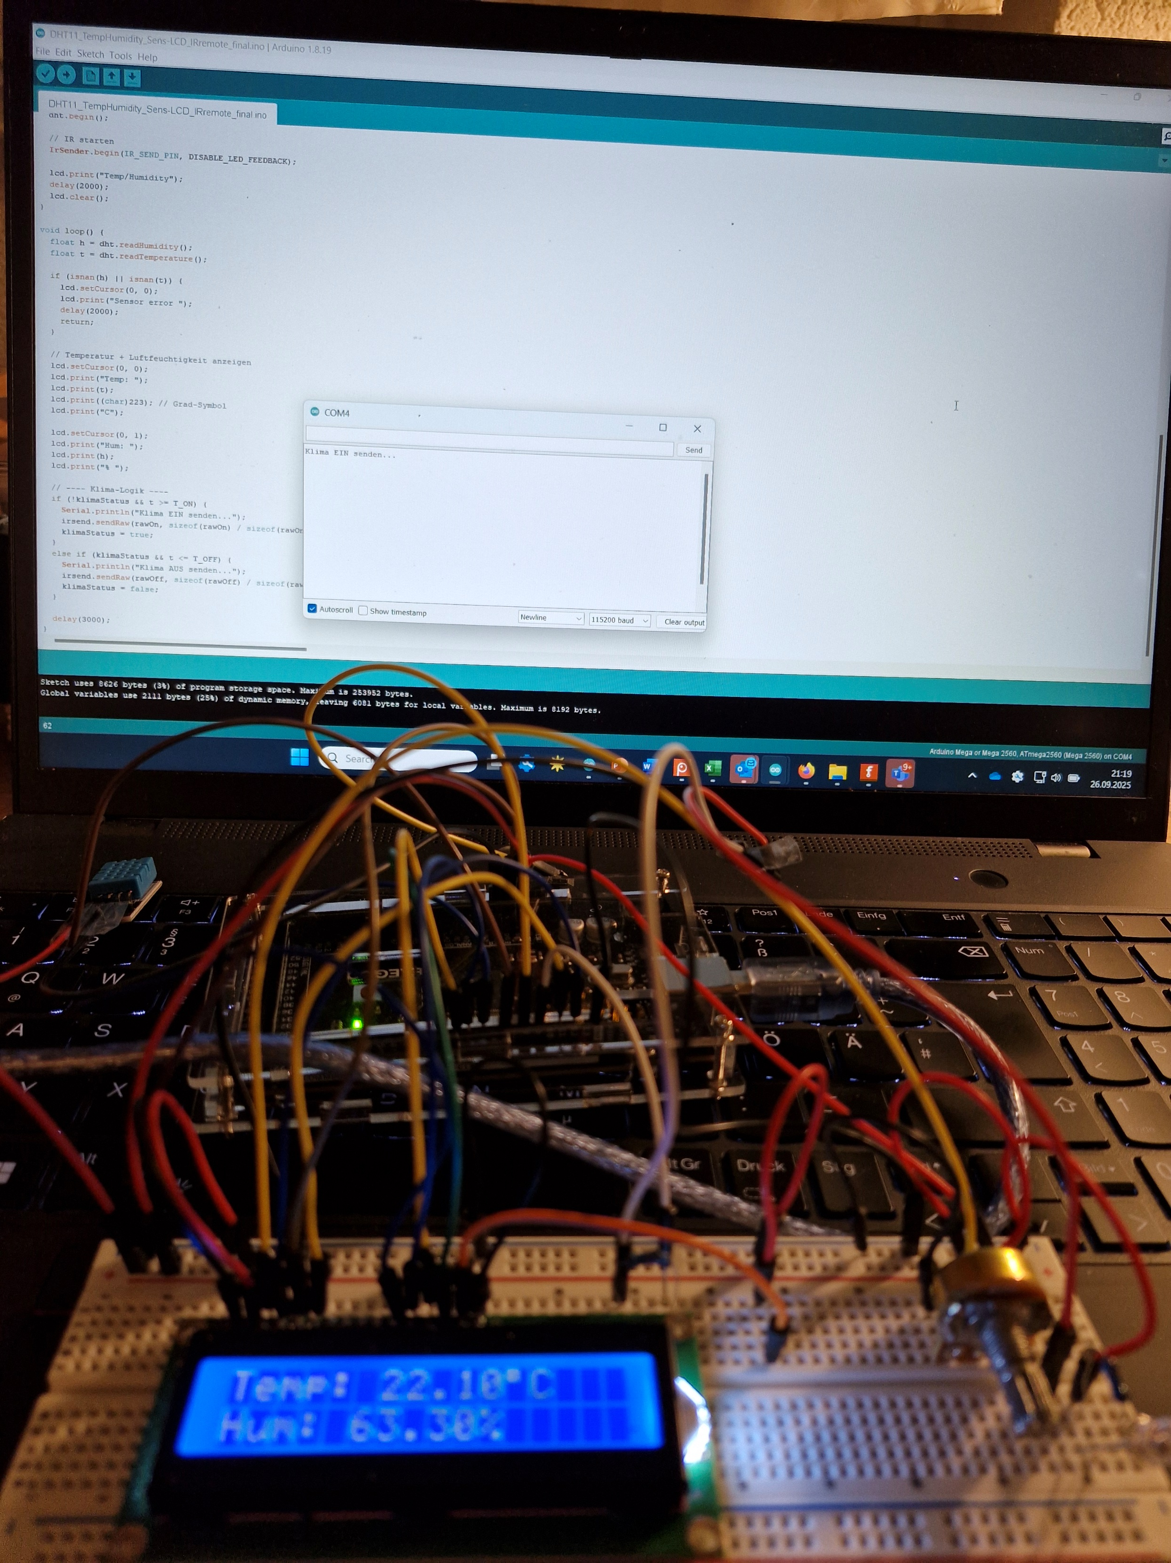
AC on/
Klima EIN
AC off/
Klima AUS
T ≥ 22°C
T ≤ 21°C

