Slide 1
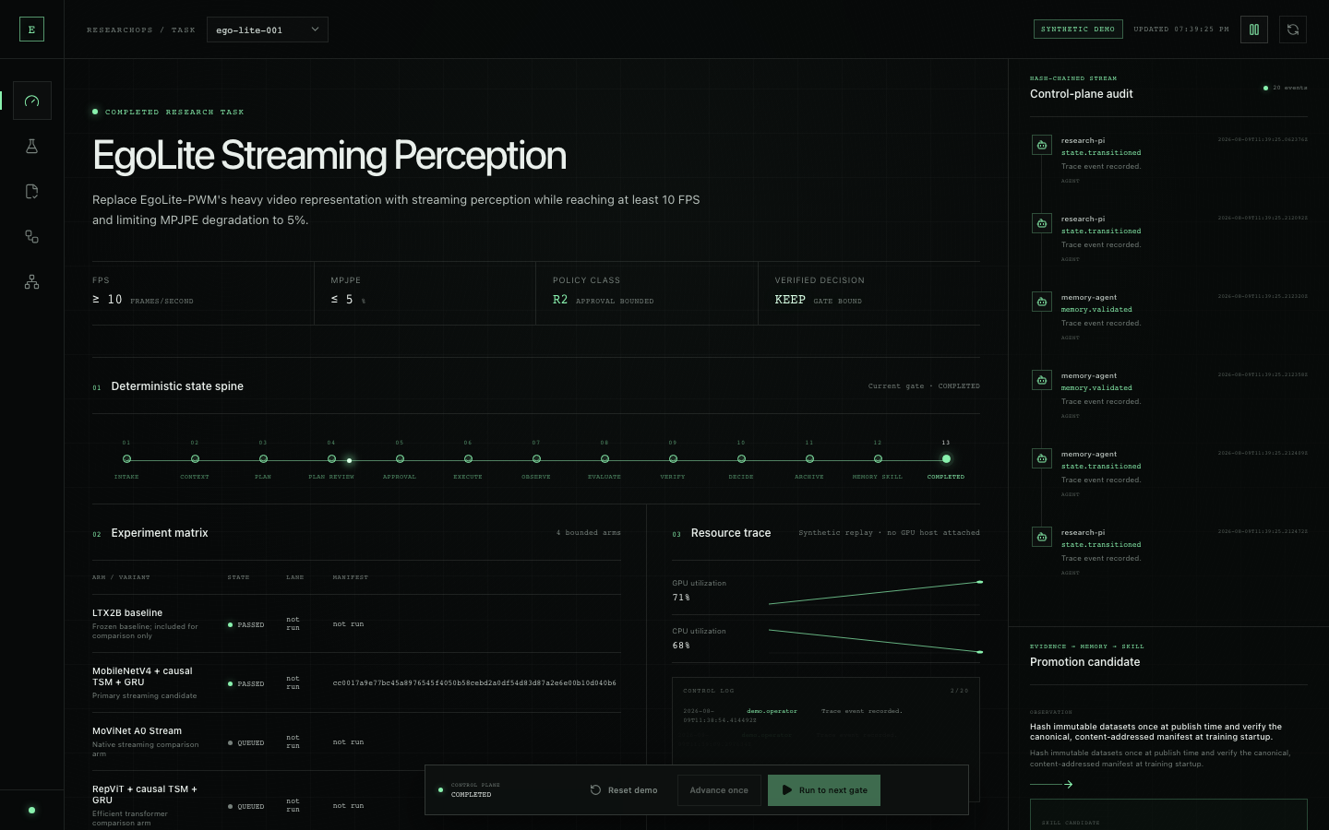
GOAI 世界人工智能开源大赛｜Agent Infra
EgoAgentOS
ResearchOps
证据门禁的多 Agent 具身科研基础设施
吕新科 · 北京邮电大学 · 智能科学与技术
Notes:
[Sources]
- https://www.goaihz.com/#tracks
- Real local Web Cockpit capture on 2026-08-09; screenshot embedded on this slide
- Repository: apps/web/ and apps/api/

Slide 2
P0 · 一页纸速览
EgoAgentOS 作品简介
项目名称
问题与场景
核心解决方案
EgoAgentOS ResearchOps
具身 AI 实验仍散落在 SSH、脚本与聊天里。
1 Manager + 6 Worker，确定性控制面执法。
研究目标 → 可审计 Decision
目标、数据、运行、指标、结论彼此割裂
AgentTeams basis + EvidenceGate
创新与差异化
开放 / 复用价值
当前进展
Planner ≠ Runner ≠ Evaluator ≠ Reviewer
开放 7 Identity、6 Skill、4 MCP 与 replay fixtures。
本地 API、Web Cockpit、SQLite 与 judge replay 已运行。
Deterministic Core + LLM Residual
VLA｜World Model｜具身研究流水线
23 API · 4 Web · 21 MCP + 2 bridge PASS
02
Notes:
[Sources]
- https://www.goaihz.com/#tracks
- Repository: docs/competition-mapping.md
- Repository test runs on 2026-08-09

Slide 3
场景 · ResearchOps 缺口
实验跑完，不等于结论可信
EgoAgentOS 把具身 AI 研发从“研究员 + SSH + 脚本”收束为可协作、可验证、可重放的生产线。
现状
EGOAGENTOS
Agent 会提案，却常常也替自己判定成功
研究控制面
研究目标
研发断点
× Context 漂移
× 高成本动作无审批
× 指标由 Agent 解释
× 失败经验难复用
01
Freeze
能力生成 / 优化层
模型 · 程序 · 轨迹
ResearchGoal + ContextBundle
代码 / 配置
02
Authorize
R0–R3 policy + scoped approval
Dataset
03
Verify
GPU / 日志
raw metrics + independent Reviewer
04
Learn
指标 / 结论
Trace → Memory → Skill
真实痛点来自 ego→HaMeR→3D pose→VLA 链路：重现实验、定位瓶颈和审查证据，比再写一段 prompt 更难。
原则：AgentTeams 负责协作；API / DB 才是事实来源。
窄场景：EgoLite streaming perception｜控制面真实｜模型与硬件数据均为 SYNTHETIC
Notes:
[Sources]
- User-provided project direction attachment: EgoAgentOS ResearchOps
- Repository: docs/architecture.md
- User-provided personal profile: ego/VLA research workflow

Slide 4
闭环 · 研究生产线
每一步都留下结构化状态、证据与责任边界
Research Goal → Experiment DAG → Execution → Evaluation → Independent Verification → Decision → Memory / Skill。
INTAKE
AGENTTEAMS · 1 TASK = 1 COLLABORATION ROOM
EVIDENCE PIPELINE
Research Goal
Research PI
DETERMINISTIC CORE
01
Plan
falsifiable + budget
ContextBundle
Control Flow · freeze / route / merge
Research State
02
Approve
R2 / R3 human gate
Scout
Architect
goal / plan / version
ExperimentPlan
risk / approval / nonce
03
Execute
typed local action
Runtime
Evaluator
Approval
run / metric / evidence
04
Verify
7 kinds + reviewer
Reviewer
Memory Curator
decision / memory refs
RunManifest
05
Learn
validated memory
Matrix conversation ≠ source of truth · 人类可观察与干预
LLM 提案 ≠ 系统裁决
Decision = metric snapshot · gate digest · reviewer · audit hash
SQLite · source of truth
Filesystem · evidence
OpenTelemetry-ready trace
Skills · versioned
External adapters · honest state
Local profile：无需 GPU / MCP / AgentTeams / Nacos / Higress 也能完成 judge replay
04
Notes:
[Sources]
- Repository: docs/architecture.md
- Repository: docs/state-machine.md
- Repository: docs/observability.md

Slide 5
架构 · Agent Infra
协作层可替换，确定性控制面不可绕过
本地 API / Web / SQLite 已运行；MCP repo HTTP loopback 与 API→GPU bridge 仅在 tests 验证；平台组件均未连接。
HUMAN
COLLABORATION PLANE · AGENTTEAMS BASIS
TOOL & EXECUTION
Researcher
Research PI / Manager
CONTROL PLANE
01
Skills
6 versioned packages
Approver
1 Manager + 6 Workers · typed envelopes
FastAPI + SQLite
02
MCP
4 srv / 7 tools
Scout
Architect
state machine / version
Judge replay
policy / approval
03
Local
synthetic worker
Runtime
Evaluator
Reviewer
evidence / evaluator
04
Platform
AgentTeams / Nacos / Higress
Reviewer
Memory
audit / replay
Operator
05
Lab
scheduler / GPU later
Room 传递引用；DB 持有 authoritative state
Deterministic Core + LLM Residual
Default Web replay ≠ MCP call · no universal shell · exact-action approval
repo · read-only
dataset · manifest
gpu · dry-run default
metrics · deterministic
API · evidence / trace
部署档位：local（已验证）｜MCP repo HTTP / bridge（tests）｜platform / lab（contracts）
05
Notes:
[Sources]
- Repository: docs/architecture.md
- Repository: integrations/agentteams/README.md
- https://hiclaw.io/

Slide 6
AgentTeams · 7 Identities
提案、执行、算分与签发必须分权
Research PI 管 Control Flow；6 个 Worker 管 Task Flow；所有命令先变成 typed artifact，再交给确定性控制面。
MATRIX ROOM
IDENTITY CONTRACT
边界先于能力
Research PI / Manager
Research PI
路由 / 决策
不得改 raw metrics
冻结 Goal · 分解 DAG · 路由 Worker · 合并结构化结果
Scout
检索 / 冻结
不得启动实验
01
Scout
上下文
02
Architect
实验设计
Architect
hypothesis / DAG
不得自批计划
Runtime
typed MCP
不得任意 shell
03
Runtime
受控执行
04
Evaluator
确定性算分
Evaluator
metric / CI
不得改 checkpoint
05
Reviewer
独立复核
06
Memory Curator
验证后沉淀
Reviewer
反证 / gate
不得执行所审实验
Memory Curator
validated write
不得把猜测写成事实
责任链：Architect → Reviewer → Runtime → Evaluator → Reviewer → PI Decision
Name · Role · Capabilities · Inputs/Outputs · Dependencies · Decision Boundary · Trace
INTAKE
CONTEXT
PLAN
REVIEW
APPROVAL
EXECUTE
RUNTIME
EVALUATE
VERIFY
DECIDE →
MEMORY
共享引用：task_id · goal_digest · plan_digest · run_id · evidence_ids · trace_id
AgentTeams 未实连；default Web 无 HTTP MCP client；API→GPU bridge 仅由 tests 验证
Notes:
[Sources]
- Repository: agents/README.md
- Repository: agents/*.yaml
- Repository: integrations/agentteams/message-envelope.schema.json

Slide 7
Policy · Approval
聊天里的“同意”，不能启动一项 R2 实验
风险分类、action digest、scope、expiry、nonce 与 replay ledger 由代码执法；R2 / R3 必须停在人类 checkpoint。
RISK POLICY
APPROVAL CONTRACT
一次批准只对应一次精确动作
R0 → R3
requester
identity
谁提出
动作越昂贵或不可逆，授权越严格
action_digest
SHA-256
绑定 config / budget / entrypoint
R0
Read only
自动 + audit
R1
Bounded mutation
≤2 modeled GPU·h
scope
task + generation
不能跨任务复用
expiry
≤15 minutes
过期即失效
R2
Expensive run
human approval
R3
Critical action
approval + rollback
nonce
single-use
原子消费
NO
No token
fail closed
X1
Used token
rejected
rollback_point
baseline plan pointer
仅记录指针；未执行回滚
audit
hash chain
每次决定可重放
bypass / expiry / scope mismatch / nonce replay → structured error + audit event
共享 secret：API mint egoap1 → GPU MCP 单次接受 / replay 拒绝；UI fallback 不互通
INTAKE
PLAN
REVIEW
APPROVAL
BLOCKED
APPROVED
ONCE
EXECUTE
VERIFY
DECIDE /
ARCHIVE
状态与操作状态分离：task stage · run status · approval status · integration truth
已验证：无审批被拒绝；token replay 被拒绝；missing trace 停在 VERIFY
Notes:
[Sources]
- Repository: docs/security.md
- Repository: docs/state-machine.md
- Repository: tests/api/
- R2 approval record includes rollback_point as a baseline plan/config pointer; no rollback execution is claimed

Slide 8
Skills + MCP · 工程体系
Skill 规定“怎么做”，MCP 限定“能调用什么”
6+4
6 个 versioned Skill 组织研究流程；4 个独立 MCP server 把 repo、dataset、GPU 与 metrics 收进 typed boundary。
SKILL MAP
COMPOSITE CONTRACT
MCP v2 · 4 SERVERS
6 个可复用能力
run_research_task@0.1.0
7 typed tools
ResearchPlan
输入
ResearchGoal + ContextBundle + Budget + Policy
repo：snapshot / read_files
只读 trusted root
01
goal.freeze · plan.validate
输出
RunManifest + MetricArtifact + Review + Decision
02
Dataset Manifest
触发
Goal frozen · plan reviewed · action authorized
dataset：create / verify manifest
gpu：launch / status
hash once · verify digest
依赖
6 Skills · 4 MCP · evidence store · audit log
03
SafeRunner
失败
MissingEvidence→PLAN；ApprovalDenied→BLOCKED；ToolError→typed retry
allowlist · approval · idempotency
当前状态
21 PASS · repo HTTP loopback smoke
安全
no universal shell · trusted roots · exact-action token
metrics_compare_paired
04
Ablation Analyzer
fixed-seed bootstrap · structured errors
GPU dry-run default · shell=False
仅 packaged synthetic_worker
paired delta · bootstrap CI
验证
JSON Schema · digest closure · independent Reviewer
复用/版本
SemVer + package digest；validated memory → Skill candidate
+ EvidenceGate / ResearchMemory；所有包均含 I/O、trigger、failure、safety、version。
fail-closed：LLM summary 不等于 metric；chat approval 不等于 authorization
+2 API→GPU MCP bridge PASS；default Web no HTTP client
Notes:
[Sources]
- Repository: skills/README.md
- Repository: mcp_servers/README.md
- Repository: mcp_servers/pyproject.toml
- https://nacos.io/en/docs/latest/manual/user/ai/skill-registry/

Slide 9
EgoLite · SYNTHETIC WORKLOAD
先验证 ResearchOps 闭环，再连接真实实验室资源
SYNTHETIC：以下模型、GPU、资源与研究指标均为 fixtures；控制面、审批、证据、测试与 UI 为本仓库实际运行。
一个窄而真实的研究问题
4 个对照臂，3 个 seeds
A · RESEARCH GOAL
B · EXPERIMENT PLAN
≥10 FPS
≤5%
EgoLite
4 arms
3 seeds
24
SYNTHETIC
acceptance target
MPJPE degradation
streaming perception
LTX2B + 3 candidates
fixed split
modeled GPU·h
no GPU host
替换 heavy video representation；不把目标阈值写成真实结果。
Plan digest + budget + entrypoint 共同决定 R2；默认 dry-run。
高成本执行先暂停
结论必须绑定原始证据
C · POLICY
D · EVIDENCE GATE
R2
scope
≤15 min
7 / 7
Reviewer
KEEP
human checkpoint
task + generation
single-use token
required evidence
independent
only after PASS
未批准：执行入口保持 BLOCKED；批准不能跨 scope、过期或重放。
code · config · dataset manifest · log · metric · trace · review
Fixture source：examples/egolite/；真实 hardware / AgentTeams / cloud 均不在本轮宣称范围
Notes:
[Sources]
- Repository: examples/egolite/README.md
- Repository: examples/egolite/goal.yaml
- Repository: docs/demo-runbook.md

Slide 10
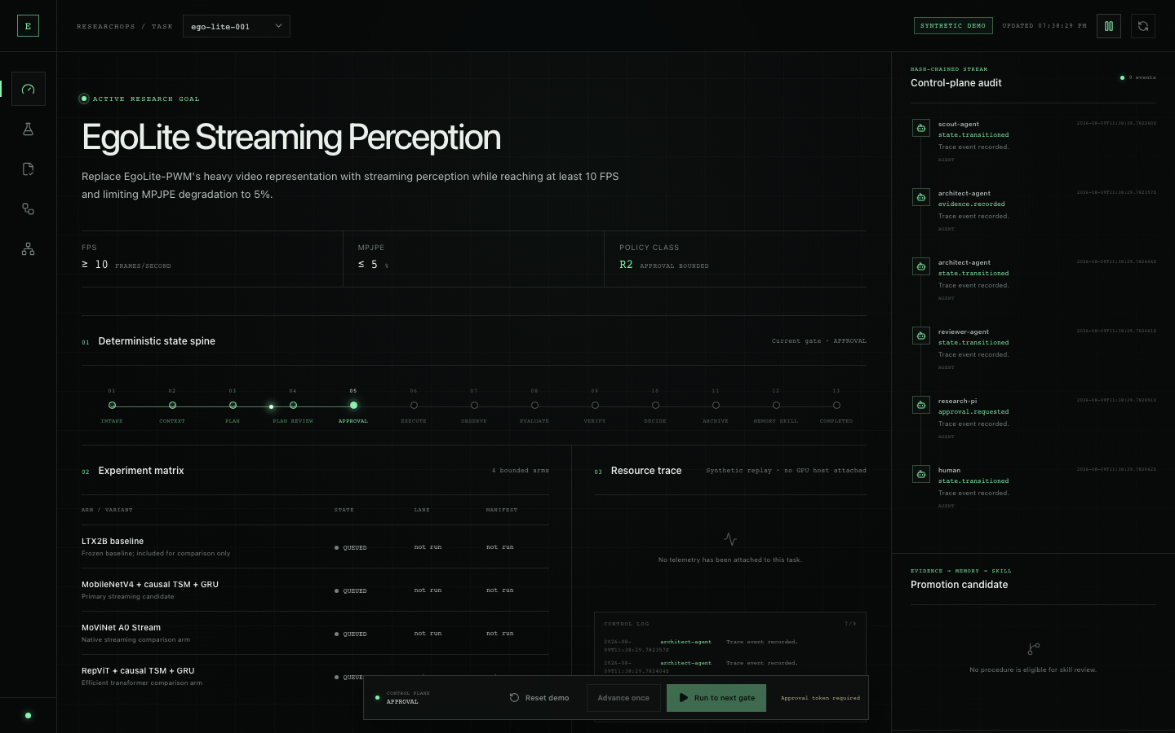
JUDGE REPLAY · CHECKPOINT 1
R2 审批
先停住
Current gate = APPROVAL；R2 执行在 token 消费前保持 blocked。
真实 Web Cockpit · 本地运行
Notes:
[Sources]
- Real local Web Cockpit capture on 2026-08-09: .tmp/deck/web-cockpit-approval-gate.png
- Repository: apps/web/
- Repository: apps/api/

Slide 11
JUDGE REPLAY · CHECKPOINT 2
7 / 7 后
才允许 KEEP
完成 13-stage replay；gate PASS、independent Reviewer、decision 与 trace 绑定。
真实 Web Cockpit · 本地运行
Notes:
[Sources]
- Real local Web Cockpit capture on 2026-08-09: .tmp/deck/web-cockpit-completed.png
- Repository: docs/demo-runbook.md
- Repository: apps/api/service.py

Slide 12
Evidence · 2026-08-09 本地复测
不是概念稿：API、Web、MCP transport 与 replay 都有当前证据
工作负载仍为 SYNTHETIC；下列 test counts、build 与 gate 行为来自本仓库当前运行。
FastAPI control plane
React Web Cockpit
A · BACKEND
B · FRONTEND
23 / 23
Ruff
MyPy
4 / 4
Build
0
UI
API/domain PASS
PASS
PASS
Web tests PASS
Vite PASS
console errors
SYNTHETIC labeled
state · policy · approval · evidence · evaluator · persistence
真实 approval / completed 截图来自运行中的 localhost:4173。
MCP v2 tool plane
Judge replay
C · MCP
D · CLOSED LOOP
21
2
23
7 / 7
KEEP
VALID
MCP standalone PASS
API→GPU bridge PASS
make test-mcp PASS
gate PASS
decision
full event chain
4 servers / 7 tools · repo HTTP initialize/tools/list · default Web no MCP client
approval consumed；bypass + replay blocked；missing-trace → VERIFY / no decision
证据命令：uv run pytest · npm test/build · uv run --project mcp_servers pytest
Notes:
[Sources]
- Backend/API domain: 23 tests passed; Ruff and MyPy verified on 2026-08-09
- Frontend: 4 tests passed; Vite production build passed; browser console had no errors
- MCP standalone: 21 tests passed, including automated repo-server loopback Streamable HTTP initialize/tools/list; API-to-GPU MCP contract bridge: 2 tests passed; make test-mcp total: 23
- Approval bridge: with shared secret, API mints egoap1 HMAC token; GPU MCP accepts once and rejects replay. Without shared secret, UI egoap_ fallback does not interoperate. Default Web has no HTTP MCP client.
- Isolated judge replay: 7/7 gate PASS, KEEP, approval consumed, full event chain valid; bypass/replay blocked; missing-trace held at VERIFY

Slide 13
Failure first · SYNTHETIC REPLAY
系统不隐藏失败；它把失败变成可验证 procedure
资源曲线与模型结果均为 SYNTHETIC fixtures；恢复状态机、manifest 生成、证据记录与 memory gate 为真实代码路径。
症状被记录
诊断不是聊天结论
A · OBSERVE
B · REVIEW
GPU low
CPU high
data wait
SHA-256
Reviewer
PLAN
No guess
synthetic signal
hash saturation
startup bottleneck
repeated full hash
confirms evidence
bounded recovery
must cite trace
Runtime 保留失败日志；原始 trace 不因重试被覆盖。
Diagnosis：worker startup 反复全量 hashing，阻塞 data path。
恢复动作受控
经验不能直接发布
C · RECOVER
D · MEMORY → SKILL
Hash once
Verify
Replay
1
Candidate
Nacos
publish time
content digest
same digest
validated success
not published
not configured
DatasetManifest 只在 trusted root 写固定 manifest；重放可验证。
Trace → episodic memory → procedural memory → reviewed Skill candidate
只有独立 review、足够成功次数与 registry response 才能标记 published
Notes:
[Sources]
- Repository: examples/egolite/fixtures/resource-before.json
- Repository: examples/egolite/fixtures/resource-after.json
- Repository: skills/dataset-manifest/
- All resource/model values on this slide are synthetic fixtures

Slide 14
开放与集成 · 事实边界
本地闭环已经可运行；外部平台绝不靠 PPT 变成“已接通”
LOCAL
每个 adapter 只显示 not_configured / configured / reachable / verified；没有握手与负测，就不写 verified。
开放：可重放的 Agent Infra
不开放：私有资产与权限
集成状态：逐项如实
APACHE-2.0 CORE
SOVEREIGN BOUNDARY
INTEGRATION TRUTH
01
FastAPI + Web Cockpit
原始 ego / lab 数据
不进入提交包
已验证
local API / Web / SQLite；repo HTTP + GPU bridge tests
02
7 Agent Identity contracts
第三方权重
遵循 upstream license
未配置
AgentTeams · Nacos · Higress · Aliyun SLS
03
6 versioned Skill packages
未声称
live GPU · real model gains
API keys / secrets
不提交；只用短期凭证
04
4 MCP servers / 7 tools
接口
typed envelopes · health truth states
真实 GPU / scheduler
operator-owned adapter
复赛
真实 Matrix room + OTel export
05
EgoLite synthetic fixtures
06
tests · replay · docs · schemas
AgentTeams room
消息不是 source of truth
决赛
受控 scheduler / GPU adapter
License · SECURITY · THIRD_PARTY · DATA/MODEL CARD 已包含
字段权限、留存和费用随部署 profile 显式披露
维护：Schema / Skill / MCP 按 SemVer；deprecation 先告警，再迁移
Notes:
[Sources]
- Repository: LICENSE
- Repository: SECURITY.md
- Repository: THIRD_PARTY.md
- Repository: DATA_CARD.md
- Repository: MODEL_CARD.md
- Repository: integrations/*/README.md

Slide 15
进展 · Evidence first
已验证、已实现、待接入三层分开陈述
初赛提交一个能 replay 的 local product；复赛再用真实平台证据升级 integration state。
现在拥有什么
从初赛到决赛的验收梯子
EVIDENCE LADDER
DELIVERY PLAN
已运行
local control plane + Web Cockpit
08.09
Local replay locked
现在
API · Web · Skills · tests · screenshots；MCP bridge = tests
FastAPI / SQLite / approval / evidence gate / trace / replay；实际页面与截图已核验。
08.10–08.15
Submission package
初赛
PPT/PDF · summary · runbook · ZIP verification
已验证
23 API · 4 Web · 21 MCP + 2 bridge
复赛
Live AgentTeams room
下一阶段
R2 pause · 7/7 gate · KEEP；default Web 无 HTTP MCP client。
typed envelopes · human intervention · room trace
复赛
Platform probes
下一阶段
Higress / Nacos / OTel · positive + negative tests
未配置
AgentTeams / Nacos / Higress / Aliyun / live GPU
目标
决赛
Controlled lab adapter
仓库保留 adapter contracts 与 truth states；不把 contract 写成已集成。
scheduler / GPU · real dataset · real metrics
SYNTHETIC：EgoLite workload、resource trace、model metrics 均非真实 GPU / dataset 实测。
降级策略：外部平台不可用→local replay；GPU 不可用→synthetic fixture；所有状态保持 honest
15
Notes:
[Sources]
- Repository: docs/claims-evidence.md
- Repository: submission/submission-checklist.md
- https://www.goaihz.com/#tracks

Slide 16
团队 · 单一架构所有权
我把具身研究经验压成一条可验证的 Agent Infra 生产线
吕新科｜北京邮电大学 · 智能科学与技术
为什么由我来做
请评委直接 replay，而不是相信我的 PPT
FOUNDER–PROBLEM FIT
JUDGE REPLAY
具身 / VLA
① 启动 local profile
01
ego→HaMeR/MANO→3D pose→VLA / 真机训练链路。
START
make up · 打开 http://localhost:4173
模型与实验
02
OpenTrackVLA、world-model、future feature 与 verifier harness。
② Reset → Run to next gate
PAUSE
观察 R2 停在 APPROVAL；尝试 bypass
Agent / 验证
03
Planner ≠ Executor ≠ Verifier；引用、反证、失败重试。
③ Approve digest → Replay
VERIFY
编译 / 系统
检查 7/7 evidence、KEEP、trace 与 candidate Skill
04
NaturalFlow compiler、Context DAG、SHA256 cache 与权限检测。
附包：docs/demo-runbook.md · docs/claims-evidence.md · tests/
EgoAgentOS：让 Agent 不只是做实验，而是管理一条可信的 AI Research 生产线。
16
Notes:
[Sources]
- User-provided personal profile attachment
- Repository: docs/demo-runbook.md
- Repository: docs/claims-evidence.md

