Slide 1
NEUXUS

Slide 2
VENV
CREATION
In the command line:
> python -m venv "C:\Users\EEG\Desktop\NeuXus online correction\env\neuxus-master"
ACTIVATION
> "C:\Users\EEG\Desktop\NeuXus online correction\env\neuxus-master\Scripts\activate.bat"
INSTALLING NEUXUS
(env-example) > pip install git+https://github.com/LaSEEB/NeuXus
USING NEUXUS
(env-example) > neuxus script_example.py
DEACTIVATION
(env-example) > deactivate
USING NEUXUS FROM BATCH FILE
If using run_script_cor.bat, right-click it, choose edit, and replace "C:\Users\EEG\Desktop\NeuXus online correction\env\neuxus-master\" with the path to the env you created!
Then, to run the correction, just double-click run_script_cor.bat

Slide 3
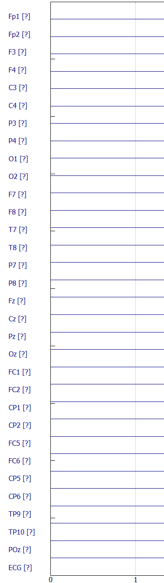
Code here
Signal_PA no unit, no signal
Can I visualize signal_GA also ?

Slide 4
Original guidelines

Slide 5
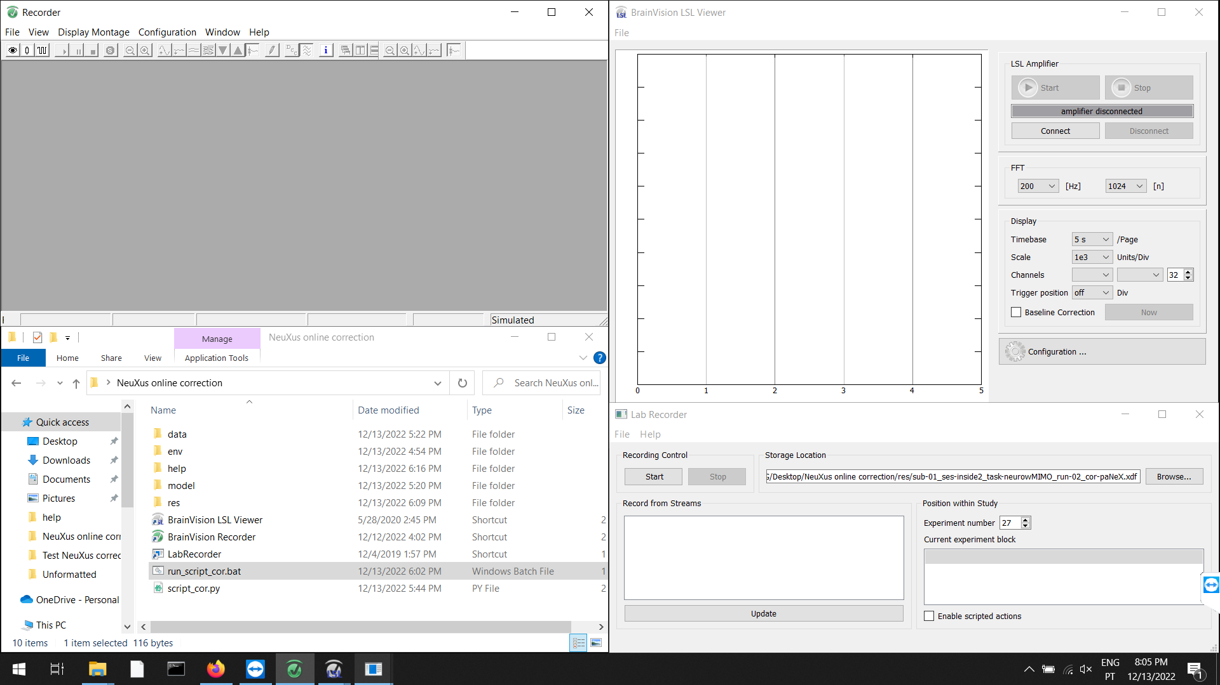
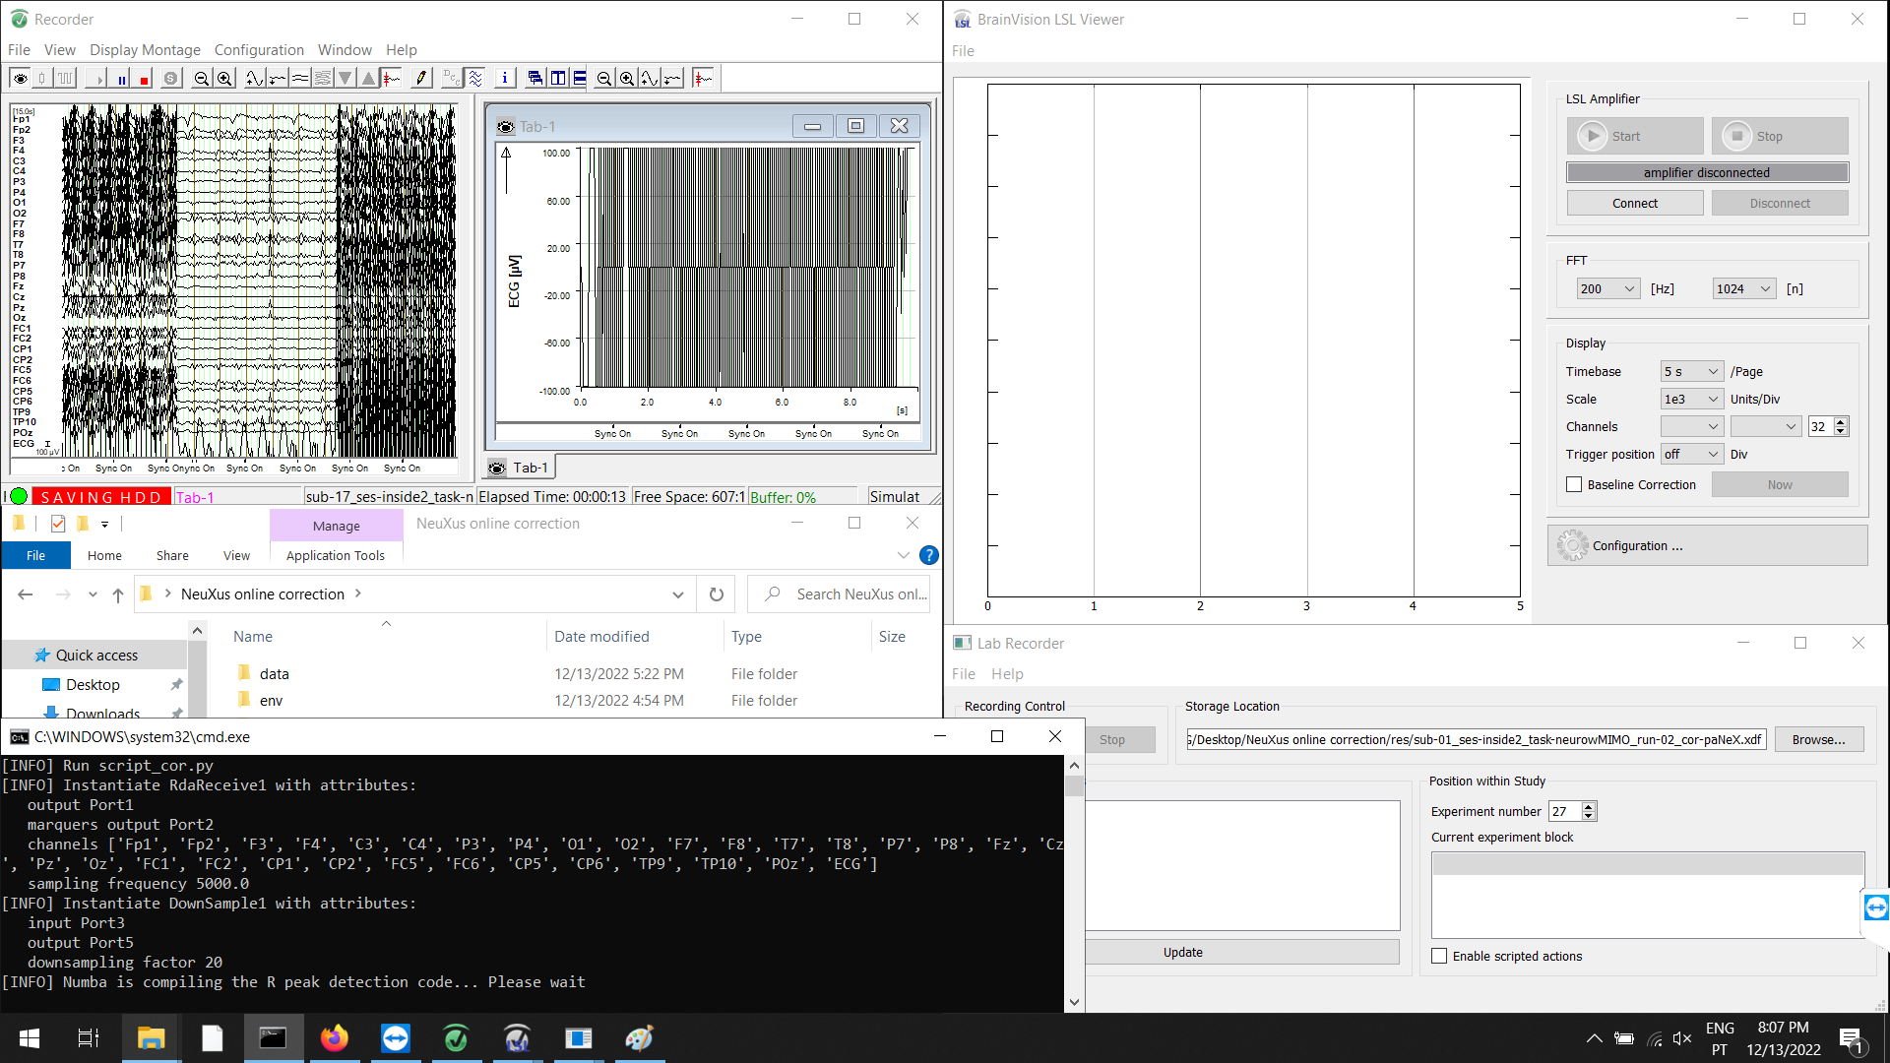
Before the fMRI acquisition starts:
# Make sure Triggerbox is connected:
- the scanner's fiber optic cable should be connected to FOV, the output pins switched to PC, and the "Bit 15 stretch" pin switched to "5 ms"
1. In the EEG laptop:
- Open Recorder
- Open the "NeuXus online correction" folder
- Open LSL Viewer
- Open LabRecorder
2. In Recorder:
a) In "File > Edit Workspace": set the raw file folder to "C:\Users\EEG\Desktop\NeuXus online correction\res"
b) In "File > Edit Workspace": set the name of the file appropriately (continue to save changes)
c) Start monitoring
# Make sure Syncbox is connected (Recorder must be receiving "Sync On" markers)
d) Start recording
3. In NeuXus online correction folder:
a) Open run_script_cor.bat
b) A command window will pop up. Wait (< 60 seconds) until it shows: "[INFO] Run pipeline". Then, NeuXus should start streaming by LSL
3. In LSL Viewer:
a) Connect to "signal_pa" and "markers_pa" streams
b) Press start

Slide 6
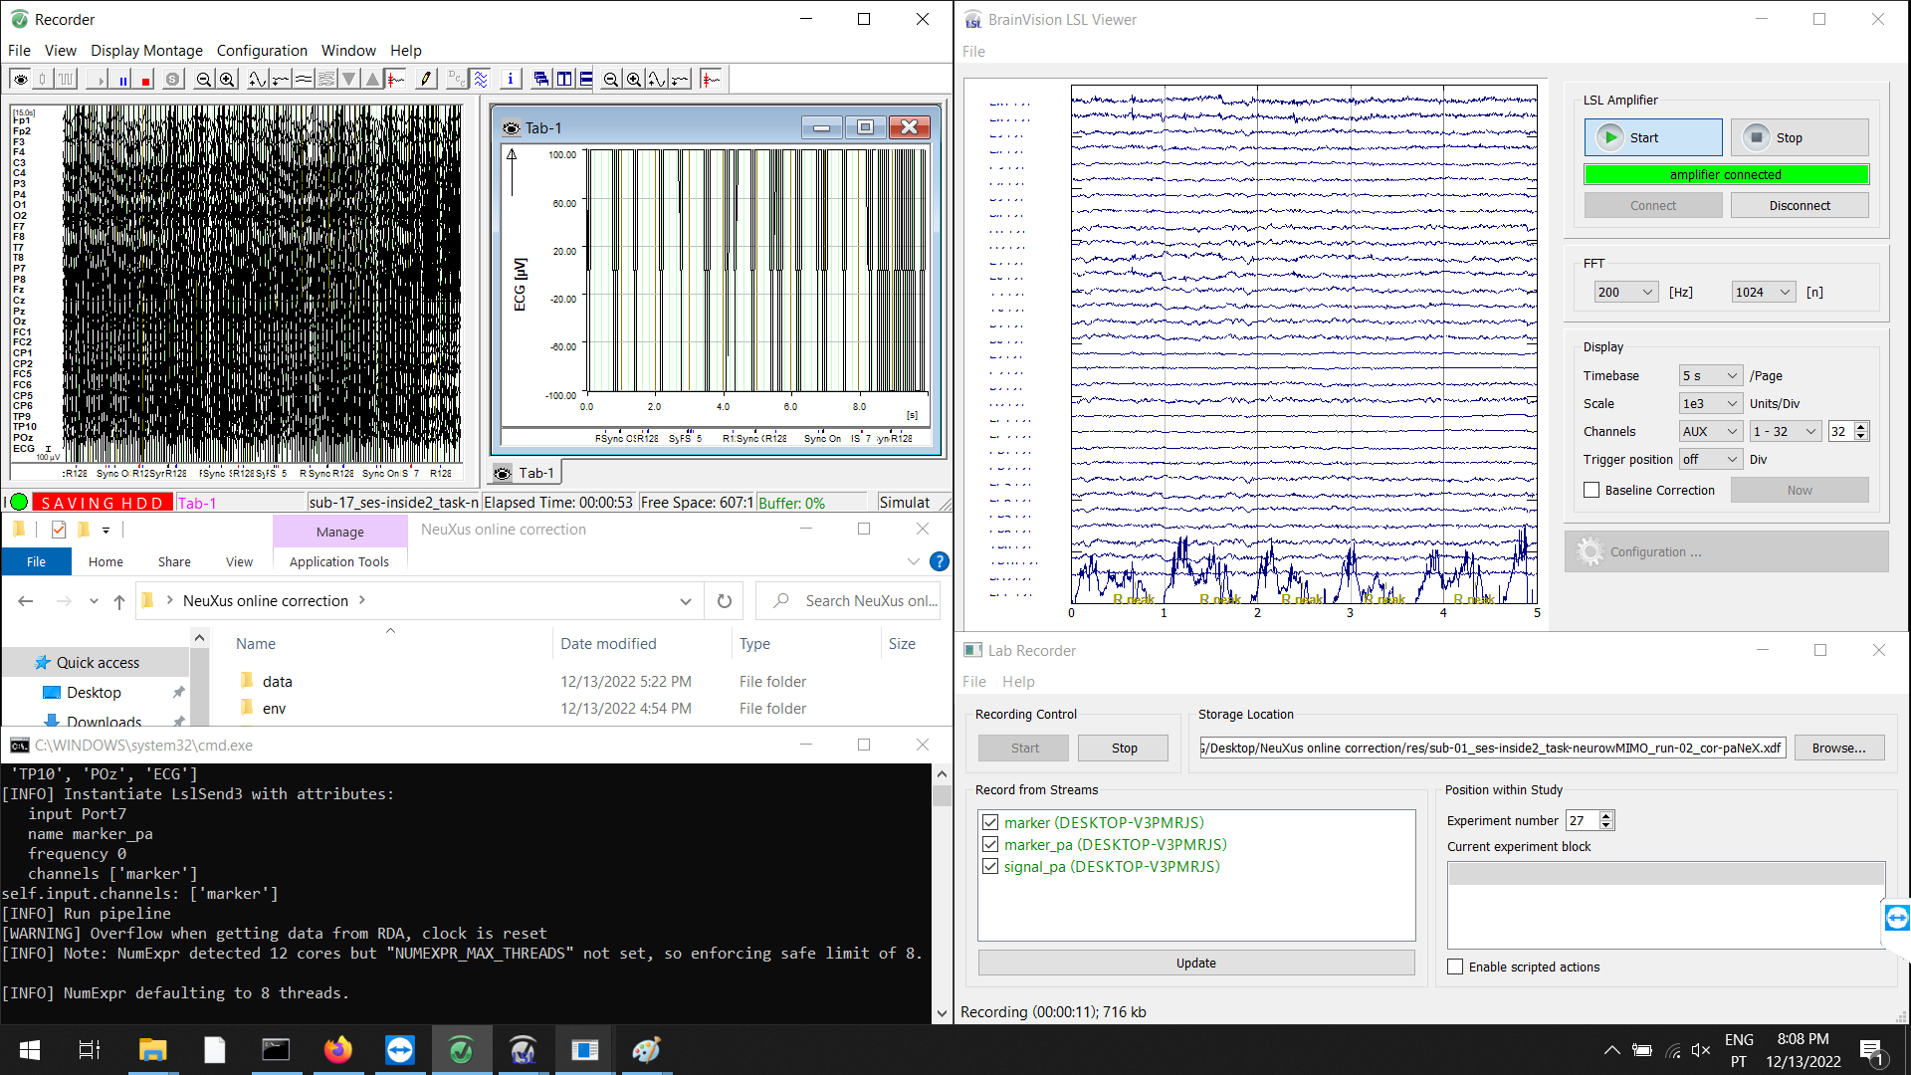
4. In Lab Recorder:
a) In "Storage location": set it to "C:/Users/EEG/Desktop/NeuXus online correction/res/sub-01_ses-inside2_task-neurowMIMO_run-02_cor-paNeX.xdf"
b) In "Record from streams": select "signal_pa", "markers_pa" and "markers" (one more stream than in LSL Viewer)
c) Press Start
5. Start the fMRI sequence
6. In LSL Viewer, check if the signal eventually becomes corrected (< 30 seconds)
# If it does not, check if Recorder receives the R128 marker at every volume
When you decide to end the acquisition: (or if there is any error)
1. In Lab Recorder: press Stop
2. In LSL Viewer: press Stop, and Disconnect
3. In the NeuXus command window: press ESC
4. In Recorder: stop recording, and stop monitoring
5. Stop the fMRI sequence

