Slide 1
NEUXUS

Slide 2
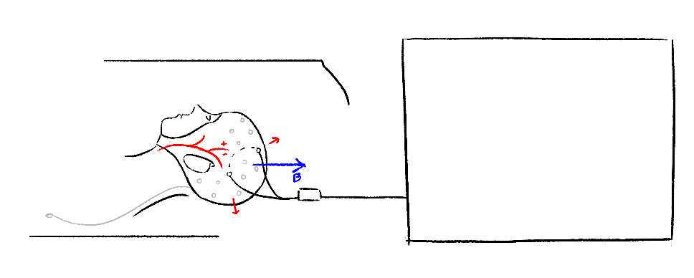
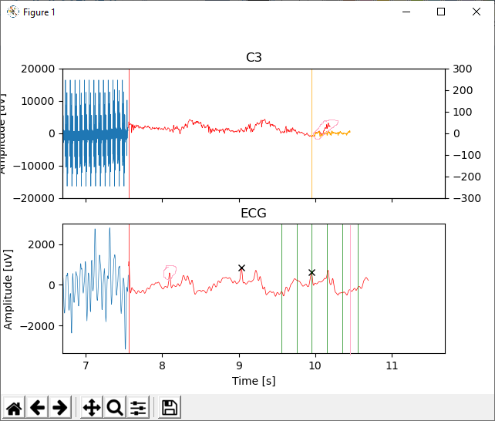
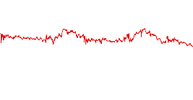
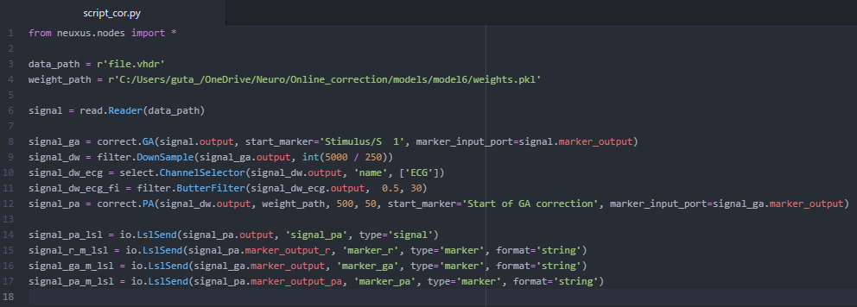
https://github.com/Soraya28/NeuXus/blob/master/examples/mri-artifact-correction/correct.py
EEG-fMRI
EEG Artifacts
Solution
GA correction
chunk template
PA correction
chunk template
GA template
Select
PA template
R-peaks
Select
Average
Average
Predict
Time
Channels
Subtract
Downsample
Filter ECG
Subtract
noisy chunk
clean chunk

Slide 3
How does it work
Uses the LSTM networkd porposed by:
https://dl.acm.org/doi/pdf/10.1145/3341105.3373945
TR template
chunk template
Cardiac cycle template
chunk template
Select
Select
R-peaks
Average
Average
Predict
Time
Channels
Subtract
Downsample
Filter ECG
Subtract
chunk
GA correction
PA correction

Slide 4
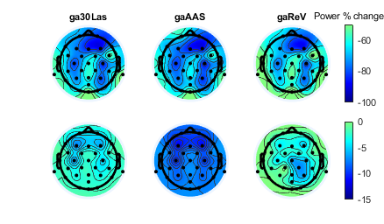
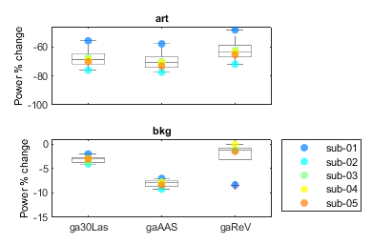
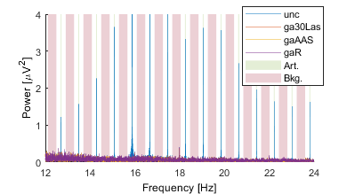
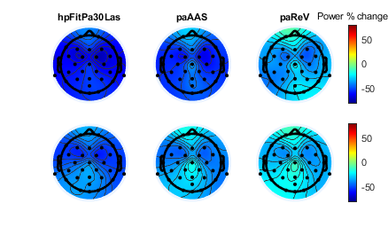
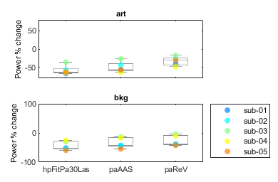
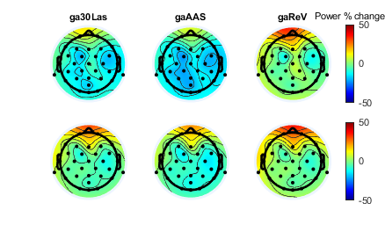
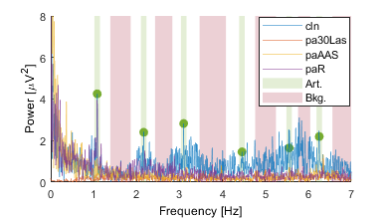
Power % change, in artifact and background bands, between:
Results
GA
Uncorrected (GA+PA) and corrected (PA)
art
art
bkg
bkg
PA
Neuxus recview eeglab
Clean (PA) and corrected (PA)
art
art
bkg
bkg

Slide 5
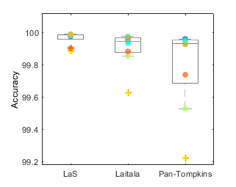
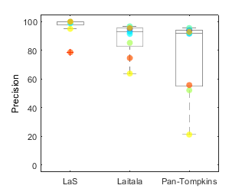
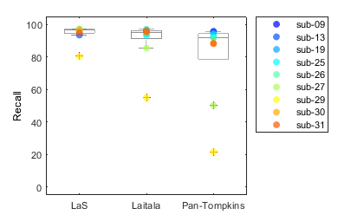
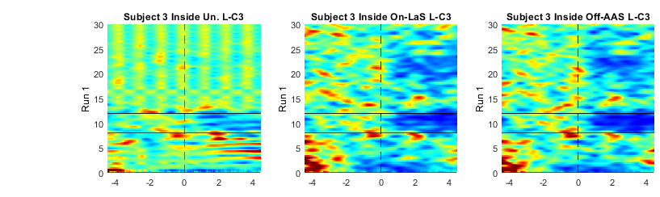
Results
QRS
GA + PA

Slide 6
doc
https://github.com/Soraya28/NeuXus/tree/doc

Slide 7
GA correction
https://github.com/Soraya28/NeuXus/blob/doc/neuxus/nodes/correct.py

Slide 8
PA correction
Robust ECG R-peak Detection Using LSTM Juho Laitala
https://github.com/jtlait/ecg2rr
https://numba.pydata.org/
Video lstm
https://www.youtube.com/watch?v=OJzF1HNVopk
See doc https://github.com/Soraya28/NeuXus/blob/doc/neuxus/nodes/correct.py*

Slide 9
LSTM - PA
Trained 6 females, 32 min of cognitive tasks
10 epochs with 40 batch of 256 windows of 2 s
For PA – GA validation, how many sub not mentinned
Cf https://github.com/jtlait/ecg2rr
PA :
normalizing ECG : Normalize a signal between the lower (default 0) and upper bound (default 1)
predict R peaks : probability of R peak at each time point, if too closed to window not considered

Slide 10
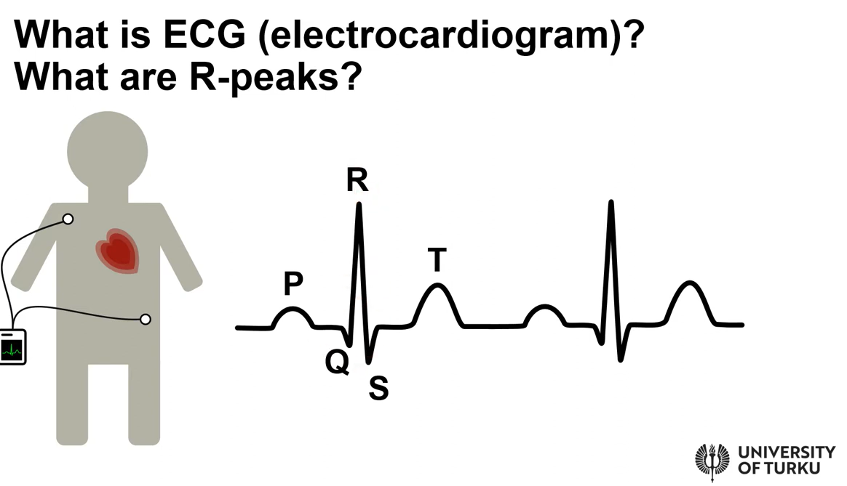
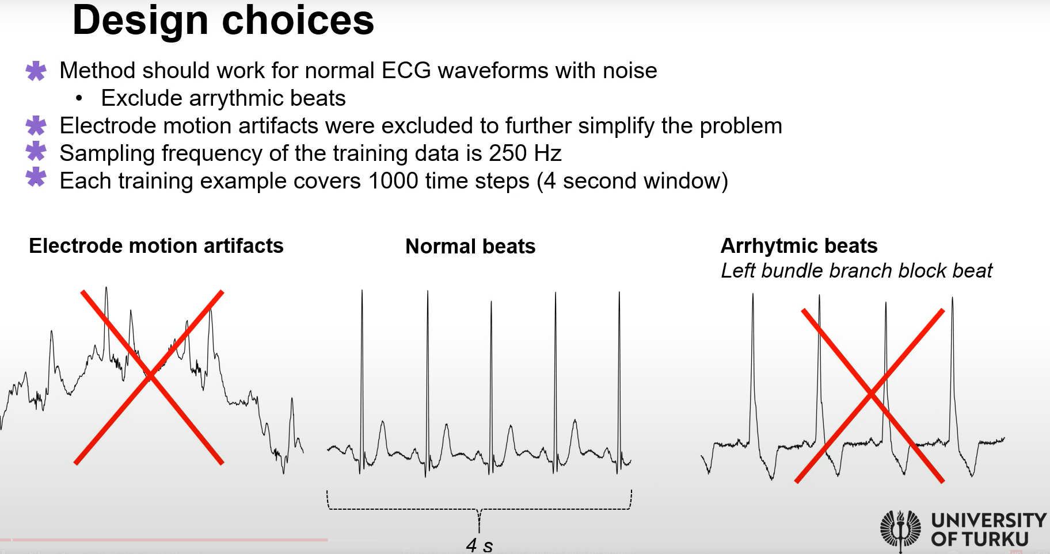
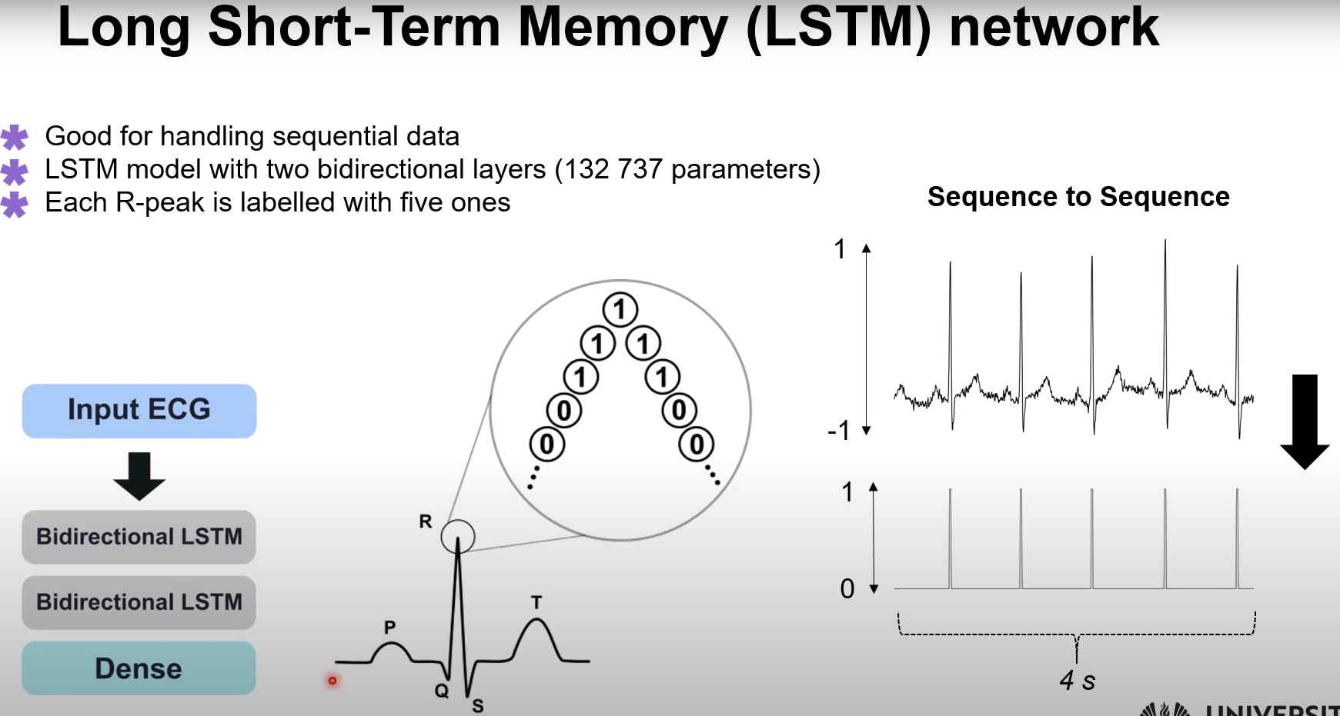
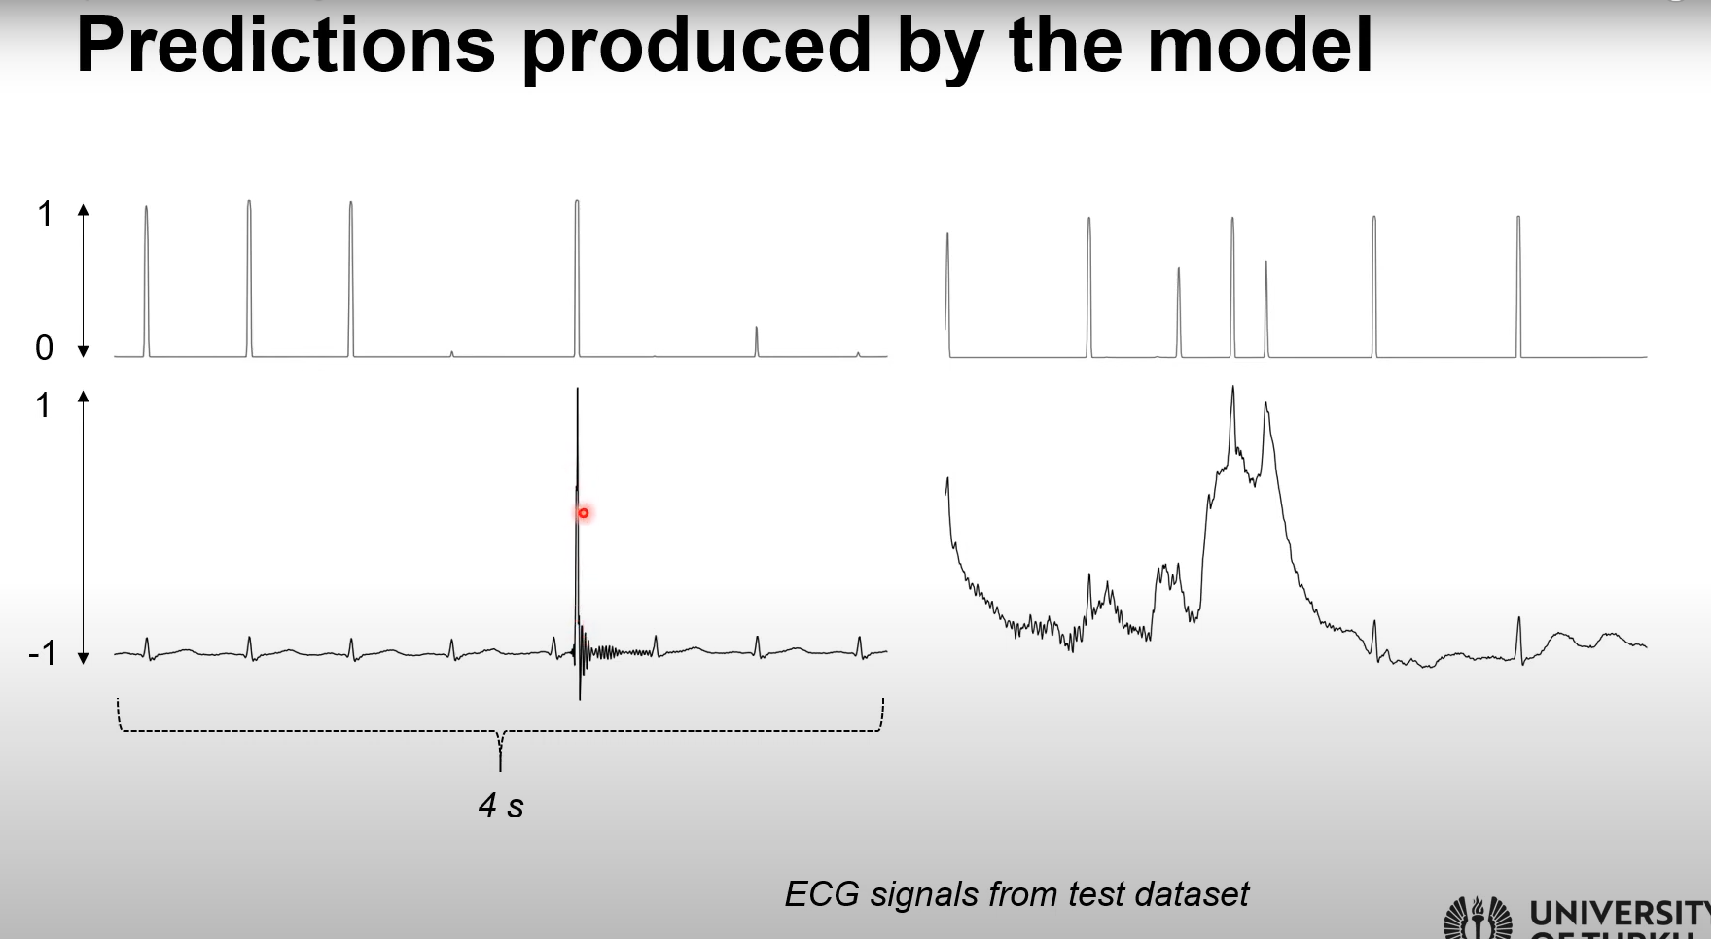
Issue if ECG noisy
ECG database
BW baseline, drift
MA motion artefact → BW + MA, or just one of them
60 Hz sinwave, simulates interference
Normal not arythmic
Adding noise
Normalize to -1, 1
LSTM good for sequential data
For each timestep, proba to be an R peak
If 5 or more predictions got high proba assign to Rpeak
Electrode contact noise
False positive

Slide 11
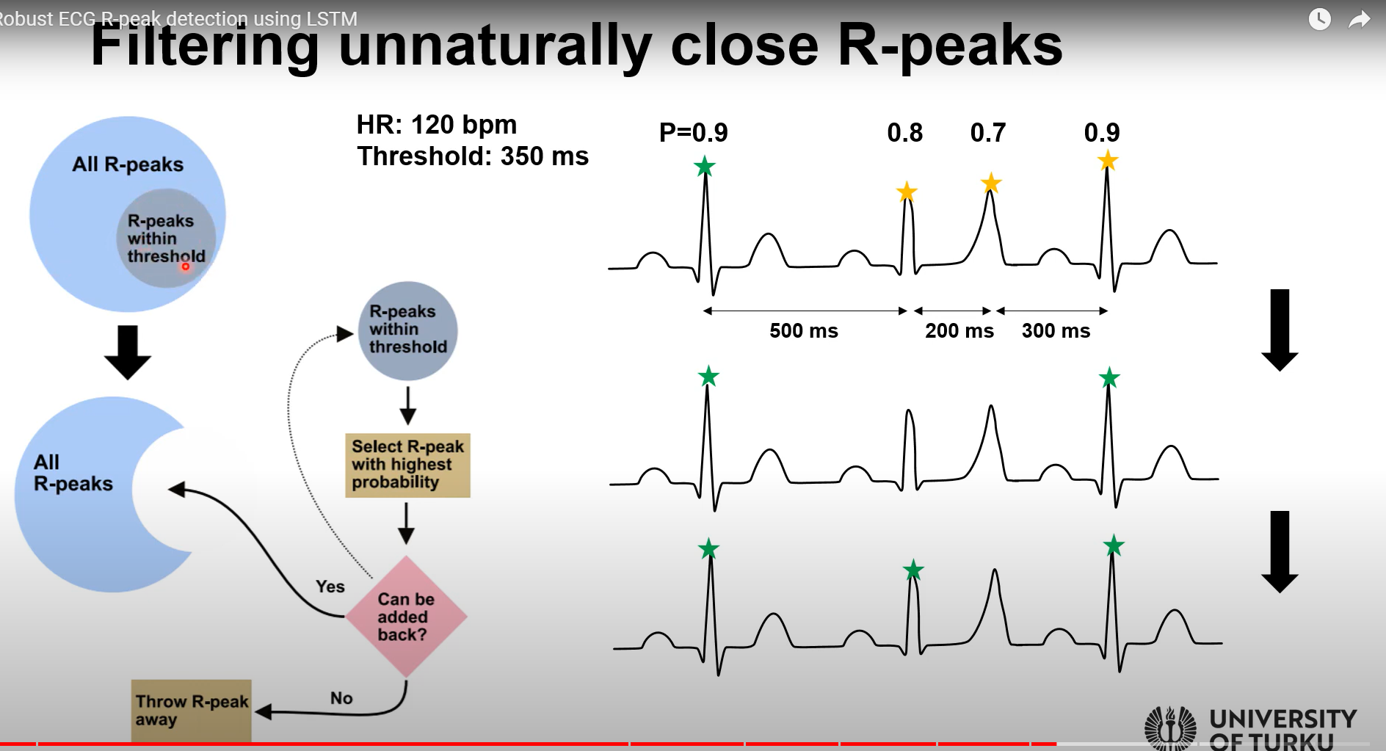
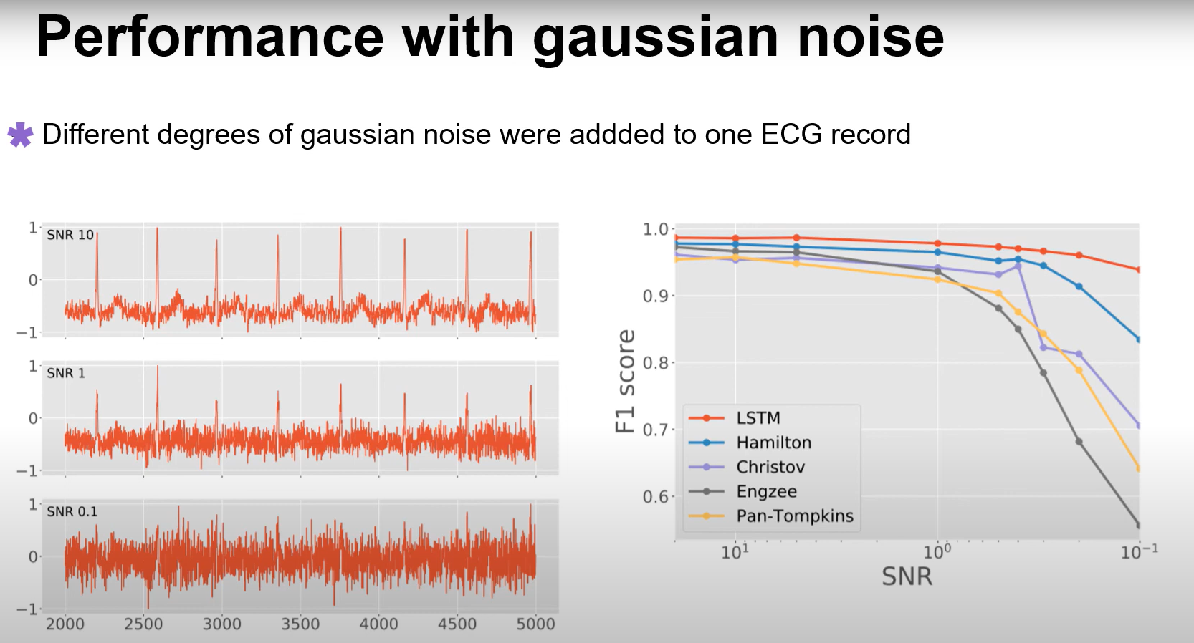
For false positive, filtering
If threshold 350ms, will substract some R peaks if distance between R peak is less than thresh
Final output, all R peak are away from at least thresh
might need to set up adaptive threshold if ECG really noisy
Performance of the new method

Slide 12
DF to raw mne
https://github.com/LaSEEB/NeuXus/blob/81d1779c02e8dcda0236f2698f9490799714598f/neuxus/node.py#L46
https://mne.tools/stable/auto_tutorials/simulation/10_array_objs.html#sphx-glr-auto-tutorials-simulation-10-array-objs-py
class Print(Node):
__init__(self, input_port):
Node.__init__(self, input_port, None)
update(self):
for chunk in self.input:
print(chunk)
[DEBUG] Input chunk of LslSend5 Fp1 Fp2 F3 ... TP10 POz ECG 1.252 23.297847 47.552322 14.224421 ... 7.896810 8.793040 -15314.381975 1.256 25.049095 46.881048 11.444911 ... 9.364090 8.881568 -15315.963226

Slide 13
Viewer
https://github.com/labstreaminglayer/App-LabRecorder
https://fcbg-hnp-meeg.github.io/bsl/dev/command_line.html#stream-viewer
Do not know how to have marker and signal at the same time, may be possible

Slide 14
Comparing EEG with EEG MRI
biosppy.plotting.plot_ecg(ts=None, raw=None, filtered=None, rpeaks=None, templates_ts=None, templates=None, heart_rate_ts=None, heart_rate=None, path=None, show=False)[source]

Slide 15
VENV
CREATION
In the command line:
> python -m venv "C:\Users\EEG\Desktop\NeuXus online correction\env\neuxus-master"
ACTIVATION
> "C:\Users\EEG\Desktop\NeuXus online correction\env\neuxus-master\Scripts\activate.bat"
INSTALLING NEUXUS
(env-example) > pip install git+https://github.com/LaSEEB/NeuXus
USING NEUXUS
(env-example) > neuxus script_example.py
DEACTIVATION
(env-example) > deactivate
USING NEUXUS FROM BATCH FILE
If using run_script_cor.bat, right-click it, choose edit, and replace "C:\Users\EEG\Desktop\NeuXus online correction\env\neuxus-master\" with the path to the env you created!
Then, to run the correction, just double-click run_script_cor.bat

Slide 16
Original guidelines

Slide 17
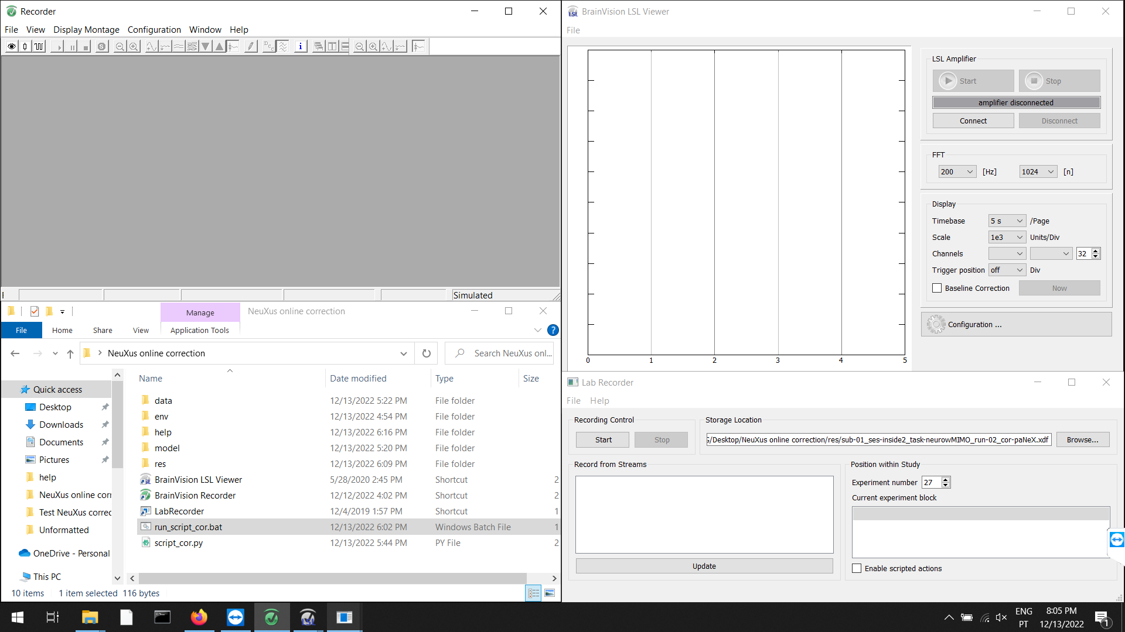
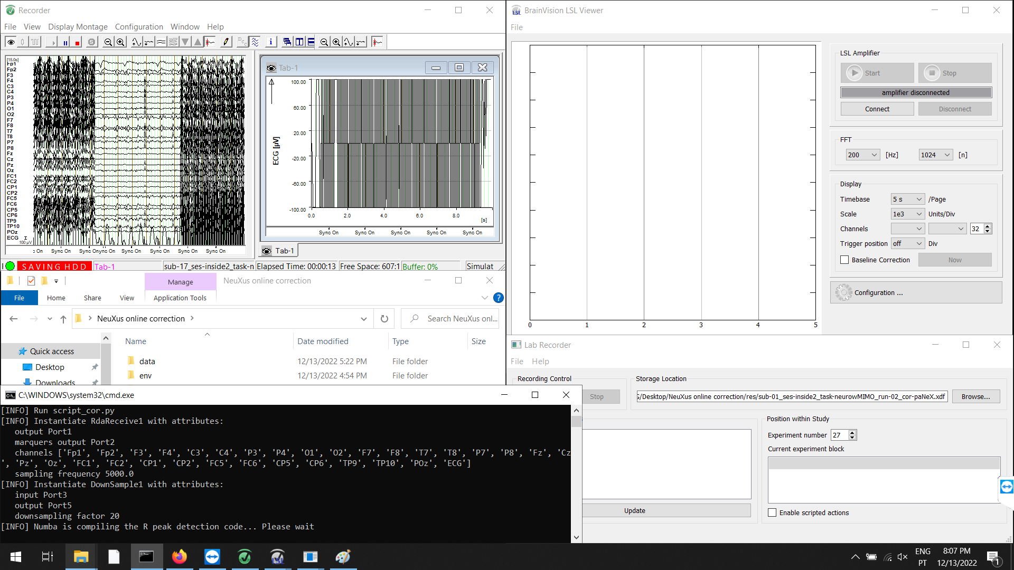
Before the fMRI acquisition starts:
# Make sure Triggerbox is connected:
- the scanner's fiber optic cable should be connected to FOV, the output pins switched to PC, and the "Bit 15 stretch" pin switched to "5 ms"
1. In the EEG laptop:
- Open Recorder
- Open the "NeuXus online correction" folder
- Open LSL Viewer
- Open LabRecorder
2. In Recorder:
a) In "File > Edit Workspace": set the raw file folder to "C:\Users\EEG\Desktop\NeuXus online correction\res"
b) In "File > Edit Workspace": set the name of the file appropriately (continue to save changes)
c) Start monitoring
# Make sure Syncbox is connected (Recorder must be receiving "Sync On" markers)
d) Start recording
3. In NeuXus online correction folder:
a) Open run_script_cor.bat
b) A command window will pop up. Wait (< 60 seconds) until it shows: "[INFO] Run pipeline". Then, NeuXus should start streaming by LSL
3. In LSL Viewer:
a) Connect to "signal_pa" and "markers_pa" streams
b) Press start

Slide 18
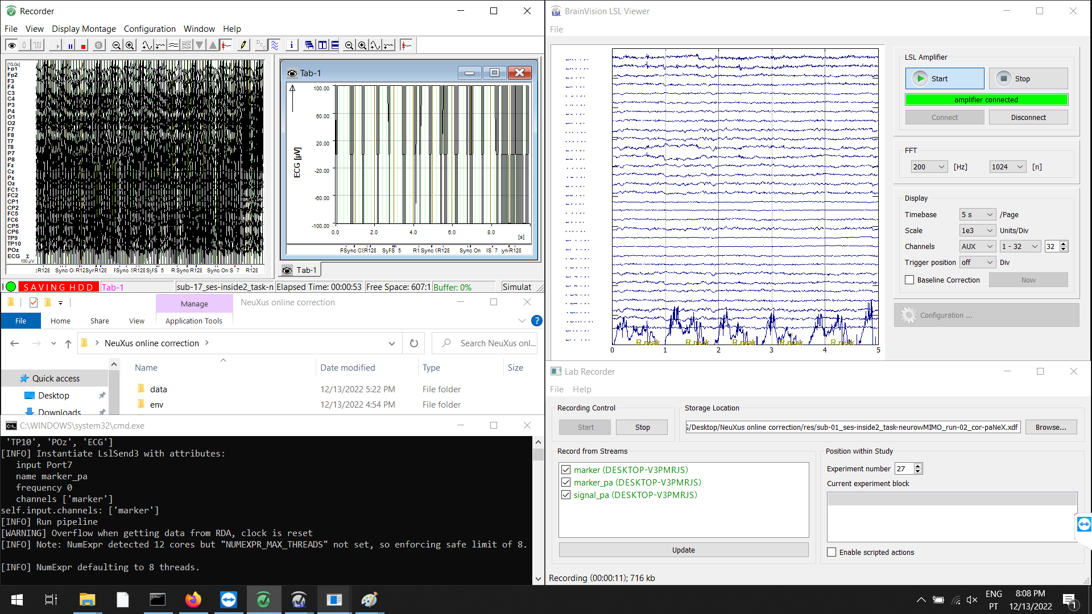
4. In Lab Recorder:
a) In "Storage location": set it to "C:/Users/EEG/Desktop/NeuXus online correction/res/sub-01_ses-inside2_task-neurowMIMO_run-02_cor-paNeX.xdf"
b) In "Record from streams": select "signal_pa", "markers_pa" and "markers" (one more stream than in LSL Viewer)
c) Press Start
5. Start the fMRI sequence
6. In LSL Viewer, check if the signal eventually becomes corrected (< 30 seconds)
# If it does not, check if Recorder receives the R128 marker at every volume
When you decide to end the acquisition: (or if there is any error)
1. In Lab Recorder: press Stop
2. In LSL Viewer: press Stop, and Disconnect
3. In the NeuXus command window: press ESC
4. In Recorder: stop recording, and stop monitoring
5. Stop the fMRI sequence

Slide 19
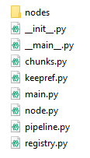
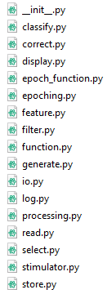
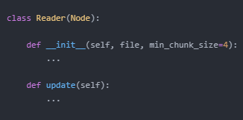
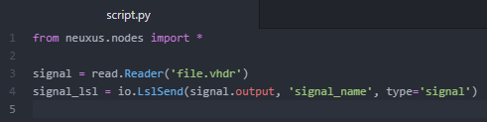
How to use it
1. Install Python
2. Install NeuXus
3. Write a script
4. Execute it with keyword: neuxus
2.
3.

Slide 20
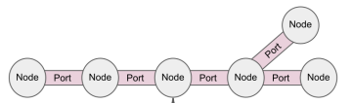
How to use it
1. Install Python
2. Install NeuXus
3. Write a script
4. Execute it with keyword: neuxus
2.
3.
node
port

Slide 21

How to use it
1. Install Python
2. Install NeuXus
3. Write a script
4. Execute it with keyword: neuxus
2.
3.
4.

Slide 22
How to extend it
1. Write/extend a node!
2. Push to github
.output
.update()
∞

Slide 23
How I extended it
EEG-fMRI
EEG Artifacts
Solution
GA correction
chunk template
PA correction
chunk template
GA template
Select
PA template
R-peaks
Select
Average
Average
Predict
Time
Channels
Subtract
Downsample
Filter ECG
Subtract
noisy chunk
clean chunk

Slide 24



An introduction to NeuXus: an open-source Python toolbox for real-time EEG processing
Gustavo Caetano
gmlcaetano@gmail.com
LaSEEB seminar
6 June 2022

