Slide 1






Cache Replacement Improvement on Last-Level Caches
Abdullah Abdul Kader
Yerania Hernandez
v

Slide 2
Problem Statement
On a cache miss. Which cache line to evict?

Slide 3
Design Overview
OPT gen
Inspired from Belady’s algorithm
Hawkeye Predictor
Identify loaded instruction as cache friendly or cache averse
Learns from OPT policy
Predictor
Past Behavior
Future
Time
What should I evict?

Slide 4
Overall Implementation
Address: X
PC
X
OPT gen
PC-based
predictor
Hit/Miss
With OPT, would X be a cache hit or a miss?
Does this PC tend to load cache- friendly or cache-averse lines?
Insert X with high or low priority
Last level cache

Slide 5
Experimental Setup
Cache Replacement Championship Simulator
SPEC 2006 Benchmark
Configurations:
Single core with 2 MB LLC without a prefetcher
Single core with 2 MB LLC with L1/L2 data prefetchers
Replacement Policy Comparison
LRU, SRRIP, Hawkeye
Notes:
2% improvement with the OPT policy
Benchmark samples of 250 million instructions, 50 for warming up the cache, and 200 million to measure the behavior

Slide 6
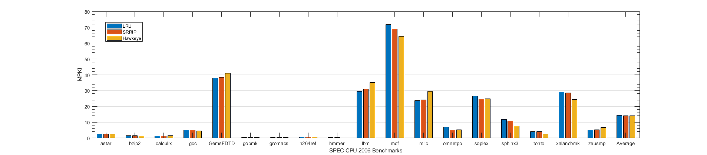
Results and Analysis
Single Core without Prefetcher
LRU: 14.32
SRRIP: 14.05
Hawkeye: 14.02

Slide 7
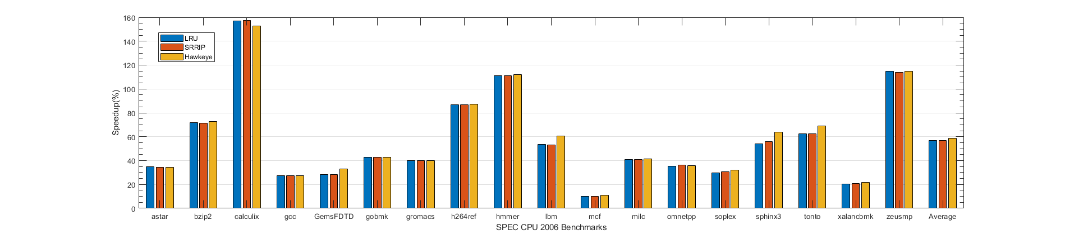
Results and Analysis
Single Core without Prefetcher
IPC (%)
LRU: 56.74%
SRRIP: 56.85%
Hawkeye: 58.52%

Slide 8
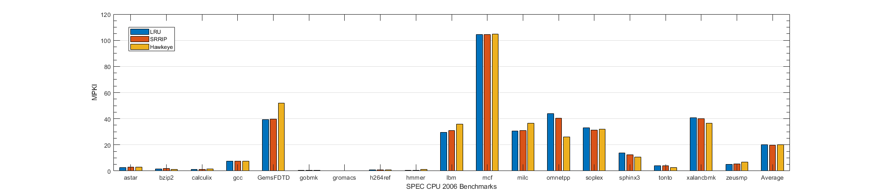
Results and Analysis
Single Core with Prefetcher
LRU: 17.99
SRRIP: 17.76
Hawkeye: 17.98

Slide 9
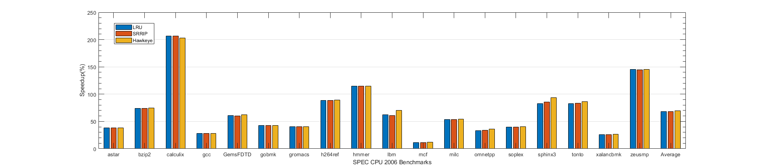
Results and Analysis
Single Core with Prefetcher
IPC (%)
LRU: 61.55%
SRRIP: 61.66%
Hawkeye: 62.89%

Slide 10
Thank you!

Slide 11
Appendix

Slide 12
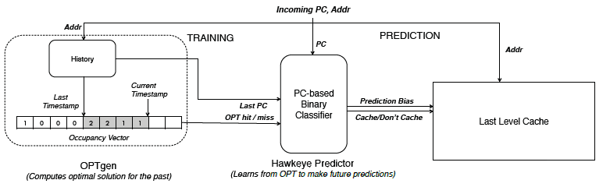
Structure Overview

Slide 13
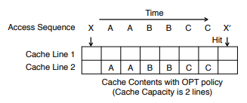
OPTgen

Slide 14
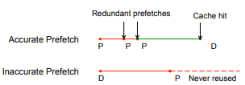
Prefetch

Slide 15
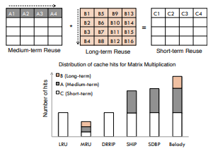
Replacement

