Slide 1
“Athena”: A Beacon of AI-Enabled Healthcare Transformation- Resource Allocation and Policy Customization
Presented at the eHealth4everyone: AI4Healthcare Hackathon
Team B
September, 2023

Slide 2

Outline
Introduction
Problem Statement
Methods & Description- “Athena”
Market size & Opportunities
Challenges and Recommendations
Call to action
Team profile
Conclusion
References

Slide 3
Introduction
SDG3: Ensure healthy lives and promote well-being for all at all ages.
Poor healthcare resource allocation and financing key challenges in Africa.
Poorly informed policy decisions, a major cause of persistently depressed metrics.
About 40% of Nigerians live in poverty, social conditions that create ill health.
Low life-expectancy in Nigeria (54 years); High U-5 mortality than other countries!
Improving health equity and tailored policies, vital in achieving SDG3.

Slide 4

Introduction
Health informatics and Digital health proposed as tools to achieve fairness in healthcare resource allocation.
Algorithmic fairness highlights specific opportunities where machine learning, public and population health may synergize to achieve health equity.
AI’s role functional in contributing novel knowledge to public health.

Slide 5
Problem Statement
Significant challenge in efficiently allocating resources and customizing healthcare policies, especially in low-resource settings.
Healthcare administrators and policy makers lack tools and systems needed to make informed decisions regarding resource allocation and policy adjustments.
Consequent, regional health disparities and poor healthcare indices.

Slide 6
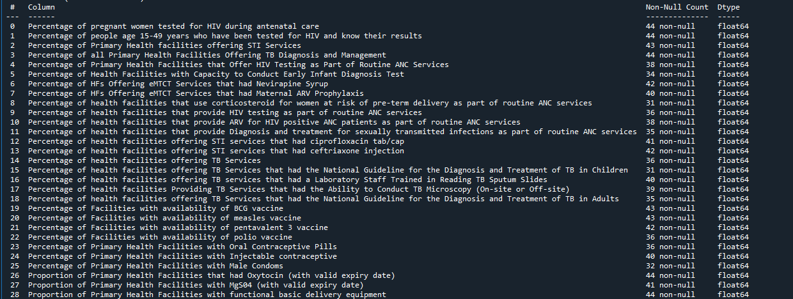
Methods & Description- “Athena”
DATA
Raw data from MSDAT. Considered 49 unique health service access metrics and the various locations.
Initial preprocessing considered 29 metrics. Details of access metrics are shown:

Slide 7
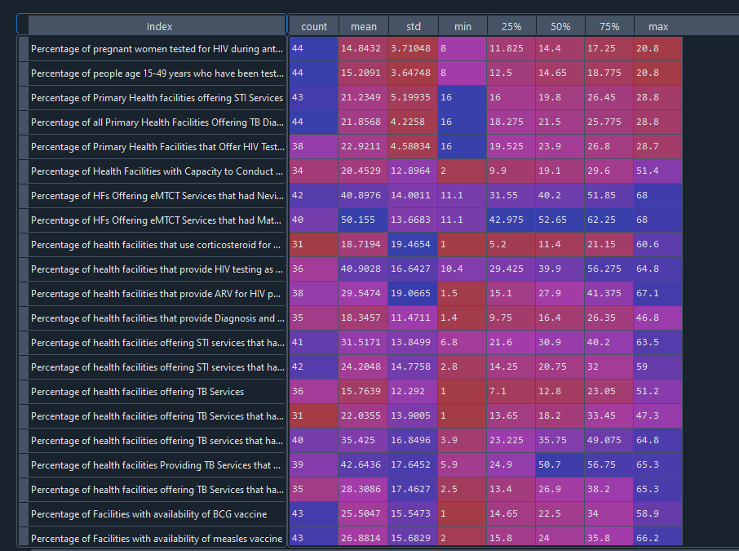
Methods & Description- “Athena”
DATA
Further descriptive statistics of select variables

Slide 8

Methods & Description- “Athena”
DATA
Nulls filled with mean of group.
Correlational analysis revealed trends e.g. % of health facilities to conduct early Infact diagnosis test was strongly correlated with facilities that provide ARV to HIV + ANC patients.
Also, % of facilities offering HIV testing as part of routine ANC was negatively correlated with % facilities offering TB services that had National guidelines for diag. & treat. of TB in children. (Perhaps resource scarcity has lead to a focus on a single disease).

Slide 9

Methods & Description- “Athena”
MODEL – “Athena”
Tripartite system- [Clustering algo, Health index categorization algo, Summary & recommendation chat LM]
Clustering algo- PCA + Kmeans. Clusters based on granular data semblances. Similar resources, policies and interventions are expected to work for groups in same clusters
Health index categorization algo- DL AutoEncoder + Quantile stats. Prioritization in resource allocation and policy formulation based on health index
Summary & recommendation chat LM- meta-llama/Llama-2-70b-chat-hf. Chatbot provides summary of health metrics and recommendations. Abstracts non-technicality and allows for data driven, tailor-made health policies

Slide 10
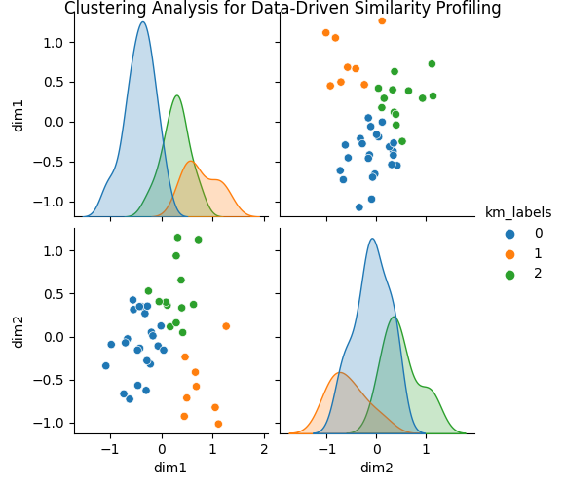
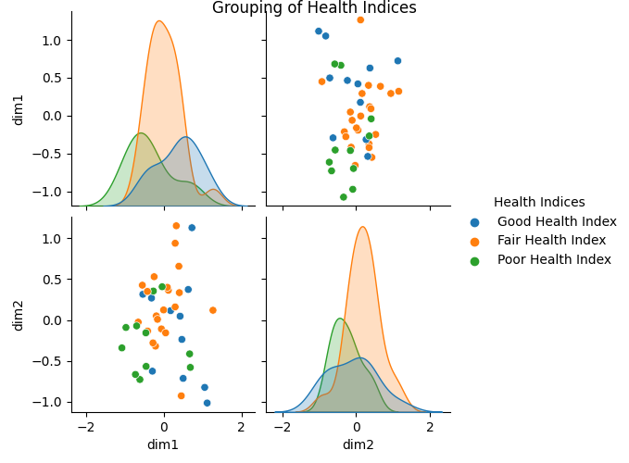
Methods & Description- “Athena”

Slide 11
Methods & Description- “Athena”
“Athena: Summary
The healthcare system in Bayelsa, Nigeria, faces several challenges in providing quality care to its population. The data analysis reveals that the state has a fair health index, with varying performance across different healthcare indicators. Some areas of concern include:
Low percentage of health facilities offering essential newborn care services, such as early infant diagnosis test and maternal ARV prophylaxis.
Limited availability of critical medicines and supplies, including corticosteroids for pre-term deliveries, HIV testing kits, and ARV drugs for HIV positive patients.
Low proportion of health facilities providing comprehensive tuberculosis services, including diagnostic capabilities and trained laboratory staff.
Limited access to family planning methods, such as oral contraceptives, injectables, and male condoms.
Inadequate infrastructure and equipment, including lack of functional basic delivery equipment and oxytocin with valid expiry dates.”

Slide 12
Methods & Description- “Athena”
“Athena: Recommendations
To address the gaps in healthcare service delivery in Bayelsa, the following recommendations are proposed:
1. Strengthen health systems management: Improve leadership and governance structures to enhance coordination and accountability among healthcare providers. Develop robust monitoring and evaluation frameworks to track progress towards healthcare goals.
2. Scale up training and capacity building: Provide regular training and capacity building programs for healthcare workers on essential newborn care, HIV testing, and TB diagnosis and treatment. Strengthen mentorship programs to support health workers in rural areas.
3. Improve medicine and supply chain management: Streamline procurement processes to ensure timely availability of essential medicines and supplies. Establish an efficient logistics management system to prevent stockouts and wastage.
4. Enhance family planning services: Increase awareness campaigns to promote uptake of various family planning methods. Ensure adequate supply of contraceptives and make them accessible to remote communities.
5. Upgrade infrastructure and equipment: Prioritize funding for facility renovation and equipping of primary health centers with basic delivery equipment, oxytocin, and other life-saving commodities. Install solar power systems to mitigate electricity challenges in rural areas.

Slide 13
Methods & Description- “Athena”
6. Promote community engagement: Foster partnerships between healthcare providers, community leaders, and religious organizations to increase awareness about healthy behaviors and promote demand for healthcare services. Encourage community participation in healthcare decision-making processes.
7. Leverage technology: Adopt digital solutions, such as telemedicine and mobile health applications, to extend healthcare services to hard-to-reach populations. Utilize data analytics to monitor disease trends, track healthcare utilization patterns, and optimize resource allocation.
8. Collaborate with private sector stakeholders: Engage with local businesses and NGOs to explore opportunities for collaboration in healthcare service delivery, capacity building, and advocacy.
9. Advocate for increased funding: Lobby government officials and development partners to allocate more resources to healthcare, particularly for primary healthcare services and essential medicines.
10. Monitor and evaluate progress: Regularly assess progress towards healthcare goals using agreed-upon indicators. Use data to hold stakeholders accountable and adjust strategies accordingly.
By implementing these recommendations, Bayelsa can significantly improve its healthcare system, move closer to achieving the SDG3 targets, and ultimately ensure better health outcomes for its population.

Slide 14
Market size & Opportunities
In 2013, Healthcare AI companies raised USD 4.3 billion globally across more than 500 equity deals.
Global market for healthcare predictive analytics valued at USD 1.48 billion in 2015.
Expected to grow at a rate of 29.3% (compound annual growth rate) by 2025.
Government bodies/initiatives, Policymakers, Funding agencies, Healthcare bodies, research organizations.
Partnerships and Collaborations- NGOs, Public-Private etc.
Improved healthcare delivery, Health equity, data-driven policies, better health metrics, value-based care, research, telemedicine.

Slide 15

Challenges and Recommendations
Limited data accessibility
Poor data quality from MSDAT- missing values
Restricted computational power
Difficulty validating unsupervised models
Culture and Language agnostic
User Adoption and Training

Slide 16
Challenges and Recommendations
Collaborative effort between local heath care providers and regional organizations to establish quality, large databases.
Large-scale practical, public health research to assess performance and implementation of models.
Effort on legal and ethical adherence of resource Health AI.
Comprehensive support and training of concerned health bodies on Health AI algorithms.
Provision of appropriate hardware for massive scalability.
Community engagement and involvement in healthcare policy discussions.

Slide 17
Call to action
Are you a healthcare leader, innovator, or policymaker?
Are you passionate about improving healthcare access and outcomes in underserved communities?
Do you believe in the power of AI to transform healthcare for the better?
It’s Time to Act!
Collaborate-Global Impact-Innovation-Improving Lives-Research & Development-AI
Together, we can “Athena” the beacon of hope for healthcare transformation in low-resource settings

Slide 18

Team profile
Members
Taofeek Togunwa (Data Science/AI)
Sodiq Jinad (Data Science/AI)
Mentors
Joseph Ologunja (AI Mentor)
Aniekan Eric (Public Health Mentor)

Slide 19
Conclusion
In the journey to address the complex challenges of healthcare, particularly in low-resource settings, “Athena”- with a focus on AI-enabled healthcare prioritization, resource allocation, and policy customization; is posed to revolutionize healthcare delivery worldwide.
“Of all the forms of inequality, injustice in health is the most shocking and inhumane.” — Martin Luther King Jr.

Slide 20
References
Brewer LC, Fortuna KL, Jones C, Walker R, Hayes SN, Patten CA, Cooper LA Back to the Future: Achieving Health Equity Through Health Informatics and Digital Health JMIR Mhealth Uhealth 2020;8(1):e14512 doi: 10.2196/14512
Denis Horgan, Mario Romao, Servaas A. Morré, Dipak Kalra; Artificial Intelligence: Power for Civilisation – and for Better Healthcare. Public Health Genomics 5 February 2020; 22 (5-6): 145–161. https://doi.org/10.1159/000504785
Love-Koh, J., Griffin, S., Kataika, E. et al. Methods to promote equity in health resource allocation in low- and middle-income countries: an overview. Global Health 16, 6 (2020). https://doi.org/10.1186/s12992-019-0537-z
Mhasawade, V., Zhao, Y. & Chunara, R. Machine learning and algorithmic fairness in public and population health. Nat Mach Intell 3, 659–666 (2021). https://doi.org/10.1038/s42256-021-00373-4
Obinna O Oleribe, Jenny Momoh, Benjamin SC Uzochukwu, Francisco Mbofana, Akin Adebiyi, Thomas Barbera, Roger Williams & Simon D Taylor-Robinson (2019) Identifying Key Challenges Facing Healthcare Systems In Africa And Potential Solutions, International Journal of General Medicine, 12:, 395-403, DOI: 10.2147/IJGM.S223882

Slide 21
References Cont’d
Shahid N, Rappon T, Berta W (2019) Applications of artificial neural networks in health care organizational decision-making: A scoping review. PLOS ONE 14(2): e0212356. https://doi.org/10.1371/journal.pone.0212356
The Lancet Nigeria Commission: investing in health and the future of the nation. Abubakar, Ibrahim et al. ,The Lancet, Volume 399, Issue 10330, 1155 - 1200

