Slide 1
Open Source
Hiragana Workbook
A free, openly licensed resource for individual learners,
study groups, and classrooms.
Created by Soreasan / ソレアサン
You’re welcome to edit, share, and reupload it
under the included license terms.
See slide 90, “Sharing and Adapting This Workbook,” for details.

Slide 2
About This Workbook
A free, openly licensed resource for individual learners, study groups, and classrooms. You’re welcome to edit, share, and reupload it under the included license terms.
See slide 90, “Sharing and Adapting This Workbook,” for details.
Learn one row at a time
Start with the row overview. Then practice each character using its pronunciation, stroke order, and mnemonic illustration.
Practice the sound rules
After the 46 basic characters, explore combined sounds, particles, long vowels, and small っ.

Slide 3
Hiragana at a Glance
Basic hiragana
Dakuten ゛ and handakuten ゜
k
s
t
n
h
m
y
r
w
が ぎ ぐ げ ご (g)
a
あ
か
さ
た
な
は
ま
や
ら
わ
ざ じ ず ぜ ぞ (z / j)
i
い
き
し
ち
に
ひ
み
り
だ ぢ づ で ど (d / j / z)
う
く
す
つ
ぬ
ふ
む
ゆ
る
ば び ぶ べ ぼ (b)
u
え
け
せ
て
ね
へ
め
れ
ぱ ぴ ぷ ぺ ぽ (p)
e
お
こ
そ
と
の
ほ
も
よ
ろ
を
Small ゃ・ゅ・ょ combinations
o
きゃ きゅ きょ しゃ しゅ しょ
ん n
ちゃ ちゅ ちょ にゃ にゅ にょ
ひゃ ひゅ ひょ みゃ みゅ みょ
りゃ りゅ りょ ぎゃ ぎゅ ぎょ
じゃ じゅ じょ びゃ びゅ びょ
ぴゃ ぴゅ ぴょ
Chart: TealComet, Hiragana Chart Seion Dakuon Yoon — CC0 1.0
Wikimedia Commons · Adapted layout; basic-row positions corrected; common combinations shown

Slide 4
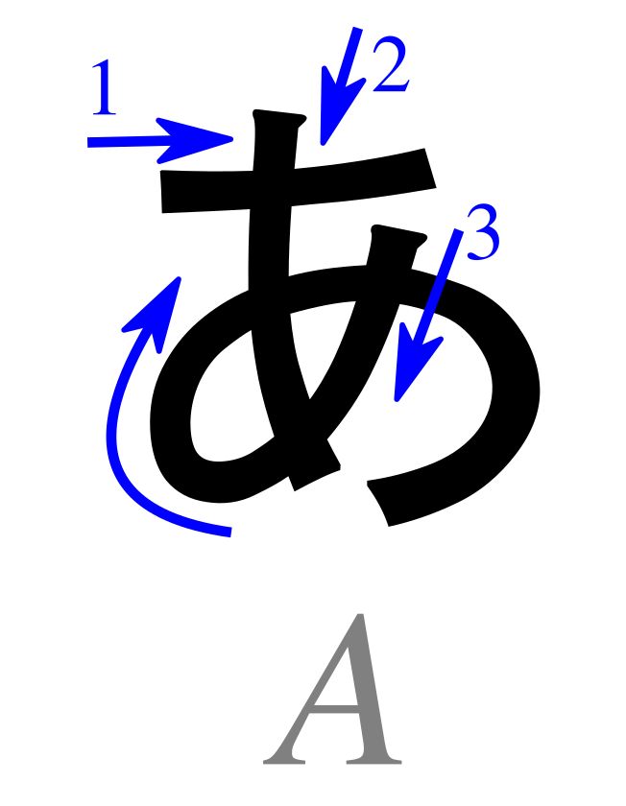
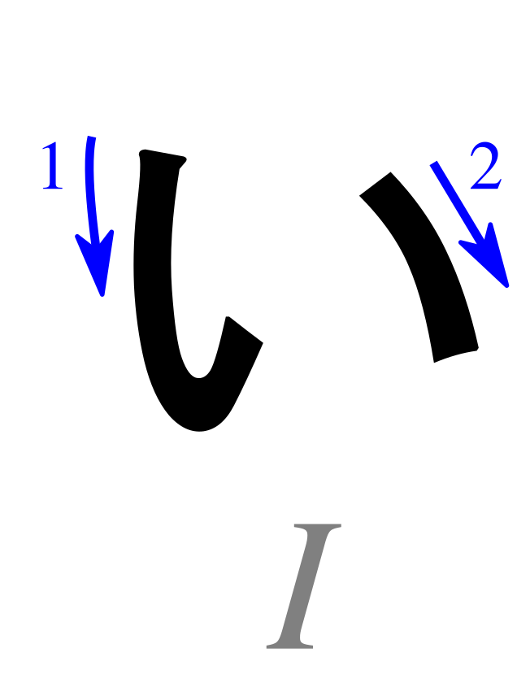
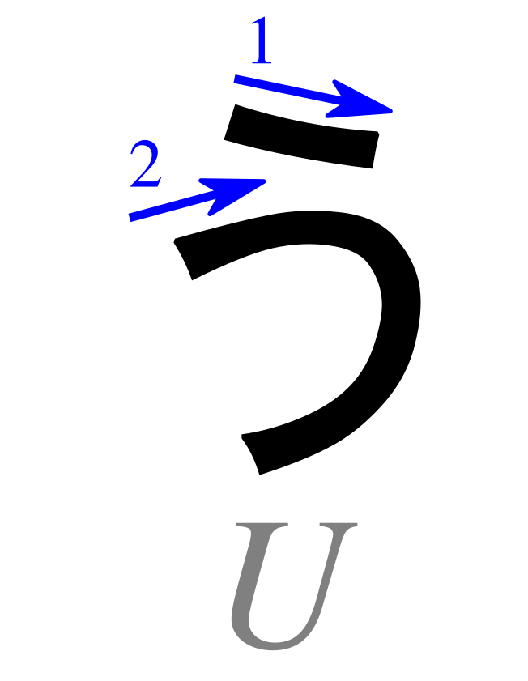
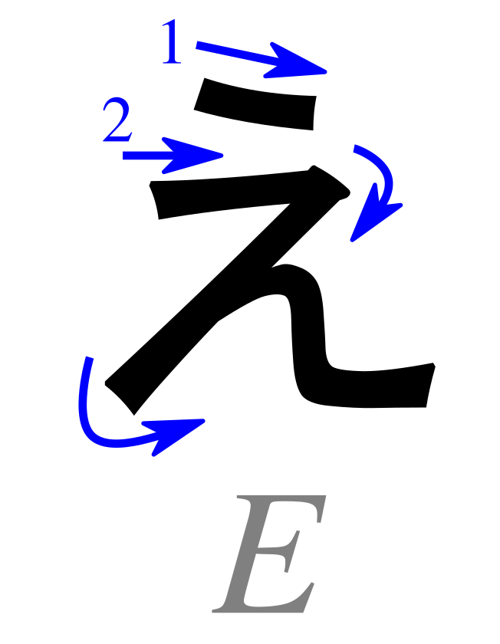
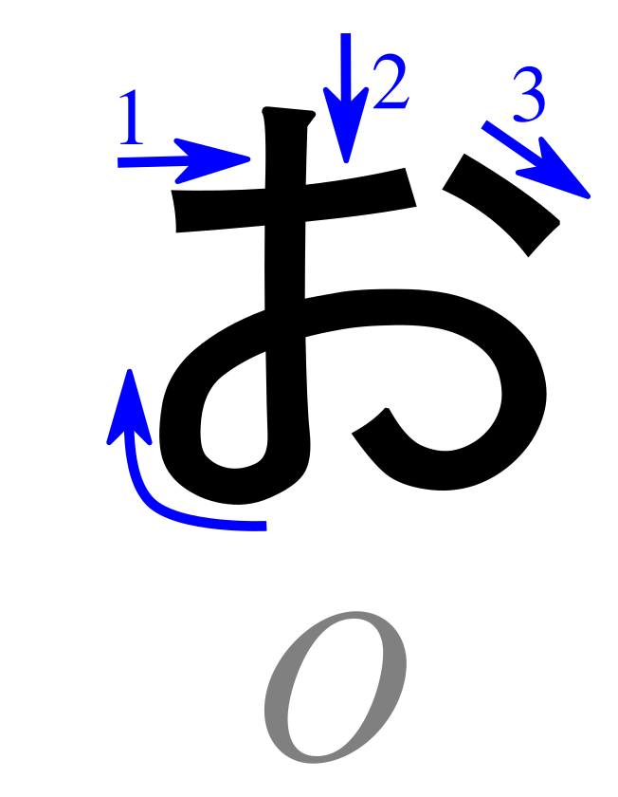
Basic Hiragana: Vowels
A
I
U
E
O
Characters: Pmx (after Karine Widmer), Table hiragana.svg — CC BY-SA 3.0 ·
Wikimedia Commons · Cropped/resized from the original work

Slide 5
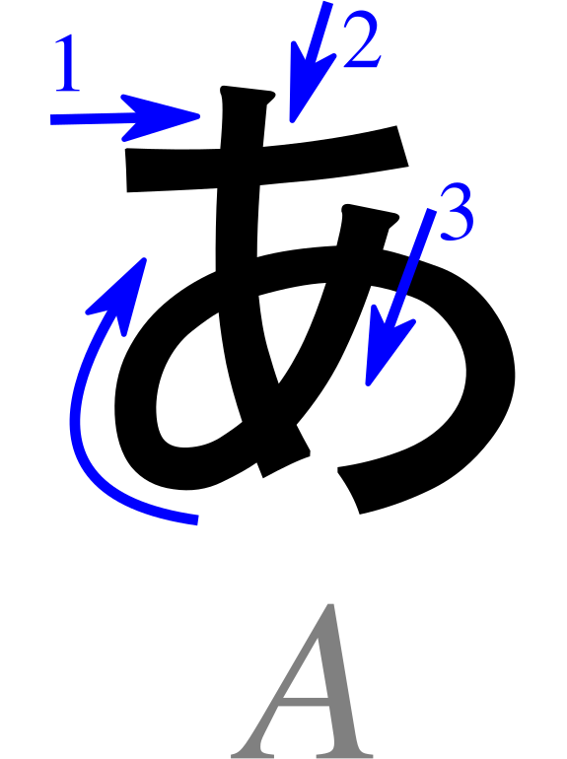

あ
Pronunciation
a - as in “father”
Romaji: a
Stroke Order
Memory Reminder
Attention!
Mnemonic: B. Domangue (LeafPiece), Japanese Kana Mnemonic Chart — CC BY-SA 4.0
Character: Pmx (after Karine Widmer), Table hiragana.svg — CC BY-SA 3.0 ·
Wikimedia Commons · Cropped/resized from the original works

Slide 6
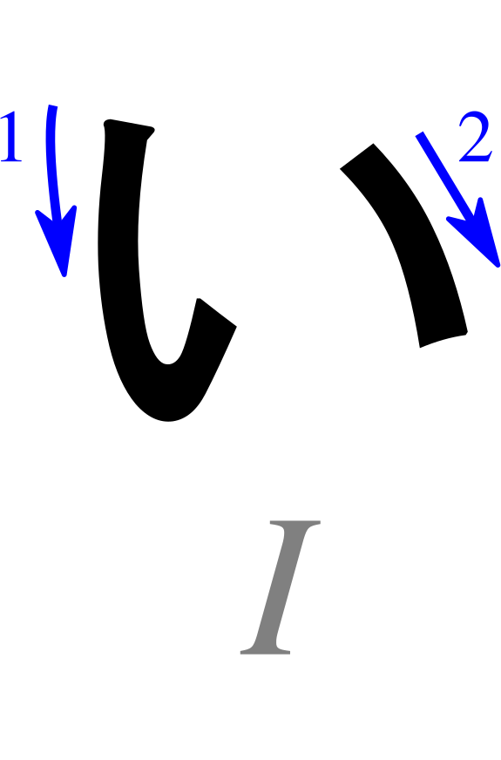
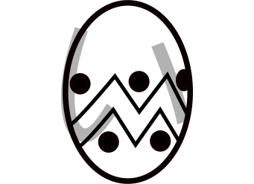
い
Pronunciation
i - as in “machine”
Romaji: i
Stroke Order
Memory Reminder
Easter egg
Mnemonic: B. Domangue (LeafPiece), Japanese Kana Mnemonic Chart — CC BY-SA 4.0
Character: Pmx (after Karine Widmer), Table hiragana.svg — CC BY-SA 3.0 ·
Wikimedia Commons · Cropped/resized from the original works

Slide 7
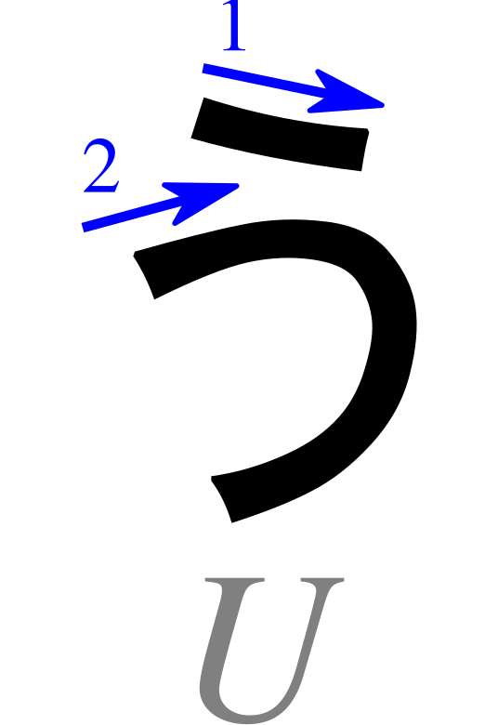
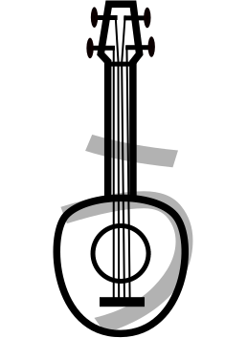
う
Pronunciation
u - as in “oo” in “food”
Romaji: u
Stroke Order
Memory Reminder
Ukulele
Mnemonic: B. Domangue (LeafPiece), Japanese Kana Mnemonic Chart — CC BY-SA 4.0
Character: Pmx (after Karine Widmer), Table hiragana.svg — CC BY-SA 3.0 ·
Wikimedia Commons · Cropped/resized from the original works

Slide 8
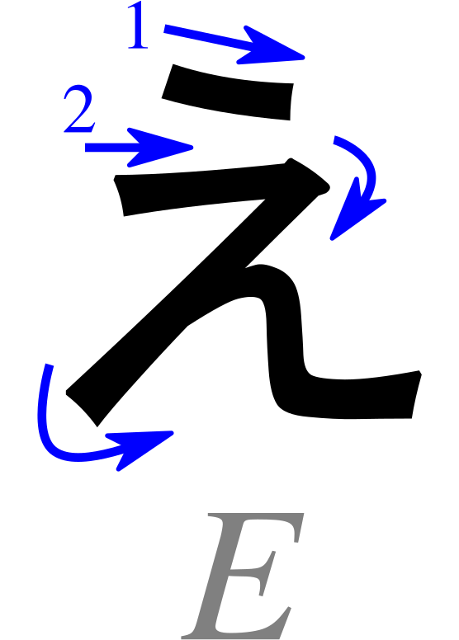
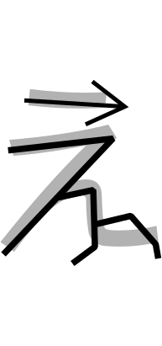
え
Pronunciation
e - as in “met”
Romaji: e
Stroke Order
Memory Reminder
Edge of the cliff
Mnemonic: B. Domangue (LeafPiece), Japanese Kana Mnemonic Chart — CC BY-SA 4.0
Character: Pmx (after Karine Widmer), Table hiragana.svg — CC BY-SA 3.0 ·
Wikimedia Commons · Cropped/resized from the original works

Slide 9
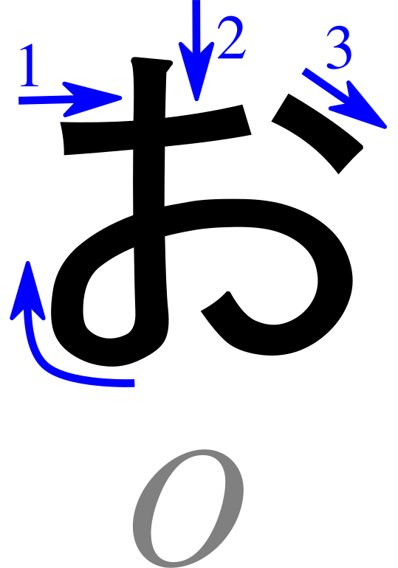
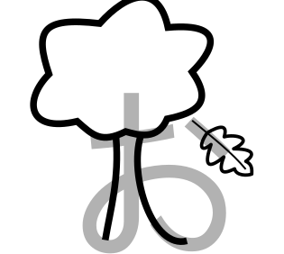
お
Pronunciation
o - as in “go”
Romaji: o
Stroke Order
Memory Reminder
Oak tree drops a leaf
Mnemonic: B. Domangue (LeafPiece), Japanese Kana Mnemonic Chart — CC BY-SA 4.0
Character: Pmx (after Karine Widmer), Table hiragana.svg — CC BY-SA 3.0 ·
Wikimedia Commons · Cropped/resized from the original works

Slide 10
Writing Practice: Vowels
Follow the stroke order. Copy each character into the practice boxes.
Characters: Pmx (after Karine Widmer), Table hiragana.svg — CC BY-SA 3.0 ·
Wikimedia Commons · Cropped/resized from the original work

Slide 11
Read These Words!
Write the romaji below each character. Then read the whole word aloud.
あ
い
う
え
love
above

Slide 12
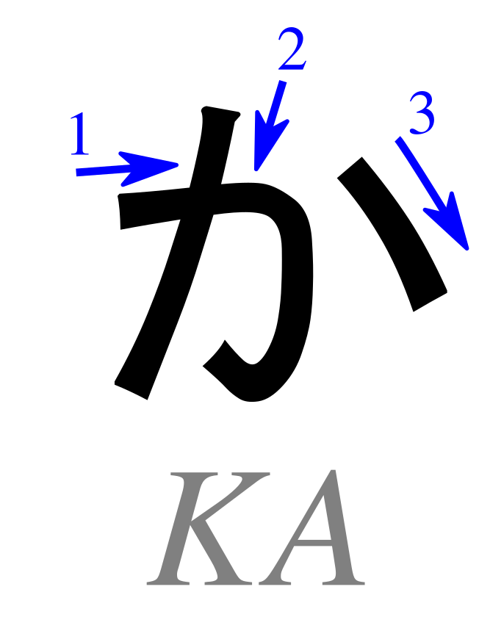
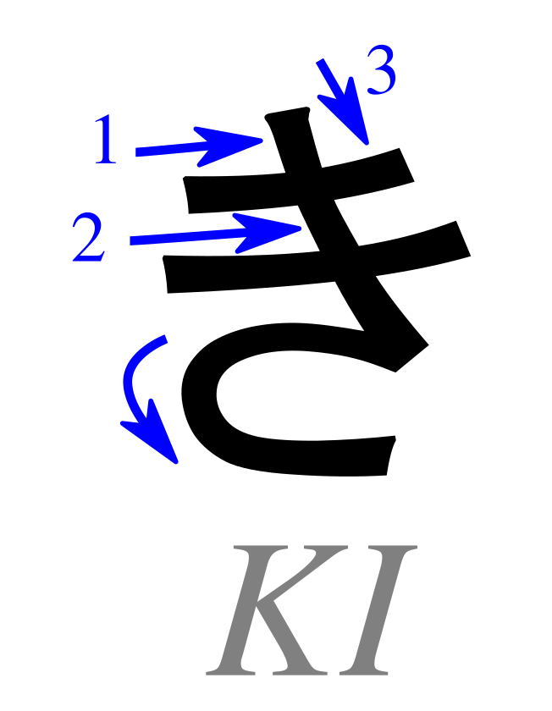
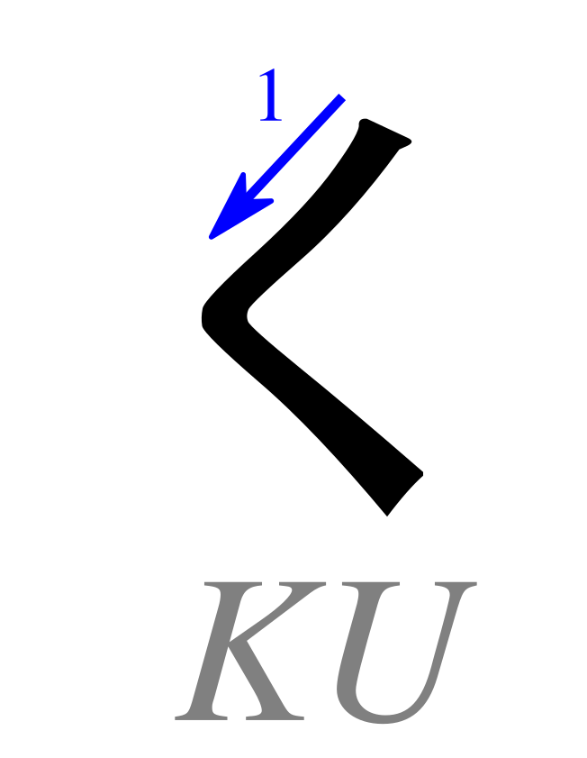
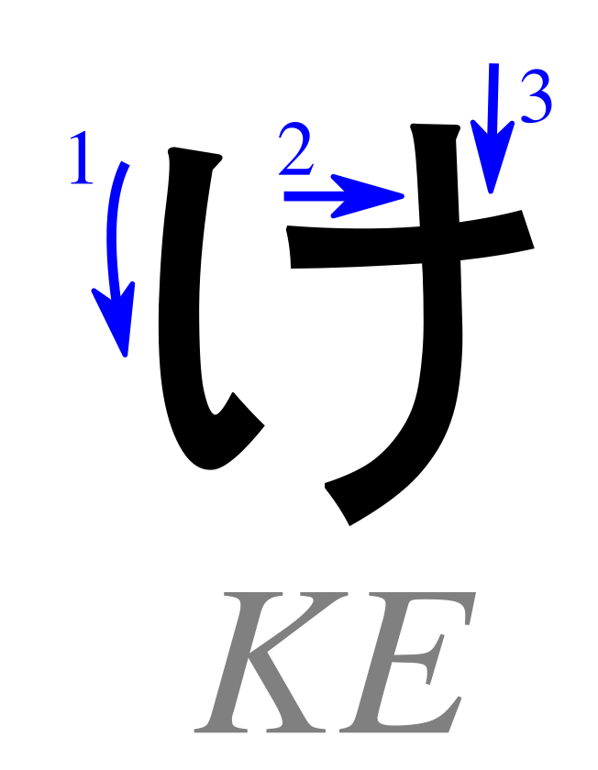
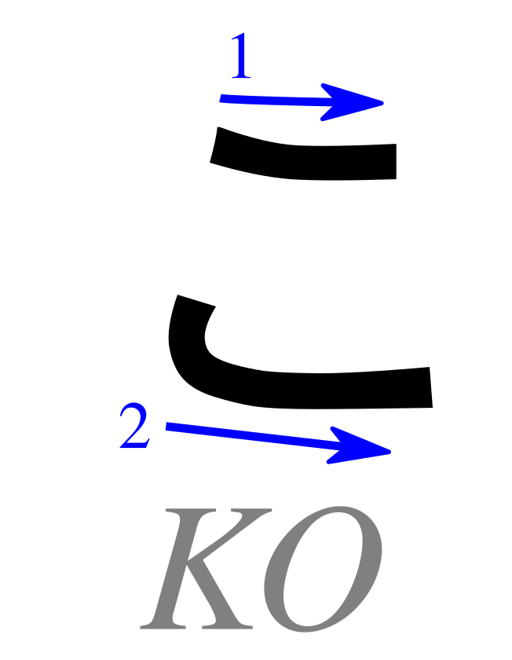
Basic Hiragana: K row
Ka
Ki
Ku
Ke
Ko
Characters: Pmx (after Karine Widmer), Table hiragana.svg — CC BY-SA 3.0 ·
Wikimedia Commons · Cropped/resized from the original work

Slide 13
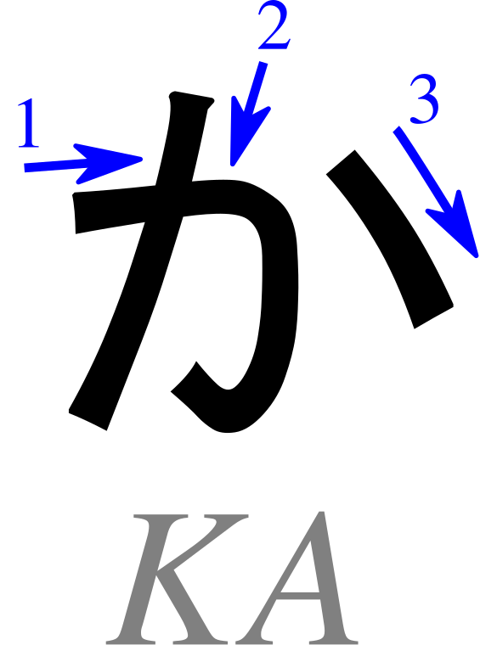

か
Pronunciation
ka - as in “karma”
Romaji: ka
Stroke Order
Memory Reminder
Cod
Mnemonic: B. Domangue (LeafPiece), Japanese Kana Mnemonic Chart — CC BY-SA 4.0
Character: Pmx (after Karine Widmer), Table hiragana.svg — CC BY-SA 3.0 ·
Wikimedia Commons · Cropped/resized from the original works

Slide 14
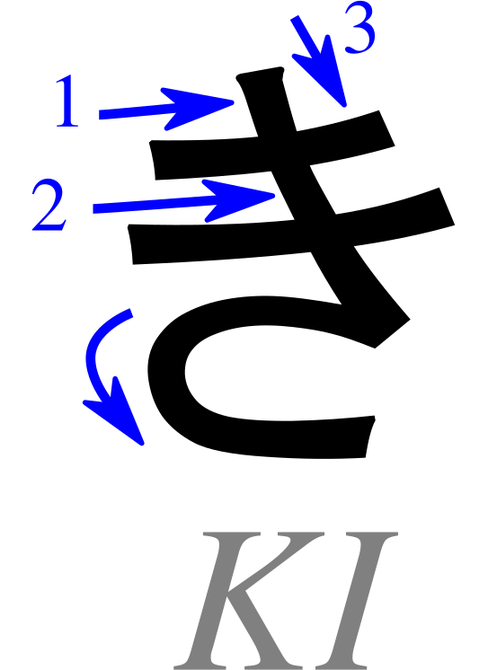

き
Pronunciation
ki - as in “key”
Romaji: ki
Stroke Order
Memory Reminder
Key
Mnemonic: B. Domangue (LeafPiece), Japanese Kana Mnemonic Chart — CC BY-SA 4.0
Character: Pmx (after Karine Widmer), Table hiragana.svg — CC BY-SA 3.0 ·
Wikimedia Commons · Cropped/resized from the original works

Slide 15
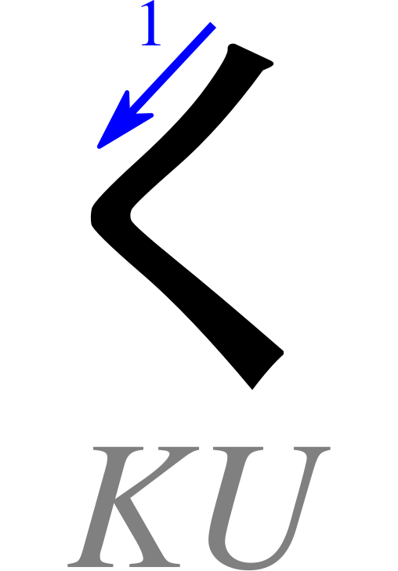
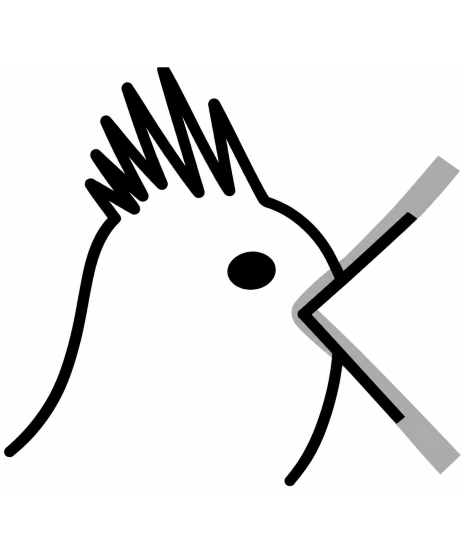
く
Pronunciation
ku - as in “coo”
Romaji: ku
Stroke Order
Memory Reminder
Cuckoo bird
Mnemonic: B. Domangue (LeafPiece), Japanese Kana Mnemonic Chart — CC BY-SA 4.0
Character: Pmx (after Karine Widmer), Table hiragana.svg — CC BY-SA 3.0 ·
Wikimedia Commons · Cropped/resized and cleaned from the original works

Slide 16
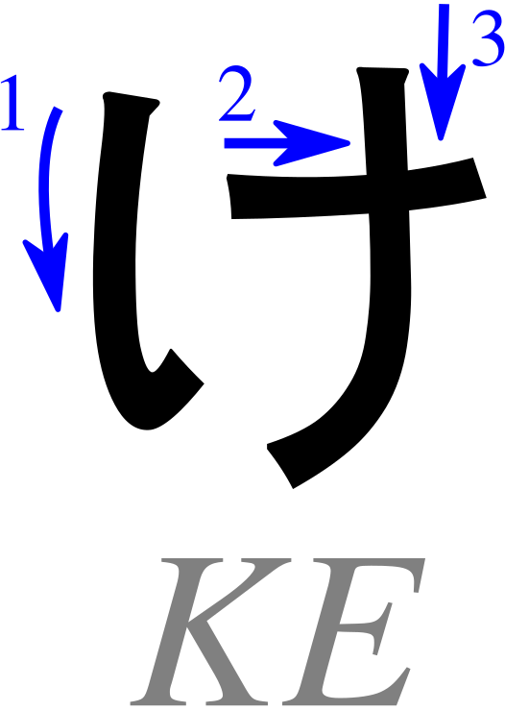
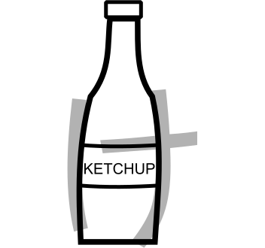
け
Pronunciation
ke - as in “kettle”
Romaji: ke
Stroke Order
Memory Reminder
Ketchup bottle
Mnemonic: B. Domangue (LeafPiece), Japanese Kana Mnemonic Chart — CC BY-SA 4.0
Character: Pmx (after Karine Widmer), Table hiragana.svg — CC BY-SA 3.0 ·
Wikimedia Commons · Cropped/resized from the original works

Slide 17
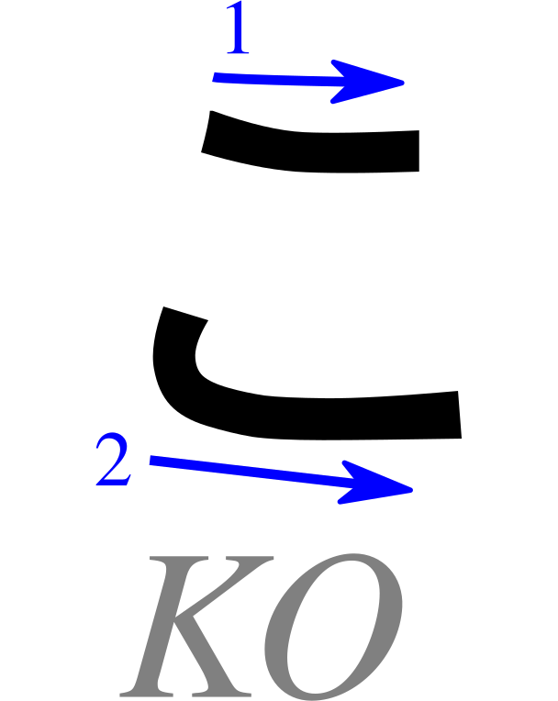

こ
Pronunciation
ko - as in “cold”
Romaji: ko
Stroke Order
Memory Reminder
Comb
Mnemonic: B. Domangue (LeafPiece), Japanese Kana Mnemonic Chart — CC BY-SA 4.0
Character: Pmx (after Karine Widmer), Table hiragana.svg — CC BY-SA 3.0 ·
Wikimedia Commons · Cropped/resized from the original works

Slide 18
Writing Practice: K row
Follow the stroke order. Copy each character into the practice boxes.
Characters: Pmx (after Karine Widmer), Table hiragana.svg — CC BY-SA 3.0 ·
Wikimedia Commons · Cropped/resized from the original work

Slide 19
Read These Words!
Write the romaji below each character. Then read the whole word aloud.
か
お
え
き
face
train station

Slide 20
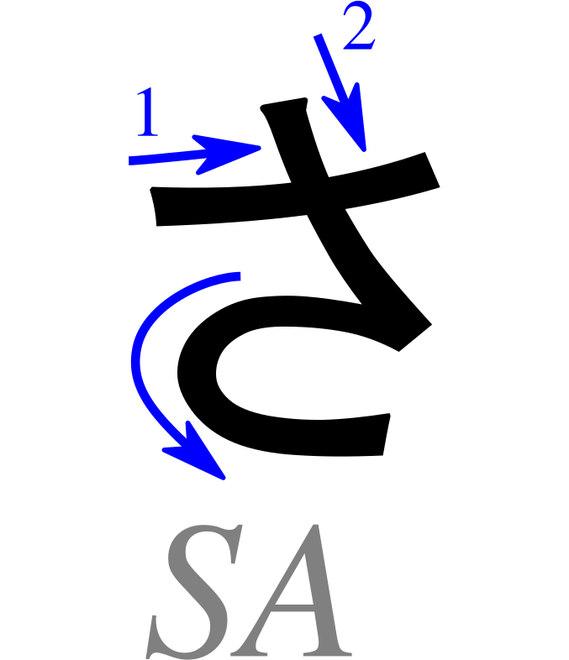
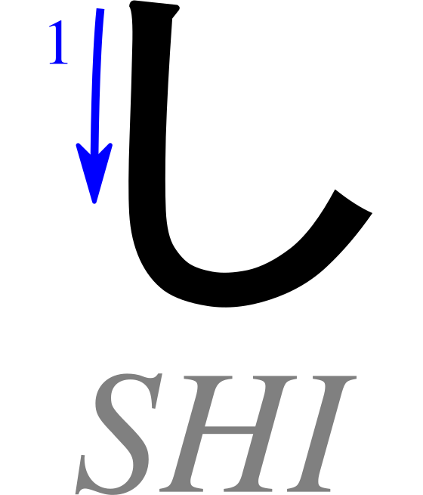
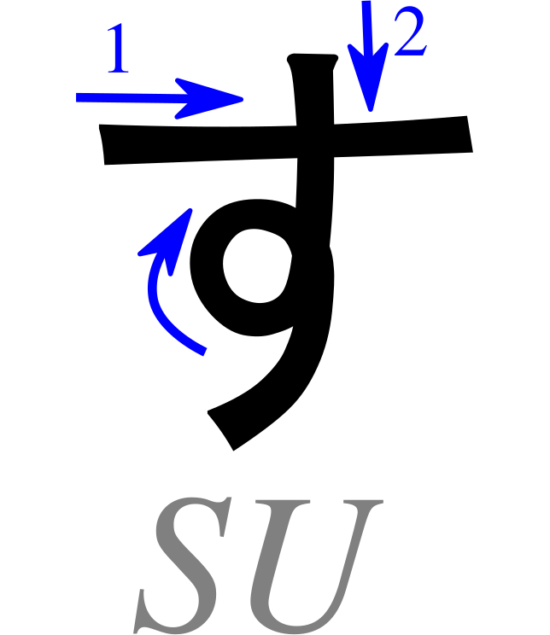
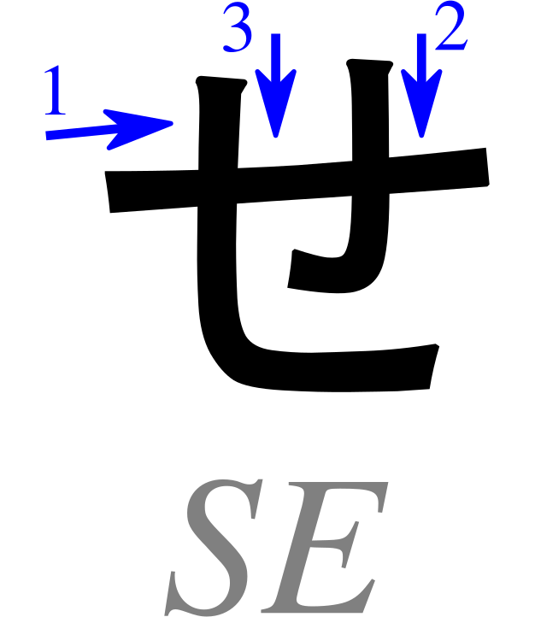
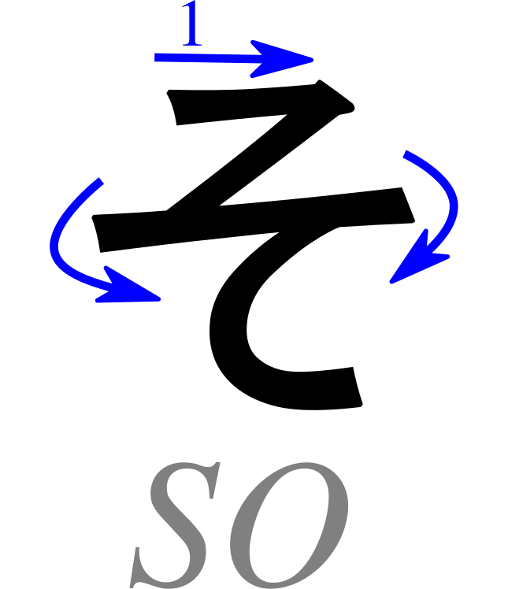
Basic Hiragana: S row
Sa
Shi
Su
Se
So
Characters: Pmx (after Karine Widmer), Table hiragana.svg — CC BY-SA 3.0 ·
Wikimedia Commons · Cropped/resized from the original work

Slide 21
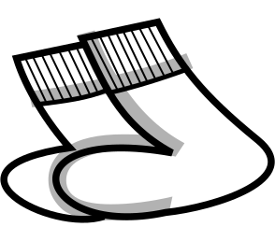
さ
Pronunciation
sa - as in “sardine”
Romaji: sa
Stroke Order
Memory Reminder
Socks
Mnemonic: B. Domangue (LeafPiece), Japanese Kana Mnemonic Chart — CC BY-SA 4.0
Character: Pmx (after Karine Widmer), Table hiragana.svg — CC BY-SA 3.0 ·
Wikimedia Commons · Cropped/resized from the original works

Slide 22

し
Pronunciation
shi - as in “sheep”
Romaji: shi
Stroke Order
Memory Reminder
Sheep
Mnemonic: B. Domangue (LeafPiece), Japanese Kana Mnemonic Chart — CC BY-SA 4.0
Character: Pmx (after Karine Widmer), Table hiragana.svg — CC BY-SA 3.0 ·
Wikimedia Commons · Cropped/resized from the original works

Slide 23
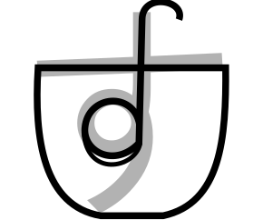
す
Pronunciation
su - as in “sou” in “soup”
Romaji: su
Stroke Order
Memory Reminder
Soup ladle in a pot
Mnemonic: B. Domangue (LeafPiece), Japanese Kana Mnemonic Chart — CC BY-SA 4.0
Character: Pmx (after Karine Widmer), Table hiragana.svg — CC BY-SA 3.0 ·
Wikimedia Commons · Cropped/resized from the original works

Slide 24
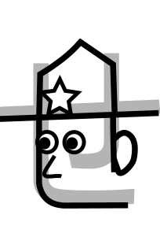
せ
Pronunciation
se - as in “set”
Romaji: se
Stroke Order
Memory Reminder
Security guard
Mnemonic: B. Domangue (LeafPiece), Japanese Kana Mnemonic Chart — CC BY-SA 4.0
Character: Pmx (after Karine Widmer), Table hiragana.svg — CC BY-SA 3.0 ·
Wikimedia Commons · Cropped/resized from the original works

Slide 25
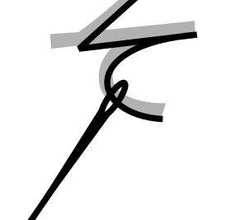
そ
Pronunciation
so - as in “sew”
Romaji: so
Stroke Order
Memory Reminder
Sew a stitch
Mnemonic: B. Domangue (LeafPiece), Japanese Kana Mnemonic Chart — CC BY-SA 4.0
Character: Pmx (after Karine Widmer), Table hiragana.svg — CC BY-SA 3.0 ·
Wikimedia Commons · Cropped/resized from the original works

Slide 26
Writing Practice: S row
Follow the stroke order. Copy each character into the practice boxes.
Characters: Pmx (after Karine Widmer), Table hiragana.svg — CC BY-SA 3.0 ·
Wikimedia Commons · Cropped/resized from the original work

Slide 27
Read These Words!
Write the romaji below each character. Then read the whole word aloud.
す
し
あ
さ
sushi
morning

Slide 28
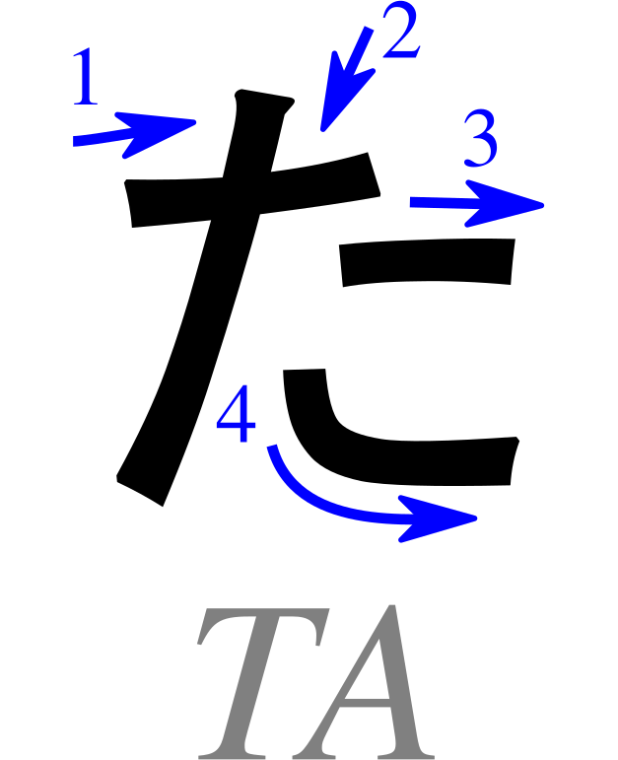
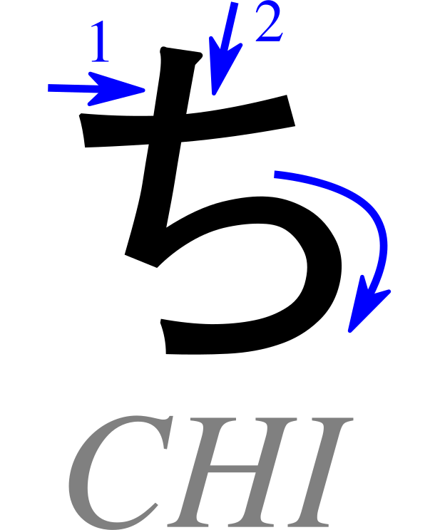
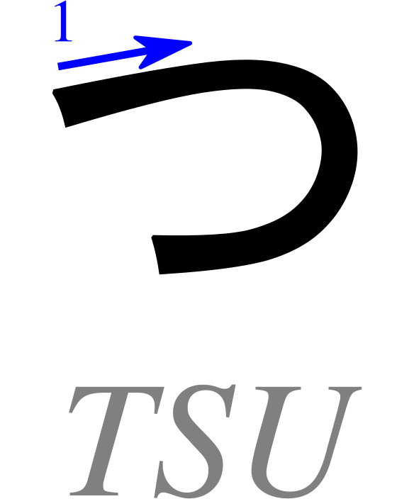
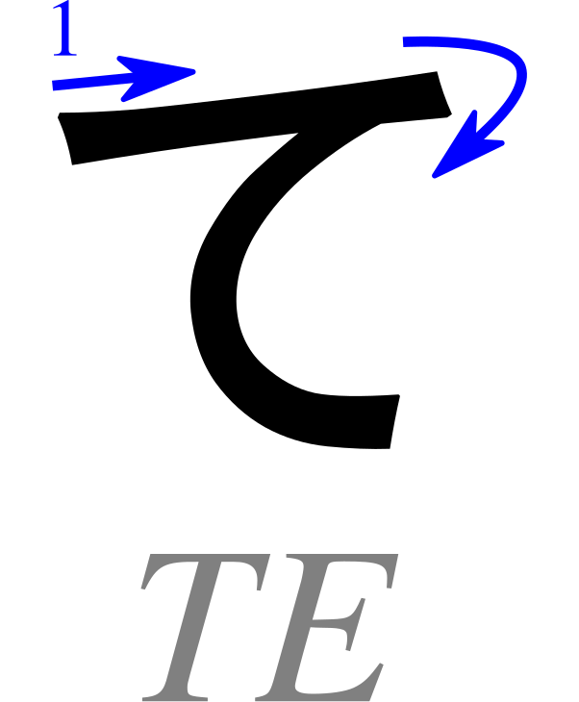
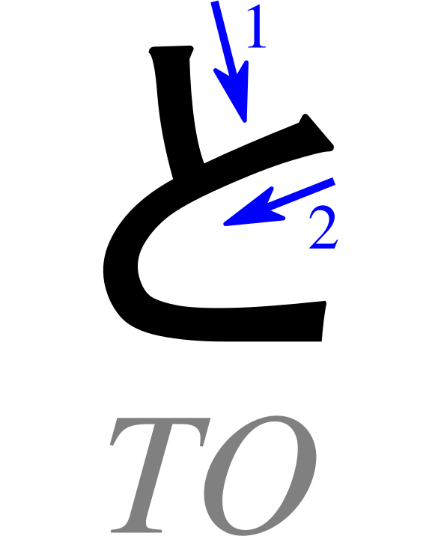
Basic Hiragana: T row
Ta
Chi
Tsu
Te
To
Characters: Pmx (after Karine Widmer), Table hiragana.svg — CC BY-SA 3.0 ·
Wikimedia Commons · Cropped/resized from the original work

Slide 29
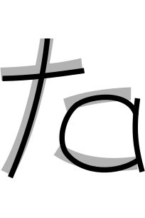
た
Pronunciation
ta - as in “taco”
Romaji: ta
Stroke Order
Memory Reminder
“Ta!”
Mnemonic: B. Domangue (LeafPiece), Japanese Kana Mnemonic Chart — CC BY-SA 4.0
Character: Pmx (after Karine Widmer), Table hiragana.svg — CC BY-SA 3.0 ·
Wikimedia Commons · Cropped/resized from the original works
Notes:
Mnemonic: B. Domangue (LeafPiece), Japanese Kana Mnemonic Chart, CC BY-SA 4.0. https://commons.wikimedia.org/wiki/File:Japanese_Kana_Mnemonic_Chart.png
Stroke order: Pmx, Table hiragana.svg, CC BY-SA 3.0. https://commons.wikimedia.org/wiki/File:Table_hiragana.svg
Images cropped and resized from the supplied charts.

Slide 30

ち
Pronunciation
chi - as in “cheese”
Romaji: chi
Stroke Order
Memory Reminder
“Cheep, cheep,” says the chick
Mnemonic: B. Domangue (LeafPiece), Japanese Kana Mnemonic Chart — CC BY-SA 4.0
Character: Pmx (after Karine Widmer), Table hiragana.svg — CC BY-SA 3.0 ·
Wikimedia Commons · Cropped/resized from the original works
Notes:
Mnemonic: B. Domangue (LeafPiece), Japanese Kana Mnemonic Chart, CC BY-SA 4.0. https://commons.wikimedia.org/wiki/File:Japanese_Kana_Mnemonic_Chart.png
Stroke order: Pmx, Table hiragana.svg, CC BY-SA 3.0. https://commons.wikimedia.org/wiki/File:Table_hiragana.svg
Images cropped and resized from the supplied charts.

Slide 31
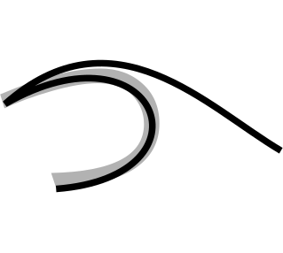
つ
Pronunciation
tsu - “ts” as in “cats,” followed by “oo”
Romaji: tsu
Stroke Order
Memory Reminder
Tsunami wave
Mnemonic: B. Domangue (LeafPiece), Japanese Kana Mnemonic Chart — CC BY-SA 4.0
Character: Pmx (after Karine Widmer), Table hiragana.svg — CC BY-SA 3.0 ·
Wikimedia Commons · Cropped/resized from the original works
Notes:
Mnemonic: B. Domangue (LeafPiece), Japanese Kana Mnemonic Chart, CC BY-SA 4.0. https://commons.wikimedia.org/wiki/File:Japanese_Kana_Mnemonic_Chart.png
Stroke order: Pmx, Table hiragana.svg, CC BY-SA 3.0. https://commons.wikimedia.org/wiki/File:Table_hiragana.svg
Images cropped and resized from the supplied charts.

Slide 32
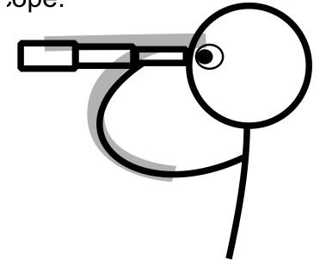
て
Pronunciation
te - as in “ten”
Romaji: te
Stroke Order
Memory Reminder
Telescope
Mnemonic: B. Domangue (LeafPiece), Japanese Kana Mnemonic Chart — CC BY-SA 4.0
Character: Pmx (after Karine Widmer), Table hiragana.svg — CC BY-SA 3.0 ·
Wikimedia Commons · Cropped/resized from the original works
Notes:
Mnemonic: B. Domangue (LeafPiece), Japanese Kana Mnemonic Chart, CC BY-SA 4.0. https://commons.wikimedia.org/wiki/File:Japanese_Kana_Mnemonic_Chart.png
Stroke order: Pmx, Table hiragana.svg, CC BY-SA 3.0. https://commons.wikimedia.org/wiki/File:Table_hiragana.svg
Images cropped and resized from the supplied charts.

Slide 33

と
Pronunciation
to - as in “toe”
Romaji: to
Stroke Order
Memory Reminder
Toaster
Mnemonic: B. Domangue (LeafPiece), Japanese Kana Mnemonic Chart — CC BY-SA 4.0
Character: Pmx (after Karine Widmer), Table hiragana.svg — CC BY-SA 3.0 ·
Wikimedia Commons · Cropped/resized from the original works
Notes:
Mnemonic: B. Domangue (LeafPiece), Japanese Kana Mnemonic Chart, CC BY-SA 4.0. https://commons.wikimedia.org/wiki/File:Japanese_Kana_Mnemonic_Chart.png
Stroke order: Pmx, Table hiragana.svg, CC BY-SA 3.0. https://commons.wikimedia.org/wiki/File:Table_hiragana.svg
Images cropped and resized from the supplied charts.

Slide 34
Writing Practice: T row
Follow the stroke order. Copy each character into the practice boxes.
Characters: Pmx (after Karine Widmer), Table hiragana.svg — CC BY-SA 3.0 ·
Wikimedia Commons · Cropped/resized from the original work

Slide 35
Read These Words!
Write the romaji below each character. Then read the whole word aloud.
た
こ
く
つ
octopus
shoes

Slide 36
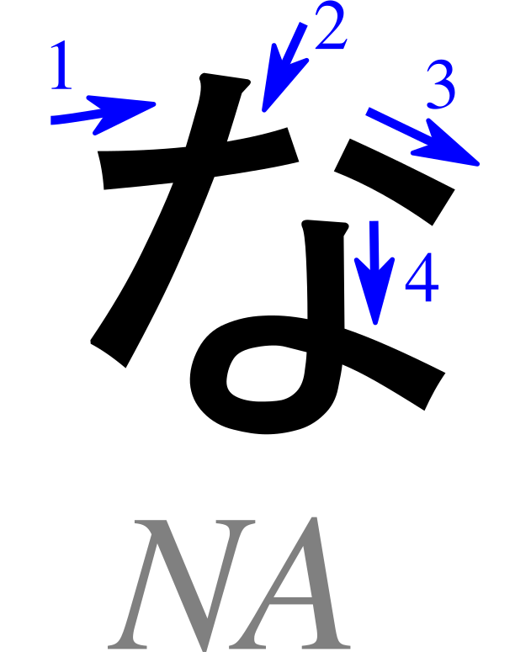
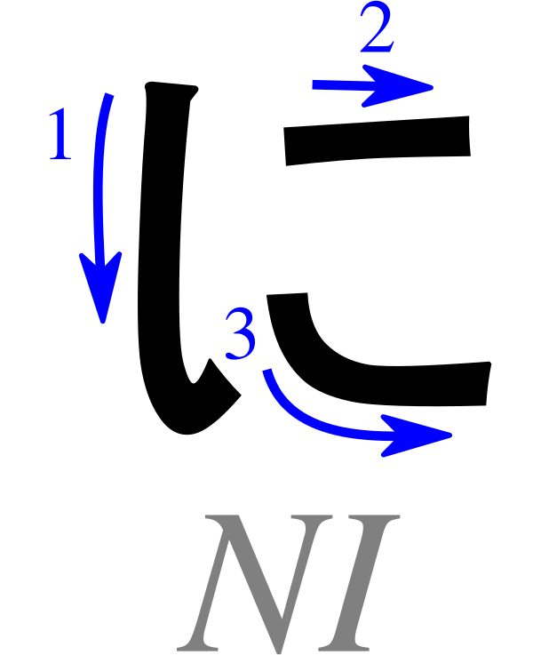
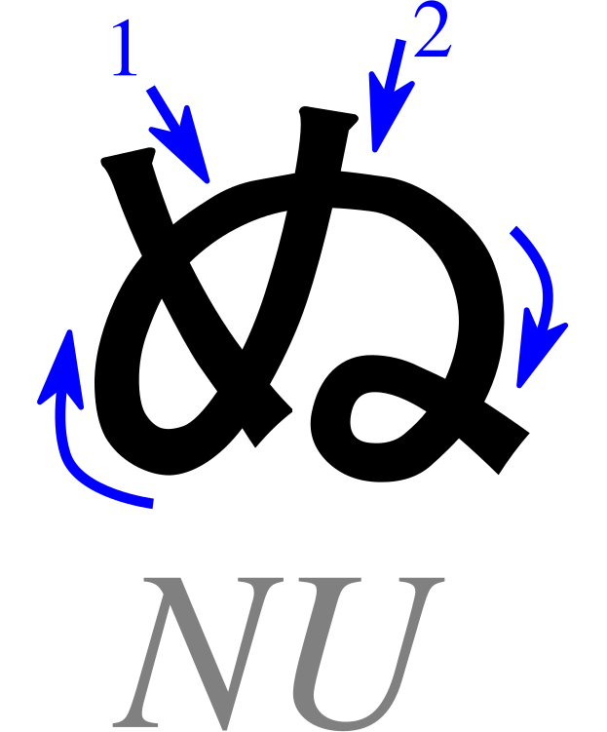
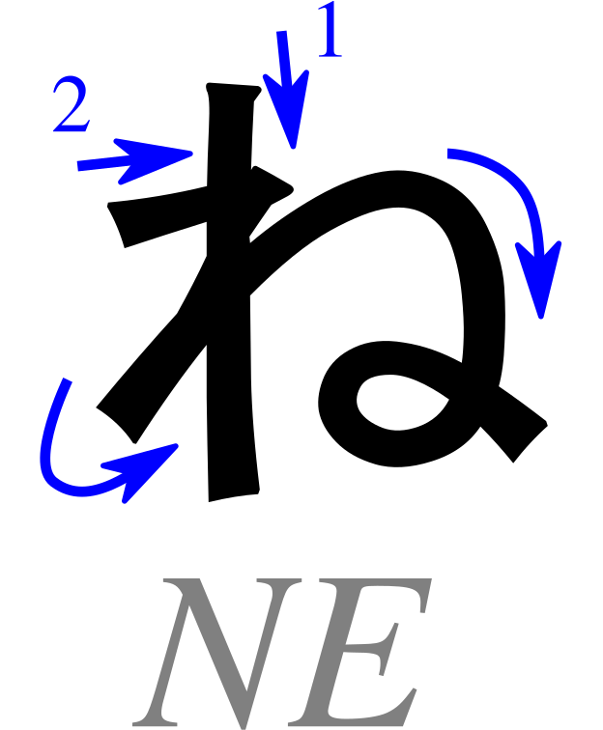
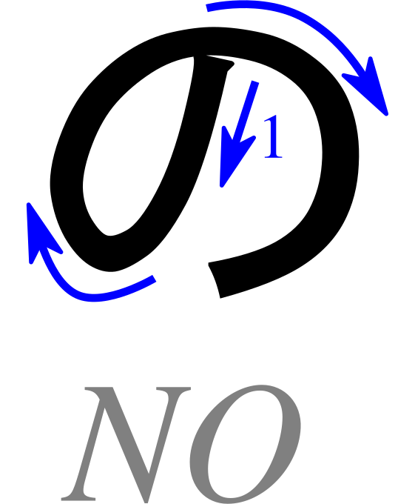
Basic Hiragana: N row
Na
Ni
Nu
Ne
No
Characters: Pmx (after Karine Widmer), Table hiragana.svg — CC BY-SA 3.0 ·
Wikimedia Commons · Cropped/resized from the original work

Slide 37
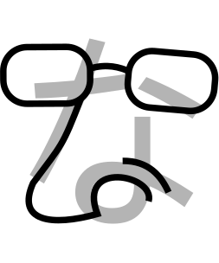
な
Pronunciation
na - as in “nacho”
Romaji: na
Stroke Order
Memory Reminder
Nostril
Mnemonic: B. Domangue (LeafPiece), Japanese Kana Mnemonic Chart — CC BY-SA 4.0
Character: Pmx (after Karine Widmer), Table hiragana.svg — CC BY-SA 3.0 ·
Wikimedia Commons · Cropped/resized from the original works
Notes:
Mnemonic: B. Domangue (LeafPiece), Japanese Kana Mnemonic Chart, CC BY-SA 4.0. https://commons.wikimedia.org/wiki/File:Japanese_Kana_Mnemonic_Chart.png
Stroke order: Pmx, Table hiragana.svg, CC BY-SA 3.0. https://commons.wikimedia.org/wiki/File:Table_hiragana.svg
Images cropped and resized from the supplied charts.

Slide 38
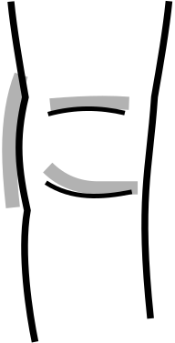
に
Pronunciation
ni - as in “knee”
Romaji: ni
Stroke Order
Memory Reminder
Knee
Mnemonic: B. Domangue (LeafPiece), Japanese Kana Mnemonic Chart — CC BY-SA 4.0
Character: Pmx (after Karine Widmer), Table hiragana.svg — CC BY-SA 3.0 ·
Wikimedia Commons · Cropped/resized from the original works
Notes:
Mnemonic: B. Domangue (LeafPiece), Japanese Kana Mnemonic Chart, CC BY-SA 4.0. https://commons.wikimedia.org/wiki/File:Japanese_Kana_Mnemonic_Chart.png
Stroke order: Pmx, Table hiragana.svg, CC BY-SA 3.0. https://commons.wikimedia.org/wiki/File:Table_hiragana.svg
Images cropped and resized from the supplied charts.

Slide 39

ぬ
Pronunciation
nu - as in “noo” in “noodle”
Romaji: nu
Stroke Order
Memory Reminder
Noodles and chopsticks
Mnemonic: B. Domangue (LeafPiece), Japanese Kana Mnemonic Chart — CC BY-SA 4.0
Character: Pmx (after Karine Widmer), Table hiragana.svg — CC BY-SA 3.0 ·
Wikimedia Commons · Cropped/resized from the original works
Notes:
Mnemonic: B. Domangue (LeafPiece), Japanese Kana Mnemonic Chart, CC BY-SA 4.0. https://commons.wikimedia.org/wiki/File:Japanese_Kana_Mnemonic_Chart.png
Stroke order: Pmx, Table hiragana.svg, CC BY-SA 3.0. https://commons.wikimedia.org/wiki/File:Table_hiragana.svg
Images cropped and resized from the supplied charts.

Slide 40

ね
Pronunciation
ne - as in “net”
Romaji: ne
Stroke Order
Memory Reminder
Next train arrives
Mnemonic: B. Domangue (LeafPiece), Japanese Kana Mnemonic Chart — CC BY-SA 4.0
Character: Pmx (after Karine Widmer), Table hiragana.svg — CC BY-SA 3.0 ·
Wikimedia Commons · Cropped/resized from the original works
Notes:
Mnemonic: B. Domangue (LeafPiece), Japanese Kana Mnemonic Chart, CC BY-SA 4.0. https://commons.wikimedia.org/wiki/File:Japanese_Kana_Mnemonic_Chart.png
Stroke order: Pmx, Table hiragana.svg, CC BY-SA 3.0. https://commons.wikimedia.org/wiki/File:Table_hiragana.svg
Images cropped and resized from the supplied charts.

Slide 41

の
Pronunciation
no - as in “no”
Romaji: no
Stroke Order
Memory Reminder
No smoking
Mnemonic: B. Domangue (LeafPiece), Japanese Kana Mnemonic Chart — CC BY-SA 4.0
Character: Pmx (after Karine Widmer), Table hiragana.svg — CC BY-SA 3.0 ·
Wikimedia Commons · Cropped/resized from the original works
Notes:
Mnemonic: B. Domangue (LeafPiece), Japanese Kana Mnemonic Chart, CC BY-SA 4.0. https://commons.wikimedia.org/wiki/File:Japanese_Kana_Mnemonic_Chart.png
Stroke order: Pmx, Table hiragana.svg, CC BY-SA 3.0. https://commons.wikimedia.org/wiki/File:Table_hiragana.svg
Images cropped and resized from the supplied charts.

Slide 42
Writing Practice: N row
Follow the stroke order. Copy each character into the practice boxes.
Characters: Pmx (after Karine Widmer), Table hiragana.svg — CC BY-SA 3.0 ·
Wikimedia Commons · Cropped/resized from the original work

Slide 43
Read These Words!
Write the romaji below each character. Then read the whole word aloud.
ね
こ
い
ぬ
cat
dog

Slide 44





Basic Hiragana: H row
Ha
Hi
Fu
He
Ho
Characters: Pmx (after Karine Widmer), Table hiragana.svg — CC BY-SA 3.0 ·
Wikimedia Commons · Cropped/resized from the original work

Slide 45

は
Pronunciation
ha - as in “ha!”
Romaji: ha
Stroke Order
Memory Reminder
Hiking boot
Mnemonic: B. Domangue (LeafPiece), Japanese Kana Mnemonic Chart — CC BY-SA 4.0
Character: Pmx (after Karine Widmer), Table hiragana.svg — CC BY-SA 3.0 ·
Wikimedia Commons · Cropped/resized from the original works
Notes:
Mnemonic: B. Domangue (LeafPiece), Japanese Kana Mnemonic Chart, CC BY-SA 4.0. https://commons.wikimedia.org/wiki/File:Japanese_Kana_Mnemonic_Chart.png
Stroke order: Pmx, Table hiragana.svg, CC BY-SA 3.0. https://commons.wikimedia.org/wiki/File:Table_hiragana.svg
Images cropped and resized from the supplied charts.

Slide 46

ひ
Pronunciation
hi - as in “heat”
Romaji: hi
Stroke Order
Memory Reminder
Heel
Mnemonic: B. Domangue (LeafPiece), Japanese Kana Mnemonic Chart — CC BY-SA 4.0
Character: Pmx (after Karine Widmer), Table hiragana.svg — CC BY-SA 3.0 ·
Wikimedia Commons · Cropped/resized from the original works
Notes:
Mnemonic: B. Domangue (LeafPiece), Japanese Kana Mnemonic Chart, CC BY-SA 4.0. https://commons.wikimedia.org/wiki/File:Japanese_Kana_Mnemonic_Chart.png
Stroke order: Pmx, Table hiragana.svg, CC BY-SA 3.0. https://commons.wikimedia.org/wiki/File:Table_hiragana.svg
Images cropped and resized from the supplied charts.

Slide 47

ふ
Pronunciation
fu - like “foo” in “food,” with a gentle puff of air
Romaji: fu
Stroke Order
Memory Reminder
Mount Fuji
Mnemonic: B. Domangue (LeafPiece), Japanese Kana Mnemonic Chart — CC BY-SA 4.0
Character: Pmx (after Karine Widmer), Table hiragana.svg — CC BY-SA 3.0 ·
Wikimedia Commons · Cropped/resized and cleaned from the original works
Notes:
Mnemonic: B. Domangue (LeafPiece), Japanese Kana Mnemonic Chart, CC BY-SA 4.0. https://commons.wikimedia.org/wiki/File:Japanese_Kana_Mnemonic_Chart.png
Stroke order: Pmx, Table hiragana.svg, CC BY-SA 3.0. https://commons.wikimedia.org/wiki/File:Table_hiragana.svg
Images cropped and resized from the supplied charts.
For ふ, blow gently between both lips, without placing the upper teeth on the lower lip.

Slide 48

へ
Pronunciation
he - as in “help”
Romaji: he
Stroke Order
Memory Reminder
Headband
Mnemonic: B. Domangue (LeafPiece), Japanese Kana Mnemonic Chart — CC BY-SA 4.0
Character: Pmx (after Karine Widmer), Table hiragana.svg — CC BY-SA 3.0 ·
Wikimedia Commons · Cropped/resized from the original works
Notes:
Mnemonic: B. Domangue (LeafPiece), Japanese Kana Mnemonic Chart, CC BY-SA 4.0. https://commons.wikimedia.org/wiki/File:Japanese_Kana_Mnemonic_Chart.png
Stroke order: Pmx, Table hiragana.svg, CC BY-SA 3.0. https://commons.wikimedia.org/wiki/File:Table_hiragana.svg
Images cropped and resized from the supplied charts.

Slide 49

ほ
Pronunciation
ho - as in “hope”
Romaji: ho
Stroke Order
Memory Reminder
Hotel room
Mnemonic: B. Domangue (LeafPiece), Japanese Kana Mnemonic Chart — CC BY-SA 4.0
Character: Pmx (after Karine Widmer), Table hiragana.svg — CC BY-SA 3.0 ·
Wikimedia Commons · Cropped/resized from the original works
Notes:
Mnemonic: B. Domangue (LeafPiece), Japanese Kana Mnemonic Chart, CC BY-SA 4.0. https://commons.wikimedia.org/wiki/File:Japanese_Kana_Mnemonic_Chart.png
Stroke order: Pmx, Table hiragana.svg, CC BY-SA 3.0. https://commons.wikimedia.org/wiki/File:Table_hiragana.svg
Images cropped and resized from the supplied charts.

Slide 50
Writing Practice: H row
Follow the stroke order. Copy each character into the practice boxes.
Characters: Pmx (after Karine Widmer), Table hiragana.svg — CC BY-SA 3.0 ·
Wikimedia Commons · Cropped/resized from the original work

Slide 51
Read These Words!
Write the romaji below each character. Then read the whole word aloud.
は
な
ほ
し
flower
star

Slide 52





Basic Hiragana: M row
Ma
Mi
Mu
Me
Mo
Characters: Pmx (after Karine Widmer), Table hiragana.svg — CC BY-SA 3.0 ·
Wikimedia Commons · Cropped/resized from the original work

Slide 53

ま
Pronunciation
ma - as in “mama”
Romaji: ma
Stroke Order
Memory Reminder
Mop and bucket
Mnemonic: B. Domangue (LeafPiece), Japanese Kana Mnemonic Chart — CC BY-SA 4.0
Character: Pmx (after Karine Widmer), Table hiragana.svg — CC BY-SA 3.0 ·
Wikimedia Commons · Cropped/resized and cleaned from the original works
Notes:
Mnemonic: B. Domangue (LeafPiece), Japanese Kana Mnemonic Chart, CC BY-SA 4.0. https://commons.wikimedia.org/wiki/File:Japanese_Kana_Mnemonic_Chart.png
Stroke order: Pmx, Table hiragana.svg, CC BY-SA 3.0. https://commons.wikimedia.org/wiki/File:Table_hiragana.svg
Images cropped and resized from the supplied charts.

Slide 54

み
Pronunciation
mi - as in “meet”
Romaji: mi
Stroke Order
Memory Reminder
Mean number is 21
Mnemonic: B. Domangue (LeafPiece), Japanese Kana Mnemonic Chart — CC BY-SA 4.0
Character: Pmx (after Karine Widmer), Table hiragana.svg — CC BY-SA 3.0 ·
Wikimedia Commons · Cropped/resized from the original works
Notes:
Mnemonic: B. Domangue (LeafPiece), Japanese Kana Mnemonic Chart, CC BY-SA 4.0. https://commons.wikimedia.org/wiki/File:Japanese_Kana_Mnemonic_Chart.png
Stroke order: Pmx, Table hiragana.svg, CC BY-SA 3.0. https://commons.wikimedia.org/wiki/File:Table_hiragana.svg
Images cropped and resized from the supplied charts.

Slide 55

む
Pronunciation
mu - as in “moo”
Romaji: mu
Stroke Order
Memory Reminder
Moose chewing leaves
Mnemonic: B. Domangue (LeafPiece), Japanese Kana Mnemonic Chart — CC BY-SA 4.0
Character: Pmx (after Karine Widmer), Table hiragana.svg — CC BY-SA 3.0 ·
Wikimedia Commons · Cropped/resized from the original works
Notes:
Mnemonic: B. Domangue (LeafPiece), Japanese Kana Mnemonic Chart, CC BY-SA 4.0. https://commons.wikimedia.org/wiki/File:Japanese_Kana_Mnemonic_Chart.png
Stroke order: Pmx, Table hiragana.svg, CC BY-SA 3.0. https://commons.wikimedia.org/wiki/File:Table_hiragana.svg
Images cropped and resized from the supplied charts.

Slide 56

め
Pronunciation
me - as in “met”
Romaji: me
Stroke Order
Memory Reminder
Medallion
Mnemonic: B. Domangue (LeafPiece), Japanese Kana Mnemonic Chart — CC BY-SA 4.0
Character: Pmx (after Karine Widmer), Table hiragana.svg — CC BY-SA 3.0 ·
Wikimedia Commons · Cropped/resized from the original works
Notes:
Mnemonic: B. Domangue (LeafPiece), Japanese Kana Mnemonic Chart, CC BY-SA 4.0. https://commons.wikimedia.org/wiki/File:Japanese_Kana_Mnemonic_Chart.png
Stroke order: Pmx, Table hiragana.svg, CC BY-SA 3.0. https://commons.wikimedia.org/wiki/File:Table_hiragana.svg
Images cropped and resized from the supplied charts.

Slide 57

も
Pronunciation
mo - as in “mow”
Romaji: mo
Stroke Order
Memory Reminder
Motorboat
Mnemonic: B. Domangue (LeafPiece), Japanese Kana Mnemonic Chart — CC BY-SA 4.0
Character: Pmx (after Karine Widmer), Table hiragana.svg — CC BY-SA 3.0 ·
Wikimedia Commons · Cropped/resized and cleaned from the original works
Notes:
Mnemonic: B. Domangue (LeafPiece), Japanese Kana Mnemonic Chart, CC BY-SA 4.0. https://commons.wikimedia.org/wiki/File:Japanese_Kana_Mnemonic_Chart.png
Stroke order: Pmx, Table hiragana.svg, CC BY-SA 3.0. https://commons.wikimedia.org/wiki/File:Table_hiragana.svg
Images cropped and resized from the supplied charts.

Slide 58
Writing Practice: M row
Follow the stroke order. Copy each character into the practice boxes.
Characters: Pmx (after Karine Widmer), Table hiragana.svg — CC BY-SA 3.0 ·
Wikimedia Commons · Cropped/resized from the original work

Slide 59
Read These Words!
Write the romaji below each character. Then read the whole word aloud.
う
ま
あ
め
horse
rain

Slide 60



Basic Hiragana: Y row
Ya
Yu
Yo
Characters: Pmx (after Karine Widmer), Table hiragana.svg — CC BY-SA 3.0 ·
Wikimedia Commons · Cropped/resized from the original work

Slide 61

や
Pronunciation
ya - as in “yard”
Romaji: ya
Stroke Order
Memory Reminder
Yawl
Mnemonic: B. Domangue (LeafPiece), Japanese Kana Mnemonic Chart — CC BY-SA 4.0
Character: Pmx (after Karine Widmer), Table hiragana.svg — CC BY-SA 3.0 ·
Wikimedia Commons · Cropped/resized from the original works
Notes:
Mnemonic: B. Domangue (LeafPiece), Japanese Kana Mnemonic Chart, CC BY-SA 4.0. https://commons.wikimedia.org/wiki/File:Japanese_Kana_Mnemonic_Chart.png
Stroke order: Pmx, Table hiragana.svg, CC BY-SA 3.0. https://commons.wikimedia.org/wiki/File:Table_hiragana.svg
Images cropped and resized from the supplied charts.

Slide 62

ゆ
Pronunciation
yu - as in “you”
Romaji: yu
Stroke Order
Memory Reminder
Utensils for eating
Mnemonic: B. Domangue (LeafPiece), Japanese Kana Mnemonic Chart — CC BY-SA 4.0
Character: Pmx (after Karine Widmer), Table hiragana.svg — CC BY-SA 3.0 ·
Wikimedia Commons · Cropped/resized from the original works
Notes:
Mnemonic: B. Domangue (LeafPiece), Japanese Kana Mnemonic Chart, CC BY-SA 4.0. https://commons.wikimedia.org/wiki/File:Japanese_Kana_Mnemonic_Chart.png
Stroke order: Pmx, Table hiragana.svg, CC BY-SA 3.0. https://commons.wikimedia.org/wiki/File:Table_hiragana.svg
Images cropped and resized from the supplied charts.

Slide 63

よ
Pronunciation
yo - as in “yoga”
Romaji: yo
Stroke Order
Memory Reminder
Yoga
Mnemonic: B. Domangue (LeafPiece), Japanese Kana Mnemonic Chart — CC BY-SA 4.0
Character: Pmx (after Karine Widmer), Table hiragana.svg — CC BY-SA 3.0 ·
Wikimedia Commons · Cropped/resized from the original works
Notes:
Mnemonic: B. Domangue (LeafPiece), Japanese Kana Mnemonic Chart, CC BY-SA 4.0. https://commons.wikimedia.org/wiki/File:Japanese_Kana_Mnemonic_Chart.png
Stroke order: Pmx, Table hiragana.svg, CC BY-SA 3.0. https://commons.wikimedia.org/wiki/File:Table_hiragana.svg
Images cropped and resized from the supplied charts.

Slide 64
Writing Practice: Y row
Follow the stroke order. Copy each character into the practice boxes.
Characters: Pmx (after Karine Widmer), Table hiragana.svg — CC BY-SA 3.0 ·
Wikimedia Commons · Cropped/resized from the original work

Slide 65
Read These Words!
Write the romaji below each character. Then read the whole word aloud.
や
さ
い
ゆ
め
vegetables
dream

Slide 66





Basic Hiragana: R row
Ra
Ri
Ru
Re
Ro
Characters: Pmx (after Karine Widmer), Table hiragana.svg — CC BY-SA 3.0 ·
Wikimedia Commons · Cropped/resized from the original work

Slide 67

ら
Pronunciation
ra - like “la” in “lava,” with a quick tongue tap
Romaji: ra
Stroke Order
Memory Reminder
Rod and reel
Mnemonic: B. Domangue (LeafPiece), Japanese Kana Mnemonic Chart — CC BY-SA 4.0
Character: Pmx (after Karine Widmer), Table hiragana.svg — CC BY-SA 3.0 ·
Wikimedia Commons · Cropped/resized from the original works
Notes:
Mnemonic: B. Domangue (LeafPiece), Japanese Kana Mnemonic Chart, CC BY-SA 4.0. https://commons.wikimedia.org/wiki/File:Japanese_Kana_Mnemonic_Chart.png
Stroke order: Pmx, Table hiragana.svg, CC BY-SA 3.0. https://commons.wikimedia.org/wiki/File:Table_hiragana.svg
Images cropped and resized from the supplied charts.
The Japanese r sound is a quick tongue tap. English examples are only rough pronunciation guides.

Slide 68

り
Pronunciation
ri - like “lee” in “leap,” with a quick tongue tap
Romaji: ri
Stroke Order
Memory Reminder
Reach high
Mnemonic: B. Domangue (LeafPiece), Japanese Kana Mnemonic Chart — CC BY-SA 4.0
Character: Pmx (after Karine Widmer), Table hiragana.svg — CC BY-SA 3.0 ·
Wikimedia Commons · Cropped/resized from the original works
Notes:
Mnemonic: B. Domangue (LeafPiece), Japanese Kana Mnemonic Chart, CC BY-SA 4.0. https://commons.wikimedia.org/wiki/File:Japanese_Kana_Mnemonic_Chart.png
Stroke order: Pmx, Table hiragana.svg, CC BY-SA 3.0. https://commons.wikimedia.org/wiki/File:Table_hiragana.svg
Images cropped and resized from the supplied charts.
The Japanese r sound is a quick tongue tap. English examples are only rough pronunciation guides.

Slide 69

る
Pronunciation
ru - like “loo” in “loop,” with a quick tongue tap
Romaji: ru
Stroke Order
Memory Reminder
Rooster
Mnemonic: B. Domangue (LeafPiece), Japanese Kana Mnemonic Chart — CC BY-SA 4.0
Character: Pmx (after Karine Widmer), Table hiragana.svg — CC BY-SA 3.0 ·
Wikimedia Commons · Cropped/resized and cleaned from the original works
Notes:
Mnemonic: B. Domangue (LeafPiece), Japanese Kana Mnemonic Chart, CC BY-SA 4.0. https://commons.wikimedia.org/wiki/File:Japanese_Kana_Mnemonic_Chart.png
Stroke order: Pmx, Table hiragana.svg, CC BY-SA 3.0. https://commons.wikimedia.org/wiki/File:Table_hiragana.svg
Images cropped and resized from the supplied charts.
The Japanese r sound is a quick tongue tap. English examples are only rough pronunciation guides.

Slide 70

れ
Pronunciation
re - like “le” in “let,” with a quick tongue tap
Romaji: re
Stroke Order
Memory Reminder
Wrench
Mnemonic: B. Domangue (LeafPiece), Japanese Kana Mnemonic Chart — CC BY-SA 4.0
Character: Pmx (after Karine Widmer), Table hiragana.svg — CC BY-SA 3.0 ·
Wikimedia Commons · Cropped/resized and cleaned from the original works
Notes:
Mnemonic: B. Domangue (LeafPiece), Japanese Kana Mnemonic Chart, CC BY-SA 4.0. https://commons.wikimedia.org/wiki/File:Japanese_Kana_Mnemonic_Chart.png
Stroke order: Pmx, Table hiragana.svg, CC BY-SA 3.0. https://commons.wikimedia.org/wiki/File:Table_hiragana.svg
Images cropped and resized from the supplied charts.
The Japanese r sound is a quick tongue tap. English examples are only rough pronunciation guides.

Slide 71

ろ
Pronunciation
ro - like “low,” with a quick tongue tap
Romaji: ro
Stroke Order
Memory Reminder
I wrote the number “3”
Mnemonic: B. Domangue (LeafPiece), Japanese Kana Mnemonic Chart — CC BY-SA 4.0
Character: Pmx (after Karine Widmer), Table hiragana.svg — CC BY-SA 3.0 ·
Wikimedia Commons · Cropped/resized from the original works
Notes:
Mnemonic: B. Domangue (LeafPiece), Japanese Kana Mnemonic Chart, CC BY-SA 4.0. https://commons.wikimedia.org/wiki/File:Japanese_Kana_Mnemonic_Chart.png
Stroke order: Pmx, Table hiragana.svg, CC BY-SA 3.0. https://commons.wikimedia.org/wiki/File:Table_hiragana.svg
Images cropped and resized from the supplied charts.
The Japanese r sound is a quick tongue tap. English examples are only rough pronunciation guides.

Slide 72
Writing Practice: R row
Follow the stroke order. Copy each character into the practice boxes.
Characters: Pmx (after Karine Widmer), Table hiragana.svg — CC BY-SA 3.0 ·
Wikimedia Commons · Cropped/resized from the original work

Slide 73
Read These Words!
Write the romaji below each character. Then read the whole word aloud.
と
り
は
る
bird
spring

Slide 74



Basic Hiragana: W row and final N
Wa
Wo
N
Characters: Pmx (after Karine Widmer), Table hiragana.svg — CC BY-SA 3.0 ·
Wikimedia Commons · Cropped/resized from the original work

Slide 75

わ
Pronunciation
wa - as in “water”
Romaji: wa
Stroke Order
Memory Reminder
Wallaby
Mnemonic: B. Domangue (LeafPiece), Japanese Kana Mnemonic Chart — CC BY-SA 4.0
Character: Pmx (after Karine Widmer), Table hiragana.svg — CC BY-SA 3.0 ·
Wikimedia Commons · Cropped/resized from the original works
Notes:
Mnemonic: B. Domangue (LeafPiece), Japanese Kana Mnemonic Chart, CC BY-SA 4.0. https://commons.wikimedia.org/wiki/File:Japanese_Kana_Mnemonic_Chart.png
Stroke order: Pmx, Table hiragana.svg, CC BY-SA 3.0. https://commons.wikimedia.org/wiki/File:Table_hiragana.svg
Images cropped and resized from the supplied charts.

Slide 76

を
Pronunciation
o - as in “go”; usually sounds the same as お
Romaji: wo
Stroke Order
Memory Reminder
Oh! Water is too cold
Mnemonic: B. Domangue (LeafPiece), Japanese Kana Mnemonic Chart — CC BY-SA 4.0
Character: Pmx (after Karine Widmer), Table hiragana.svg — CC BY-SA 3.0 ·
Wikimedia Commons · Cropped/resized from the original works
Notes:
Mnemonic: B. Domangue (LeafPiece), Japanese Kana Mnemonic Chart, CC BY-SA 4.0. https://commons.wikimedia.org/wiki/File:Japanese_Kana_Mnemonic_Chart.png
Stroke order: Pmx, Table hiragana.svg, CC BY-SA 3.0. https://commons.wikimedia.org/wiki/File:Table_hiragana.svg
Images cropped and resized from the supplied charts.
を is normally pronounced o in modern standard Japanese. The romaji wo distinguishes it from お.

Slide 77

ん
Pronunciation
n - like the final “n” in “sun”; give it one beat
Romaji: n
Stroke Order
Memory Reminder
The letter “n”
Mnemonic: B. Domangue (LeafPiece), Japanese Kana Mnemonic Chart — CC BY-SA 4.0
Character: Pmx (after Karine Widmer), Table hiragana.svg — CC BY-SA 3.0 ·
Wikimedia Commons · Cropped/resized from the original works
Notes:
Mnemonic: B. Domangue (LeafPiece), Japanese Kana Mnemonic Chart, CC BY-SA 4.0. https://commons.wikimedia.org/wiki/File:Japanese_Kana_Mnemonic_Chart.png
Stroke order: Pmx, Table hiragana.svg, CC BY-SA 3.0. https://commons.wikimedia.org/wiki/File:Table_hiragana.svg
Images cropped and resized from the supplied charts.
ん is a separate mora. Its nasal pronunciation changes with the following sound.

Slide 78
Writing Practice: W row and final N
Follow the stroke order. Copy each character into the practice boxes.
Characters: Pmx (after Karine Widmer), Table hiragana.svg — CC BY-SA 3.0 ·
Wikimedia Commons · Cropped/resized from the original work

Slide 79
Read These Words!
Write the romaji below each character. Then read the whole word aloud.
わ
た
し
ほ
ん
I / me
book

Slide 80
Hiragana Sound Rules
は + ゛
は + ゜
き + small ゃ
は (particle)
ば
ぱ
きゃ
は
ba
pa
kya
wa
Dakuten
Handakuten
Combined sounds
Particle reading
Also in this section: writing forms, long vowels, and small っ

Slide 81

Dakuten and Handakuten
Dakuten: two small strokes
か + ゛ = が
ka ga
k → g s → z
t → d h → b
じ / ぢ = ji ず / づ = zu
Handakuten: a small circle
は + ゜ = ぱ
ha
pa
(h row only)
Chart: TealComet, Hiragana Chart Seion Dakuon Yoon — CC0 1.0
Wikimedia Commons · Cropped/resized from the original work
Notes:
Chart: TealComet, Hiragana Chart Seion Dakuon Yoon, CC0 1.0. https://commons.wikimedia.org/wiki/File:Hiragana_Chart_Seion_Dakuon_Yoon.png
Cropped and resized from the supplied chart.
Concept reference: The Japan Foundation, Irodori kana introduction. https://www.irodori.jpf.go.jp/assets/data/Kana_all.pdf
Dakuten changes k to g, s to z, t to d, h to b. じ is ji; ぢ and づ are uncommon and usually read ji and zu. Handakuten applies to the h row only, producing p.

Slide 82

Small ゃ・ゅ・ょ: Combined Sounds
Add a small ゃ, ゅ, or ょ to an i-row kana.
き
+
ゃ
=
きゃ
ki
small ya
kya (one beat)
きや
きゃ
ki-ya
Two beats
kya
One beat
Chart: TealComet, Hiragana Chart Seion Dakuon Yoon — CC0 1.0
Wikimedia Commons · Cropped/resized from the original work
Notes:
Chart: TealComet, Hiragana Chart Seion Dakuon Yoon, CC0 1.0. https://commons.wikimedia.org/wiki/File:Hiragana_Chart_Seion_Dakuon_Yoon.png
Cropped and resized from the supplied chart.
Concept reference: The Japan Foundation, Irodori kana introduction. https://www.irodori.jpf.go.jp/assets/data/Kana_all.pdf
Small ya, yu, yo combine with i-row kana to form one mora. Compare full-sized きや (ki-ya, two morae) with きゃ (kya, one mora). Examples shown are ky, sh and ch series.

Slide 83
Hiragana Particles: は・へ・を
Some hiragana sound different when they are particles.
は → wa へ → e を → o
は marks the topic. へ marks a direction. を marks an object.
わたしは
がっこうへ
みずを
watashi wa
gakkou e
mizu o
In ordinary words, は is ha and へ is he.
Notes:
Particles: は is wa, へ is e, and を is o. In words such as はな, は is ha. Source: Japan Foundation Irodori Starter grammar explanations.

Slide 84
Printed and Handwritten Hiragana
Printed fonts and handwriting can look different.
き さ り
For き and さ, the final curved stroke can be separate.
The two strokes of り can also be separate.
Use the stroke-order diagrams as your writing models.
Notes:
Printed and handwritten き, さ and り can differ in stroke connections. Students should follow the separate stroke-order models. Source: Japan Foundation Irodori Kana_all.pdf, Writing by hand.

Slide 85
Long Vowels: An Extra Beat
Hiragana usually uses a vowel kana to make a vowel longer.
おかあさん
okaasan
mother
おねえさん
oneesan
older sister
せんせい
sensei
teacher
おとうさん
otousan
father
い often extends e; う often extends o. Learn each word’s spelling.
Notes:
おかあさん okaasan, おねえさん oneesan, せんせい sensei (usually pronounced sensee), おとうさん otousan (usually pronounced otoosan). Hiragana commonly writes long e with い or え and long o with う or お. Source: https://www.irodori.jpf.go.jp/assets/data/Kana_all.pdf

Slide 86
Small っ: A Consonant Hold
つ tsu / っ consonant hold
Small っ makes the next consonant longer.
In romaji, we usually show this by doubling the consonant.
き
っ
ぷ
ki
hold
pu
= 3 beats
きっぷ
ざっし
kippu = ticket
zasshi = magazine
Notes:
きっぷ kippu = ticket, ざっし zasshi = magazine. Small っ holds the next consonant for one beat. Source: https://www.irodori.jpf.go.jp/assets/data/Kana_all.pdf

Slide 87
Build These Sounds!
Write the resulting hiragana. Keep small kana small.
か + ゛
は + ゜
き + small ゃ
し + small ゅ
Dakuten
Handakuten
Combined sound
Combined sound
For combinations, use the second box for the small character.
Notes:
Instructor answers: か + dakuten = が (ga); は + handakuten = ぱ (pa); き + small ゃ = きゃ (kya); し + small ゅ = しゅ (shu).

Slide 88
Read These Words! Sound Rules
Write the whole word in romaji. Then read it aloud.
がくせい
さんぽ
おちゃ
student
walk
tea
びょういん
おかあさん
きっぷ
hospital
mother
ticket
Notes:
Instructor answers: がくせい gakusei (student); さんぽ sanpo (walk); おちゃ ocha (tea); びょういん byouin (hospital); おかあさん okaasan (mother); きっぷ kippu (ticket). びょういん has four beats: byo-u-i-n. Romaji may use macrons for long vowels.

Slide 89
About & Credits
Project Notes
Sharing &
Licensing
Sources &
Attribution
About the creator
and AI assistance
How to reuse and
adapt the workbook
Artwork creators
and original sources

Slide 90
Sharing and Adapting This Workbook
Original contributions by Soreasan / ソレアサン are licensed under Creative Commons Attribution-ShareAlike 4.0 International (CC BY-SA 4.0).
You may copy, share, teach from, and adapt those contributions, including for commercial use, under the license terms.
Keep the credits and license links. Identify your changes. Share adaptations under CC BY-SA 4.0 or a permitted compatible license. Do not add restrictions that conflict with the license.
Third-party artwork retains its credited license. Preserve the source, creator, license, and cropping/resizing notices when reusing it. See the Sources & Attribution slides.
creativecommons.org/licenses/by-sa/4.0/

Slide 91
Project Notes
Independent project
This workbook is an independent personal project created by
Soreasan / ソレアサン.
Please direct questions, corrections, and concerns about this workbook to the creator.
AI assistance
AI tools assisted with slide organization, layout, and drafting. Artwork sources are credited separately.
Provided as-is, without warranties. Please review the material before teaching or adapting it.

Slide 92

Sources & Attribution
Japanese Kana Mnemonic Chart
B. Domangue (LeafPiece), 2016
Licensed under CC BY-SA 4.0
Source: Wikimedia Commons
https://commons.wikimedia.org/wiki/File:Japanese_Kana_Mnemonic_Chart.png
Mnemonic illustrations are cropped and resized from this work.
Some illustrations were cleaned to remove stray text or marks.

Slide 93
Sources & Attribution
Hiragana Table with Stroke Order
Pmx, 2007 (based on Karine Widmer’s table)
“Table hiragana.svg”
Licensed under CC BY-SA 3.0
Source: Wikimedia Commons
https://commons.wikimedia.org/wiki/File:Table_hiragana.svg
Individual illustrations throughout this presentation are cropped and resized from this work.

Slide 94

Sources & Attribution
Hiragana Chart: Seion, Dakuon and Yoon
TealComet, 2024
“Hiragana Chart Seion Dakuon Yoon.png”
Released under CC0 1.0 (Public Domain Dedication)
Source: Wikimedia Commons
https://commons.wikimedia.org/wiki/File:Hiragana_Chart_Seion_Dakuon_Yoon.png
Chart sections in this presentation are cropped and resized from this work.

