Slide 1
Open Source
Katakana Workbook
A free, openly licensed resource for individual learners,
study groups, and classrooms.
Created by Soreasan / ソレアサン
You’re welcome to edit, share, and reupload it
under the included license terms.
See slide 90, “Sharing and Adapting This Workbook,” for details.

Slide 2
About This Workbook
A free, openly licensed resource for individual learners, study groups, and classrooms. You’re welcome to edit, share, and reupload it under the included license terms.
See slide 90, “Sharing and Adapting This Workbook,” for details.
Learn one row at a time
Start with the row overview. Then practice each character using its pronunciation, stroke order, and mnemonic illustration.
Practice the sound rules
After the 46 basic characters, explore small kana, sound changes, long vowels, and the final review.

Slide 3
Katakana at a Glance
Basic katakana
Dakuten ゛ and handakuten ゜
k
s
t
n
h
m
y
r
w
ガ ギ グ ゲ ゴ (g)
a
ア
カ
サ
タ
ナ
ハ
マ
ヤ
ラ
ワ
ザ ジ ズ ゼ ゾ (z / j)
i
イ
キ
シ
チ
ニ
ヒ
ミ
リ
ダ ヂ ヅ デ ド (d / j / z)
ウ
ク
ス
ツ
ヌ
フ
ム
ユ
ル
バ ビ ブ ベ ボ (b)
u
エ
ケ
セ
テ
ネ
ヘ
メ
レ
パ ピ プ ペ ポ (p)
e
オ
コ
ソ
ト
ノ
ホ
モ
ヨ
ロ
ヲ
Small ャ・ュ・ョ combinations
o
キャ キュ キョ シャ シュ ショ
ン n
チャ チュ チョ ニャ ニュ ニョ
ヒャ ヒュ ヒョ ミャ ミュ ミョ
リャ リュ リョ ギャ ギュ ギョ
ジャ ジュ ジョ ビャ ビュ ビョ
ピャ ピュ ピョ
Chart: TealComet, Katakana Chart Seion Dakuon Yoon — CC0 1.0
Wikimedia Commons · Adapted layout; basic-row positions corrected; common combinations shown

Slide 4
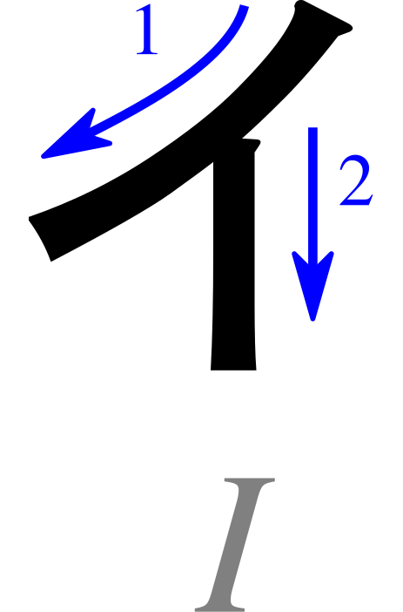
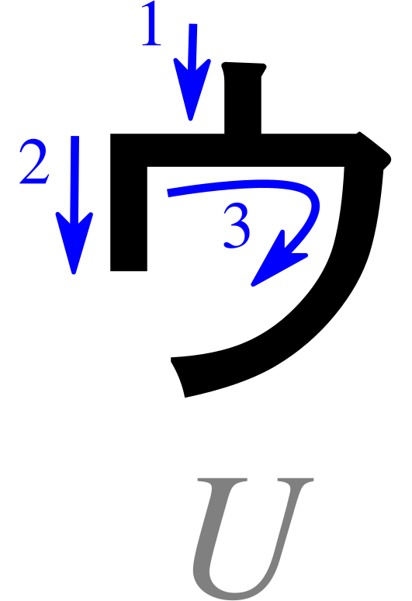
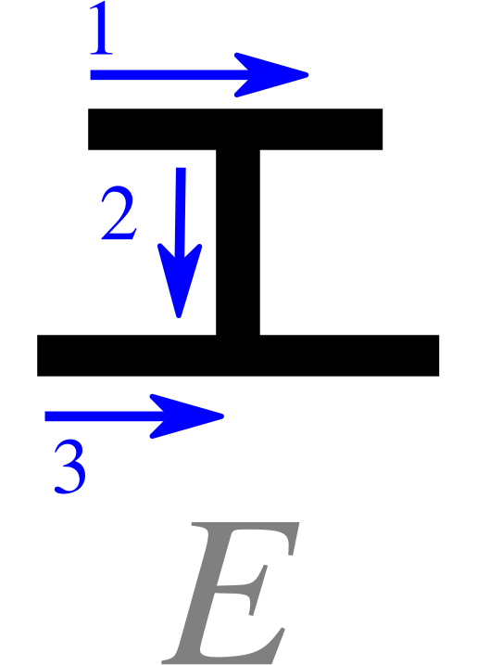
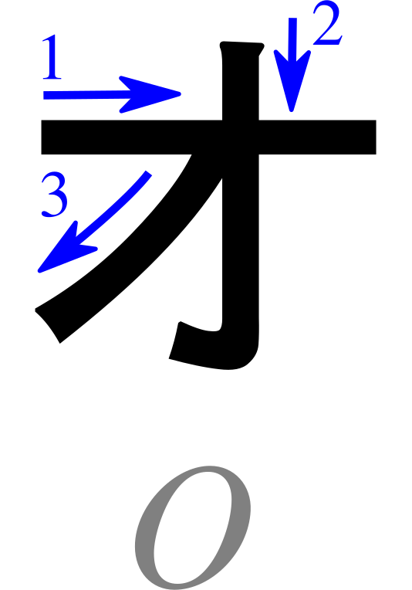
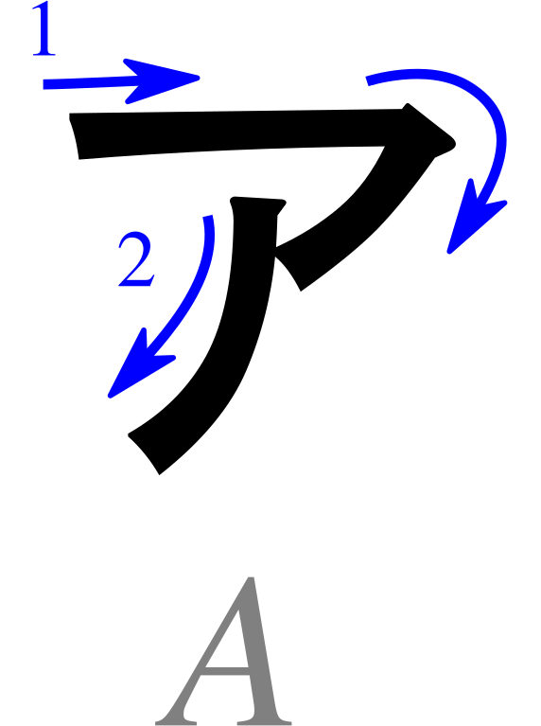
Basic Katakana: Vowels
A
I
U
E
O
Characters: Pmx, Table katakana.svg — CC BY-SA 3.0 ·
Wikimedia Commons · Cropped/resized from the original work

Slide 5
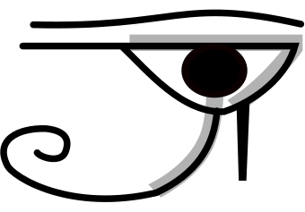
ア
Pronunciation
a - as in “father”
Romaji: a
Stroke Order
Memory Reminder
Ah! An Eye of Horus
Mnemonic: B. Domangue (LeafPiece), Japanese Kana Mnemonic Chart — CC BY-SA 4.0
Character: Pmx, Table katakana.svg — CC BY-SA 3.0 ·
Wikimedia Commons · Cropped/resized from the original works

Slide 6
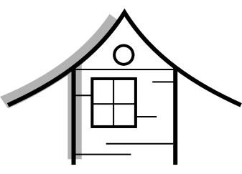
イ
Pronunciation
i - as in “machine”
Romaji: i
Stroke Order
Memory Reminder
Eaves on a house.
Mnemonic: B. Domangue (LeafPiece), Japanese Kana Mnemonic Chart — CC BY-SA 4.0
Character: Pmx, Table katakana.svg — CC BY-SA 3.0 ·
Wikimedia Commons · Cropped/resized from the original works

Slide 7
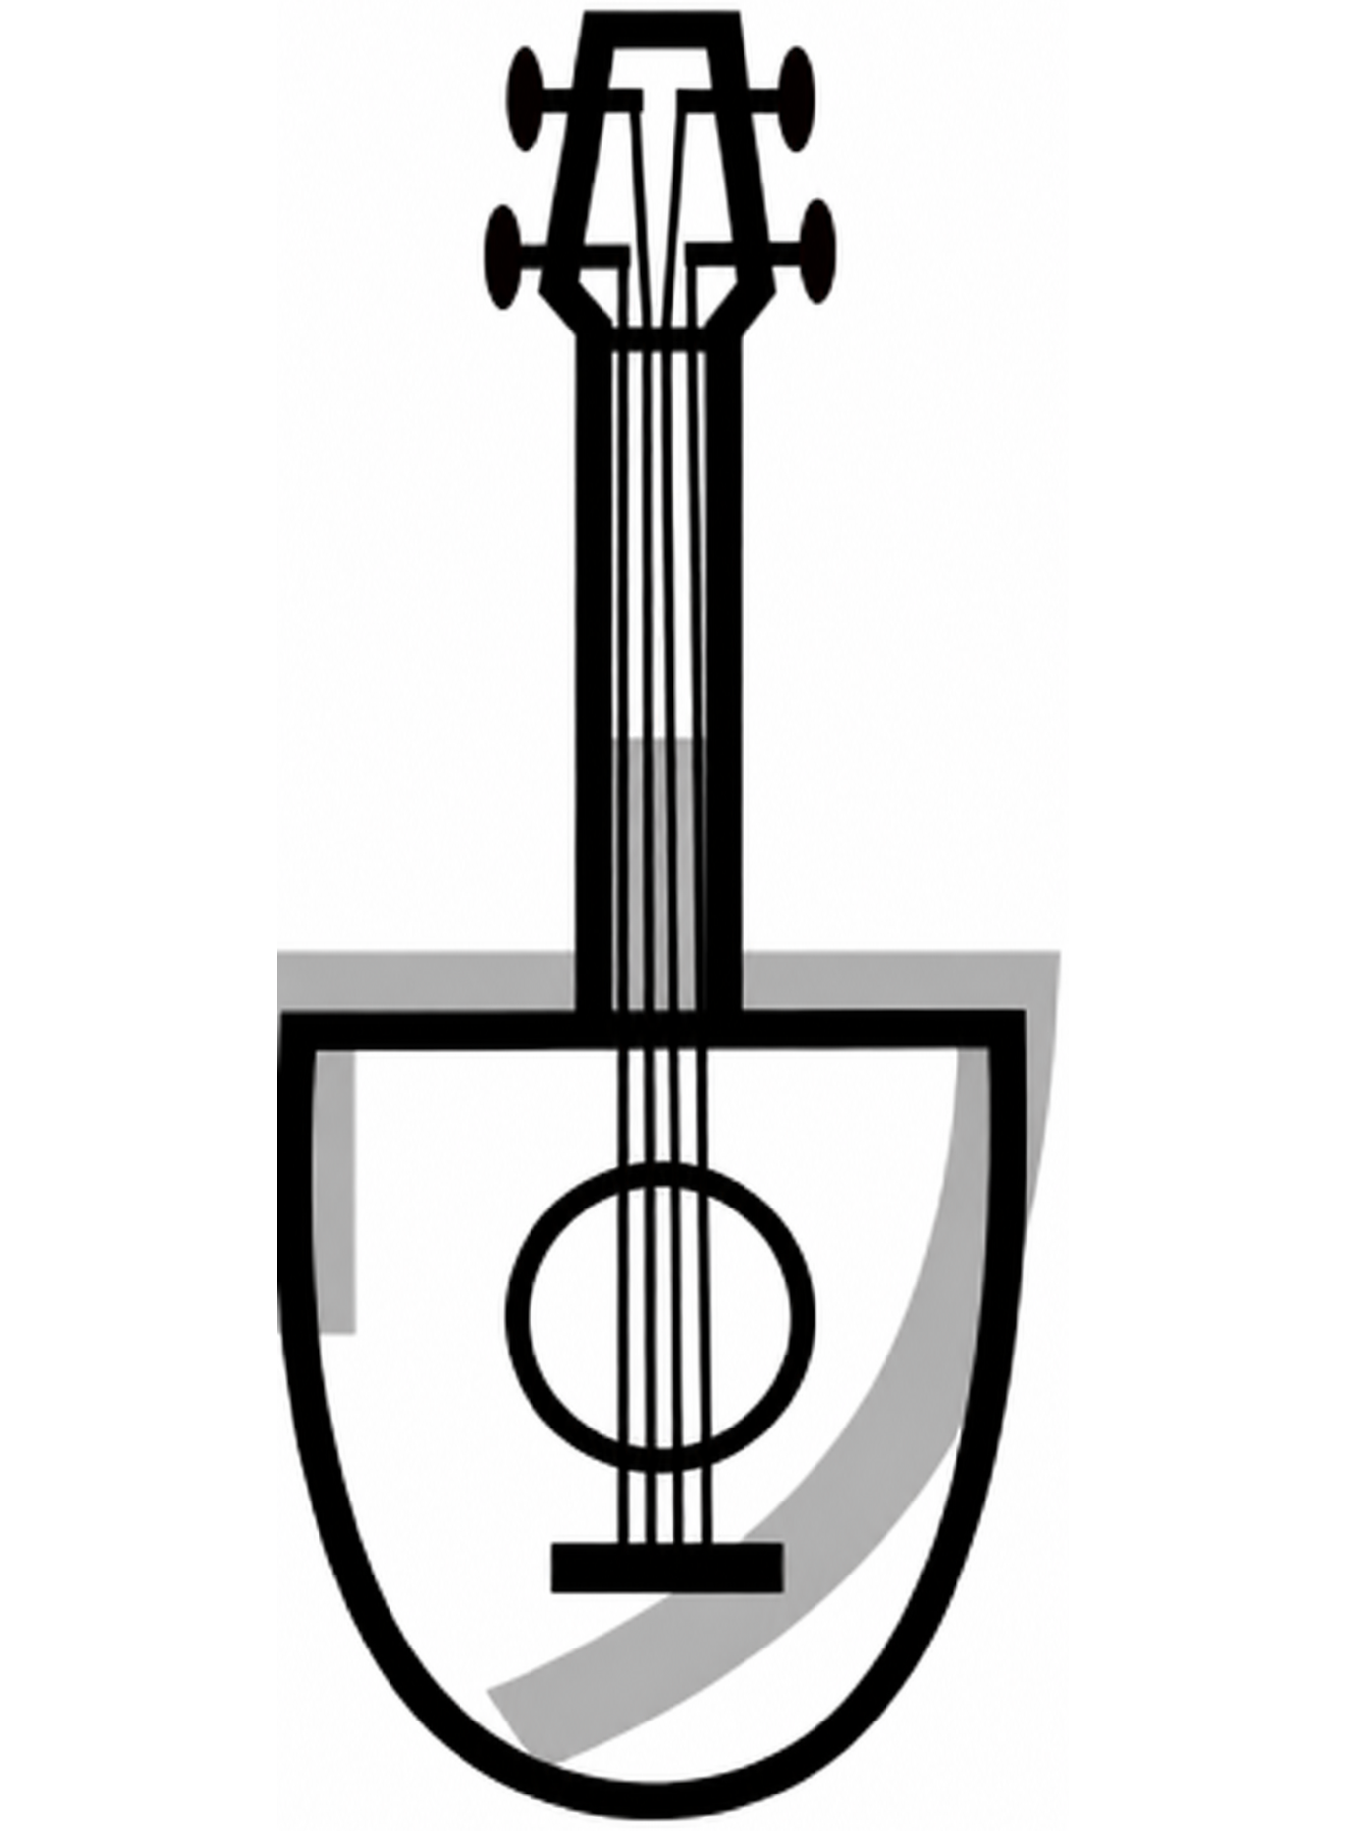
ウ
Pronunciation
u - as in “oo” in “food”
Romaji: u
Stroke Order
Memory Reminder
Ukelele
Mnemonic: B. Domangue (LeafPiece), Japanese Kana Mnemonic Chart — CC BY-SA 4.0
Character: Pmx, Table katakana.svg — CC BY-SA 3.0 ·
Wikimedia Commons · Cropped/resized and cleaned from the original works

Slide 8
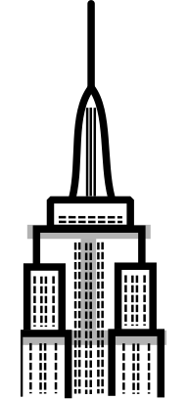
エ
Pronunciation
e - as in “met”
Romaji: e
Stroke Order
Memory Reminder
Empire State Building
Mnemonic: B. Domangue (LeafPiece), Japanese Kana Mnemonic Chart — CC BY-SA 4.0
Character: Pmx, Table katakana.svg — CC BY-SA 3.0 ·
Wikimedia Commons · Cropped/resized from the original works

Slide 9
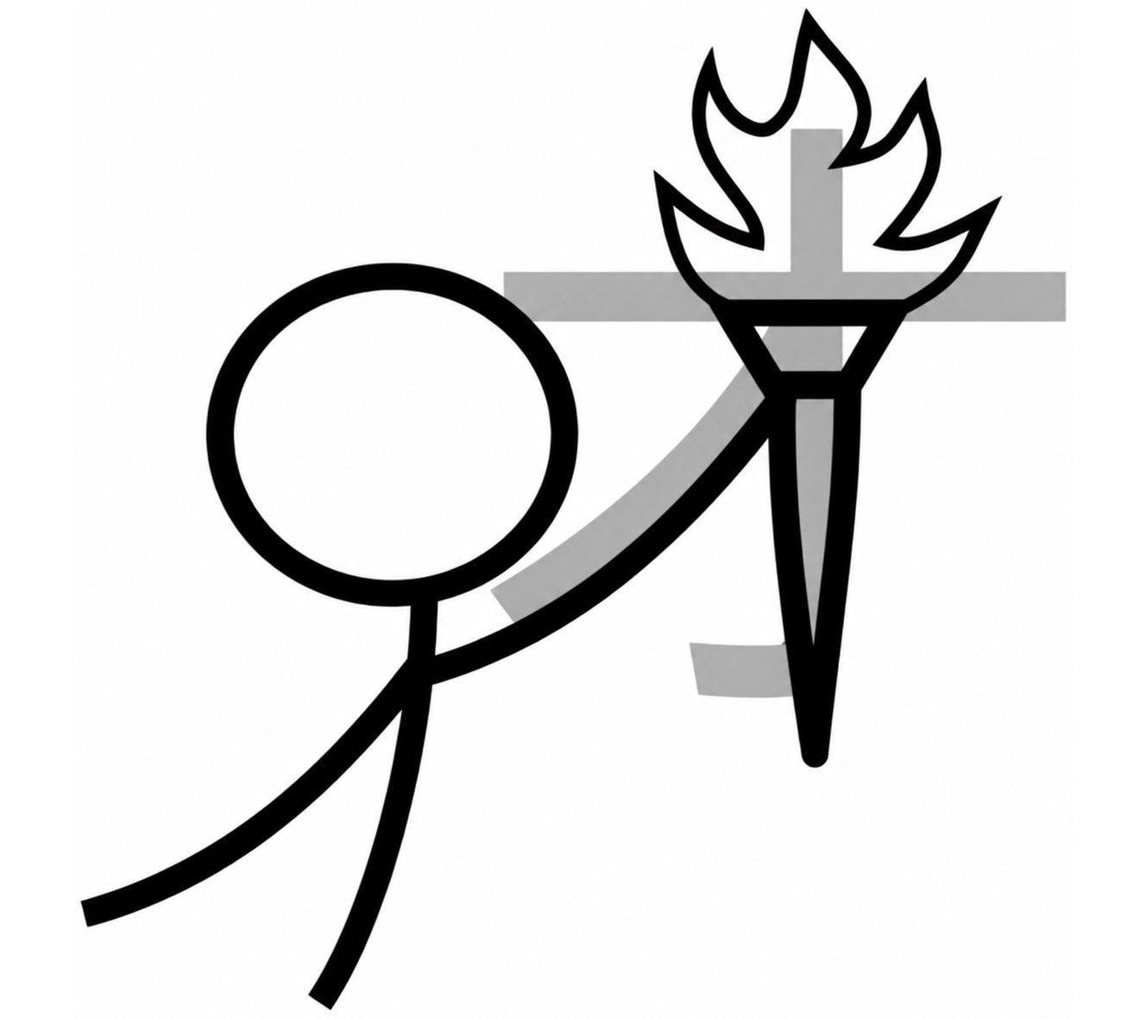
オ
Pronunciation
o - as in “go”
Romaji: o
Stroke Order
Memory Reminder
Olympic torch
Mnemonic: B. Domangue (LeafPiece), Japanese Kana Mnemonic Chart — CC BY-SA 4.0
Character: Pmx, Table katakana.svg — CC BY-SA 3.0 ·
Wikimedia Commons · Cropped/resized and cleaned from the original works

Slide 10
Writing Practice: Vowels
Follow the stroke order. Copy each character into the practice boxes.
Characters: Pmx, Table katakana.svg — CC BY-SA 3.0 ·
Wikimedia Commons · Cropped/resized from the original work

Slide 11
Read These Words!
Write the romaji below each character. Then read the whole word aloud.
エ
ア
ア
イ
air
eye

Slide 12
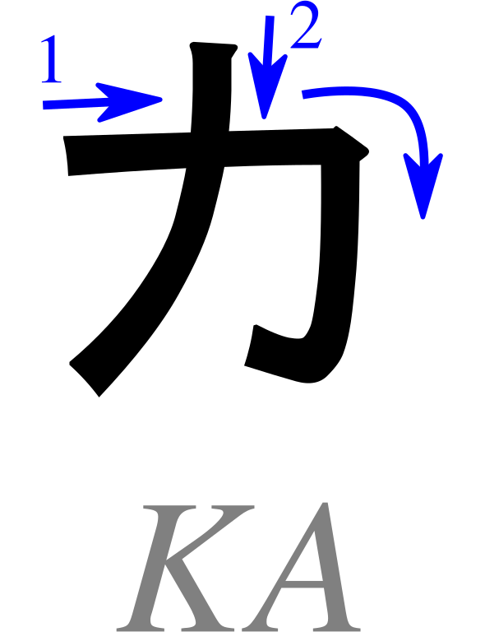
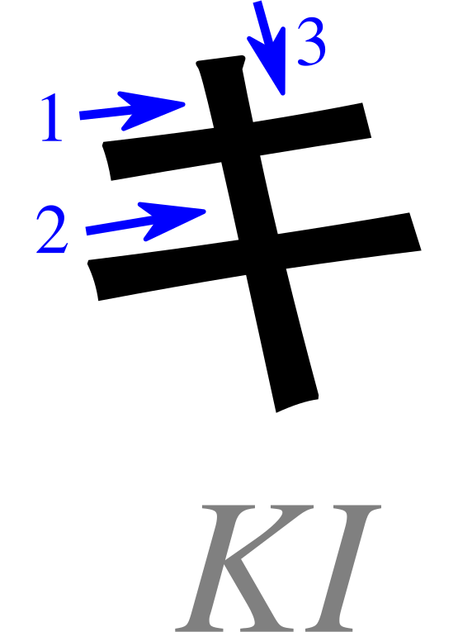
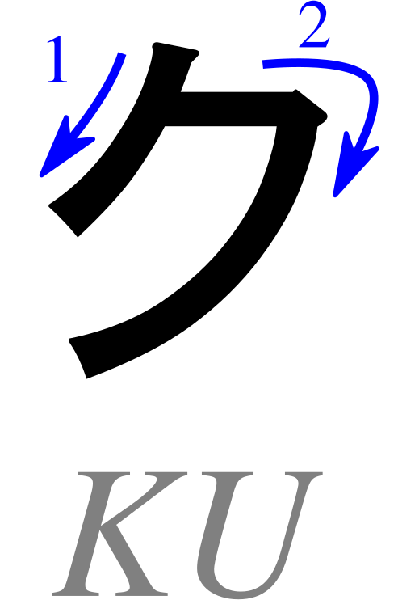
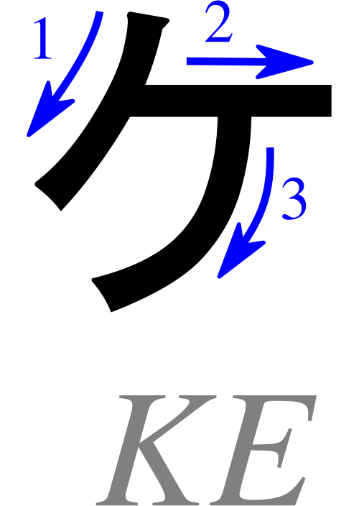
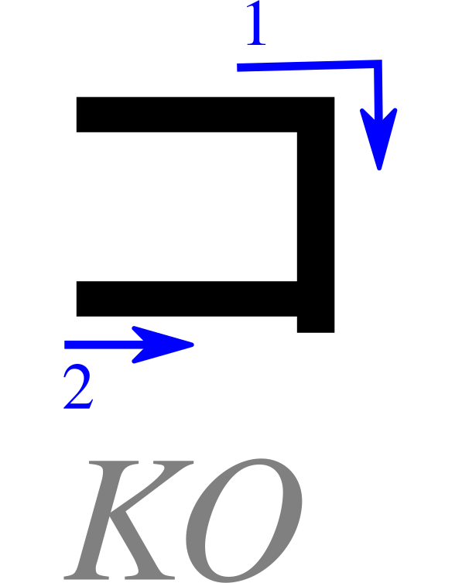
Basic Katakana: K row
Ka
Ki
Ku
Ke
Ko
Characters: Pmx, Table katakana.svg — CC BY-SA 3.0 ·
Wikimedia Commons · Cropped/resized from the original work

Slide 13

カ
Pronunciation
ka - as in “karma”
Romaji: ka
Stroke Order
Memory Reminder
Cod.
Mnemonic: B. Domangue (LeafPiece), Japanese Kana Mnemonic Chart — CC BY-SA 4.0
Character: Pmx, Table katakana.svg — CC BY-SA 3.0 ·
Wikimedia Commons · Cropped/resized from the original works

Slide 14
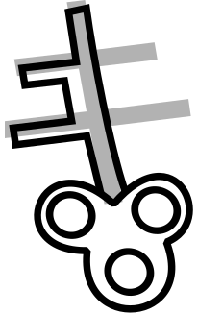
キ
Pronunciation
ki - as in “key”
Romaji: ki
Stroke Order
Memory Reminder
Key
Mnemonic: B. Domangue (LeafPiece), Japanese Kana Mnemonic Chart — CC BY-SA 4.0
Character: Pmx, Table katakana.svg — CC BY-SA 3.0 ·
Wikimedia Commons · Cropped/resized from the original works

Slide 15

ク
Pronunciation
ku - as in “coo”
Romaji: ku
Stroke Order
Memory Reminder
Coonskin cap
Mnemonic: B. Domangue (LeafPiece), Japanese Kana Mnemonic Chart — CC BY-SA 4.0
Character: Pmx, Table katakana.svg — CC BY-SA 3.0 ·
Wikimedia Commons · Cropped/resized from the original works

Slide 16
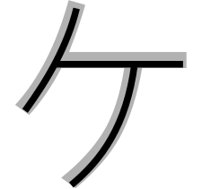
ケ
Pronunciation
ke - as in “kettle”
Romaji: ke
Stroke Order
Memory Reminder
The letter “K.”
Mnemonic: B. Domangue (LeafPiece), Japanese Kana Mnemonic Chart — CC BY-SA 4.0
Character: Pmx, Table katakana.svg — CC BY-SA 3.0 ·
Wikimedia Commons · Cropped/resized from the original works

Slide 17
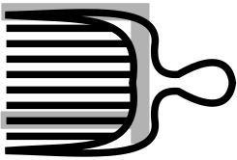
コ
Pronunciation
ko - as in “cold”
Romaji: ko
Stroke Order
Memory Reminder
Comb
Mnemonic: B. Domangue (LeafPiece), Japanese Kana Mnemonic Chart — CC BY-SA 4.0
Character: Pmx, Table katakana.svg — CC BY-SA 3.0 ·
Wikimedia Commons · Cropped/resized from the original works

Slide 18
Writing Practice: K row
Follow the stroke order. Copy each character into the practice boxes.
Characters: Pmx, Table katakana.svg — CC BY-SA 3.0 ·
Wikimedia Commons · Cropped/resized from the original work

Slide 19
Read These Words!
Write the romaji below each character. Then read the whole word aloud.
コ
コ
ア
ケ
ア
cocoa
care

Slide 20
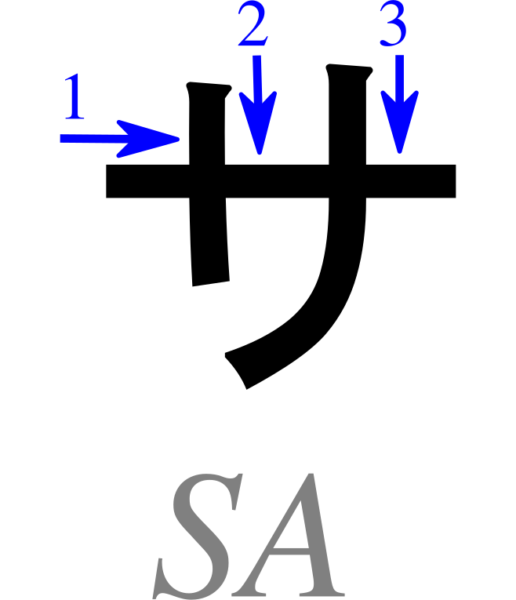
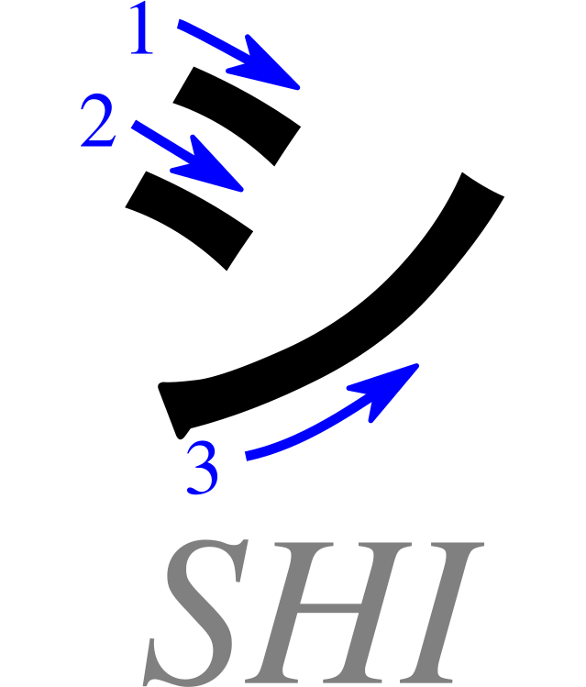
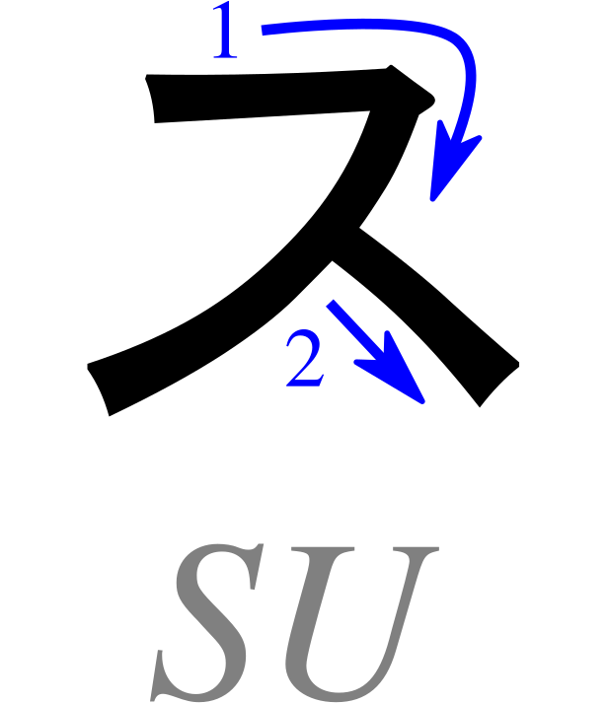
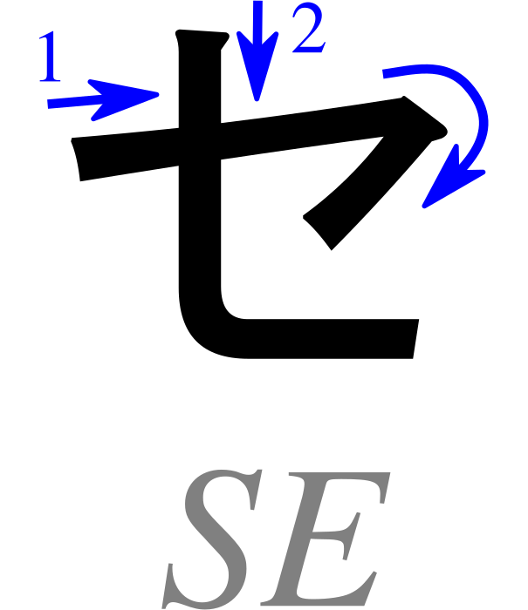
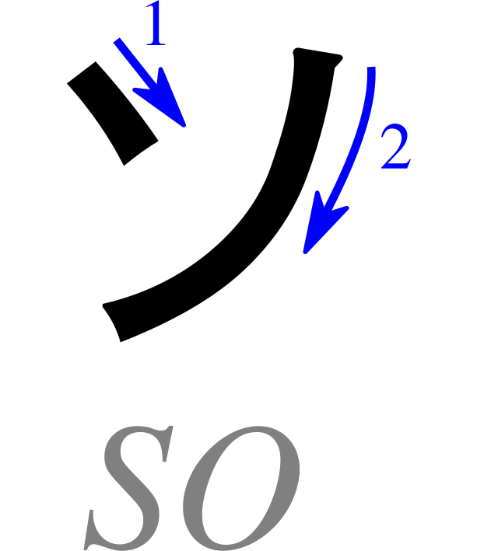
Basic Katakana: S row
Sa
Shi
Su
Se
So
Characters: Pmx, Table katakana.svg — CC BY-SA 3.0 ·
Wikimedia Commons · Cropped/resized from the original work

Slide 21
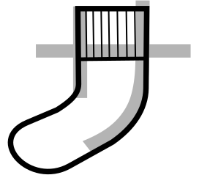
サ
Pronunciation
sa - as in “sardine”
Romaji: sa
Stroke Order
Memory Reminder
Sock
Mnemonic: B. Domangue (LeafPiece), Japanese Kana Mnemonic Chart — CC BY-SA 4.0
Character: Pmx, Table katakana.svg — CC BY-SA 3.0 ·
Wikimedia Commons · Cropped/resized from the original works

Slide 22
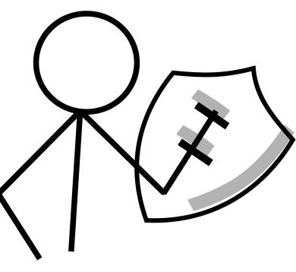
シ
Pronunciation
shi - as in “sheep”
Romaji: shi
Stroke Order
Memory Reminder
Shield
Mnemonic: B. Domangue (LeafPiece), Japanese Kana Mnemonic Chart — CC BY-SA 4.0
Character: Pmx, Table katakana.svg — CC BY-SA 3.0 ·
Wikimedia Commons · Cropped/resized from the original works

Slide 23
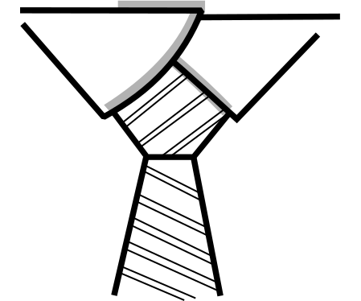
ス
Pronunciation
su - as in “sou” in “soup”
Romaji: su
Stroke Order
Memory Reminder
Suit and tie
Mnemonic: B. Domangue (LeafPiece), Japanese Kana Mnemonic Chart — CC BY-SA 4.0
Character: Pmx, Table katakana.svg — CC BY-SA 3.0 ·
Wikimedia Commons · Cropped/resized from the original works

Slide 24
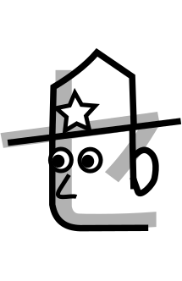
セ
Pronunciation
se - as in “set”
Romaji: se
Stroke Order
Memory Reminder
Security Guard
Mnemonic: B. Domangue (LeafPiece), Japanese Kana Mnemonic Chart — CC BY-SA 4.0
Character: Pmx, Table katakana.svg — CC BY-SA 3.0 ·
Wikimedia Commons · Cropped/resized from the original works

Slide 25

ソ
Pronunciation
so - as in “sew”
Romaji: so
Stroke Order
Memory Reminder
Sew a button
Mnemonic: B. Domangue (LeafPiece), Japanese Kana Mnemonic Chart — CC BY-SA 4.0
Character: Pmx, Table katakana.svg — CC BY-SA 3.0 ·
Wikimedia Commons · Cropped/resized from the original works

Slide 26
Writing Practice: S row
Follow the stroke order. Copy each character into the practice boxes.
Characters: Pmx, Table katakana.svg — CC BY-SA 3.0 ·
Wikimedia Commons · Cropped/resized from the original work

Slide 27
Read These Words!
Write the romaji below each character. Then read the whole word aloud.
ア
イ
ス
キ
ス
ice / ice cream
kiss

Slide 28
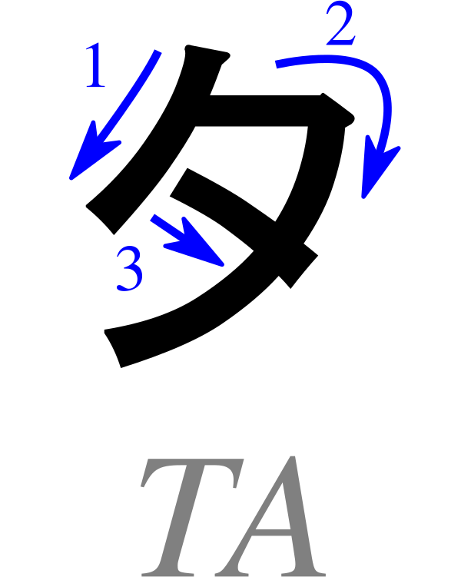
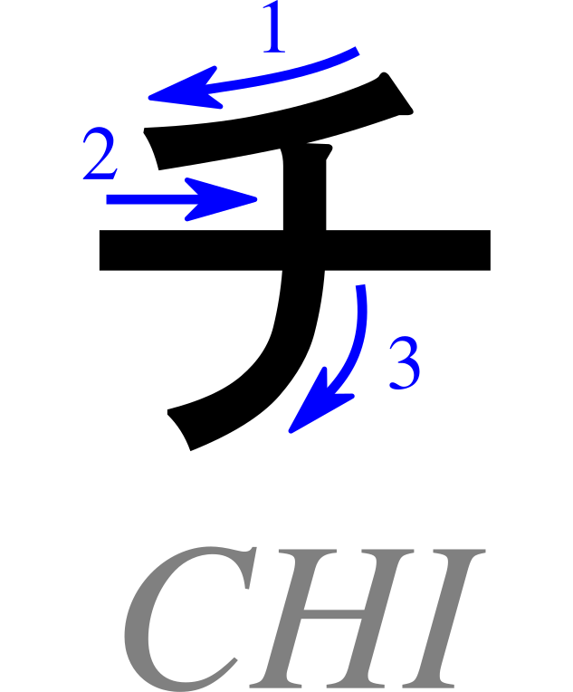
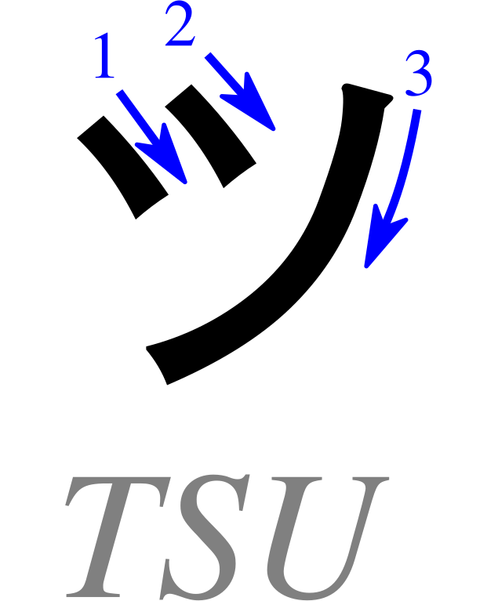
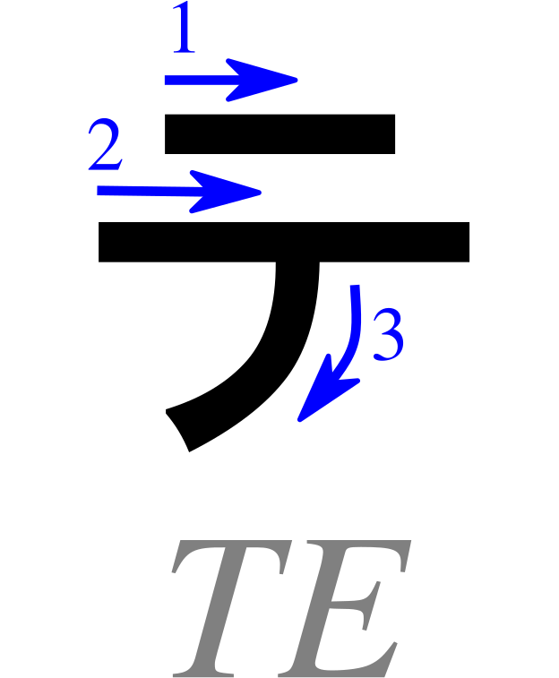
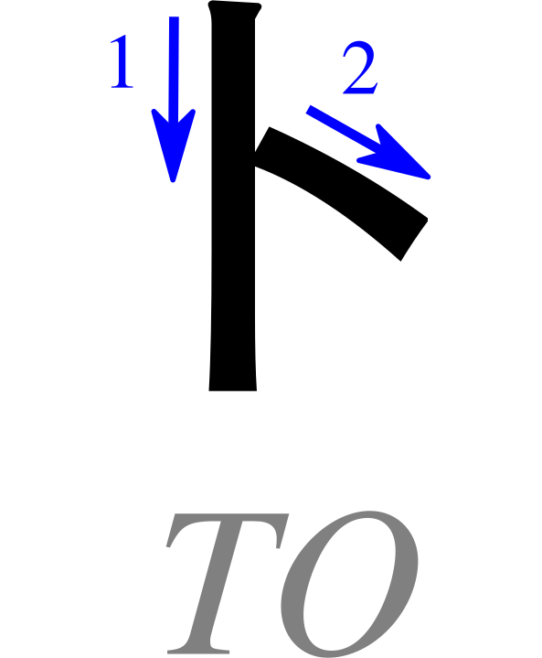
Basic Katakana: T row
Ta
Chi
Tsu
Te
To
Characters: Pmx, Table katakana.svg — CC BY-SA 3.0 ·
Wikimedia Commons · Cropped/resized from the original work

Slide 29

タ
Pronunciation
ta - as in “taco”
Romaji: ta
Stroke Order
Memory Reminder
Tomcat
Mnemonic: B. Domangue (LeafPiece), Japanese Kana Mnemonic Chart — CC BY-SA 4.0
Character: Pmx, Table katakana.svg — CC BY-SA 3.0 ·
Wikimedia Commons · Cropped/resized from the original works
Notes:
Mnemonic: B. Domangue (LeafPiece), Japanese Kana Mnemonic Chart, CC BY-SA 4.0. https://commons.wikimedia.org/wiki/File:Japanese_Kana_Mnemonic_Chart.png
Stroke order: Pmx, Table katakana.svg, CC BY-SA 3.0. https://commons.wikimedia.org/wiki/File:Table_katakana.svg
Images cropped and resized from the supplied charts.

Slide 30
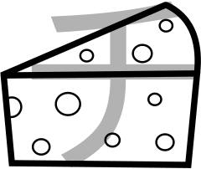
チ
Pronunciation
chi - as in “cheese”
Romaji: chi
Stroke Order
Memory Reminder
Cheese wedge
Mnemonic: B. Domangue (LeafPiece), Japanese Kana Mnemonic Chart — CC BY-SA 4.0
Character: Pmx, Table katakana.svg — CC BY-SA 3.0 ·
Wikimedia Commons · Cropped/resized from the original works
Notes:
Mnemonic: B. Domangue (LeafPiece), Japanese Kana Mnemonic Chart, CC BY-SA 4.0. https://commons.wikimedia.org/wiki/File:Japanese_Kana_Mnemonic_Chart.png
Stroke order: Pmx, Table katakana.svg, CC BY-SA 3.0. https://commons.wikimedia.org/wiki/File:Table_katakana.svg
Images cropped and resized from the supplied charts.

Slide 31

ツ
Pronunciation
tsu - “ts” as in “cats,” followed by “oo”
Romaji: tsu
Stroke Order
Memory Reminder
Tsunami wave
Mnemonic: B. Domangue (LeafPiece), Japanese Kana Mnemonic Chart — CC BY-SA 4.0
Character: Pmx, Table katakana.svg — CC BY-SA 3.0 ·
Wikimedia Commons · Cropped/resized and cleaned from the original works
Notes:
Mnemonic: B. Domangue (LeafPiece), Japanese Kana Mnemonic Chart, CC BY-SA 4.0. https://commons.wikimedia.org/wiki/File:Japanese_Kana_Mnemonic_Chart.png
Stroke order: Pmx, Table katakana.svg, CC BY-SA 3.0. https://commons.wikimedia.org/wiki/File:Table_katakana.svg
Images cropped and resized from the supplied charts.

Slide 32
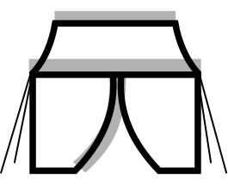
テ
Pronunciation
te - as in “ten”
Romaji: te
Stroke Order
Memory Reminder
Tent
Mnemonic: B. Domangue (LeafPiece), Japanese Kana Mnemonic Chart — CC BY-SA 4.0
Character: Pmx, Table katakana.svg — CC BY-SA 3.0 ·
Wikimedia Commons · Cropped/resized from the original works
Notes:
Mnemonic: B. Domangue (LeafPiece), Japanese Kana Mnemonic Chart, CC BY-SA 4.0. https://commons.wikimedia.org/wiki/File:Japanese_Kana_Mnemonic_Chart.png
Stroke order: Pmx, Table katakana.svg, CC BY-SA 3.0. https://commons.wikimedia.org/wiki/File:Table_katakana.svg
Images cropped and resized from the supplied charts.

Slide 33
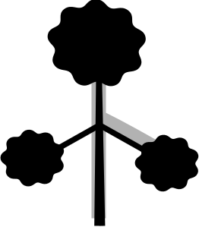
ト
Pronunciation
to - as in “toe”
Romaji: to
Stroke Order
Memory Reminder
Topiary
Mnemonic: B. Domangue (LeafPiece), Japanese Kana Mnemonic Chart — CC BY-SA 4.0
Character: Pmx, Table katakana.svg — CC BY-SA 3.0 ·
Wikimedia Commons · Cropped/resized from the original works
Notes:
Mnemonic: B. Domangue (LeafPiece), Japanese Kana Mnemonic Chart, CC BY-SA 4.0. https://commons.wikimedia.org/wiki/File:Japanese_Kana_Mnemonic_Chart.png
Stroke order: Pmx, Table katakana.svg, CC BY-SA 3.0. https://commons.wikimedia.org/wiki/File:Table_katakana.svg
Images cropped and resized from the supplied charts.

Slide 34
Writing Practice: T row
Follow the stroke order. Copy each character into the practice boxes.
Characters: Pmx, Table katakana.svg — CC BY-SA 3.0 ·
Wikimedia Commons · Cropped/resized from the original work

Slide 35
Read These Words!
Write the romaji below each character. Then read the whole word aloud.
テ
キ
ス
ト
タ
コ
ス
text / textbook
tacos

Slide 36
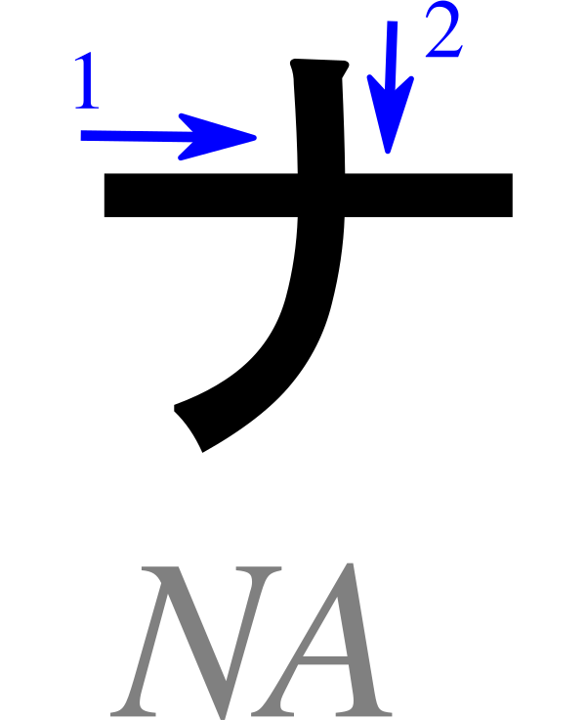
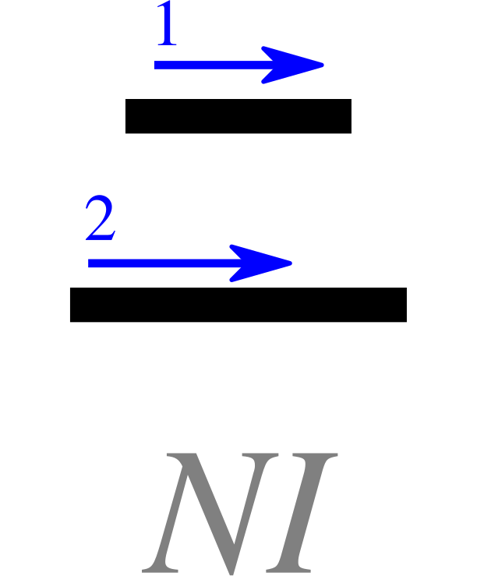
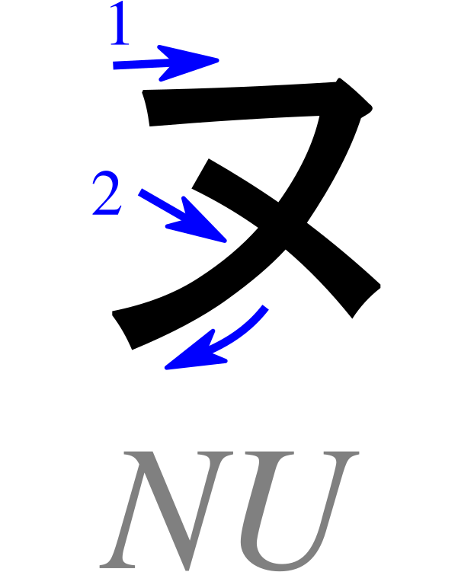
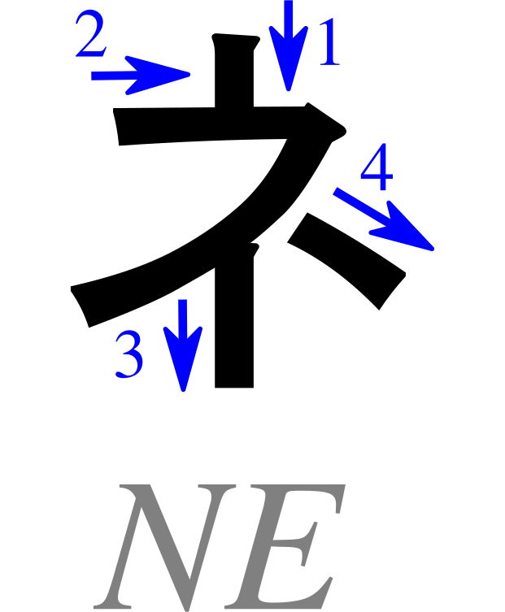
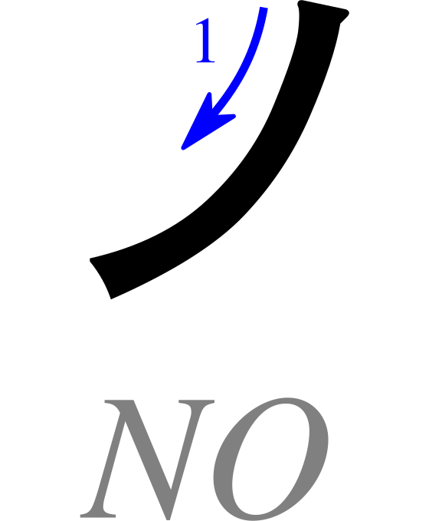
Basic Katakana: N row
Na
Ni
Nu
Ne
No
Characters: Pmx, Table katakana.svg — CC BY-SA 3.0 ·
Wikimedia Commons · Cropped/resized from the original work

Slide 37
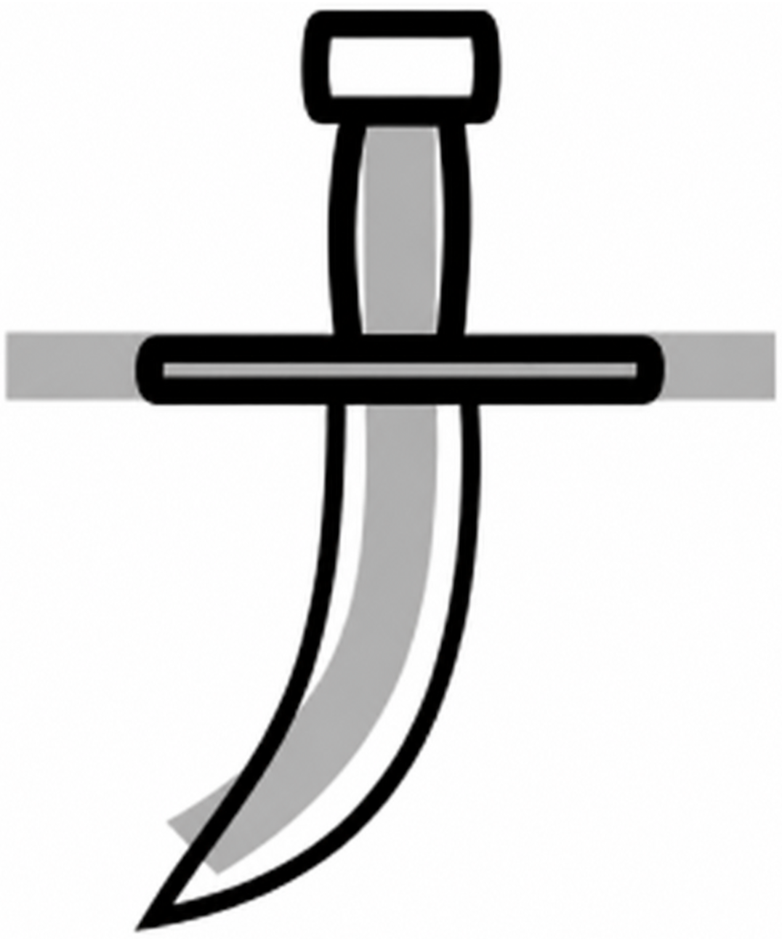
ナ
Pronunciation
na - as in “nacho”
Romaji: na
Stroke Order
Memory Reminder
Knife
Mnemonic: B. Domangue (LeafPiece), Japanese Kana Mnemonic Chart — CC BY-SA 4.0
Character: Pmx, Table katakana.svg — CC BY-SA 3.0 ·
Wikimedia Commons · Cropped/resized and cleaned from the original works
Notes:
Mnemonic: B. Domangue (LeafPiece), Japanese Kana Mnemonic Chart, CC BY-SA 4.0. https://commons.wikimedia.org/wiki/File:Japanese_Kana_Mnemonic_Chart.png
Stroke order: Pmx, Table katakana.svg, CC BY-SA 3.0. https://commons.wikimedia.org/wiki/File:Table_katakana.svg
Images cropped and resized from the supplied charts.

Slide 38
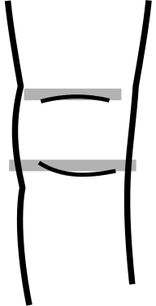
ニ
Pronunciation
ni - as in “knee”
Romaji: ni
Stroke Order
Memory Reminder
Knee
Mnemonic: B. Domangue (LeafPiece), Japanese Kana Mnemonic Chart — CC BY-SA 4.0
Character: Pmx, Table katakana.svg — CC BY-SA 3.0 ·
Wikimedia Commons · Cropped/resized from the original works
Notes:
Mnemonic: B. Domangue (LeafPiece), Japanese Kana Mnemonic Chart, CC BY-SA 4.0. https://commons.wikimedia.org/wiki/File:Japanese_Kana_Mnemonic_Chart.png
Stroke order: Pmx, Table katakana.svg, CC BY-SA 3.0. https://commons.wikimedia.org/wiki/File:Table_katakana.svg
Images cropped and resized from the supplied charts.

Slide 39

ヌ
Pronunciation
nu - as in “noo” in “noodle”
Romaji: nu
Stroke Order
Memory Reminder
Newborn in a stroller
Mnemonic: B. Domangue (LeafPiece), Japanese Kana Mnemonic Chart — CC BY-SA 4.0
Character: Pmx, Table katakana.svg — CC BY-SA 3.0 ·
Wikimedia Commons · Cropped/resized from the original works
Notes:
Mnemonic: B. Domangue (LeafPiece), Japanese Kana Mnemonic Chart, CC BY-SA 4.0. https://commons.wikimedia.org/wiki/File:Japanese_Kana_Mnemonic_Chart.png
Stroke order: Pmx, Table katakana.svg, CC BY-SA 3.0. https://commons.wikimedia.org/wiki/File:Table_katakana.svg
Images cropped and resized from the supplied charts.

Slide 40
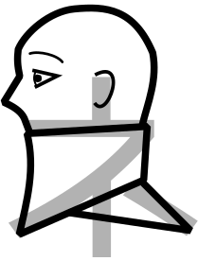
ネ
Pronunciation
ne - as in “net”
Romaji: ne
Stroke Order
Memory Reminder
Neck brace
Mnemonic: B. Domangue (LeafPiece), Japanese Kana Mnemonic Chart — CC BY-SA 4.0
Character: Pmx, Table katakana.svg — CC BY-SA 3.0 ·
Wikimedia Commons · Cropped/resized from the original works
Notes:
Mnemonic: B. Domangue (LeafPiece), Japanese Kana Mnemonic Chart, CC BY-SA 4.0. https://commons.wikimedia.org/wiki/File:Japanese_Kana_Mnemonic_Chart.png
Stroke order: Pmx, Table katakana.svg, CC BY-SA 3.0. https://commons.wikimedia.org/wiki/File:Table_katakana.svg
Images cropped and resized from the supplied charts.

Slide 41

ノ
Pronunciation
no - as in “no”
Romaji: no
Stroke Order
Memory Reminder
No smoking
Mnemonic: B. Domangue (LeafPiece), Japanese Kana Mnemonic Chart — CC BY-SA 4.0
Character: Pmx, Table katakana.svg — CC BY-SA 3.0 ·
Wikimedia Commons · Cropped/resized from the original works
Notes:
Mnemonic: B. Domangue (LeafPiece), Japanese Kana Mnemonic Chart, CC BY-SA 4.0. https://commons.wikimedia.org/wiki/File:Japanese_Kana_Mnemonic_Chart.png
Stroke order: Pmx, Table katakana.svg, CC BY-SA 3.0. https://commons.wikimedia.org/wiki/File:Table_katakana.svg
Images cropped and resized from the supplied charts.

Slide 42
Writing Practice: N row
Follow the stroke order. Copy each character into the practice boxes.
Characters: Pmx, Table katakana.svg — CC BY-SA 3.0 ·
Wikimedia Commons · Cropped/resized from the original work

Slide 43
Read These Words!
Write the romaji below each character. Then read the whole word aloud.
ネ
コ
イ
ヌ
cat
dog

Slide 44
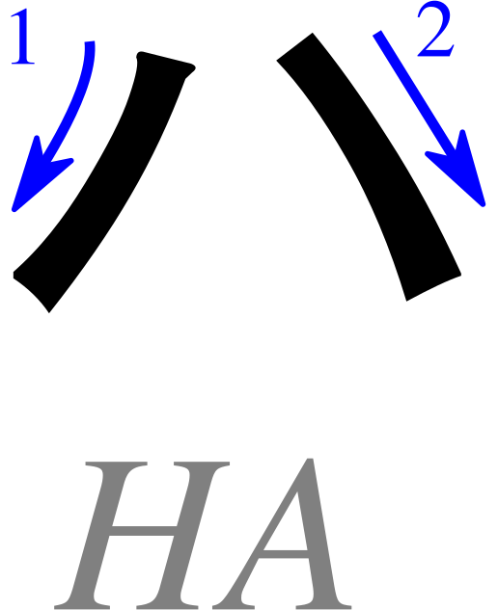
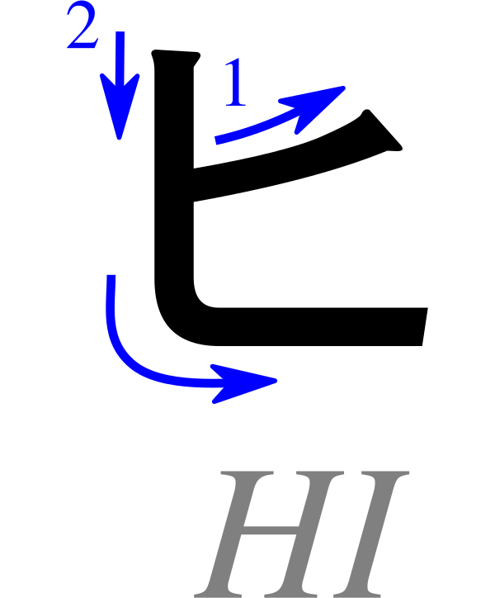
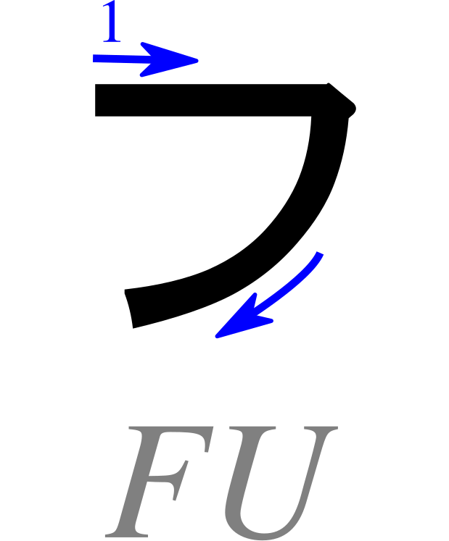
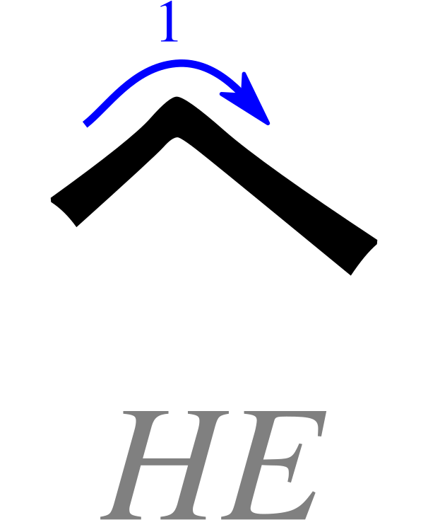
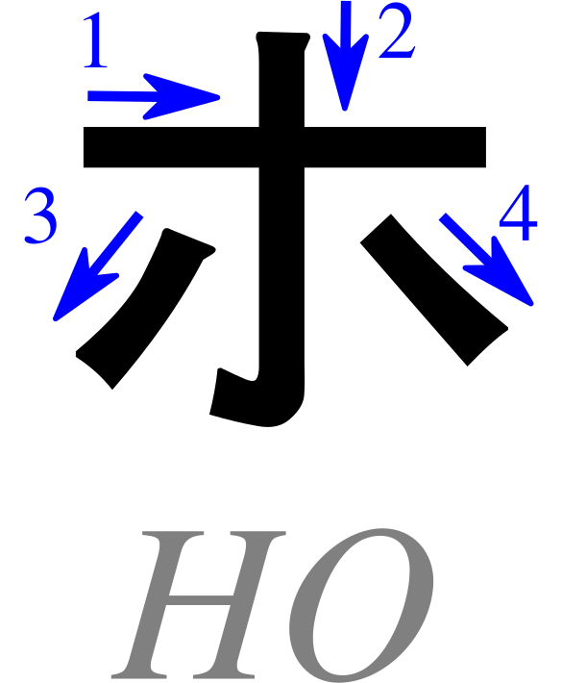
Basic Katakana: H row
Ha
Hi
Fu
He
Ho
Characters: Pmx, Table katakana.svg — CC BY-SA 3.0 ·
Wikimedia Commons · Cropped/resized from the original work

Slide 45
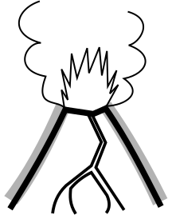
ハ
Pronunciation
ha - as in “ha!”
Romaji: ha
Stroke Order
Memory Reminder
Hot lava
Mnemonic: B. Domangue (LeafPiece), Japanese Kana Mnemonic Chart — CC BY-SA 4.0
Character: Pmx, Table katakana.svg — CC BY-SA 3.0 ·
Wikimedia Commons · Cropped/resized from the original works
Notes:
Mnemonic: B. Domangue (LeafPiece), Japanese Kana Mnemonic Chart, CC BY-SA 4.0. https://commons.wikimedia.org/wiki/File:Japanese_Kana_Mnemonic_Chart.png
Stroke order: Pmx, Table katakana.svg, CC BY-SA 3.0. https://commons.wikimedia.org/wiki/File:Table_katakana.svg
Images cropped and resized from the supplied charts.

Slide 46
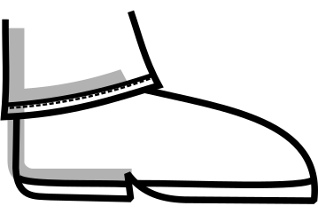
ヒ
Pronunciation
hi - as in “heat”
Romaji: hi
Stroke Order
Memory Reminder
Heel
Mnemonic: B. Domangue (LeafPiece), Japanese Kana Mnemonic Chart — CC BY-SA 4.0
Character: Pmx, Table katakana.svg — CC BY-SA 3.0 ·
Wikimedia Commons · Cropped/resized from the original works
Notes:
Mnemonic: B. Domangue (LeafPiece), Japanese Kana Mnemonic Chart, CC BY-SA 4.0. https://commons.wikimedia.org/wiki/File:Japanese_Kana_Mnemonic_Chart.png
Stroke order: Pmx, Table katakana.svg, CC BY-SA 3.0. https://commons.wikimedia.org/wiki/File:Table_katakana.svg
Images cropped and resized from the supplied charts.

Slide 47

フ
Pronunciation
fu - like “foo” in “food,” with a gentle puff of air
Romaji: fu
Stroke Order
Memory Reminder
Fool’s hat
Mnemonic: B. Domangue (LeafPiece), Japanese Kana Mnemonic Chart — CC BY-SA 4.0
Character: Pmx, Table katakana.svg — CC BY-SA 3.0 ·
Wikimedia Commons · Cropped/resized from the original works
Notes:
Mnemonic: B. Domangue (LeafPiece), Japanese Kana Mnemonic Chart, CC BY-SA 4.0. https://commons.wikimedia.org/wiki/File:Japanese_Kana_Mnemonic_Chart.png
Stroke order: Pmx, Table katakana.svg, CC BY-SA 3.0. https://commons.wikimedia.org/wiki/File:Table_katakana.svg
Images cropped and resized from the supplied charts.
For フ, blow gently between both lips, without placing the upper teeth on the lower lip.

Slide 48

ヘ
Pronunciation
he - as in “help”
Romaji: he
Stroke Order
Memory Reminder
Headband
Mnemonic: B. Domangue (LeafPiece), Japanese Kana Mnemonic Chart — CC BY-SA 4.0
Character: Pmx, Table katakana.svg — CC BY-SA 3.0 ·
Wikimedia Commons · Cropped/resized from the original works
Notes:
Mnemonic: B. Domangue (LeafPiece), Japanese Kana Mnemonic Chart, CC BY-SA 4.0. https://commons.wikimedia.org/wiki/File:Japanese_Kana_Mnemonic_Chart.png
Stroke order: Pmx, Table katakana.svg, CC BY-SA 3.0. https://commons.wikimedia.org/wiki/File:Table_katakana.svg
Images cropped and resized from the supplied charts.

Slide 49

ホ
Pronunciation
ho - as in “hope”
Romaji: ho
Stroke Order
Memory Reminder
Holy cross
Mnemonic: B. Domangue (LeafPiece), Japanese Kana Mnemonic Chart — CC BY-SA 4.0
Character: Pmx, Table katakana.svg — CC BY-SA 3.0 ·
Wikimedia Commons · Cropped/resized and cleaned from the original works
Notes:
Mnemonic: B. Domangue (LeafPiece), Japanese Kana Mnemonic Chart, CC BY-SA 4.0. https://commons.wikimedia.org/wiki/File:Japanese_Kana_Mnemonic_Chart.png
Stroke order: Pmx, Table katakana.svg, CC BY-SA 3.0. https://commons.wikimedia.org/wiki/File:Table_katakana.svg
Images cropped and resized from the supplied charts.

Slide 50
Writing Practice: H row
Follow the stroke order. Copy each character into the practice boxes.
Characters: Pmx, Table katakana.svg — CC BY-SA 3.0 ·
Wikimedia Commons · Cropped/resized from the original work

Slide 51
Read These Words!
Write the romaji below each character. Then read the whole word aloud.
ハ
ウ
ス
ハ
イ
エ
ナ
house
hyena

Slide 52





Basic Katakana: M row
Ma
Mi
Mu
Me
Mo
Characters: Pmx, Table katakana.svg — CC BY-SA 3.0 ·
Wikimedia Commons · Cropped/resized from the original work

Slide 53

マ
Pronunciation
ma - as in “mama”
Romaji: ma
Stroke Order
Memory Reminder
Mockingbird
Mnemonic: B. Domangue (LeafPiece), Japanese Kana Mnemonic Chart — CC BY-SA 4.0
Character: Pmx, Table katakana.svg — CC BY-SA 3.0 ·
Wikimedia Commons · Cropped/resized from the original works
Notes:
Mnemonic: B. Domangue (LeafPiece), Japanese Kana Mnemonic Chart, CC BY-SA 4.0. https://commons.wikimedia.org/wiki/File:Japanese_Kana_Mnemonic_Chart.png
Stroke order: Pmx, Table katakana.svg, CC BY-SA 3.0. https://commons.wikimedia.org/wiki/File:Table_katakana.svg
Images cropped and resized from the supplied charts.

Slide 54

ミ
Pronunciation
mi - as in “meet”
Romaji: mi
Stroke Order
Memory Reminder
Median in the road
Mnemonic: B. Domangue (LeafPiece), Japanese Kana Mnemonic Chart — CC BY-SA 4.0
Character: Pmx, Table katakana.svg — CC BY-SA 3.0 ·
Wikimedia Commons · Cropped/resized from the original works
Notes:
Mnemonic: B. Domangue (LeafPiece), Japanese Kana Mnemonic Chart, CC BY-SA 4.0. https://commons.wikimedia.org/wiki/File:Japanese_Kana_Mnemonic_Chart.png
Stroke order: Pmx, Table katakana.svg, CC BY-SA 3.0. https://commons.wikimedia.org/wiki/File:Table_katakana.svg
Images cropped and resized from the supplied charts.

Slide 55

ム
Pronunciation
mu - as in “moo”
Romaji: mu
Stroke Order
Memory Reminder
Moon viewed from above
Mnemonic: B. Domangue (LeafPiece), Japanese Kana Mnemonic Chart — CC BY-SA 4.0
Character: Pmx, Table katakana.svg — CC BY-SA 3.0 ·
Wikimedia Commons · Cropped/resized and cleaned from the original works
Notes:
Mnemonic: B. Domangue (LeafPiece), Japanese Kana Mnemonic Chart, CC BY-SA 4.0. https://commons.wikimedia.org/wiki/File:Japanese_Kana_Mnemonic_Chart.png
Stroke order: Pmx, Table katakana.svg, CC BY-SA 3.0. https://commons.wikimedia.org/wiki/File:Table_katakana.svg
Images cropped and resized from the supplied charts.

Slide 56

メ
Pronunciation
me - as in “met”
Romaji: me
Stroke Order
Memory Reminder
Metal knife
Mnemonic: B. Domangue (LeafPiece), Japanese Kana Mnemonic Chart — CC BY-SA 4.0
Character: Pmx, Table katakana.svg — CC BY-SA 3.0 ·
Wikimedia Commons · Cropped/resized from the original works
Notes:
Mnemonic: B. Domangue (LeafPiece), Japanese Kana Mnemonic Chart, CC BY-SA 4.0. https://commons.wikimedia.org/wiki/File:Japanese_Kana_Mnemonic_Chart.png
Stroke order: Pmx, Table katakana.svg, CC BY-SA 3.0. https://commons.wikimedia.org/wiki/File:Table_katakana.svg
Images cropped and resized from the supplied charts.

Slide 57

モ
Pronunciation
mo - as in “mow”
Romaji: mo
Stroke Order
Memory Reminder
Motorboat
Mnemonic: B. Domangue (LeafPiece), Japanese Kana Mnemonic Chart — CC BY-SA 4.0
Character: Pmx, Table katakana.svg — CC BY-SA 3.0 ·
Wikimedia Commons · Cropped/resized from the original works
Notes:
Mnemonic: B. Domangue (LeafPiece), Japanese Kana Mnemonic Chart, CC BY-SA 4.0. https://commons.wikimedia.org/wiki/File:Japanese_Kana_Mnemonic_Chart.png
Stroke order: Pmx, Table katakana.svg, CC BY-SA 3.0. https://commons.wikimedia.org/wiki/File:Table_katakana.svg
Images cropped and resized from the supplied charts.

Slide 58
Writing Practice: M row
Follow the stroke order. Copy each character into the practice boxes.
Characters: Pmx, Table katakana.svg — CC BY-SA 3.0 ·
Wikimedia Commons · Cropped/resized from the original work

Slide 59
Read These Words!
Write the romaji below each character. Then read the whole word aloud.
マ
イ
ク
ウ
マ
microphone
horse

Slide 60



Basic Katakana: Y row
Ya
Yu
Yo
Characters: Pmx, Table katakana.svg — CC BY-SA 3.0 ·
Wikimedia Commons · Cropped/resized from the original work

Slide 61

ヤ
Pronunciation
ya - as in “yard”
Romaji: ya
Stroke Order
Memory Reminder
Yawl
Mnemonic: B. Domangue (LeafPiece), Japanese Kana Mnemonic Chart — CC BY-SA 4.0
Character: Pmx, Table katakana.svg — CC BY-SA 3.0 ·
Wikimedia Commons · Cropped/resized from the original works
Notes:
Mnemonic: B. Domangue (LeafPiece), Japanese Kana Mnemonic Chart, CC BY-SA 4.0. https://commons.wikimedia.org/wiki/File:Japanese_Kana_Mnemonic_Chart.png
Stroke order: Pmx, Table katakana.svg, CC BY-SA 3.0. https://commons.wikimedia.org/wiki/File:Table_katakana.svg
Images cropped and resized from the supplied charts.

Slide 62

ユ
Pronunciation
yu - as in “you”
Romaji: yu
Stroke Order
Memory Reminder
U-turn
Mnemonic: B. Domangue (LeafPiece), Japanese Kana Mnemonic Chart — CC BY-SA 4.0
Character: Pmx, Table katakana.svg — CC BY-SA 3.0 ·
Wikimedia Commons · Cropped/resized from the original works
Notes:
Mnemonic: B. Domangue (LeafPiece), Japanese Kana Mnemonic Chart, CC BY-SA 4.0. https://commons.wikimedia.org/wiki/File:Japanese_Kana_Mnemonic_Chart.png
Stroke order: Pmx, Table katakana.svg, CC BY-SA 3.0. https://commons.wikimedia.org/wiki/File:Table_katakana.svg
Images cropped and resized from the supplied charts.

Slide 63

ヨ
Pronunciation
yo - as in “yoga”
Romaji: yo
Stroke Order
Memory Reminder
Yoga shorts
Mnemonic: B. Domangue (LeafPiece), Japanese Kana Mnemonic Chart — CC BY-SA 4.0
Character: Pmx, Table katakana.svg — CC BY-SA 3.0 ·
Wikimedia Commons · Cropped/resized from the original works
Notes:
Mnemonic: B. Domangue (LeafPiece), Japanese Kana Mnemonic Chart, CC BY-SA 4.0. https://commons.wikimedia.org/wiki/File:Japanese_Kana_Mnemonic_Chart.png
Stroke order: Pmx, Table katakana.svg, CC BY-SA 3.0. https://commons.wikimedia.org/wiki/File:Table_katakana.svg
Images cropped and resized from the supplied charts.

Slide 64
Writing Practice: Y row
Follow the stroke order. Copy each character into the practice boxes.
Characters: Pmx, Table katakana.svg — CC BY-SA 3.0 ·
Wikimedia Commons · Cropped/resized from the original work

Slide 65
Read These Words!
Write the romaji below each character. Then read the whole word aloud.
タ
イ
ヤ
ヤ
マ
ネ
コ
tire
wildcat

Slide 66





Basic Katakana: R row
Ra
Ri
Ru
Re
Ro
Characters: Pmx, Table katakana.svg — CC BY-SA 3.0 ·
Wikimedia Commons · Cropped/resized from the original work

Slide 67

ラ
Pronunciation
ra - like “la” in “lava,” with a quick tongue tap
Romaji: ra
Stroke Order
Memory Reminder
Robber
Mnemonic: B. Domangue (LeafPiece), Japanese Kana Mnemonic Chart — CC BY-SA 4.0
Character: Pmx, Table katakana.svg — CC BY-SA 3.0 ·
Wikimedia Commons · Cropped/resized from the original works
Notes:
Mnemonic: B. Domangue (LeafPiece), Japanese Kana Mnemonic Chart, CC BY-SA 4.0. https://commons.wikimedia.org/wiki/File:Japanese_Kana_Mnemonic_Chart.png
Stroke order: Pmx, Table katakana.svg, CC BY-SA 3.0. https://commons.wikimedia.org/wiki/File:Table_katakana.svg
Images cropped and resized from the supplied charts.
The Japanese r sound is a quick tongue tap. English examples are only rough pronunciation guides.

Slide 68

リ
Pronunciation
ri - like “lee” in “leap,” with a quick tongue tap
Romaji: ri
Stroke Order
Memory Reminder
Reach high
Mnemonic: B. Domangue (LeafPiece), Japanese Kana Mnemonic Chart — CC BY-SA 4.0
Character: Pmx, Table katakana.svg — CC BY-SA 3.0 ·
Wikimedia Commons · Cropped/resized from the original works
Notes:
Mnemonic: B. Domangue (LeafPiece), Japanese Kana Mnemonic Chart, CC BY-SA 4.0. https://commons.wikimedia.org/wiki/File:Japanese_Kana_Mnemonic_Chart.png
Stroke order: Pmx, Table katakana.svg, CC BY-SA 3.0. https://commons.wikimedia.org/wiki/File:Table_katakana.svg
Images cropped and resized from the supplied charts.
The Japanese r sound is a quick tongue tap. English examples are only rough pronunciation guides.

Slide 69

ル
Pronunciation
ru - like “loo” in “loop,” with a quick tongue tap
Romaji: ru
Stroke Order
Memory Reminder
Rhubarb stalk
Mnemonic: B. Domangue (LeafPiece), Japanese Kana Mnemonic Chart — CC BY-SA 4.0
Character: Pmx, Table katakana.svg — CC BY-SA 3.0 ·
Wikimedia Commons · Cropped/resized from the original works
Notes:
Mnemonic: B. Domangue (LeafPiece), Japanese Kana Mnemonic Chart, CC BY-SA 4.0. https://commons.wikimedia.org/wiki/File:Japanese_Kana_Mnemonic_Chart.png
Stroke order: Pmx, Table katakana.svg, CC BY-SA 3.0. https://commons.wikimedia.org/wiki/File:Table_katakana.svg
Images cropped and resized from the supplied charts.
The Japanese r sound is a quick tongue tap. English examples are only rough pronunciation guides.

Slide 70

レ
Pronunciation
re - like “le” in “let,” with a quick tongue tap
Romaji: re
Stroke Order
Memory Reminder
Referee whistle
Mnemonic: B. Domangue (LeafPiece), Japanese Kana Mnemonic Chart — CC BY-SA 4.0
Character: Pmx, Table katakana.svg — CC BY-SA 3.0 ·
Wikimedia Commons · Cropped/resized from the original works
Notes:
Mnemonic: B. Domangue (LeafPiece), Japanese Kana Mnemonic Chart, CC BY-SA 4.0. https://commons.wikimedia.org/wiki/File:Japanese_Kana_Mnemonic_Chart.png
Stroke order: Pmx, Table katakana.svg, CC BY-SA 3.0. https://commons.wikimedia.org/wiki/File:Table_katakana.svg
Images cropped and resized from the supplied charts.
The Japanese r sound is a quick tongue tap. English examples are only rough pronunciation guides.

Slide 71

ロ
Pronunciation
ro - like “low,” with a quick tongue tap
Romaji: ro
Stroke Order
Memory Reminder
Road sign
Mnemonic: B. Domangue (LeafPiece), Japanese Kana Mnemonic Chart — CC BY-SA 4.0
Character: Pmx, Table katakana.svg — CC BY-SA 3.0 ·
Wikimedia Commons · Cropped/resized from the original works
Notes:
Mnemonic: B. Domangue (LeafPiece), Japanese Kana Mnemonic Chart, CC BY-SA 4.0. https://commons.wikimedia.org/wiki/File:Japanese_Kana_Mnemonic_Chart.png
Stroke order: Pmx, Table katakana.svg, CC BY-SA 3.0. https://commons.wikimedia.org/wiki/File:Table_katakana.svg
Images cropped and resized from the supplied charts.
The Japanese r sound is a quick tongue tap. English examples are only rough pronunciation guides.

Slide 72
Writing Practice: R row
Follow the stroke order. Copy each character into the practice boxes.
Characters: Pmx, Table katakana.svg — CC BY-SA 3.0 ·
Wikimedia Commons · Cropped/resized from the original work

Slide 73
Read These Words!
Write the romaji below each character. Then read the whole word aloud.
ミ
ル
ク
ホ
テ
ル
milk
hotel

Slide 74



Basic Katakana: W row and final N
Wa
Wo
N
Characters: Pmx, Table katakana.svg — CC BY-SA 3.0 ·
Wikimedia Commons · Cropped/resized from the original work

Slide 75

ワ
Pronunciation
wa - as in “water”
Romaji: wa
Stroke Order
Memory Reminder
Watermelon slice
Mnemonic: B. Domangue (LeafPiece), Japanese Kana Mnemonic Chart — CC BY-SA 4.0
Character: Pmx, Table katakana.svg — CC BY-SA 3.0 ·
Wikimedia Commons · Cropped/resized from the original works
Notes:
Mnemonic: B. Domangue (LeafPiece), Japanese Kana Mnemonic Chart, CC BY-SA 4.0. https://commons.wikimedia.org/wiki/File:Japanese_Kana_Mnemonic_Chart.png
Stroke order: Pmx, Table katakana.svg, CC BY-SA 3.0. https://commons.wikimedia.org/wiki/File:Table_katakana.svg
Images cropped and resized from the supplied charts.

Slide 76

ヲ
Pronunciation
o - as in “go”; usually sounds the same as オ
Romaji: wo
Stroke Order
Memory Reminder
Oatmeal in a bowl
Mnemonic: B. Domangue (LeafPiece), Japanese Kana Mnemonic Chart — CC BY-SA 4.0
Character: Pmx, Table katakana.svg — CC BY-SA 3.0 ·
Wikimedia Commons · Cropped/resized from the original works
Notes:
Mnemonic: B. Domangue (LeafPiece), Japanese Kana Mnemonic Chart, CC BY-SA 4.0. https://commons.wikimedia.org/wiki/File:Japanese_Kana_Mnemonic_Chart.png
Stroke order: Pmx, Table katakana.svg, CC BY-SA 3.0. https://commons.wikimedia.org/wiki/File:Table_katakana.svg
Images cropped and resized from the supplied charts.
ヲ is normally pronounced o in modern standard Japanese. The romaji wo distinguishes it from オ.

Slide 77

ン
Pronunciation
n - like the final “n” in “sun”; give it one beat
Romaji: n
Stroke Order
Memory Reminder
Envelope
Mnemonic: B. Domangue (LeafPiece), Japanese Kana Mnemonic Chart — CC BY-SA 4.0
Character: Pmx, Table katakana.svg — CC BY-SA 3.0 ·
Wikimedia Commons · Cropped/resized and cleaned from the original works
Notes:
Mnemonic: B. Domangue (LeafPiece), Japanese Kana Mnemonic Chart, CC BY-SA 4.0. https://commons.wikimedia.org/wiki/File:Japanese_Kana_Mnemonic_Chart.png
Stroke order: Pmx, Table katakana.svg, CC BY-SA 3.0. https://commons.wikimedia.org/wiki/File:Table_katakana.svg
Images cropped and resized from the supplied charts.
ン is a separate mora. Its nasal pronunciation changes with the following sound.

Slide 78
Writing Practice: W row and final N
Follow the stroke order. Copy each character into the practice boxes.
Characters: Pmx, Table katakana.svg — CC BY-SA 3.0 ·
Wikimedia Commons · Cropped/resized from the original work

Slide 79
Read These Words!
Write the romaji below each character. Then read the whole word aloud.
ワ
イ
ン
ア
ニ
メ
wine
animation / anime

Slide 80
Katakana Sound Rules
ハ + ゛
ハ + ゜
キ + small ャ
テ + small ィ
バ
パ
キャ
ティ
ba
pa
kya
ti
Dakuten
Handakuten
Combined sounds
Loanword sounds
Also in this section: long vowels ー and small ッ

Slide 81

Dakuten and Handakuten
Dakuten: two small strokes
カ + ゛ = ガ
ka ga
k → g s → z
t → d h → b
ジ / ヂ = ji ズ / ヅ = zu
Handakuten: a small circle
ハ + ゜ = パ
ha pa (h row only)
Chart: TealComet, Katakana Chart Seion Dakuon Yoon — CC0 1.0
Wikimedia Commons · Cropped/resized from the original work
Notes:
Chart: TealComet, Katakana Chart Seion Dakuon Yoon, CC0 1.0. https://commons.wikimedia.org/wiki/File:Katakana_Chart_Seion_Dakuon_Yoon.png
Cropped and resized from the supplied chart.
Concept reference: The Japan Foundation, Irodori kana introduction. https://www.irodori.jpf.go.jp/assets/data/Kana_all.pdf
Dakuten changes k to g, s to z, t to d, h to b. ジ is ji; ヂ and ヅ are uncommon and usually read ji and zu. Handakuten applies to the h row only, producing p.

Slide 82

Small ャ・ュ・ョ: Combined Sounds
Add a small ャ, ュ, or ョ to an i-row kana.
キ + ャ = キャ
ki small ya kya (one beat)
キヤ
キャ
ki-ya
Two beats
kya
One beat
Chart: TealComet, Katakana Chart Seion Dakuon Yoon — CC0 1.0
Wikimedia Commons · Cropped/resized from the original work
Notes:
Chart: TealComet, Katakana Chart Seion Dakuon Yoon, CC0 1.0. https://commons.wikimedia.org/wiki/File:Katakana_Chart_Seion_Dakuon_Yoon.png
Cropped and resized from the supplied chart.
Concept reference: The Japan Foundation, Irodori kana introduction. https://www.irodori.jpf.go.jp/assets/data/Kana_all.pdf
Small ya, yu, yo combine with i-row kana to form one mora. Compare full-sized キヤ (ki-ya, two morae) with キャ (kya, one mora). Examples shown are ky, sh and ch series.

Slide 83
Small Vowels: More Loanword Sounds
Small ァ・ィ・ゥ・ェ・ォ create extra sound combinations.
テ + ィ = ティ
フ + ァ = ファ
te small i ti
fu small a fa
ティ ti ディ di トゥ tu
ファ fa フィ fi フェ fe フォ fo
ウィ wi ウェ we ウォ wo
The small vowel combines with the preceding kana into one beat.
Notes:
Concept reference: Agency for Cultural Affairs, foreign-word spelling guidance. https://www.bunka.go.jp/kokugo_nihongo/sisaku/joho/joho/kijun/naikaku/gairai/honbun04.html
Extended combinations include small vowels, not only small ya/yu/yo. The examples are common patterns, not an exhaustive chart. One beat for ティ and ファ. English approximations are guides only.

Slide 84
ヴ and V-Sound Combinations
ウ + ゛ = ヴ
Dakuten on ウ creates ヴ, used for some foreign v sounds.
ヴ + ァ = ヴァ
ヴァ va ヴィ vi ヴ vu ヴェ ve ヴォ vo
ヴァイオリン / バイオリン
Both spellings mean “violin.”
Notes:
Concept reference: Agency for Cultural Affairs, foreign-word spelling guidance. https://www.bunka.go.jp/kokugo_nihongo/sisaku/joho/joho/kijun/naikaku/gairai/honbun05.html
ヴ and its combinations represent foreign v sounds in some spellings. Familiar b-row spellings are also valid for many established loanwords. Both ヴァイオリン and バイオリン are listed in the official example collection.

Slide 85
Long Vowels: The ー Mark
ー holds the preceding vowel for one extra beat.
ケ
ー
キ
ke
e
ki
= 3 beats
ケーキ
チーズ
コーヒー
keeki
cake
chiizu
cheese
koohii
coffee
Notes:
Concept reference: The Japan Foundation, Irodori kana introduction. https://www.irodori.jpf.go.jp/assets/data/Kana_all.pdf
The long-vowel mark lengthens the previous vowel by one mora. ケーキ has three morae: ke-e-ki. チーズ is chi-i-zu, and コーヒー is ko-o-hi-i. Romaji here writes repeated vowels to show the timing.

Slide 86
Small ッ: A Consonant Hold
ツ tsu / ッ consonant hold
Small ッ makes the next consonant longer.
In romaji, we usually show this by doubling the consonant.
カ
ッ
プ
ka
hold
pu
= 3 beats
カップ
ベッド
kappu = cup
beddo = bed
Notes:
Concept reference: The Japan Foundation, Irodori kana introduction. https://www.irodori.jpf.go.jp/assets/data/Kana_all.pdf
Small ッ contributes one mora of consonant closure or lengthening. For カップ, prepare the p closure and hold it for one beat before releasing プ. It is not pronounced tsu. Romaji doubles the next consonant: kappu, beddo.

Slide 87
Build These Sounds!
Write the resulting katakana. Keep small kana small.
カ + ゛
ハ + ゜
キ + small ャ
テ + small ィ
Dakuten
Handakuten
Combined sound
Loanword sound
For combinations, use the second box for the small character.
Notes:
Instructor answers: カ + dakuten = ガ (ga). ハ + handakuten = パ (pa). キ + small ャ = キャ (kya). テ + small ィ = ティ (ti).

Slide 88
Read These Words! Sound Rules
Write the whole word in romaji. Then read it aloud.
バナナ
パンダ
シャツ
banana
panda
shirt
ティー
ケーキ
カップ
tea
cake
cup
Notes:
Instructor answers: バナナ banana; パンダ panda; シャツ shatsu; ティー tii; ケーキ keeki; カップ kappu. Long vowels may also use macrons: tī, kēki.

Slide 89
About & Credits
Project Notes
Sharing &
Licensing
Sources &
Attribution
About the creator
and AI assistance
How to reuse and
adapt the workbook
Artwork creators
and original sources

Slide 90
Sharing and Adapting This Workbook
Original contributions by Soreasan / ソレアサン are licensed under Creative Commons Attribution-ShareAlike 4.0 International (CC BY-SA 4.0).
You may copy, share, teach from, and adapt those contributions, including for commercial use, under the license terms.
Keep the credits and license links. Identify your changes. Share adaptations under CC BY-SA 4.0 or a permitted compatible license. Do not add restrictions that conflict with the license.
Third-party artwork retains its credited license. Preserve the source, creator, license, and cropping/resizing notices when reusing it. See the Sources & Attribution slides.
creativecommons.org/licenses/by-sa/4.0/

Slide 91
Project Notes
Independent project
This workbook is an independent personal project created by
Soreasan / ソレアサン.
Please direct questions, corrections, and concerns about this workbook to the creator.
AI assistance
AI tools assisted with slide organization, layout, and drafting. Artwork sources are credited separately.
Provided as-is, without warranties. Please review the material before teaching or adapting it.

Slide 92

Sources & Attribution
Japanese Kana Mnemonic Chart
B. Domangue (LeafPiece), 2016
Licensed under CC BY-SA 4.0
Source: Wikimedia Commons
https://commons.wikimedia.org/wiki/File:Japanese_Kana_Mnemonic_Chart.png
Mnemonic illustrations are cropped and resized from this work.
Some illustrations were cleaned to remove stray text or marks.

Slide 93
Sources & Attribution
Katakana Table with Stroke Order
Pmx, 2007
“Table katakana.svg”
Licensed under CC BY-SA 3.0
Source: Wikimedia Commons
https://commons.wikimedia.org/wiki/File:Table_katakana.svg
Individual illustrations throughout this presentation are cropped and resized from this work.

Slide 94

Sources & Attribution
Katakana Chart: Seion, Dakuon and Yoon
TealComet, 2024
“Katakana Chart Seion Dakuon Yoon.png”
Released under CC0 1.0 (Public Domain Dedication)
Source: Wikimedia Commons
https://commons.wikimedia.org/wiki/File:Katakana_Chart_Seion_Dakuon_Yoon.png
Chart sections in this presentation are cropped and resized from this work.

