Slide 1
CSE110A: Compilers May 16, 2022
Topics:
Basic blocks
Local value numbering

Slide 2
Announcements
New grades:
HW 2 posted
Please let us know within 1 week if there are any issues!
Pending grades
Midterm (expect by next Friday)
HW 3 is released
Due in two weeks from release date
Get started early; you have all the material you need!
Packet updated (hopefully for the last time). Just updated the path to classir.h in ir_compiler.py.
Keep your eye on piazza for this assignment!

Slide 3
Announcements
HW 4 should be released by May 23
This will give you 2 weeks to get it in before the final date (June 7)
You cannot turn this homework in after June 7
This is not my policy, it is the department policy!

Slide 4
Quiz

Slide 5
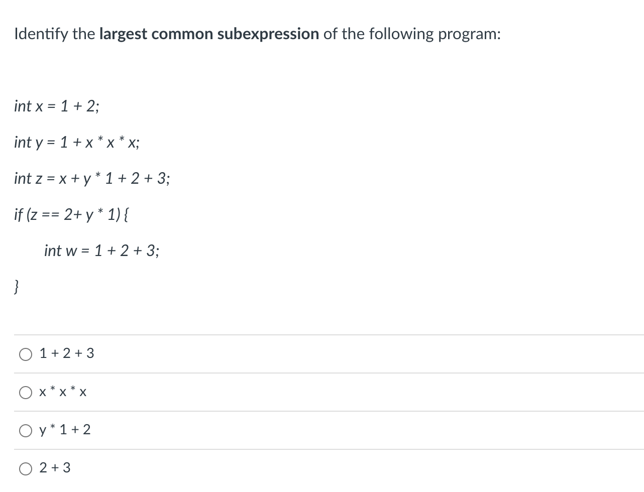
Quiz

Slide 6
Discussion
int x = 1 + 2;
int y = 1 + x * x * x;
int z = x + y * 1 + 2 + 3;
if (z == 2+ y * 1) {
int w = 1 + 2 + 3;
}

Slide 7
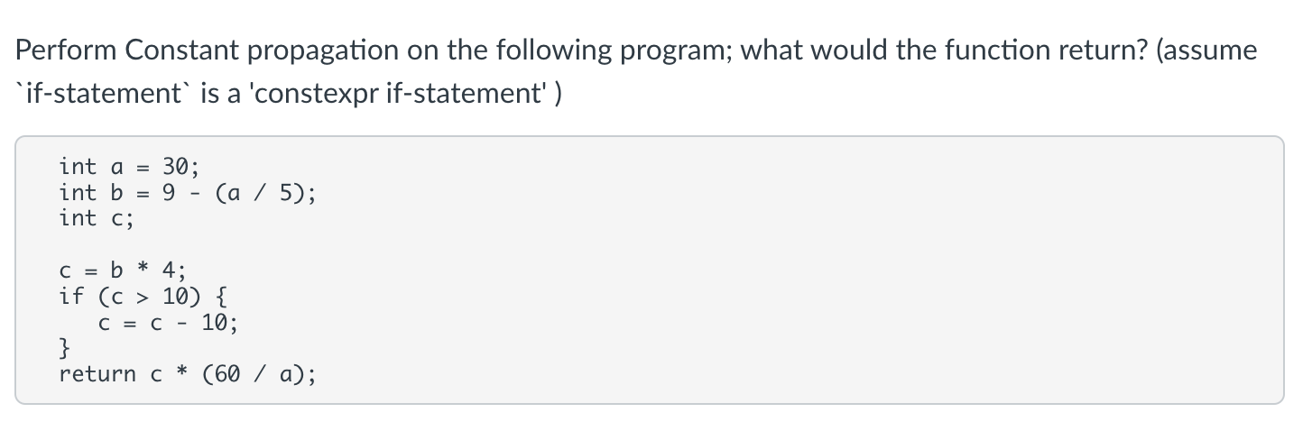
Quiz

Slide 8
Discussion
int a = 30;
int b = 9 - (a / 5);
int c;
c = b * 4;
if (c > 10) { c = c - 10; }
return c * (60 / a);

Slide 9

Quiz

Slide 10
Optimization categories
local optimizations: examine a ”basic block”, i.e. a small region of code with no control flow.
Regional optimizations: several basic blocks with simple control flow.
Global optimization: optimizes across an entire function

Slide 11
Implicit parse tree
IR programs
if_else_statement := IF LPAR expr RPAR statement ELSE statement
if (program0) {
program1
}
else {
program2
}
IR Analysis/ Optimization
loop!
We have several structures to utilize
to analyze and optimize programs!
optimized IR program
target code gen
What IRs do we have at this point?
3 address code
AST
target code optimizations
virtual_reg vr3;
virtual_reg _new_name0;
virtual_reg _new_name1;
vr0 = int2vr(5);
_new_name0 = vr0;
vr1 = int2vr(6);
AST<+,float>
loop!
AST<+,int>
AST<5.5, float>
machine code
AST<x, int>
AST<y, int>

Slide 12
Optimization categories
local optimizations: examine a ”basic block”, i.e. a small region of code with no control flow.
Regional optimizations: several basic blocks with simple control flow
Global optimization: optimizes across an entire function
Discussion:
What are the pros and cons of each?
Why don’t we go further than functions?

Slide 13
Basic blocks

Slide 14
IR Program structure
A sequence of 3 address instructions
Programs can be split into Basic Blocks:
A sequence of 3 address instructions such that:
There is a single entry, single exit
Important property: an instruction in a basic block can assume that all preceding instructions will execute
Single Basic Block
Label_x:
op1;
op2;
op3;
br label_z;

Slide 15
IR Program structure
A sequence of 3 address instructions
Programs can be split into Basic Blocks:
A sequence of 3 address instructions such that:
There is a single entry, single exit
Important property: an instruction in a basic block can assume that all preceding instructions will execute
Two Basic Blocks
Single Basic Block
Label_x:
op1; op2; op3; Label_y: op4; op5;
Label_x:
op1;
op2;
op3;
br label_z;

Slide 16
IR Program structure
How might they appear in a high-level language? What are some examples?
A sequence of 3 address instructions
Programs can be split into Basic Blocks:
A sequence of 3 address instructions such that:
There is a single entry, single exit
Important property: an instruction in a basic block can assume that all preceding instructions will execute
Two Basic Blocks
Single Basic Block
Label_x:
op1; op2; op3; Label_y: op4; op5;
Label_x:
op1;
op2;
op3;
br label_z;

Slide 17
IR Program structure
How might they appear in a high-level language?
How many basic blocks?
… if (x) { …
} else { …
}
…
A sequence of 3 address instructions
Programs can be split into Basic Blocks:
A sequence of 3 address instructions such that:
There is a single entry, single exit
Important property: an instruction in a basic block can assume that all preceding instructions will execute
Two Basic Blocks
Single Basic Block
Label_x:
op1; op2; op3; Label_y: op4; op5;
Label_x:
op1;
op2;
op3;
br label_z;

Slide 18
Converting 3 address code into basic blocks
Let’s try an example: test 4 in HW 3:

Slide 19
Converting 3 address code into basic blocks
Simple algorithm:
keep a list of basic blocks
a basic block is a list of instructions
Iterate over the 3 address instructions
if you see a branch or a label, finalize the current basic block and start a new one.
otherwise just add the current instruction to the current basic block

Slide 20
Converting 3 address code into basic blocks
pseudo code
basic_blocks = []
bb = []
for instr in program:
if instr type is in [branch, label]:
bb.append(instr)
basic_blocks.append[bb]
bb = []
else:
bb.append(instr)

Slide 21
Optimization levels
Local optimizations:
Optimizes an individual basic block
Regional optimizations:
Combines several basic blocks
Global optimizations:
operates across an entire procedure

Slide 22
Optimization levels
Label_0:
x = a + b; y = a + b;
Local optimizations:
Optimizes an individual basic block
Regional optimizations:
Combines several basic blocks
Global optimizations:
operates across an entire procedure

Slide 23
Optimization levels
Label_0:
x = a + b; y = a + b;
optimized to
Label_0:
x = a + b; y = x;
Local optimizations:
Optimizes an individual basic block
Regional optimizations:
Combines several basic blocks
Global optimizations:
operates across an entire procedure

Slide 24
Optimization levels
Label_0:
x = a + b; y = a + b;
optimized to
Label_0:
x = a + b; y = x;
Local optimizations:
Optimizes an individual basic block
Regional optimizations:
Combines several basic blocks
Global optimizations:
operates across an entire procedure
Label_0:
x = a + b; Label_1:
y = a + b;
CANNOT always optimized to
Label_0:
x = a + b; Label_1:
y = x;

Slide 25
Optimization levels
Label_0:
x = a + b; y = a + b;
optimized to
Label_0:
x = a + b; y = x;
Local optimizations:
Optimizes an individual basic block
Regional optimizations:
Combines several basic blocks
Global optimizations:
operates across an entire procedure
Label_0:
x = a + b; Label_1:
y = a + b;
CANNOT always optimized to
Label_0:
x = a + b; Label_1:
y = x;
br Label_1; Label_0:
x = a + b; Label_1:
y = a + b;
code could skip Label_0, leaving x undefined!

Slide 26
Regional Optimization
… if (x) { …
} else { x = a + b;
} y = a + b;
…
we cannot replace: y = a + b. with
y = x;

Slide 27
Regional Optimization
… if (x) { …
} else { x = a + b;
} y = a + b;
…
we cannot replace: y = a + b. with
y = x;
x = a + b; if (x) { …
} else { …
} y = a + b;
…
This requires regional analysis
But in this case, we can check if a and b are not redefined, then y = a + b; can be replaced with y = x;

Slide 28
Local value numbering
A local optimization over 3 address code
Attempts to replace arithmetic operations (expensive) with copy instructions (cheap)
Can be extended to a regional optimization using flow analysis

Slide 29
Local value numbering
A local optimization over 3 address code
Attempts to replace arithmetic operations (expensive) with copy instructions (cheap)
Can be extended to a regional optimization using flow analysis
a = b + c; b = a - d; c = b + c;
d = a - d;

Slide 30
Local value numbering
A local optimization over 3 address code
Attempts to replace arithmetic operations (expensive) with copy instructions (cheap)
Can be extended to a regional optimization using flow analysis
a = b + c; b = a - d; c = b + c;
d = a - d;
a = b + c; b = a - d; c = a;
d = a - d;
valid?

Slide 31
Local value numbering
A local optimization over 3 address code
Attempts to replace arithmetic operations (expensive) with copy instructions (cheap)
Can be extended to a regional optimization using flow analysis
a = b + c; b = a - d; c = b + c;
d = a - d;
a = b + c; b = a - d; c = a;
d = a - d;
valid?
No! Because b is redefined

Slide 32
Local value numbering
A local optimization over 3 address code
Attempts to replace arithmetic operations (expensive) with copy instructions (cheap)
Can be extended to a regional optimization using flow analysis
a = b + c; b = a - d; c = b + c;
d = a - d;
a = b + c; b = a - d; c = b + c;
d = b;
valid?

Slide 33
Local value numbering
A local optimization over 3 address code
Attempts to replace arithmetic operations (expensive) with copy instructions (cheap)
Can be extended to a regional optimization using flow analysis
a = b + c; b = a - d; c = b + c;
d = a - d;
a = b + c; b = a - d; c = b + c;
d = b;
valid?
yes!

Slide 34
Local value numbering
Algorithm:
Provide a number to each variable. Update the number each time the variable is updated.
Keep a global counter; increment with new variables or assignments
a = b + c; b = a - d; c = b + c;
d = a - d;
Global_counter = 0

Slide 35
Local value numbering
Algorithm:
Provide a number to each variable. Update the number each time the variable is updated.
Keep a global counter; increment with new variables or assignments
a2 = b0 + c1; b4 = a2 - d3; c5 = b4 + c1;
d6 = a2 - d3;
Global_counter = 7

Slide 36
Local value numbering
Algorithm: Now that variables are numbered
Iterate sequentially through instructions. Keep a hash table of the rhs (numbered variables and operation) mapped to their lhs.
At each step, check to see if the rhs has already been computed.
a2 = b0 + c1; b4 = a2 - d3; c5 = b4 + c1;
d6 = a2 - d3;

Slide 37
Local value numbering
Algorithm: Now that variables are numbered
Iterate sequentially through instructions. Keep a hash table of the rhs (numbered variables and operation) mapped to their lhs.
At each step, check to see if the rhs has already been computed.
a2 = b0 + c1; b4 = a2 - d3; c5 = b4 + c1;
d6 = a2 - d3;
H = {
}

Slide 38
Local value numbering
Algorithm: Now that variables are numbered
Iterate sequentially through instructions. Keep a hash table of the rhs (numbered variables and operation) mapped to their lhs.
At each step, check to see if the rhs has already been computed.
a2 = b0 + c1; b4 = a2 - d3; c5 = b4 + c1;
d6 = a2 - d3;
H = { “b0 + c1” : “a2”,
}

Slide 39
Local value numbering
Algorithm: Now that variables are numbered
Iterate sequentially through instructions. Keep a hash table of the rhs (numbered variables and operation) mapped to their lhs.
At each step, check to see if the rhs has already been computed.
a2 = b0 + c1; b4 = a2 - d3; c5 = b4 + c1;
d6 = a2 - d3;
H = { “b0 + c1” : “a2”,
}

Slide 40
Local value numbering
Algorithm: Now that variables are numbered
Iterate sequentially through instructions. Keep a hash table of the rhs (numbered variables and operation) mapped to their lhs.
At each step, check to see if the rhs has already been computed.
a2 = b0 + c1; b4 = a2 - d3; c5 = b4 + c1;
d6 = a2 - d3;
H = { “b0 + c1” : “a2”, “a2 - d3” : ”b4”,
}

Slide 41
Local value numbering
Algorithm: Now that variables are numbered
Iterate sequentially through instructions. Keep a hash table of the rhs (numbered variables and operation) mapped to their lhs.
At each step, check to see if the rhs has already been computed.
a2 = b0 + c1; b4 = a2 - d3; c5 = b4 + c1;
d6 = a2 - d3;
H = { “b0 + c1” : “a2”, “a2 - d3” : ”b4”,
}

Slide 42
Local value numbering
Algorithm: Now that variables are numbered
Iterate sequentially through instructions. Keep a hash table of the rhs (numbered variables and operation) mapped to their lhs.
At each step, check to see if the rhs has already been computed.
a2 = b0 + c1; b4 = a2 - d3; c5 = b4 + c1;
d6 = a2 - d3;
H = { “b0 + c1” : “a2”, “a2 - d3” : ”b4”,
}
mismatch due to numberings!

Slide 43
Local value numbering
Algorithm: Now that variables are numbered
Iterate sequentially through instructions. Keep a hash table of the rhs (numbered variables and operation) mapped to their lhs.
At each step, check to see if the rhs has already been computed.
a2 = b0 + c1; b4 = a2 - d3; c5 = b4 + c1;
d6 = a2 - d3;
H = { “b0 + c1” : “a2”, “a2 - d3” : ”b4”, “b4 + c1” : “c5”,
}

Slide 44
Local value numbering
Algorithm: Now that variables are numbered
Iterate sequentially through instructions. Keep a hash table of the rhs (numbered variables and operation) mapped to their lhs.
At each step, check to see if the rhs has already been computed.
a2 = b0 + c1; b4 = a2 - d3; c5 = b4 + c1;
d6 = a2 - d3;
H = { “b0 + c1” : “a2”, “a2 - d3” : ”b4”, “b4 + c1” : “c5”,
}

Slide 45
Local value numbering
Algorithm: Now that variables are numbered
Iterate sequentially through instructions. Keep a hash table of the rhs (numbered variables and operation) mapped to their lhs.
At each step, check to see if the rhs has already been computed.
a2 = b0 + c1; b4 = a2 - d3; c5 = b4 + c1;
d6 = b4;
H = { “b0 + c1” : “a2”, “a2 - d3” : ”b4”, “b4 + c1” : “c5”,
}
match!

Slide 46
What else can we do?

Slide 47
What else can we do?
Consider this snippet:
a2 = c1 - b0; f4 = d3 * a2; c5 = b0 - c1;
d6 = a2 * d3;

Slide 48
Commutative operations
What is the definition of commutative?

Slide 49
Commutative operations
What is the definition of commutative?
x OP y == y OP x
What operators are commutative? Which ones are not?

Slide 50
Adding commutativity to local value numbering
For commutative operators (e.g. + *), the analysis should consider a deterministic order of operands.
You can use variable numbers or lexigraphical order

Slide 51
Local value numbering: commutative operations
Algorithm optimization:
for commutative operations, re-order operands into a deterministic order
a2 = c1 - b0; f4 = d3 * a2; c5 = b0 - c1;
d6 = a2 * d3;
H = {
}

Slide 52
Local value numbering: commutative operations
Algorithm optimization:
for commutative operations, re-order operands into a deterministic order
cannot re-order because - is not commutative
a2 = c1 - b0; f4 = d3 * a2; c5 = b0 - c1;
d6 = a2 * d3;
H = { “c1 - b0” : “a2”,
}

Slide 53
Local value numbering: commutative operations
Algorithm optimization:
for commutative operations, re-order operands into a deterministic order
a2 = c1 - b0; f4 = d3 * a2; c5 = b0 - c1;
d6 = a2 * d3;
H = { “c1 - b0” : “a2”,
}

Slide 54
Local value numbering: commutative operations
Algorithm optimization:
for commutative operations, re-order operands into a deterministic order
re-ordered because a2 < d3 lexigraphically
a2 = c1 - b0; f4 = d3 * a2; c5 = b0 - c1;
d6 = a2 * d3;
H = { “c1 - b0” : “a2”, ”a2 * d3” : “f4”,
}

Slide 55
Local value numbering: commutative operations
Algorithm optimization:
for commutative operations, re-order operands into a deterministic order
a2 = c1 - b0; f4 = d3 * a2; c5 = b0 - c1;
d6 = a2 * d3;
H = { “c1 - b0” : “a2”, ”a2 * d3” : “f4”,
}

Slide 56
Local value numbering: commutative operations
Algorithm optimization:
for commutative operations, re-order operands into a deterministic order
a2 = c1 - b0; f4 = d3 * a2; c5 = b0 - c1;
d6 = a2 * d3;
H = { “c1 - b0” : “a2”, ”a2 * d3” : “f4”,
”b0 - c1” : “c5”,
}

Slide 57
Local value numbering: commutative operations
Algorithm optimization:
for commutative operations, re-order operands into a deterministic order
a2 = c1 - b0; f4 = d3 * a2; c5 = b0 - c1;
d6 = a2 * d3;
H = { “c1 - b0” : “a2”, ”a2 * d3” : “f4”,
”b0 - c1” : “c5”,
}

Slide 58
Local value numbering: commutative operations
Algorithm optimization:
for commutative operations, re-order operands into a deterministic order
a2 = c1 - b0; f4 = d3 * a2; c5 = b0 - c1;
d6 = f4;
H = { “c1 - b0” : “a2”, ”a2 * d3” : “f4”,
”b0 - c1” : “c5”,
}

Slide 59
Other considerations?

Slide 60
Local value numbering w/out adding registers
We’ve assumed we have access to an unlimited number of virtual registers.
In some cases we may not be able to add virtual registers
If an expensive register allocation pass has already occurred.
New constraint:
We need to produce a program such that variables without the numbers is still valid.

Slide 61
Local value numbering w/out adding registers
Example:
local value numbering with unlimited virtual registers
a3 = x1 + y2; a5 = z4;
b6 = a3;
a = x + y; a = z;
b = x + y;
numbering
a3 = x1 + y2; a5 = z4;
b6 = x1 + y2;
a = x + y; a = z;
b = a;
if we drop the numbers, the optimization is invalid.

Slide 62
Local value numbering w/out adding registers
Solutions?
a = x + y; a = z;
b = x + y;
numbering
a3 = x1 + y2; a5 = z4;
b6 = x1 + y2;

Slide 63
Local value numbering w/out adding registers
Keep another hash table to keep the current variable number
a = x + y; a = z;
b = x + y; c = x + y;

Slide 64
Local value numbering w/out adding registers
Keep another hash table to keep the current variable number
a = x + y; a = z;
b = x + y; c = x + y;
We cannot optimize the first line, but we can optimize the second

Slide 65
Local value numbering w/out adding registers
Keep another hash table to keep the current variable number
a = x + y; a = z;
b = x + y; c = x + y;

Slide 66
Local value numbering w/out adding registers
Keep another hash table to keep the current variable number
a = x + y; a = z;
b = x + y; c = x + y;
First we number

Slide 67
Local value numbering w/out adding registers
Keep another hash table to keep the current variable number
a3 = x1 + y2; a5 = z4;
b6 = x1 + y2; c7 = x1 + y2;

Slide 68
Local value numbering w/out adding registers
Keep another hash table to keep the current variable number
Current_val = {
}
a3 = x1 + y2; a5 = z4;
b6 = x1 + y2; c7 = x1 + y2;
H = {
}

Slide 69
Local value numbering w/out adding registers
Keep another hash table to keep the current variable number
Current_val = { ”a” : 3,
}
a3 = x1 + y2; a5 = z4;
b6 = x1 + y2; c7 = x1 + y2;
H = { ”x1 + y2” : ”a3”,
}

Slide 70
Local value numbering w/out adding registers
Keep another hash table to keep the current variable number
Current_val = { ”a” : 3,
}
a3 = x1 + y2; a5 = z4;
b6 = x1 + y2; c7 = x1 + y2;
H = { ”x1 + y2” : ”a3”,
}

Slide 71
Local value numbering w/out adding registers
Keep another hash table to keep the current variable number
Current_val = { ”a” : 5,
}
a3 = x1 + y2; a5 = z4;
b6 = x1 + y2; c7 = x1 + y2;
H = { ”x1 + y2” : ”a3”,
}

Slide 72
Local value numbering w/out adding registers
Keep another hash table to keep the current variable number
Current_val = { ”a” : 5,
}
a3 = x1 + y2; a5 = z4;
b6 = x1 + y2; c7 = x1 + y2;
H = { ”x1 + y2” : ”a3”,
}

Slide 73
Local value numbering w/out adding registers
Keep another hash table to keep the current variable number
Current_val = { ”a” : 5,
}
a3 = x1 + y2; a5 = z4;
b6 = x1 + y2; c7 = x1 + y2;
H = { ”x1 + y2” : ”a3”,
}

Slide 74
Local value numbering w/out adding registers
Keep another hash table to keep the current variable number
Current_val = { ”a” : 5,
”b” : 6
}
a3 = x1 + y2; a5 = z4;
b6 = x1 + y2; c7 = x1 + y2;
H = { ”x1 + y2” : ”b6”,
}

Slide 75
Local value numbering w/out adding registers
Keep another hash table to keep the current variable number
Current_val = { ”a” : 5,
”b” : 6
}
a3 = x1 + y2; a5 = z4;
b6 = x1 + y2; c7 = x1 + y2;
H = { ”x1 + y2” : ”b6”,
}

Slide 76
Local value numbering w/out adding registers
Keep another hash table to keep the current variable number
Current_val = { ”a” : 5,
”b” : 6
}
a3 = x1 + y2; a5 = z4;
b6 = x1 + y2; c7 = x1 + y2;
H = { ”x1 + y2” : ”b6”,
}

Slide 77
Local value numbering w/out adding registers
Keep another hash table to keep the current variable number
Current_val = { ”a” : 5,
”b” : 6
}
a3 = x1 + y2; a5 = z4;
b6 = x1 + y2; c7 = b6;
H = { ”x1 + y2” : ”b6”,
}

Slide 78
Anything else we can add to local value numbering?

Slide 79
Anything else we can add to local value numbering?
Final heuristic: keep sets of possible values

Slide 80
Local value numbering: value sets
Final heuristic: keep sets of possible values
Current_val = {
}
a = x + y; b = x + y;
a = z; c = x + y;
H = {
}

Slide 81
Local value numbering: value sets
Final heuristic: keep sets of possible values
Current_val = {
}
a3 = x1 + y2; b4 = x1 + y2;
a6 = z5; c7 = x1 + y2;
H = {
}

Slide 82
Local value numbering: value sets
Final heuristic: keep sets of possible values
Current_val = {
“a” : 6,
“b” : 4 }
a3 = x1 + y2; b4 = a3;
a6 = z5; c7 = x1 + y2;
H = { “x1 + y2” : “a3”
}

Slide 83
Local value numbering: value sets
Final heuristic: keep sets of possible values
Current_val = {
“a” : 6,
“b” : 4 }
a3 = x1 + y2; b4 = a3;
a6 = z5; c7 = x1 + y2;
H = { “x1 + y2” : “a3”
}

Slide 84
Local value numbering: value sets
Final heuristic: keep sets of possible values
Current_val = {
“a” : 6,
“b” : 4 }
a3 = x1 + y2; b4 = a3;
a6 = z5; c7 = x1 + y2;
H = { “x1 + y2” : “a3”
}
but we could have replaced it with b4!

Slide 85
Local value numbering: value sets
Final heuristic: keep sets of possible values
Current_val = {
“a” : 3,
}
rewind to this point
a3 = x1 + y2; b4 = x1 + y2;
a6 = z5; c7 = x1 + y2;
H = { “x1 + y2” : “a3”
}

Slide 86
Local value numbering: value sets
Final heuristic: keep sets of possible values
Current_val = {
“a” : 3, ”b” : 4
}
a3 = x1 + y2; b4 = a3;
a6 = z5; c7 = x1 + y2;
H = { “x1 + y2” : [“a3”, “b4”],
}
hash a list of possible values

Slide 87
Local value numbering: value sets
Final heuristic: keep sets of possible values
Current_val = {
“a” : 6,
“b” : 4 }
a3 = x1 + y2; b4 = a3;
a6 = z5; c7 = x1 + y2;
H = { “x1 + y2” : [“a3”, ”b4”],
}
fast forward again

Slide 88
Local value numbering: value sets
Final heuristic: keep sets of possible values
Current_val = {
“a” : 6,
“b” : 4 }
a3 = x1 + y2; b4 = a3;
a6 = z5; c7 = b4;
H = { “x1 + y2” : [“a3”, ”b4”],
}
fast forward again

Slide 89
Local value numbering: Memory
Consider a 3 address code that allows memory accesses
a[i] = x[j] + y[k]; b[i] = x[j] + y[k];
is this transformation allowed? No!
only if the compiler can prove that a does not alias x and y
a[i] = x[j] + y[k]; b[i] = a[i];
In the worst case, every time a memory location is updated, the compiler must update the value for all pointers.

Slide 90
Local value numbering: Memory
How to number:
Number each pointer/index pair
(a[i],3) = (x[j],1) + (y[k],2); b[i] = x[j] + y[k];

Slide 91
Local value numbering: Memory
How to number:
Number each pointer/index pair
Any pointer/index pair that might alias must be incremented at each instruction
(a[i],3) = (x[j],1) + (y[k],2); (b[i],6) = (x[j],4) + (y[k],5);

Slide 92
Local value numbering: Memory
How to number:
Number each pointer/index pair
Any pointer/index pair that might alias must be incremented at each instruction
compiler analysis:
can we trace a,x,y to a = malloc(…);
x = malloc(…);
y = malloc(…);
// a,x,y are never overwritten
(a[i],3) = (x[j],1) + (y[k],2); (b[i],6) = (x[j],4) + (y[k],5);

Slide 93
Local value numbering: Memory
How to number:
Number each pointer/index pair
Any pointer/index pair that might alias must be incremented at each instruction
compiler analysis:
can we trace a,x,y to a = malloc(…);
x = malloc(…);
y = malloc(…);
// a,x,y are never overwritten
(a[i],3) = (x[j],1) + (y[k],2); (b[i],6) = (x[j],1) + (y[k],2);
in this case we do not have to update the number

Slide 94
Local value numbering: Memory
How to number:
Number each pointer/index pair
Any pointer/index pair that might alias must be incremented at each instruction
(a[i],3) = (x[j],1) + (y[k],2); (b[i],6) = (x[j],4) + (y[k],5);
programmer annotations can also tell the compiler that no other pointer can access the memory pointed to by a

Slide 95
Local value numbering: Memory
How to number:
Number each pointer/index pair
Any pointer/index pair that might alias must be incremented at each instruction
(a[i],3) = (x[j],1) + (y[k],2); (b[i],6) = (x[j],4) + (y[k],5);
restrict a
programmer annotations can also tell the compiler that no other pointer can access the memory pointed to by a
in this case we do not have to update the number

Slide 96
Local value numbering: Memory
How to number:
Number each pointer/index pair
Any pointer/index pair that might alias must be incremented at each instruction
(a[i],3) = (x[j],1) + (y[k],2); (b[i],6) = (a[i],3);

Slide 97
Optimizing over wider regions
Local value numbering operated over just one basic block.
We want optimizations that operate over several basic blocks (a region), or across an entire procedure (global)
For this, we need Control Flow Graphs and Flow Analysis
We may have time to discuss this later in the module

Slide 98
See everyone on Wednesday
Topics: Loop unrolling

