Slide 1
CSE110A: Compilers April 1, 2022
The dog ran across the park
ARTICLE
NOUN
VERB
PREPOSITION
ARTICLE
NOUN
Topics:
Lexical Analysis
Introduction
Scanners
Ad hoc scanner
Limitations

Slide 2
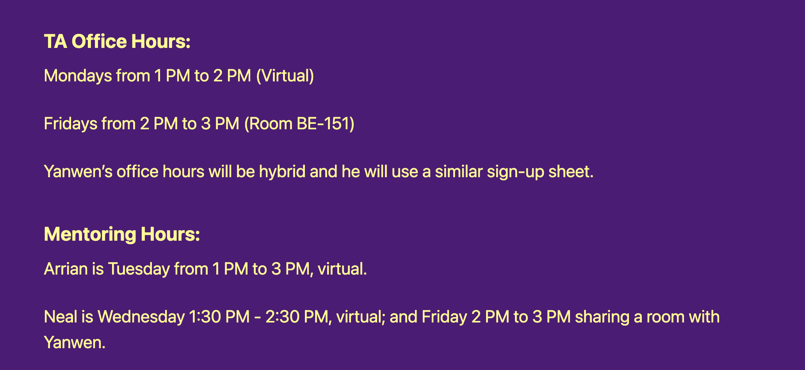
Announcements
We have a room for office hours!

Slide 3
Announcements
Docker setup instructions are available
https://sorensenucsc.github.io/CSE110A-sp2022/homework-setup.html
We will add the required software needed for the HWs to the docker image.
Please try this out over the next few days and let us know if you have issues
Your code must run in the docker to be graded!
There can be tons of tiny differences when developing Python natively

Slide 4
Quiz

Slide 5
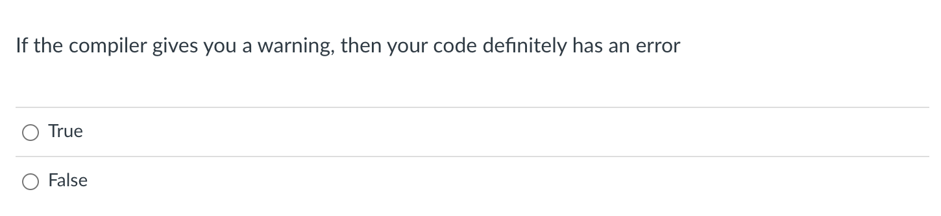
Compiler Warnings

Slide 6
Compiler Warnings
int foo(int condition) {
int x;
if (condition) {
x = 5;
}
int y = x;
return y;
}
Clang gives a warning

Slide 7
Compiler Warnings
int foo(int condition) {
int x;
if (condition) {
x = 5;
}
int y = x;
return y;
}
What if its only called like this?
int main() {
foo(1);
return 0;
}

Slide 8
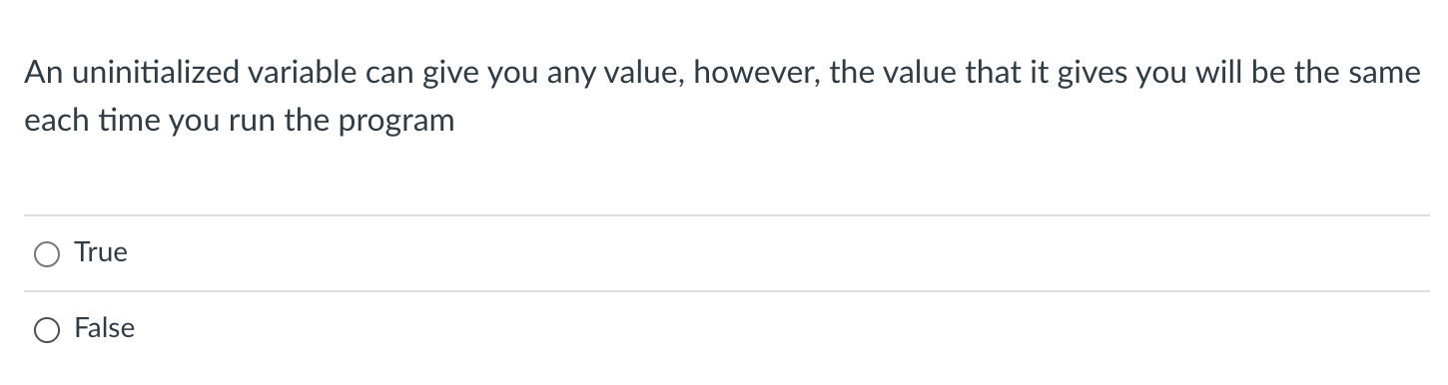
Uninitialized variables

Slide 9
Uninitialized variables
Docker vs OSX Demo
Docker is consistent at low optimization
Docker is not consistent at high optimizations
OSX is not consistent

Slide 10
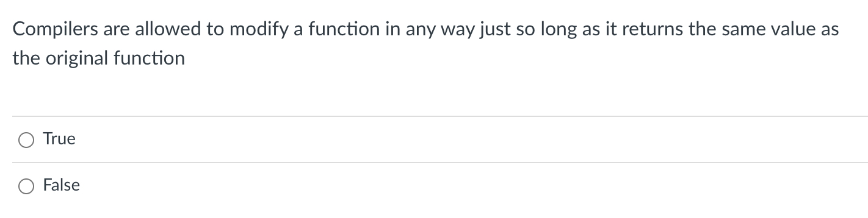
Compilers modifying code

Slide 11
Compilers modifying code
Consider this:
int write_data_to_file(char * data) {
f = fopen("data.txt");
f.write(data);
f.close();
return 0;
}
Can the compiler transform it to this?
int write_data_to_file(char * data) {
return 0;
}

Slide 12
Compilers modifying code
Anything that a function does that has an effect outside of itself is called a “side effect”
Consider this:
int write_data_to_file(char * data) {
f = fopen("data.txt");
f.write(data);
f.close();
return 0;
}
Can the compiler transform it to this? NO
int write_data_to_file(char * data) {
return 0;
}

Slide 13
Compilers modifying code
Consider another one:
int signal(int * flag) {
*flag = 1;
return 0;
}
Memory writes cannot be optimized!
Can the compiler transform it to this? NO
int signal(int * flag) {
return 0;
}

Slide 14
Compilers modifying code
Consider another one:
int signal(int * flag) {
*flag = 1;
return 0;
}
Are memory reads side effects?
Can the compiler transform it to this? NO
int signal(int * flag) {
return 0;
}

Slide 15
Compilers modifying code
Consider another one:
int signal(int * flag) {
*flag = 1;
return 0;
}
int wait(int * flag) {
while (*flag != 0);
return 0;
}
Can the compiler transform it to this?
Can the compiler transform it to this?
int signal(int * flag) {
return 0;
}
int wait(int * flag) {
return 0;
}

Slide 16
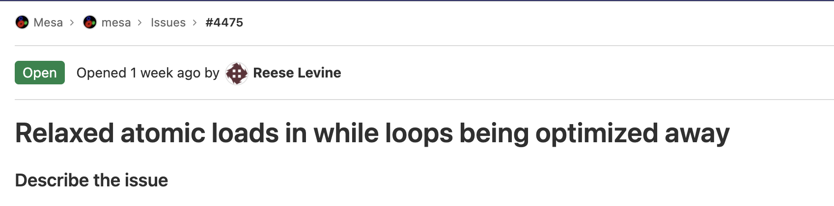
Recent issues discovered by UCSC grad students!
https://gitlab.freedesktop.org/mesa/mesa/-/issues/4475

Slide 17
Benefits to modular compiler design

Slide 18
Benefits to modular compiler design
compiler
creates structure
produces executable code
Optimizations
Optimizations
Optimizations
machine code
input program
Front end
Optimizations
Back end
string
parsing
code gen
optimizations
build on each other
Medium detailed view
more about optimizations: https://stackoverflow.com/questions/15548023/clang-optimization-levels

Slide 19
Review

Slide 20
IR program
input program
Lexical Analysis
Syntactic Analyzer
Semantic Analyzer
Intermediate code gen
IR optimizations
loop!
optimized IR program
string
token stream
syntax tree
syntax tree
target code gen
ISA program
target code optimizations
loop!
optimized ISA program
machine code
More detailed view

Slide 21
IR program
input program
Lexical Analysis
Syntactic Analyzer
Semantic Analyzer
Intermediate code gen
IR optimizations
loop!
optimized IR program
string
token stream
syntax tree
syntax tree
target code gen
front end parser creates structure
ISA program
target code optimizations
loop!
Let’s do a quick review tour through the front end
optimized ISA program
machine code

Slide 22
IR program
input program
Lexical Analysis
Syntactic Analyzer
Semantic Analyzer
Intermediate code gen
IR optimizations
loop!
optimized IR program
string
token stream
syntax tree
syntax tree
target code gen
position = initial + rate * 60;
ISA program
target code gen
loop!
optimized ISA program
machine code
More detailed view

Slide 23
IR program
input program
Lexical Analysis
Syntactic Analyzer
Semantic Analyzer
Intermediate code gen
IR optimizations
loop!
optimized IR program
string
token stream
syntax tree
syntax tree
target code gen
position = initial + rate * 60;
Token stream
<id,1> <assign,=> <id,2> <bin_op,+> <id,3> <bin_op,*> <num,60> <semi,;>
target code gen
id | name | info
1 | position | float
2 | initial | float
3 | rate | float
loop!
optimized ISA program
machine code
Symbol table

Slide 24
position = initial + rate * 60;
IR program
input program
Lexical Analysis
Syntactic Analyzer
Semantic Analyzer
Intermediate code gen
IR optimizations
loop!
optimized IR program
string
token stream
syntax tree
syntax tree
target code gen
Token stream
<id,1> <assign,=> <id,2> <bin_op,+> <id,3> <bin_op,*> <num,60> <semi,;>
Syntax tree
=
target code gen
+
loop!
<id,1>
<id,2>
*
<id,3>
60
machine code

Slide 25
position = initial + rate * 60;
IR program
input program
Lexical Analysis
Syntactic Analyzer
Semantic Analyzer
Intermediate code gen
IR optimizations
loop!
optimized IR program
string
token stream
syntax tree
syntax tree
target code gen
Token stream
<id,1> <assign,=> <id,2> <bin_op,+> <id,3> <bin_op,*> <num,60> <semi,;>
Syntax tree
=
target code gen
+
loop!
<id,1>
Can we multiply a float by an integer?
<id,2>
*
<id,3>
60
machine code

Slide 26
position = initial + rate * 60;
IR program
input program
Lexical Analysis
Syntactic Analyzer
Semantic Analyzer
Intermediate code gen
IR optimizations
loop!
optimized IR program
string
token stream
syntax tree
syntax tree
target code gen
Token stream
<id,1> <assign,=> <id,2> <bin_op,+> <id,3> <bin_op,*> <num,60> <semi,;>
Syntax tree
=
target code gen
+
loop!
<id,1>
<id,2>
*
int_to_float
machine code
<id,3>
60

Slide 27
position = initial + rate * 60;
IR program
input program
Lexical Analysis
Syntactic Analyzer
Semantic Analyzer
Intermediate code gen
IR optimizations
loop!
optimized IR program
token stream
syntax tree
syntax tree
Syntax tree
target code gen
=
<id,1>
+
<id,2>
*
int_to_float
target code gen
<id,3>
loop!
60
IR program
%r0 = int_to_float(60); %r1 = %r0 * id3; %r2 = %r1 + id2;
%id1 = %r2;
machine code

Slide 28
First module
IR program
input program
Lexical Analysis
Syntactic Analyzer
Semantic Analyzer
Intermediate code gen
IR optimizations
loop!
optimized IR program
string
token stream
syntax tree
syntax tree
target code gen
position = initial + rate * 60;
Token stream
<id,1> <assign,=> <id,2> <bin_op,+> <id,3> <bin_op,*> <num,60> <semi,;>
target code gen
id | name | info
1 | position | float
2 | initial | float
3 | rate | float
loop!
optimized ISA program
machine code
Symbol table

Slide 29
Schedule
Introduction Lexical Analysis
Programs for Lexical Analysis
Lexical analysis of a simple programming language
naïve implementation

Slide 30
Schedule
Introduction Lexical Analysis
Programs for Lexical Analysis
Lexical analysis of a simple programming language
naïve implementation

Slide 31
Parsing is the first step in a compiler
How do we parse a sentence in English?

Slide 32
Parsing is the first step in a compiler
How do we parse a sentence in English?
The dog ran across the park

Slide 33
Parsing is the first step in a compiler
How do we parse a sentence in English?
The dog ran across the park
ARTICLE
NOUN
VERB
PREPOSITION
ARTICLE
NOUN

Slide 34
Parsing is the first step in a compiler
How do we parse a sentence in English?
The dog ran across the park
ARTICLE
NOUN
VERB
PREPOSITION
ARTICLE
NOUN
Grammar and Syntax
What about semantics?

Slide 35
Parsing is the first step in a compiler
How do we parse a sentence in English?
The dog ran across the park
ARTICLE
NOUN
VERB
PREPOSITION
ARTICLE
NOUN
Grammar and Syntax
What about semantics?

Slide 36
Parsing is the first step in a compiler
How do we parse a sentence in English?
My dog ran across the park
ARTICLE
NOUN
VERB
PREPOSITION
ARTICLE
NOUN
Grammar and Syntax
What about semantics?

Slide 37
New Question
Can we define a simple language using these building blocks?
ARTICLE
NOUN
VERB
ADJECTIVE

Slide 38
A Simple Language
ARTICLE = {The, A, My, Your}
NOUN = {Dog, Car, Computer}
VERB = {Ran, Crashed, Accelerated}
ADJECTIVE = {Purple, Spotted, Old}

Slide 39
A Simple Language
ARTICLE = {The, A, My, Your}
NOUN = {Dog, Car, Computer}
VERB = {Ran, Crashed, Accelerated}
ADJECTIVE = {Purple, Spotted, Old}
ARTICLE NOUN VERB

Slide 40
A Simple Language
ARTICLE = {The, A, My, Your}
NOUN = {Dog, Car, Computer}
VERB = {Ran, Crashed, Accelerated}
ADJECTIVE = {Purple, Spotted, Old}
Question mark means optional
ARTICLE ADJECTIVE? NOUN VERB

Slide 41
A Simple Language
ARTICLE = {The, A, My, Your}
NOUN = {Dog, Car, Computer}
VERB = {Ran, Crashed, Accelerated}
ADJECTIVE = {Purple, Spotted, Old}
ARTICLE ADJECTIVE? NOUN VERB
My Old Computer Crashed

Slide 42
A Simple Language
ARTICLE = {The, A, My, Your}
NOUN = {Dog, Car, Computer}
VERB = {Ran, Crashed, Accelerated}
ADJECTIVE = {Purple, Spotted, Old}
ARTICLE ADJECTIVE? NOUN VERB
The Purple Dog Crashed

Slide 43
A Simple Language
ARTICLE = {The, A, My, Your}
NOUN = {Dog, Car, Computer}
VERB = {Ran, Crashed, Accelerated}
ADJECTIVE = {Purple, Spotted, Old}
grammatically correct,
semantically correct?
ARTICLE ADJECTIVE? NOUN VERB
The Purple Dog Crashed

Slide 44
A Simple Language
ARTICLE = {The, A, My, Your}
NOUN = {Dog, Car, Computer}
VERB = {Ran, Crashed, Accelerated}
ADJECTIVE = {Purple, Spotted, Old}
What other sentences can you construct?
How could we expand the language?
ARTICLE ADJECTIVE? NOUN VERB

Slide 45
A Simple Language
ARTICLE = {The, A, My, Your}
NOUN = {Dog, Car, Computer}
VERB = {Ran, Crashed, Accelerated}
ADJECTIVE = {Purple, Spotted, Old}
What other languages can you specify?
ARTICLE ADJECTIVE? NOUN VERB

Slide 46
A Simple Language
ARTICLE = {The, A, My, Your}
NOUN = {Dog, Car, Computer}
VERB = {Ran, Crashed, Accelerated}
ADJECTIVE = {Purple, Spotted, Old}
What other languages can you specify?
ARTICLE ADJECTIVE* NOUN VERB
repeat (0 or more times)

Slide 47
Lexical Analysis Labels Parts of Speech
Parser (module 2) will talk about the organization of the parts of speech
Lexical Analysis
Parser
ARTICLE ADJECTIVE* NOUN VERB
ARTICLE = {The, A, My, Your}
NOUN = {Dog, Car, Computer}
VERB = {Ran, Crashed, Accelerated}
ADJECTIVE = {Purple, Spotted, Old}

Slide 48
Schedule
Introduction Lexical Analysis
Programs for Lexical Analysis
Lexical analysis of a simple programming language
naïve implementation

Slide 49
Programs for Lexical Analysis
Scanner (sometimes called lexer)
Defined by a list of tokens and definitions:
ARTICLE = {The, A, My, Your}
NOUN = {Dog, Car, Computer}
VERB = {Ran, Crashed, Accelerated}
ADJECTIVE = {Purple, Spotted, Old}
Tokens
Tokens Definitions

Slide 50
Programs for Lexical Analysis
Scanner (sometimes called lexer)
Defined by a list of tokens and definitions:
Original program:
Lex
https://en.wikipedia.org/wiki/Lex_(software)
ARTICLE = {The, A, My, Your}
NOUN = {Dog, Car, Computer}
VERB = {Ran, Crashed, Accelerated}
ADJECTIVE = {Purple, Spotted, Old}
Popular implementations
Flex
Tokens
Tokens Definitions

Slide 51
Scanner API
// Constructor, generates a Scanner
s = ScannerGenerator(tokens)
// The string we want to do // lexical analysis on
s.input(“My Old Computer Crashed“)

Slide 52
Scanner API
What do we want?

Slide 53
Scanner API
What do we want?
“My Old Computer Crashed”
Scanner

Slide 54
Scanner API
What do we want?
“My Old Computer Crashed”
Scanner
[(ARTICLE), (ADJECTIVE), (NOUN), (VERB)]
Useful, but we might need more information

Slide 55
Scanner API
What do we want?
“My Old Computer Crashed”
Scanner
[(ARTICLE), (ADJECTIVE), (NOUN), (VERB)]
Useful, but we might need more information
Lexeme: (TOKEN, value)

Slide 56
Scanner API
What do we want?
“My Old Computer Crashed”
Scanner
[(ARTICLE, “My”), (ADJECTIVE, “Old”), (NOUN, “Computer”), (VERB, “Crashed”)]

Slide 57
Scanner API
What do we want?
“My Old Computer Crashed”
Scanner
[(ARTICLE, “My”), (ADJECTIVE, “Old”), (NOUN, “Computer”), (VERB, “Crashed”)]
Lexeme: (TOKEN, value)

Slide 58
Scanner API
What do we want?
“My Old Computer Crashed”
Scanner
classically, this occurs one lexeme at a time
[(ARTICLE, “My”), (ADJECTIVE, “Old”), (NOUN, “Computer”), (VERB, “Crashed”)]

Slide 59
Scanner API
// Constructor, generates a Scanner
s = ScannerGenerator(tokens)
// The string we want to do // lexical analysis on
s.input(“My Old Computer Crashed“)
// Returns the next lexeme
s.token()

Slide 60
> s = ScanerGenerator(tokens) > s.input(“My Old Computer Crashed”) > s.token()

Slide 61
> s = ScanerGenerator(tokens) > s.input(“My Old Computer Crashed”) > s.token() (ARTICLE, “My”)
> s.token()

Slide 62
> s = ScanerGenerator(tokens) > s.input(“My Old Computer Crashed”) > s.token() (ARTICLE, “My”)
> s.token() (ADJECTIVE, “Old”)
> s.token()

Slide 63
> s = ScanerGenerator(tokens) > s.input(“My Old Computer Crashed”) > s.token() (ARTICLE, “My”)
> s.token() (ADJECTIVE, “Old”)
> s.token() (NOUN, “Computer”)

Slide 64
> s = ScanerGenerator(tokens) > s.input(“My Old Computer Crashed”) > s.token() (ARTICLE, “My”)
> s.token() (ADJECTIVE, “Old”)
> s.token() (NOUN, “Computer”)
> s.token()

Slide 65
> s = ScanerGenerator(tokens) > s.input(“My Old Computer Crashed”) > s.token() (ARTICLE, “My”)
> s.token() (ADJECTIVE, “Old”)
> s.token() (NOUN, “Computer”)
> s.token() (VERB, “Crashed”) > s.token()

Slide 66
> s = ScanerGenerator(tokens) > s.input(“My Old Computer Crashed”) > s.token() (ARTICLE, “My”)
> s.token() (ADJECTIVE, “Old”)
> s.token() (NOUN, “Computer”)
> s.token() (VERB, “Crashed”) > s.token() None

Slide 67
Schedule
Introduction Lexical Analysis
Programs for Lexical Analysis
Lexical analysis of a simple programming language
naïve implementation

Slide 68
Lexical analysis of a simple programming lang.
Lets write tokens and definitions for a simple programming language
integer arithmetic (+,*)
variables, assignments, non-negative integers
example
x = 5 + 4 * 3;
What tokens should we have? Ideas?

Slide 69
Lexical analysis of a simple programming lang.
Lets write tokens and definitions for a simple programming language
integer arithmetic (+,*)
variables, assignments, non-negative integers
example
x = 5 + 4 * 3;
maybe something like this?
ID = [characters]
NUM = [numbers]
ASSIGN = ”=“
PLUS = “+”
MULT = “*”

Slide 70
Lexical analysis of a simple programming lang.
Lets write tokens and definitions for a simple programming language
integer arithmetic (+,*)
variables, assignments, non-negative integers
example
x = 5 + 4 * 3;
maybe something like this?
ID = [characters]
NUM = [numbers]
ASSIGN = ”=“
PLUS = “+”
MULT = “*”
[(ID, x), (ASSIGN, “=“), (NUM, ”5”), (PLUS, “+”) ,
(NUM, “4”), (MULT, “*”), (NUM, “3”)]

Slide 71
Lexical analysis of a simple programming lang.
Lets write tokens and definitions for a simple programming language
integer arithmetic (+,*)
variables, assignments, non-negative integers
example
Other options for tokens we could define?
x = 5 + 4 * 3;
maybe something like this?
ID = [characters]
NUM = [numbers]
ASSIGN = ”=“
PLUS = “+”
MULT = “*”

Slide 72
Lexical analysis of a simple programming lang.
Lets write tokens and definitions for a simple programming language
integer arithmetic (+,*)
variables and assignments
example
Other options for tokens we could define?
x = 5 + 4 * 3;
maybe something like this?
ID = [characters]
NUM = [numbers]
ASSIGN = ”=“
PLUS = “+”
MULT = “*”
ID = [characters]
NUM = [numbers]
ASSIGN = ”=“
OP = {“+”, “*”}

Slide 73
Lexical analysis of a simple programming lang.
Lets write tokens and definitions for a simple programming language
integer arithmetic (+,*)
variables and assignments
example
Other options for tokens we could define?
x = 5 + 4 * 3;
maybe something like this?
ID = [characters]
NUM = [numbers]
ASSIGN = ”=“
PLUS = “+”
MULT = “*”
ID = [characters]
NUM = [numbers]
ASSIGN = ”=“
OP = {“+”, “*”}
(OP, “+”) (OP, “*”)
We can always
distinguish using the value

Slide 74
Lexical analysis of a simple programming lang.
Lets write tokens and definitions for a simple programming language
integer arithmetic (+,*)
variables and assignments
example
Other options for tokens we could define?
x = 5 + 4 * 3;
maybe something like this?
ID = [characters]
NUM = [numbers]
ASSIGN = ”=“
PLUS = “+”
MULT = “*”

Slide 75
Lexical analysis of a simple programming lang.
Lets write tokens and definitions for a simple programming language
integer arithmetic (+,*)
variables and assignments
example
Other options for tokens we could define?
x = 5 + 4 * 3;
maybe something like this?
ID = [characters]
FIVE = “5”
FOUR = “4”
...
PLUS = “+”
MULT = “*”
ID = [characters]
NUM = [numbers]
ASSIGN = ”=“
PLUS = “+”
MULT = “*”
what do we think about this?

Slide 76
Lexical analysis of a simple programming lang.
Lets write tokens and definitions for a simple programming language
integer arithmetic (+,*)
variables and assignments
example
What are we missing?
x = 5 + 4 * 3;
ID = [characters]
NUM = [numbers]
ASSIGN = ”=“
PLUS = “+”
MULT = “*”

Slide 77
Lexical analysis of a simple programming lang.
Lets write tokens and definitions for a simple programming language
integer arithmetic (+,*)
variables and assignments
example
What are we missing?
x = 5 + 4 * 3;
whitespace!
ID = [characters]
NUM = [numbers]
ASSIGN = ”=“
PLUS = “+”
MULT = “*”

Slide 78
Lexical analysis of a simple programming lang.
Lets write tokens and definitions for a simple programming language
integer arithmetic (+,*)
variables and assignments
example
What are we missing?
x = 5 + 4 * 3;
whitespace!
ID = [characters]
NUM = [numbers]
ASSIGN = ”=“
PLUS = “+”
MULT = “*”
IGNORE = “ “
Typically* we ignore whitespace and newlines and tabs
*unless we are python 😖
Ignored tokens do not get returned as a lexeme

Slide 79
Parsing is the first step in a compiler
How do we parse a sentence in English?
The dog ran across the park
ARTICLE
NOUN
VERB
PREPOSITION
ARTICLE
NOUN
White space is ignored because it is not meaningful!

Slide 80
Longest possible match
Consider the token:
CLASS_TOKEN = {“cse”, “110”, “cse110”}
What would the lexemes be for: “cse110”
options:
(CLASS_TOKEN, ”cse”) (CLASS_TOKEN, ”110”)
(CLASS_TOKEN, ”cse110”)

Slide 81
Longest possible match
Consider the token:
CLASS_TOKEN = {“cse”, “110”, “cse110”}
What would the lexemes be for: “cse110”
options:
(CLASS_TOKEN, ”cse”) (CLASS_TOKEN, ”110”)
(CLASS_TOKEN, ”cse110”)
This one!

Slide 82
Longest possible match
Important for operators, e.g. in C
++, +=
how would we scan “x++;”
[(ID, “x”), (ADD, “+”), (ADD, “+”), (SEMI, “;”)]
[(ID, “x”), (INCREMENT, “++”), (SEMI, “;”)]

Slide 83
Longest possible match
Important for variable names and numbers
how would we scan: “my_var = 10;” ?

Slide 84
Longest possible match
Important for variable names and numbers
how would we scan: “my_var = 10;” ?
[(ID, “my_var”), (ASSIGN, “=”), (NUM, “10”), (SEMI, “;”)]

Slide 85
Schedule
Introduction Lexical Analysis
Programs for Lexical Analysis
Lexical analysis of a simple programming language
naïve implementation

Slide 86
Naïve implementation
A scanner that implements
ID = [characters]
NUM = [numbers]
ASSIGN = ”=“
PLUS = “+”
MULT = “*”
IGNORE = [“ “]

Slide 87
Naïve implementation
Building block:
class StringStream:
def __init__(self, input_string):
self.string = input_string
def is_empty(self):
return len(self.string) == 0
def peek_char(self):
if not self.is_empty():
return self.string[0]
return None
def eat_char(self):
self.string = self.string[1:]

Slide 88
Naïve implementation
First step in implementing the scanner
class NaiveScanner:
def __init__(self, input_string):
self.ss = StringStream(input_string)
def token(self):
if self.ss.is_empty():
return None
while self.ss.peek_char() in IGNORE:
self.ss.eat_char()
ID = [characters]
NUM = [numbers]
ASSIGN = ”=“
PLUS = “+”
MULT = “*”
IGNORE = [“ “]

Slide 89
Naïve implementation
First step in implementing the scanner
class NaiveScanner:
def token(self):
...
if self.ss.peek_char() == "+":
value = self.ss.peek_char()
self.ss.eat_char()
return ("ADD", value)
if self.ss.peek_char() == "*":
value = self.ss.peek_char()
self.ss.eat_char()
return ("MULT", value)
ID = [characters]
NUM = [numbers]
ASSIGN = ”=“
PLUS = “+”
MULT = “*”
IGNORE = [“ “]

Slide 90
Naïve implementation
First step in implementing the scanner
class NaiveScanner:
def token(self):
...
if self.ss.peek_char() in NUMS:
value = ""
while self.ss.peek_char() in NUMS:
value += self.ss.peek_char()
self.ss.eat_char()
return ("NUM", value)
ID = [characters]
NUM = [numbers]
ASSIGN = ”=“
PLUS = “+”
MULT = “*”
IGNORE = [“ “]

Slide 91
Code Demo

Slide 92
What are the issues with our Scanner?
Think about it for next class, where we will discuss:
Regular Expressions!

