Slide 1
CSE110A: Compilers April 27, 2022
..
AST
..
..
..
..
Topics:
Module 3: Intermediate representations
Intro to intermediate representations
ASTs
parse trees into ASTs
CFG
...
...
...
...
3 address code
store i32 0, ptr %2
%3 = load i32, ptr %1
%4 = add nsw i32 %3, 1,
store i32 %4, ptr %1
%5 = load i32, ptr %2

Slide 2
Announcements
HW 2
Due on Monday by midnight
Still have lots of chances for help
If you haven’t started yet, I highly suggest that you start!
Midterm will be given on May 2
Take home midterm.
Assigned on Monday morning and due on Friday by midnight
No late midterms are accepted

Slide 3
Announcements
HW 2
Due on Monday by midnight
Still have lots of chances for help
If you haven’t started yet, I highly suggest that you start!
Midterm will be given on May 2
Take home midterm.
Assigned on Monday morning and due on Friday by midnight
No late midterms are accepted
HW 1 grades
Hoping to get them by Monday

Slide 4
Announcements
Neal wrote a recursive descent primer on Piazza, check it out!

Slide 5
Homework 2 clarifications
Tip for starting on statement rules

Slide 6
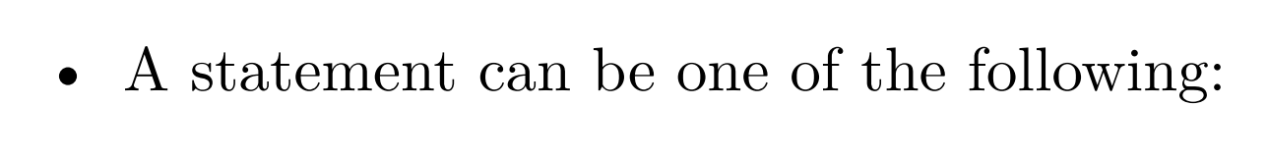
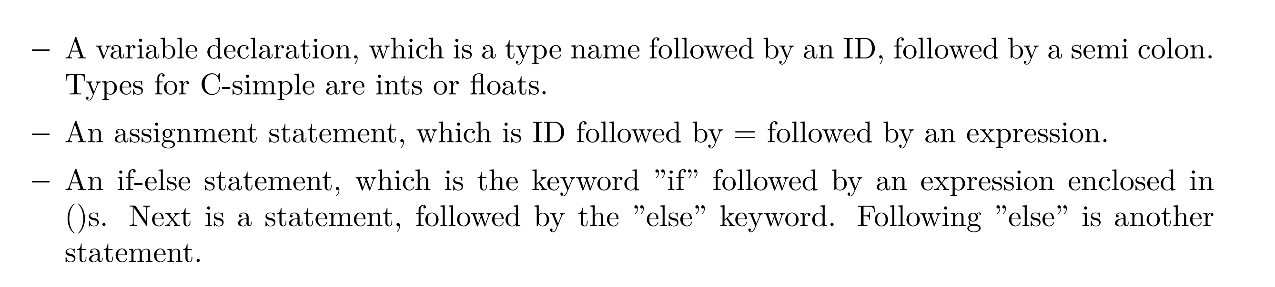
Simply translate the English:

Slide 7
Simply translate the English:
Statement ::= variable_declaration
| assignment_statement | if_else_statement

Slide 8
Simply translate the English:
Statement ::= variable_declaration
| assignment_statement | if_else_statement
variable_declaration ::= TYPE ID SEMI

Slide 9
Simply translate the English:
Statement ::= variable_declaration
| assignment_statement | if_else_statement
variable_declaration ::= TYPE ID SEMI

Slide 10
Simply translate the English:
Statement ::= variable_declaration
| assignment_statement | if_else_statement
variable_declaration ::= type ID SEMI
type ::= FLOAT
| INT

Slide 11
Homework 2 clarifications
Statement precedence
Do we need to encode statement precedence? Or associativity?

Slide 12
Homework 2 clarifications
Statement_list ::= Statement_list Statement
| Statement
Which one do we want?
Statement_list ::= Statement Statement_list
| Statement

Slide 13
Homework 2 clarifications
Statement_list ::= Statement_list Statement
| Statement
We don’t want left recursion for top-down
parsing
Statement_list ::= Statement Statement_list
| Statement
We might want left recursion for left associativity
int x; x = 42; x = 52;
think about this program. We want to evaluate it left to right.

Slide 14
Homework 2 clarifications
Statement_list ::= Statement Statement_list
| Statement
int x; x = 42; x = 52;
Statement_list
int x;
Statement_list
x = 42;
Statement_list
x = 52;

Slide 15
Homework 2 clarifications
there is no evaluation
associated with a
statement list. The evaluation should occur at the statement
Thus we can use the right recursive form with no issue. We also don’t have to worry about statement
precedence
Statement_list ::= Statement Statement_list
| Statement
int x; x = 42; x = 52;
Statement_list
int x;
Statement_list
x = 42;
Statement_list
x = 52;

Slide 16
Homework 2 clarifications
Left associativity and left recursion expressions

Slide 17
Simple grammar for minus expressions
Expr ::= Expr MINUS NUM
| NUM
5 - 4 - 3
Expr
Expr
Left recursive grammar makes this parse tree. It encodes
associativity
-
3
5
-
4

Slide 18
Simple grammar for minus expressions
Expr ::= Expr MINUS NUM
| NUM
5 - 4 - 3
Expr
Left recursive grammar makes this parse tree. It encodes
associativity. But left recursion won’t work
for top-down parsers!
Expr
-
3
5
-
4
What if we do it right recursive
5 - 4 - 3
Expr ::= NUM MINUS Expr
| NUM
Expr
We can use this grammar in a top-down parser, but it doesn’t encode associativity
5
-
Expr
4
-
3

Slide 19
Simple grammar for minus expressions
Expr ::= Expr MINUS NUM
| NUM
5 - 4 - 3
Expr
Left recursive grammar makes this parse tree. It encodes
associativity. But left recursion won’t work
for top-down parsers!
Expr
-
3
5
-
4
What if we follow the recipe
Expr ::= NUM Expr2
Expr2 ::= MINUS NUM Expr2
| “”

Slide 20
Simple grammar for minus expressions
Expr ::= Expr MINUS NUM
| NUM
5 - 4 - 3
Expr
Left recursive grammar makes this parse tree. It encodes
associativity. But left recursion won’t work
for top-down parsers!
Expr
-
3
5
-
4
Expr
How about this one?
What if we follow the recipe
Expr ::= NUM Expr2
Expr2 ::= MINUS NUM Expr2
| “”
5
Expr2
-
4
Expr2
-
3
Expr2

Slide 21
Simple grammar for minus expressions
Expr ::= Expr MINUS NUM
| NUM
5 - 4 - 3
Expr
Left recursive grammar makes this parse tree. It encodes
associativity. But left recursion won’t work
for top-down parsers!
Expr
-
3
5
-
4
Expr
How about this one?
It isn’t really clear...
We will talk about it more today but for your homework, encode associativity in your original grammar (1.1) and use the recipe for eliminating left recursion for the rest.
What if we follow the recipe
Expr ::= NUM Expr2
Expr2 ::= MINUS NUM Expr2
| “”
5
Expr2
-
4
Expr2
-
3
Expr2

Slide 22
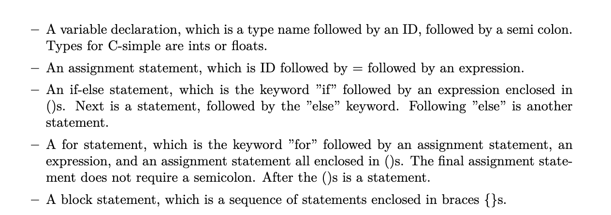
Homework 2 clarifications
Scopes for symbol table
In which cases do you need to start a new scope?

Slide 23
Homework 2 clarifications
Scopes for symbol table
In which cases do you need to start a new scope?

Slide 24
Homework 2 clarifications
Scopes for symbol table
In which cases do you need to start a new scope?

Slide 25
Homework 2 clarifications
Scopes for symbol table
In which cases do you need to start a new scope?

Slide 26
Homework 2 clarifications
Scopes for symbol table
In which cases do you need to start a new scope?
int foo() {
if (1)
int x;
else
int y;
return 0;
}
Is this allowed in C-simple?
Is it allowed in C?

Slide 27
Homework 2 clarifications
Scopes for symbol table
In which cases do you need to start a new scope?
int foo() {
if (1)
int x;
else
int y;
return 0;
}
I have failed ☹ C-simple is not a strict subset of C
We won’t test
this case.
Is this allowed in C-simple? Yes!
Is it allowed in C? No!

Slide 28
Homework 2 clarifications
Scopes for symbol table
In which cases do you need to start a new scope?

Slide 29
Homework 2 clarifications
Scopes for symbol table
In which cases do you need to start a new scope?
int foo() {
int i;
for (i = 0; i < 100; i = i + 1)
int y;
return 0;
}

Slide 30
Homework 2 clarifications
Scopes for symbol table
In which cases do you need to start a new scope?
int foo() {
int i;
for (i = 0; i < 100; i = i + 1)
int y;
return 0;
}
We won’t test this
case either.
Is this allowed in C-simple? Yes!
Is it allowed in C? No!

Slide 31
Homework 2 clarifications
Scopes for symbol table
In which cases do you need to start a new scope?
How about this one?
int foo() {
for (int i = 0; i < 100; i = i + 1) i = i + 1;
return 0;
}

Slide 32
Homework 2 clarifications
Scopes for symbol table
In which cases do you need to start a new scope?
starts a new scope in C. But you don’t have to worry about it in C-simple
int foo() {
for (int i = 0; i < 100; i = i + 1) i = i + 1;
return 0;
}
Is this allowed in C-simple? No!
Is it allowed in C? Yes!

Slide 33
Homework 2 clarifications
Scopes for symbol table
In which cases do you need to start a new scope?

Slide 34
Homework 2 clarifications
Scopes for symbol table
In which cases do you need to start a new scope?
int x;
{
int y;
x++;
y++;
}
y++;

Slide 35
Homework 2 clarifications
Scopes for symbol table
In which cases do you need to start a new scope?
int x;
{
int y;
x++;
y++;
}
y++;
block statement needs a new scope

Slide 36
Quiz

Slide 37
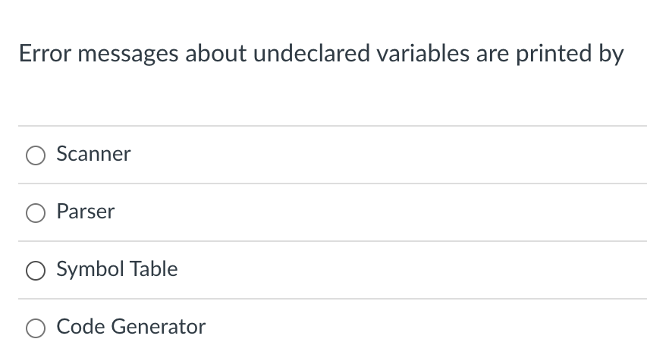
Quiz

Slide 38
Quiz
int x;
{
int y;
x++;
y++;
}
y++;

Slide 39
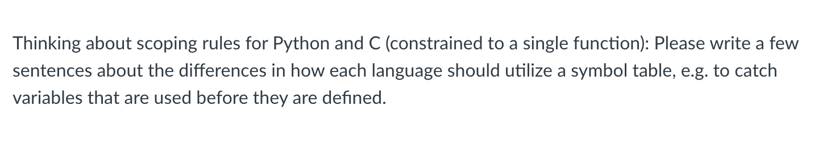
Quiz

Slide 40
Quiz
int main() {
if (1) {
int x = 5;
}
printf("%d\n",x);
}
if (1):
x = 5
print(x)
is this allowed?
is this allowed?

Slide 41
Quiz
int main() {
if (1) {
int x = 5;
}
printf("%d\n",x);
}
if (1):
x = 5
print(x)
is this allowed? yes
is this allowed? no

Slide 42
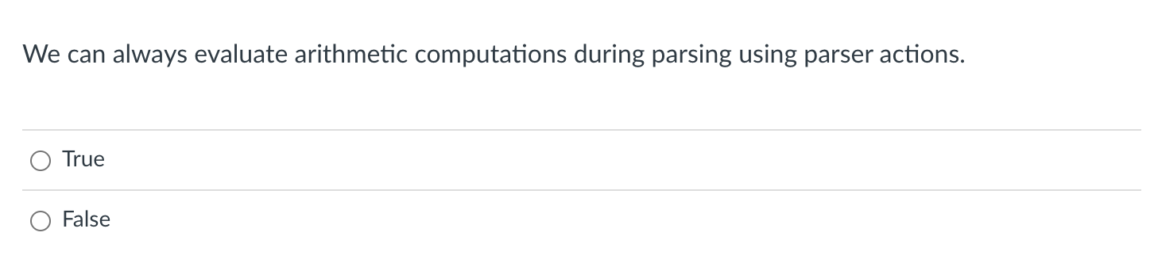
Quiz

Slide 43
Quiz
5 - 4 - 3
Expr
Simple grammar for minus expressions
Expr
-
3
Expr ::= Expr MINUS NUM
| NUM
5
-
4

Slide 44
Quiz
5 - 4 - 3
Expr
Simple grammar for minus expressions
Expr
-
3
Expr ::= Expr MINUS NUM {return $1 - $3}
| NUM {return $1}
5
-
4

Slide 45
Quiz
5 - 4 - 3
Expr
Simple grammar for minus expressions
Expr
-
3
Expr ::= Expr MINUS NUM {return $1 - $3}
| NUM {return $1}
5
-
4
returns 5
returns 4

Slide 46
Quiz
5 - 4 - 3
Expr
Simple grammar for minus expressions
returns 1
Expr
-
3
Expr ::= Expr MINUS NUM {return $1 - $3}
| NUM {return $1}
5
-
4
returns 5
returns 4

Slide 47
Quiz
5 - 4 - 3
Expr
Simple grammar for minus expressions
returns 1
Expr
-
3
Expr ::= Expr MINUS NUM {return $1 - $3}
| NUM {return $1}
returns 3
5
-
4
returns 5
returns 4

Slide 48
Quiz
5 - 4 - 3
Expr
returns -2
Simple grammar for minus expressions
returns 1
Expr
-
3
Expr ::= Expr MINUS NUM {return $1 - $3}
| NUM {return $1}
returns 3
5
-
4
returns 5
returns 4

Slide 49
Quiz
So why can’t we always evaluate arithmetic expressions during parsing?

Slide 50
Quiz
So why can’t we always evaluate arithmetic expressions during parsing?
x - y - z
Expr
Expr ::= Expr MINUS UNIT {return $1 - $3}
| UNIT {return $1}
UNIT ::= NUM {return $1}
| ID {return $1}
Expr
-
z
x
-
y

Slide 51
Quiz
We cannot evaluate the program unless we know the value of x,y,z. What are some examples when we wouldn’t know the values?
x - y - z
Expr
Expr ::= Expr MINUS UNIT {return $1 - $3}
| UNIT {return $1}
UNIT ::= NUM {return $1}
| ID {return $1}
Expr
-
z
x
-
y

Slide 52
Quiz
But we might be able to do some optimizations...
x - y - z
Expr
Expr ::= Expr MINUS UNIT {return $1 - $3}
| UNIT {return $1}
UNIT ::= NUM {return $1}
| ID {return $1}
Expr
-
z
x
-
y

Slide 53
Quiz
But we might be able to do some optimizations...
x - x - z
Expr
Expr ::= Expr MINUS UNIT {return $1 - $3}
| UNIT {return $1}
UNIT ::= NUM {return $1}
| ID {return $1}
Expr
-
z
x
-
x

Slide 54
Quiz
But we might be able to do some optimizations...
x - x - z
Expr
Expr ::= Expr MINUS UNIT {if $1 == $3 then 0 else ...}
| UNIT {return $1}
UNIT ::= NUM {return $1}
| ID {return $1}
0
-
z

Slide 55
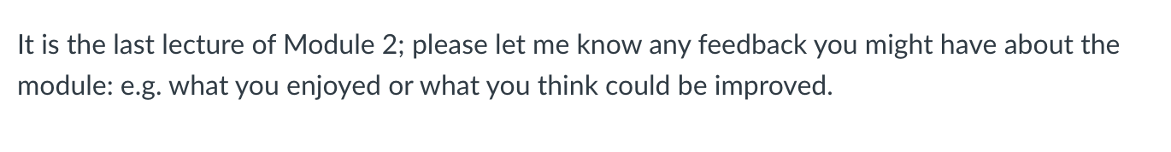
Quiz
Thanks for your feedback! Apologies again about the disorganization caused by the technical failure!

Slide 56
Review
We covered most of last lecture’s material in the quiz

Slide 57
New module!
Intermediate representations
Where are we at in our compiler flow?

Slide 58
Compiler Architecture
compiler
creates structure
produces executable code
Optimizations
Optimizations
Optimizations
machine code
input program
Front end
Optimizations
Back end
string
parsing
code gen
optimizations
build on each other
Medium detailed view
more about optimizations: https://stackoverflow.com/questions/15548023/clang-optimization-levels

Slide 59
More detailed view

Slide 60
input program
Lexical Analysis
Syntactic Analyzer
Semantic Analyzer
Intermediate code gen
IR optimizations
loop!
target code gen
target code gen
loop!
machine code
More detailed view

Slide 61
input program
Lexical Analysis
Syntactic Analyzer
Intermediate code gen
IR Analysis/ Optimization
loop!
We’re going to move semantic analysis
into IR optimizations and analysis
target code gen
target code gen
loop!
machine code
More detailed view

Slide 62
IR programs
input program
Lexical Analysis
Syntactic Analyzer
Intermediate code gen
IR Analysis/ Optimization
loop!
optimized IR program
string
token stream
syntax tree
target code gen
ISA program
target code optimizations
loop!
optimized ISA program
machine code
More detailed view

Slide 63
IR programs
input program
Lexical Analysis
Syntactic Analyzer
Intermediate code gen
IR Analysis/ Optimization
loop!
optimized IR program
string
token stream
syntax tree
target code gen
position = initial + rate * 60;
ISA program
target code gen
loop!
optimized ISA program
machine code
More detailed view

Slide 64
IR programs
input program
Lexical Analysis
Syntactic Analyzer
Intermediate code gen
IR Analysis/ Optimization
loop!
optimized IR program
string
token stream
syntax tree
target code gen
position = initial + rate * 60;
Token stream
<id,> <assign,=> <id,> <bin_op,+> <id,> <bin_op,*> <num,60> <semi,;>
target code gen
loop!
optimized ISA program
machine code

Slide 65
position = initial + rate * 60;
IR programs
input program
Lexical Analysis
Syntactic Analyzer
Intermediate code gen
IR Analysis/ Optimization
loop!
optimized IR program
string
token stream
syntax tree
target code gen
Token stream
<id,> <assign,=> <id,> <bin_op,+> <id,> <bin_op,*> <num,60> <semi,;>
Syntax tree
assign
target code gen
expr
loop!
<id,1>
=
<id,2>
term
+
<id,3>
60
machine code
*

Slide 66
position = initial + rate * 60;
IR programs
input program
Lexical Analysis
Syntactic Analyzer
Intermediate code gen
IR Analysis/ Optimization
loop!
optimized IR program
string
token stream
syntax tree
target code gen
Syntax tree
assign
<id,1>
=
expr
<id,2>
term
+
target code gen
<id,3>
60
AST
*
loop!
=
<id,1>
+
<id,2>
*
machine code
<id,3>
60

Slide 67
position = initial + rate * 60;
IR programs
input program
Lexical Analysis
Syntactic Analyzer
Intermediate code gen
IR Analysis/ Optimization
loop!
optimized IR program
string
token stream
syntax tree
target code gen
AST
=
<id,1>
+
target code gen
<id,2>
*
loop!
int_to_float
<id,3>
60
machine code

Slide 68
position = initial + rate * 60;
IR programs
input program
Lexical Analysis
Syntactic Analyzer
Semantic Analyzer
Intermediate code gen
IR optimizations
loop!
optimized IR program
token stream
syntax tree
syntax tree
AST
target code gen
=
<id,1>
+
<id,2>
*
int_to_float
target code gen
<id,3>
loop!
60
3-address code program
%r0 = int_to_float(60); %r1 = %r0 * id3; %r2 = %r1 + id2;
%id1 = %r2;
machine code

Slide 69
Intermediate representations
Several forms:
tree - abstract syntax tree
graphs - control flow graph
linear program - 3 address code
Often times the program is represented as a hybrid
graphs where nodes are a linear program
linear program where expressions are ASTs
Progression:
start close to a parse tree
move closer to an ISA

Slide 70
Intermediate representations
Several forms:
tree - abstract syntax tree
graphs - control flow graph
linear program - 3 address code
Different optimizations and analysis are more suitable for IRs in different forms.

Slide 71
Example: loop unrolling
for_statement
assignment
comparison
update
statement
for (i = 0; i < 100; i = i +1) {
x = x + 1;
}

Slide 72
Example: loop unrolling
Check:
1. Find iteration variable by
examining assignment, comparison and update.
2. found i
3. check that statement doesn’t change i.
4. check that comparison goes around an even number of times.
for_statement
assignment
comparison
update
statement
for (i = 0; i < 100; i = i + 1) {
x = x + 1;
}

Slide 73
Example: loop unrolling
Check:
1. Find iteration variable by
examining assignment, comparison and update.
2. found i
3. check that statement doesn’t change i.
4. check that comparison goes around an even number of times.
Perform optimization
copy statement and put an update before it
for_statement
assignment
comparison
update
statement update statement
for (i = 0; i < 100; i = i + 1) {
x = x + 1;
}

Slide 74
Example: loop unrolling
Check:
1. Find iteration variable by
examining assignment, comparison and update.
2. found i
3. check that statement doesn’t change i.
4. check that comparison goes around an even number of times.
Perform optimization
copy statement and put an update before it
for_statement
assignment
comparison
update
statement update statement
for (i = 0; i < 100; i = i + 1) {
x = x + 1;
i = i + 1;
x = x + 1;
}

Slide 75
Example: loop unrolling
Check:
1. Find iteration variable by
examining assignment, comparison and update.
2. found i
3. check that statement doesn’t change i.
4. check that comparison goes around an even number of times.
Perform optimization
copy statement and put an update before it
br label %3, !dbg !22
3: ; preds = %13, %0
%4 = load i32, ptr %1, align 4, !dbg !23
%5 = icmp slt i32 %4, 100, !dbg !25
br i1 %5, label %6, label %16, !dbg !26
6: ; preds = %3
%7 = load i32, ptr %2, align 4, !dbg !27
%8 = add nsw i32 %7, 1, !dbg !29
store i32 %8, ptr %2, align 4, !dbg !30
%9 = load i32, ptr %1, align 4, !dbg !31
%10 = add nsw i32 %9, 1, !dbg !32
store i32 %10, ptr %1, align 4, !dbg !33
%11 = load i32, ptr %2, align 4, !dbg !34
%12 = add nsw i32 %11, 1, !dbg !35
store i32 %12, ptr %2, align 4, !dbg !36
br label %13, !dbg !37
13: ; preds = %6
%14 = load i32, ptr %1, align 4, !dbg !38
%15 = add nsw i32 %14, 1, !dbg !39
store i32 %15, ptr %1, align 4, !dbg !40
br label %3, !dbg !41, !llvm.loop !42
LLVM IR for the
for loop. Much
harder to analyze!

Slide 76
Example: common subexpression elimination
z = x + y;
a = b + c;
d = x + y;
Can this be optimized?

Slide 77
Example: common subexpression elimination
z = x + y;
a = b + c;
d = x + y;
Can this be optimized?
z = x + y;
a = b + c;
d = z;
remove redundant addition
Easy to do this optimization when code is a low level form like this

Slide 78
Our first IR: abstract syntax tree
One step away from parse trees
Great representation for expressions
Natural representation to apply type checking

Slide 79
What is an AST?
input: 1+5*6
We’ll start by looking at a parse tree:
expr
expr
<PLUS,”+”>
term
Operator | Name | Productions
+ | expr | : expr PLUS term | term
* | term | : term TIMES factor | factor
() | factor | : LPAREN expr RPAREN | NUM
term
term
<TIMES, “*”>
factor
factor
<NUM, “6”>
factor
<NUM, “5”>
<NUM, “1”>

Slide 80
What is an AST?
input: 1+5*6
We’ll start by looking at a parse tree:
expr
expr
<PLUS,”+”>
term
Operator | Name | Productions
+ | expr | : expr PLUS term | term
* | term | : term TIMES factor | factor
() | factor | : LPAREN expr RPAREN | NUM
term
term
<TIMES, “*”>
factor
factor
<NUM, “6”>
factor
<NUM, “5”>
<NUM, “1”>
What are leaves?

Slide 81
What is an AST?
input: 1+5*6
We’ll start by looking at a parse tree:
expr
expr
<PLUS,”+”>
term
Operator | Name | Productions
+ | expr | : expr PLUS term | term
* | term | : term TIMES factor | factor
() | factor | : LPAREN expr RPAREN | NUM
term
term
<TIMES, “*”>
factor
factor
<NUM, “6”>
factor
<NUM, “5”>
<NUM, “1”>
What are leaves? lexemes

Slide 82
What is an AST?
input: 1+5*6
We’ll start by looking at a parse tree:
expr
expr
<PLUS,”+”>
term
Operator | Name | Productions
+ | expr | : expr PLUS term | term
* | term | : term TIMES factor | factor
() | factor | : LPAREN expr RPAREN | NUM
term
term
<TIMES, “*”>
factor
factor
<NUM, “6”>
factor
<NUM, “5”>
<NUM, “1”>
What are nodes?

Slide 83
What is an AST?
input: 1+5*6
We’ll start by looking at a parse tree:
expr
expr
<PLUS,”+”>
term
Operator | Name | Productions
+ | expr | : expr PLUS term | term
* | term | : term TIMES factor | factor
() | factor | : LPAREN expr RPAREN | NUM
term
term
<TIMES, “*”>
factor
factor
<NUM, “6”>
factor
<NUM, “5”>
<NUM, “1”>
What are nodes? non-terminals

Slide 84
What is an AST?
input: 1+5*6
Parse trees are defined by the grammar
Tokens
Production rules
Parse trees are often not explicitly constructed. We use them to visualize the parsing computation
expr
expr
<PLUS,”+”>
term
term
term
<TIMES, “*”>
factor
factor
<NUM, “6”>
factor
<NUM, “5”>
<NUM, “1”>

Slide 85
What is an AST?
input: 1+5*6
+
expr
1
*
expr
<PLUS,”+”>
term
5
6
term
factor
term
<TIMES, “*”>
factor
<NUM, “6”>
AST
factor
What are some differences?
<NUM, “5”>
<NUM, “1”>

Slide 86
What is an AST?
input: 1+5*6
+
expr
1
*
expr
<PLUS,”+”>
term
5
6
term
factor
term
<TIMES, “*”>
factor
<NUM, “6”>
AST
factor
What are some differences?
disjoint from the grammar
leaves are data, not lexemes
nodes are operators, not non-terminals
<NUM, “5”>
<NUM, “1”>

Slide 87
Example
input: (1+5)*6
expr
term
what happens to ()s in an AST?
<TIMES, “*”>
term
factor
factor
<NUM, “6”>
Operator | Name | Productions
+ | expr | : expr PLUS term | term
* | term | : term TIMES factor | factor
() | factor | : LPAR expr RPAR | NUM
<LPAR, “(”>
expr
<RPAR, “)”>
expr
<PLUS,”+”>
term
factor
term
<NUM, “5”>
factor
<NUM, “1”>

Slide 88
Example
input: (1+5)*6
expr
term
what happens to ()s in an AST?
<TIMES, “*”>
term
factor
*
factor
<NUM, “6”>
+
6
expr
<RPAR, “)”>
<LPAR, “(”>
1
5
<PLUS,”+”>
term
expr
factor
term
No need for (), they simply encode precedence. And now we have precedence in the AST tree structure
<NUM, “5”>
factor
<NUM, “1”>

Slide 89
formalizing an AST
A tree based data structure, used to represent expressions
Main building block: Node
Leaf node: ID or Number
Node with one child: Unary operator (-) or type conversion (int_to_float)
Node with two children: Binary operator (+,*)

Slide 90
formalizing an AST
A tree based data structure, used to represent expressions
Main building block: Node
Leaf node: ID or Number
Node with one child: Unary operator (-) or type conversion (int_to_float)
Node with two children: Binary operator (+,*)

Slide 91
class ASTNode():
def __init__(self):
pass
class ASTLeafNode(ASTNode):
def __init__(self, value):
self.value = value
class ASTNumNode(ASTLeafNode):
def __init__(self, value):
super().__init__(value)
class ASTIDNode(ASTLeafNode):
def __init__(self, value):
super().__init__(value)
class ASTBinOpNode(ASTNode):
def __init__(self, l_child, r_child):
self.l_child = l_child
self.r_child = r_child
class ASTPlusNode(ASTBinOpNode):
def __init__(self, l_child, r_child):
super().__init__(l_child,r_child)
class ASTMultNode(ASTBinOpNode):
def __init__(self, l_child, r_child):
super().__init__(l_child,r_child)

Slide 92
Creating an AST from production rules
Operator | Name | Productions | Production action
+ | expr | : expr PLUS term | term | {} {}
* | term | : term TIMES factor | factor | {} {}
() | factor | : LPAR expr RPAR | NUM | ID | {} {} {}

Slide 93
Creating an AST from production rules
Operator | Name | Productions | Production action
+ | expr | : expr PLUS term | term | {return ASTAddNode($1,$3)} {return $1}
* | term | : term TIMES factor | factor | {return ASTMultNode($1,$3)} {return $1}
() | factor | : LPAR expr RPAR | NUM | ID | {return $2} {return ASTNumNode($1)} {return ASTIDNode($1)}

Slide 94
input: (1+5)*6
Name | Productions | Production action
expr | : expr PLUS term | term | {return ASTAddNode($1,$3)} {return $1}
term | : term TIMES factor | factor | {return ASTMultNode($1,$3)} {return $1}
factor | : LPAR expr RPAR | NUM | ID | {return $2} {return ASTNumNode($1)} {return ASTIDNode($1)}
expr
term
term
<TIMES, “*”>
factor
factor
<NUM, “6”>
Lets build the AST
<LPAR, “(”>
expr
<RPAR, “)”>
expr
<PLUS,”+”>
term
factor
term
<NUM, “5”>
factor
<NUM, “1”>

Slide 95
input: (1+5)*6
Name | Productions | Production action
expr | : expr PLUS term | term | {return ASTAddNode($1,$3)} {return $1}
term | : term TIMES factor | factor | {return ASTMultNode($1,$3)} {return $1}
factor | : LPAR expr RPAR | NUM | ID | {return $2} {return ASTNumNode($1)} {return ASTIDNode($1)}
expr
term
term
<TIMES, “*”>
factor
factor
<NUM, “6”>
AST<*>
<LPAR, “(”>
expr
<RPAR, “)”>
expr
<PLUS,”+”>
term
AST<+>
AST<6>
factor
term
AST<1>
AST<5>
<NUM, “5”>
factor
<NUM, “1”>

Slide 96
Creating an AST from top down grammar
5 - 4 - 3
Expr ::= NUM Expr2
Expr2 ::= MINUS NUM Expr2
| “”
Expr
5
Expr2
-
4
Expr2
-
3
Expr2

Slide 97
Creating an AST from top down grammar
5 - 4 - 3
Expr ::= NUM Expr2
Expr2 ::= MINUS NUM Expr2
| “”
Expr
5
Expr2
AST<->
-
4
Expr2
-
3
Expr2
AST<->
AST<3>
AST<5>
AST<4>
How do we get to the desired parse tree?

Slide 98
Creating an AST from top down grammar
5 - 4 - 3
Expr ::= NUM Expr2
Expr2 ::= MINUS NUM Expr2
| “”
Expr
5
Expr2
Keep in mind that because we wrote our own parser,
we can inject code at any point during the parse.
-
4
Expr2
-
3
Expr2

Slide 99
Creating an AST from top down grammar
5 - 4 - 3
Expr ::= NUM Expr2
Expr2 ::= MINUS NUM Expr2
| “”
Expr
5
Expr2
Get number node after we see a number
-
4
Expr2
-
3
Expr2
AST<5>

Slide 100
Creating an AST from top down grammar
5 - 4 - 3
Expr ::= NUM Expr2
Expr2 ::= MINUS NUM Expr2
| “”
Expr
5
Expr2
Pass the node down
-
4
Expr2
-
3
Expr2
AST<5>

Slide 101
Creating an AST from top down grammar
5 - 4 - 3
Expr ::= NUM Expr2
Expr2 ::= MINUS NUM Expr2
| “”
Expr
AST<5>
5
Expr2
Pass the node down
-
4
Expr2
-
3
Expr2
AST<5>

Slide 102
Creating an AST from top down grammar
5 - 4 - 3
Expr ::= NUM Expr2
Expr2 ::= MINUS NUM Expr2
| “”
Expr
AST<5>
5
Expr2
-
4
Expr2
In Expr2, after 4 is parsed, create a number node and a minus node
-
3
Expr2
AST<->
AST<5>
AST<5>
AST<4>

Slide 103
Creating an AST from top down grammar
5 - 4 - 3
Expr ::= NUM Expr2
Expr2 ::= MINUS NUM Expr2
| “”
Expr
5
Expr2
AST<->
-
4
Expr2
pass the new node down
-
3
Expr2
AST<->
AST<5>
AST<5>
AST<4>

Slide 104
Creating an AST from top down grammar
5 - 4 - 3
Expr ::= NUM Expr2
Expr2 ::= MINUS NUM Expr2
| “”
Expr
5
Expr2
AST<->
AST<->
-
4
Expr2
-
3
Expr2
AST<->
AST<3>
In Expr2, after 3 is parsed, create a number node and a minus node
AST<5>
AST<5>
AST<4>

Slide 105
Creating an AST from top down grammar
5 - 4 - 3
Expr ::= NUM Expr2
Expr2 ::= MINUS NUM Expr2
| “”
Expr
5
Expr2
AST<->
-
4
Expr2
AST<->
-
3
Expr2
AST<->
AST<3>
pass down the new node
AST<5>
AST<5>
AST<4>

Slide 106
Creating an AST from top down grammar
5 - 4 - 3
Expr ::= NUM Expr2
Expr2 ::= MINUS NUM Expr2
| “”
AST<->
Expr
5
Expr2
AST<->
-
4
Expr2
-
3
Expr2
AST<->
AST<3>
return the node when there is nothing left to parse
AST<5>
AST<5>
AST<4>

Slide 107
Creating an AST from top down grammar
Expr ::= NUM Expr2
Expr2 ::= MINUS NUM Expr2
| “”
def parse_expr(self):
#lexemes second field is the value
value = self.next_word[1]
node = ASTNumNode(value)
self.eat("NUM")
return self.parse_expr2(node)

Slide 108
Creating an AST from top down grammar
Expr ::= NUM Expr2
Expr2 ::= MINUS NUM Expr2
| “”
def parse_expr(self):
#lexemes second field is the value
value = self.next_word[1]
node = ASTNumNode(value)
self.eat("NUM")
return self.parse_expr2(node)
def parse_expr2(self, lhs_node):
# ... for applying the first production rule
self.eat("MINUS")
value = self.next_word[1]
rhs_node = ASTNumNode(value)
self.eat("NUM")
node = ASTMinusNode(lhs_node, rhs_node)
return self.parse_expr2(node)

Slide 109
Creating an AST from top down grammar
Expr ::= NUM Expr2
Expr2 ::= MINUS NUM Expr2
| “”
def parse_expr(self):
#lexemes second field is the value
value = self.next_word[1]
node = ASTNumNode(value)
self.eat("NUM")
return self.parse_expr2(node)
def parse_expr2(self, lhs_node):
# ... for applying the second production rule
return lhs_node

Slide 110
Creating an AST from top down grammar
Expr ::= Term Expr2
Expr2 ::= MINUS Term Expr2
| “”
def parse_expr(self):
#lexemes second field is the value
value = self.next_word[1]
node = ASTNumNode(value)
self.eat("NUM")
return self.parse_expr2(node)
In a more realistic grammar, you might have more layers: e.g. a Term how to adapt?
def parse_expr2(self, lhs_node):
# ... for applying the first production rule
self.eat("MINUS")
value = self.next_word[1]
rhs_node = ASTNumNode(value)
self.eat("NUM")
node = ASTMinusNode(lhs_node, rhs_node)
return self.expr2(node)

Slide 111
Creating an AST from top down grammar
Expr ::= Term Expr2
Expr2 ::= MINUS Term Expr2
| “”
def parse_expr(self):
node = self.parse_term()
return self.parse_expr2(node)
In a more realistic grammar, you might have more layers: e.g. a Term how to adapt?
def parse_expr2(self, lhs_node):
# ... for applying the first production rule
self.eat("MINUS")
rhs_node = self.parse_term()
node = ASTMinusNode(lhs_node, rhs_node)
return self.parse_expr2(node)
The parse_term will figure out how
to get you an AST node
for that term.

Slide 112
See everyone on Friday
We will discuss type checking on ASTs

