Slide 1
CSE110A: Compilers April 6, 2022
The dog ran across the park
ARTICLE
NOUN
VERB
PREPOSITION
ARTICLE
NOUN
Topics:
Finishing regular expressions
Using regular expression’s in scanners
Exact match scanner
Start-of-string Scanner
Named group matcher

Slide 2
Announcements
HW 1 is released
By the end of today you should have most of what you need
We will discuss token actions on Friday which you will need for keywords
We’ve updated the spec once, there are likely more issues, please let us know!
Due April 18 by midnight
We have office hours this week; come see us!
Let us know any feedback you have about the assignments; they are new!

Slide 3
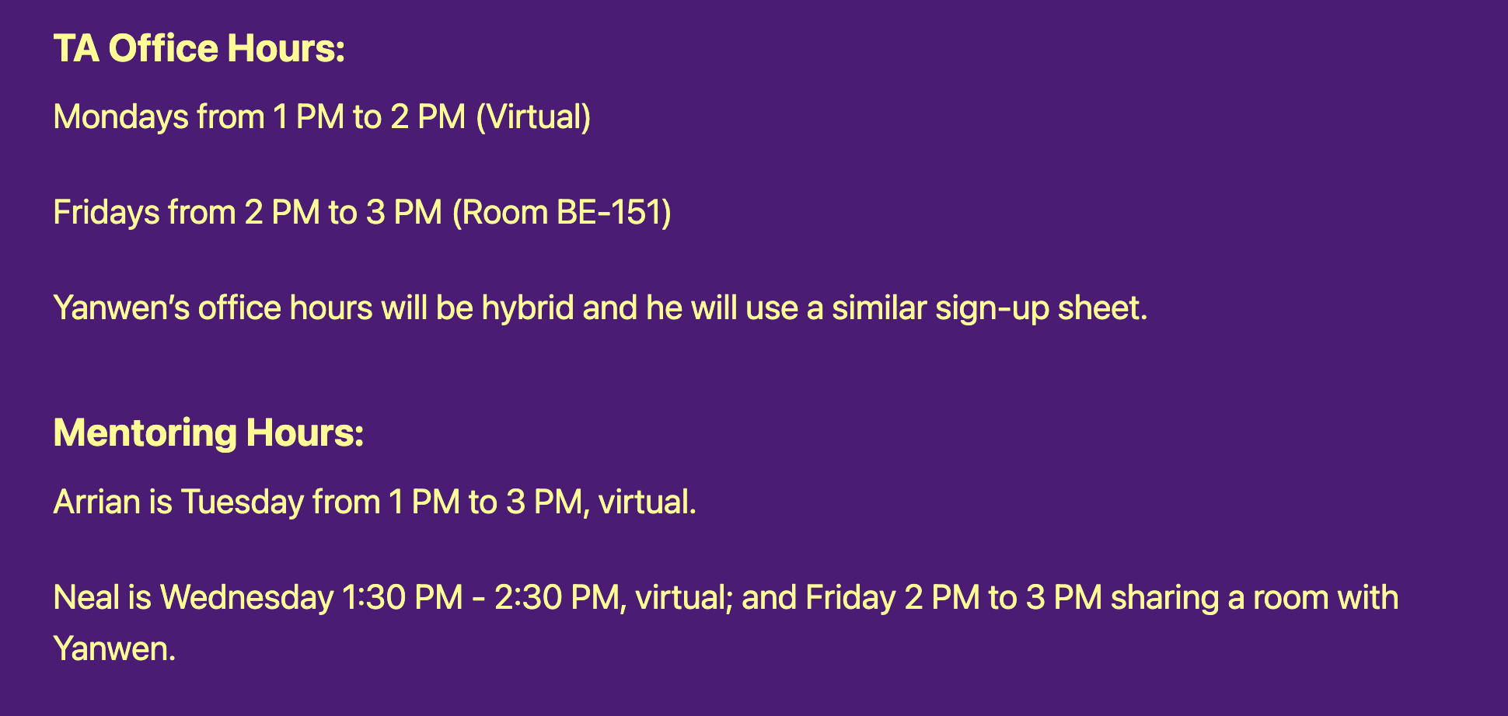
Announcements
My office hours:
Thursday, 3 - 5 PM
Sign-up sheet goes live around noon
10 minute slots
Other office hours:

Slide 4
Announcements
Please enroll in Piazza!
Only 50 students are enrolled. There are ~68 students in the class. People are asking good clarification questions that will help you
Docker instructions are on the website. Let us know ASAP if you have issues

Slide 5
Announcements
Homework clarifications
For part 1
Any sequence of digits with a . anywhere in it

Slide 6
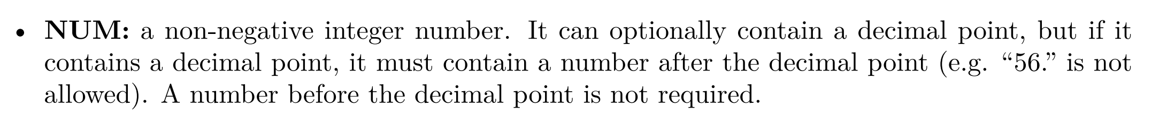
Announcements
Homework clarifications
For part 2 - which feeds into part 3,4

Slide 7
Quiz

Slide 8
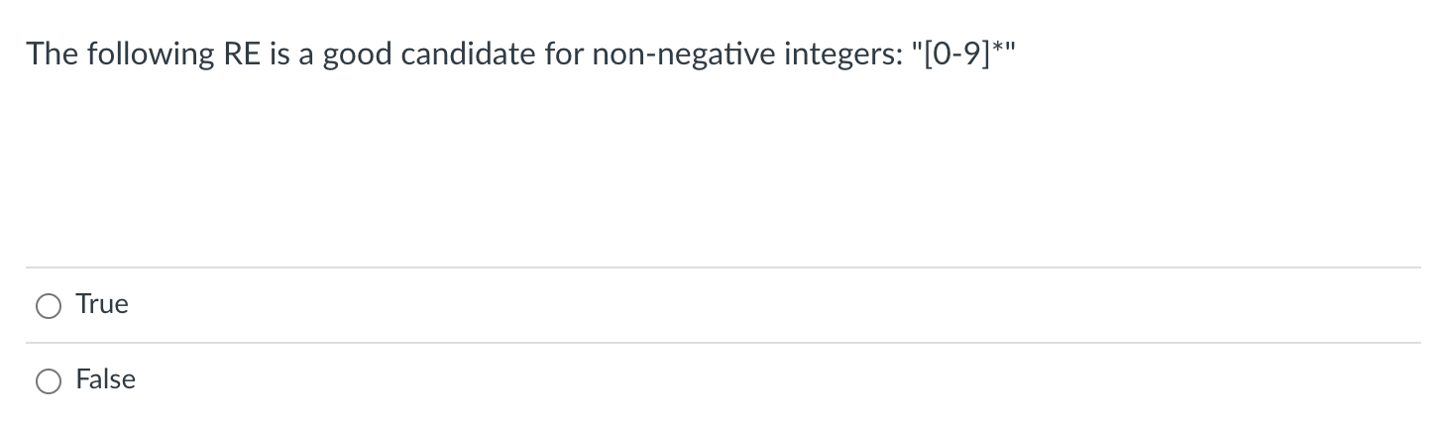
Integer RE

Slide 9
Integer RE
Does the ”” match the RE?

Slide 10
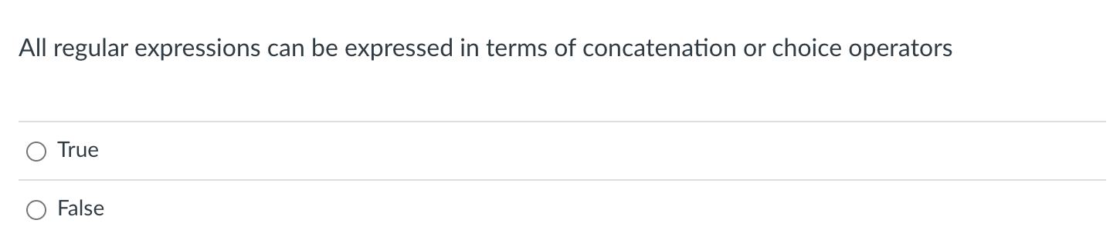
Fundamental RE operators

Slide 11
Fundamental RE operators
Fundamental RE operators are:
Concatenate: put the regexes next to each other
“|” : Choice: one or the other
“*” : Repeat: 0 or more copies
Practically:
a* roughly is the same as “” | “a” | “aa” | “aaa” ...
in theory, REs can accept strings of arbitrary length (not infinite strings though).
in practice, strings have a reasonable bound. Repeat (*) is a good abstraction though!

Slide 12
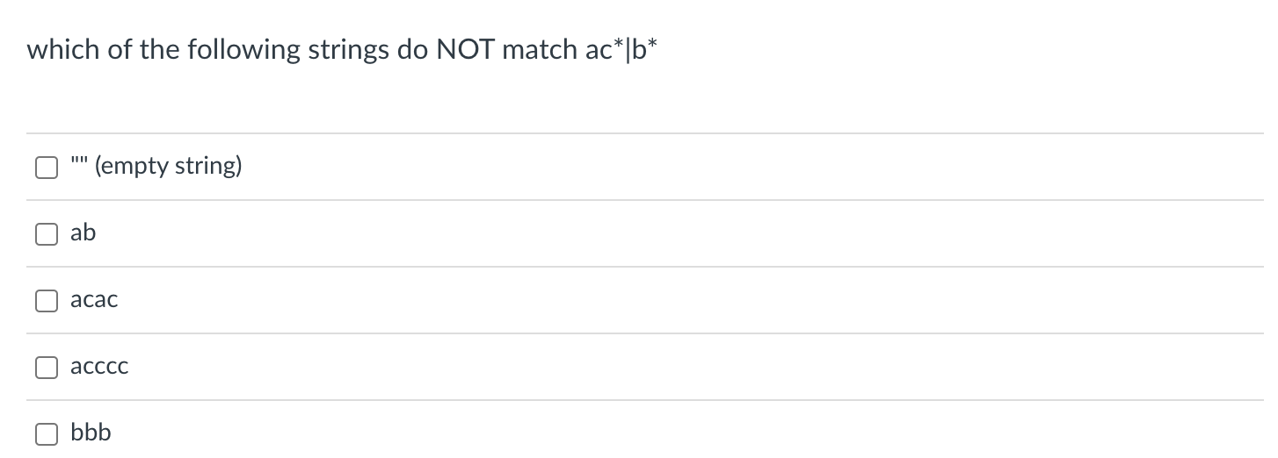
RE examples

Slide 13
RE examples
ac*|b*
“”
“ab”
“acac”
“acccc”
“bbb”
Let’s work through them

Slide 14
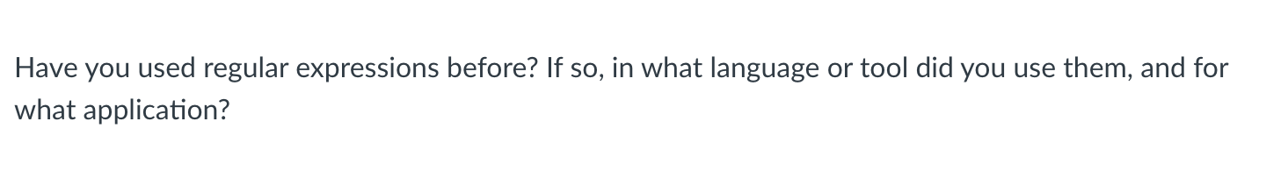
RE experiences

Slide 15
Review
Some syntactic sugar and useful interfaces

Slide 16
Regular expressions
strict repeat operator: +
one or more repeats (the * operator is 0 or more repeats)
derivation: “r+” = “rr*”
Let’s revisit binary numbers and decimal numbers
“(0|1)+”

Slide 17
Regular expressions
Ranges:
digits [0-9]
alpha [a-z], [A-Z]
Derivation: [0-9] = ”1|2|3|4|5|6|7|8|9”
Lets try C style IDs: “[a-zA-Z][0-9a-zA-Z]*”
Hexadecimal numbers: “0x[0-9a-fA-F]+”

Slide 18
Regular expressions
optional operator ?
optional characters
“r?” = “|r”
Example: “ab?”
Let’s do simple floating point numbers: “[0-9]+(\.[0-9]+)?”

Slide 19
Regular expressions
any character ‘.’
example using email (this is probably too general!)
”.*@.*\.com”

Slide 20
Using REs
What if we want either the domain or user name from the email?
We can use groups!
use ()s to deliminate groups
”(.*)@(.*\.com)”
Index the resulting object with [1] and [2] to get to the user name and domain respectively

Slide 21
Using REs
you can give groups id names rather than using indices
“(?P<name>.+)@(?P<domain>.+\.com)”

Slide 22
Review
Why do we want REs?

Slide 23
Naïve Scanner
simple string stream, peek/eat model
class NaiveScanner:
def token(self):
...
if self.ss.peek_char() in NUMS:
value = ""
while self.ss.peek_char() in NUMS:
value += self.ss.peek_char()
self.ss.eat_char()
return ("NUM", value)
ID = [characters]
NUM = [numbers]
ASSIGN = ”=“
PLUS = “+”
MULT = “*”
IGNORE = [“ “]

Slide 24
Shortcomings of Naïve scanner
IDs with numbers in them?
x1, y1, etc.
how would you solve?
Numbers with a decimal point in them?
4.5, 9999.99998
how would you solve this?
Two character operators:
++, +=
how would you solve this?

Slide 25
We need a new token definition language

Slide 26
Can we express these tokens using REs?
ARTICLE = {The, A, My, Your}
NOUN = {Dog, Car, Computer}
VERB = {Ran, Crashed, Accelerated}
ADJECTIVE = {Purple, Spotted, Old}
Tokens
Tokens Definitions

Slide 27
Can we express these tokens using REs? Yes!
ARTICLE = “The|A|Mine|Your”
NOUN = “Dog|Car|Computer”
VERB = “Ran|Crashed|Accelerated”
ADJECTIVE = “Purple|Spotted|Old”
Tokens
Tokens Definitions

Slide 28
Let’s write our tokens as regular expressions
For our simple programming language
ID = [characters]
NUM = [numbers]
ASSIGN = ”=“
PLUS = “+”
MULT = “*”
IGNORE = [“ “, “\n”]

Slide 29
Let’s write our tokens as regular expressions
For our simple programming language
ID = [characters]
NUM = [numbers]
ASSIGN = ”=“
PLUS = “+”
MULT = “*”
IGNORE = [“ “, “\n”]
ID = “[a-z]+”
NUM = “[0-9]+”
ASSIGN = ”=“
PLUS = “+”
MULT = “*”
IGNORE = “ |\n”
Some benefits of REs? Let’s try adding some extensions:

Slide 30
Let’s write our tokens as regular expressions
For our simple programming language
ID = [characters]
NUM = [numbers]
ASSIGN = ”=“
PLUS = “+”
MULT = “*”
IGNORE = [“ “, “\n”]
ID = “[a-z]+”
NUM = “[0-9]+”
ASSIGN = ”=“
PLUS = “+”
MULT = “*”
IGNORE = “ |\n”
Some benefits of REs? Let’s try adding some extensions: * increment operator?
* digits in IDs?

Slide 31
Finishing up last lecture
A few final thoughts:

Slide 32
RE examples
What can REs not do?
Nested structures, such as parathesis matching:
Try doing arithmetic expressions
You will not be able to match ()s
Classical example: REs cannot capture same number of repeats:
A{N}B{N}
REs cannot parse HTML!!!
One of the most upvoted answers on stackoverflow!
https://stackoverflow.com/questions/1732348/regex-match-open-tags-except-xhtml-self-contained-tags/1732454#1732454

Slide 33
How to implement an RE matcher?
Overview: first you have to parse the RE...
Chicken and egg problem
The language of REs is not a regular language. It is context sensitive (because it has ()s)
But once you can parse the RE, there are several options

Slide 34
How to implement an RE matcher?
parsing with derivatives
We discuss this in CSE211
Elegant solution, but difficult to make fast
Convert to an automata
Learn more about this CSE103
A cool website
https://ivanzuzak.info/noam/webapps/fsm_simulator/

Slide 35
New material for today
Using RE matchers to build scanners
Exact match (EM) scanners
Start-of-string (SOS) scanners
named group (NG) scanners

Slide 36
New material for today
Using RE matchers to build scanners
Exact match (EM) scanners
Start-of-string (SOS) scanners
named group (NG) scanners

Slide 37
The problem
How do we move from an RE match to performing lexical analysis on a string
ID = “[a-z]+”
NUM = “[0-9]+”
ASSIGN = ”=“
PLUS = “+”
MULT = “*”
IGNORE = “ |\n” SEMI = “;”
“variable = 50 + 30 * 20;”

Slide 38
The problem
How do we move from an RE match to performing lexical analysis on a string
ID = “[a-z]+”
NUM = “[0-9]+”
ASSIGN = ”=“
PLUS = “+”
MULT = “*”
IGNORE = “ |\n” SEMI = “;”
“variable = 50 + 30 * 20;”
[(ID, “variable”), (ASSIGN, “=“), (NUM, “50”), (PLUS, “+”), (NUM, “30”),
(MULT, “*”), (NUM, ”20”), (SEMI, “;”)]

Slide 39
The problem
How do we move from an RE match to performing lexical analysis on a string
Do these match?
ID = “[a-z]+”
NUM = “[0-9]+”
ASSIGN = ”=“
PLUS = “+”
MULT = “*”
IGNORE = “ |\n” SEMI = “;”
“variable = 50 + 30 * 20;”
[(ID, “variable”), (ASSIGN, “=“), (NUM, “50”), (PLUS, “+”), (NUM, “30”),
(MULT, “*”), (NUM, ”20”), (SEMI, “;”)]

Slide 40
The problem
How do we move from an RE match to performing lexical analysis on a string
Do any of the tokens match?
ID = “[a-z]+”
NUM = “[0-9]+”
ASSIGN = ”=“
PLUS = “+”
MULT = “*”
IGNORE = “ |\n” SEMI = “;”
“variable = 50 + 30 * 20;”
[(ID, “variable”), (ASSIGN, “=“), (NUM, “50”), (PLUS, “+”), (NUM, “30”),
(MULT, “*”), (NUM, ”20”), (SEMI, “;”)]

Slide 41
The problem
How do we move from an RE match to performing lexical analysis on a string
What if we start “peeking” characters
ID = “[a-z]+”
NUM = “[0-9]+”
ASSIGN = ”=“
PLUS = “+”
MULT = “*”
IGNORE = “ |\n” SEMI = “;”
“variable = 50 + 30 * 20;”
[(ID, “variable”), (ASSIGN, “=“), (NUM, “50”), (PLUS, “+”), (NUM, “30”),
(MULT, “*”), (NUM, ”20”), (SEMI, “;”)]

Slide 42
The problem
How do we move from an RE match to performing lexical analysis on a string
Match!
ID = “[a-z]+”
NUM = “[0-9]+”
ASSIGN = ”=“
PLUS = “+”
MULT = “*”
IGNORE = “ |\n” SEMI = “;”
“variable = 50 + 30 * 20;”
[(ID, “variable”), (ASSIGN, “=“), (NUM, “50”), (PLUS, “+”), (NUM, “30”),
(MULT, “*”), (NUM, ”20”), (SEMI, “;”)]

Slide 43
The problem
How do we move from an RE match to performing lexical analysis on a string
Match! (ID, “v”)
ID = “[a-z]+”
NUM = “[0-9]+”
ASSIGN = ”=“
PLUS = “+”
MULT = “*”
IGNORE = “ |\n” SEMI = “;”
“variable = 50 + 30 * 20;”
[(ID, “variable”), (ASSIGN, “=“), (NUM, “50”), (PLUS, “+”), (NUM, “30”),
(MULT, “*”), (NUM, ”20”), (SEMI, “;”)]

Slide 44
The problem
How do we move from an RE match to performing lexical analysis on a string
Match! (ID, “v”)
but what is the issue?
ID = “[a-z]+”
NUM = “[0-9]+”
ASSIGN = ”=“
PLUS = “+”
MULT = “*”
IGNORE = “ |\n” SEMI = “;”
“variable = 50 + 30 * 20;”
[(ID, “variable”), (ASSIGN, “=“), (NUM, “50”), (PLUS, “+”), (NUM, “30”),
(MULT, “*”), (NUM, ”20”), (SEMI, “;”)]

Slide 45
The problem
How do we move from an RE match to performing lexical analysis on a string
Match! (ID, “v”)
but what is the issue? Not the longest match
ID = “[a-z]+”
NUM = “[0-9]+”
ASSIGN = ”=“
PLUS = “+”
MULT = “*”
IGNORE = “ |\n” SEMI = “;”
“variable = 50 + 30 * 20;”
[(ID, “variable”), (ASSIGN, “=“), (NUM, “50”), (PLUS, “+”), (NUM, “30”),
(MULT, “*”), (NUM, ”20”), (SEMI, “;”)]

Slide 46
The problem
How do we move from an RE match to performing lexical analysis on a string
So what’s our strategy?
ID = “[a-z]+”
NUM = “[0-9]+”
ASSIGN = ”=“
PLUS = “+”
MULT = “*”
IGNORE = “ |\n” SEMI = “;”
“variable = 50 + 30 * 20;”
[(ID, “variable”), (ASSIGN, “=“), (NUM, “50”), (PLUS, “+”), (NUM, “30”),
(MULT, “*”), (NUM, ”20”), (SEMI, “;”)]

Slide 47
New material for today
Using RE matchers to build scanners
Exact match (EM) scanners
Start-of-string (SOS) scanners
named group (NG) scanners

Slide 48
EM Scanner
Start with the whole string, remove one character at the end until a match is found. Then return the lexeme
ID = “[a-z]+”
NUM = “[0-9]+”
ASSIGN = ”=“
PLUS = “+”
MULT = “*”
IGNORE = “ |\n” SEMI = “;”
“variable = 50 + 30 * 20;”

Slide 49
EM Scanner
Start with the whole string, remove one character at the end until a match is found. Then return the lexeme
start with the whole string
ID = “[a-z]+”
NUM = “[0-9]+”
ASSIGN = ”=“
PLUS = “+”
MULT = “*”
IGNORE = “ |\n” SEMI = “;”
“variable = 50 + 30 * 20;”

Slide 50
EM Scanner
Start with the whole string, remove one character at the end until a match is found. Then return the lexeme
Try to match with all the tokens
start with the whole string
ID = “[a-z]+”
NUM = “[0-9]+”
ASSIGN = ”=“
PLUS = “+”
MULT = “*”
IGNORE = “ |\n” SEMI = “;”
“variable = 50 + 30 * 20;”

Slide 51
EM Scanner
Start with the whole string, remove one character at the end until a match is found. Then return the lexeme
Try to match with all the tokens. No match.
start with the whole string
ID = “[a-z]+”
NUM = “[0-9]+”
ASSIGN = ”=“
PLUS = “+”
MULT = “*”
IGNORE = “ |\n” SEMI = “;”
“variable = 50 + 30 * 20;”

Slide 52
EM Scanner
Start with the whole string, remove one character at the end until a match is found. Then return the lexeme
Try to match with all the tokens. No match.
Try with one character chopped from back
ID = “[a-z]+”
NUM = “[0-9]+”
ASSIGN = ”=“
PLUS = “+”
MULT = “*”
IGNORE = “ |\n” SEMI = “;”
“variable = 50 + 30 * 20;”

Slide 53
EM Scanner
Start with the whole string, remove one character at the end until a match is found. Then return the lexeme
Try to match with all the tokens. No match.
So on
ID = “[a-z]+”
NUM = “[0-9]+”
ASSIGN = ”=“
PLUS = “+”
MULT = “*”
IGNORE = “ |\n” SEMI = “;”
“variable = 50 + 30 * 20;”

Slide 54
EM Scanner
Start with the whole string, remove one character at the end until a match is found. Then return the lexeme
Try to match with all the tokens. No match.
So on
ID = “[a-z]+”
NUM = “[0-9]+”
ASSIGN = ”=“
PLUS = “+”
MULT = “*”
IGNORE = “ |\n” SEMI = “;”
“variable = 50 + 30 * 20;”

Slide 55
EM Scanner
Start with the whole string, remove one character at the end until a match is found. Then return the lexeme
Try to match with all the tokens. No match.
Where do find a match?
ID = “[a-z]+”
NUM = “[0-9]+”
ASSIGN = ”=“
PLUS = “+”
MULT = “*”
IGNORE = “ |\n” SEMI = “;”
“variable = 50 + 30 * 20;”

Slide 56
EM Scanner
Start with the whole string, remove one character at the end until a match is found. Then return the lexeme
we can match id
at this point
ID = “[a-z]+”
NUM = “[0-9]+”
ASSIGN = ”=“
PLUS = “+”
MULT = “*”
IGNORE = “ |\n” SEMI = “;”
“variable = 50 + 30 * 20;”

Slide 57
EM Scanner
Start with the whole string, remove one character at the end until a match is found. Then return the lexeme
we can match id
at this point
ID = “[a-z]+”
NUM = “[0-9]+”
ASSIGN = ”=“
PLUS = “+”
MULT = “*”
IGNORE = “ |\n” SEMI = “;”
“variable = 50 + 30 * 20;”
Return the lexeme
(ID, “variable”)

Slide 58
EM Scanner
Start with the whole string, remove one character at the end until a match is found. Then return the lexeme
Chop the string
ID = “[a-z]+”
NUM = “[0-9]+”
ASSIGN = ”=“
PLUS = “+”
MULT = “*”
IGNORE = “ |\n” SEMI = “;”
“ = 50 + 30 * 20;”
(ID, “variable”)

Slide 59
EM Scanner
Start with the whole string, remove one character at the end until a match is found. Then return the lexeme
Start the process over
ID = “[a-z]+”
NUM = “[0-9]+”
ASSIGN = ”=“
PLUS = “+”
MULT = “*”
IGNORE = “ |\n” SEMI = “;”
“ = 50 + 30 * 20;”
(ID, “variable”)

Slide 60
EM Scanner
Start with the whole string, remove one character at the end until a match is found. Then return the lexeme
Start the process over Where is our next match?
ID = “[a-z]+”
NUM = “[0-9]+”
ASSIGN = ”=“
PLUS = “+”
MULT = “*”
IGNORE = “ |\n” SEMI = “;”
“ = 50 + 30 * 20;”
(ID, “variable”)

Slide 61
Look at the code
Provided in your homework

Slide 62
EM Scanner
Pros
Cons

Slide 63
EM Scanner
Pros
Uses an exact RE matcher. Many RE match algorithms are exact!
Cons
SLOW! Each lexeme requires many many many calls to each RE match!

Slide 64
New material for today
Using RE matchers to build scanners
Exact match (EM) scanners
Start-of-string (SOS) scanners
named group (NG) scanners

Slide 65
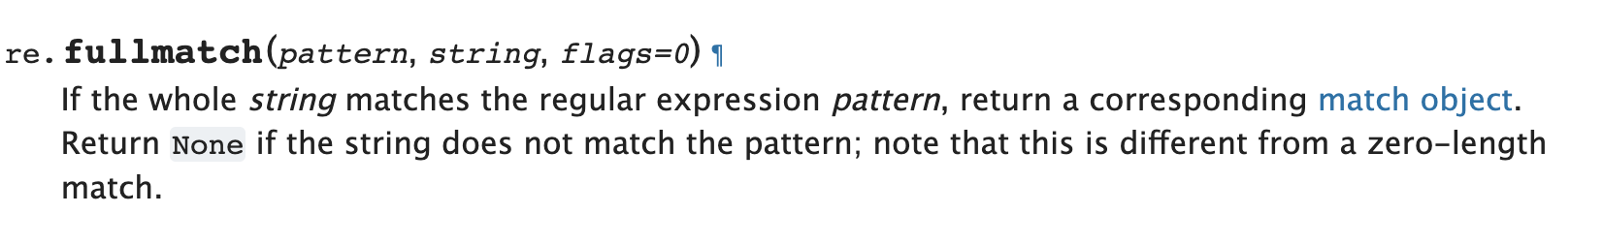
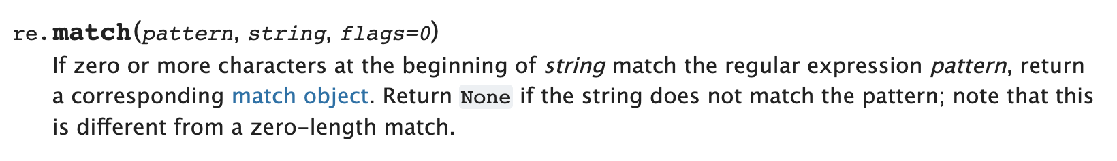
SOS Scanner
We will use a new RE match function

Slide 66
SOS Scanner
The match API gives us a match starting at the beginning of the string
ID = “[a-z]+”
NUM = “[0-9]+”
ASSIGN = ”=“
PLUS = “+”
MULT = “*”
IGNORE = “ |\n” SEMI = “;”
“variable = 50 + 30 * 20;”

Slide 67
SOS Scanner
The match API gives us a match starting at the beginning of the string
Feed full string into each token definition
ID = “[a-z]+”
NUM = “[0-9]+”
ASSIGN = ”=“
PLUS = “+”
MULT = “*”
IGNORE = “ |\n” SEMI = “;”
“variable = 50 + 30 * 20;”

Slide 68
SOS Scanner
The match API gives us a match starting at the beginning of the string
Feed full string into each token definition
ID = “[a-z]+”
NUM = “[0-9]+”
ASSIGN = ”=“
PLUS = “+”
MULT = “*”
IGNORE = “ |\n” SEMI = “;”
“variable = 50 + 30 * 20;”
We get 1 match. We can return the lexeme
(ID, “variable”)

Slide 69
SOS Scanner
The match API gives us a match starting at the beginning of the string
Chop the string
ID = “[a-z]+”
NUM = “[0-9]+”
ASSIGN = ”=“
PLUS = “+”
MULT = “*”
IGNORE = “ |\n” SEMI = “;”
“variable = 50 + 30 * 20;”
We get 1 match. We can return the lexeme
(ID, “variable”)

Slide 70
SOS Scanner
The match API gives us a match starting at the beginning of the string
Chop the string
ID = “[a-z]+”
NUM = “[0-9]+”
ASSIGN = ”=“
PLUS = “+”
MULT = “*”
IGNORE = “ |\n” SEMI = “;”
“ = 50 + 30 * 20;”
We get 1 match. We can return the lexeme
(ID, “variable”)

Slide 71
SOS Scanner
The match API gives us a match starting at the beginning of the string
What about the next one
ID = “[a-z]+”
NUM = “[0-9]+”
ASSIGN = ”=“
PLUS = “+”
MULT = “*”
IGNORE = “ |\n” SEMI = “;”
“ = 50 + 30 * 20;”
(ID, “variable”)

Slide 72
SOS Scanner
The match API gives us a match starting at the beginning of the string
What about the next one
ID = “[a-z]+”
NUM = “[0-9]+”
ASSIGN = ”=“
PLUS = “+”
MULT = “*”
IGNORE = “ |\n” SEMI = “;”
“ = 50 + 30 * 20;”
1 match: IGNORE
(ID, “variable”)

Slide 73
SOS Scanner
The match API gives us a match starting at the beginning of the string
Chop the string
ID = “[a-z]+”
NUM = “[0-9]+”
ASSIGN = ”=“
PLUS = “+”
MULT = “*”
IGNORE = “ |\n” SEMI = “;”
“ = 50 + 30 * 20;”
1 match: IGNORE
(ID, “variable”)

Slide 74
SOS Scanner
The match API gives us a match starting at the beginning of the string
Chop the string
ID = “[a-z]+”
NUM = “[0-9]+”
ASSIGN = ”=“
PLUS = “+”
MULT = “*”
IGNORE = “ |\n” SEMI = “;”
“= 50 + 30 * 20;”
1 match: IGNORE
(ID, “variable”)

Slide 75
SOS Scanner
Consideration
How to scan this string?
“CSE110A”
LETTERS = “[A-Z]+”
NUM = “[0-9]+”
CLASS = ”CSE110A“

Slide 76
SOS Scanner
Consideration
How to scan this string?
Try to match on each token
“CSE110A”
LETTERS = “[A-Z]+”
NUM = “[0-9]+”
CLASS = ”CSE110A“

Slide 77
SOS Scanner
Consideration
How to scan this string?
Try to match on each token
“CSE110A”
LETTERS = “[A-Z]+”
NUM = “[0-9]+”
CLASS = ”CSE110A“
Two matches:
LETTERS: “CSE”
CLASS: ”CSE110A”
Which one do we choose?

Slide 78
SOS Scanner
Consideration
How to scan this string?
Try to match on each token
“CSE110A”
LETTERS = “[A-Z]+”
NUM = “[0-9]+”
CLASS = ”CSE110A“
Two matches:
LETTERS: “CSE”
CLASS: ”CSE110A”
Which one do we choose?
The longest one!
After each pass through token REs we have to measure match length

Slide 79
SOS Scanner
Consideration
How to scan this string?
Try to match on each token
“CSE110A”
LETTERS = “[A-Z]+”
NUM = “[0-9]+”
CLASS = ”CSE110A“
Two matches:
LETTERS: “CSE”
CLASS: ”CSE110A”
Which one do we choose?
The longest one!
After each pass through token REs we have to measure match length
Why didn’t we have to do this for the exact match Scanner?

Slide 80
SOS Scanner
One more consideration
Within 1 RE, how does this match?
“CSE110A”
CLASS = “CSE|110A|CSE110A”

Slide 81
SOS Scanner
One more consideration
Within 1 RE, how does this match?
“CSE110A”
CLASS = “CSE|110A|CSE110A”
Returns “CSE”, but this isn’t what we want!!!

Slide 82
SOS Scanner
One more consideration
Within 1 RE, how does this match?
“CSE110A”
CLASS = “CSE|110A|CSE110A”
Returns “CSE”, but this isn’t what we want!!!
When using the SOS Scanner: A token definition either should not:
contain choices where one choice is a prefix of another
order choices such that the longest choice is the first one

Slide 83
SOS Scanner
One more consideration
Within 1 RE, how does this match?
“CSE110A”
CLASS = “CSE|110A|CSE110A”
Returns “CSE”, but this isn’t what we want!!!
When using the SOS Scanner: A token definition either should not:
contain choices where one choice is a prefix of another
order choices such that the longest choice is the first one
CLASS = “CSE110A|110A|CSE”

Slide 84
SOS Scanner
Pros
Cons

Slide 85
SOS Scanner
Pros
Much faster than EM scanner. Only 1 call to each RE per token() call
Cons
Depends on an efficient implementation of match()
Typically provided in most RE libraries (for this exact reason)
Requires some care in token definitions and prefixes

Slide 86
New material for today
Using RE matchers to build scanners
Exact match (EM) scanners
Start-of-string (SOS) scanners
named group (NG) scanners

Slide 87
SOS Scanner
We’re going to optimize this to 1 RE call! It can really help if you have many tokens
Pros
Much faster than EM scanner. Only 1 call to each RE per token() call
Cons
Depends on an efficient implementation of match()
Typically provided in most RE libraries (for this exact reason)
Requires some care in token definitions and prefixes

Slide 88
NG Scanner
We will still use the match API call

Slide 89
NG Scanner
Start out with token definitions
Merge them into one RE definition
ID = “[a-z]+”
NUM = “[0-9]+”
ASSIGN = ”=“
PLUS = “+”
MULT = “*”
IGNORE = “ |\n” SEMI = “;”
SINGLE_RE =

Slide 90
NG Scanner
Start out with token definitions
Merge them into one RE definition
ID = “[a-z]+”
NUM = “[0-9]+”
ASSIGN = ”=“
PLUS = “+”
MULT = “*”
IGNORE = “ |\n” SEMI = “;”
SINGLE_RE = “[a-z]+”

Slide 91
NG Scanner
Start out with token definitions
Merge them into one RE definition
ID = “[a-z]+”
NUM = “[0-9]+”
ASSIGN = ”=“
PLUS = “+”
MULT = “*”
IGNORE = “ |\n” SEMI = “;”
SINGLE_RE = “([a-z]+)”

Slide 92
NG Scanner
Start out with token definitions
Merge them into one RE definition
ID = “[a-z]+”
NUM = “[0-9]+”
ASSIGN = ”=“
PLUS = “+”
MULT = “*”
IGNORE = “ |\n” SEMI = “;”
SINGLE_RE = “([a-z]+)|([0-9]+)”

Slide 93
NG Scanner
Start out with token definitions
Merge them into one RE definition
and so on
ID = “[a-z]+”
NUM = “[0-9]+”
ASSIGN = ”=“
PLUS = “+”
MULT = “*”
IGNORE = “ |\n” SEMI = “;”
SINGLE_RE = “([a-z]+)|([0-9]+)|(..)|”

Slide 94
NG Scanner
Start out with token definitions
Merge them into one RE definition
Give each group a name corresponding to its token
ID = “[a-z]+”
NUM = “[0-9]+”
ASSIGN = ”=“
PLUS = “+”
MULT = “*”
IGNORE = “ |\n” SEMI = “;”
SINGLE_RE = “(?P<ID>[a-z]+)|
(?P<NUM>[0-9]+)
|(..)|”

Slide 95
NG Scanner
Start out with token definitions
Merge them into one RE definition
It’s a giant RE, but you can construct
it automatically
SINGLE_RE = “(?P<ID>[a-z]+)|
(?P<NUM>[0-9]+)|
(?P<ASSIGN>=)|
(?P<PLUS>+)|
(?P<MULT>*)|
(?P<IGNORE> |\n)|
(?P<SEMI>;)”

Slide 96
NG Scanner
to implement token()
Try to match the whole string to the single RE
SINGLE_RE = “(?P<ID>[a-z]+)|
(?P<NUM>[0-9]+)|
(?P<ASSIGN>=)|
(?P<PLUS>+)|
(?P<MULT>*)|
(?P<IGNORE> |\n)|
(?P<SEMI>;)”
“variable = 50 + 30 * 20;”

Slide 97
NG Scanner
to implement token()
Try to match the whole string to the single RE
SINGLE_RE = “(?P<ID>[a-z]+)|
(?P<NUM>[0-9]+)|
(?P<ASSIGN>=)|
(?P<PLUS>+)|
(?P<MULT>*)|
(?P<IGNORE> |\n)|
(?P<SEMI>;)”
“variable = 50 + 30 * 20;”
Check the group dictionary in the result

Slide 98
NG Scanner
to implement token()
Try to match the whole string to the single RE
SINGLE_RE = “(?P<ID>[a-z]+)|
(?P<NUM>[0-9]+)|
(?P<ASSIGN>=)|
(?P<PLUS>+)|
(?P<MULT>*)|
(?P<IGNORE> |\n)|
(?P<SEMI>;)”
“variable = 50 + 30 * 20;”
{”ID” : “variable”
“NUM” : None
“ASSIGN” : None
“PLUS” : None
“MULT” : None “IGNORE” : None
“SEMI” : None}

Slide 99
NG Scanner
to implement token()
Try to match the whole string to the single RE
SINGLE_RE = “(?P<ID>[a-z]+)|
(?P<NUM>[0-9]+)|
(?P<ASSIGN>=)|
(?P<PLUS>+)|
(?P<MULT>*)|
(?P<IGNORE> |\n)|
(?P<SEMI>;)”
“variable = 50 + 30 * 20;”
{”ID” : “variable”
“NUM” : None
“ASSIGN” : None
“PLUS” : None
“MULT” : None “IGNORE” : None
“SEMI” : None}

Slide 100
NG Scanner
to implement token()
Try to match the whole string to the single RE
SINGLE_RE = “(?P<ID>[a-z]+)|
(?P<NUM>[0-9]+)|
(?P<ASSIGN>=)|
(?P<PLUS>+)|
(?P<MULT>*)|
(?P<IGNORE> |\n)|
(?P<SEMI>;)”
“variable = 50 + 30 * 20;”
{”ID” : “variable”
“NUM” : None
“ASSIGN” : None
“PLUS” : None
“MULT” : None “IGNORE” : None
“SEMI” : None}
Return the lexeme (ID, “variable”)

Slide 101
NG Scanner
to implement token()
chop!
SINGLE_RE = “(?P<ID>[a-z]+)|
(?P<NUM>[0-9]+)|
(?P<ASSIGN>=)|
(?P<PLUS>+)|
(?P<MULT>*)|
(?P<IGNORE> |\n)|
(?P<SEMI>;)”
“variable = 50 + 30 * 20;”
{”ID” : “variable”
“NUM” : None
“ASSIGN” : None
“PLUS” : None
“MULT” : None “IGNORE” : None
“SEMI” : None}
Return the lexeme (ID, “variable”)

Slide 102
NG Scanner
to implement token()
chop!
SINGLE_RE = “(?P<ID>[a-z]+)|
(?P<NUM>[0-9]+)|
(?P<ASSIGN>=)|
(?P<PLUS>+)|
(?P<MULT>*)|
(?P<IGNORE> |\n)|
(?P<SEMI>;)”
“ = 50 + 30 * 20;”

Slide 103
How to deal with common prefixes in token definitions?
Recall from SOS scanner:
How to scan this string?
“CSE110A”
LETTERS = “[A-Z]+”
NUM = “[0-9]+”
CLASS = ”CSE110A“

Slide 104
How to deal with common prefixes in token definitions?
Convert to a single RE
How to scan this string?
“CSE110A”
SINGLE_RE = “
(?P<LETTERS>([A-Z]+)|
(?P<NUM>([0-9]+)|
(?P<CLASS>CSE110A)”

Slide 105
How to deal with common prefixes in token definitions?
Convert to a single RE
How to scan this string?
“CSE110A”
SINGLE_RE = “
(?P<LETTERS>([A-Z]+)|
(?P<NUM>([0-9]+)|
(?P<CLASS>CSE110A)”
What do we think the dictionary will look like?

Slide 106
How to deal with common prefixes in token definitions?
Convert to a single RE
How to scan this string?
“CSE110A”
SINGLE_RE = “
(?P<LETTERS>([A-Z]+)|
(?P<NUM>([0-9]+)|
(?P<CLASS>CSE110A)”
{”LETTERS” : “CSE”
“NUM” : None
“CLASS” : None
}

Slide 107
How to deal with common prefixes in token definitions?
Convert to a single RE
“CSE110A”
SINGLE_RE = “
(?P<LETTERS>([A-Z]+)|
(?P<NUM>([0-9]+)|
(?P<CLASS>CSE110A)”
{”LETTERS” : “CSE”
“NUM” : None
“CLASS” : None
}
What does this mean?
Tokens should not contain prefixes of each other
OR
Tokens that share a common prefix should be ordered such that the longer token comes first

Slide 108
How to deal with common prefixes in token definitions?
Convert to a single RE
“CSE110A”
SINGLE_RE = “
(?P<LETTERS>([A-Z]+)|
(?P<NUM>([0-9]+)|
(?P<CLASS>CSE110A)”
{”LETTERS” : “CSE”
“NUM” : None
“CLASS” : None
}
What does this mean?
Tokens should not contain prefixes of each other
OR
Tokens that share a common prefix should be ordered such that the longer token comes first

Slide 109
How to deal with common prefixes in token definitions?
Careful with these tokens
INCR = “++”
ADD = “+”
EQ = “==“ ASSIGN = “=“
Ensure that you provide them in the right order so that the longer one is first!

Slide 110
How to deal with common prefixes in token definitions?
Convert to a single RE
How to scan this string?
“CSE110A”
SINGLE_RE = “
(?P<LETTERS>([A-Z]+)|
(?P<NUM>([0-9]+)|
(?P<CLASS>CSE110A)”
What do we think the dictionary will look like?
SINGLE_RE = “(?P<LETTERS>([A-Z]+)|(?P<NUM>([0-9]+)|(?P<CLASS>CSE110A)”

Slide 111
NG Scanner
Pros
Cons

Slide 112
NG Scanner
Pros
FAST! Only 1 RE call per token()
Cons
Requires a named group RE library
inter-token interactions need to be considered

Slide 113
Scanners we have discussed
Naïve Scanner
RE based scanners
Exact match (EM) scanners
Start-of-string (SOS) scanners
named group (NG) scanners
Which one to use?
Complex decision with performance, expressivity, and token requirements

Slide 114
On Friday
We will discuss token actions and how to use them to implement keywords and line numbers
We will discuss a classic scanner generator: lex
See you on Friday!

