Slide 1
CSE110A: Compilers April 22, 2022
..
Topics:
Symbol Tables in parsing
Parsing actions
Parser generators
int main() { printf(““);
return 0; }
..
..
..
..

Slide 2
Announcements
HW 2 is out!
due on May 2 at midnight
You had everything for part 1 and 2 after wednesday
You will have everything you need for part 3 after today
Plenty of chances for help. Get started early
Midterm will be given on May 2
Take home midterm.
Assigned on Monday and due on Friday
No late midterms are accepted
No class on Monday (use the time to work on homework)

Slide 3
Announcements
Expect HW 1 grades around May 2
You have 2 weeks to do the homework and we get 2 weeks to grade it

Slide 4
Announcements
HW 2 clarifications:
No skeleton for part 1 - it is done completely in your report
Please read the piazza for questions about the grammar and other hints
An assignment statement is followed by a semi colon. The language is a subset of C. Anything that C-simple accepts should also be accepted by C (with the same meaning).

Slide 5
Announcements
Some more homework examples:
Variable declarations vs. assignment statements
for statements
block statements

Slide 6
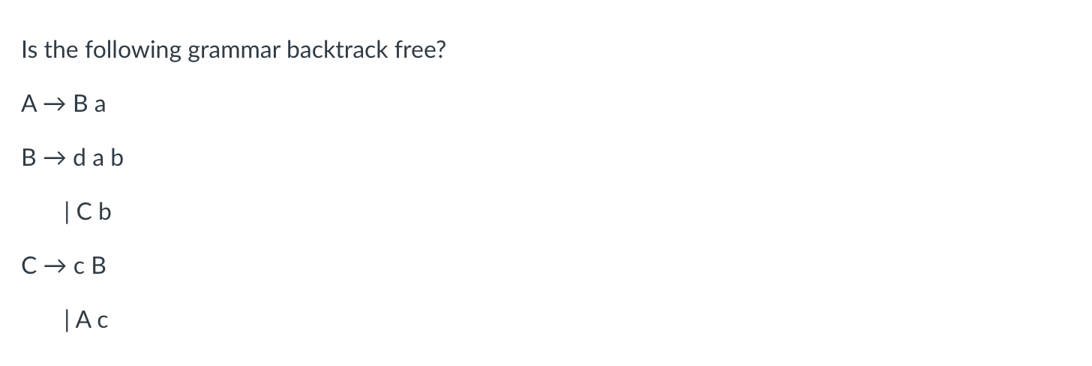
Quiz

Slide 7
Quiz
First sets
{}
{}
{}
{}
{}

Slide 8
Quiz
First sets
{d,c}
{d}
{d,c}
{c}
{d,c}
no! in both B and C we do not have disjoint first sets

Slide 9
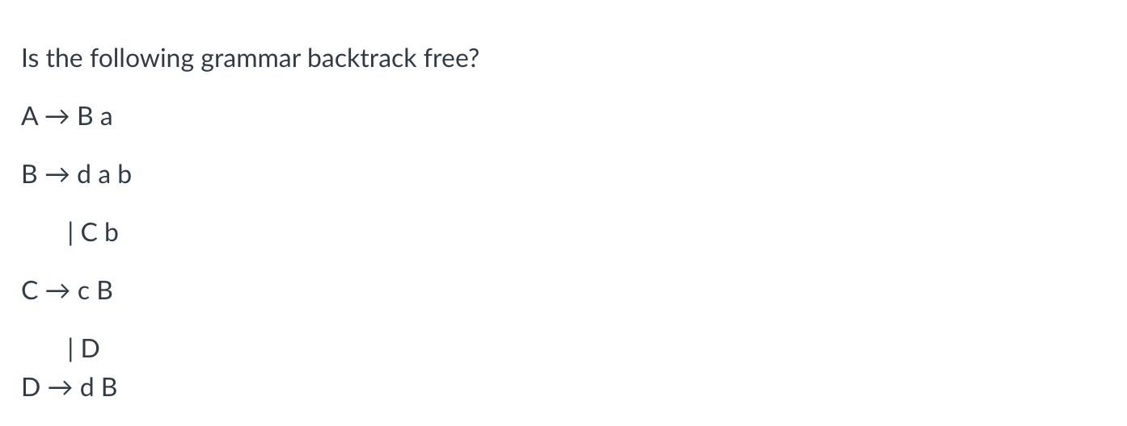
Quiz

Slide 10
Quiz
First sets
{}
{}
{}
{}
{}
{}

Slide 11
Quiz
First sets
{c,d}
{d}
{c,d}
{c}
{d}
{d}
No, because for production B the first sets are not disjoint

Slide 12
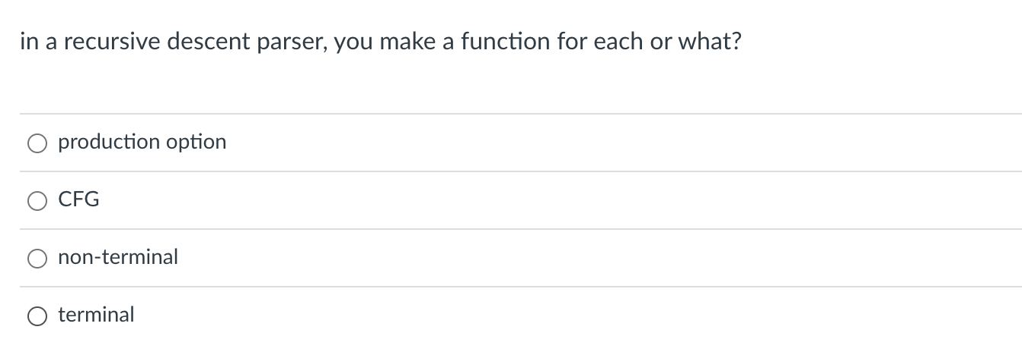
Quiz

Slide 13
Let’s look at the grammar
1: Expr ::= Unit Expr2
2: Expr2 ::= Op Unit Expr2
3: | “” 4: Unit ::= ‘(‘ Expr ‘)’
5: | ID
6: Op ::= ‘+’
7: | ‘*’
How do we parse an Expr?

Slide 14
Let’s look at the grammar
1: Expr ::= Unit Expr2
2: Expr2 ::= Op Unit Expr2
3: | “” 4: Unit ::= ‘(‘ Expr ‘)’
5: | ID
6: Op ::= ‘+’
7: | ‘*’
How do we parse an Expr?
We parse a Unit followed by an Expr2
We can just write exactly that!
def parse_Expr(self):
self.parse_Unit();
self.parse_Expr2();
return

Slide 15
Let’s look at the grammar
1: Expr ::= Unit Expr2
2: Expr2 ::= Op Unit Expr2
3: | “” 4: Unit ::= ‘(‘ Expr ‘)’
5: | ID
6: Op ::= ‘+’
7: | ‘*’
How do we parse an Expr2?

Slide 16
Let’s look at the grammar
1: Expr ::= Unit Expr2
2: Expr2 ::= Op Unit Expr2
3: | “” 4: Unit ::= ‘(‘ Expr ‘)’
5: | ID
6: Op ::= ‘+’
7: | ‘*’
How do we parse an Expr2?
First+ sets: 1: {‘(‘, ID}
2: {‘+’, ‘*’}
3: {None, ’)’} 4: {‘(‘}
5: {ID}
6: {‘+’}
7: {‘*’}

Slide 17
Let’s look at the grammar
1: Expr ::= Unit Expr2
2: Expr2 ::= Op Unit Expr2
3: | “” 4: Unit ::= ‘(‘ Expr ‘)’
5: | ID
6: Op ::= ‘+’
7: | ‘*’
How do we parse an Expr2?
def parse_Expr2(self):
token_id = get_token_id(self.to_match)
# Expr2 ::= Op Unit Expr2
if token_id in ["PLUS", "MULT"]:
self.parse_Op()
self.parse_Unit()
self.parse_Expr2()
return
# Expr2 ::= ""
if token_id in [None, ”RPAR"]:
return
raise ParserException(-1, # line number (for you to do)
self.to_match, # observed token
["PLUS", "MULT", ”RPAR"]) # expected token
First+ sets: 1: {‘(‘, ID}
2: {‘+’, ‘*’}
3: {None, ’)’} 4: {‘(‘}
5: {ID}
6: {‘+’}
7: {‘*’}

Slide 18
Let’s look at the grammar
1: Expr ::= Unit Expr2
2: Expr2 ::= Op Unit Expr2
3: | “” 4: Unit ::= ‘(‘ Expr ‘)’
5: | ID
6: Op ::= ‘+’
7: | ‘*’
How do we parse a Unit?
First+ sets: 1: {‘(‘, ID}
2: {‘+’, ‘*’}
3: {None, ’)’} 4: {‘(‘}
5: {ID}
6: {‘+’}
7: {‘*’}

Slide 19
Let’s look at the grammar
1: Expr ::= Unit Expr2
2: Expr2 ::= Op Unit Expr2
3: | “” 4: Unit ::= ‘(‘ Expr ‘)’
5: | ID
6: Op ::= ‘+’
7: | ‘*’
How do we parse a Unit?
def parse_Unit(self):
token_id = get_token_id(self.to_match)
# Unit ::= ‘(‘ Expr ‘)’
if token_id == "LPAR":
self.eat("LPAR")
self.parse_Expr()
self.eat("RPAR")
return
# Unit :: = ID
if token_id == "ID":
self.eat("ID")
return
raise ParserException(-1, # line number (for you to do)
self.to_match, # observed token
["LPAR", "ID"]) # expected token
First+ sets: 1: {‘(‘, ID}
2: {‘+’, ‘*’}
3: {None, ’)’} 4: {‘(‘}
5: {ID}
6: {‘+’}
7: {‘*’}

Slide 20
Let’s look at the grammar
1: Expr ::= Unit Expr2
2: Expr2 ::= Op Unit Expr2
3: | “” 4: Unit ::= ‘(‘ Expr ‘)’
5: | ID
6: Op ::= ‘+’
7: | ‘*’
How do we parse a Unit?
def parse_Unit(self):
token_id = get_token_id(self.to_match)
# Unit ::= ‘(‘ Expr ‘)’
if token_id == "LPAR":
self.eat("LPAR")
self.parse_Expr()
self.eat("RPAR")
return
# Unit :: = ID
if token_id == "ID":
self.eat("ID")
return
raise ParserException(-1, # line number (for you to do)
self.to_match, # observed token
["LPAR", "ID"]) # expected token
ensure that to_match has token ID of “LPAREN”
and get the next token
First+ sets: 1: {‘(‘, ID}
2: {‘+’, ‘*’}
3: {None, ’)’} 4: {‘(‘}
5: {ID}
6: {‘+’}
7: {‘*’}

Slide 21
Let’s look at the grammar
1: Expr ::= Unit Expr2
2: Expr2 ::= Op Unit Expr2
3: | “” 4: Unit ::= ‘(‘ Expr ‘)’
5: | ID
6: Op ::= ‘+’
7: | ‘*’
How do we parse an Op?
First+ sets: 1: {‘(‘, ID}
2: {‘+’, ‘*’}
3: {None, ’)’} 4: {‘(‘}
5: {ID}
6: {‘+’}
7: {‘*’}

Slide 22
Let’s look at the grammar
1: Expr ::= Unit Expr2
2: Expr2 ::= Op Unit Expr2
3: | “” 4: Unit ::= ‘(‘ Expr ‘)’
5: | ID
6: Op ::= ‘+’
7: | ‘*’
How do we parse an Op?
def parse_Op(self):
token_id = get_token_id(self.to_match)
# Op ::= '+'
if token_id == "PLUS":
self.eat("PLUS")
return
# Op ::= '*'
if token_id == "MULT":
self.eat("MULT")
return
raise ParserException(-1, # line number (for you to do)
self.to_match, # observed token
["MULT", "PLUS"]) # expected token
First+ sets: 1: {‘(‘, ID}
2: {‘+’, ‘*’}
3: {None, ’)’} 4: {‘(‘}
5: {ID}
6: {‘+’}
7: {‘*’}

Slide 23
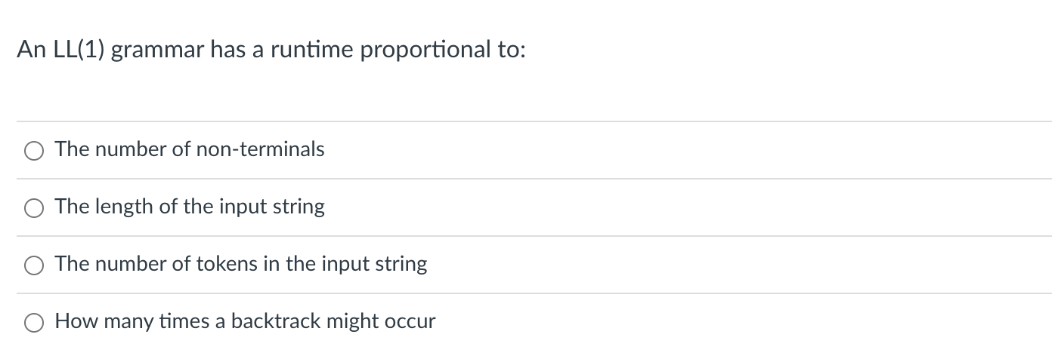
Quiz
parsing

Slide 24
Quiz
parsing

Slide 25
Quiz
parsing

Slide 26
Quiz
parsing
Likely plays a small role, but typically the number of non-terminals is much smaller than the input string

Slide 27
Quiz
parsing

Slide 28
Quiz
parsing
Good answer, but potentially the input string is one giant ID. Then the parser simply needs to match one token.

Slide 29
Quiz
parsing

Slide 30
Quiz
parsing
The parser needs to match every single token once. This
is the correct answer

Slide 31
Quiz
parsing

Slide 32
Quiz
parsing
Backtracking is not required for LL(1) grammar

Slide 33
Review

Slide 34
Do we need backtracking?
The First+ set is the combination of First and Follow sets
First+ sets: 1: {‘(‘, ID}
2: {‘+’, ‘*’}
3: {None, ’)’} 4: {‘(‘}
5: {ID}
6: {‘+’}
7: {‘*’}
1: Expr ::= Unit Expr2
2: Expr2 ::= Op Unit Expr2
3: | “” 4: Unit ::= ‘(‘ Expr ‘)’
5: | ID
6: Op ::= ‘+’
7: | ‘*’
For each non-terminal: if every production has a disjoint First+ set then
we do not need any backtracking!

Slide 35
Do we need backtracking?
The First+ set is the combination of First and Follow sets
First+ sets: 1: {‘(‘, ID}
2: {‘+’, ‘*’}
3: {None, ’)’} 4: {‘(‘}
5: {ID}
6: {‘+’}
7: {‘*’}
1: Expr ::= Unit Expr2
2: Expr2 ::= Op Unit Expr2
3: | “” 4: Unit ::= ‘(‘ Expr ‘)’
5: | ID
6: Op ::= ‘+’
7: | ‘*’
For each non-terminal: if every production has a disjoint First+ set then
we do not need any backtracking!

Slide 36
Sometimes the grammar needs to be refactored
1: Factor ::= ID
2: | ID ‘[‘ Args ‘]’
3: | ID ‘(‘ Args ‘)’
...

Slide 37
Sometimes the grammar needs to be refactored
First 1: {ID}
2: {ID}
3: {ID}
...
1: Factor ::= ID
2: | ID ‘[‘ Args ‘]’
3: | ID ‘(‘ Args ‘)’
...

Slide 38
Sometimes the grammar needs to be refactored
First 1: {ID}
2: {ID}
3: {ID}
...
1: Factor ::= ID
2: | ID ‘[‘ Args ‘]’
3: | ID ‘(‘ Args ‘)’
...
We cannot select the next rule based on a single look ahead
token!

Slide 39
Sometimes the grammar needs to be refactored
First 1: {ID}
2: {ID}
3: {ID}
...
1: Factor ::= ID
2: | ID ‘[‘ Args ‘]’
3: | ID ‘(‘ Args ‘)’
...
We can refactor
First 1: {ID}
2: {‘[‘}
3: {‘(‘}
4: {“”}
1: Factor ::= ID Option_args
2: Option_args ::= ‘[‘ Args ‘]’
3: | ‘(‘ Args ‘)’
4: | “”

Slide 40
Sometimes the grammar needs to be refactored
First 1: {ID}
2: {ID}
3: {ID}
...
1: Factor ::= ID
2: | ID ‘[‘ Args ‘]’
3: | ID ‘(‘ Args ‘)’
...
We can refactor
First 1: {ID}
2: {‘[‘}
3: {‘(‘}
4: {“”}
1: Factor ::= ID Option_args
2: Option_args ::= ‘[‘ Args ‘]’
3: | ‘(‘ Args ‘)’
4: | “”
// We will need to compute the follow set

Slide 41
Sometimes the grammar needs to be refactored
First 1: {ID}
2: {ID}
3: {ID}
...
1: Factor ::= ID
2: | ID ‘[‘ Args ‘]’
3: | ID ‘(‘ Args ‘)’
...
It is not always possible to
rewrite grammars into a
predictive form, but many
programming languages can be.
We can refactor
First 1: {ID}
2: {‘[‘}
3: {‘(‘}
4: {“”}
1: Factor ::= ID Option_args
2: Option_args ::= ‘[‘ Args ‘]’
3: | ‘(‘ Args ‘)’
4: | “”
// We will need to compute the follow set

Slide 42
New material

Slide 43
Scope
What is scope?
Can it be determined at compile time? Can it be determined at runtime?
C vs. Python
Anyone have any interesting scoping rules they know of?

Slide 44
Scope
Lexical scope example
int x = 0;
int y = 0;
{
int y = 0;
x+=1;
y+=1;
}
x+=1;
y+=1;
What are the final values in x and y?

Slide 45
Scope
We can catch certain variable scope errors at parse time
e.g. if a variable was declared in the current scope or not

Slide 46
Scope
Lexical scope example
int x = 0;
int y = 0;
{
int y = 0;
x+=1;
y+=1;
}
x+=1;
y+=1;
int x = 0;
{
int y = 0;
x+=1;
y+=1;
}
x+=1;
y+=1;
This program should parse and execute
What about this one?

Slide 47
Scope
Lexical scope example
int x = 0;
int y = 0;
{
int y = 0;
x+=1;
y+=1;
}
x+=1;
y+=1;
int x = 0;
{
int y = 0;
x+=1;
y+=1;
}
x+=1;
y+=1;
undeclared!
This program should parse and execute
What about this one?

Slide 48
How to track scope?

Slide 49
How to track scope?
Symbol table object
two methods:
lookup(id) : lookup an id in the symbol table. Returns None if the id is not in the symbol table.
insert(id,info) : insert a new id (or overwrite an existing id) into the symbol table along with a set of information about the id.
What information might we store about an id?

Slide 50
a very simple programming language
ID = [a-z]+
INCREMENT = “\+\+”
TYPE = “int”
LBRAC = “{“
RBRAC = “}”
SEMI = “;”
statements are either a declaration or an increment
int x;
x++;
int y;
y++;

Slide 51
a very simple programming language
ID = [a-z]+
INCREMENT = “\+\+”
TYPE = “int”
LBRAC = “{“
RBRAC = “}”
SEMI = “;”
statements are either a declaration or an increment
int x;
{
int y;
x++;
y++;
}
y++;

Slide 52
a very simple programming language
ID = [a-z]+
INCREMENT = “\+\+”
TYPE = “int”
LBRAC = “{“
RBRAC = “}”
SEMI = “;”
statements are either a declaration or an increment
int x;
{
int y;
x++;
y++;
}
y++;
error!

Slide 53
How to track scope?
Say we are matched the statement: int x;
SymbolTable ST;
declare_statement ::= TYPE ID SEMI
{}
lookup(id) : lookup an id in the symbol table. Returns None if the id is not in the symbol table.
insert(id,info) : insert a new id (or overwrite an existing id) into the symbol table along with a set of information about the id.

Slide 54
How to track scope?
Say we are matched the statement: int x;
SymbolTable ST;
declare_statement ::= TYPE ID SEMI
{
self.eat(TYPE)
variable_name = self.to_match[1] # lexeme value
self.eat(ID)
ST.insert(variable_name,None)
self.eat(SEMI)
}

Slide 55
How to track scope?
Say we are matched string: x++;
SymbolTable ST;
inc_statement ::= ID INCREMENT SEMI
{}
lookup(id) : lookup an id in the symbol table. Returns None if the id is not in the symbol table.
insert(id,info) : insert a new id (or overwrite an existing id) into the symbol table along with a set of information about the id.

Slide 56
How to track scope?
Say we are matched string: x++;
SymbolTable ST;
inc_statement ::= ID INCREMENT SEMI
{
variable_name = self.to_match[1] # lexeme value
if ST.lookup(variable_name) is None:
raise SymbolTableException(variable_name)
self.eat(ID)
self.eat(INCREMENT)
self.eat(SEMI)
}

Slide 57
How to track scope?
SymbolTable ST;
statement : LBRAC statement_list RBRAC
int x;
{
int y;
x++;
y++;
}
y++;

Slide 58
How to track scope?
SymbolTable ST;
statement : LBRAC statement_list RBRAC
int x;
{
int y;
x++;
y++;
}
y++;
start a new scope S
remove the scope S

Slide 59
How to track scope?
Symbol table
four methods:
lookup(id) : lookup an id in the symbol table. Returns None if the id is not in the symbol table.
insert(id,info) : insert a new id into the symbol table along with a set of information about the id.
push_scope() : push a new scope to the symbol table
pop_scope() : pop a scope from the symbol table

Slide 60
How to track scope?
SymbolTable ST;
statement : LBRAC statement_list RBRAC
You will be adding the functions to push and pop scopes in your homework

Slide 61
How to implement a symbol table?
Thoughts? What data structures are good at mapping strings?
Symbol table
four methods:
lookup(id) : lookup an id in the symbol table. Returns None if the id is not in the symbol table.
insert(id,info) : insert a new id into the symbol table along with a set of information about the id.
push_scope() : push a new scope to the symbol table
pop_scope() : pop a scope from the symbol table

Slide 62
How to implement a symbol table?
Many ways to implement:
A good way is a stack of hash tables:
HT 0
base scope
Stack of hash tables

Slide 63
How to implement a symbol table?
Many ways to implement:
A good way is a stack of hash tables:
HT 0
push_scope()
Stack of hash tables

Slide 64
How to implement a symbol table?
Many ways to implement:
A good way is a stack of hash tables:
adds a new Hash Table to the top of the stack
HT 1
HT 0
push_scope()
Stack of hash tables

Slide 65
How to implement a symbol table?
Many ways to implement:
A good way is a stack of hash tables:
HT 1
insert(id,data)
HT 0
Stack of hash tables

Slide 66
How to implement a symbol table?
Many ways to implement:
A good way is a stack of hash tables:
insert (id -> data) at top hash table
HT 1
insert(id,data)
HT 0
Stack of hash tables

Slide 67
How to implement a symbol table?
Many ways to implement:
A good way is a stack of hash tables:
HT 1
HT 0
lookup(id)
Stack of hash tables

Slide 68
How to implement a symbol table?
Many ways to implement:
A good way is a stack of hash tables:
HT 1
check here first
HT 0
lookup(id)
Stack of hash tables

Slide 69
How to implement a symbol table?
Many ways to implement:
A good way is a stack of hash tables:
HT 1
HT 0
then check here
lookup(id)
Stack of hash tables

Slide 70
How to implement a symbol table?
Many ways to implement:
A good way is a stack of hash tables:
HT 1
HT 0
pop_scope()
Stack of hash tables

Slide 71
How to implement a symbol table?
Many ways to implement:
A good way is a stack of hash tables:
HT 0
Stack of hash tables

Slide 72
How to implement a symbol table?
Example
int x = 0;
{
int y = 0;
y++;
x++;
}
x++;
y++;
HT 0
Stack of hash tables

Slide 73
Parser actions

Slide 74
Parser actions
Like token actions: perform an action each time a production option is matched. Useful for: tracking state

Slide 75
Parser actions
Like token actions: perform an action each time a production option is matched.
Typically performed after the entire production action is matched
Useful for:
tracking state

Slide 76
Example
Say we are matched the statement: int x;
SymbolTable ST;
declare_statement ::= TYPE ID SEMI
{
self.eat(TYPE)
variable_name = self.to_match[1] # lexeme value
self.eat(ID)
ST.insert(variable_name,None)
self.eat(SEMI)
}
If we wrote our own recursive descent parser we can implement our own actions inlined

Slide 77
Example
Say we are matched the statement: int x;
SymbolTable ST;
declare_statement ::= TYPE ID SEMI
{
ST.insert($2, None);
}
Parser actions would be written like this
$1
$2
$3
result of each symbol. For a terminal it will be the value
always some way to refer to symbol value, e.g. an array

Slide 78
What values get returned from non-terminals?
1: Expr ::= Expr ‘+’ Unit {print $1}
2: | Expr ‘-’ Unit
3: | Unit 4: Unit ::= ‘(‘ Expr ‘)’
5: | NUM
What does this print?

Slide 79
What values get returned from non-terminals?
1: Expr ::= Expr ‘+’ Unit {print $1; return “expr”}
2: | Expr ‘-’ Unit {return “expr”}
3: | Unit {...} 4: Unit ::= ‘(‘ Expr ‘)’
5: | NUM
Each production rule needs to return something

Slide 80
What values get returned from non-terminals?
building a calculator
1: Expr ::= Expr ‘+’ Unit {}
2: | Expr ‘-’ Unit {}
3: | Unit {} 4: Unit ::= ‘(‘ Expr ‘)’ {}
5: | NUM {}

Slide 81
What values get returned from non-terminals?
building a calculator
1: Expr ::= Expr ‘+’ Unit {return $1 + $3}
2: | Expr ‘-’ Unit {return $1 - $3}
3: | Unit {return $1} 4: Unit ::= ‘(‘ Expr ‘)’ {return $2}
5: | NUM {return $1}

Slide 82
Shortcomings of parser actions

Slide 83
Difficult to perform actions in the middle of a production
SymbolTable ST;
statement : LBRAC statement_list RBRAC
int x;
{
int y;
x++;
y++;
}
y++;
start a new scope S
remove the scope S

Slide 84
Parser generators
You provide the CFG, along with some hints, you get a parser back
They typically use bottom-up parsers
Algorithm is more complicated
Able to handle more types of grammars naturally
Able to naturally encode precedence and associativity
Examples of tools:
Yacc, Antrl, PLY

Slide 85
calculator example
These slides follow the calculator example from the PLY documentation

Slide 86
calculator example
import ply.lex as lex
tokens = ["NUM", "MULT", "PLUS", "MINUS", "DIV", "LPAR", "RPAR"]
t_NUM = '[0-9]+'
t_MULT = '\*'
t_PLUS = '\+'
t_MINUS = '-'
t_DIV = '/'
t_LPAR = '\('
t_RPAR = ‘\)'
t_ignore = ' '
# Error handling rule
def t_error(t):
print("Illegal character '%s'" % t.value[0])
exit(1)
lexer = lex.lex()
Set up the lexer

Slide 87
calculator example
Import the library
import ply.yacc as yacc
Simple rule
def p_expr_num(p):
"expr : NUM"
p[0] = int(p[1])
functions are given prefixed by p_
production rules are the doc string
return values are stored in p[0]
children values are in p[1], p[2], etc.

Slide 88
calculator example
Try it out

Slide 89
calculator example
Next rule
def p_expr_plus(p):
"expr : expr PLUS expr"
p[0] = p[1] + p[3]
Try it again

Slide 90
calculator example
Set associativity (and precedence)
precedence = (
('left', 'PLUS'),
)

Slide 91
calculator example
Next rules
def p_expr_minus(p):
"expr : expr MINUS expr"
p[0] = p[1] - p[3]
def p_expr_mult(p):
"expr : expr MULT expr"
p[0] = p[1] * p[3]
def p_expr_div(p):
"expr : expr DIV expr"
p[0] = p[1] / p[3]
precedence = [
('left', 'PLUS', 'MINUS'),
('left', 'MULT', 'DIV'),
]

Slide 92
calculator example
Last rule for expressions
def p_expr_par(p):
"expr : LPAR expr RPAR"
p[0] = p[2]

Slide 93
calculator example
An extra we can easily implement
def p_expr_div(p):
"expr : expr DIV expr"
if p[3] == 0:
print("divide by 0 error:")
print("cannot divide: " + str(p[1]) + " by 0")
exit(1)
p[0] = p[1] / p[3]

Slide 94
calculator example
Combining rules:
def p_expr_bin(p):
"""
expr : expr PLUS expr
| expr MINUS expr
| expr MULT expr
"""
if p[2] == '+':
p[0] = p[1] + p[3]
elif p[2] == '-':
p[0] = p[1] - p[3]
elif p[2] == '*':
p[0] = p[1] * p[3]
else:
assert(False)
def p_expr_plus(p):
"expr : expr PLUS expr"
p[0] = p[1] + p[3]
def p_expr_minus(p):
"expr : expr MINUS expr"
p[0] = p[1] - p[3]
def p_expr_mult(p):
"expr : expr MULT expr"
p[0] = p[1] * p[3]

Slide 95
calculator example
Other useful options
Error recovery
Error reporting (it is better in our top down parsers)
Question: how would we do a calculator implementation in our C-simple grammar? It is not left recursive so it is not as natural...

Slide 96
See you on Wednesday!
Work on HW 2
Starting the next module: intermediate representations

