Slide 1
CSE110A: Compilers May 18, 2022
Topics:
Local value numbering 2
Loop transformations

Slide 2
Announcements
New grades:
HW 2 posted
Please let us know within 1 week if there are any issues!
Pending grades
Midterm (expect by Monday)
HW 3 is released
Due on Tuesday
Get started if you haven’t
I have office hours tomorrow
Keep your eye on piazza for this assignment!

Slide 3
Announcements
No class on Friday
Take the time to work on Homework 3!

Slide 4
Quiz

Slide 5
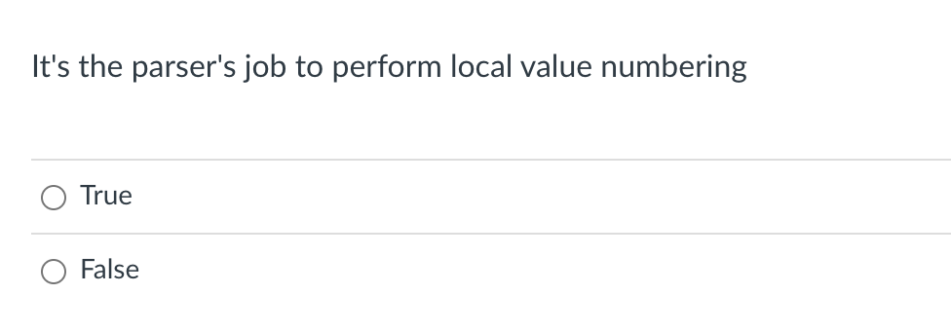
Quiz

Slide 6
Discussion
Local value numbering operates over 3 address code
The parser produces 3 address code
In some cases, the parser might use LVN, but it is independent
a2 = b0 + c1; b4 = a2 - d3; c5 = b4 + c1;
d6 = a2 - d3;
H = { “b0 + c1” : “a2”,
}

Slide 7
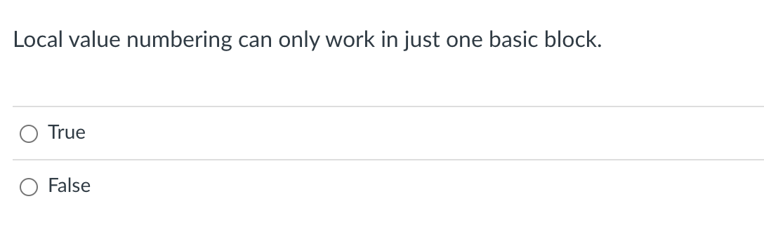
Quiz

Slide 8
Discussion
Reminder on a basic block

Slide 9
Discussion
How might they appear in a high-level language?
How many basic blocks?
… if (expr) { …
} else { …
}
…
Programs can be split into Basic Blocks:
A sequence of 3 address instructions such that:
There is a single entry, single exit
Important property: an instruction in a basic block can assume that all preceding instructions will execute
Two Basic Blocks
Single Basic Block
Label_x:
op1; op2; op3; Label_y: op4; op5;
Label_x:
op1;
op2;
op3;
br label_z;

Slide 10
Discussion
Label_0:
x = a + b; y = a + b;
optimized to
Label_0:
x = a + b; y = x;
Label_0:
x = a + b; Label_1:
y = a + b;
CANNOT always optimized to
Label_0:
x = a + b; Label_1:
y = x;
br Label_1; Label_0:
x = a + b; Label_1:
y = a + b;

Slide 11
Quiz
True! Although you might imagine algorithms that can work on more basic blocks.
This is called superlocal value numbering

Slide 12
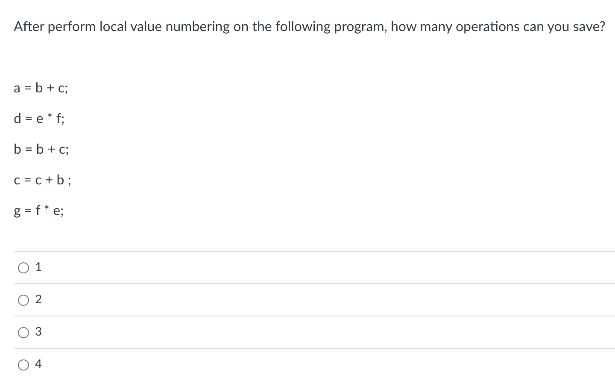
Quiz

Slide 13
Discussion
a = b + c;
d = e * f;
b = b + c;
c = c + b ;
g = f * e;
H = { ,
}

Slide 14
Discussion
a = b + c;
d = e * f;
b = b + c;
c = c + b ;
g = f - e;
H = { ,
}
What if we changed this?

Slide 15
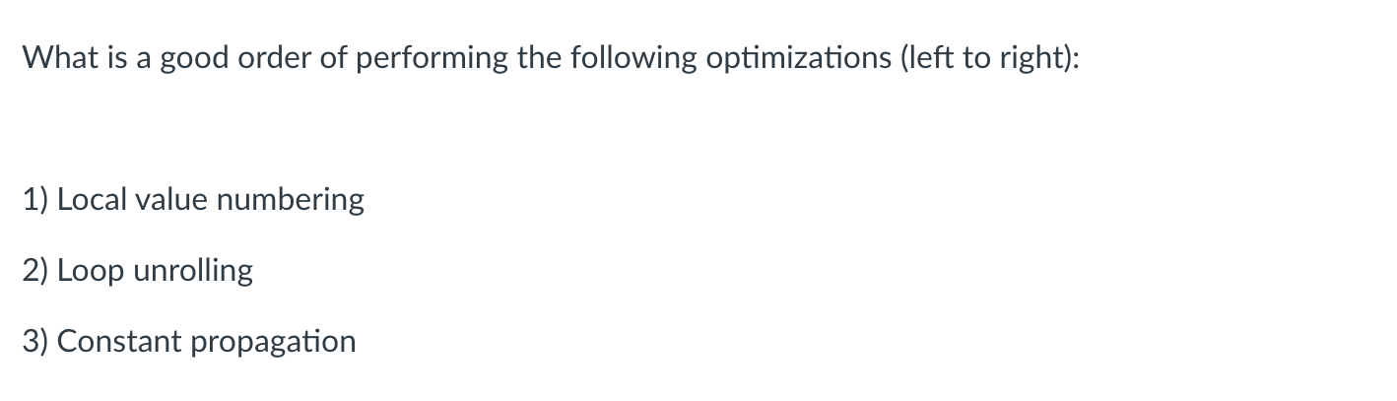
Quiz

Slide 16
Discussion
for (int i = 0; i < 10; i++) {
x = x + 1;
}
loop unrolling
for (int i = 0; i < 10; i++) {
x = x + 1;
i++;
x = x + 1;
}
how might this influence other optimizations?

Slide 17
Discussion
for (int i = 0; i < 10; i++) {
x = y + z;
}
loop unrolling
for (int i = 0; i < 10; i++) {
x = y + z;
i++;
x = y + z; // can be replaced
// using LVN
}
how might this influence other optimizations?

Slide 18
Discussion
a = 16;
b = a + c;
d = 16;
e = d + c;
How might constant propagation change this program

Slide 19
Discussion
a = 16;
b = a + c;
d = 16;
e = d + c;
How might constant propagation change this program
a = 16;
b = 16 + c;
d = 16;
e = 16 + c;

Slide 20
Discussion
a = 16;
b = a + c;
d = 16;
e = d + c;
How might constant propagation change this program
a = 16;
b = 16 + c;
d = 16;
e = 16 + c;
LVN can now replace the bottom one
It’s a little more difficult to apply
to ClassIeR. Do people have any ideas?

Slide 21
Quiz
Loop unrolling -> Constant propagation -> Local value numbering

Slide 22
Next quiz
Teaching feedback from CITL
Part of a larger program to help improves classes here

Slide 23
Review
Basic blocks
A piece of 3 address code that has one entry and one exit
Any line of code can assume that all lines before it have been executed
Allows “local” reasoning
pycfg example
Local value numbering
Local optimization
Simple algorithm that can be built on:
initial version just used string comparison
next we added commutativity
lastly we extended the algorithm to not add any new registers

Slide 24
Review
Algorithm for applying LVN:
split 3 address code into basic blocks
for each basic block
number the variables
try to remove expensive arithmetic operations

Slide 25
Today
Adding constant folding to LVN
Discussing memory and functions in LVN
How to add optimized code blocks back into the IR

Slide 26
Constant propagation and constant folding
Colloquially, they are often used interchangeably
Technically (e.g. according to the books)
Constant propagation is replacing variables with constants
Constant folding is compile-time evaluation when constants are known

Slide 27
Constant propagation and constant folding
int x = 14;
int y = 7 - x / 2;
return y * (28 / x + 2);
from: https://en.wikipedia.org/wiki/Constant_folding#Constant_propagation

Slide 28
Constant propagation and constant folding
int x = 14;
int y = 7 - x / 2;
return y * (28 / x + 2);
constant propagation
int x = 14;
int y = 7 - 14 / 2;
return y * (28 / 14 + 2);
from: https://en.wikipedia.org/wiki/Constant_folding#Constant_propagation

Slide 29
Constant propagation and constant folding
int x = 14;
int y = 7 - x / 2;
return y * (28 / x + 2);
constant propagation
int x = 14;
int y = 7 - 14 / 2;
return y * (28 / 14 + 2);
int x = 14;
int y = 0;
return y * (28 / 14 + 2);
constant folding
from: https://en.wikipedia.org/wiki/Constant_folding#Constant_propagation

Slide 30
Constant propagation and constant folding
int x = 14;
int y = 7 - x / 2;
return y * (28 / x + 2);
int x = 14;
int y = 0;
return 0 * (28 / 14 + 2);
constant propagation
constant propagation
int x = 14;
int y = 7 - 14 / 2;
return y * (28 / 14 + 2);
int x = 14;
int y = 0;
return y * (28 / 14 + 2);
constant folding
from: https://en.wikipedia.org/wiki/Constant_folding#Constant_propagation

Slide 31
Constant propagation and constant folding
int x = 14;
int y = 7 - x / 2;
return y * (28 / x + 2);
int x = 14;
int y = 0;
return 0 * (28 / 14 + 2);
constant propagation
constant propagation
constant folding
int x = 14;
int y = 7 - 14 / 2;
return y * (28 / 14 + 2);
int x = 14;
int y = 0;
return y * (28 / 14 + 2);
constant folding
int x = 14;
int y = 0;
return 0;
from: https://en.wikipedia.org/wiki/Constant_folding#Constant_propagation

Slide 32
Typically performed at the same time
int x = 14;
int y = 7 - x / 2;
return y * (28 / x + 2);
constant propagation and folding second line
int x = 14;
int y = 0;
return y * (28 / 14 + 2);
int x = 14;
int y = 0;
return 0;
constant propagation and folding third line
from: https://en.wikipedia.org/wiki/Constant_folding#Constant_propagation

Slide 33
Adding constant folding to LVN
b = 5;
c = 3;
a = b + c; b = a - d; c = a + c;
d = a - d;
H = {
}
Known_values = {
}

Slide 34
Adding constant folding to LVN
numbering
b0 = 5;
c1 = 3;
a2 = b0 + c1; b4 = a2 - d3; c5 = a2 + c1;
d6 = a2 - d3;
H = {
}
Known_values = {
}

Slide 35
Adding constant folding to LVN
As you are iterating through code, add any constant mappings to Known_values:
b0 = 5;
c1 = 3;
a2 = b0 + c1; b4 = a2 - d3; c5 = a2 + c1;
d6 = a2 - d3;
H = {
}
Known_values = {
}

Slide 36
Adding constant folding to LVN
As you are iterating through code, add any constant mappings to Known_values:
b0 = 5;
c1 = 3;
a2 = b0 + c1; b4 = a2 - d3; c5 = a2 + c1;
d6 = a2 - d3;
H = {
}
Known_values = {
“b0” : 5
“c1” : 3
}

Slide 37
Adding constant folding to LVN
When you find an arithmetic operation, first check if operands are known
b0 = 5;
c1 = 3;
a2 = b0 + c1; b4 = a2 - d3; c5 = a2 + c1;
d6 = a2 - d3;
H = {
}
Known_values = {
“b0” : 5
“c1” : 3
}

Slide 38
Adding constant folding to LVN
When you find an arithmetic operation, first check if operands are known
b0 = 5;
c1 = 3;
a2 = b0 + c1; b4 = a2 - d3; c5 = a2 + c1;
d6 = a2 - d3;
H = {
}
5 + 3
evaluate and add to known values
Known_values = {
“b0” : 5
“c1” : 3
}

Slide 39
Adding constant folding to LVN
When you find an arithmetic operation, first check if operands are known
b0 = 5;
c1 = 3;
a2 = 8; b4 = a2 - d3; c5 = a2 + c1;
d6 = a2 - d3;
H = {
}
5 + 3
evaluate and add to known values
Known_values = {
“b0” : 5
“c1” : 3
“a2” : 8
}

Slide 40
Adding constant folding to LVN
When you find an arithmetic operation, first check if operands are known
b0 = 5;
c1 = 3;
a2 = 8; b4 = 8 - d3; c5 = a2 + c1;
d6 = a2 - d3;
propagate constant (if IR allows it)
H = {
}
Known_values = {
“b0” : 5
“c1” : 3
“a2” : 8
}

Slide 41
Adding constant folding to LVN
When you find an arithmetic operation, first check if operands are known
b0 = 5;
c1 = 3;
a2 = 8; b4 = 8 - d3; c5 = a2 + c1;
d6 = a2 - d3;
why do we want to store 8
here rather than a2?
add to H
H = {
“8 - d3” : b4
}
Known_values = {
“b0” : 5
“c1” : 3
“a2” : 8
}
continue on.

Slide 42
Arithmetic identities
b0 = 0;
d3 = 1;
f7 = 4;
a2 = b0 + c1; b4 = a2 * d3; d6 = e5 * f7;
H = {
}
Known_values = {
}

Slide 43
Arithmetic identities
what can we do here?
b0 = 0;
d3 = 1;
f7 = 4;
a2 = b0 + c1; b4 = a2 * d3; d6 = e5 * f7;
H = {
}
Known_values = {
”b0”:0, “d3”:1, “f7”:4
}

Slide 44
Arithmetic identities
what can we do here?
add a special rule for +
that if any side is 0, you can
just drop the 0.
b0 = 0;
d3 = 1;
f7 = 4;
a2 = b0 + c1; b4 = a2 * d3; d6 = e5 * f7;
H = {
}
Known_values = {
”b0”:0, “d3”:1, “f7”:4
}

Slide 45
Arithmetic identities
what can we do here?
add a special rule for +
that if any side is 0, you can
just drop the 0.
b0 = 0;
d3 = 1;
f7 = 4;
a2 = c1; b4 = a2 * d3; d6 = e5 * f7;
H = {
}
Known_values = {
”b0”:0, “d3”:1, “f7”:4
}
What other rules could we have?

Slide 46
Other considerations in LVN
Memory and functions

Slide 47
Local value numbering: Memory
Consider a 3 address code that allows memory accesses
a[i] = x[j] + y[k]; b[i] = x[j] + y[k];
is this transformation allowed?
a[i] = x[j] + y[k]; b[i] = a[i];

Slide 48
Local value numbering: Memory
Consider a 3 address code that allows memory accesses
a[i] = x[j] + y[k]; b[i] = x[j] + y[k];
is this transformation allowed? No!
only if the compiler can prove that a does not alias x and y
a[i] = x[j] + y[k]; b[i] = a[i];
In the worst case, every time a memory location is updated, the compiler must update the value for all pointers.

Slide 49
Local value numbering: Memory
Consider a 3 address code that allows memory accesses
a[i] = x[j] + y[k]; b[i] = x[j] + y[k];
Example, initially:
i = j
a = x
y[k] = 1
x[j] = 1
What does b[i] equal at the end of
each computation?
a[i] = x[j] + y[k]; b[i] = a[i];

Slide 50
Local value numbering: Memory
How to number:
Number each pointer/index pair
a[i] = x[j] + y[k]; b = x[j] + y[k];

Slide 51
Local value numbering: Memory
How to number:
Number each pointer/index pair
Any pointer/index pair that might alias must be incremented at each instruction
(a[i],3) = (x[j],1) + (y[k],2); (b,6) = (x[j],?) + (y[k],?);

Slide 52
Local value numbering: Memory
How to number:
Number each pointer/index pair
Any pointer/index pair that might alias must be incremented at each instruction
(a[i],3) = (x[j],1) + (y[k],2); (b,6) = (x[j],4) + (y[k],5);
Does this help at all?

Slide 53
Local value numbering: Memory
How to number:
Number each pointer/index pair
Any pointer/index pair that might alias must be incremented at each instruction
(a[i],3) = (x[j],1) + (y[k],2); (b,6) = (x[j],4) + (y[k],5);
(c,7) = (x[j],4) + (y[k],5);
Does this help at all?
If there is no memory writes between an assignment to a variable
then we can do a replacement

Slide 54
Local value numbering: Memory
How to number:
Number each pointer/index pair
Any pointer/index pair that might alias must be incremented at each instruction
(a[i],3) = (x[j],1) + (y[k],2); (b,6) = (x[j],4) + (y[k],5);
(c,7) = (b,6);
Does this help at all?
If there is no memory writes between an assignment to a variable
then we can do a replacement

Slide 55
Local value numbering: Memory
How to number:
Number each pointer/index pair
Any pointer/index pair that might alias must be incremented at each instruction
A compiler analysis might try to determine that addresses can’t alias
can we trace a,x,y to a = malloc(…);
x = malloc(…);
y = malloc(…);
// a,x,y are never overwritten
(a[i],3) = (x[j],1) + (y[k],2); (b[i],6) = (x[j],4) + (y[k],5);

Slide 56
Local value numbering: Memory
How to number:
Number each pointer/index pair
Any pointer/index pair that might alias must be incremented at each instruction
A compiler analysis might try to determine that addresses can’t alias
can we trace a,x,y to a = malloc(…);
x = malloc(…);
y = malloc(…);
// a,x,y are never overwritten
(a[i],3) = (x[j],1) + (y[k],2); (b[i],6) = (x[j],1) + (y[k],2);
in this case we do not have to update the number

Slide 57
Local value numbering: Memory
How to number:
Number each pointer/index pair
Any pointer/index pair that might alias must be incremented at each instruction
(a[i],3) = (x[j],1) + (y[k],2); (b[i],6) = (x[j],4) + (y[k],5);
programmer annotations can also tell the compiler that no other pointer can access the memory pointed to by a

Slide 58
Local value numbering: Memory
How to number:
Number each pointer/index pair
Any pointer/index pair that might alias must be incremented at each instruction
(a[i],3) = (x[j],1) + (y[k],2); (b[i],6) = (x[j],4) + (y[k],5);
restrict a
programmer annotations can also tell the compiler that no other pointer can access the memory pointed to by a
in this case we do not have to update the number
Warning: the compiler does not enforce this!

Slide 59
Local value numbering: Memory
How to number:
Number each pointer/index pair
Any pointer/index pair that might alias must be incremented at each instruction
(a[i],3) = (x[j],1) + (y[k],2); (b[i],6) = (a[i],3);

Slide 60
Local value numbering: functions

Slide 61
Local value numbering: functions
How to number?
a = foo(x);
x = b;
c = foo(x);

Slide 62
Local value numbering: functions
How to number?
the same way
a = foo(x);
x = b;
c = foo(x);
a1 = foo(x0);
x3 = b2;
c4 = foo(x3);
What if you had
first class functions?

Slide 63
Local value numbering: functions
How to number?
the same way
a = foo(x);
x = b;
c = foo(x);
a1 = foo(x0);
x3 = b2;
c4 = foo(x3);
Can we replace?

Slide 64
Local value numbering: functions
How to number?
the same way
a = foo(x);
c = foo(x);
a1 = foo(x0);
c2 = foo(x0);
How about now?

Slide 65
Local value numbering: functions
How to number?
the same way
a = foo(x);
c = foo(x);
a1 = foo(x0);
c2 = foo(x0);
How about now?
int count = 0;
int foo(int x) {
count += 1;
return 0;
};
What if foo had this implementation?

Slide 66
Local value numbering: functions
How to number?
the same way
a = foo(x);
c = foo(x);
a1 = foo(x0);
c2 = foo(x0);
How about now?
int count = 0;
int foo(int x) {
count += 1;
return 0;
};
side effects!
What if foo had this implementation?

Slide 67
Local value numbering: functions
a = foo(x);
c = foo(x);
print(count);
a1 = foo(x0);
c2 = a1;
print(count);
are these two programs the same?
int count = 0;
int foo(int x) {
count += 1;
return 0;
};

Slide 68
Local value numbering: functions
In C/++, functions are assumed to have side effects
A function that does not have side effects is called “pure”
You can annotate a function as pure
__attribute__((pure))
warning: compiler does not check this and you can introduce subtle bugs
Functional languages tend to have a pure-by-default design. Allows more compiler optimizations, but less control to the programmer.

Slide 69
How to stitch optimized code back into the program

Slide 70
How to stitch optimized code back into the program
a = b + c;
d = e + f;
g = b + c;
label_0:
h = g + a;
k = a + g;

Slide 71
How to stitch optimized code back into the program
split into basic blocks
a = b + c;
d = e + f;
g = b + c;
label_0:
h = g + a;
k = a + g;
a = b + c;
d = e + f;
g = b + c;
label_0:
h = g + a;
k = a + g;

Slide 72
How to stitch optimized code back into the program
number
a = b + c;
d = e + f;
g = b + c;
label_0:
h = g + a;
k = a + g;
a = b + c;
d = e + f;
g = b + c;
a2 = b0 + c1;
d5 = e3 + f4;
g6 = b0 + c1;
label_0:
h = g + a;
k = a + g;
label_0:
h2 = g0 + a1;
k3 = a1 + g0;

Slide 73
How to stitch optimized code back into the program
move code on slide to make room
a2 = b0 + c1;
d5 = e3 + f4;
g6 = b0 + c1;
label_0:
h2 = g0 + a1;
k3 = a1 + g0;

Slide 74
How to stitch optimized code back into the program
optimize
a2 = b0 + c1;
d5 = e3 + f4;
g6 = b0 + c1;
a2 = b0 + c1;
d5 = e3 + f4;
g6 = a2;
label_0:
h2 = g0 + a1;
k3 = a1 + g0;
label_0:
h2 = g0 + a1;
k3 = h2;

Slide 75
How to stitch optimized code back into the program
optimize
put together?
a2 = b0 + c1;
d5 = e3 + f4;
g6 = b0 + c1;
a2 = b0 + c1;
d5 = e3 + f4;
g6 = a2;
a2 = b0 + c1;
d5 = e3 + f4;
g6 = a2;
label_0:
h2 = g0 + a1;
k3 = h2;
label_0:
h2 = g0 + a1;
k3 = a1 + g0;
label_0:
h2 = g0 + a1;
k3 = h2;
What are the issues?

Slide 76
How to stitch optimized code back into the program
optimize
put together?
a2 = b0 + c1;
d5 = e3 + f4;
g6 = b0 + c1;
a2 = b0 + c1;
d5 = e3 + f4;
g6 = a2;
a2 = b0 + c1;
d5 = e3 + f4;
g6 = a2;
label_0:
h2 = g0 + a1;
k3 = h2;
label_0:
h2 = g0 + a1;
k3 = a1 + g0;
label_0:
h2 = g0 + a1;
k3 = h2;
undefined!
What are the issues?

Slide 77
How to stitch optimized code back into the program
stitch part 1: assign original variables their latest values
a2 = b0 + c1;
d5 = e3 + f4;
g6 = a2;
g = g6;
d = d5
a = a2;
optimize
a2 = b0 + c1;
d5 = e3 + f4;
g6 = b0 + c1;
a2 = b0 + c1;
d5 = e3 + f4;
g6 = a2;
label_0:
h2 = g0 + a1;
k3 = a1 + g0;
label_0:
h2 = g0 + a1;
k3 = h2;
label_0:
h2 = g0 + a1;
k3 = h2;
h = h2;
k = k3;

Slide 78
How to stitch optimized code back into the program
make room on slide
a2 = b0 + c1;
d5 = e3 + f4;
g6 = a2;
g = g6;
d = d5
a = a2;
label_0:
h2 = g0 + a1;
k3 = h2;
h = h2;
k = k3;
what else needs to be done?

Slide 79
How to stitch optimized code back into the program
stitch part 2: drop numbers from first use of variables
a2 = b0 + c1;
d5 = e3 + f4;
g6 = a2;
g = g6;
d = d5
a = a2;
a2 = b + c;
d5 = e + f;
g6 = a2;
g = g6;
d = d5
a = a2;
label_0:
h2 = g0 + a1;
k3 = h2;
h = h2;
k = k3;
label_0:
h2 = g + a;
k3 = h2;
h = h2;
k = k3;

Slide 80
How to stitch optimized code back into the program
Now they can be combined
a2 = b0 + c1;
d5 = e3 + f4;
g6 = a2;
g = g6;
d = d5
a = a2;
a2 = b + c;
d5 = e + f;
g6 = a2;
g = g6;
d = d5
a = a2;
a2 = b + c;
d5 = e + f;
g6 = a2;
g = g6;
d = d5
a = a2;
label_0:
h2 = g + a;
k3 = h2;
h = h2;
k = k3;
label_0:
h2 = g0 + a1;
k3 = h2;
h = h2;
k = k3;
label_0:
h2 = g + a;
k3 = h2;
h = h2;
k = k3;

Slide 81
How to stitch optimized code back into the program
new
is it really optimized?
It looks a lot longer...
a2 = b + c;
d5 = e + f;
g6 = a2;
g = g6;
d = d5
a = a2;
label_0:
h2 = g + a;
k3 = h2;
h = h2;
k = k3;
original
a = b + c;
d = e + f;
g = b + c;
label_0:
h = g + a;
k = a + g;

Slide 82
How to stitch optimized code back into the program
new
is it really optimized?
Common pattern for code to get
larger, but it will contain patterns
that are easier optimize away
later passes will minimize copies
a2 = b + c;
d5 = e + f;
g6 = a2;
g = g6;
d = d5
a = a2;
label_0:
h2 = g + a;
k3 = h2;
h = h2;
k = k3;
original
a = b + c;
d = e + f;
g = b + c;
label_0:
h = g + a;
k = a + g;

Slide 83
Loop optimizations

Slide 84
For loops
How do they look in different languages
C/C++
Python
Numpy
How do Python and Numpy look under the hood?
The more constrained the for loops are, the more assumptions the compiler can make, but less flexibility for the programmer

Slide 85
For loops
The compiler can optimize For loops if they fit a certain pattern
When developing a compiler optimization, we start with strict constraints and then slowly relax them and make the optimization more general.
Sometimes it is not worth relaxing the constraints (code gets too complex)
If you know the constraints, then often you can write code such that the compiler can recognize the pattern and optimize!

Slide 86
For loops terminology
Loop body:
A series of statements that are executed each loop iteration
Loop condition:
the condition that decides whether the loop body is executed
Iteration variable:
A variable that is updated exactly once during the loop
The loop condition depends on the iteration variable

Slide 87
Loop unrolling
Executing multiple instances of the loop body without checking the loop condition.
FOR LPAR assignment_statement expr SEMI assignment_statement RPAR statement
unrolled by a factor of 2
for (int i = 0; i < 128; i++) {
// body
}
for (int i = 0; i < 128; i++) {
// body
i++
// body
}
could we unroll more?

Slide 88
Loop unrolling conditions
Under what conditions can we unroll?
FOR LPAR assignment_statement expr SEMI assignment_statement RPAR statement
for (int i = 0; i < 128; i++) {
// body
}

Slide 89
Loop unrolling conditions
Under what conditions can we unroll?
FOR LPAR assignment_statement expr SEMI assignment_statement RPAR statement
for (int i = 0; i < 128; i++) {
// body
}
Validate that we actually have an iteration variable 1. lhs of assignment statement
2. no assignment to variable in body
3. lhs of loop condition
4. lhs of assignment_statement
Do these guarantee we will find an iteration variable?
What happens if we don’t find one?

Slide 90
Loop unrolling conditions
Under what conditions can we unroll?
FOR LPAR assignment_statement expr SEMI assignment_statement RPAR statement
for (int i = 0; i < 128; i++) {
// body
}
Validate that we actually have an iteration variable 1. lhs of assignment statement
2. no assignment to variable in body
3. lhs of loop condition
4. lhs of assignment_statement
How does C-simple help us here?
Do these guarantee we will find an iteration variable?
What happens if we don’t find one?

Slide 91
Loop unrolling conditions
Under what conditions can we unroll?
FOR LPAR assignment_statement expr SEMI assignment_statement RPAR statement
for (int i = 0; i < 128; i++) {
// body
}
Validate properties of iteration variable 1. ?

Slide 92
Loop unrolling conditions
Under what conditions can we unroll?
FOR LPAR assignment_statement expr SEMI assignment_statement RPAR statement
for (int i = 0; i < 128; i++) {
// body
}
Validate properties of iteration variable 1. identify an iteration range (start and end)
2. increment by 1

Slide 93
See everyone on Monday
No class on Friday
See you on Monday
Topics: Continue Loop unrolling

