Slide 1
CSE110A: Compilers April 18, 2022
..
Topics:
Top down parsing
Dealing with left recursion
Lookahead sets
int main() { printf(““);
return 0; }
..
..
..
..

Slide 2
Announcements
HW 1 is due today
No guaranteed help after business hours (e.g. after class at 5 PM)
HW 2 is scheduled for release today by midnight
you have two weeks to do it.
due on May 2 at midnight
you have what you need for part 1 today
you should have what you need for part 2 on Wednesday
you should have what you need for part 3 on Friday
Plenty of time for help for HW 2!

Slide 3
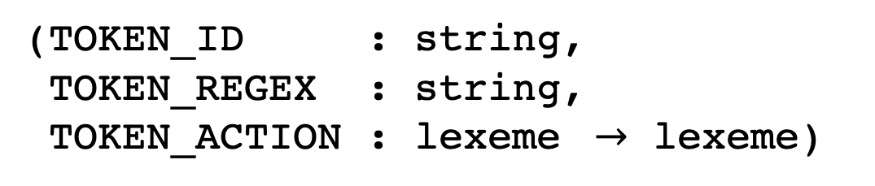
Announcements
Homework clarification: token actions
You can use lists, functions, variables etc in tokens.py as token actions
These components get bound to the tokens array
You should only use the token array in your scanners, and you should be prepared to accept as input any token arrays
Your token array should be an array of tuples:
(TOKEN_ID : string, TOKEN_REGEX : string,
TOKEN_ACTION : lexeme $→$ lexeme)

Slide 4
Quiz
Unfortunately Monday’s lecture put us behind
and we weren’t able to get through all the
material we needed for the quiz again
To make up for it, I will make Friday’s quiz due on Wednesday so that you can answer the extra questions with enough background

Slide 5
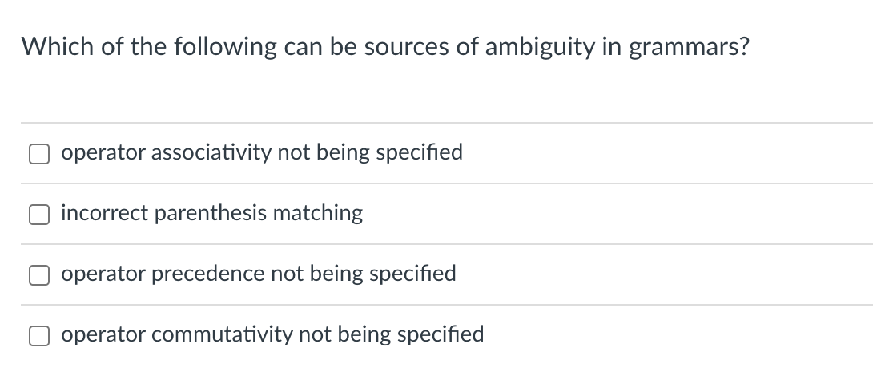
Quiz

Slide 6
Quiz

Slide 7
What about for a different operator?
input: 2-3-4
Evaluates (2-3) - 4
expr
Evaluates 2 - (3 - 4)
expr
expr
<MINUS>
expr
expr
<MINUS>
expr
expr
<MINUS>
expr
term
term
expr
<MINUS>
expr
term
term
factor
term
term
factor
factor
factor
<NUM, 4>
factor
factor
<NUM, 2>
<NUM, 2>
<NUM, 3>
<NUM, 3>
<NUM, 4>
Which one is right?

Slide 8
Associativity for a single operator
input: 2-3-4
expr
expr
<MINUS>
expr
Operator | Name | Productions
- | expr | : expr MINUS NUM | NUM
<NUM, 2>
expr
<MINUS>
expr
<NUM, 3>
<NUM, 4>
No longer allowed

Slide 9
Quiz

Slide 10
Quiz
Not really a cause of ambiguous grammars

Slide 11
Quiz

Slide 12
Ambiguous grammars
expr ::= NUM
| expr PLUS expr
| expr TIMES expr
| LPAREN expr RPAREN
input: 1 + 5 * 6
Evaluations are different!
expr
expr
expr
expr
expr
<PLUS>
expr
<TIMES>
expr
expr
<NUM, 1>
expr
<TIMES>
expr
<PLUS>
<NUM, 6>
<NUM, 1>
<NUM, 5>
<NUM, 5>
<NUM, 6>

Slide 13
Avoiding Ambiguity
Precedence
increases going down
new production rules
One non-terminal for each level of precedence
lowest precedence at the top
highest precedence at the bottom
Operator | Name | Productions
+,- | expr | : expr PLUS expr | expr MINUS expr | term
* | term | : term TIMES term | pow
^ | pow | : pow ^ pow | factor
() | factor | : LPAREN expr RPAREN | NUM

Slide 14
Quiz
What is commutativity?

Slide 15
Quiz
What is commutativity? a + b == b + a

Slide 16
Quiz
What is commutativity? a + b == b + a
Parsing doesn’t really consider commutativity, but optimizations will

Slide 17
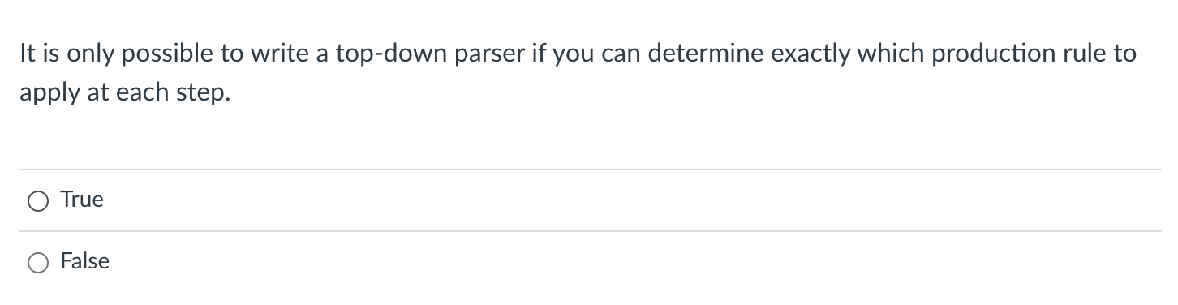
Quiz
We’re doing this a little out of order

Slide 18
root = start symbol; focus = root;
push(None);
to_match = s.token();
while (true):
if (focus is a nonterminal)
pick next rule (A ::= B1,B2,B3...BN);
push(BN... B3, B2);
focus = B1
else if (focus == to_match)
to_match = s.token()
focus = pop()
else if (to_match == None and focus == None)
Accept
1: Expr ::= Expr Op Unit
2: | Unit 3: Unit ::= ‘(‘ Expr ‘)’
4: | ID
5: Op ::= ‘+’
6: | ‘*’
Currently we assume this is magic and picks
the right rule every time
Can we derive the string (a+b)*c
Expanded Rule | Sentential Form
start | Expr
1 | Expr Op Unit
2 | Unit Op Unit
3 | ( Expr ) Op Unit
1 | ( Expr Op Unit) Op Unit
2 | ( Unit Op Unit) Op Unit
Variable | Value
focus | Expr
to_match | ‘a‘
s.istring | “+b)*c”
stack | Op Unit ) Op Unit None

Slide 19
Quiz
We’re doing this a little out of order
Answer:
true with what we’ve seen so far
true if you want an efficient parser
false in general

Slide 20
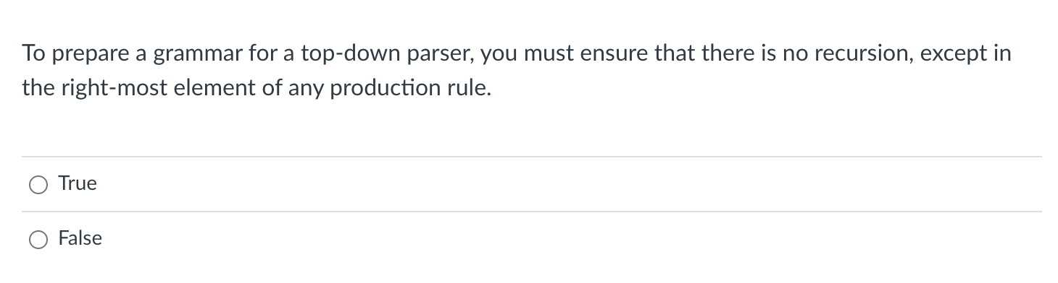
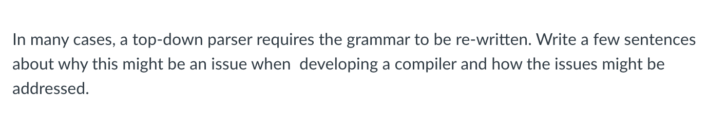
Quiz
We will answer these ones today in class

Slide 21
Review
Let’s do a few more examples of top down parsing

Slide 22
root = start symbol; focus = root;
push(None);
to_match = s.token();
while (true):
if (focus is a nonterminal)
pick next rule (A ::= B1,B2,B3...BN);
push(BN... B3, B2);
focus = B1
else if (focus == to_match)
to_match = s.token()
focus = pop()
else if (to_match == None and focus == None)
Accept
1: Expr ::= Expr ‘+’ ID
2: | ID
Currently we assume this is magic and picks
the right rule every time
Can we derive the string a
Expanded Rule | Sentential Form
start | Expr
Variable | Value
focus | Expr
to_match
s.istring
stack

Slide 23
One more example

Slide 24
root = start symbol; focus = root;
push(None);
to_match = s.token();
while (true):
if (focus is a nonterminal)
pick next rule (A ::= B1,B2,B3...BN);
push(BN... B3, B2);
focus = B1
else if (focus == to_match)
to_match = s.token()
focus = pop()
else if (to_match == None and focus == None)
Accept
1: Expr ::= Expr ‘+’ ID
2: | ID
Currently we assume this is magic and picks
the right rule every time
Can we derive the string a+b
Expanded Rule | Sentential Form
start | Expr
Variable | Value
focus | Expr

Slide 25
New material
We are going to zoom in on:
pick next rule (A ::= B1,B2,B3...BN);
So far this rule has been magic. Let’s start by
turning that magic off

Slide 26
New material
We are going to zoom in on:
pick next rule (A ::= B1,B2,B3...BN);
So far this rule has been magic. Let’s start
turning that magic off what could the most demonic choice do...

Slide 27
root = start symbol; focus = root;
push(None);
to_match = s.token();
while (true):
if (focus is a nonterminal)
pick next rule (A ::= B1,B2,B3...BN);
push(BN... B3, B2);
focus = B1
else if (focus == to_match)
to_match = s.token()
focus = pop()
else if (to_match == None and focus == None)
Accept
1: Expr ::= Expr ‘+’ ID
2: | ID
What could a demonic choice do?
Can we derive the string a
Expanded Rule | Sentential Form
start | Expr
Variable | Value
focus
to_match
s.istring
stack

Slide 28
root = start symbol; focus = root;
push(None);
to_match = s.token();
while (true):
if (focus is a nonterminal)
pick next rule (A ::= B1,B2,B3...BN);
push(BN... B3, B2);
focus = B1
else if (focus == to_match)
to_match = s.token()
focus = pop()
else if (to_match == None and focus == None)
Accept
1: Expr ::= Expr ‘+’ ID
2: | ID
What could a demonic choice do?
Can we derive the string a
Expanded Rule | Sentential Form
start | Expr
1 | Expr ‘+’ ID
1 | Expr ‘+’ ID ‘+’ ID
1 | Expr ‘+’ ID ‘+’ ID ‘+’ ID
1 | ....
1 | ....
1 | ....
Variable | Value
focus
to_match
s.istring
stack
Infinite recursion!

Slide 29
Top down parsing does not handle left recursion
1: Expr ::= Expr Op Unit
2: | Unit 3: Unit ::= ‘(‘ Expr ‘)’
4: | ID
5: Op ::= ‘+’
6: | ‘*’
direct left recursion

Slide 30
Top down parsing does not handle left recursion
1: Expr ::= Expr Op Unit
2: | Unit 3: Unit ::= ‘(‘ Expr ‘)’
4: | ID
5: Op ::= ‘+’
6: | ‘*’
1: Expr_base ::= Unit
2: | Expr_op
3: Expr_op ::= Expr_base Op Unit 4: Unit ::= ‘(‘ Expr_base ‘)’
5: | ID
6: Op ::= ‘+’
7: | ‘*’
direct left recursion
indirect left recursion
Top down parsing cannot handle either

Slide 31
Top down parsing does not handle left recursion
Luckily
In general, any CFG can be re-written without left recursion

Slide 32
Eliminating direct left recursion
Fee ::= Fee “a”
| “b”
What does this grammar describe?

Slide 33
Eliminating direct left recursion
The grammar can be rewritten as
Fee ::= Fee “a”
| “b”
Fee ::= “b” Fee2
Fee2 ::= “a” Fee2
| “”

Slide 34
Eliminating direct left recursion
A and B can be any sequence of non-terminals and terminals
Fee ::= Fee A
| B
Fee ::= B Fee2
Fee2 ::= A Fee2
| “”

Slide 35
Eliminating direct left recursion
1: Expr ::= Expr Op Unit
2: | Unit 3: Unit ::= ‘(‘ Expr ‘)’
4: | ID
5: Op ::= ‘+’
6: | ‘*’
Lets do this one as an example:
Fee ::= B Fee2
Fee2 ::= A Fee2
| “”
Fee ::= Fee A
| B

Slide 36
Eliminating direct left recursion
A = Op Unit
B = Unit
1: Expr ::= Expr Op Unit
2: | Unit 3: Unit ::= ‘(‘ Expr ‘)’
4: | ID
5: Op ::= ‘+’
6: | ‘*’
1: Expr ::= Unit Expr2
2: Expr2 ::= Op Unit Expr2
3: | “” 4: Unit ::= ‘(‘ Expr ‘)’
5: | ID
6: Op ::= ‘+’
7: | ‘*’
Lets do this one as an example:
Fee ::= B Fee2
Fee2 ::= A Fee2
| “”
Fee ::= Fee A
| B

Slide 37
Eliminating direct left recursion
1: Expr ::= Expr ‘+’ ID
2: | ID
Lets do this one as an example:
Fee ::= B Fee2
Fee2 ::= A Fee2
| “”
Fee ::= Fee A
| B

Slide 38
Eliminating direct left recursion
A = ‘+ ID
B = ID
1: Expr ::= Expr ‘+’ ID
2: | ID
1: Expr ::= ID Expr2
2: Expr2 ::= ‘+’ Expr2
3: | ””
Lets do this one as an example:
Fee ::= B Fee2
Fee2 ::= A Fee2
| “”
Fee ::= Fee A
| B

Slide 39
root = start symbol; focus = root;
push(None);
to_match = s.token();
while (true):
if (focus is a nonterminal)
pick next rule (A ::= B1,B2,B3...BN);
push(BN... B3, B2);
focus = B1
else if (focus == to_match)
to_match = s.token()
focus = pop()
else if (to_match == None and focus == None)
Accept
1: Expr ::= ID Expr2
2: Expr2 ::= ‘+’ Expr2
3: | ””
Can we match: “a”?
Expanded Rule | Sentential Form
start | Expr
Variable | Value
focus
to_match
s.istring
stack

Slide 40
root = start symbol; focus = root;
push(None);
to_match = s.token();
while (true):
if (focus is a nonterminal)
pick next rule (A ::= B1,B2,B3...BN);
push(BN... B3, B2);
focus = B1
else if (focus == to_match)
to_match = s.token()
focus = pop()
else if (to_match == None and focus == None)
Accept
How to handle this case?
1: Expr ::= ID Expr2
2: Expr2 ::= ‘+’ Expr2
3: | ””
Can we match: “a”?
Expanded Rule | Sentential Form
start | Expr
1 | ID Expr2
Variable | Value
focus | Expr2
to_match | None
s.istring | “”
stack | None

Slide 41
root = start symbol; focus = root;
push(None);
to_match = s.token();
while (true):
if (focus is a nonterminal)
pick next rule (A ::= B1,B2,B3...BN);
if B1 == “”: focus=pop(); continue;
push(BN... B3, B2);
focus = B1
else if (focus == to_match)
to_match = s.token()
focus = pop()
else if (to_match == None and focus == None)
Accept
1: Expr ::= ID Expr2
2: Expr2 ::= ‘+’ Expr2
3: | ””
How to handle this case?
Can we match: “a”?
Expanded Rule | Sentential Form
start | Expr
1 | ID Expr2
Variable | Value
focus | Expr2
to_match | None
s.istring | “”
stack | None

Slide 42
root = start symbol; focus = root;
push(None);
to_match = s.token();
while (true):
if (focus is a nonterminal)
pick next rule (A ::= B1,B2,B3...BN);
if B1 == “”: focus=pop(); continue;
push(BN... B3, B2);
focus = B1
else if (focus == to_match)
to_match = s.token()
focus = pop()
else if (to_match == None and focus == None)
Accept
1: Expr ::= ID Expr2
2: Expr2 ::= ‘+’ Expr2
3: | ””
How to handle this case?
Can we match: “a”?
Expanded Rule | Sentential Form
start | Expr
1 | ID Expr2
3 | ID
Variable | Value
focus | Expr2
to_match | None
s.istring | “”
stack | None

Slide 43
How about indirect left recursion?
1: Expr ::= Expr Op Unit
2: | Unit 3: Unit ::= ‘(‘ Expr ‘)’
4: | ID
5: Op ::= ‘+’
6: | ‘*’
1: Expr_base ::= Unit
2: | Expr_op
3: Expr_op ::= Expr_base Op Unit 4: Unit ::= ‘(‘ Expr_base ‘)’
5: | ID
6: Op ::= ‘+’
7: | ‘*’
direct left recursion
indirect left recursion
Top down parsing cannot handle either

Slide 44
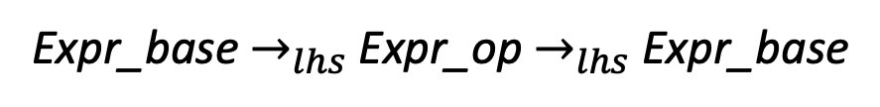
How about indirect left recursion?
1: Expr_base ::= Unit
2: | Expr_op
3: Expr_op ::= Expr_base Op Unit 4: Unit ::= ‘(‘ Expr_base ‘)’
5: | ID
6: Op ::= ‘+’
7: | ‘*’
Identify indirect left left recursion
Expr_base $→_{lhs}$ Expr_op $→_{lhs}$Expr_base

Slide 45
How about indirect left recursion?
1: Expr_base ::= Unit
2: | Expr_op
3: Expr_op ::= Expr_base Op Unit 4: Unit ::= ‘(‘ Expr_base ‘)’
5: | ID
6: Op ::= ‘+’
7: | ‘*’
Identify indirect left left recursion
Expr_base $→_{lhs}$ Expr_op $→_{lhs}$Expr_base
Substitute indirect non-terminal closer to initial non-terminal

Slide 46
How about indirect left recursion?
1: Expr_base ::= Unit
2: | Expr_op
3: Expr_op ::= Expr_base Op Unit 4: Unit ::= ‘(‘ Expr_base ‘)’
5: | ID
6: Op ::= ‘+’
7: | ‘*’
1: Expr_base ::= Unit
2: | Expr_base Op Unit
3: Expr_op ::= Expr_base Op Unit 4: Unit ::= ‘(‘ Expr_base ‘)’
5: | ID
6: Op ::= ‘+’
7: | ‘*’
What to do with production rule 3?
Identify indirect left left recursion
Expr_base $→_{lhs}$ Expr_op $→_{lhs}$Expr_base
Substitute indirect non-terminal closer to initial non-terminal

Slide 47
How about indirect left recursion?
1: Expr_base ::= Unit
2: | Expr_op
3: Expr_op ::= Expr_base Op Unit 4: Unit ::= ‘(‘ Expr_base ‘)’
5: | ID
6: Op ::= ‘+’
7: | ‘*’
1: Expr_base ::= Unit
2: | Expr_base Op Unit
3: Expr_op ::= Expr_base Op Unit 4: Unit ::= ‘(‘ Expr_base ‘)’
5: | ID
6: Op ::= ‘+’
7: | ‘*’
What to do with production rule 3? It may need to stay if another production rule references it!
Identify indirect left left recursion
Expr_base $→_{lhs}$ Expr_op $→_{lhs}$Expr_base
Substitute indirect non-terminal closer to initial non-terminal

Slide 48
What else do we need to do
pick next rule (A ::= B1,B2,B3...BN);
We cannot have infinite recursion. What is next?

Slide 49
What else do we need to do
pick next rule (A ::= B1,B2,B3...BN);
We cannot have infinite recursion. What is next?
We need to deal with incorrect choices

Slide 50
root = start symbol; focus = root;
push(None);
to_match = s.token();
while (true):
if (focus is a nonterminal)
pick next rule (A ::= B1,B2,B3...BN);
if B1 == “”: focus=pop(); continue;
push(BN... B3, B2);
focus = B1
else if (focus == to_match)
to_match = s.token()
focus = pop()
else if (to_match == None and focus == None)
Accept
1: Expr ::= ID Expr2
2: Expr2 ::= ‘+’ Expr2
| ””
Can we match: “a”?
Expanded Rule | Sentential Form
start | Expr
Variable | Value
focus | Expr2
to_match | None
s.istring | “”
stack | None

Slide 51
root = start symbol; focus = root;
push(None);
to_match = s.token();
while (true):
if (focus is a nonterminal)
pick next rule (A ::= B1,B2,B3...BN);
if B1 == “”: focus=pop(); continue;
push(BN... B3, B2);
focus = B1
else if (focus == to_match)
to_match = s.token()
focus = pop()
else if (to_match == None and focus == None)
Accept
1: Expr ::= ID Expr2
2: Expr2 ::= ‘+’ Expr2
| ””
Can we match: “a”?
Expanded Rule | Sentential Form
start | Expr
1 | ID Expr2
2 | ID ‘+’ Expr2
Variable | Value
focus | ‘+’
to_match | None
s.istring | “”
stack | Expr2

Slide 52
root = start symbol; focus = root;
push(None);
to_match = s.token();
while (true):
if (focus is a nonterminal)
cache_state();
pick next rule (A ::= B1,B2,B3...BN);
if B1 == “”: focus=pop(); continue;
push(BN... B3, B2);
focus = B1
else if (focus == to_match)
to_match = s.token()
focus = pop()
else if (to_match == None and focus == None)
Accept
else if (we have a cached state)
backtrack();
else
parser_error()
1: Expr ::= ID Expr2
2: Expr2 ::= ‘+’ Expr2
| ””
Keep track of what choices we’ve done
Can we match: “a”?
Expanded Rule | Sentential Form
start | Expr
1 | ID Expr2
2 | ID ’+’ Expr2

Slide 53
Backtracking gets complicated...
Do we need to backtrack?
In the general case, yes
In many useful cases, no

Slide 54
root = start symbol; focus = root;
push(None);
to_match = s.token();
while (true):
if (focus is a nonterminal)
pick next rule (A ::= B1,B2,B3...BN);
if B1 == “”: focus=pop(); continue;
push(BN... B3, B2);
focus = B1
else if (focus == to_match)
to_match = s.token()
focus = pop()
else if (to_match == None and focus == None)
Accept
1: Expr ::= ID Expr2
2: Expr2 ::= ‘+’ Expr2
| ””
Could we make a smarter choice here?
Can we match: “a”?
Expanded Rule | Sentential Form
start | Expr
1 | ID Expr2
Variable | Value
focus | Expr2
to_match | None
s.istring | “”
stack | None

Slide 55
The First Set
For each production choice, find the set
of tokens that each production can start with
1: Expr ::= Unit Expr2
2: Expr2 ::= Op Unit Expr2
3: | “” 4: Unit ::= ‘(‘ Expr ‘)’
5: | ID
6: Op ::= ‘+’
7: | ‘*’

Slide 56
The First Set
For each production choice, find the set
of tokens that each production can start with
First sets: 1: {}
2: {}
3: {} 4: {}
5: {}
6: {}
7: {}
1: Expr ::= Unit Expr2
2: Expr2 ::= Op Unit Expr2
3: | “” 4: Unit ::= ‘(‘ Expr ‘)’
5: | ID
6: Op ::= ‘+’
7: | ‘*’

Slide 57
The First Set
For each production choice, find the set
of tokens that each production can start with
First sets: 1: {‘(‘, ID}
2: {‘+’, ‘*’}
3: {} 4: {‘(‘}
5: {ID}
6: {‘+’}
7: {‘*’}
1: Expr ::= Unit Expr2
2: Expr2 ::= Op Unit Expr2
3: | “” 4: Unit ::= ‘(‘ Expr ‘)’
5: | ID
6: Op ::= ‘+’
7: | ‘*’
We can use first sets to decide which rule to pick!

Slide 58
root = start symbol; focus = root;
push(None);
to_match = s.token();
while (true):
if (focus is a nonterminal)
pick next rule (A ::= B1,B2,B3...BN);
push(BN... B3, B2);
focus = B1
else if (focus == to_match)
to_match = s.token()
focus = pop()
else if (to_match == None and focus == None)
Accept
1: Expr ::= Unit Expr2
2: Expr2 ::= Op Unit Expr2
3: | “” 4: Unit ::= ‘(‘ Expr ‘)’
5: | ID
6: Op ::= ‘+’
7: | ‘*’
First sets: 1: {‘(‘, ID}
2: {‘+’, ‘*’}
3: {} 4: {‘(‘}
5: {ID}
6: {‘+’}
7: {‘*’}
Variable | Value
focus
to_match
s.istring
stack
We simply use to_match and compare it to the first sets for each choice
For example, OP, and UNIT

Slide 59
The First Set
Rules with “” in their First set need special attention
First sets: 1: {‘(‘, ID}
2: {‘+’, ‘*’}
3: {“”} 4: {‘(‘}
5: {ID}
6: {‘+’}
7: {‘*’}
Follow sets: 1: NA
2: NA
3: {} 4: NA
5: NA
6: NA
7: NA
1: Expr ::= Unit Expr2
2: Expr2 ::= Op Unit Expr2
3: | “” 4: Unit ::= ‘(‘ Expr ‘)’
5: | ID
6: Op ::= ‘+’
7: | ‘*’

Slide 60
The First Set
Rules with “” in their First set need special attention
First sets: 1: {‘(‘, ID}
2: {‘+’, ‘*’}
3: {“”} 4: {‘(‘}
5: {ID}
6: {‘+’}
7: {‘*’}
Follow sets: 1: NA
2: NA
3: {} 4: NA
5: NA
6: NA
7: NA
1: Expr ::= Unit Expr2
2: Expr2 ::= Op Unit Expr2
3: | “” 4: Unit ::= ‘(‘ Expr ‘)’
5: | ID
6: Op ::= ‘+’
7: | ‘*’
We need to find the tokens that any string
that follows the production can start with.

Slide 61
The First Set
Rules with “” in their First set need special attention
First sets: 1: {‘(‘, ID}
2: {‘+’, ‘*’}
3: {“”} 4: {‘(‘}
5: {ID}
6: {‘+’}
7: {‘*’}
Follow sets: 1: NA
2: NA
3: {None, ’)’} 4: NA
5: NA
6: NA
7: NA
1: Expr ::= Unit Expr2
2: Expr2 ::= Op Unit Expr2
3: | “” 4: Unit ::= ‘(‘ Expr ‘)’
5: | ID
6: Op ::= ‘+’
7: | ‘*’
We need to find the tokens that any string
that follows the production can start with.

Slide 62
The First Set
The First+ set is the combination of First and Follow sets
First sets: 1: {‘(‘, ID}
2: {‘+’, ‘*’}
3: {“”} 4: {‘(‘}
5: {ID}
6: {‘+’}
7: {‘*’}
Follow sets: 1: NA
2: NA
3: {None, ’)’} 4: NA
5: NA
6: NA
7: NA
First+ sets: 1: {‘(‘, ID}
2: {‘+’, ‘*’}
3: {None, ’)’} 4: {‘(‘}
5: {ID}
6: {‘+’}
7: {‘*’}
1: Expr ::= Unit Expr2
2: Expr2 ::= Op Unit Expr2
3: | “” 4: Unit ::= ‘(‘ Expr ‘)’
5: | ID
6: Op ::= ‘+’
7: | ‘*’

Slide 63
The First Set
The First+ set is the combination of First and Follow sets
First+ sets: 1: {‘(‘, ID}
2: {‘+’, ‘*’}
3: {None, ’)’} 4: {‘(‘}
5: {ID}
6: {‘+’}
7: {‘*’}
1: Expr ::= Unit Expr2
2: Expr2 ::= Op Unit Expr2
3: | “” 4: Unit ::= ‘(‘ Expr ‘)’
5: | ID
6: Op ::= ‘+’
7: | ‘*’
For each non-terminal: if every production has a disjoint First+ set then
we do not need any backtracking!

Slide 64
The First Set
The First+ set is the combination of First and Follow sets
First+ sets: 1: {‘(‘, ID}
2: {‘+’, ‘*’}
3: {None, ’)’} 4: {‘(‘}
5: {ID}
6: {‘+’}
7: {‘*’}
1: Expr ::= Unit Expr2
2: Expr2 ::= Op Unit Expr2
3: | “” 4: Unit ::= ‘(‘ Expr ‘)’
5: | ID
6: Op ::= ‘+’
7: | ‘*’
For each non-terminal: if every production has a disjoint First+ set then
we do not need any backtracking!

Slide 65
The First Set
The First+ set is the combination of First and Follow sets
First+ sets: 1: {‘(‘, ID}
2: {‘+’, ‘*’}
3: {None, ’)’} 4: {‘(‘}
5: {ID}
6: {‘+’}
7: {‘*’}
1: Expr ::= Unit Expr2
2: Expr2 ::= Op Unit Expr2
3: | “” 4: Unit ::= ‘(‘ Expr ‘)’
5: | ID
6: Op ::= ‘+’
7: | ‘*’
These grammars are called LL(1)
L - scanning the input left to right
L - left derivation
1 - how many look ahead symbols
They are also called predictive grammars
Many programming languages are LL(1)
For each non-terminal: if every production has a disjoint First+ set then
we do not need any backtracking!

Slide 66
Sometimes the grammar needs to be refactored
1: Factor ::= ID
2: | ID ‘[‘ Args ‘]’
3: | ID ‘(‘ Args ‘)’
...

Slide 67
Sometimes the grammar needs to be refactored
First 1: {}
2: {}
3: {}
...
1: Factor ::= ID
2: | ID ‘[‘ Args ‘]’
3: | ID ‘(‘ Args ‘)’
...

Slide 68
Sometimes the grammar needs to be refactored
First 1: {ID}
2: {ID}
3: {ID}
...
1: Factor ::= ID
2: | ID ‘[‘ Args ‘]’
3: | ID ‘(‘ Args ‘)’
...
We cannot select the next rule based on a single look ahead
token!

Slide 69
Sometimes the grammar needs to be refactored
First 1: {ID}
2: {ID}
3: {ID}
...
1: Factor ::= ID
2: | ID ‘[‘ Args ‘]’
3: | ID ‘(‘ Args ‘)’
...
We can refactor
First 1: {}
2: {}
3: {}
4: {}
1: Factor ::= ID Option_args
2: Option_args ::= ‘[‘ Args ‘]’
3: | ‘(‘ Args ‘)’
4: | “”

Slide 70
Sometimes the grammar needs to be refactored
First 1: {ID}
2: {ID}
3: {ID}
...
1: Factor ::= ID
2: | ID ‘[‘ Args ‘]’
3: | ID ‘(‘ Args ‘)’
...
We can refactor
First 1: {ID}
2: {‘[‘}
3: {‘(‘}
4: {“”}
1: Factor ::= ID Option_args
2: Option_args ::= ‘[‘ Args ‘]’
3: | ‘(‘ Args ‘)’
4: | “”
// We will need to compute the follow set

Slide 71
Sometimes the grammar needs to be refactored
First 1: {ID}
2: {ID}
3: {ID}
...
1: Factor ::= ID
2: | ID ‘[‘ Args ‘]’
3: | ID ‘(‘ Args ‘)’
...
It is not always possible to
rewrite grammars into a
predictive form, but many
programming languages can be.
We can refactor
First 1: {ID}
2: {‘[‘}
3: {‘(‘}
4: {“”}
1: Factor ::= ID Option_args
2: Option_args ::= ‘[‘ Args ‘]’
3: | ‘(‘ Args ‘)’
4: | “”
// We will need to compute the follow set

Slide 72
We now have a full top-down parsing algorithm!

Slide 73
root = start symbol; focus = root;
push(None);
to_match = s.token();
while (true):
if (focus is a nonterminal)
pick next rule (A ::= B1,B2,B3...BN);
push(BN... B3, B2);
focus = B1
else if (focus == to_match)
to_match = s.token()
focus = pop()
else if (to_match == None and focus == None)
Accept
First+ sets: 1: {‘(‘, ID}
2: {‘+’, ‘*’}
3: {None, ’)’} 4: {‘(‘}
5: {ID}
6: {‘+’}
7: {‘*’}
1: Expr ::= Unit Expr2
2: Expr2 ::= Op Unit Expr2
3: | “” 4: Unit ::= ‘(‘ Expr ‘)’
5: | ID
6: Op ::= ‘+’
7: | ‘*’
First+ sets for each production rule
input grammar, refactored to remove left recursion
To pick the next rule, compare to_match with the possible first+ sets. Pick the rule whose first+ set contains to_match. If there is no such rule then it is a parsing error.

Slide 74
Quiz

Slide 75
Next time: recursive descent parser
Simpler implementation of a top down parser

