Slide 1
CSE110A: Compilers April 13, 2022
..
Topics:
Syntactic Analysis continued
Derivations
Parse trees
Precedence and associativity
int main() { printf(““);
return 0; }
..
..
..
..

Slide 2
Announcements
HW 1 is out
Due next Monday at Midnight
Plenty of help available
I have office hours tomorrow
TAs and tutors have office hours on Friday
No guaranteed help over the weekend or off business hours
Thanks to those who are asking/answering questions on Piazza
And especially for finding bugs in the HW!
Plan on HW2 assigned on Monday (Due 2 weeks later)

Slide 3
Announcements
For part 3 and 4:
Only use the “tokens” from tokens.py
We will use our own tokens.py to test. If you rely on anything else from that file it will break our grading
You should use token actions for keywords, even though first class functions can be a little strange at first
Just to clarify: slides are all available on the website!

Slide 4
Quiz
With the technical issues we didn’t get through all the material to answer all the quiz
questions, but we will today

Slide 5
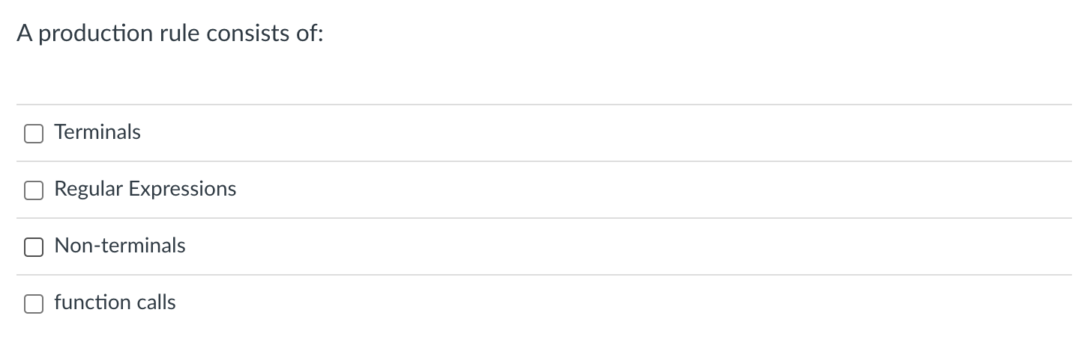
Quiz
Start out-of-order

Slide 6
Context-free grammar
We will use Backus–Naur form (BNF) form
Production rules contain a sequence of either non-terminals or terminals
In our class, terminals will either be string constants or tokens
Traditionally tokens will be all caps.
Examples:
add_expr ::= NUM ‘+’ NUM
mult_expr ::= NUM ‘*’ NUM
joint_expr ::= add_expr ‘*’ add_expr
simple_expr ::= NUM ‘+’ NUM
| NUM ‘*’ NUM

Slide 7
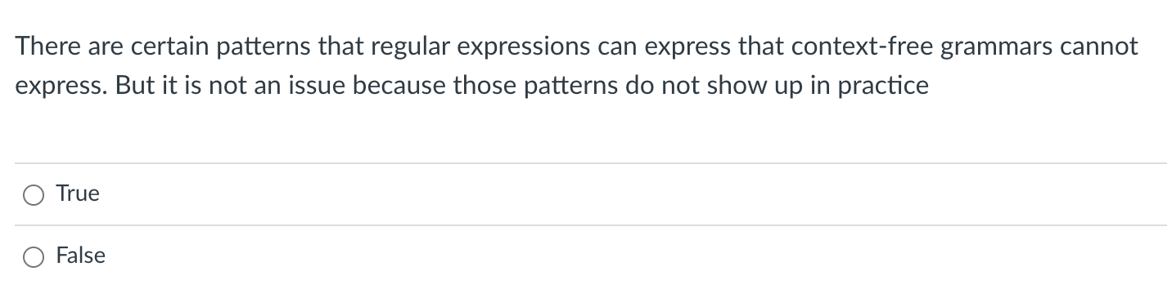
Quiz

Slide 8
Any RE can be expressed in BNF
We just need to show fundamental operators
concat, choice, star

Slide 9
Any RE can be expressed in BNF
We just need to show fundamental operators
concat, choice, star
add_expr ::= NUM ‘+’ NUM

Slide 10
Any RE can be expressed in BNF
We just need to show fundamental operators
concat, choice, star
simple_expr ::= NUM ‘+’ NUM
| NUM ‘*’ NUM

Slide 11
Any RE can be expressed in BNF
We just need to show fundamental operators
concat, choice, star
How to express “a*” in BNF?
a_star ::= ?

Slide 12
Any RE can be expressed in BNF
We just need to show fundamental operators
concat, choice, star
How to express “a*” in BNF?
a_star ::= ””
| “a”
| “a” a_star

Slide 13
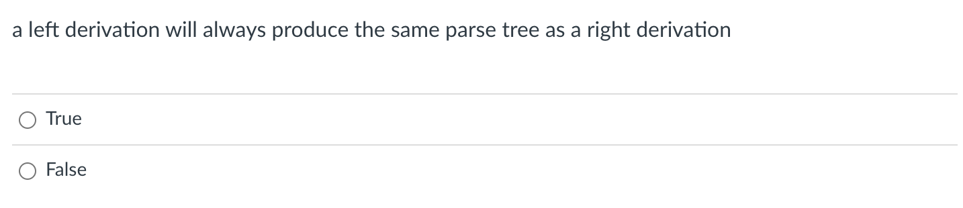
Quiz
We didn’t get this far in the lecture

Slide 14
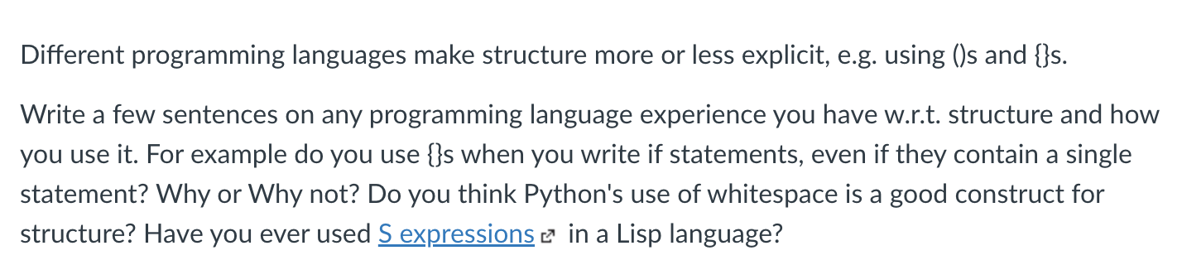
Quiz

Slide 15
Programming language structure
if (x) {
my_var++;
}
vs.
if (x)
my_var++;
Should conditionals require braces?
5 + 6 * 3
vs.
5 + (6 * 3)
should expressions require parenthesis?
(+ 5 (* 6 3))
vs.
(+ 5 (* 6 3))
S expressions (lisp) require explicit structure
What are pros and cons of each?

Slide 16
Programming language structure
int x = 1;
int y = 0;
int check0 = 0;
if (x)
if (y)
pass();
else
check0 = 1;
pop quiz: what is the value of check0 at the end?

Slide 17
Programming language structure
x = 1
y = 0
check0 = 0
if (x):
if (y):
pass
else:
check0 = 1
print(check0)
How does Python handle this?

Slide 18
Programming language structure
x = 1
y = 0
check0 = 0
if (x):
if (y):
pass
else:
check0 = 1
print(check0)
x = 1
y = 0
check0 = 0
if (x):
if (y):
pass
else:
check0 = 1
print(check0)
Invalid syntax, you need to indent, which makes it clear
How does Python handle this?

Slide 19
Review
Regular expressions are insufficient for expressing the language grammar
Mostly because of ()s and {}s

Slide 20
Review: matching () with regex
\(? NUM ((PLUS | MULT) \(? NUM \)?)*
Test RE
5
5 + 6
5 + 6 * 3
But what does this one mean? What if we want different precedence?
(5 + 6) * 3
Can we do this one?

Slide 21
Review: matching () with regex
\(? NUM ((PLUS | MULT) \(? NUM \)?)*
Seems like it works! But what is the issue?
(5 + 6 * 3
What about this one?
()s are a key part of syntax. They are import for the structure we want to create and
we need to reliably detect strings that are not syntactically valid!

Slide 22
Review
How can a CFG handle ()’s
\(? NUM ((PLUS | MULT) \(? NUM \)?)*
As an exercise, how would we express this expression in BNF
- an expression with ()s +, *?
Expr ::=

Slide 23
Review
How can a CFG handle ()’s
\(? NUM ((PLUS | MULT) \(? NUM \)?)*
As an exercise, how would we express this expression in BNF
- an expression with ()s +, *?
Expr ::= NUM
| EXPR PLUS EXPR
| EXPR MULT EXPR
| \( EXPR \)

Slide 24
Review
How to derive strings from a context free grammar

Slide 25
Deriving strings
Give each production rule a numeric id
1: SheepNoise ::= ‘baa’ SheepNoise
2: | ‘baa’
RULE | Sentential Form
start | SheepNoise
RULE | Sentential Form
start | SheepNoise

Slide 26
Deriving strings
Give each production rule a numeric id
1: SheepNoise ::= ‘baa’ SheepNoise
2: | ‘baa’
RULE | Sentential Form
start | SheepNoise
2 | baa
RULE | Sentential Form
start | SheepNoise
1 | baa SheepNoise
2 | baa baa

Slide 27
Case study in string derivation: CSmith

Slide 28
Case study in string derivation: CSmith
Using a CFG, you can derive random strings in a language
C-Smith
Generates random C programs
Used to test compiler correctness
clang -00
run
Random C program
Check outcome. Is it the same? if not, then there is a bug in one of the compilers
clang -03
run
gcc ...
run

Slide 29
Case study
400+ compiler bugs found
Demo
clang -00
run
Random C program
Check outcome. Is it the same? if not, then there is a bug in one of the compilers
clang -03
run
gcc ...
run

Slide 30
Case study
int main() {
int x;
printf("%d\n", x);
return 0;
}
Big challenge: Undefined behavior
Even though the program is syntactically valid, the behavior may be undefined
Uninitialized variables can return
anything!
Use advanced compiler analysis
to catch these issues
clang -00
run
Random C program
Check outcome. Is it the same? if not, then there is a bug in one of the compilers
clang -03
run
gcc ...
run

Slide 31
Moving on to new material
We are going to start with the derivation we did at the end of class last time

Slide 32
A more complicated derivation
1: Expr ::= ‘(’ Expr ‘)’
2: | Expr Op ID
3: | ID
4: Op ::= ‘+’
5: Op | ‘*’
Can we derive the string (a+b)*c
RULE | Sentential Form
start | Expr

Slide 33
A more complicated derivation
1: Expr ::= ‘(’ Expr ‘)’
2: | Expr Op ID
3: | ID
4: Op ::= ‘+’
5: Op | ‘*’
Can we derive the string (a+b)*c
RULE | Sentential Form
start | Expr
2 | Expr Op ID
5 | Expr * ID
1 | (Expr) * ID
2 | (Expr Op ID) * ID
4 | (Expr + ID) * ID
3 | (ID + ID) * ID

Slide 34
A more complicated derivation
1: Expr ::= ‘(’ Expr ‘)’
2: | Expr Op ID
3: | ID
4: Op ::= ‘+’
5: Op | ‘*’
Can we derive the string (a+b)*c
We can visualize this as a tree:
RULE | Sentential Form
start | Expr
2 | Expr Op ID
5 | Expr * ID
1 | (Expr) * ID
2 | (Expr Op ID) * ID
4 | (Expr + ID) * ID
3 | (ID + ID) * ID
Expr

Slide 35
A more complicated derivation
1: Expr ::= ‘(’ Expr ‘)’
2: | Expr Op ID
3: | ID
4: Op ::= ‘+’
5: Op | ‘*’
Can we derive the string (a+b)*c
We can visualize this as a tree:
RULE | Sentential Form
start | Expr
2 | Expr Op ID
5 | Expr * ID
1 | (Expr) * ID
2 | (Expr Op ID) * ID
4 | (Expr + ID) * ID
3 | (ID + ID) * ID
Expr
Expr
Op
(ID, c)

Slide 36
A more complicated derivation
1: Expr ::= ‘(’ Expr ‘)’
2: | Expr Op ID
3: | ID
4: Op ::= ‘+’
5: Op | ‘*’
Can we derive the string (a+b)*c
We can visualize this as a tree:
RULE | Sentential Form
start | Expr
2 | Expr Op ID
5 | Expr * ID
1 | (Expr) * ID
2 | (Expr Op ID) * ID
4 | (Expr + ID) * ID
3 | (ID + ID) * ID
Expr
Expr
Op
(ID, c)
*

Slide 37
A more complicated derivation
1: Expr ::= ‘(’ Expr ‘)’
2: | Expr Op ID
3: | ID
4: Op ::= ‘+’
5: Op | ‘*’
Can we derive the string (a+b)*c
We can visualize this as a tree:
RULE | Sentential Form
start | Expr
2 | Expr Op ID
5 | Expr * ID
1 | (Expr) * ID
2 | (Expr Op ID) * ID
4 | (Expr + ID) * ID
3 | (ID + ID) * ID
Expr
Expr
Op
(ID, c)
(
Expr
)
*

Slide 38
A more complicated derivation
1: Expr ::= ‘(’ Expr ‘)’
2: | Expr Op ID
3: | ID
4: Op ::= ‘+’
5: Op | ‘*’
Can we derive the string (a+b)*c
We can visualize this as a tree:
RULE | Sentential Form
start | Expr
2 | Expr Op ID
5 | Expr * ID
1 | (Expr) * ID
2 | (Expr Op ID) * ID
4 | (Expr + ID) * ID
3 | (ID + ID) * ID
Expr
Expr
Op
(ID, c)
(
Expr
)
*
Expr
Op
(ID, b)

Slide 39
A more complicated derivation
1: Expr ::= ‘(’ Expr ‘)’
2: | Expr Op ID
3: | ID
4: Op ::= ‘+’
5: Op | ‘*’
Can we derive the string (a+b)*c
We can visualize this as a tree:
RULE | Sentential Form
start | Expr
2 | Expr Op ID
5 | Expr * ID
1 | (Expr) * ID
2 | (Expr Op ID) * ID
4 | (Expr + ID) * ID
3 | (ID + ID) * ID
Expr
Expr
Op
(ID, c)
(
Expr
)
*
Expr
Op
(ID, b)
+

Slide 40
A more complicated derivation
1: Expr ::= ‘(’ Expr ‘)’
2: | Expr Op ID
3: | ID
4: Op ::= ‘+’
5: Op | ‘*’
Are there other ways to derive(a+b)*c?
We can visualize this as a tree:
RULE | Sentential Form
start | Expr
2 | Expr Op ID
5 | Expr * ID
1 | (Expr) * ID
2 | (Expr Op ID) * ID
4 | (Expr + ID) * ID
3 | (ID + ID) * ID
Expr
Expr
Op
(ID, c)
(
Expr
)
*
Expr
Op
(ID, b)
(ID, a)
+

Slide 41
A more complicated derivation
1: Expr ::= ‘(’ Expr ‘)’
2: | Expr Op ID
3: | ID
4: Op ::= ‘+’
5: Op | ‘*’
Are there other ways to derive(a+b)*c?
RULE | Sentential Form
start | Expr
2 | Expr Op ID
5 | Expr * ID
1 | (Expr) * ID
2 | (Expr Op ID) * ID
4 | (Expr + ID) * ID
3 | (ID + ID) * ID
RULE | Sentential Form
start | Expr

Slide 42
A more complicated derivation
1: Expr ::= ‘(’ Expr ‘)’
2: | Expr Op ID
3: | ID
4: Op ::= ‘+’
5: Op | ‘*’
Are there other ways to derive(a+b)*c?
RULE | Sentential Form
start | Expr
2 | Expr Op ID
5 | Expr * ID
1 | (Expr) * ID
2 | (Expr Op ID) * ID
4 | (Expr + ID) * ID
3 | (ID + ID) * ID
RULE | Sentential Form
start | Expr
2 | Expr Op ID
1 | (Expr) Op ID
2 | (Expr Op ID) Op ID
3 | (ID Op ID) Op ID
4 | (ID + ID) Op ID
5 | (ID + ID) + ID
right derivation
left derivation

Slide 43
A more complicated derivation
1: Expr ::= ‘(’ Expr ‘)’
2: | Expr Op ID
3: | ID
4: Op ::= ‘+’
5: Op | ‘*’
Are there other ways to derive(a+b)*c?
Expr
RULE | Sentential Form
start | Expr
2 | Expr Op ID
1 | (Expr) Op ID
2 | (Expr Op ID) Op ID
3 | (ID Op ID) Op ID
4 | (ID + ID) Op ID
5 | (ID + ID) + ID
Expr
Op
(ID, c)
(
Expr
)
*
Expr
Op
(ID, b)
same parse tree
(ID, a)
+
left derivation

Slide 44
Ambiguous grammars
What happens when different derivations have different parse trees?
1: Statement ::= ”if” Expr “then” Statement “else” Statement
2: | ”if” Expr “then” Statement
3: | Assignment
4: | ....
can we derive this string?
if Expr₁ then if Expr₂ then Assignment₁ else Assignment₂
Next few figures taken from the EAC book (Chapter 3.1)

Slide 45
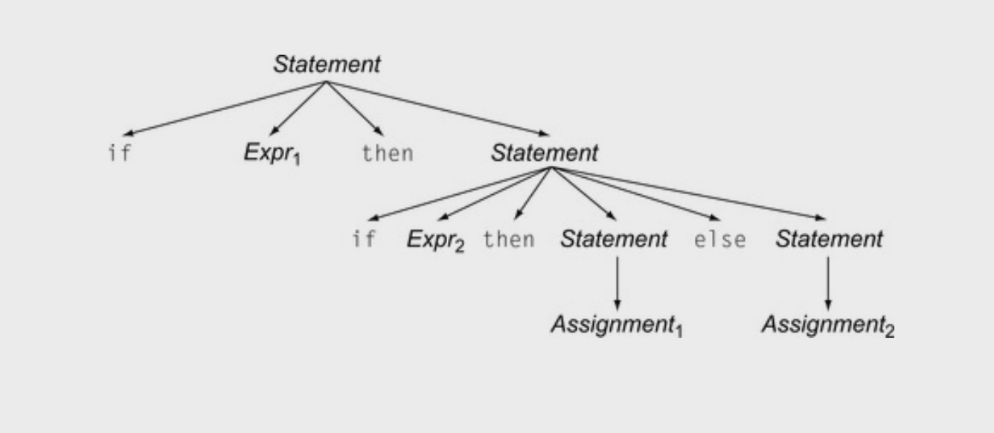
Ambiguous grammars
1: Statement ::= ”if” Expr “then” Statement “else” Statement
2: | ”if” Expr “then” Statement
3: | Assignment
4: | ....
if Expr₁ then if Expr₂ then Assignment₁ else Assignment₂

Slide 46
Ambiguous grammars
1: Statement ::= ”if” Expr “then” Statement “else” Statement
2: | ”if” Expr “then” Statement
3: | Assignment
4: | ....
if Expr₁ then if Expr₂ then Assignment₁ else Assignment₂
Valid derivation

Slide 47
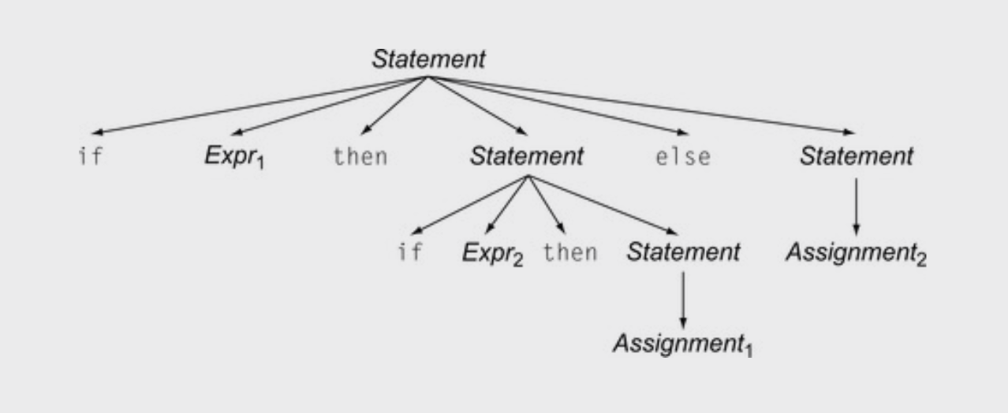
Ambiguous grammars
1: Statement ::= ”if” Expr “then” Statement “else” Statement
2: | ”if” Expr “then” Statement
3: | Assignment
4: | ....
if Expr₁ then if Expr₂ then Assignment₁ else Assignment₂
Valid derivation

Slide 48
Ambiguous grammars
1: Statement ::= ”if” Expr “then” Statement “else” Statement
2: | ”if” Expr “then” Statement
3: | Assignment
4: | ....
if Expr₁ then if Expr₂ then Assignment₁ else Assignment₂
Valid derivation
Also a valid derivation

Slide 49
Ambiguous grammars
Is this an issue? Don’t we only care if a grammar can derive a string?
Valid derivation
Also a valid derivation

Slide 50
Meaning into structure
We want to start encoding meaning into the parse structure. We will want as much structure as possible as we continue through the compiler
The structure is that we want evaluation of program to correspond to a post order traversal of the parse tree (also called the natural traversal)

Slide 51
Post order traversal
visiting for for different types
of traversals:
pre order?
in order?
post order?

Slide 52
Post order traversal
3
visiting for for different types
of traversals:
post order
1
2

Slide 53
Post order traversal
What if you have more children?
post order

Slide 54
Post order traversal
5
What if you have more children?
post order
1
2
3
4

Slide 55
Ambiguous grammars
When we encode meaning into structure, these are very different programs
Valid derivation
Also a valid derivation

Slide 56
Ambiguous expressions
First lets define tokens:
NUM = ”[0-9]+”
PLUS = ‘\+’
TIMES = ’\*’
LP = ‘\(’
RP = \)’
Expr :== NUM
| Expr PLUS Expr
| Expr TIMES Expr
| LP Expr RP
Lets define a simple expression language

Slide 57
Parse trees examples
input: 5
expr ::= NUM
| expr PLUS expr
| expr TIMES expr
| LPAREN expr RPAREN
expr

Slide 58
Parse trees examples
input: 5
expr ::= NUM
| expr PLUS expr
| expr TIMES expr
| LPAREN expr RPAREN
expr
<NUM, 5>

Slide 59
Parse trees examples
input: 5*6
expr ::= NUM
| expr PLUS expr
| expr TIMES expr
| LPAREN expr RPAREN

Slide 60
Parse trees examples
input: 5*6
expr ::= NUM
| expr PLUS expr
| expr TIMES expr
| LPAREN expr RPAREN
expr

Slide 61
Parse trees examples
input: 5*6
expr ::= NUM
| expr PLUS expr
| expr TIMES expr
| LPAREN expr RPAREN
expr
expr
<TIMES>
expr

Slide 62
Parse trees examples
input: 5*6
expr ::= NUM
| expr PLUS expr
| expr TIMES expr
| LPAREN expr RPAREN
expr
expr
<TIMES>
expr
<NUM, 5>
<NUM, 6>

Slide 63
Parse trees examples
input: 5**6
What happens in an error?
expr ::= NUM
| expr PLUS expr
| expr TIMES expr
| LPAREN expr RPAREN
expr

Slide 64
Parse trees examples
input: 5**6
What happens in an error?
expr ::= NUM
| expr PLUS expr
| expr TIMES expr
| LPAREN expr RPAREN
expr
expr
<TIMES>
expr

Slide 65
Parse trees examples
input: 5**6
What happens in an error?
expr ::= NUM
| expr PLUS expr
| expr TIMES expr
| LPAREN expr RPAREN
expr
expr
<TIMES>
expr
<NUM, 5>
<TIMES>
<NUM, 6>
Not possible!

Slide 66
Parse trees examples
input: (1+5)*6
expr ::= NUM
| expr PLUS expr
| expr TIMES expr
| LPAREN expr RPAREN

Slide 67
Parse trees examples
input: (1+5)*6
expr ::= NUM
| expr PLUS expr
| expr TIMES expr
| LPAREN expr RPAREN
expr

Slide 68
Parse trees examples
input: (1+5)*6
expr ::= NUM
| expr PLUS expr
| expr TIMES expr
| LPAREN expr RPAREN
expr
expr
<TIMES>
expr

Slide 69
Parse trees examples
input: (1+5)*6
expr ::= NUM
| expr PLUS expr
| expr TIMES expr
| LPAREN expr RPAREN
expr
expr
<TIMES>
expr
<NUM, 6>

Slide 70
Parse trees examples
input: (1+5)*6
expr ::= NUM
| expr PLUS expr
| expr TIMES expr
| LPAREN expr RPAREN
expr
expr
<TIMES>
expr
<LPAREN>
expr
<RPAREN>
<NUM, 6>

Slide 71
Parse trees examples
input: (1+5)*6
expr ::= NUM
| expr PLUS expr
| expr TIMES expr
| LPAREN expr RPAREN
expr
expr
<TIMES>
expr
<LPAREN>
expr
<RPAREN>
<NUM, 6>
expr
<PLUS>
expr

Slide 72
Parse trees examples
input: (1+5)*6
expr ::= NUM
| expr PLUS expr
| expr TIMES expr
| LPAREN expr RPAREN
expr
expr
<TIMES>
expr
<LPAREN>
expr
<RPAREN>
<NUM, 6>
expr
<PLUS>
expr
<NUM, 1>
<NUM, 5>

Slide 73
Parse trees examples
Does this parse tree capture the structure we want?
input: (1+5)*6
expr ::= NUM
| expr PLUS expr
| expr TIMES expr
| LPAREN expr RPAREN
expr
expr
<TIMES>
expr
<LPAREN>
expr
<RPAREN>
<NUM, 6>
expr
<PLUS>
expr
<NUM, 1>
<NUM, 5>

Slide 74
Parse trees
How about: 1 + 5 * 6
expr ::= NUM
| expr PLUS expr
| expr TIMES expr
| LPAREN expr RPAREN

Slide 75
Parse trees
How about: 1 + 5 * 6
expr
expr ::= NUM
| expr PLUS expr
| expr TIMES expr
| LPAREN expr RPAREN
expr
<TIMES>
expr
expr
<PLUS>
expr
<NUM, 6>
<NUM, 1>
<NUM, 5>

Slide 76
Ambiguous grammars
expr ::= NUM
| expr PLUS expr
| expr TIMES expr
| LPAREN expr RPAREN
input: 1 + 5 * 6
expr
expr
<TIMES>
expr
expr
<PLUS>
expr
<NUM, 6>
<NUM, 1>
<NUM, 5>

Slide 77
Ambiguous grammars
expr ::= NUM
| expr PLUS expr
| expr TIMES expr
| LPAREN expr RPAREN
input: 1 + 5 * 6
expr
expr
expr
expr
expr
<PLUS>
expr
<TIMES>
expr
expr
<NUM, 1>
expr
<TIMES>
expr
<PLUS>
<NUM, 6>
<NUM, 1>
<NUM, 5>
<NUM, 5>
<NUM, 6>

Slide 78
Avoiding Ambiguity
How to avoid ambiguity related to precedence?
Define precedence: ambiguity comes from conflicts. Explicitly define how to deal with conflicts, e.g. write* has higher precedence than +
Some parser generators support this, e.g. Yacc

Slide 79
Avoiding Ambiguity
How to avoid ambiguity related to precedence?
Second way: new production rules
One non-terminal for each level of precedence
lowest precedence at the top
highest precedence at the bottom
Lets try with expressions and the following:
+ * ()

Slide 80
Avoiding Ambiguity
Precedence
increases going down
How to avoid ambiguity related to precedence?
Second way: new production rules
One non-terminal for each level of precedence
lowest precedence at the top
highest precedence at the bottom
Lets try with expressions and the following:
+ * ()
Operator | Name | Productions
+ | expr | : expr PLUS expr | term
* | term | : term TIMES term | factor
() | factor | : LPAREN expr RPAREN | NUM

Slide 81
Now lets create a parse tree
input: 1+5*6
Operator | Name | Productions
+ | expr | : expr PLUS expr | term
* | term | : term TIMES term | factor
() | factor | : LPAREN expr RPAREN | NUM

Slide 82
Now lets create a parse tree
input: 1+5*6
expr
Operator | Name | Productions
+ | expr | : expr PLUS expr | term
* | term | : term TIMES term | factor
() | factor | : LPAREN expr RPAREN | NUM

Slide 83
Now lets create a parse tree
input: 1+5*6
expr
Operator | Name | Productions
+ | expr | : expr PLUS expr | term
* | term | : term TIMES term | factor
() | factor | : LPAREN expr RPAREN | NUM
expr
<PLUS>
expr

Slide 84
Now lets create a parse tree
input: 1+5*6
expr
Operator | Name | Productions
+ | expr | : expr PLUS expr | term
* | term | : term TIMES term | factor
() | factor | : LPAREN expr RPAREN | NUM
expr
<PLUS>
expr
term
factor
<NUM, 1>

Slide 85
Now lets create a parse tree
input: 1+5*6
expr
Operator | Name | Productions
+ | expr | : expr PLUS expr | term
* | term | : term TIMES term | factor
() | factor | : LPAREN expr RPAREN | NUM
expr
<PLUS>
expr
term
term
factor
<NUM, 1>

Slide 86
Now lets create a parse tree
input: 1+5*6
expr
Operator | Name | Productions
+ | expr | : expr PLUS expr | term
* | term | : term TIMES term | factor
() | factor | : LPAREN expr RPAREN | NUM
expr
<PLUS>
expr
term
term
term
<TIMES>
term
factor
<NUM, 1>

Slide 87
Now lets create a parse tree
input: 1+5*6
expr
Operator | Name | Productions
+ | expr | : expr PLUS expr | term
* | term | : term TIMES term | factor
() | factor | : LPAREN expr RPAREN | NUM
expr
<PLUS>
expr
term
term
term
<TIMES>
term
factor
factor
factor
<NUM, 1>
<NUM, 5>
<NUM, 6>

Slide 88
Parsing REs
Let’s try it for regular expressions, {| . * ()}
Assume . is concat
Operator | Name | Productions

Slide 89
Parsing REs
Let’s try it for regular expressions, {| . * ()}
Assume . is concat
Operator | Name | Productions
| | choice | : choice PIPE choice | concat
. | concat | : concat DOT concat | starred
* | starred | : starred STAR | unit
() | unit | : LPAREN choice RPAREN | CHAR

Slide 90
Parsing REs
input: a.b | c*
Let’s try it for regular expressions, {| . * ()}
Assume . is concat
Operator | Name | Productions
| | choice | : choice PIPE choice | concat
. | concat | : concat DOT concat | starred
* | starred | : starred STAR | unit
() | unit | : LPAREN choice RPAREN | CHAR

Slide 91
Parsing REs
input: a.b | c*
Let’s try it for regular expressions, {| . * ()}
Assume . is concat
union
Operator | Name | Productions
| | choice | : choice PIPE choice | concat
. | concat | : concat DOT concat | starred
* | starred | : starred STAR | unit
() | unit | : LPAREN choice RPAREN | CHAR
union
<|>
union
concat
concat
concat
<.>
concat
starred
starred
starred
unit
<*>
unit
unit
<CHAR, c>
<CHAR, a>
<CHAR ,b>

Slide 92
How many levels of precedence does C have?
https://en.cppreference.com/w/c/language/operator_precedence

Slide 93
Have we removed all ambiguity?

Slide 94
Let’s make some more parse trees
input: 2+3+4
Operator | Name | Productions
+ | expr | : expr PLUS expr | term
* | term | : term TIMES term | factor
() | factor | : LP expr RP | NUM

Slide 95
Let’s make some more parse trees
input: 2+3+4
expr
Operator | Name | Productions
+ | expr | : expr PLUS expr | term
* | term | : term TIMES term | factor
() | factor | : LP expr RP | NUM
expr
<PLUS>
expr
term
expr
<PLUS>
expr
term
term
factor
factor
factor
<NUM, 2>
<NUM, 3>
<NUM, 4>

Slide 96
This is ambiguous, is it an issue?
input: 2+3+4
expr
expr
expr
<PLUS>
expr
expr
<PLUS>
expr
expr
<PLUS>
expr
term
term
expr
<PLUS>
expr
term
term
factor
term
term
factor
factor
factor
<NUM, 4>
factor
factor
<NUM, 2>
<NUM, 2>
<NUM, 3>
<NUM, 3>
<NUM, 4>

Slide 97
What about for a different operator?
input: 2-3-4

Slide 98
What about for a different operator?
input: 2-3-4
expr
expr
expr
<MINUS>
expr
expr
<MINUS>
expr
expr
<MINUS>
expr
term
term
expr
<MINUS>
expr
term
term
factor
term
term
factor
factor
factor
<NUM, 4>
factor
factor
<NUM, 2>
<NUM, 2>
<NUM, 3>
<NUM, 3>
<NUM, 4>
Which one is right?

Slide 99
Associativity
Describes the order in which apply the same operator
Sometimes it doesn’t matter:
When?

Slide 100
Associativity
Describes the order in which apply the same operator
Sometimes it doesn’t matter:
Integer arithmetic
Integer multiplication
Good test:
((a OP b) OP c) == (a OP (b OP c))
What about floating point arithmetic?
These operators
are said to be associative

Slide 101
Associativity
If an operator is not associative then we define
left to right (left-associative)
2-3-4 is evaluated as ((2-3) - 4)
What other operators are left-associative
right-to-left (right-associative)
Any operators you can think of?

Slide 102
Associativity
If an operator is not associative then we define
left to right (left-associative)
2-3-4 is evaluated as ((2-3) - 4)
What other operators are left-associative
right-to-left (right-associative)
Assignment, power operator

Slide 103
How to encode associativity?
Like precedence, some tools (e.g. YACC) allow associativity specification through keywords:
“+”: left, “^”: right
Like precedence, we can also encode it into the production rules

Slide 104
Associativity for a single operator
input: 2-3-4
expr
expr
<MINUS>
expr
Operator | Name | Productions
- | expr | : expr MINUS expr | NUM
<NUM, 2>
expr
<MINUS>
expr
<NUM, 3>
<NUM, 4>

Slide 105
Associativity for a single operator
input: 2-3-4
expr
expr
<MINUS>
expr
Operator | Name | Productions
- | expr | : expr MINUS NUM | NUM
<NUM, 2>
expr
<MINUS>
expr
<NUM, 3>
<NUM, 4>
No longer allowed

Slide 106
Associativity for a single operator
input: 2-3-4
expr
expr
<MINUS>
<NUM,?>
Operator | Name | Productions
- | expr | : expr MINUS NUM | NUM
Lets start over

Slide 107
Associativity for a single operator
input: 2-3-4
expr
expr
<MINUS>
<NUM,4>
Operator | Name | Productions
- | expr | : expr MINUS NUM | NUM

Slide 108
Associativity for a single operator
input: 2-3-4
expr
expr
<MINUS>
<NUM,4>
Operator | Name | Productions
- | expr | : expr MINUS NUM | NUM
expr
<MINUS>
<NUM,3>

Slide 109
Associativity for a single operator
input: 2-3-4
expr
expr
<MINUS>
<NUM,4>
Operator | Name | Productions
- | expr | : expr MINUS NUM | NUM
expr
<MINUS>
<NUM, 3>
<NUM, 2>

Slide 110
Should you have associativity when its not required?
input: 2+3+4
Benefits?
Drawbacks?
expr
expr
<PLUS>
<NUM,4>
Operator | Name | Productions
+ | expr | : expr PLUS expr | NUM
expr
<PLUS>
<NUM, 3>
<NUM, 2>

Slide 111
Should you have associativity when its not required?
input: 2+3+4
Benefits?
Drawbacks?
expr
expr
<PLUS>
<NUM,4>
Operator | Name | Productions
+ | expr | : expr PLUS expr | NUM
expr
<PLUS>
<NUM, 3>
<NUM, 2>
Good design principle to avoid ambiguous grammars,
even when strictly not required too.
Helps with debugging, etc. etc.
Many tools will warn if it detects ambiguity

Slide 112
Let’s make a richer expression grammar
Let’s do operators [+,*,-,/,^] and()
Operator | Name | Productions
Tokens:
NUM = “[0-9]+”
PLUS = ‘\+’
TIMES = ’\*’
LP = ‘\(’
RP = \)’ MINUS = ‘-’
DIV = ‘/’
CARROT =’ \^’

Slide 113
Let’s make a richer expression grammar
Let’s do operators [+,*,-,/,^] and()
Operator | Name | Productions
+,- | expr | : expr PLUS term | expr MINUS term | term
*,/ | term | : term TIMES pow | term DIV pow | pow
^ | pow | : factor CARROT pow | factor
() | factor | : LPAR expr RPAR | NUM
Tokens:
NUM = “[0-9]+”
PLUS = ‘\+’
TIMES = ’\*’
LP = ‘\(’
RP = \)’ MINUS = ‘-’
DIV = ‘/’
CARROT =’ \^’

Slide 114
What associativities does C have?
https://en.cppreference.com/w/c/language/operator_precedence

Slide 115
Next time: algorithms for syntactic analysis
Top down parsing
oracle parsing
removing left recursion
constructing lookahead sets

