Slide 1
CSE110A: Compilers April 4, 2022
The dog ran across the park
ARTICLE
NOUN
VERB
PREPOSITION
ARTICLE
NOUN
Topics:
Lexical Analysis:
Short comings of naïve scanner
Regular expressions:
Recursive definition
Syntactic sugar
groups

Slide 2
Announcements
HW 1 will be released by midnight tonight
You have what you need to start working on part 1
You will have what you need for part 2 after Wednesday
You will have what you need for part 3 after Friday
Due one week from today (by midnight)
We will have office hours this week, come see us!

Slide 3
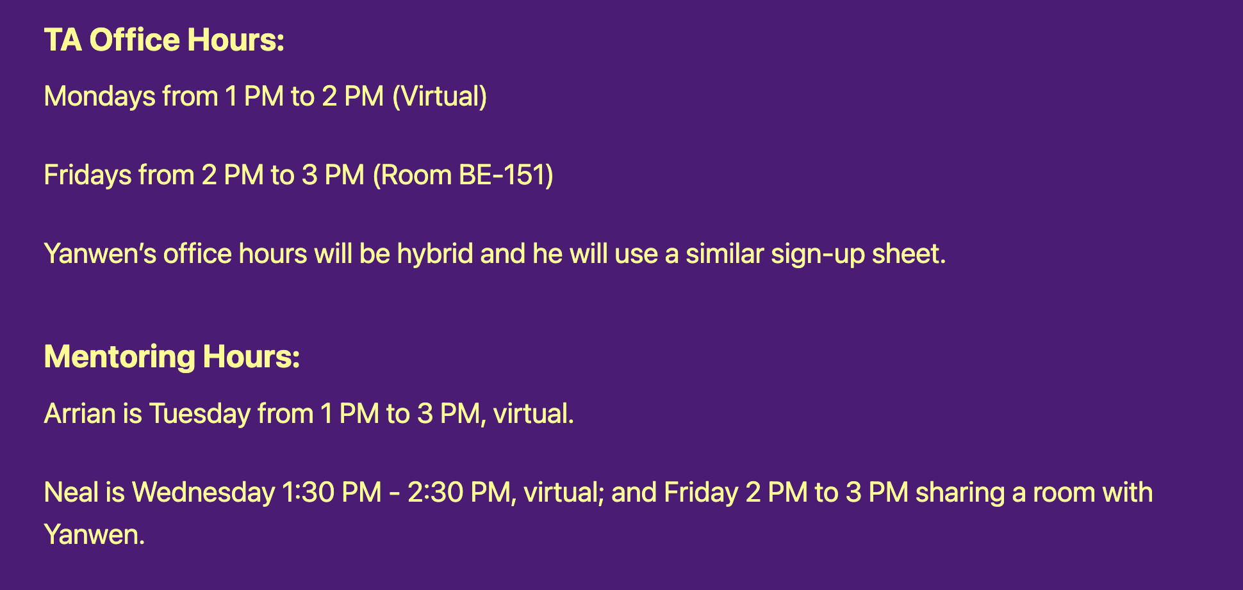
Announcements
My office hours:
Thursday, 3 - 5 PM
Sign-up sheet goes live around noon
10 minute slots
Other office hours:

Slide 4
Announcements
Docker setup instructions are available
https://sorensenucsc.github.io/CSE110A-sp2022/homework-setup.html
We will add the required software needed for the HWs to the docker image.
Please try this out over the next few days and let us know if you have issues
Your code must run in the docker to be graded!
There can be tons of tiny differences when developing Python natively
If you want packages installed globally, let us know!

Slide 5
Quiz

Slide 6
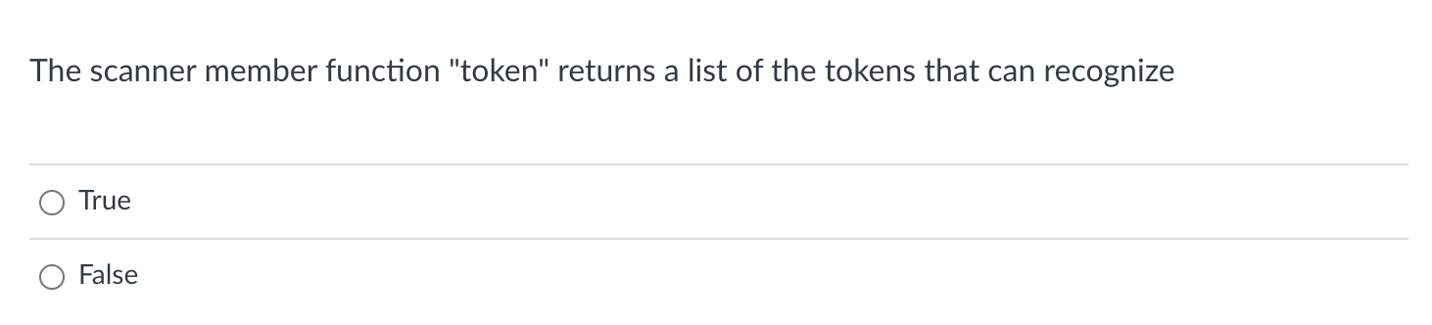
Scanner API

Slide 7
Programs for Lexical Analysis
Scanner (sometimes called lexer)
Defined by a list of tokens and definitions:
Original program:
Lex
https://en.wikipedia.org/wiki/Lex_(software)
ARTICLE = {The, A, My, Your}
NOUN = {Dog, Car, Computer}
VERB = {Ran, Crashed, Accelerated}
ADJECTIVE = {Purple, Spotted, Old}
Popular implementations
Flex
Tokens
Tokens Definitions

Slide 8
Scanner API
# Constructor, generates a Scanner
s = ScannerGenerator(tokens)
# The string we want to do # lexical analysis on
s.input(“My Old Computer Crashed“)
# Returns the next lexeme
s.token()

Slide 9
> s = ScanerGenerator(tokens) > s.input(“My Old Computer Crashed”) > s.token() (ARTICLE, “My”)
> s.token() (ADJECTIVE, “Old”)
> s.token() (NOUN, “Computer”)
> s.token() (VERB, “Crashed”) > s.token() None

Slide 10
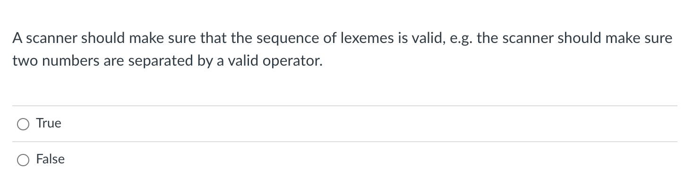
Scanning vs. Parsing

Slide 11
Programs for Lexical Analysis
Scanner (sometimes called lexer)
Defined by a list of tokens and definitions:
Original program:
Lex
https://en.wikipedia.org/wiki/Lex_(software)
ARTICLE = {The, A, My, Your}
NOUN = {Dog, Car, Computer}
VERB = {Ran, Crashed, Accelerated}
ADJECTIVE = {Purple, Spotted, Old}
Popular implementations
Flex
Tokens
Tokens Definitions

Slide 12
Parsing is the first step in a compiler
How do we parse a sentence in English?
My dog ran across the park
ARTICLE
NOUN
VERB
PREPOSITION
ARTICLE
NOUN

Slide 13
Parsing is the first step in a compiler
How do we parse a sentence in English?
My My My My My My
ARTICLE
ARTICLE
ARTICLE
ARTICLE
ARTICLE
ARTICLE
Lexical analysis doesn’t care about the order of tokens. Just so long as there are valid tokens.

Slide 14
Programs for Lexical Analysis
Scanner (sometimes called lexer)
Defined by a list of tokens and definitions:
Original program:
Lex
https://en.wikipedia.org/wiki/Lex_(software)
ARTICLE = {The, A, My, Your}
NOUN = {Dog, Car, Computer}
VERB = {Ran, Crashed, Accelerated}
ADJECTIVE = {Purple, Spotted, Old}
Popular implementations
Flex
Tokens
Tokens Definitions

Slide 15
Parsing is the first step in a compiler
How do we parse a sentence in English?
My My Quietly My My My
What happens here?

Slide 16
Parsing is the first step in a compiler
How do we parse a sentence in English?
My My Quietly My My
ARTICLE
ARTICLE
?
What happens here?
Scanner error here. Many scanners stop and report the error location

Slide 17
Parsing is the first step in a compiler
How do we parse a sentence in English?
My My Quietly My My
ARTICLE
ARTICLE
?
ARTICLE
ARTICLE
What happens here?
Scanner error here. Some scanners try to recover and keep going (difficult, and requires ad hoc rules)

Slide 18
Scanning vs. Parsing
False! The order of tokens will be checked by the parser later on!

Slide 19
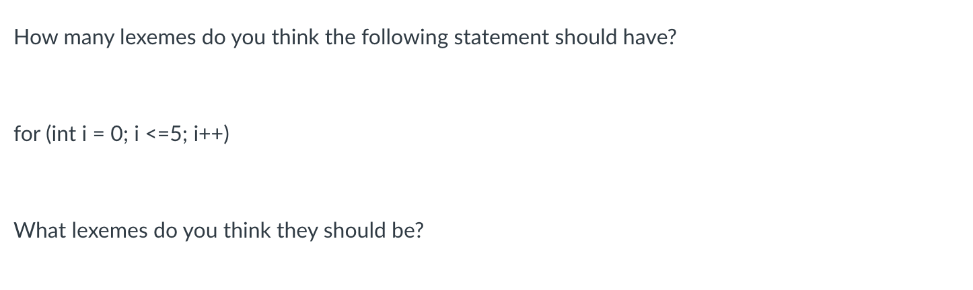
Scanning a simple PL statement

Slide 20
Scanning a simple PL statement
for (int i = 0; i <= 5; i++)

Slide 21
Scanning a simple PL statement
for (int i = 0; i <= 5; i++)
[(ID, “for”), (PAR, “(“), (ID, “int”), (ID, “i”),
(ASSIGN, “=“), (NUM, “0”), (SEMI, “;”), (ID, “i”),
(LE, “<=“), (NUM, “5”), (SEMI, “;”), (ID, “i”), (INCR, “++”), (PAR, “)”)]

Slide 22
Scanning a simple PL statement
for (int i = 0; i <= 5; i++)
[(ID, “for”), (PAR, “(“), (ID, “int”), (ID, “i”),
(ASSIGN, “=“), (NUM, “0”), (SEMI, “;”), (ID, “i”),
(LE, “<=“), (NUM, “5”), (SEMI, “;”), (ID, “i”), (INCR, “++”), (PAR, “)”)]
Why not: ”<“ and “=“ separately?

Slide 23
Scanning a simple PL statement
for (int i = 0; i <= 5; i++)
[(ID, “for”), (PAR, “(“), (ID, “int”), (ID, “i”),
(ASSIGN, “=“), (NUM, “0”), (SEMI, “;”), (ID, “i”),
(LE, “<=“), (NUM, “5”), (SEMI, “;”), (ID, “i”), (INCR, “++”), (PAR, “)”)]
Should these be the same token?

Slide 24
Scanning a simple PL statement
for (int i = 0; i <= 5; i++)
[(ID, “for”), (LPAR, “(“), (ID, “int”), (ID, “i”),
(ASSIGN, “=“), (NUM, “0”), (SEMI, “;”), (ID, “i”),
(LE, “<=“), (NUM, “5”), (SEMI, “;”), (ID, “i”), (INCR, “++”), (RPAR, “)”)]
Should these be the same token? Probably not

Slide 25
Review

Slide 26
Naïve implementation
A scanner that implements
ID = [characters]
NUM = [numbers]
ASSIGN = ”=“
PLUS = “+”
MULT = “*”
IGNORE = [“ “]

Slide 27
Naïve implementation
Building block:
class StringStream:
def __init__(self, input_string):
self.string = input_string
def is_empty(self):
return len(self.string) == 0
def peek_char(self):
if not self.is_empty():
return self.string[0]
return None
def eat_char(self):
self.string = self.string[1:]

Slide 28
Naïve implementation
First step in implementing the scanner
class NaiveScanner:
def __init__(self, input_string):
self.ss = StringStream(input_string)
def token(self):
while self.ss.peek_char() in IGNORE:
self.ss.eat_char()
if self.ss.is_empty():
return None
ID = [characters]
NUM = [numbers]
ASSIGN = ”=“
PLUS = “+”
MULT = “*”
IGNORE = [“ “]

Slide 29
Naïve implementation
First step in implementing the scanner
class NaiveScanner:
def token(self):
...
if self.ss.peek_char() == "+":
value = self.ss.peek_char()
self.ss.eat_char()
return ("ADD", value)
if self.ss.peek_char() == "*":
value = self.ss.peek_char()
self.ss.eat_char()
return ("MULT", value)
ID = [characters]
NUM = [numbers]
ASSIGN = ”=“
PLUS = “+”
MULT = “*”
IGNORE = [“ “]

Slide 30
Naïve implementation
First step in implementing the scanner
class NaiveScanner:
def token(self):
...
if self.ss.peek_char() in NUMS:
value = ""
while self.ss.peek_char() in NUMS:
value += self.ss.peek_char()
self.ss.eat_char()
return ("NUM", value)
ID = [characters]
NUM = [numbers]
ASSIGN = ”=“
PLUS = “+”
MULT = “*”
IGNORE = [“ “]

Slide 31
Schedule
Naïve Parser:
Code demo and discussion
Regular expressions

Slide 32
Code Demo

Slide 33
Shortcomings of Naïve scanner
Any thoughts?

Slide 34
Shortcomings of Naïve scanner
IDs with numbers in them?
x1, y1, etc.
how would you solve?
Numbers with a decimal point in them?
4.5, 9999.99998
how would you solve this?
Two character operators:
++, +=
how would you solve this?

Slide 35
Shortcomings of Naïve scanner
IDs with numbers in them?
x1, y1, etc.
how would you solve?
Numbers with a decimal point in them?
4.5, 9999.99998
how would you solve this?
Two character operators:
++, +=
how would you solve this?
Things get really hacky really quickly!
Creates a bad design that is
not easily extended
or maintained

Slide 36
How do we solve this?
A new token definition language:
Regular expressions
Tokens will be defined using regular expressions
Scanners can then utilize regular expression matchers
Benefits:
Extensible design
easy to add new tokens, modify existing definitions
Modular
Scanner can utilize common regex libraries
Cons:
Token definitions are restricted to regular languages
Potentially slower
Regular expression matchers are complicated

Slide 37
How do we solve this?
A new token definition language:
Regular expressions
Tokens will be defined using regular expressions
Scanners can then utilize regular expression matchers
Benefits:
Extensible design
easy to add new tokens, modify existing definitions
Modular
Scanner can utilize common regex libraries
Cons:
Token definitions are restricted to regular languages
Potentially slower
Regular expression matchers are complicated

Slide 38
Schedule
Naïve Parser:
Code demo and discussion
Regular expressions

Slide 39
Regular expressions
Some theory:
Given a language L, a string s is either part of that language or not
Integers are a language: “5”, “6”, “-7” is in the language. “abc” is not.
Languages are grouped into families depending on how “hard” it is to determine if a string is part of that language.

Slide 40
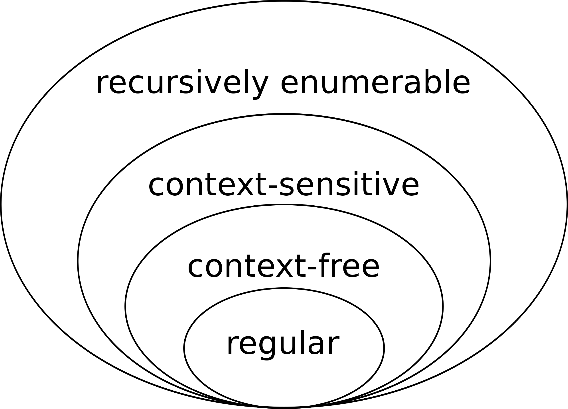
Regular expressions
The simplest languages are regular. We will use regular languages as our token language. We will use the next level: context-free, as the
language for our parser. Higher levels are interesting, but not as useful
in compilers. Why?
image source: wikipedia

Slide 41
Regular expressions
The simplest languages are regular. We will use regular languages as our token language. We will use the next level: context-free, as the
language for our parser. Higher levels are interesting, but not as useful
in compilers. Why? Because deciding if a string is in a recursively enumerable language is undecidable.
image source: wikipedia

Slide 42
Regular expressions
What is a regular language?
image source: wikipedia

Slide 43
Regular expressions
What is a regular language?
For this class: A regular language is a language that can be expressed as a regular expression.
image source: wikipedia

Slide 44
Regular expressions
What is a regular language?
For this class: A regular language is a language that can be expressed as a regular expression.
What is a regular expression?
image source: wikipedia

Slide 45
Schedule
Naïve Parser:
Code demo and discussion
Regular expressions

Slide 46
Regular expressions
We will define regular expressions (RE) recursively
We will show examples at each step.
And show to match them in Python
A string matches an RE if it belongs to the regular language defined by the RE
Python has a great RE matching library

Slide 47
Regular expressions
# import the library
import re
# pattern is a string representing the RE
# the function reports whether string matches RE
re.fullmatch(pattern, string)

Slide 48
Regular expressions
We will define regular expressions (RE) recursively
Like any recursive function, we can start with the base case:
a regular expression can be a single character or the empty string

Slide 49
Regular expressions
We will define regular expressions (RE) recursively
Like any recursive function, we can start with the base case:
a regular expression can be a single character or the empty string
Example:
ASSIGN = “=“
PLUS = ”+”
Python:
import re
re.fullmatch(“=“, “=“)
re.fullmatch(“+”, “+”) # what happens here?

Slide 50
Regular expressions
When we define regular expressions, some characters are special.
They are operators in the regular expression language
If we want to use them as a character, then we need to ”escape them” with a \
“+” happens to be one of those characters
https://riptutorial.com/regex/example/15848/what-characters-need-to-be-escaped-
Python:
import re
re.fullmatch(“=“, “=“)
re.fullmatch(“\+”, “+”) # what happens here?

Slide 51
Regular expressions
We will define regular expressions (RE) recursively
Like any recursive function, we can start with the base case:
a regular expression can be a single character or the empty string
Python:
import re
re.fullmatch(““, ““)
Not super useful for us, but useful for the theory

Slide 52
Regular expressions
First recursive case: concatenation
Two REs can be concatenated by simply writing them in sequence:
RE1 = ”a”, RE2 = “b”
concatenated it is: RE12 = “ab”
This allows us to build words
Example:
FOR = “for“
WHILE = ”while”
Python:
import re
re.fullmatch(“for“, “for“)
re.fullmatch(“a+b”, “a+b”) # what happens here?

Slide 53
Can we define these tokens yet?
ARTICLE = {The, A, My, Your}
NOUN = {Dog, Car, Computer}
VERB = {Ran, Crashed, Accelerated}
ADJECTIVE = {Purple, Spotted, Old}
Tokens
Tokens Definitions

Slide 54
Can we define these tokens yet? No, we need one more operator
ARTICLE = {The, A, My, Your}
NOUN = {Dog, Car, Computer}
VERB = {Ran, Crashed, Accelerated}
ADJECTIVE = {Purple, Spotted, Old}
Tokens
Tokens Definitions

Slide 55
Regular expressions
Second recursive operator: choice (sometimes called ”union”, or “or”)
Two REs can be choiced together using the “|” operator
RE1 = “a”, RE2 = “b”
The choice is: RE1|2 = “a|b”
Matches either
Example:
OP = “*|+“
CMP = “==|<=|>=”
Python:
import re
re.fullmatch(“*|+“, “+“)
re.fullmatch(“==|<=|>=”, “==”)

Slide 56
Can we define these tokens yet?
ARTICLE = {The, A, My, Your}
NOUN = {Dog, Car, Computer}
VERB = {Ran, Crashed, Accelerated}
ADJECTIVE = {Purple, Spotted, Old}
Tokens
Tokens Definitions

Slide 57
Can we define these tokens yet? Yes!
ARTICLE = “The|A|Mine|Your”
NOUN = “Dog|Car|Computer”
VERB = “Ran|Crashed|Accelerated”
ADJECTIVE = “Purple|Spotted|Old”
Tokens
Tokens Definitions

Slide 58
Can we define these tokens yet?
ID = [characters]
NUM = [numbers]
ASSIGN = ”=“
PLUS = “+”
MULT = “*”
IGNORE = [“ “]

Slide 59
Can we define these tokens yet? No!
ID = [characters]
NUM = [numbers]
ASSIGN = ”=“
PLUS = “+”
MULT = “*”
IGNORE = [“ “]

Slide 60
Regular expressions
Last recursive operator: Repeat
Unary operator: *
RE1 = “a”
Repeat RE1 zero or more times: ”a*”
Example:
RE1 = “a*“
RE2 = “a*|b*”
RE3 = ”a|b*
Python:
import re
re.fullmatch(“a*|b*“, “aaa“)
re.fullmatch(“a*|b*”, “”)

Slide 61
Regular expressions
Last recursive operator: Repeat
Unary operator: *
RE1 = “a”
Repeat RE1 zero or more times: ”a*”
Example:
RE1 = “a*“
RE2 = “a*|b*”
RE3 = ”a|b*
Python:
import re
re.fullmatch(“a*|b*“, “aaa“)
re.fullmatch(“a*|b*”, “”)
Precidence?

Slide 62
Regular expressions
Lets make an RE for binary numbers
Lets make an RE for decimal numbers

Slide 63
Regular expressions
These are the theoretical foundational operators.
Most languages give syntactic sugar to make common cases easier
Most languages also break the theory
Perl regexes are extremely complicated
https://www.perlmonks.org/?node_id=809842
Python regexes (with recursion) are can capture context free languages
https://www.npopov.com/2012/06/15/The-true-power-of-regular-expressions.html#matching-context-free-languages

Slide 64
Regular expressions
strict repeat operator: +
one or more repeats (the * operator is 0 or more repeats)
derivation: “r+” = “rr*”
Let’s revisit binary numbers and decimal numbers
“(0|1)+”

Slide 65
Regular expressions
Ranges:
digits [0-9]
alpha [a-z], [A-Z]
Derivation: [0-9] = ”1|2|3|4|5|6|7|8|9”
Lets try C style IDs:
Hexadecimal numbers:

Slide 66
Regular expressions
Ranges:
digits [0-9]
alpha [a-z], [A-Z]
Derivation: [0-9] = ”1|2|3|4|5|6|7|8|9”
Lets try C style IDs: “[a-zA-Z][0-9a-zA-Z]*”
Hexadecimal numbers: “0x[0-9a-fA-F]”

Slide 67
Regular expressions
optional operator ?
optional characters
“r?” = “|r”
Example: “ab?”
Let’s do simple floating point numbers

Slide 68
Regular expressions
optional operator ?
optional characters
“r?” = “|r”
Example: “ab?”
Let’s do simple floating point numbers: “[0-9]+(\.[0-9]+)?”

Slide 69
Regular expressions
any character ‘.’
example using email (this is probably too general!)

Slide 70
Regular expressions
any character ‘.’
example using email (this is probably too general!)
”.*@.*\.com”

Slide 71
Using REs
What if we want either the domain or user name from the email?
We can use groups!
use ()s to deliminate groups
”(.*)@(.*\.com)”
Index the resulting object with [1] and [2] to get to the user name and domain respectively

Slide 72
Using REs
you can give groups id names rather than using indices
“(?P<name>.+)@(?P<domain>.+\.com)”

Slide 73
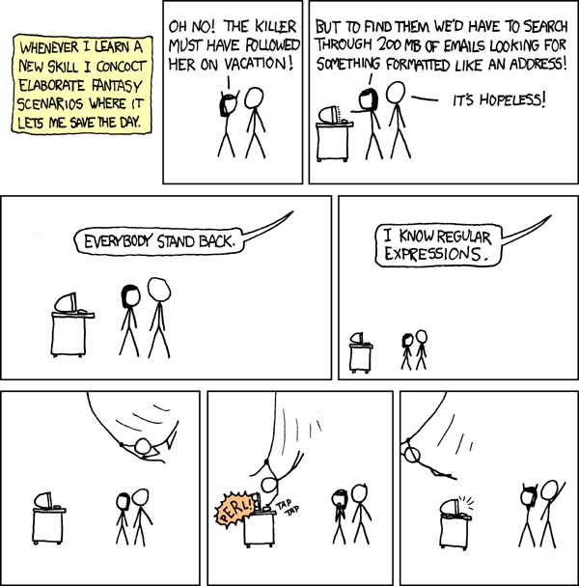
RE examples
XKCD comic
https://xkcd.com/208/

Slide 74
REs are good for?
Scanning large amounts of documents quickly, looking for:
Websites
Email
Profiling numbers
Variable usages
What else?

Slide 75
RE examples
What can REs not do?
Nested structures, such as parathesis matching:
Try doing arithmetic expressions
You will not be able to match ()s
Classical example: REs cannot capture same number of repeats:
A{N}B{N}
REs cannot parse HTML!!!
One of the most upvoted answers on stackoverflow!
https://stackoverflow.com/questions/1732348/regex-match-open-tags-except-xhtml-self-contained-tags/1732454#1732454

Slide 76
Let’s write our tokens as regular expressions
For our simple programming language
ID = [characters]
NUM = [numbers]
ASSIGN = ”=“
PLUS = “+”
MULT = “*”
IGNORE = [“ “]

Slide 77
How to implement an RE matcher?
Overview: first you have to parse the RE...
Chicken and egg problem
The language of REs is not a regular language. It is context sensitive (because it has ()s)
But once you can parse the RE, there are several options

Slide 78
How to implement an RE matcher?
parsing with derivatives
We discuss this in CSE211
Elegant solution, but difficult to make fast
Convert to an automata
Learn more about this CSE103
A cool website
https://ivanzuzak.info/noam/webapps/fsm_simulator/

Slide 79
How to use REs in a scanner implementation?
We will discuss next class
See you on Wednesday!

