Slide 1
CSE110A: Compilers May 6, 2022
..
AST
..
..
..
..
Topics:
more 3-address code
converting AST to 3-address code
converting control flow statements to 3-address code
CFG
...
...
...
...
3 address code
store i32 0, ptr %2
%3 = load i32, ptr %1
%4 = add nsw i32 %3, 1,
store i32 %4, ptr %1
%5 = load i32, ptr %2

Slide 2
Announcements
HW 1 grades are released
You have until Monday to let us know about any issues
Midterm is out
There is a piazza post with clarifications
No late midterms will be accepted
My advice is to try to turn it in by tonight
that way if there are any issues, you have until Friday to turn it in
As always, no help guaranteed outside of business hours
After 5 PM on Friday, you are on your own

Slide 3
Announcements
Expect HW 3 on Monday by midnight
It will be similar to HW 2 in terms of workload and conceptual depth
I suggest you start early
HW 2 was difficult, but most of our office hours had slots in the first week it was assigned!
It will build on the parser of HW 2
You can use your own with some small modifications
or we will provide one
The idea is that you should be able to plug in parts from all the homeworks to have one big project at the end!

Slide 4
Announcements
Schedule update
We will likely need 1 or 2 more days of the IR module
So we will start the optimization module next Wednesday or Friday
I’ll adjust the schedule accordingly
With homeworks:
Originally scheduled to have 5 homeworks but due to time constraints, we will likely only have 4 homeworks.
It’s the first time I’m teaching this class. All of the homeworks, exams, and lectures are new, so we’ve had to adapt.
Apologies to those who want more compiler homeworks. You can always take CSE211 if you are interested ☺

Slide 5
Quiz

Slide 6
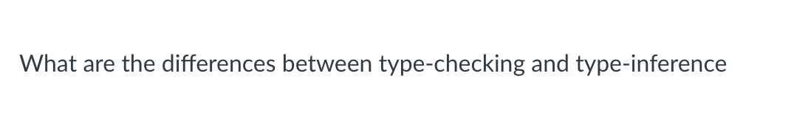
Quiz

Slide 7
Discussion
Type inference:
Rules about how types convert between each other implicitly
Examples:
2 + 3.0
int x = 6.0
7.0 < 6.0
Assigns a type to each expression
Type checking:
Happens during type inference.
If a type cannot be given to an expression then it raises an error
Examples?

Slide 8
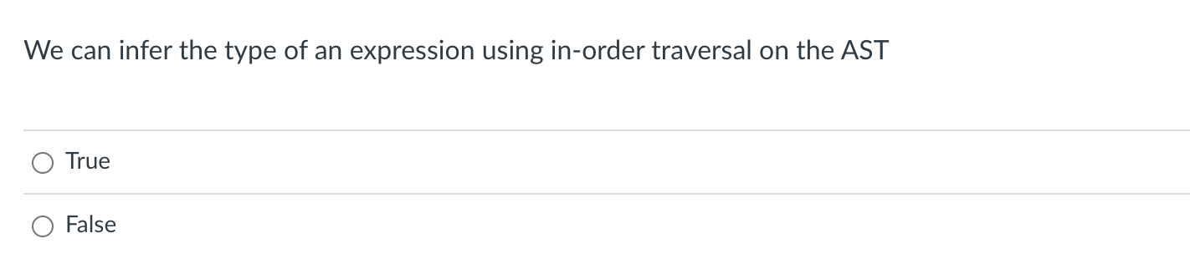
Quiz

Slide 9
Discussion
What is the in order traversal order?

Slide 10
Discussion
What is the in order traversal order?
if this was an AST for: “2 + (3.0 + 5.0)”
AST<+, ?>
2
we cannot evaluate 2 before 4!
1
4
AST<+, ?>
AST<2, int>
3
5
AST<5.0, float>
AST<3.0, float>

Slide 11
Discussion
What is the post order traversal order?
if this was an AST for: “2 + (3.0 + 5.0)”
AST<+, ?>
AST<+, ?>
AST<2, int>
AST<5.0, float>
AST<3.0, float>

Slide 12
Discussion
What is the post order traversal order?
if this was an AST for: “2 + (3.0 + 5.0)”
AST<+, ?>
5
Now we can do type inference
1
4
AST<+, ?>
AST<2, int>
2
3
AST<5.0, float>
AST<3.0, float>

Slide 13
Discussion
What is the post order traversal order?
if this was an AST for: “2 + (&c + 5.0)”
AST<+, ?>
5
How does this change things?
1
4
AST<+, ?>
AST<2, int>
2
3
AST<5.0, float>
AST<&c, ptr>

Slide 14
Discussion
Example
Does this express pass C’s type checking?
int *c;
int x;
c + x = 6.0;

Slide 15
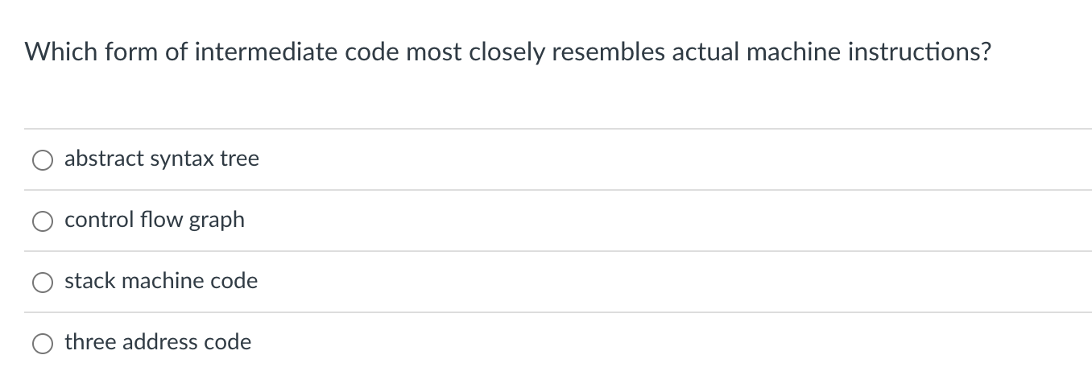
Quiz

Slide 16
Discussion
AST
3 - address code
AST<+,float>
store i32 0, ptr %2
%3 = load i32, ptr %1
%4 = add nsw i32 %3, 1,
store i32 %4, ptr %1
%5 = load i32, ptr %2
AST<+,int>
AST<5.5, float>
AST<x, int>
AST<y, int>
Much closer to machine code
Much closer to parse tree

Slide 17
Different IRs
Several types of linear code:
1 address code
2 address code
3 address code
used for stack machines, some ideas are used in the JVM and
web assembly. Creates compact code
push 2
push 4
multiply
push 8
subtract
Execute this code as an exercise

Slide 18
Different IRs
Several types of linear code:
1 address code
2 address code
3 address code
used for stack machines, some ideas are used in the JVM and
web assembly. Creates compact code
Stack machine can be a useful IR, but I’m not sure any machine that actually uses it. Jeremy mentioned that the original Nintendo processor used 2-address code for its ISA.
In those cases the destination registration is built into the instruction

Slide 19
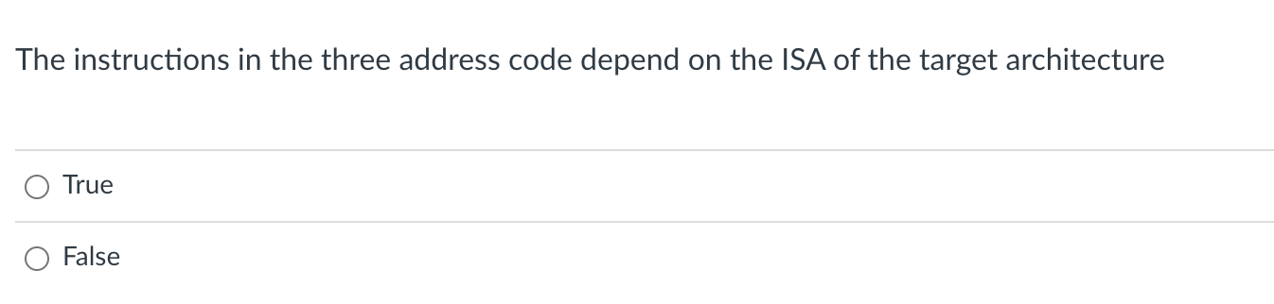
Quiz

Slide 20
Discussion
book
this class
LLVM IR
r₀ ← x + y;
r₁ ← 5 * 7;
r₂ ← r₀ / r₁
vr0 = addi(x,y);
vr1 = multi(5,7);
vr2 = divi(vr0,vr1);
%8 = add nsw i32 %6, %7
%11 = mul nsw i32 5, 7
%15 = sdiv i32 %13, %14
It depends
Your 3-address code should be close enough to make the final translation to ISA easier
But it should be general enough to be able to target many backends.

Slide 21
Discussion
book
this class
LLVM IR
r₀ ← x + y;
r₁ ← 5 * 7;
r₂ ← r₀ / r₁
vr0 = addi(x,y);
vr1 = multi(5,7);
vr2 = divi(vr0,vr1);
%8 = add nsw i32 %6, %7
%11 = mul nsw i32 5, 7
%15 = sdiv i32 %13, %14
Types are a consideration here
It depends
Your 3-address code should be close enough to make the final translation to ISA easier
But it should be general enough to be able to target many backends.

Slide 22
Discussion
book
this class
LLVM IR
r₀ ← x + y;
r₁ ← 5 * 7;
r₂ ← r₀ / r₁
vr0 = addi(x,y);
vr1 = multi(5,7);
vr2 = divi(vr0,vr1);
%8 = add nsw i32 %6, %7
%11 = mul nsw i32 5, 7
%15 = sdiv i32 %13, %14
Virtual registers are a consideration here e.g., how many, if they are typed, etc.
Types are a consideration here
It depends
Your 3-address code should be close enough to make the final translation to ISA easier
But it should be general enough to be able to target many backends.

Slide 23
Review
We went over some of this stuff pretty quickly last time

Slide 24
3-address code
We will call our code Class-IR
Example:
Virtual registers
vr0 = addi(x,y);
vr1 = multi(5,7);
vr2 = divi(vr0,vr1);
typed instructions

Slide 25
3-address code
What does this code do?
Control flow in 3 address code
Similar to an ISA:
We have labels
and branch instructions
branch x - branch unconditionally to label z
bne x,y,z - branch to z if x and y are not equal
label0:
vr0 = addi(x,y);
vr1 = multi(5,7);
vr2 = divi(vr0,vr1);
branch label0;
vr3 = ...
vr4 = ...

Slide 26
3-address code
What does this code do?
Control flow in 3 address code
Similar to an ISA:
We have labels
and branch instructions
branch x - branch unconditionally to label z
bne x,y,z - branch to z if x and y are not equal
label0:
vr0 = addi(vr0,-1);
bne vr2 0 label0;
vr3 = ...
vr4 = ...

Slide 27
Class-IR
A deeper dive
You will need to be familiar with this language for the next two homeworks
It is untyped
checks your type inference
There is a slightly modified version of Class-IR that can compile and execute in C++, which is how you will test it

Slide 28
Class-IR
Inputs/outputs: 32-bit typed inputs
e.g.: int x, int y, float z
Types: 32-bit untyped virtual register
given as vrX where X is an integer:
e.g. vr0, vr1, vr2, vr3 ...
we will assume input/output names are disjoint from virtual register names

Slide 29
Class-IR
binary operators:
dst = operation(op0, op1);
operations can be one of:
[add, sub, mult, div, eq, lt]
each operation is followed by an i or f, which specifies how the bits in the registers are interpreted

Slide 30
Class-IR
binary operators:
dst = operation(op0, op1);
operations can be one of:
[add, sub, mult, div, eq, lt]
each operation is followed by an i or f, which specifies how the bits in the registers are interpreted
this gets us closer to assembly

Slide 31
Class-IR
binary operators:
dst = operation(op0, op1);
operations can be one of:
[add, sub, mult, div, eq, lt]
each operation is followed by an i or f, which specifies how the bits in the registers are interpreted
We should have an AST binary operator for each of these. They should also be close
to your production rules in the grammar. We want to make translations as easy as possible!

Slide 32
Class-IR
binary operators:
dst = operation(op0, op1);
operations can be one of:
[add, sub, mult, div, eq, lt]
all of dst, op0, and op1 must be untyped virtual registers.

Slide 33
Class-IR
binary operators:
dst = operation(op0, op1);
Examples:
vr0 = addi(vr1, vr2);
vr3 = subf(vr4, vr5);
x = multf(vr0, vr1); not allowed!
vr0 = addi(vr1, 1); not allowed!
We’ll talk about how to do this using other instructions

Slide 34
Class-IR
Control flow
branch(label);
branches unconditionally to the label
bne(op0, op1, label)
if op0 is not equal to op1 then branch to label
operands must be virtual registers!
beq(op0, op1, label)
Same as bne except it is for equal

Slide 35
Class-IR
Assignment
vr0 = vr1
one virtual register can be assigned to another

Slide 36
Class-IR
Assignment
vr0 = vr1
one virtual register can be assigned to another
Examples:
vr0 = 1; not allowed
vr1 = x; not allowed

Slide 37
Class-IR
unary conversion operators:
dst = operation(op0);
operations can be one of:
[vr_int2float, vr_float2int]
converts the bits in a virtual register from one type to another. op0 and dst must be a virtual register!

Slide 38
Class-IR
unary conversion operators:
dst = operation(op0);
Examples:
vr0 = vr_int2float(vr1);
vr2 = vr_float2int(1.0); not allowed!

Slide 39
Class-IR
unary get typed data
dst = operation(op0);
operations are: [vr2int, vr2float]
Example:
x = vr2int(vr1);
y = vr2float(vr3);
Given inputs: int x and float y

Slide 40
Class-IR
unary get untyped register
dst = operation(op0);
operations are: [int2vr, float2vr]
Example:
rv1 = int2vr(x);
rv2 = float2vr(2.0);
Given inputs: int x and float y

Slide 41
Example
adding the values 1 - 9 in to an input/output variable: int x

Slide 42
Example
adding the values 1 - 9 in to an input/output variable: int x
vr0 = int2vr(1);
vr1 = int2vr(1);
vr2 = int2vr(10);
loop_start:
vr3 = lti(vr0, vr2);
bne(vr3, vr1, end_label);
vr4 = int2vr(x);
vr5 = addi(vr4,r0);
x = vr2int(vr5);
vr0 = addi(vr0, vr1);
branch(loop_start);
end_label:

Slide 43
Converting AST into Class-IR
int x;
int y;
float w; w = x + y + 5.5
After type inference
AST<+,float>
AST<int2float, float>
AST<+,int>
AST<5.5, float>
AST<x, int>
AST<y, int>

Slide 44
Converting AST into Class-IR
int x;
int y;
float w; w = x + y + 5.5
After type inference
We will start by adding a new
member to each AST node: A virtual register
Each node needs a distinct virtual register
AST<+,float, vr5>
AST<int2float, float, vr3>
AST<+,int, vr2>
AST<5.5, float, vr4>
AST<x, int, vr0>
AST<y, int, vr1>

Slide 45
A reminder on where we are with our code
Our base AST Node needs a virtual register
class ASTNode():
def __init__(self):
self.node_type = None
self.vr = None
pass
def set_vr(self, r):
self.vr = r
def get_vr(self):
return self.vr
A simple class that can allocate virtual registers
class VRAllocator():
def __init__(self):
self.count = 0
def get_new_register(self):
vr = "vr" + str(self.count)
self.count += 1
return vr

Slide 46
A reminder on where we are with our code
To provide each node in the AST a virtual node,
simply traverse the tree (any order), get a new
virtual register, and set the virtual register
Our base AST Node needs a virtual register
class ASTNode():
def __init__(self):
self.node_type = None
self.vr = None
pass
def set_vr(self, r):
self.vr = r
def get_vr(self):
return self.vr
A simple class that can allocate virtual registers
class VRAllocator():
def __init__(self):
self.count = 0
def get_new_register(self):
vr = "vr" + str(self.count)
self.count += 1
return vr

Slide 47
Converting AST into Class-IR
int x;
int y;
float w; w = x + y + 5.5
Next each AST node needs
to know how to print a
3 address instruction
After type inference
AST<+,float, vr5>
AST<int2float, float, vr3>
AST<+,int, vr2>
AST<5.5, float, vr4>
AST<x, int, vr0>
AST<y, int, vr1>

Slide 48
Converting AST into Class-IR
int x;
int y;
float w; w = x + y + 5.5
Next each AST node needs
to know how to print a
3 address instruction
Let’s look at add
After type inference
AST<+,float, vr5>
AST<int2float, float, vr3>
AST<+,int, vr2>
AST<5.5, float, vr4>
AST<x, int, vr0>
AST<y, int, vr1>

Slide 49
class ASTPlusNode(ASTBinOpNode):
def __init__(self, l_child, r_child):
super().__init__(l_child,r_child)
# return a string of the three address instruction
# that this node encodes
def three_addr_code(self): ??

Slide 50
class ASTPlusNode(ASTBinOpNode):
def __init__(self, l_child, r_child):
super().__init__(l_child,r_child)
# return a string of the three address instruction
# that this node encodes
def three_addr_code(self): ??
return "%s = %s(%s,%s);" % (self.vr, self.get_op(), self.l_child.vr, self.r_child.vr)

Slide 51
class ASTPlusNode(ASTBinOpNode):
def __init__(self, l_child, r_child):
super().__init__(l_child,r_child)
# return a string of the three address instruction
# that this node encodes
def three_addr_code(self): ??
return "%s = %s(%s,%s);" % (self.vr, self.get_op(), self.l_child.vr, self.r_child.vr)
What is this one?

Slide 52
def get_op(self):
if self.node_type is Types.INT:
return "addi"
else:
return "addf"
return "%s = %s(%s,%s);" % (self.vr, self.get_op(), self.l_child.vr, self.r_child.vr)
What is this one?

Slide 53
AST<+,float, vr5>
def get_op(self):
if self.node_type is Types.INT:
return "addi"
else:
return "addf"
AST<int2float, float, vr3>
AST<+,int, vr2>
AST<5.5, float, vr4>
AST<x, int, vr0>
AST<y, int, vr1>
return "%s = %s(%s,%s);" % (self.vr, self.get_op(), self.l_child.vr, self.r_child.vr)

Slide 54
AST<+,float, vr5>
def get_op(self):
if self.node_type is Types.INT:
return "addi"
else:
return "addf"
AST<int2float, float, vr3>
AST<+,int, vr2>
AST<5.5, float, vr4>
AST<x, int, vr0>
AST<y, int, vr1>
return "%s = %s(%s,%s);" % (self.vr, self.get_op(), self.l_child.vr, self.r_child.vr)
vr2 = addi(vr0,vr1);

Slide 55
Converting AST into Class-IR
int x;
int y;
float w; w = x + y + 5.5
Next each AST node needs
to know how to print a
3 address instruction
Let’s look at a leaf
After type inference
AST<+,float, vr5>
AST<int2float, float, vr3>
AST<+,int, vr2>
AST<5.5, float, vr4>
AST<x, int, vr0>
AST<y, int, vr1>

Slide 56
class ASTIDNode(ASTLeafNode):
def __init__(self, value, value_type):
super().__init__(value)
self.set_type(value_type)
# return a string of the three address instruction
# that this node encodes
def three_addr_code(self):
??

Slide 57
class ASTIDNode(ASTLeafNode):
def __init__(self, value, value_type):
super().__init__(value)
self.set_type(value_type)
# return a string of the three address instruction
# that this node encodes
def three_addr_code(self):
??
return "%s = %s(%s);" % (self.vr, self.get_op(), self.value)

Slide 58
def get_op(self):
if self.node_type is Types.INT:
return ”int2vr"
else:
return ”float2vr"
return "%s = %s(%s);" % (self.vr, self.get_op(), self.value)

Slide 59
AST<+,float, vr5>
def get_op(self):
if self.node_type is Types.INT:
return ”int2vr"
else:
return ”float2vr"
AST<int2float, float, vr3>
AST<+,int, vr2>
AST<5.5, float, vr4>
AST<x, int, vr0>
AST<y, int, vr1>
return "%s = %s(%s);" % (self.vr, self.get_op(), self.value)
vr4 = float2vr(5.5);

Slide 60
int x;
int y;
float w; w = x + y + 5.5
we can get 3 address instructions for each node
AST<+,float, vr5>
AST<int2float, float, vr3>
AST<+,int, vr2>
AST<5.5, float, vr4>
AST<x, int, vr0>
AST<y, int, vr1>

Slide 61
int x;
int y;
float w; w = x + y + 5.5
vr5 = addf(vr3,vr4);
AST<+,float, vr5>
vr3 = vr_int2float(vr2);
AST<int2float, float, vr3>
vr2 = addi(vr0,vr1);
AST<+,int, vr2>
AST<5.5, float, vr4>
vr4 = float2vr(5.5);
AST<x, int, vr0>
AST<y, int, vr1>
vr0 = int2vr(x);
vr1 = int2vr(y);

Slide 62
int x;
int y;
float w; w = x + y + 5.5
vr5 = addf(vr3,vr4);
AST<+,float, vr5>
vr3 = vr_int2float(vr2);
AST<int2float, float, vr3>
vr2 = addi(vr0,vr1);
AST<+,int, vr2>
AST<5.5, float, vr4>
vr4 = float2vr(5.5);
AST<x, int, vr0>
AST<y, int, vr1>
vr0 = int2vr(x);
vr1 = int2vr(y);
What now? We can create a 3 address program doing a post-order traversal

Slide 63
int x;
int y;
float w; w = x + y + 5.5
AST<+,float, vr5>
AST<int2float, float, vr3>
AST<+,int, vr2>
AST<5.5, float, vr4>
AST<x, int, vr0>
AST<y, int, vr1>
Final program
vr0 = int2vr(x);
vr1 = int2vr(y);
We can create a 3 address program doing a post-order traversal
vr2 = addi(vr0,vr1);
vr3 = vr_int2float(vr2);
vr4 = float2vr(5.5);
vr5 = addf(vr3,vr4);

Slide 64
How does this actually look in code?
Each AST node (expression) needs a function:
linearize_expr()
Gives a list of 3 address instructions for the expression
As always, we’re going to use recursion

Slide 65
vr5 = addf(vr3,vr4);
AST<+,float, vr5>
vr3 = vr_int2float(vr2);
AST<int2float, float, vr3>
vr2 = addi(vr0,vr1);
AST<+,int, vr2>
AST<5.5, float, vr4>
vr4 = float2vr(5.5);
AST<x, int, vr0>
AST<y, int, vr1>
vr0 = int2vr(x);
vr1 = int2vr(y);
How do you linearize a leaf node?
class ASTIDNode(ASTLeafNode):
def __init__(self, value, value_type):
super().__init__(value)
self.set_type(value_type)
def linearize_expr(self):
???

Slide 66
vr5 = addf(vr3,vr4);
AST<+,float, vr5>
vr3 = vr_int2float(vr2);
AST<int2float, float, vr3>
vr2 = addi(vr0,vr1);
AST<+,int, vr2>
AST<5.5, float, vr4>
vr4 = float2vr(5.5);
AST<x, int, vr0>
AST<y, int, vr1>
vr0 = int2vr(x);
vr1 = int2vr(y);
How do you linearize a leaf node?
class ASTIDNode(ASTLeafNode):
def __init__(self, value, value_type):
super().__init__(value)
self.set_type(value_type)
def linearize_expr(self):
It needs to return a list, so we just put the leaf’s instruction in the list
return [self.three_addr_code()]

Slide 67
vr5 = addf(vr3,vr4);
AST<+,float, vr5>
vr3 = vr_int2float(vr2);
AST<int2float, float, vr3>
vr2 = addi(vr0,vr1);
AST<+,int, vr2>
AST<5.5, float, vr4>
vr4 = float2vr(5.5);
AST<x, int, vr0>
AST<y, int, vr1>
vr0 = int2vr(x);
vr1 = int2vr(y);
How do you linearize a non leaf node?

Slide 68
vr5 = addf(vr3,vr4);
AST<+,float, vr5>
vr3 = vr_int2float(vr2);
AST<int2float, float, vr3>
vr2 = addi(vr0,vr1);
AST<+,int, vr2>
AST<5.5, float, vr4>
vr4 = float2vr(5.5);
AST<x, int, vr0>
AST<y, int, vr1>
vr0 = int2vr(x);
vr1 = int2vr(y);
How do you linearize a non leaf node?
1. Linearize the children
2. concatenate the lists
3. append your 3 address instruction to the end.

Slide 69
vr5 = addf(vr3,vr4);
do example in class
AST<+,float, vr5>
vr3 = vr_int2float(vr2);
AST<int2float, float, vr3>
vr2 = addi(vr0,vr1);
AST<+,int, vr2>
AST<5.5, float, vr4>
vr4 = float2vr(5.5);
AST<x, int, vr0>
AST<y, int, vr1>
vr0 = int2vr(x);
vr1 = int2vr(y);
How do you linearize a non leaf node?
1. Linearize the children
2. concatenate the lists
3. append your 3 address instruction to the end.

Slide 70
Converting ASTs into 3 address code summary
Each node gets a virtual register
Each node needs to implement a function to get a three address instruction
Each node needs a linearize function

Slide 71
Backing up to an even higher level
We know how to parse an expression: parse_expr
We know how to create an AST during parsing
We know how to do type inference on an AST
We know how to convert a type-safe AST into 3 address code

Slide 72
Backing up to an even higher level
We can now define what our parser will return: A list of 3 address code
We can get 3 address code from parsing expressions, now we just need to get it from statements

Slide 73
From our grammar
statement := declaration_statement
| assignment_statement
| if_else statement
| block_statement
| for_loop_statement
Our top down parser should have a function called parse_statement
This should return a list of 3 address code instructions that encode the statment

Slide 74
From our grammar
statement := declaration_statement
| assignment_statement
| if_else statement
| block_statement
| for_loop_statement
Our top down parser should have a function called parse_statement
This should return a list of 3 address code instructions that encode the statment

Slide 75
int x;
int y;
float w; w = x + y + 5.5
assignment_statement_base := ID ASSIGN expr
{
id_name = to_match[1]
eat(“ID”);
eat(“ASSIGN”);
ast = parse_expr()
type_inference(ast)
assign_registers(ast)
program = ast.linearize()
new_inst = “%s = %s” % ?
return program + [new_inst]
}

Slide 76
int x;
int y;
float w; w = x + y + 5.5
assignment_statement_base := ID ASSIGN expr
AST<+,float, vr5>
AST<int2float, float, vr3>
{
id_name = to_match[1]
eat(“ID”);
eat(“ASSIGN”);
ast = parse_expr()
type_inference(ast)
assign_registers(ast)
program = ast.linearize()
new_inst = “%s = %s” % ?
return program + [new_inst]
}
AST<+,int, vr2>
AST<5.5, float, vr4>
AST<x, int, vr0>
AST<y, int, vr1>

Slide 77
int x;
int y;
float w; w = x + y + 5.5
assignment_statement_base := ID ASSIGN expr
AST<+,float, vr5>
AST<int2float, float, vr3>
{
id_name = to_match[1]
eat(“ID”);
eat(“ASSIGN”);
ast = parse_expr()
type_inference(ast)
assign_registers(ast)
program = ast.linearize()
new_inst = “%s = %s” % (id_name, ast.vr)
return program + [new_inst]
}
AST<+,int, vr2>
AST<5.5, float, vr4>
AST<x, int, vr0>
AST<y, int, vr1>

Slide 78
int x;
int y;
float w; w = x + y + 5.5
assignment_statement_base := ID ASSIGN expr
program
vr0 = int2vr(x);
vr1 = int2vr(y);
{
id_name = to_match[1]
eat(“ID”);
eat(“ASSIGN”);
ast = parse_expr()
type_inference(ast)
assign_registers(ast)
program = ast.linearize()
new_inst = “%s = %s” % (id_name, ast.vr)
return program + [new_inst]
}
vr2 = addi(vr0,vr1);
vr3 = vr_int2float(vr2);
vr4 = float2vr(5.5);
vr5 = addf(vr3,vr4);
new inst
w = vr5

Slide 79
int x;
int y;
float w; w = x + y + 5.5
What are we missing here?
1. If the type of ID doesn’t match the type of the ast, then the ast needs to be converted.
2. ID should be checked if it is an input/output variable. which means it will need to be handled differently.
3. You need to check the ID in the symbol table
assignment_statement_base := ID ASSIGN expr
{
id_name = to_match[1]
eat(“ID”);
eat(“ASSIGN”);
ast = parse_expr()
type_inference(ast)
assign_registers(ast)
program = ast.linearize()
new_inst = “%s = %s” % (id_name, ast.vr)
return program + [new_inst]
}

Slide 80
int x;
int y;
float w; w = x + y + 5.5
What are we missing here?
1. If the type of ID doesn’t match the type of the ast, then the ast needs to be converted.
2. ID should be checked if it is an input/output variable. which means it will need to be handled differently.
3. You need to check the ID in the symbol table
assignment_statement_base := ID ASSIGN expr
{
id_name = to_match[1]
eat(“ID”);
eat(“ASSIGN”);
ast = parse_expr()
type_inference(ast)
assign_registers(ast)
program = ast.linearize()
new_inst = “%s = %s” % (id_name, ast.vr)
return program + [new_inst]
}
It can get a little messy

Slide 81
statement := declaration_statement
| assignment_statement
| if_else_statement
| block_statement
| for_loop_statement

Slide 82
if_else_statement := IF LPAR expr RPAR statement ELSE statement
{
eat(“IF”);
eat(“LPAR”);
program0 = # Get program from expr
eat(“RPAR”);
program1 = # Get program from statement
eat(“ELSE”)
program2 = # Get program from statement
...
}

Slide 83
if_else_statement := IF LPAR expr RPAR statement ELSE statement
if (program0) {
program1
}
else {
program2
}
{
eat(“IF”);
eat(“LPAR”);
program0 = # Get program from expr
eat(“RPAR”);
program1 = # Get program from statement
eat(“ELSE”)
program2 = # Get program from statement
...
}
We need to convert this to 3 address code
beq (program0, 0, else_label)
program1;
branch end_label;
else_label:
program2
end_label:

Slide 84
See everyone on Monday
We’ll discuss more about turning statements into 3 address code

