Slide 1
CSE110A: Compilers April 8, 2022
The dog ran across the park
ARTICLE
NOUN
VERB
PREPOSITION
ARTICLE
NOUN
Topics:
Finishing up Scanners
Scanner actions
PLY Scanner

Slide 2
Announcements
HW 1 is released
By the end of today you should have everything that you need
I’ve updated the spec again, there are likely more issues, please let us know!
Part 2 now has the assignment operator
Due April 18 by midnight
We have office hours this week; come see us!
Let us know any feedback you have about the assignments; they are new!

Slide 3
Announcements
Please enroll in Piazza!
Lots of these discussions are happening on Piazza
Please try to set up Docker ASAP
TAs and tutors have been awesome at replying to issues and helping

Slide 4
Announcements
Homework clarifications
For part 2:
what is the behavior of trying to scan: “56.”?
make sure to escape the characters that you need to
As a challenge: I was able to find an additional optimization that improved performance on the SOS and NG scanner by 2x

Slide 5
Announcements
Homework clarifications
Comments about line numbers in ScannerExceptions
Not required
Left over from first draft of homework

Slide 6
Announcements
Like I’ve done in the past, you can discuss your performance with your classmates after the first week that the assignment as been out
Do not discuss your implementation in detail
Do not share code or token definitions
Everyone’s computer is different so performance will not match perfectly.

Slide 7
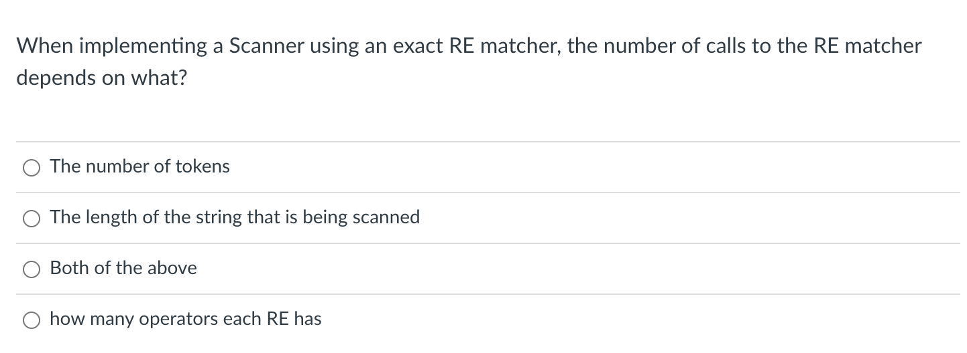
Quiz

Slide 8
EM Scanner
Start with the whole string, remove one character at the end until a match is found. Then return the lexeme
ID = “[a-z]+”
NUM = “[0-9]+”
ASSIGN = ”=“
PLUS = “+”
MULT = “*”
IGNORE = “ |\n” SEMI = “;”
“variable = 50 + 30 * 20;”

Slide 9
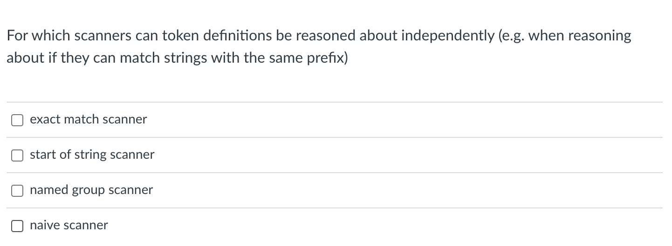
Quiz

Slide 10
EM Scanner
Start with the whole string, remove one character at the end until a match is found. Then return the lexeme
ID = “[a-z]+”
NUM = “[0-9]+”
ASSIGN = ”=“
PLUS = “+”
MULT = “*”
IGNORE = “ |\n” SEMI = “;”
“variable = 50 + 30 * 20;”

Slide 11
SOS Scanner
Consideration
How to scan this string?
Try to match on each token
“CSE110A”
LETTERS = “[A-Z]+”
NUM = “[0-9]+”
CLASS = ”CSE110A“
Two matches:
LETTERS: “CSE”
CLASS: ”CSE110A”
Which one do we choose?

Slide 12
SOS Scanner
One more consideration
Within 1 RE, how does this match?
“CSE110A”
CLASS = “CSE|110A|CSE110A”
Returns “CSE”, but this isn’t what we want!!!
When using the SOS Scanner: A token definition either should not:
contain choices where one choice is a prefix of another
order choices such that the longest choice is the first one
CLASS = “CSE110A|110A|CSE”

Slide 13
How to deal with common prefixes in token definitions?
Convert to a single RE
How to scan this string?
“CSE110A”
SINGLE_RE = “
(?P<LETTERS>([A-Z]+)|
(?P<NUM>([0-9]+)|
(?P<CLASS>CSE110A)”
{”LETTERS” : “CSE”
“NUM” : None
“CLASS” : None
}

Slide 14
Quiz

Slide 15
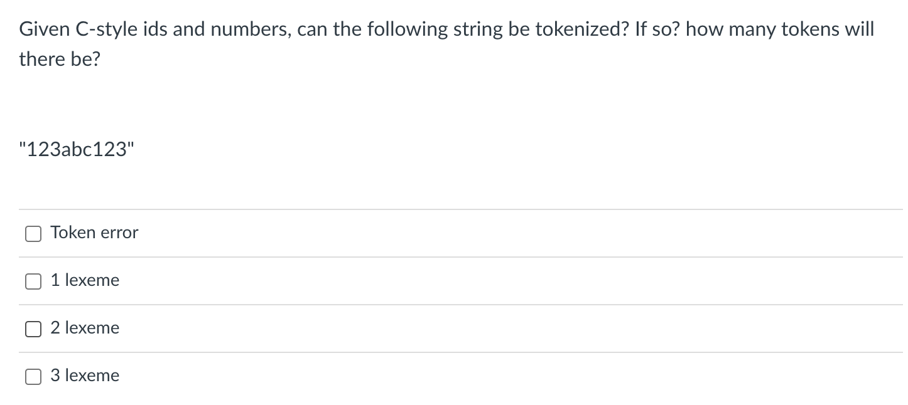
Quiz

Slide 16
tokenizing
“123abc123”
ID = “[a-z][0-9a-z]+”
NUM = “[0-9]+”

Slide 17
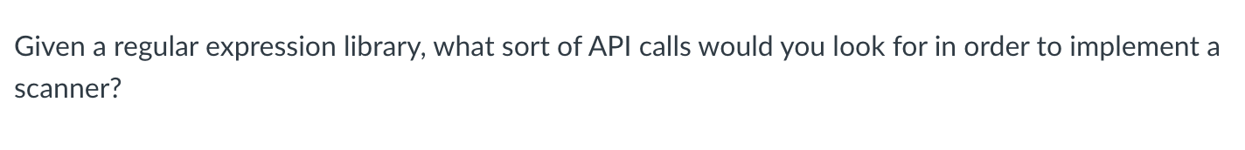
Quiz

Slide 18
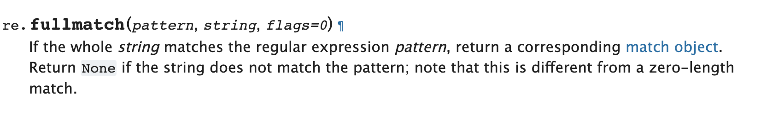
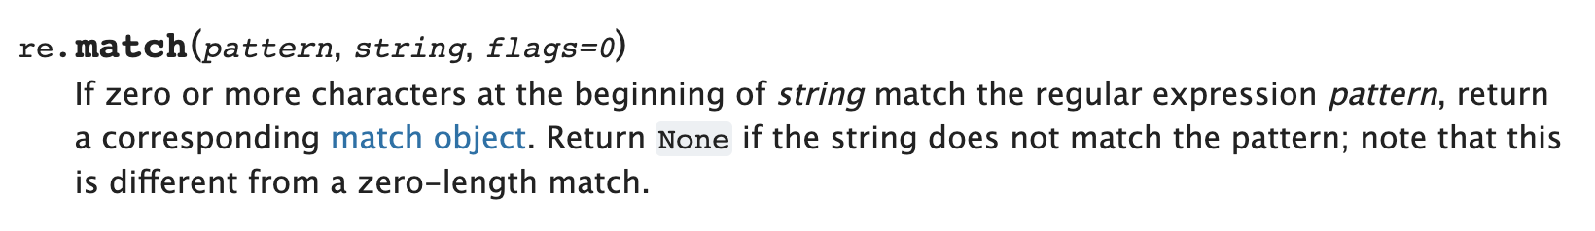
Regex API calls

Slide 19
Regex API calls
Other considerations?

Slide 20
Regex API calls
Other considerations?
Named groups?
Operators to escape?
How it handles choice?
Speed?

Slide 21
Review

Slide 22
Review
3 different scanner implementations
Exact match (EM) scanner
Start-of-string (SOS) scanner
named group (NG) scanner

Slide 23
EM Scanner
Start with the whole string, remove one character at the end until a match is found. Then return the lexeme
ID = “[a-z]+”
NUM = “[0-9]+”
ASSIGN = ”=“
PLUS = “+”
MULT = “*”
IGNORE = “ |\n” SEMI = “;”
“variable = 50 + 30 * 20;”

Slide 24
EM Scanner
Pros
Uses an exact RE matcher. Many RE match algorithms are exact!
Cons
SLOW! Each lexeme requires many many many calls to each RE match!

Slide 25
SOS Scanner
The match API gives us a match starting at the beginning of the string
ID = “[a-z]+”
NUM = “[0-9]+”
ASSIGN = ”=“
PLUS = “+”
MULT = “*”
IGNORE = “ |\n” SEMI = “;”
“variable = 50 + 30 * 20;”

Slide 26
SOS Scanner
Pros
Much faster than EM scanner. Only 1 call to each RE per token() call
Cons
Depends on an efficient implementation of match()
Typically provided in most RE libraries (for this exact reason)
Requires some care in token definitions and prefixes

Slide 27
NG Scanner
to implement token()
Try to match the whole string to the single RE
SINGLE_RE = “(?P<ID>[a-z]+)|
(?P<NUM>[0-9]+)|
(?P<ASSIGN>=)|
(?P<PLUS>+)|
(?P<MULT>*)|
(?P<IGNORE> |\n)|
(?P<SEMI>;)”
“variable = 50 + 30 * 20;”

Slide 28
NG Scanner
Pros
FAST! Only 1 RE call per token()
Cons
Requires a named group RE library
inter-token interactions need to be considered

Slide 29
In practice
Most scanner generators that I am aware of have SOS semantics
You can reason about tokens independently
Use fast ”match” implementations under the hood
Mainstream compilers:
have hand coded and hand optimized scanners
_very_ fast
_very_ hard to modify
Only worth it to do this if you have the need and time

Slide 30
New material
Token actions
Replacement
Keywords
Error reporting
Scanner error recovery
Using a scanner generator

Slide 31
New material
Token actions
Replacement
Keywords
Error reporting
Scanner error recovery
Using a scanner generator

Slide 32
First class functions
A programming language is said to have first class functions if functions can be stored as variables
Python has great support for this
Functional languages have great support (and compiler helps out by checking types)
In C++
Classically: function pointers
Newer: supports lambdas

Slide 33
Functions as part of a token definition
In our scanners, we give them as the 3rd element in the token tuple definition
A token action takes in a lexeme and returns a lexeme.
Possibly the same lexeme
They generally do three things:
modify a token
refine a token
modify the scanner state

Slide 34
Functions as part of a token definition
Once a token is matched, its token action is called on its lexeme,
and the lexeme it returns is returned from the scanner,
Code example in the EM

Slide 35
Examples
Token actions generally do three things:
modify a token
refine a token
modify the scanner state

Slide 36
Modify a token
Example using natural language

Slide 37
Modify a token
PRONOUN = {His, Her, Their}
NOUN = {Dog, Cat, Car, Park}
VERB = {Slept, Ate, Ran}
ADJECTIVE = {Purple, Spotted, Old}
Tokens
Tokens Definitions

Slide 38
Modify a token
Example using types
Some ML frameworks have float16 types in their programming languages
Many devices only support float types (32 bit)
float16 x, y;
return x+y;
Scanner can easily change float16 to float with a token action
float x, y;
return x+y;

Slide 39
Examples
Token actions generally do three things:
modify a token
refine a token
modify the scanner state

Slide 40
Keywords: (finally!)

Slide 41
Keywords
TOKENS
ID = [a-z]+
NUM = [0-9]+
ASSIGN = ”=“
PLUS = “+”
MULT = “*”
IGNORE = [“ “, “\n”]
KEYWORDS
[(INT,“int”), (“FLOAT”, “float”) ...]

Slide 42
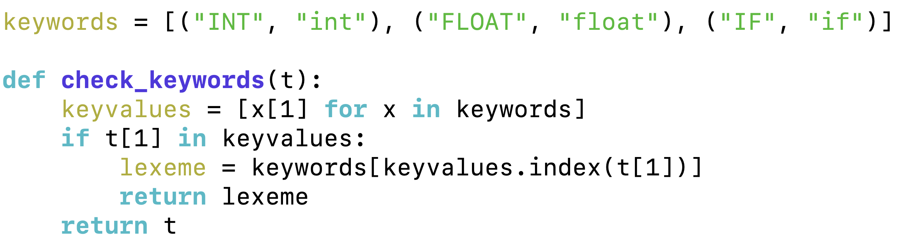
Keywords
TOKENS
ID = [a-z]+
NUM = [0-9]+
ASSIGN = ”=“
PLUS = “+”
MULT = “*”
IGNORE = [“ “, “\n”]
KEYWORDS
[(INT,“int”), (“FLOAT”, “float”) ...]

Slide 43
Keywords
TOKENS
ID = [a-z]+
NUM = [0-9]+
ASSIGN = ”=“
PLUS = “+”
MULT = “*”
IGNORE = [“ “, “\n”]
KEYWORDS
[(INT,“int”), (“FLOAT”, “float”) ...]
Code example in EM Scanner

Slide 44
Examples
Token actions generally do three things:
modify a token
refine a token
modify the scanner state

Slide 45
Modifying state
Our big use case here is error reporting
Line number
Column number
Doesn’t work in our homework
Our homework has scanners import tokens
Usually it is the other way around!!
Maybe some of you can think of a design where it does work in our homework

Slide 46
Modifying state
In the common case, we can create a scanner and then update a class member in a token action
EM Scanner example:

Slide 47
Advanced topic
Recovering from errors (syntax highlighting)
Show python example
return an error token and try to recover
eating one character
eating until a space
eating until a newline

Slide 48
Next topic
Using a scanner generator:
They have their own designs and it is important to understand trade-offs and design decisions
Classically:
Lex and Flex
Modern:
Antlr (ANother Tool for Language Recognition)
A good in-between:
PLY - a Lex and Yacc implementation in Python

Slide 49
Lex/Flex
Old tools - input is a token specification file. Produces a complicated C file that you would include in your project
New language technology makes things a lot easier (higher order functions, fast RE matchers, etc.)

Slide 50
PLY
written mostly for education purposes. Uses only core python features
Personally, I have used it many times for little compiler projects
Documented to be a python implementation of Lex, but uses a much nicer interface

Slide 51
How to use PLY’s Scanner

Slide 52
Scanner Demo
Library import
import ply.lex as lex
Token list
tokens = ["ADJECTIVE", "NOUN", "VERB", "ARTICLE"]
Token specification
t_ADJECTIVE = "old|purple|spotted"
t_NOUN = "dog|computer|car"
t_ARTICLE = "the|my|a|your"
t_VERB = "ran|crashed|accelerated"

Slide 53
Scanner Demo
Build the lexer
lexer = lex.lex()
what happens?
Need an error function
# Error handling rule
def t_error(t):
print("Illegal character '%s'" % t.value[0])
exit(1)

Slide 54
Scanner Demo
Now give the lexer some input
lexer.input("dog")
The lexer streams the input, we need to stream the tokens:
# Tokenize
while True:
tok = lexer.token()
if not tok:
break # No more input
print(tok)

Slide 55
Scanner Demo
line number (1 indexed)
output:
LexToken(NOUN, 'dog’, 1, 0)
number of characters streamed (0 indexed)
try a longer string:
lexer.input("dog computer")
What happens?

Slide 56
Scanner Demo
Need to add a token for whitespace!
tokens = ["ADJECTIVE", "NOUN", "VERB", "ARTICLE", "WHITESPACE"]
...
t_WHITESPACE = '\ '
Now we can lex:
LexToken(NOUN,'dog',1,0)
LexToken(WHITESPACE,' ',1,3)
LexToken(NOUN,'computer',1,4)

Slide 57
Scanner Demo
Now we can do a sentence
lexer.input("my spotted dog ran")
LexToken(ARTICLE,'my',1,0)
LexToken(WHITESPACE,' ',1,2)
LexToken(ADJECTIVE,'spotted',1,3)
LexToken(WHITESPACE,' ',1,10)
LexToken(NOUN,'dog',1,11)
LexToken(WHITESPACE,' ',1,14)
LexToken(VERB,'ran',1,15)
Can we clean this up?

Slide 58
Scanner Demo
We can ignore whitespace
#t_WHITESPACE = '\
t_ignore = ' '
gets simplified to:
LexToken(ARTICLE,'my',1,0)
LexToken(WHITESPACE,' ',1,2)
LexToken(ADJECTIVE,'spotted',1,3)
LexToken(WHITESPACE,' ',1,10)
LexToken(NOUN,'dog',1,11)
LexToken(WHITESPACE,' ',1,14)
LexToken(VERB,'ran',1,15)
LexToken(ARTICLE,'my',1,0)
LexToken(ADJECTIVE,'spotted',1,3)
LexToken(NOUN,'dog',1,11)
LexToken(VERB,'ran',1,15)

Slide 59
Scanner Demo
What about newlines?
lexer.input("""
my spotted dog ran
the old computer crashed
""")
Need to add a newline token!

Slide 60
Scanner Demo
What about newlines?
lexer.input("""
my spotted dog ran
the old computer crashed
""")
Need to add a newline token!
tokens = ["ADJECTIVE", "NOUN", "VERB", "ARTICLE", "NEWLINE"]
t_NEWLINE = "\\n"

Slide 61
Scanner Demo
LexToken(NEWLINE,'\n',1,0)
LexToken(ARTICLE,'my',1,1)
LexToken(ADJECTIVE,'spotted',1,4)
LexToken(NOUN,'dog',1,12)
LexToken(VERB,'ran',1,16)
LexToken(NEWLINE,'\n',1,19)
LexToken(ARTICLE,'the',1,20)
Line numbers are not updating

Slide 62
Scanner Demo
Token actions, similar to production actions
t_NEWLINE = "\\n"
Changes into:
def t_NEWLINE(t):
"\\n"
t.lexer.lineno += 1
return t
docstring is the regex, lexer object which has a linenumber attribute.
If we don’t return anything, then it is ignored.

Slide 63
Scanner Demo
Example: changing gendered pronouns into gender neutral pronouns
tokens = ["ADJECTIVE", "NOUN", "VERB", "ARTICLE", "NEWLINE", "PRONOUN"]
t_PRONOUN = "her|his|their"
lexer.input("""
his spotted dog ran
her old computer crashed
""")

Slide 64
Scanner Demo
Add a token action:
def t_PRONOUN(t):
"her|his|their"
if t.value in ["his", "her"]:
t.value = "their"
return t
Now output will have all gender neutral pronouns!

Slide 65
On Monday
Enjoy your weekend!
We will be starting Module 2 on parsing!

