Slide 1
CSE110A: Compilers May 25, 2022
Topics:
Loop transformations
Homework overview
More loop transforms

Slide 2
Announcements
New grades:
Midterm grades are out
Let us know within a week if there are issues.
You should be able to see comments for each subsection if you missed points
If not let us know
Double check the comments. If we messed up let us know
Average was ~76%
HW 3 is due
It was due yesterday
get it in ASAP if you have not
Homework 4 is released
my opinion:
conceptually it is not as hard as HW2 or HW3.
Practically it is difficult to deal with all the corner cases.
start early!

Slide 3
Quiz

Slide 4
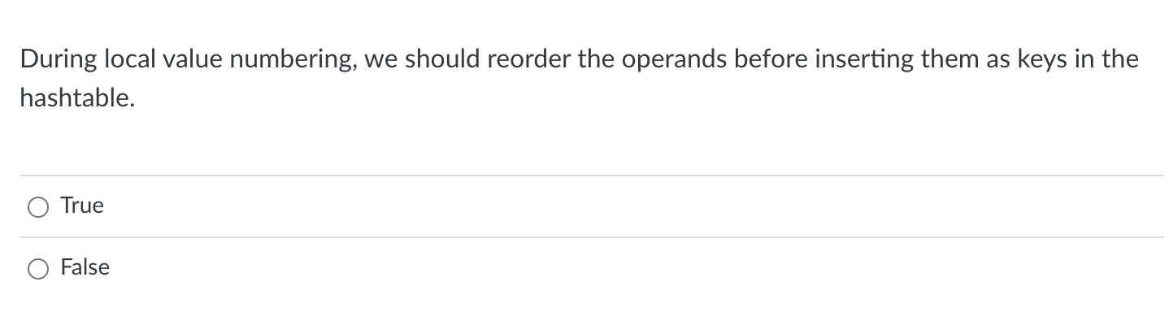
Quiz

Slide 5
Discussion
a = c + b; d = b + c;
H = {
}

Slide 6
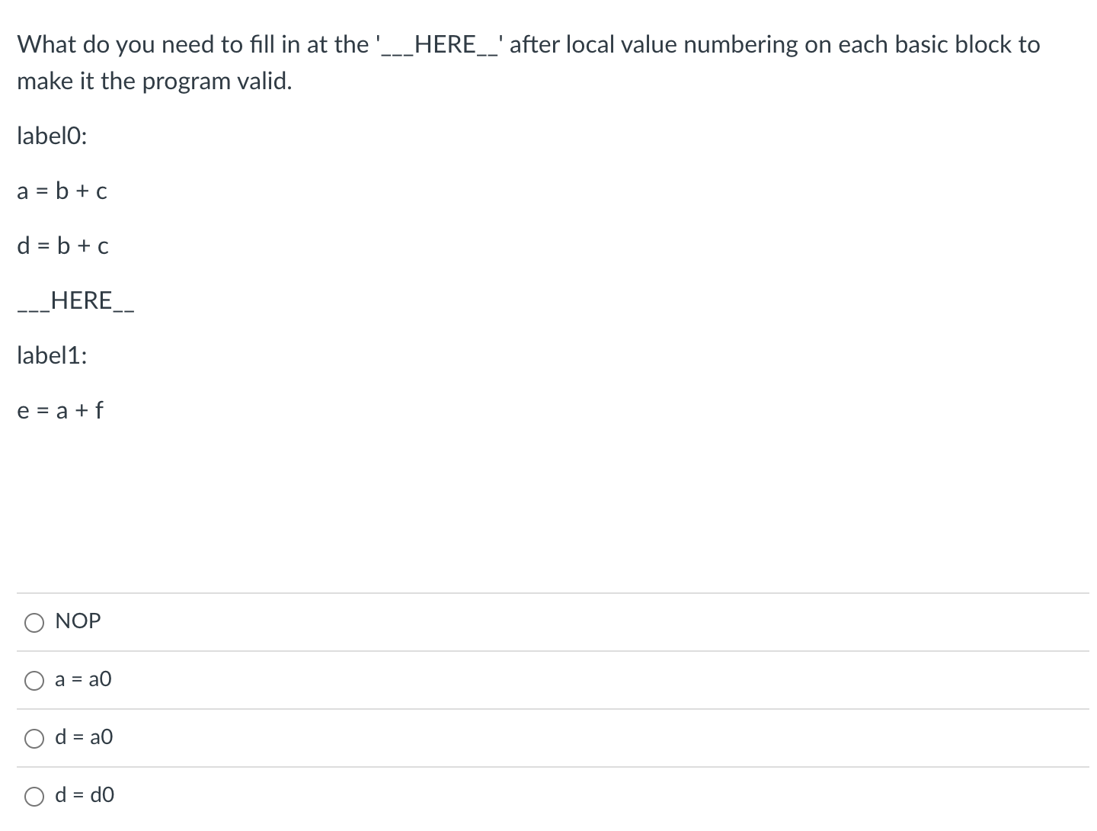
Quiz

Slide 7
Discussion
work through the example
label0:
a = b + c
d = b + c
___HERE__
label1:
e = a + f

Slide 8
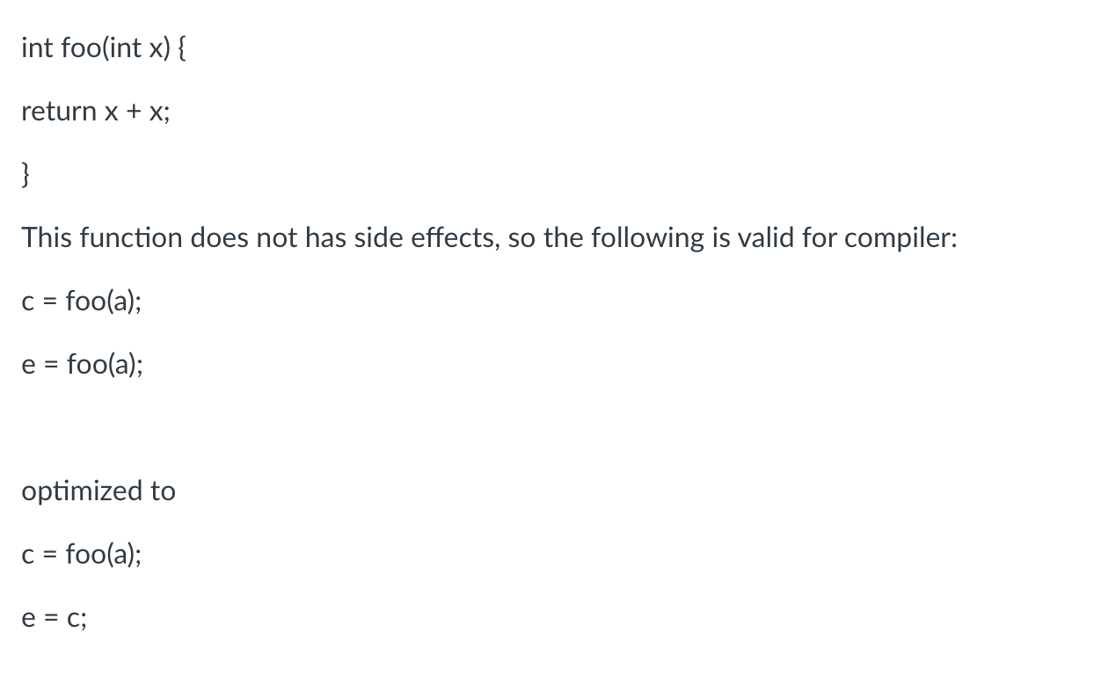
Quiz

Slide 9
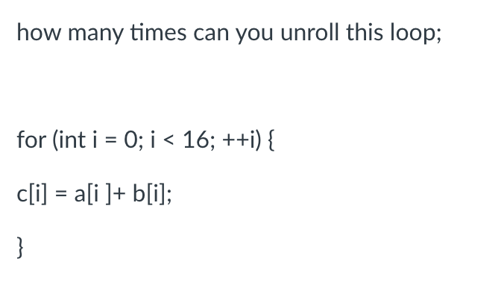
Quiz

Slide 10
Discussion
work through the example
how many comparisons and branches can you save?
What if i was a memory location?
for (int i = 0; i < 16; ++i) {
c[i] = a[i] + b[i];
}

Slide 11
Review
Stitching optimized blocks back into the whole program

Slide 12
How to stitch optimized code back into the program
a = b + c;
d = e + f;
g = b + c;
label_0:
h = g + a;
k = a + g;

Slide 13
How to stitch optimized code back into the program
gets optimized to this:
a = b + c;
d = e + f;
g = b + c;
label_0:
h = g + a;
k = a + g;
a2 = b0 + c1;
d5 = e3 + f4;
g6 = a2;
label_0:
h2 = g0 + a1;
k3 = h2;

Slide 14
How to stitch optimized code back into the program
gets optimized to this:
Can it be stitched together like this?
a = b + c;
d = e + f;
g = b + c;
label_0:
h = g + a;
k = a + g;
a2 = b0 + c1;
d5 = e3 + f4;
g6 = a2;
a2 = b0 + c1;
d5 = e3 + f4;
g6 = a2;
label_0:
h2 = g0 + a1;
k3 = h2;
label_0:
h2 = g0 + a1;
k3 = h2;

Slide 15
How to stitch optimized code back into the program
easiest way showing only first basic block :
gets optimized to this:
b0 = b;
c1 = c;
e3 = e;
f4 = f;
a2 = b0 + c1;
d5 = e3 + f4;
g6 = a2;
a = a2;
d = d5;
g = g6;
a = b + c;
d = e + f;
g = b + c;
label_0:
h = g + a;
k = a + g;
a2 = b0 + c1;
d5 = e3 + f4;
g6 = a2;
label_0:
h2 = g0 + a1;
k3 = h2;

Slide 16
How to stitch optimized code back into the program
easiest way showing only first basic block :
gets optimized to this:
b0 = b;
c1 = c;
e3 = e;
f4 = f;
a2 = b0 + c1;
d5 = e3 + f4;
g6 = a2;
a = a2;
d = d5;
g = g6;
a = b + c;
d = e + f;
g = b + c;
label_0:
h = g + a;
k = a + g;
a2 = b0 + c1;
d5 = e3 + f4;
g6 = a2;
label_0:
h2 = g0 + a1;
k3 = h2;
For a language like ClassIeR:
record new vrs:
{b0, c1, e3, f4, a2, d5, g6}

Slide 17
How to stitch optimized code back into the program
b0 = b;
c1 = c;
e3 = e;
f4 = f; a2 = b0 + c1;
d5 = e3 + f4;
g6 = a2;
a = a2;
d = d5;
g = g6;
label_0:
g0 = g;
a1 = a;
h2 = g0 + a1;
k3 = h2;
h = h2;
k = k3;
a2 = b0 + c1;
d5 = e3 + f4;
g6 = a2;
Whole example:
label_0:
h2 = g0 + a1;
k3 = h2;
new variables: {b0, c1, e3, f4, a2, d5, g6}
{g0, a1, h2, k3}

Slide 18
How to stitch optimized code back into the program
b0 = b;
c1 = c;
e3 = e;
f4 = f; a2 = b0 + c1;
d5 = e3 + f4;
g6 = a2;
a = a2;
d = d5;
g = g6;
label_0:
g0 = g;
a1 = a;
h2 = g0 + a1;
k3 = h2;
h = h2;
k = k3;
a2 = b0 + c1;
d5 = e3 + f4;
g6 = a2;
Whole example:
label_0:
h2 = g0 + a1;
k3 = h2;
Special cases: labels and branches:
how to stitch with them?
new variables: {b0, c1, e3, f4, a2, d5, g6}
{g0, a1, h2, k3}

Slide 19
Picking back up where we left off: Loop Unrolling

Slide 20
For loops terminology
Loop body:
A series of statements that are executed each loop iteration
Loop condition:
the condition that decides whether the loop body is executed
Iteration variable:
A variable that is updated exactly once during the loop
The loop condition depends on the iteration variable
The loop condition is only updated through the iteration variable

Slide 21
Examples
iteration variable
loop body
loop condition
for (int i = 0; i < 1024; i++) {
counter += 1;
}
for (; i < 1024; i+=counter) {
counter += 1;
}
while (1) {
i++;
counter += 1;
if (i < 1024) {
break;
}
}
In general, is it possible to determine if an iteration
variable exists or not?

Slide 22
Loop unrolling

Slide 23
Loop unrolling
Executing multiple instances of the loop body without checking the loop condition.
FOR LPAR assignment_statement expr SEMI assignment_statement RPAR statement
unrolled by a factor of 2
for (int i = 0; i < 128; i++) {
// body
}
for (int i = 0; i < 128; i++) {
// body
i++
// body
}
could we unroll more?

Slide 24
Loop unrolling conditions
Under what conditions can we unroll?
FOR LPAR assignment_statement expr SEMI assignment_statement RPAR statement
for (int i = 0; i < 128; i++) {
// body
}
Validate that we actually have an iteration variable

Slide 25
Loop unrolling conditions
Under what conditions can we unroll?
FOR LPAR assignment_statement expr SEMI assignment_statement RPAR statement
for (int i = 0; i < 128; i++) {
// body
}
Validate that we actually have an iteration variable 1. find candidate on lhs of assignment statement

Slide 26
Loop unrolling conditions
Under what conditions can we unroll?
FOR LPAR assignment_statement expr SEMI assignment_statement RPAR statement
for (int i = 0; i < 128; i++) {
// body
}
Validate that we actually have an iteration variable 1. find candidate on lhs of assignment statement
2. check no assignments to candidate in body

Slide 27
Loop unrolling conditions
Under what conditions can we unroll?
FOR LPAR assignment_statement expr SEMI assignment_statement RPAR statement
for (int i = 0; i < 128; i++) {
// body
}
Validate that we actually have an iteration variable 1. find candidate on lhs of assignment statement
2. check no assignments to candidate in body
3. check that it matches lhs of assignment_statement

Slide 28
Loop unrolling conditions
Under what conditions can we unroll?
FOR LPAR assignment_statement expr SEMI assignment_statement RPAR statement
for (int i = 0; i < 128; i++) {
// body
}
Validate that we actually have an iteration variable 1. find candidate on lhs of assignment statement
2. check no assignments to candidate in body
3. check that it matches lhs of assignment_statement
4. check loop condition
* check that candidate variable is on lhs * check that the rhs is a variable (cond) or literal
* check that cond is not assigned in body

Slide 29
Loop unrolling conditions
Under what conditions can we unroll?
FOR LPAR assignment_statement expr SEMI assignment_statement RPAR statement
for (int i = 0; i < 128; i++) {
// body
}
Validate that we actually have an iteration variable 1. find candidate on lhs of assignment statement
2. check no assignments to candidate in body
3. check that it matches lhs of assignment_statement
4. check loop condition
* check that candidate variable is on lhs * check that the rhs is a variable or literal (cond)
* check that cond is not assigned in body
Do these guarantee we will find an iteration variable?
What happens if we don’t find one?
how does C-simple help us here?

Slide 30
Loop unrolling conditions
Several ways to unroll
More constraints: Simpler to unroll in code generation
Less constraints: Harder to unroll in code generation
Base constraints (required for any unrolling):
Validate that we actually have an iteration variable 1. find candidate on lhs of assignment statement
2. check no assignments to candidate in body
3. check that it matches lhs of assignment_statement
4. check loop condition
* check that candidate variable is on lhs * check that the rhs is a variable or literal (cond)
* check that cond is not assigned in body

Slide 31
Loop unrolling conditions
Simple unroll
Most constraints
Easiest code generation
For unroll factor F
Simple unroll constraints:
Loop update increments by 1
Find the concrete number of loop iterations, LI
F must divide LI evenly
Simple unroll code generation:
create a new body = body + update + body ... F times
perform codegen

Slide 32
Loop unrolling conditions
FOR LPAR assignment_statement expr SEMI assignment_statement RPAR statement
for (int i = 0; i < 128; i++) {
// body
}
For unroll factor F
Simple unroll constraints:
Loop update increments by 1
Find the concrete number of loop iterations, LI
F must divide LI evenly
Simple unroll code generation:
create a new body = body + update + body ... F times
perform codegen
how to do these
steps?

Slide 33
Loop unrolling conditions
FOR LPAR assignment_statement expr SEMI assignment_statement RPAR statement
for (int i = 0; i < 128; i++) {
// body
}
For unroll factor F
Simple unroll constraints:
Loop update increments by 1
Find the concrete number of loop iterations, LI
F must divide LI evenly
Simple unroll code generation:
create a new body = body + update + body ... F times
perform codegen
result for a factor of 2
for (int i = 0; i < 128; i++) {
// body
i++
// body
}

Slide 34
Loop unrolling conditions
what can go wrong?
FOR LPAR assignment_statement expr SEMI assignment_statement RPAR statement
for (int i = 0; i < 8; i+=3) {
// body
}
For unroll factor F
Simple unroll constraints:
Loop update increments by 1
Find the concrete number of loop iterations, LI
F must divide LI evenly
Simple unroll code generation:
create a new body = body + update + body ... F times
perform codegen

Slide 35
Loop unrolling conditions
what can go wrong?
FOR LPAR assignment_statement expr SEMI assignment_statement RPAR statement
for (int i = 0; i < 8; i+=3) {
// body
}
For unroll factor F
Simple unroll constraints:
Loop update increments by 1
Find the concrete number of loop iterations, LI
F must divide LI evenly
Simple unroll code generation:
create a new body = body + update + body ... F times
perform codegen
Actually this is fine as long as i is updated with
a constant addition. but we need a more
complicated formula to calculate LI:
ceil((end - start)/update)
But you may want to keep your life simpler by constraining it. We will keep it for now

Slide 36
Loop unrolling conditions
what can go wrong?
FOR LPAR assignment_statement expr SEMI assignment_statement RPAR statement
for (int i = 0; i < 8; i+=3) {
// body
}
For unroll factor F
Simple unroll constraints:
Loop update increments by 1
Find the concrete number of loop iterations, LI
F must divide LI evenly
Simple unroll code generation:
create a new body = body + update + body ... F times
perform codegen
Do example

Slide 37
Loop unrolling conditions
what can go wrong?
FOR LPAR assignment_statement expr SEMI assignment_statement RPAR statement
for (int i = 0; i < 4; i++) {
// body
}
For unroll factor F
Simple unroll constraints:
Loop update increments by 1
Find the concrete number of loop iterations, LI
F must divide LI evenly
Simple unroll code generation:
create a new body = body + update + body ... F times
perform codegen
What if we try to unroll this by a factor of 3?

Slide 38
Loop unrolling conditions
what can go wrong?
FOR LPAR assignment_statement expr SEMI assignment_statement RPAR statement
for (int i = 0; i < 4; i++) {
// body
}
What if we try to unroll this by a factor of 3?
For unroll factor F
Simple unroll constraints:
Loop update increments by 1
Find the concrete number of loop iterations, LI
F must divide LI evenly
Simple unroll code generation:
create a new body = body + update + body ... F times
perform codegen
for (int i = 0; i < 4; i++) {
// body i++
// body i++
// body }
How many times
do we execute
body?

Slide 39
Loop unrolling conditions
Let’s examine this a bit closer?
for (int i = 0; i < 4; i++) {
// body
}
What if we try to unroll this by a factor of 3?
for (int i = 0; i < 4; i++) {
// body i++
// body i++
// body }
How many times
do we execute
body?

Slide 40
Loop unrolling conditions
what if we executed the unrolled loop
as many times as it was valid, and did
the rest with a non-unrolled loop
Let’s examine this a bit closer?
for (int i = ?; i < ?; i++) {
// body i++
// body i++
// body }
for (int i = 0; i < 4; i++) {
// body
}
What if we try to unroll this by a factor of 3?
for (int i = 0; i < 4; i++) {
// body i++
// body i++
// body }
How many times
do we execute
body?
for (int i = ?; i < ?; i++) {
// body
}

Slide 41
Loop unrolling conditions
what if we executed the unrolled loop
as many times as it was valid, and did
the rest with a non-unrolled loop
initially the loop starts the same as the original loop
for (int i = ?; i < ?; i++) {
// body i++
// body i++
// body }
for (int i = 0; i < 4; i++) {
// body
}
find out how many unrolled loops we can execute:
?
This gives us the first bound
for (int i = ?; i < ?; i++) {
// body
}
second loop is initialized with the first bound
second loop’s bound is same as the original loop

Slide 42
Loop unrolling conditions
what if we executed the unrolled loop
as many times as it was valid, and did
the rest with a non-unrolled loop
initially the loop starts the same as the original loop
for (int i = ?; i < ?; i++) {
// body i++
// body i++
// body }
for (int i = 0; i < 4; i++) {
// body
}
find out how many unrolled loops we can execute:
(4 / 3) * 3 = 3
This gives us the first bound
for (int i = ?; i < ?; i++) {
// body
}
second loop is initialized with the first bound
second loop’s bound is same as the original loop

Slide 43
Loop unrolling conditions
what if we executed the unrolled loop
as many times as it was valid, and did
the rest with a non-unrolled loop
What about in the general case? For unroll factor F?
for (int i = ?; i < ?; i++) {
// body i++
... }
for (int i = x; i < y; i++) {
// body
}
find out how many unrolled loops we can execute:
?
This gives us the first bound
for (int i = ?; i < ?; i++) {
// body
}
second loop is initialized with the first bound
second loop’s bound is same as the original loop

Slide 44
Loop unrolling conditions
general unroll
For unroll factor F
General unroll constraints:
Loop update increments by 1
Find the concrete number of loop iterations, LI
General unroll code generation:
Create simple unrolled loop with new bound: (LI/F)*F
Create cleanup (basic) loop with initialization: (LI/F)*F
perform codegen
None of these numbers have to be concrete!

Slide 45
Homework overview
discussion and demo on command line

Slide 46
More loop transforms
Loop nesting order
Loop tiling
General area is called polyhedral compilation
https://en.wikipedia.org/wiki/Polytope_model

Slide 47
New constraints:
Typically requires that loop iterations are independent
You can do the loop iterations in any order and get the same result
are these independent?
for (int i = 0; i < 2; i++) {
counter += 1;
}
vs
for (int i = 0; i < 1024; i++) {
counter = i;
}

Slide 48




Motivation:
pretty straight forward computation
for brightening (1 pass over all pixels)
Image processing
This computation is known as the “Local Laplacian Filter”. Requires visiting all pixels 99 times
We want to be able to do this
fast and efficiently!
Main results in from an image DSL show
a 1.7x speedup with 1/5 the LoC
over hand optimized versions at Adobe
from: https://people.csail.mit.edu/sparis/publi/2011/siggraph/

Slide 49
for (int y = 0; y < 4; y++) {
for (int x = 0; x < 4; x++) {
output[y,x] = x + y;
}
}
you can compute the pixels in any order you want, you just have to compute all of them!
from: https://halide-lang.org/tutorials/tutorial_lesson_05_scheduling_1.html

Slide 50
for (int y = 0; y < 4; y++) {
for (int x = 0; x < 4; x++) {
output[y,x] = x + y;
}
}
you can compute the pixels in any order you want, you just have to compute all of them!
for (int x = 0; x < 4; x++) {
for (int y = 0; y < 4; y++) {
output[y,x] = x + y;
}
}
What is the difference here? What will the difference be?
from: https://halide-lang.org/tutorials/tutorial_lesson_05_scheduling_1.html

Slide 51
Demo
Why do we see the performance difference?

Slide 52




Adding 2D arrays together
Memory accesses
$$A=B+C$$
$$A$$
$$B$$
$$C$$

Slide 53
But sometimes there isn’t a good ordering

Slide 54

transposed arrays
In some cases, there might not be a good nesting order for all accesses:
$$A=B+C^{T}$$
$$A$$
$$B$$
$$C$$

Slide 55
transposed arrays
In some cases, there might not be a good nesting order for all accesses:
$$A=B+C^{T}$$
$$A$$
$$B$$
$$C$$
cold miss for all of them

Slide 56
transposed arrays
In some cases, there might not be a good nesting order for all accesses:
$$A=B+C^{T}$$
$$A$$
$$B$$
$$C$$
Hit on A and B. Miss on C

Slide 57
transposed arrays
In some cases, there might not be a good nesting order for all accesses:
$$A=B+C^{T}$$
$$A$$
$$B$$
$$C$$
Hit on A and B. Miss on C

Slide 58
What happens here?
Demo

Slide 59
How can we fix it?
Can we use the compiler?

Slide 60
for (int y = 0; y < 4; y++) {
for (int x = 0; x < 4; x++) {
output[y,x] = x + y;
}
}
Loop splitting:
for (int y = 0; y < 4; y++) {
for (int x_outer = 0; x_outer < 4; x_outer+=2) {
for (int x = x_outer; x < x_outer+2; x++) {
output[y,x] = x + y;
}
}
}
What is the difference here?
from: https://halide-lang.org/tutorials/tutorial_lesson_05_scheduling_1.html

Slide 61
Does loop splitting by itself work?
Lets try it
demo

Slide 62
We can chain optimizations
Lets try chaining loop splitting and reorder
Demo

Slide 63
We can chain optimizations
Lets try chaining loop splitting and reorder
Demo
What happened?!

Slide 64
Our new schedule looks like this:
Why is this beneficial?
from: https://halide-lang.org/tutorials/tutorial_lesson_05_scheduling_1.html

Slide 65
blocking

Slide 66




blocking
Blocking operates on smaller chunks to exploit locality in column increment accesses. Example 2x2
$$A=B+C^{T}$$
$$A$$
$$B$$
$$C$$

Slide 67
blocking
Blocking operates on smaller chunks to exploit locality in column increment accesses. Example 2x2
$$A=B+C^{T}$$
$$A$$
$$B$$
$$C$$

Slide 68
blocking
Blocking operates on smaller chunks to exploit locality in column increment accesses. Example 2x2
$$A=B+C^{T}$$
$$A$$
$$B$$
$$C$$
cold miss for all of them

Slide 69
blocking
Blocking operates on smaller chunks to exploit locality in column increment accesses. Example 2x2
$$A=B+C^{T}$$
$$A$$
$$B$$
$$C$$
Miss on C

Slide 70
blocking
Blocking operates on smaller chunks to exploit locality in column increment accesses. Example 2x2
$$A=B+C^{T}$$
$$A$$
$$B$$
$$C$$
Miss on A,B, hit on C

Slide 71
blocking
Blocking operates on smaller chunks to exploit locality in column increment accesses. Example 2x2
$$A=B+C^{T}$$
$$A$$
$$B$$
$$C$$
Hit on all!

Slide 72
See everyone on Friday
Control flow graphs

