Slide 1
CSE110A: Compilers June 3, 2022
start:
r0 = ...;
r1 = ...;
br r0, if, else;
b0
Topics:
Live variable analysis
Class conclusion
b1
b2
if: r2 = ...;
br end_if;
else:
r3 = ...; br end_if;
end_if:
r4 = ...;
b3

Slide 2
Announcements
Homework 3 grades are out!
Let us know if there are issues ASAP
Homework 4 is out
Due on the date of the final (June 7 by midnight). No late days for this HW
SETs are out:
please take some time to fill them out
It really helps make the classes better in the future

Slide 3
Announcements
Final is on June 7 (less than 1 week away)
Similar to Midterm
Major difference: only 1 day to do it: it will be assigned by 8 AM on June 7 and due by midnight on June 7.
No time limit enforced during those hours
Open note, slides, internet, etc.
Do not discuss any aspect of the final with classmates while it is out
Do not discuss (or ask questions about) the test on an online forum; we do monitor these things!
Similar length to Midterm
Designed to take 2-3 hours assuming ~6 hours of studying
As you saw with the midterm: it is common to spend longer on take home tests
Cumulative material: Anything discussed in class if fair game.

Slide 4
Announcements
Final is on June 7 (less than 1 week away)
We will keep a piazza note with clarification questions
Ask any clarifications as a private piazza post
Not guaranteed help outside of business hours
Help will be guaranteed 7:30 PM to 10:30 PM (the scheduled time of the test)

Slide 5
No quiz from last time

Slide 6
Review

Slide 7
Control flow graphs

Slide 8
Control flow graphs
start:
r0 = ...;
r1 = ...;
br r0, if, else;
A graph where:
nodes are basic blocks
edges mean that it is possible for one block to branch to another
if: r2 = ...;
br end_if;
else:
r3 = ...;
end_if:
r4 = ...;

Slide 9
Control flow graphs
start:
r0 = ...;
r1 = ...;
br r0, if, else;
A graph where:
nodes are basic blocks
edges mean that it is possible for one block to branch to another
if: r2 = ...;
br end_if;
else:
r3 = ...; br end_if;
end_if:
r4 = ...;

Slide 10
Control flow graphs
start:
r0 = ...;
r1 = ...;
br r0, if, else;
b0
A graph where:
nodes are basic blocks
edges mean that it is possible for one block to branch to another
b1
b2
if: r2 = ...;
br end_if;
else:
r3 = ...; br end_if;
end_if:
r4 = ...;
b3

Slide 11
Interesting CFGs
start:
r0 = ...;
r1 = ...;
br r0, if, else;
b0
CFGs are easiest to construct over 3 address code.
Labels are explicit and it is easy to partition code into basic blocks
But we can think about CFG patterns from high level code
b1
b2
if: r2 = ...;
br end_if;
else:
r3 = ...; br end_if;
end_if:
r4 = ...;
b3
if/else pattern

Slide 12



Interesting CFGs
weather current = get_weather();
Case statements
printf(" Bring a jacket!\n" );
printf(”Bring sunscreen!\n" );
weather current = get_weather();
switch(current) {
case SUNNY :
printf(”Bring sunscreen!\n" );
break;
case RAINY :
printf(”Bring an umbrella!\n" );
case CLOUDY :
printf(" Bring a jacket!\n" );
break;
}
printf("See you soon!\n" );
printf(”Bring an umbrella!\n" );
printf("See you soon!\n" );

Slide 13




Interesting CFGs
Loops
int loop = x; check loop!=100
printf("inside loop!\n");
loop+=1;
check loop != 100;
int loop = x;
while(loop!=100) {
printf("inside loop!\n");
loop+=1;
}
printf("outside loop!\n");
printf("outside loop!\n");

Slide 14



Interesting CFGs
Loops with a break statement
int loop = x; check loop!=100
int loop = x;
while(loop!=100) {
printf("inside loop!\n");
if (loop < 0) { printf(”breaking!\n");
break;
}
loop+=1;
}
printf("outside loop!\n");
printf("inside loop!\n");
printf(”breaking!\n");
loop+=1
printf("outside loop!\n");

Slide 15
CFG demo
python demo

Slide 16
Live Variable Analysis
A variable v is live at some point p in the program if there exists a path from p to some use of v where v has not been redefined
examples:

Slide 17
Live Variable Analysis
A variable v is live at some point p in the program if there exists a path from p to some use of v where v has not been redefined
examples:
x = 5
if (z):
y = 6 else:
y = x print(y) print(w)

Slide 18
Live Variable Analysis
A variable v is live at some point p in the program if there exists a path from p to some use of v where v has not been redefined
examples:
p
Live variables: ?
x = 5
if (z):
y = 6 else:
y = x print(y) print(w)

Slide 19
Live Variable Analysis
A variable v is live at some point p in the program if there exists a path from p to some use of v where v has not been redefined
examples:
x = 5
if (z):
y = 6 else:
y = x print(y) print(w)
p
Live variables: ?

Slide 20
Live Variable Analysis
A variable v is live at some point p in the program if there exists a path from p to some use of v where v has not been redefined
examples:
x = 5
if (z):
y = 6 else:
y = x print(y) print(w)
p
Live variables: ?

Slide 21
Live Variable Analysis
A variable v is live at some point p in the program if there exists a path from p to some use of v where v has not been redefined
examples:
p
//start x = 5
if (z):
y = 6 else:
y = x print(y) print(w)
Live variables: z,w
Potentially using an uninitialized variable!

Slide 22
Example
See code in godbolt
int foo(int num) {
int i;
int j;
if (num > 0) {
i = 5;
j = 4;
}
else {
i = 6;
}
return i + j;
}

Slide 23
Example
See code in godbolt
int foo(int num) {
int i;
int j;
if (num > 0) {
i = 5;
j = 4;
}
else {
i = 6;
}
return i + j;
}
Code gives detailed warning in Clang
No warning in gcc

Slide 24
Example
See code in godbolt
int foo(int num) {
int i;
int j;
i = 6;
return i + j;
}

Slide 25
Example
See code in godbolt
int foo(int num) {
int i;
int j;
i = 6;
return i + j;
}
Now code gives warning in gcc
So gcc must only implement their live variable analysis as a local
analysis!

Slide 26
Live variable analysis in the CFG:
B0
i = 1;
For each block B_{x} : we want to compute LiveOut: The set of variables that are live at the end of B_{x}
B1
<some branch on i>
s = 0;
B2
s = s + 1;
i = i + 1; <some branch on i>
B3
B4
print(s);

Slide 27
Live variable analysis in the CFG:
B0
i = 1;
LiveOut: ?
B1
<some branch on i>
LiveOut: ?
s = 0;
B2
LiveOut: ?
s = s + 1;
i = i + 1; <some branch on i>
B3
LiveOut: ?
B4
print(s);
LiveOut: ?

Slide 28
Live variable analysis in the CFG:
B0
i = 1;
To compute the LiveOut sets, we need two initial sets: VarKill for block b is any variable in block b that gets overwritten UEVar (upward exposed variable) for block b is any variable in b that is read before being overwritten
B1
<some branch on i>
s = 0;
B2
Block | VarKill | UEVar
B0
B1
B2
B3
B4
s = s + 1;
i = i + 1; <some branch on i>
B3
B4
print(s);

Slide 29
Live variable analysis in the CFG:
B0
i = 1;
To compute the LiveOut sets, we need two initial sets: VarKill for block b is any variable in block b that gets overwritten UEVar (upward exposed variable) for block b is any variable in b that is read before being overwritten
B1
<some branch on i>
s = 0;
B2
Block | VarKill | UEVar
B0 | i
B1 | {}
B2 | s
B3 | s,i
B4 | {}
s = s + 1;
i = i + 1; <some branch on i>
B3
B4
print(s);

Slide 30
Live variable analysis in the CFG:
B0
i = 1;
To compute the LiveOut sets, we need two initial sets: VarKill for block b is any variable in block b that gets overwritten UEVar (upward exposed variable) for block b is any variable in b that is read before being overwritten
B1
<some branch on i>
s = 0;
B2
Block | VarKill | UEVar
B0 | i | {}
B1 | {} | i
B2 | s | {}
B3 | s,i | s,i
B4 | {} | s
s = s + 1;
i = i + 1; <some branch on i>
B3
B4
print(s);

Slide 31
Live variable analysis in the CFG:
Initial condition: LiveOut(n) = {} for all nodes
Ground truth, no variables are live at the exit of the program, i.e. end node n_{end} has LiveOut(n_{end})= {}

Slide 32
Live variable analysis in the CFG:
Initial condition: LiveOut(n) = {} for all nodes
Ground truth, no variables are live at the exit of the program, i.e. end node n_{end} has LiveOut(n_{end})= {}
Now we can perform the iterative fixed point computation:
LiveOut(n) = ∪_{s in succ(n)} ( UEVar(s) ∪ (LiveOut(s) ⋂ VarKill(s) ))

Slide 33
Live variable analysis in the CFG:
LiveOut(n) = ∪_{s in succ(n)} ( UEVar(s) ∪ (LiveOut(s) ⋂ VarKill(s) ))
n
s₀
s₁
s₂

Slide 34
Live variable analysis in the CFG:
LiveOut(n) = ∪_{s in succ(n)} ( UEVar(s) ∪ (LiveOut(s) ⋂ VarKill(s) ))
n
s₀
s₁
s₂
any variable in UEVar(s) is live at n

Slide 35
Live variable analysis in the CFG:
LiveOut(n) = ∪_{s in succ(n)} ( UEVar(s) ∪ (LiveOut(s) ⋂ VarKill(s) ))
n
if s₀ is just this
s₀
s₁
s₂
any variable in UEVar(s) is live at n
x = a + b
Then
UEVar(s₀) = {a,b}
These are live at the end of n!

Slide 36
Live variable analysis in the CFG:
LiveOut(n) = ∪_{s in succ(n)} ( UEVar(s) ∪ (LiveOut(s) ⋂ VarKill(s) ))
n
s₀
s₁
s₂
variables that are live at the end of s, and not overwritten by s

Slide 37
Live variable analysis in the CFG:
LiveOut(n) = ∪_{s in succ(n)} ( UEVar(s) ∪ (LiveOut(s) ⋂ VarKill(s) ))
n
if s₀ is just this
s₀
s₁
s₂
variables that are live at the end of s, and not overwritten by s
x = a + b
Lets say:
Liveout(s₀) = x,c

Slide 38
Bstart
Now we can perform the iterative fixed point computation:
LiveOut(n) = ∪_{s in succ(n)} ( UEVar(s) ∪ (LiveOut(s) ⋂ VarKill(s) ))
B0
i = 1;
B1
<some branch on i>
Block | VarKill | UEVar | ~VarKill | LiveOut I₀
Bstart | {} | {} | i,s | {}
B0 | i | {} | s | {}
B1 | {} | i | i,s | {}
B2 | s | {} | i | {}
B3 | i,s | i,s | {} | {}
B4 | {} | s | i,s | {}
Bend | {} | {} | i,s | {}
B2
s = 0;
s = s + 1;
i = i + 1; <some branch on i>
B3
B4
print(s);
Bend

Slide 39
Bstart
Now we can perform the iterative fixed point computation:
LiveOut(n) = ∪_{s in succ(n)} ( UEVar(s) ∪ (LiveOut(s) ⋂ VarKill(s) ))
B0
i = 1;
B1
<some branch on i>
Block | VarKill | UEVar | ~VarKill | LiveOut I₀ | LiveOut I₁
Bstart | {} | {} | i,s | {}
B0 | i | {} | s | {}
B1 | {} | i | i,s | {}
B2 | s | {} | i | {}
B3 | i,s | i,s | {} | {}
B4 | {} | s | i,s | {}
Bend | {} | {} | i,s | {}
B2
s = 0;
s = s + 1;
i = i + 1; <some branch on i>
B3
B4
print(s);
Bend

Slide 40
Bstart
Now we can perform the iterative fixed point computation:
LiveOut(n) = ∪_{s in succ(n)} ( UEVar(s) ∪ (LiveOut(s) ⋂ VarKill(s) ))
B0
i = 1;
B1
<some branch on i>
Block | VarKill | UEVar | ~VarKill | LiveOut I₀ | LiveOut I₁
Bstart | {} | {} | i,s | {} | {}
B0 | i | {} | s | {} | i
B1 | {} | i | i,s | {} | i,s
B2 | s | {} | i | {} | i,s
B3 | i,s | i,s | {} | {} | i,s
B4 | {} | s | i,s | {} | {}
Bend | {} | {} | i,s | {} | {}
B2
s = 0;
s = s + 1;
i = i + 1; <some branch on i>
B3
B4
print(s);
Bend

Slide 41
Bstart
Now we can perform the iterative fixed point computation:
LiveOut(n) = ∪_{s in succ(n)} ( UEVar(s) ∪ (LiveOut(s) ⋂ VarKill(s) ))
B0
i = 1;
B1
<some branch on i>
Block | VarKill | UEVar | ~VarKill | LiveOut I₀ | LiveOut I₁ | LiveOut I₂
Bstart | {} | {} | i,s | {} | {}
B0 | i | {} | s | {} | i
B1 | {} | i | i,s | {} | i,s
B2 | s | {} | i | {} | i,s
B3 | i,s | i,s | {} | {} | i,s
B4 | {} | s | i,s | {} | {}
Bend | {} | {} | i,s | {} | {}
B2
s = 0;
s = s + 1;
i = i + 1; <some branch on i>
B3
B4
print(s);
Bend

Slide 42
Bstart
Now we can perform the iterative fixed point computation:
LiveOut(n) = ∪_{s in succ(n)} ( UEVar(s) ∪ (LiveOut(s) ⋂ VarKill(s) ))
B0
i = 1;
B1
<some branch on i>
Block | VarKill | UEVar | ~VarKill | LiveOut I₀ | LiveOut I₁ | LiveOut I₂
Bstart | {} | {} | i,s | {} | {} | {}
B0 | i | {} | s | {} | i | i,s
B1 | {} | i | i,s | {} | i,s | i,s
B2 | s | {} | i | {} | i,s | i,s
B3 | i,s | i,s | {} | {} | i,s | i,s
B4 | {} | s | i,s | {} | {} | {}
Bend | {} | {} | i,s | {} | {} | {}
B2
s = 0;
s = s + 1;
i = i + 1; <some branch on i>
B3
B4
print(s);
Bend

Slide 43
Bstart
Now we can perform the iterative fixed point computation:
LiveOut(n) = ∪_{s in succ(n)} ( UEVar(s) ∪ (LiveOut(s) ⋂ VarKill(s) ))
B0
i = 1;
B1
<some branch on i>
Block | VarKill | UEVar | ~VarKill | LiveOut I₀ | LiveOut I₁ | LiveOut I₂ | .. I₃
Bstart | {} | {} | i,s | {} | {} | {}
B0 | i | {} | s | {} | i | i,s
B1 | {} | i | i,s | {} | i,s | i,s
B2 | s | {} | i | {} | i,s | i,s
B3 | i,s | i,s | {} | {} | i,s | i,s
B4 | {} | s | i,s | {} | {} | {}
Bend | {} | {} | i,s | {} | {} | {}
B2
s = 0;
s = s + 1;
i = i + 1; <some branch on i>
B3
B4
print(s);
Bend

Slide 44
Bstart
Now we can perform the iterative fixed point computation:
LiveOut(n) = ∪_{s in succ(n)} ( UEVar(s) ∪ (LiveOut(s) ⋂ VarKill(s) ))
B0
i = 1;
B1
<some branch on i>
Block | VarKill | UEVar | ~VarKill | LiveOut I₀ | LiveOut I₁ | LiveOut I₂ | .. I₃
Bstart | {} | {} | i,s | {} | {} | {} | s
B0 | i | {} | s | {} | i | i,s | i,s
B1 | {} | i | i,s | {} | i,s | i,s | i,s
B2 | s | {} | i | {} | i,s | i,s | i,s
B3 | i,s | i,s | {} | {} | i,s | i,s | i,s
B4 | {} | s | i,s | {} | {} | {} | {}
Bend | {} | {} | i,s | {} | {} | {} | {}
B2
s = 0;
s = s + 1;
i = i + 1; <some branch on i>
B3
B4
print(s);
Bend

Slide 45
What if we traversed the CFG in a different order?

Slide 46
Bstart
Now we can perform the iterative fixed point computation:
LiveOut(n) = ∪_{s in succ(n)} ( UEVar(s) ∪ (LiveOut(s) ⋂ VarKill(s) ))
B0
i = 1;
B1
<some branch on i>
Block | VarKill | UEVar | ~VarKill | LiveOut I₀ | LiveOut I₁
Bstart | {} | {} | i,s | {}
B0 | i | {} | s | {}
B1 | {} | i | i,s | {}
B2 | s | {} | i | {}
B3 | i,s | i,s | {} | {}
B4 | {} | s | i,s | {}
Bend | {} | {} | i,s | {}
B2
s = 0;
s = s + 1;
i = i + 1; <some branch on i>
B3
B4
print(s);
Bend
Lets do it backwards this time

Slide 47
Traversal order in data flow algorithms
If your analysis flows backwards (get information from your children)
You want a post-order traversal
visit as many children as possible before visiting the parents
live variable analysis is a backwards flow analysis
If you flow forward, then you want a reverse post order traversal
Visit as many parents as possible
Global constant propagation is an example

Slide 48
Live variable limitations
To compute the LiveOut sets, we need two initial sets: VarKill for block b is any variable in block b that gets overwritten UEVar (upward exposed variable) for block b is any variable in b that is read before being overwritten. Consider:
s = a[x] + 1;

Slide 49
Live variable limitations
To compute the LiveOut sets, we need two initial sets: VarKill for block b is any variable in block b that gets overwritten UEVar (upward exposed variable) for block b is any variable in b that is read before being overwritten. Consider:
s = a[x] + 1;
UEVar needs to assume a[x] is any memory location that it cannot prove non-aliasing
LiveOut(n) = ∪_{s in succ(n)} ( UEVar(s) ∪ (LiveOut(s) ⋂ VarKill(s) ))

Slide 50
Live variable limitations
To compute the LiveOut sets, we need two initial sets: VarKill for block b is any variable in block b that gets overwritten UEVar (upward exposed variable) for block b is any variable in b that is read before being overwritten. Consider:
a[x] = s + 1;
LiveOut(n) = ∪_{s in succ(n)} ( UEVar(s) ∪ (LiveOut(s) ⋂ VarKill(s) ))

Slide 51
Live variable limitations
To compute the LiveOut sets, we need two initial sets: VarKill for block b is any variable in block b that gets overwritten UEVar (upward exposed variable) for block b is any variable in b that is read before being overwritten. Consider:
a[x] = s + 1;
VarKill also needs to know about aliasing
LiveOut(n) = ∪_{s in succ(n)} ( UEVar(s) ∪ (LiveOut(s) ⋂ VarKill(s) ))

Slide 52
Demo
Godbolt demo
int foo(int num, int x, int y) {
int i[4];
int j[4];
return i[x] + j[y];
}

Slide 53
Demo
Godbolt demo
int foo(int num, int x, int y) {
int i[4];
int j[4];
return i[x] + j[y];
}
no warning in clang...
warning in gcc

Slide 54
Demo
Godbolt demo
int foo(int num, int x, int y) {
int i[4];
int j[4];
j[0] = 0;
i[0] = 0;
return i[x] + j[y];
}

Slide 55
Demo
Godbolt demo
int foo(int num, int x, int y) {
int i[4];
int j[4];
j[0] = 0;
i[0] = 0;
return i[x] + j[y];
}
No more warning.
Thus analysis must not be very precise

Slide 56
Live variable limitations
Imprecision can come from CFG construction:
consider:
br 1 < 0, dead_branch, alive_branch

Slide 57
Live variable limitations
Imprecision can come from CFG construction:
consider:
br 1 < 0, dead_branch, alive_branch
could come from arguments, etc.
n
dead_branch
alive_branch
s₀
s₁

Slide 58
Live variable limitations
Imprecision can come from CFG construction:
consider first class labels (or functions): br label_reg where label_reg is a register that contains a register
need to branch to all possible basic blocks!
n
s₀
s₁
s₂
s₃

Slide 59
Summary
Global analysis is difficult and often very imprecise
Algorithms operate over CFGs and model how information can flow through the CFG
Live variable analysis can be used to catch potential uses of initialized variables
Other data flow instantiations can be used to do global constant propagation, global copy folding, etc.

Slide 60
Done with lectures!

Slide 61
Recap
Module 1 - Scanners: using regular expressions to break down programs into tokens
Module 2 - Parsing: using context free grammars to turn program strings into trees
Module 3 - Intermediate representation: explicitly constructing ASTs, performing type checking and generating 3 address code
Module 4 - Optimization and analysis: local, regional, and global analysis/operations. We can speed up some code significantly and make code safer

Slide 62
Recap
Combined, your homeworks compile a non-trivial subset of C into an (optimized) IR that is very close to an ISA
Even though Clang and GCC and millions of lines of code long, I hope this class made them slightly less magical to you!
My hope is that this class made you think hard about programming languages, architectures, and how to negotiate between them
Thank you for your patience as we designed the class!

Slide 63
If you want to work more on your compiler
Chapter 11: instruction selection
Different strategies depending on RISC or CISC
Currently changing landscape in modern computing (ARM, Apple M1, RISC-V)
Chapter 12: instruction scheduling
Chapter 13: register allocation

Slide 64
If you are interested in this material
Grad compilers: Discusses more about data flow analysis, SSA intermediate representation, and domain specific languages
Programming languages: Discusses properties of programming languages, their structure, and their semantics
Formal methods: Discusses how we can use the source code to prove more in depth properties about the program (e.g. that there are no bugs)
Architecture: Discusses how the processor works; however, in order to be useful, architecture features must be available somehow to the programmer (usually through a programming language and a compiler)

Slide 65
Tons of opportunities
Grad school: there is tons of research going on in all of these areas
Industry:
Nearly every major tech company has (several) compiler teams now
Apple: LLVM
Microsoft: VSCode
Microsoft: Github
Nvidia: nvcc
Intel: icc
Game dev
...
https://mgaudet.github.io/CompilerJobs/

Slide 66
Compilers are going to be increasingly important in the next era of computing

Slide 67
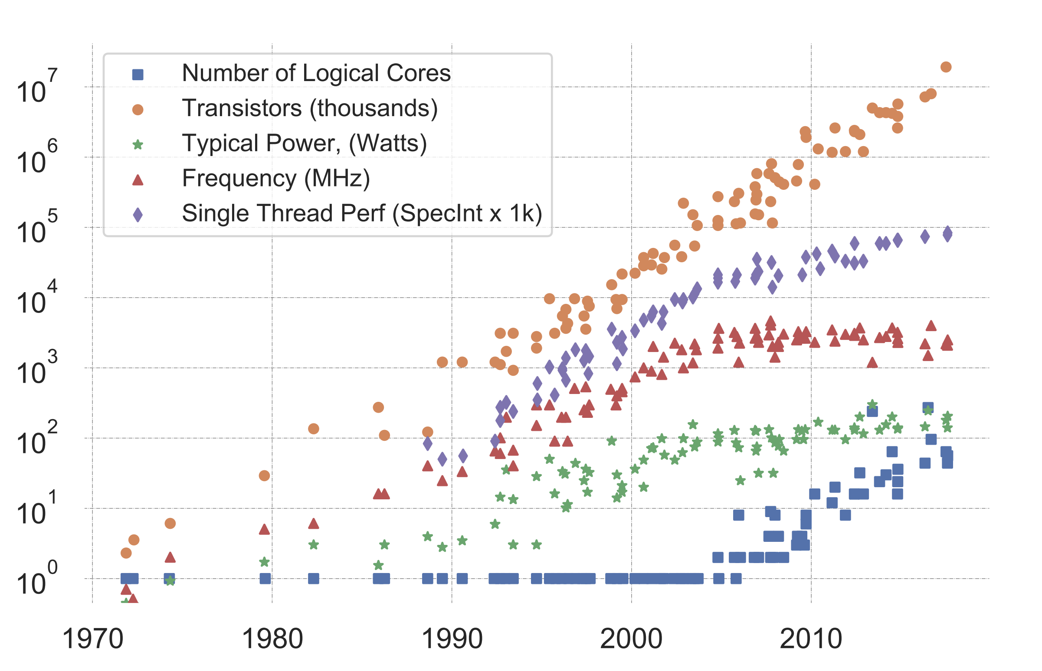
computer
raw speed
has leveled off
Number of cores
is starting to level
off
K. Rupp, “40 Years of Mircroprocessor Trend Data,” https://www. karlrupp.net/2015/06/40-years-of-microprocessor-trend-data, 2015.

Slide 68
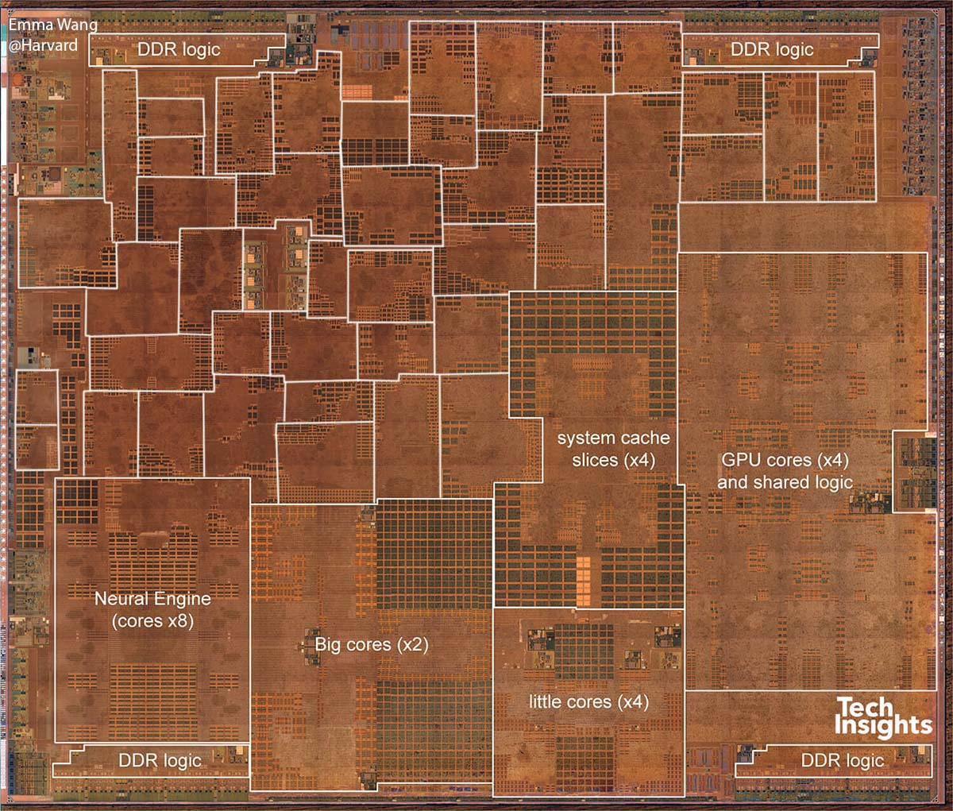
Modern SoC
From David Brooks lab at Harvard: http://vlsiarch.eecs.harvard.edu/research/accelerators/die-photo-analysis/
Compilers will need to be able to map software efficiently to a range of different accelerators

Slide 69
Thanks everyone!!
For those of you who are graduating: congrats!
A CS degree is an incredible accomplishment!
For those of you who are not:
I hope to see you around next year!
Don’t be a stranger! We love hearing from you!
If you have any feedback about the class, please let me know!
Good luck on the final and enjoy your summer!

