Slide 1
CSE110A: Compilers May 13, 2022
Topics:
Finish intro to optimizations
Basic blocks
Local value numbering

Slide 2
Announcements
Pending grades
HW 2 (expect by Monday)
Midterm (expect by next Friday)
HW 3 is released
Due in two weeks from release date
Get started early; you have all the material you need!
Packet updated, but nothing major

Slide 3
Quick homework demo

Slide 4
Quiz

Slide 5
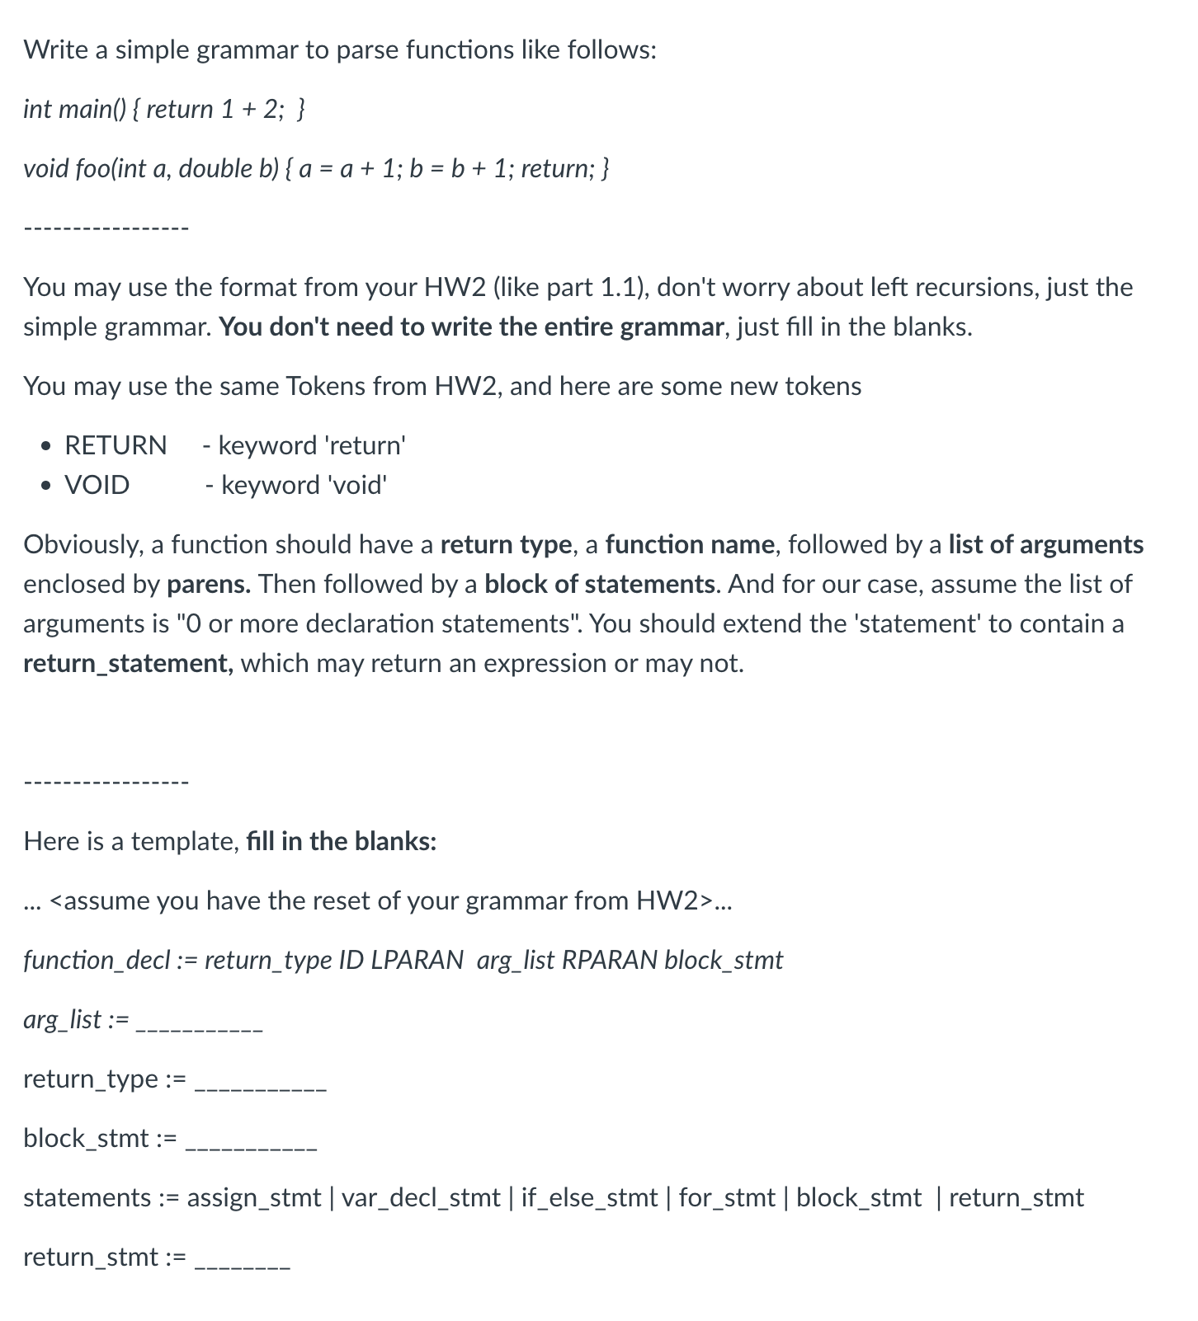
Quiz

Slide 6
Quiz
Let’s do the exercise

Slide 7
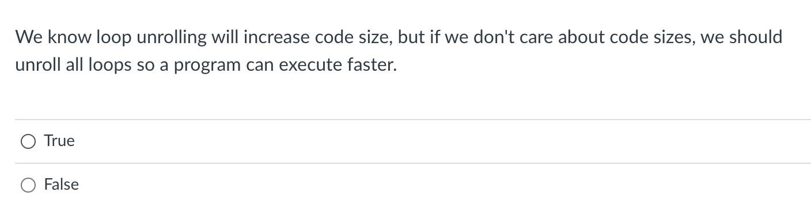
Quiz

Slide 8
Discussion
Why might it not be a good idea?

Slide 9
Discussion
Why might it not be a good idea?
Instruction cache
branch predictors
In practice, compilers rarely unroll by more than 4 or 8.

Slide 10
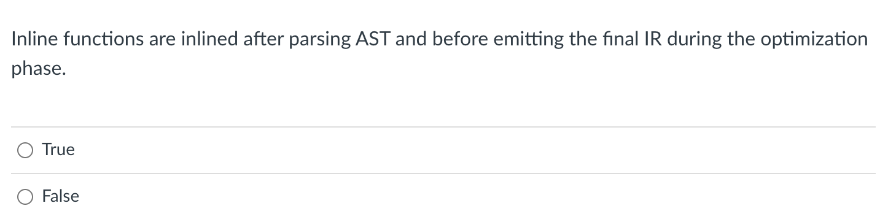
Quiz

Slide 11
Discussion

Slide 12
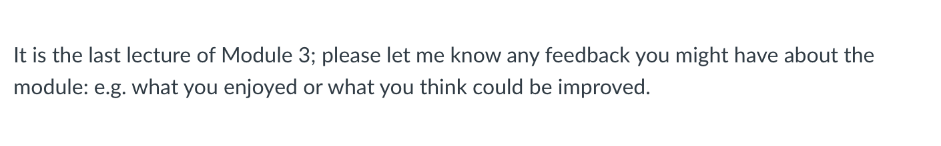
Quiz
As always, thanks for your feedback!

Slide 13
Extra quiz question
What would we need to do to extend our C-simple parse to handle if/else if/else statements?

Slide 14
Review
We started talking about compiler optimizations.
There’s still much more to say, so let’s pick up there.

Slide 15
Discussion
What are compiler optimizations?
Why do we want compiler optimizations?

Slide 16
Discussion
What are compiler optimizations?
automated program transforms designed to make code more optimal
optimal can mean different things
code optimized for one system might be different for code optimized for a different system
we can optimize for speed, for energy efficiency, or for code size. What else?
Why do we want the compiler to help us optimize?
So we can write more maintainable/portable code
So we don’t have to worry about learning nuanced details about every possible system

Slide 17
Discussion
What are some compiler optimizations you know about?
for (int i = 0; i < 10; i++) {
x = x + 1;
}
loop unrolling
for (int i = 0; i < 10; i++) {
x = x + 1;
i++;
x = x + 1;
}

Slide 18
Discussion
What are some compiler optimizations you know about?
int foo() {
int i,j,k;
i = 10;
j = i;
k = j;
return k;
}
for (int i = 0; i < 10; i++) {
x = x + 1;
}
loop unrolling
for (int i = 0; i < 10; i++) {
x = x + 1;
i++;
x = x + 1;
}
constant propagation
int foo() {
int i,j,k;
return 10;
}

Slide 19
Discussion
What are some compiler optimizations you know about?
for (int i = 0; i < 10; i++) {
x = x + 1;
}
loop unrolling
for (int i = 0; i < 10; i++) {
x = x + 1;
i++;
x = x + 1;
}
What does this save us?

Slide 20
Discussion
What are some compiler optimizations you know about?
for (int i = 0; i < 10; i++) {
x = x + 1;
}
optimizations at one stage can enable optimizations at another stage:
loop unrolling
for (int i = 0; i < 10; i++) {
x = x + 1;
i++;
x = x + 1;
}
for (int i = 0; i < 10; i+=2) {
x = x + 2;
}
provides a bigger window for local analysis
What does this save us?

Slide 21
Discussion
What are some compiler optimizations you know about?
let’s do a few more
Function inlining
int add(int x, int y) {
return x + y;
}
int foo(int x, int y, int z) {
return add(x,y);
}
int foo(int x, int y, int z) {
return x + y;
}
What does this save us?
code size? speed? the ability to debug? local regions to optimize more?

Slide 22
Discussion
How do you enable compiler optimizations?

Slide 23
Discussion
How do you enable compiler optimizations?
most C/++ compilers
optimizing for speed
-O0, -O1, -O2, -O3
what about O4?
optimizing for size
-Os, -Oz
relax some constraints (especially around floating point):
-Ofast
Godbolt example
https://stackoverflow.com/questions/15548023/clang-optimization-levels

Slide 24
Discussion
How do you enable compiler optimizations?
most C/++ compilers
optimizing for speed
-O0, -O1, -O2, -O3
what about O4?
optimizing for size
-Os, -Oz
relax some constraints (especially around floating point):
-Ofast
Godbolt example
https://stackoverflow.com/questions/15548023/clang-optimization-levels

Slide 25
Discussion
What are some of the biggest improvements you’ve seen from compiler optimizations?

Slide 26
Discussion
What are some of the biggest improvements you’ve seen from compiler optimizations?
compiler optimizations are great at well-structured, regular loops and arrays
Example: adding together two matrices

Slide 27
Discussion
What kind of transforms on your code is the compiler allowed to do?
many_add example

Slide 28
Discussion
What kind of transforms on your code is the compiler allowed to do?
many_add example
Why did we get such a dramatic increase?

Slide 29
Discussion
What kind of transforms on your code is the compiler allowed to do?
many_add example
Why did we get such a dramatic increase?
Programs must maintain their input/output behavior
Hard to precisely define (and still being discussed in C++ groups)
input/output can be files, volatile memory, console log, etc.

Slide 30
Discussion
int p(int arr[], int start, int end)
{
int pivot = arr[start];
int count = 0;
for (int i = start + 1; i <= end; i++) {
if (arr[i] <= pivot)
count++;
}
int pivotIndex = start + count;
swap(arr[pivotIndex], arr[start]);
int i = start, j = end;
while (i < pivotIndex && j > pivotIndex) {
while (arr[i] <= pivot) {
i++;
}
while (arr[j] > pivot) {
j--;
}
if (i < pivotIndex && j > pivotIndex) {
swap(arr[i++], arr[j--]);
}
}
return pivotIndex;
}
void foo(int *arr, int n)
{
if (start >= end)
return;
int p = p(arr, m, n);
foo(arr, start, p - 1);
foo(arr, p + 1, end);
}
Extreme example
void foo(int * arr, int n)
{
int i, j;
for (i = 0; i < n - 1; i++)
for (j = 0; j < n - i - 1; j++)
if (arr[j] > arr[j + 1]) {
tmp = arr[j];
arr[j] = arr[j + 1]);
arr[j + 1] = tmp;
}
}
is this transform legal?
code from https://www.geeksforgeeks.org/

Slide 31
Discussion
Yes this transform
would be legal!
Could any compiler figure it out?
currently unlikely..
This is a technique called “super optimizing” and it is
getting more and more interest
int p(int arr[], int start, int end)
{
int pivot = arr[start];
int count = 0;
for (int i = start + 1; i <= end; i++) {
if (arr[i] <= pivot)
count++;
}
int pivotIndex = start + count;
swap(arr[pivotIndex], arr[start]);
int i = start, j = end;
while (i < pivotIndex && j > pivotIndex) {
while (arr[i] <= pivot) {
i++;
}
while (arr[j] > pivot) {
j--;
}
if (i < pivotIndex && j > pivotIndex) {
swap(arr[i++], arr[j--]);
}
}
return pivotIndex;
}
void foo(int *arr, int n)
{
if (start >= end)
return;
int p = p(arr, m, n);
foo(arr, start, p - 1);
foo(arr, p + 1, end);
}
Extreme example
bubble sort
void foo(int * arr, int n)
{
int i, j;
for (i = 0; i < n - 1; i++)
for (j = 0; j < n - i - 1; j++)
if (arr[j] > arr[j + 1]) {
tmp = arr[j];
arr[j] = arr[j + 1]);
arr[j + 1] = tmp;
}
}
quick sort
is this transform legal?
code from https://www.geeksforgeeks.org/

Slide 32
Moving on

Slide 33
Zooming out again: Compiler Architecture
compiler
creates structure
produces executable code
Optimizations
Optimizations
Optimizations
machine code
input program
Front end
Optimizations
Back end
string
parsing
code gen
optimizations
build on each other
IRs and type inference type inference are at the boundary of parsing and optimizations

Slide 34
IR programs
input program
Lexical Analysis
Syntactic Analyzer
Intermediate code gen
IR Analysis/ Optimization
loop!
optimized IR program
token stream
syntax tree
target code gen
What IRs do we have at this point?
target code optimizations
loop!
machine code

Slide 35
IR programs
input program
Lexical Analysis
Syntactic Analyzer
Intermediate code gen
IR Analysis/ Optimization
loop!
optimized IR program
token stream
syntax tree
target code gen
What IRs do we have at this point?
3 address code
target code optimizations
virtual_reg vr3;
virtual_reg _new_name0;
virtual_reg _new_name1;
vr0 = int2vr(5);
_new_name0 = vr0;
vr1 = int2vr(6);
loop!
machine code

Slide 36
IR programs
input program
Lexical Analysis
Syntactic Analyzer
Intermediate code gen
IR Analysis/ Optimization
loop!
optimized IR program
token stream
syntax tree
target code gen
What IRs do we have at this point?
3 address code
AST
target code optimizations
virtual_reg vr3;
virtual_reg _new_name0;
virtual_reg _new_name1;
vr0 = int2vr(5);
_new_name0 = vr0;
vr1 = int2vr(6);
AST<+,float>
loop!
AST<+,int>
AST<5.5, float>
machine code
AST<x, int>
AST<y, int>

Slide 37
Implicit parse tree
IR programs
if_else_statement := IF LPAR expr RPAR statement ELSE statement
if (program0) {
program1
}
else {
program2
}
IR Analysis/ Optimization
loop!
We have several structures to utilize
to analyze and optimize programs!
optimized IR program
target code gen
What IRs do we have at this point?
3 address code
AST
target code optimizations
virtual_reg vr3;
virtual_reg _new_name0;
virtual_reg _new_name1;
vr0 = int2vr(5);
_new_name0 = vr0;
vr1 = int2vr(6);
AST<+,float>
loop!
AST<+,int>
AST<5.5, float>
machine code
AST<x, int>
AST<y, int>

Slide 38
Optimization categories
Machine-independent - these optimizations should work well across many different systems
Examples?
Machine dependent - these optimizations start to optimize the code for a given system
Examples?

Slide 39
Optimization categories
Machine-independent - these optimizations should work well across many different systems
Examples?
All the examples we looked at before seem like they will help across many systems
Machine dependent - these optimizations start to optimize the code for a given system
Examples?
loop chunking for cache line size and vectorization.
instruction re-orderings to take advantage of processor pipelines.
fused multiply-and-add instructions

Slide 40
Optimization categories
Machine-independent - these optimizations should work well across many different systems
Examples?
All the examples we looked at before seem like they will help across many systems
In this module we will be looking at machine-independent optimizations. Module 5 might start to look at others
What are the pros of machine-independent optimizations?

Slide 41
Optimization categories
Next category level is how much code we need to reason about for the optimization.
local optimizations: examine a ”basic block”, i.e. a small region of code with no control flow.
Examples?
Regional optimizations: several basic blocks with simple control flow.
Examples?
Global optimization: optimizes across an entire function

Slide 42
Optimization categories
local optimizations: examine a ”basic block”, i.e. a small region of code with no control flow.
Regional optimizations: several basic blocks with simple control flow
Global optimization: optimizes across an entire function
Discussion:
What are the pros and cons of each?
Why don’t we go further than functions?

Slide 43
Optimization categories
local optimizations: examine a ”basic block”, i.e. a small region of code with no control flow.
Regional optimizations: several basic blocks with simple control flow
Global optimization: optimizes across an entire function
For this module:
We will look at two optimizations in detail:
A local optimization: Local value numbering
A regional optimization: Loop unrolling
We will implement both as homework
We will discuss several other optimizations and analysis

Slide 44
Basic blocks

Slide 45
IR Program structure
A sequence of 3 address instructions
Programs can be split into Basic Blocks:
A sequence of 3 address instructions such that:
There is a single entry, single exit
Important property: an instruction in a basic block can assume that all preceding instructions will execute
Single Basic Block
Label_x:
op1;
op2;
op3;
br label_z;

Slide 46
IR Program structure
A sequence of 3 address instructions
Programs can be split into Basic Blocks:
A sequence of 3 address instructions such that:
There is a single entry, single exit
Important property: an instruction in a basic block can assume that all preceding instructions will execute
Two Basic Blocks
Single Basic Block
Label_x:
op1; op2; op3; Label_y: op4; op5;
Label_x:
op1;
op2;
op3;
br label_z;

Slide 47
IR Program structure
How might they appear in a high-level language? What are some examples?
A sequence of 3 address instructions
Programs can be split into Basic Blocks:
A sequence of 3 address instructions such that:
There is a single entry, single exit
Important property: an instruction in a basic block can assume that all preceding instructions will execute
Two Basic Blocks
Single Basic Block
Label_x:
op1; op2; op3; Label_y: op4; op5;
Label_x:
op1;
op2;
op3;
br label_z;

Slide 48
IR Program structure
How might they appear in a high-level language?
How many basic blocks?
… if (x) { …
} else { …
}
…
A sequence of 3 address instructions
Programs can be split into Basic Blocks:
A sequence of 3 address instructions such that:
There is a single entry, single exit
Important property: an instruction in a basic block can assume that all preceding instructions will execute
Two Basic Blocks
Single Basic Block
Label_x:
op1; op2; op3; Label_y: op4; op5;
Label_x:
op1;
op2;
op3;
br label_z;

Slide 49
Converting 3 address code into basic blocks
Let’s try an example: test 4 in HW 3:

Slide 50
Converting 3 address code into basic blocks
Simple algorithm:
keep a list of basic blocks
a basic block is a list of instructions
Iterate over the 3 address instructions
if you see a branch or a label, finalize the current basic block and start a new one.

Slide 51
Converting 3 address code into basic blocks
pseudo code
basic_blocks = []
bb = []
for instr in program:
if instr type is in [branch, label]:
bb.append(instr)
basic_blocks.append[bb]
bb = []
else:
bb.append(instr)

Slide 52
Optimization levels
Local optimizations:
Optimizes an individual basic block
Regional optimizations:
Combines several basic blocks
Global optimizations:
operates across an entire procedure
what about across procedures?

Slide 53
Optimization levels
Label_0:
x = a + b; y = a + b;
Local optimizations:
Optimizes an individual basic block
Regional optimizations:
Combines several basic blocks
Global optimizations:
operates across an entire procedure
what about across procedures?

Slide 54
Optimization levels
Label_0:
x = a + b; y = a + b;
optimized to
Label_0:
x = a + b; y = x;
Local optimizations:
Optimizes an individual basic block
Regional optimizations:
Combines several basic blocks
Global optimizations:
operates across an entire procedure
what about across procedures?

Slide 55
Optimization levels
Label_0:
x = a + b; y = a + b;
optimized to
Label_0:
x = a + b; y = x;
Local optimizations:
Optimizes an individual basic block
Regional optimizations:
Combines several basic blocks
Global optimizations:
operates across an entire procedure
what about across procedures?
Label_0:
x = a + b; Label_1:
y = a + b;
CANNOT always optimized to
Label_0:
x = a + b; Label_1:
y = x;

Slide 56
Optimization levels
Label_0:
x = a + b; y = a + b;
optimized to
Label_0:
x = a + b; y = x;
Local optimizations:
Optimizes an individual basic block
Regional optimizations:
Combines several basic blocks
Global optimizations:
operates across an entire procedure
what about across procedures?
Label_0:
x = a + b; Label_1:
y = a + b;
CANNOT always optimized to
Label_0:
x = a + b; Label_1:
y = x;
br Label_1; Label_0:
x = a + b; Label_1:
y = a + b;
code could skip Label_0, leaving x undefined!

Slide 57
Regional Optimization
… if (x) { …
} else { x = a + b;
} y = a + b;
…
we cannot replace: y = a + b. with
y = x;

Slide 58
Regional Optimization
… if (x) { …
} else { x = a + b;
} y = a + b;
…
we cannot replace: y = a + b. with
y = x;
x = a + b; if (x) { …
} else { …
} y = a + b;
…
But in this case, we can check if a and b are not redefined, then y = a + b; can be replaced with y = x;
This requires regional analysis and optimizations

Slide 59
See everyone on Monday
A concrete optimization: local value numbering

