Slide 1
CSE110A: Compilers May 9, 2022
..
AST
..
..
..
..
Topics:
converting statements to 3 address code
homework review
CFG
...
...
...
...
3 address code
store i32 0, ptr %2
%3 = load i32, ptr %1
%4 = add nsw i32 %3, 1,
store i32 %4, ptr %1
%5 = load i32, ptr %2

Slide 2
Announcements
Hope everyone had a nice weekend without HW or exams in this class
Midterm is submitted, thanks for your hard work!
We plan to have it graded in 2 weeks
HW 2 is in
We plan to have it graded in 1 week
HW 3 will be released by midnight tonight
It is a big assignment! Please get started earlier
Early office hours are much less busy!

Slide 3
Announcements
Schedule:
Hopefully we will finish module 3 today
Plan to move to module 4: optimizations on Wednesday

Slide 4
Quiz

Slide 5
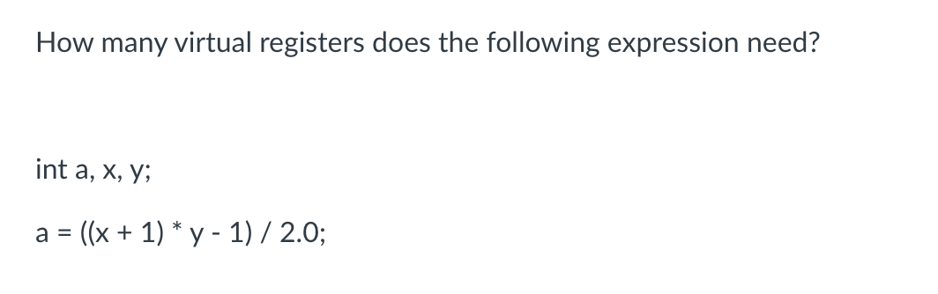
Quiz

Slide 6
Discussion
two ways to do this: First
a = ((x + 1) * y - 1) / 2.0f;
vr0 = x + 1
vr1 = vr0 * y
vr2 = vr1 - 1
vr3 = int2float(vr2)
vr4 = vr3 / 2.0f
vr5 = float2int(vr4)
a = vr5
Are all of these necessary?

Slide 7
Discussion
two ways to do this: Second way: use Godbolt
use clang with flag: -emit-llvm
%5 = load i32, ptr %3, align 4, !dbg !20
%6 = add nsw i32 %5, 1, !dbg !21
%7 = load i32, ptr %4, align 4, !dbg !22
%8 = mul nsw i32 %6, %7, !dbg !23
%9 = sub nsw i32 %8, 1, !dbg !24
%10 = sitofp i32 %9 to float, !dbg !25
%11 = fdiv float %10, 2.000000e+00, !dbg !26
%12 = fptosi float %11 to i32, !dbg !25
int foo_int(int x, int y) {
return ((x + 1) * y - 1) / 2.0f;
}

Slide 8
Discussion
two ways to do this: Second way: use Godbolt
use clang with flag: -emit-llvm
%5 = load i32, ptr %3, align 4, !dbg !20
%6 = add nsw i32 %5, 1, !dbg !21
%7 = load i32, ptr %4, align 4, !dbg !22
%8 = mul nsw i32 %6, %7, !dbg !23
%9 = sub nsw i32 %8, 1, !dbg !24
%10 = sitofp i32 %9 to float, !dbg !25
%11 = fdiv float %10, 2.000000e+00, !dbg !26
%12 = fptosi float %11 to i32, !dbg !25
int foo_int(int x, int y) {
return ((x + 1) * y - 1) / 2.0f;
}
we probably wouldn’t count loads for our purposes

Slide 9
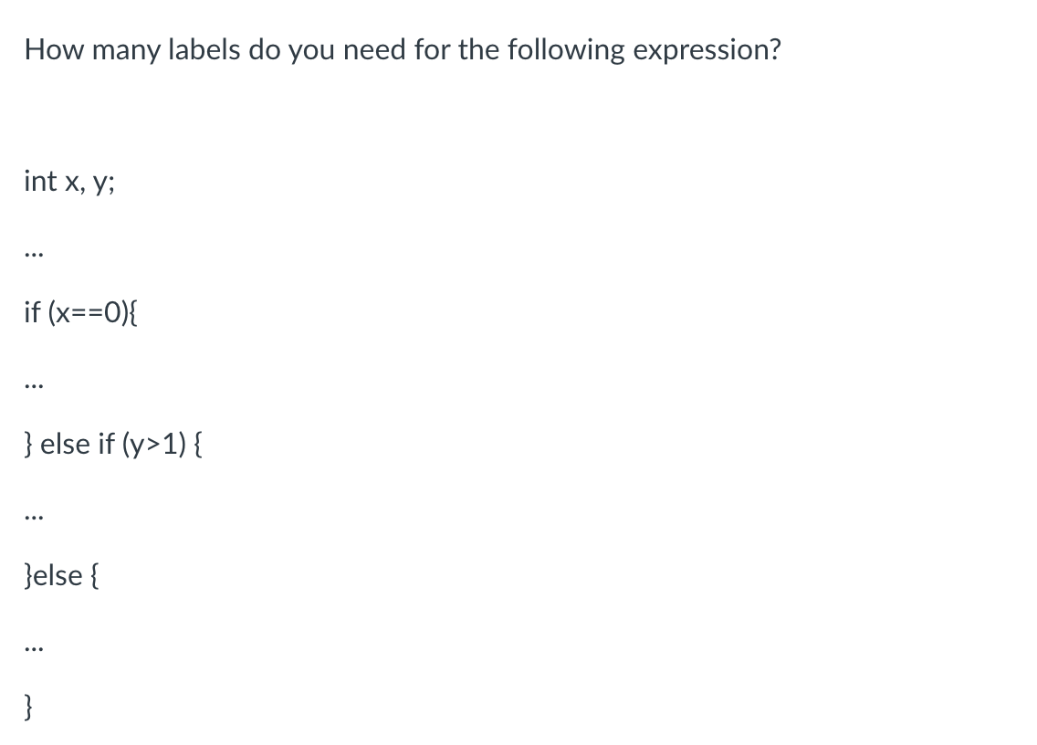
Quiz

Slide 10
int x, y;
...
if (x==0){
...
} else if (y>1) {
...
} else {
...
}
where do we need the labels?

Slide 11
int x, y;
...
if !(x == 0) goto elseif;
...
goto end;
elseif:
if !(y>1) goto else:
...
goto end;
else:
...
}
end:
where do we need the labels?

Slide 12
Quiz discussion
What about Godbolt?

Slide 13
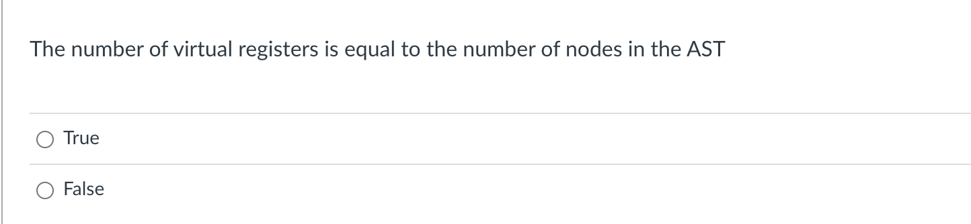
Quiz

Slide 14
Converting AST into Class-IR
int x;
int y;
float w; w = x + y + 5.5
After type inference
We will start by adding a new
member to each AST node: A virtual register
Each node needs a distinct virtual register
AST<+,float, vr5>
AST<int2float, float, vr3>
AST<+,int, vr2>
AST<5.5, float, vr4>
AST<x, int, vr0>
AST<y, int, vr1>

Slide 15
Discussion
The easiest (and most common way) is to allocate a virtual register for each node
You might not need nodes for some variables or literal
depends on the IR and type system
You could potentially re-use virtual registers, but typically this isn’t done at this point.

Slide 16
Converting AST into Class-IR
int x;
int y;
float w; w = x + y + 5.5
AST<+,float, vr2>
potentially registers could be reused if they
are not used again
AST<int2float, float, vr0>
AST<+,int, vr2>
AST<5.5, float, vr4>
AST<x, int, vr0>
AST<y, int, vr1>

Slide 17
Review
Class IR:
or ClassIeR
Converting an AST into ClassIeR

Slide 18
Class-IR
Inputs/outputs (IO): 32-bit typed inputs
e.g.: int x, int y, float z
Program Variables (Variables): 32-bit untyped virtual register
given as vrX where X is an integer:
e.g. vr0, vr1, vr2, vr3 ...
we will assume input/output names are disjoint from virtual register names

Slide 19
Class-IR
binary operators:
dst = operation(op0, op1);
operations can be one of:
[add, sub, mult, div, eq, lt]
each operation is followed by an i or f, which specifies how the bits in the registers are interpreted

Slide 20
Class-IR
binary operators:
dst = operation(op0, op1);
operations can be one of:
[add, sub, mult, div, eq, lt]
all of dst, op0, and op1 must be untyped virtual registers.

Slide 21
Class-IR
binary operators:
dst = operation(op0, op1);
Examples:
vr0 = addi(vr1, vr2);
vr3 = subf(vr4, vr5);
x = multf(vr0, vr1); not allowed!
vr0 = addi(vr1, 1); not allowed!
We’ll talk about how to do this using other instructions

Slide 22
Class-IR
Control flow
branch(label);
branches unconditionally to the label
bne(op0, op1, label)
if op0 is not equal to op1 then branch to label
operands must be virtual registers!
beq(op0, op1, label)
Same as bne except it is for equal

Slide 23
Class-IR
Assignment
vr0 = vr1
one virtual register can be assigned to another

Slide 24
Class-IR
Assignment
vr0 = vr1
one virtual register can be assigned to another
Examples:
vr0 = 1; not allowed
vr1 = x; not allowed

Slide 25
Class-IR
unary get untyped register
dst = operation(op0);
operations are: [int2vr, float2vr]
Example:
vr1 = int2vr(x);
vr2 = float2vr(2.0);
Given IO: int x and float y

Slide 26
Class-IR
unary get typed data
dst = operation(op0);
operations are: [vr2int, vr2float]
Example:
x = vr2int(vr1);
y = vr2float(vr3);
Given IO: int x and float y

Slide 27
Class-IR
unary conversion operators:
dst = operation(op0);
operations can be one of:
[vr_int2float, vr_float2int]
converts the bits in a virtual register from one type to another. op0 and dst must be a virtual register!

Slide 28
Class-IR
unary conversion operators:
dst = operation(op0);
Examples:
vr0 = vr_int2float(vr1);
vr2 = vr_float2int(1.0); not allowed!

Slide 29
Example
adding the values 1 - 9 in to an input/output variable: int x

Slide 30
Example
adding the values 1 - 9 in to an input/output variable: int x
vr0 = int2vr(1);
vr1 = int2vr(1);
vr2 = int2vr(10);
loop_start:
vr3 = lti(vr0, vr2);
bne(vr3, vr1, end_label);
vr4 = int2vr(x);
vr5 = addi(vr4,vr0);
x = vr2int(vr5);
vr0 = addi(vr0, vr1);
branch(loop_start);
end_label:

Slide 31
Converting AST into Class-IR

Slide 32
Converting AST into Class-IR
int x;
int y;
float w; w = x + y + 5.5
After type inference
AST<+,float>
AST<int2float, float>
AST<+,int>
AST<5.5, float>
AST<x, int>
AST<y, int>

Slide 33
Converting AST into Class-IR
int x;
int y;
float w; w = x + y + 5.5
After type inference
We will start by adding a new
member to each AST node: A virtual register
Each node needs a distinct virtual register
AST<+,float, vr5>
AST<int2float, float, vr3>
AST<+,int, vr2>
AST<5.5, float, vr4>
AST<x, int, vr0>
AST<y, int, vr1>

Slide 34
Converting AST into Class-IR
int x;
int y;
float w; w = x + y + 5.5
Next each AST node needs
to know how to print a
3 address instruction
After type inference
AST<+,float, vr5>
AST<int2float, float, vr3>
AST<+,int, vr2>
AST<5.5, float, vr4>
AST<x, int, vr0>
AST<y, int, vr1>

Slide 35
Converting AST into Class-IR
int x;
int y;
float w; w = x + y + 5.5
Next each AST node needs
to know how to print a
3 address instruction
Let’s look at add
After type inference
AST<+,float, vr5>
AST<int2float, float, vr3>
AST<+,int, vr2>
AST<5.5, float, vr4>
AST<x, int, vr0>
AST<y, int, vr1>

Slide 36
class ASTPlusNode(ASTBinOpNode):
def __init__(self, l_child, r_child):
super().__init__(l_child,r_child)
# return a string of the three address instruction
# that this node encodes
def three_addr_code(self): ??
return "%s = %s(%s,%s);" % (self.vr, self.get_op(), self.l_child.vr, self.r_child.vr)

Slide 37
class ASTPlusNode(ASTBinOpNode):
def __init__(self, l_child, r_child):
super().__init__(l_child,r_child)
# return a string of the three address instruction
# that this node encodes
def three_addr_code(self): ??
return "%s = %s(%s,%s);" % (self.vr, self.get_op(), self.l_child.vr, self.r_child.vr)
What is this one?

Slide 38
def get_op(self):
if self.node_type is Types.INT:
return "addi"
else:
return "addf"
return "%s = %s(%s,%s);" % (self.vr, self.get_op(), self.l_child.vr, self.r_child.vr)
What is this one?

Slide 39
AST<+,float, vr5>
def get_op(self):
if self.node_type is Types.INT:
return "addi"
else:
return "addf"
AST<int2float, float, vr3>
AST<+,int, vr2>
AST<5.5, float, vr4>
AST<x, int, vr0>
AST<y, int, vr1>
return "%s = %s(%s,%s);" % (self.vr, self.get_op(), self.l_child.vr, self.r_child.vr)

Slide 40
AST<+,float, vr5>
def get_op(self):
if self.node_type is Types.INT:
return "addi"
else:
return "addf"
AST<int2float, float, vr3>
AST<+,int, vr2>
AST<5.5, float, vr4>
AST<x, int, vr0>
AST<y, int, vr1>
return "%s = %s(%s,%s);" % (self.vr, self.get_op(), self.l_child.vr, self.r_child.vr)
vr2 = addi(vr0,vr1);

Slide 41
int x;
int y;
float w; w = x + y + 5.5
vr5 = addf(vr3,vr4);
AST<+,float, vr5>
vr3 = vr_int2float(vr2);
AST<int2float, float, vr3>
vr2 = addi(vr0,vr1);
AST<+,int, vr2>
AST<5.5, float, vr4>
vr4 = float2vr(5.5);
AST<x, int, vr0>
AST<y, int, vr1>
vr0 = int2vr(x);
vr1 = int2vr(y);

Slide 42
int x;
int y;
float w; w = x + y + 5.5
AST<+,float, vr5>
AST<int2float, float, vr3>
AST<+,int, vr2>
AST<5.5, float, vr4>
AST<x, int, vr0>
AST<y, int, vr1>
Final program
vr0 = int2vr(x);
vr1 = int2vr(y);
We can create a 3 address program doing a post-order traversal
vr2 = addi(vr0,vr1);
vr3 = vr_int2float(vr2);
vr4 = float2vr(5.5);
vr5 = addf(vr3,vr4);

Slide 43
Backing up to an even higher level
We know how to parse an expression: parse_expr
We know how to create an AST during parsing
We know how to do type inference on an AST
We know how to convert a type-safe AST into 3 address code

Slide 44
Backing up to an even higher level
We can now define what our parser will return: A list of 3 address code
We can get 3 address code from parsing expressions, now we just need to get it from statements

Slide 45
From our grammar
statement := declaration_statement
| assignment_statement
| if_else_statement
| block_statement
| for_loop_statement
Our top down parser should have a function called parse_statement
This should return a list of 3 address code instructions that encode the statement

Slide 46
From our grammar
statement := declaration_statement
| assignment_statement
| if_else_statement
| block_statement
| for_loop_statement
Our top down parser should have a function called parse_statement
This should return a list of 3 address code instructions that encode the statement

Slide 47
int x;
int y;
float w; w = x + y + 5.5
assignment_statement_base := ID ASSIGN expr
{
id_name = to_match[1]
eat(“ID”);
eat(“ASSIGN”);
ast = parse_expr()
type_inference(ast)
assign_registers(ast)
program = ast.linearize()
new_inst = “%s = %s” % ?
return program + [new_inst]
}

Slide 48
int x;
int y;
float w; w = x + y + 5.5
assignment_statement_base := ID ASSIGN expr
AST<+,float, vr5>
AST<int2float, float, vr3>
{
id_name = to_match[1]
eat(“ID”);
eat(“ASSIGN”);
ast = parse_expr()
type_inference(ast)
assign_registers(ast)
program = ast.linearize()
new_inst = “%s = %s” % ?
return program + [new_inst]
}
AST<+,int, vr2>
AST<5.5, float, vr4>
AST<x, int, vr0>
AST<y, int, vr1>

Slide 49
int x;
int y;
float w; w = x + y + 5.5
assignment_statement_base := ID ASSIGN expr
AST<+,float, vr5>
AST<int2float, float, vr3>
{
id_name = to_match[1]
eat(“ID”);
eat(“ASSIGN”);
ast = parse_expr()
type_inference(ast)
assign_registers(ast)
program = ast.linearize()
new_inst = “%s = %s” % (id_name, ast.vr)
return program + [new_inst]
}
AST<+,int, vr2>
AST<5.5, float, vr4>
AST<x, int, vr0>
AST<y, int, vr1>

Slide 50
int x;
int y;
float w; w = x + y + 5.5
assignment_statement_base := ID ASSIGN expr
program
vr0 = int2vr(x);
vr1 = int2vr(y);
{
id_name = to_match[1]
eat(“ID”);
eat(“ASSIGN”);
ast = parse_expr()
type_inference(ast)
assign_registers(ast)
program = ast.linearize()
new_inst = “%s = %s” % (id_name, ast.vr)
return program + [new_inst]
}
vr2 = addi(vr0,vr1);
vr3 = vr_int2float(vr2);
vr4 = float2vr(5.5);
vr5 = addf(vr3,vr4);
new inst
w = vr5

Slide 51
int x;
int y;
float w; w = x + y + 5.5
What are we missing here?
1. If the type of ID doesn’t match the type of the ast, then the ast needs to be converted.
2. ID should be checked if it is an input/output variable. which means it will need to be handled differently.
3. You need to check the ID in the symbol table
assignment_statement_base := ID ASSIGN expr
{
id_name = to_match[1]
eat(“ID”);
eat(“ASSIGN”);
ast = parse_expr()
type_inference(ast)
assign_registers(ast)
program = ast.linearize()
new_inst = “%s = %s” % (id_name, ast.vr)
return program + [new_inst]
}
it can get a little messy

Slide 52
int x;
int y;
int w; w = x + y + 5.5
assignment_statement_base := ID ASSIGN expr
{
id_name = to_match[1]
id_data_type = # get ID data type
eat(“ID”);
eat(“ASSIGN”);
ast = parse_expr()
type_inference(ast)
if id_data_type == INT and
ast.node_type == FLOAT:
ast = ASTFloatToInt(ast)
assign_registers(ast)
program = ast.linearize()
new_inst = “%s = %s” % (id_name, ast.vr)
return program + [new_inst]
}

Slide 53
int x;
int y;
int w; w = x + y + 5.5
assignment_statement_base := ID ASSIGN expr
{
id_name = to_match[1]
eat(“ID”);
eat(“ASSIGN”);
ast = parse_expr()
type_inference(ast)
assign_registers(ast)
program = ast.linearize()
new_inst = “%s = %s” % (id_name, ast.vr)
return program + [new_inst]
}

Slide 54
int x;
int y;
int w; w = x + y + 5.5
assignment_statement_base := ID ASSIGN expr
{
id_name = to_match[1]
id_data_type = # get ID data type from symbol table
eat(“ID”);
eat(“ASSIGN”);
ast = parse_expr()
type_inference(ast)
if id_data_type == INT and
ast.node_type == FLOAT:
ast = ASTFloatToInt(ast)
assign_registers(ast)
program = ast.linearize()
new_inst = “%s = %s” % (id_name, ast.vr)
return program + [new_inst]
}

Slide 55
int x;
int y;
int w; w = x + y + 5.5
AST<float2int,int, ?>
assignment_statement_base := ID ASSIGN expr
{
id_name = to_match[1]
id_data_type = # get ID data type
eat(“ID”);
eat(“ASSIGN”);
ast = parse_expr()
type_inference(ast)
if id_data_type == INT and
ast.node_type == FLOAT:
ast = ASTFloatToInt(ast)
assign_registers(ast)
program = ast.linearize()
new_inst = “%s = %s” % (id_name, ast.vr)
return program + [new_inst]
}
AST<+,float, ?>
AST<int2float, float, ?>
AST<+,int, ?>
AST<5.5, float, ?>
AST<x, int, ?>
AST<y, int, ?>

Slide 56
int x;
int y;
int w; w = x + y + 5.5
AST<float2int,int, vr6>
assignment_statement_base := ID ASSIGN expr
{
id_name = to_match[1]
id_data_type = # get ID data type
eat(“ID”);
eat(“ASSIGN”);
ast = parse_expr()
type_inference(ast)
if id_data_type == INT and
ast.node_type == FLOAT:
ast = ASTFloatToInt(ast)
assign_registers(ast)
program = ast.linearize()
new_inst = “%s = %s” % (id_name, ast.vr)
return program + [new_inst]
}
AST<+,float, vr5>
AST<int2float, float, vr3>
AST<+,int, vr2>
AST<5.5, float, vr4>
AST<x, int, vr0>
AST<y, int, vr1>

Slide 57
(IO: int w)
int x;
int y; w = x + y + 5.5
How would we deal with w as an IO variable?
AST<float2int,int, vr6>
assignment_statement_base := ID ASSIGN expr
{
id_name = to_match[1]
id_data_type = # get ID data type
eat(“ID”);
eat(“ASSIGN”);
ast = parse_expr()
type_inference(ast)
if id_data_type == INT and
ast.node_type == FLOAT:
ast = ASTFloatToInt(ast)
assign_registers(ast)
program = ast.linearize()
new_inst = “%s = %s” % (id_name, ast.vr)
return program + [new_inst]
}
AST<+,float, vr5>
AST<int2float, float, vr3>
AST<+,int, vr2>
AST<5.5, float, vr4>
AST<x, int, vr0>
AST<y, int, vr1>

Slide 58
(IO: int w)
int x;
int y; w = x + y + 5.5
How would we deal with w as an IO variable?
AST<float2int,int, vr6>
assignment_statement_base := ID ASSIGN expr
{
id_name = to_match[1]
id_data_type = # get ID data type
eat(“ID”);
eat(“ASSIGN”);
ast = parse_expr()
type_inference(ast)
if id_data_type == INT and
ast.node_type == FLOAT:
ast = ASTFloatToInt(ast)
assign_registers(ast)
program = ast.linearize()
new_inst = “%s = vr2int(%s)” % (id_name, ast.vr)
return program + [new_inst]
}
AST<+,float, vr5>
AST<int2float, float, vr3>
AST<+,int, vr2>
AST<5.5, float, vr4>
AST<x, int, vr0>
AST<y, int, vr1>
Only if it is an IO variable!
It gets a little messy

Slide 59
Let’s do another one
statement := declaration_statement
| assignment_statement
| if_else_statement
| block_statement
| for_loop_statement

Slide 60
if_else_statement := IF LPAR expr RPAR statement ELSE statement
if (program0) {
program1
}
else {
program2
}
{
eat(“IF”);
eat(“LPAR”);
expr_ast = parse_expr()
...
program0 = # type safe and linearized ast
eat(“RPAR”);
program1 = parse_statement()
eat(“ELSE”)
program2 = parse_statement()
...
}
We need to convert this to 3 address code

Slide 61
if_else_statement := IF LPAR expr RPAR statement ELSE statement
if (program0) {
program1
}
else {
program2
}
{
eat(“IF”);
eat(“LPAR”);
expr_ast = parse_expr()
...
program0 = # type safe and linearized ast
eat(“RPAR”);
program1 = parse_statement()
eat(“ELSE”)
program2 = parse_statement()
...
}
We need to convert this to 3 address code
program0
program1
program2

Slide 62
if_else_statement := IF LPAR expr RPAR statement ELSE statement
if (program0) {
program1
}
else {
program2
}
{
eat(“IF”);
eat(“LPAR”);
expr_ast = parse_expr()
...
program0 = # type safe and linearized ast
eat(“RPAR”);
program1 = parse_statement()
eat(“ELSE”)
program2 = parse_statement()
...
}
We need to convert this to 3 address code
program0;
vrX = int2vr(0)
beq(expr_ast.vr, vrX, else_label);
program1
branch(end_label);
else_label:
program2 end_label:

Slide 63
if_else_statement := IF LPAR expr RPAR statement ELSE statement
if (program0) {
program1
}
else {
program2
}
{
...
# get resources
end_label = mk_new_label()
else_label = mk_new_label()
vrX = mk_new_vr()
# make instructions
ins0 = “%s = int2vr(0)” % vrX
ins1 = “beq(%s, %s, %s);” %
(expr_ast.vr, vrX, else_label)
ins2 = “branch(%s)” % end_label
# concatenate all programs
return program0 + [ins0, ins1] + program1 + [ins2, label_code(else_label)] + program2 + [label_code(end_label)]
}
We need to convert this to 3 address code
program0;
vrX = int2vr(0)
beq(expr_ast.vr, vrX, else_label);
program1
branch(end_label);
else_label:
program2 end_label:

Slide 64
if_else_statement := IF LPAR expr RPAR statement ELSE statement
{
...
# get resources
end_label = mk_new_label()
else_label = mk_new_label()
vrX = mk_new_vr()
# make instructions
ins0 = “%s = int2vr(0)” % vrX
ins1 = “beq(%s, %s, %s);” %
(expr_ast.vr, vrX, else_label)
ins2 = “branch(%s)” % end_label
# concatenate all programs
return program0 + [ins0, ins1] + program1 + [ins2, label_code(else_label)] + program2 + [label_code(end_label)]
}
class VRAllocator():
def __init__(self):
self.count = 0
def get_new_register(self):
vr = "vr" + str(self.count)
self.count += 1
return vr

Slide 65
if_else_statement := IF LPAR expr RPAR statement ELSE statement
{
...
# get resources
end_label = mk_new_label()
else_label = mk_new_label()
vrX = mk_new_vr()
# make instructions
ins0 = “%s = int2vr(0)” % vrX
ins1 = “beq(%s, %s, %s);” %
(expr_ast.vr, vrX, else_label)
ins2 = “branch(%s)” % end_label
# concatenate all programs
return program0 + [ins0, ins1] + program1 + [ins2, label_code(else_label)] + program2 + [label_code(end_label)]
}
class LabelAllocator():
def __init__(self):
self.count = 0
def get_new_register(self):
lb = ”label" + str(self.count)
self.count += 1
return lb

Slide 66
if_else_statement := IF LPAR expr RPAR statement ELSE statement
{
...
# get resources
end_label = mk_new_label()
else_label = mk_new_label()
vrX = mk_new_vr()
# make instructions
ins0 = “%s = int2vr(0)” % vrX
ins1 = “beq(%s, %s, %s);” %
(expr_ast.vr, vrX, else_label)
ins2 = “branch(%s)” % end_label
# concatenate all programs
return program0 + [ins0, ins1] + program1 + [ins2, label_code(else_label)] + program2 + [label_code(end_label)]
}
program0;
vrX = int2vr(0)
beq(expr_ast.vr, vrX, else_label);
program1
branch(end_label);
else_label:
program2 end_label:
Need a :

Slide 67
if_else_statement := IF LPAR expr RPAR statement ELSE statement
{
...
# get resources
end_label = mk_new_label()
else_label = mk_new_label()
vrX = mk_new_vr()
# make instructions
ins0 = “%s = int2vr(0)” % vrX
ins1 = “beq(%s, %s, %s);” %
(expr_ast.vr, vrX, else_label)
ins2 = “branch(%s)” % end_label
# concatenate all programs
return program0 + [ins0, ins1] + program1 + [ins2, label_code(else_label)] + program2 + [label_code(end_label)]
}
def label_code(l): return l + “:”

Slide 68
statement := declaration_statement
| assignment_statement
| if_else_statement
| block_statement
| for_loop_statement
We did these two
You do these two for your homework
Draw out for loops just like how we did with the if statements!

Slide 69
statement := declaration_statement
| assignment_statement
| if_else_statement
| block_statement
| for_loop_statement
How do we handle declaration statements in Class IR?
How do we handle variables

Slide 70
Class-IR
Inputs/outputs (IO): 32-bit typed inputs
e.g.: int x, int y, float z
Program Variables (Variables): 32-bit untyped virtual register
given as vrX where X is an integer:
e.g. vr0, vr1, vr2, vr3 ...
we will assume input/output names are disjoint from virtual register names

Slide 71
Two different ID nodes
Gets compiled into an untyped virtual register
class ASTVarIDNode(ASTLeafNode):
def __init__(self, value, value_type):
super().__init__(value)
self.node_type = value_type
Gets compiled into a typed IO variable
class ASTIOIDNode(ASTLeafNode):
def __init__(self, value, value_type):
super().__init__(value)
self.node_type = value_type

Slide 72
Two different ID nodes
What we are compiling
void test4(float &x) {
int i;
for (i = 0; i < 100; i = i + 1) {
x = i;
}
}

Slide 73
Class-IR
What we are compiling
void test4(float &x) {
int i;
for (i = 0; i < 10; i = i + 1) {
x = i;
}
}
IO variables
program variables
int main() {
int a = 0;
test1(a);
cout << a << endl;
return 0;
}
What does this print?

Slide 74
What we are compiling
IO variables
void test4(float &x) {
int i;
for (i = 0; i < 100; i = i + 1) {
x = i;
}
}
program variables
Every time you access an IO variable, you need to convert it to a vr first using float2vr or int2vr
class ASTIOIDNode(ASTLeafNode):
...
def three_addr_code(self):
if self.node_type == Types.INT:
return "%s = int2vr(%s);" % (self.vr, self.value)
if self.node_type == Types.FLOAT:
return "%s = float2vr(%s);" % (self.vr, self.value)

Slide 75
What we are compiling
IO variables
void test4(float &x) {
int i;
for (i = 0; i < 100; i = i + 1) {
x = i;
}
}
program variables
Every time you access a program variable, it does not need to be converted.
Because its value is a virtual register, you can even just use its value as its
virtual register
class ASTVarIDNode(ASTLeafNode):
...
def three_addr_code(self):
return "%s = %s;" % (self.vr, self.value)

Slide 76
building an expression AST, we parse a unit at the base
unit := ID
| ...
How do we know whether to make an IO node or a Var node?
{
id_name = self.to_match[1]
data_type = # get type from symbol table
eat(“ID”)
return ASTIDNode(id_name, data_type)
}
Previously we had just one ID node

Slide 77
building an expression AST, we parse a unit at the base
unit := ID
| ...
How do we know whether to make an IO node or a Var node?
{
id_name = self.to_match[1]
data_type = # get type from symbol table
eat(“ID”)
return ASTIDNode(id_name, data_type)
}

Slide 78
building an expression AST, we parse a unit at the base
unit := ID
| ...
How do we know whether to make an IO node or a Var node?
{
id_name = self.to_match[1]
id_data = # get id_data from the symbol table
eat(“ID”)
return ASTIDNode(id_name, ...)
}
id_data should contain:
id_type: IO or Var
data_type: int or float

Slide 79
building an expression AST, we parse a unit at the base
unit := ID
| ...
How do we know whether to make an IO node or a Var node?
{
id_name = self.to_match[1]
id_data = # get id_data from the symbol table
eat(“ID”)
if (id_data.id_type == IO)
return ASTIOIDNode(id_name, id_data.data_type)
else
return ASTVarIDNode(id_name, id_data.data_type)
}
id_data should contain:
id_type: IO or Var
data_type: int or float

Slide 80
Getting back to our statements:
statement := declaration_statement
| assignment_statement
| if_else_statement
| block_statement
| for_loop_statement
When we declare a variable, we need
to mark it as a program variable in
the symbol table

Slide 81
Getting back to our statements:
statement := declaration_statement
| assignment_statement
| if_else_statement
| block_statement
| for_loop_statement
We need to use symbol table data for
something else. What?

Slide 82
Getting back to our statements:
statement := declaration_statement
| assignment_statement
| if_else_statement
| block_statement
| for_loop_statement
We need to use symbol table data for
something else. What?
Scopes! Class IR has no {}s, so we need to manage scopes

Slide 83
Scopes
int x;
int y;
x = 5;
{
int x;
x = 6;
y = x;
}
What does y hold?

Slide 84
Scopes
int x;
int y;
x = 5;
{
int x;
x = 6;
y = x;
}
How can we get rid of the {}’s?
What does y hold?

Slide 85
Scopes
Let’s walk through it with a symbol table
int x;
int y;
x = 5;
{
int x;
x = 6;
y = x;
}

Slide 86
Scopes
Let’s walk through it with a symbol table
int x;
int y;
x = 5;
{
int x;
x = 6;
y = x;
}
HT0
symbol table hash table stack

Slide 87
Scopes
rename
Let’s walk through it with a symbol table
int x_0;
int y;
x = 5;
{
int x;
x = 6;
y = x;
}
make a new unique name for x
HT0
x: (INT, VAR, “x_0”)
symbol table hash table stack

Slide 88
Scopes
Let’s walk through it with a symbol table
int x_0;
int y;
x = 5;
{
int x;
x = 6;
y = x;
}
HT0
x: (INT, VAR, “x_0”)
symbol table hash table stack

Slide 89
Scopes
rename
Let’s walk through it with a symbol table
int x_0;
int y_0;
x = 5;
{
int x;
x = 6;
y = x;
}
make a new unique name for y
HT0
x: (INT, VAR, “x_0”)
y: (INT, VAR, “y_0”)
symbol table hash table stack

Slide 90
Scopes
search
Let’s walk through it with a symbol table
int x_0;
int y_0;
x = 5;
{
int x;
x = 6;
y = x;
}
HT0
x: (INT, VAR, “x_0”)
y: (INT, VAR, “y_0”)
symbol table hash table stack

Slide 91
Scopes
replace with new name
Let’s walk through it with a symbol table
int x_0;
int y_0;
x_0 = 5;
{
int x;
x = 6;
y = x;
}
HT0
x: (INT, VAR, “x_0”)
y: (INT, VAR, “y_0”)
symbol table hash table stack

Slide 92
Scopes
Let’s walk through it with a symbol table
int x_0;
int y_0;
x_0 = 5;
{
int x;
x = 6;
y = x;
}
new scope. Add x with a new name
HT1
x: (INT, VAR, “x_1”)
HT0
x: (INT, VAR, “x_0”)
y: (INT, VAR, “y_0”)
symbol table hash table stack

Slide 93
Scopes
Let’s walk through it with a symbol table
int x_0;
int y_0;
x_0 = 5;
{
int x_1;
x = 6;
y = x;
}
new scope. Add x with a new name
HT1
x: (INT, VAR, “x_1”)
HT0
x: (INT, VAR, “x_0”)
y: (INT, VAR, “y_0”)
symbol table hash table stack

Slide 94
Scopes
Let’s walk through it with a symbol table
int x_0;
int y_0;
x_0 = 5;
{
int x_1;
x = 6;
y = x;
}
new scope. Add x with a new name
lookup
HT1
x: (INT, VAR, “x_1”)
HT0
x: (INT, VAR, “x_0”)
y: (INT, VAR, “y_0”)
symbol table hash table stack

Slide 95
Scopes
Let’s walk through it with a symbol table
int x_0;
int y_0;
x_0 = 5;
{
int x_1;
x_1 = 6;
y = x;
}
new scope. Add x with a new name
lookup
HT1
x: (INT, VAR, “x_1”)
HT0
x: (INT, VAR, “x_0”)
y: (INT, VAR, “y_0”)
symbol table hash table stack

Slide 96
Scopes
Let’s walk through it with a symbol table
int x_0;
int y_0;
x_0 = 5;
{
int x_1;
x_1 = 6;
y = x;
}
new scope. Add x with a new name
lookup
HT1
x: (INT, VAR, “x_1”)
HT0
x: (INT, VAR, “x_0”)
y: (INT, VAR, “y_0”)
symbol table hash table stack

Slide 97
Scopes
Let’s walk through it with a symbol table
int x_0;
int y_0;
x_0 = 5;
{
int x_1;
x_1 = 6;
y_0 = x_1;
}
new scope. Add x with a new name
lookup
HT1
x: (INT, VAR, “x_1”)
HT0
x: (INT, VAR, “x_0”)
y: (INT, VAR, “y_0”)
symbol table hash table stack

Slide 98
Scopes
Let’s walk through it with a symbol table
int x_0;
int y_0;
x_0 = 5;
{
int x_1;
x_1 = 6;
y_0 = x_1;
}
new scope. Add x with a new name
HT1
x: (INT, VAR, “x_1”)
No more need for {}
HT0
x: (INT, VAR, “x_0”)
y: (INT, VAR, “y_0”)
symbol table hash table stack

Slide 99
Scopes
Let’s walk through it with a symbol table
int x_0;
int y_0;
x_0 = 5;
int x_1;
x_1 = 6;
y_0 = x_1;
new scope. Add x with a new name
HT1
x: (INT, VAR, “x_1”)
No more need for {}
HT0
x: (INT, VAR, “x_0”)
y: (INT, VAR, “y_0”)
symbol table hash table stack

Slide 100
Class-IR
Remind ourselves what we are compiling
void test4(float &x) {
int i;
for (i = 0; i < 100; i = i + 1) {
x = x + i;
}
}
We only need new names for program
variables, not for IO variables

Slide 101
building an expression AST, we parse a unit at the base
unit := ID
| ...
How do we know whether to make an IO node or a Var node?
{
id_name = self.to_match[1]
id_data = # get id_data from the symbol table
eat(“ID”)
if (id_data.id_type == IO)
return ASTIOIDNode(id_name, id_data.data_type)
else
return ASTVarIDNode(id_data.new_name, id_data.data_type)
}
id_data should contain:
id_type: IO or Var
data_type: int or float
new_name: new unique name

Slide 102
Look at homework

Slide 103
See everyone on Wednesday
Hopefully starting Module 4!

