Slide 1
CSE110A: Compilers April 11, 2022
..
Topics:
Starting Module 2: Parsing
Introduction
Production Rules
Derivations and Parse Trees
A Simple Expression Grammar
int main() { printf(““);
return 0; }
..
..
..
..

Slide 2
Announcements
HW 1 is out
You have 1 week left to do it
Due April 18 by midnight
Visit us for office hours
Sign up for Piazza
And thanks to those who are asking/answering questions

Slide 3
Announcements
Homework clarifications
For part 2:
All characters are case insensitive!

Slide 4
Announcements
Homework clarifications
For part 4: You should not hard code the RegEx: you should generate it given the list of tokens

Slide 5
Announcements
Homework clarifications
For part 4: You should not hard code the RegEx: you should generate it given the list of tokens
How we will grade:
Your tokens will be graded using the our solution scanner importing your tokens
We will then put in our own tokens to grade your SOS and NG scanners

Slide 6
Announcements
Homework clarifications
General question: How to scan “+++”

Slide 7
Announcements
Homework clarifications
General question: How to scan “+++”
[(INCR, “++”), (PLUS, “+”)]
If you aren’t careful, in the SOS or NG scanner you could get: [(PLUS, “+”), (PLUS, “+”), (PLUS, “+”)] This is not correct!

Slide 8
Quiz

Slide 9
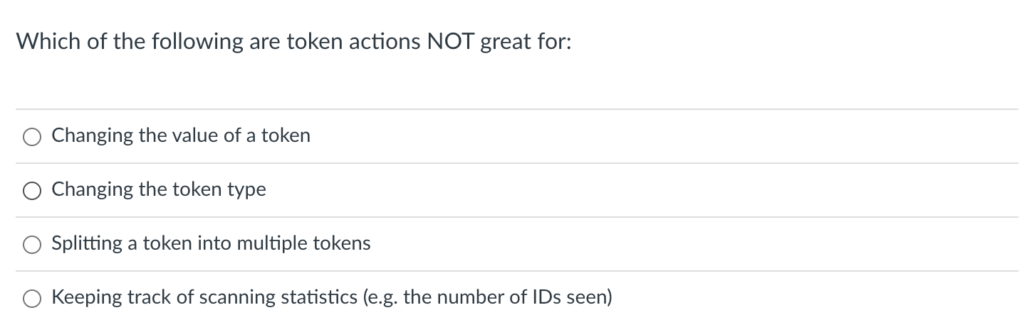
Quiz

Slide 10
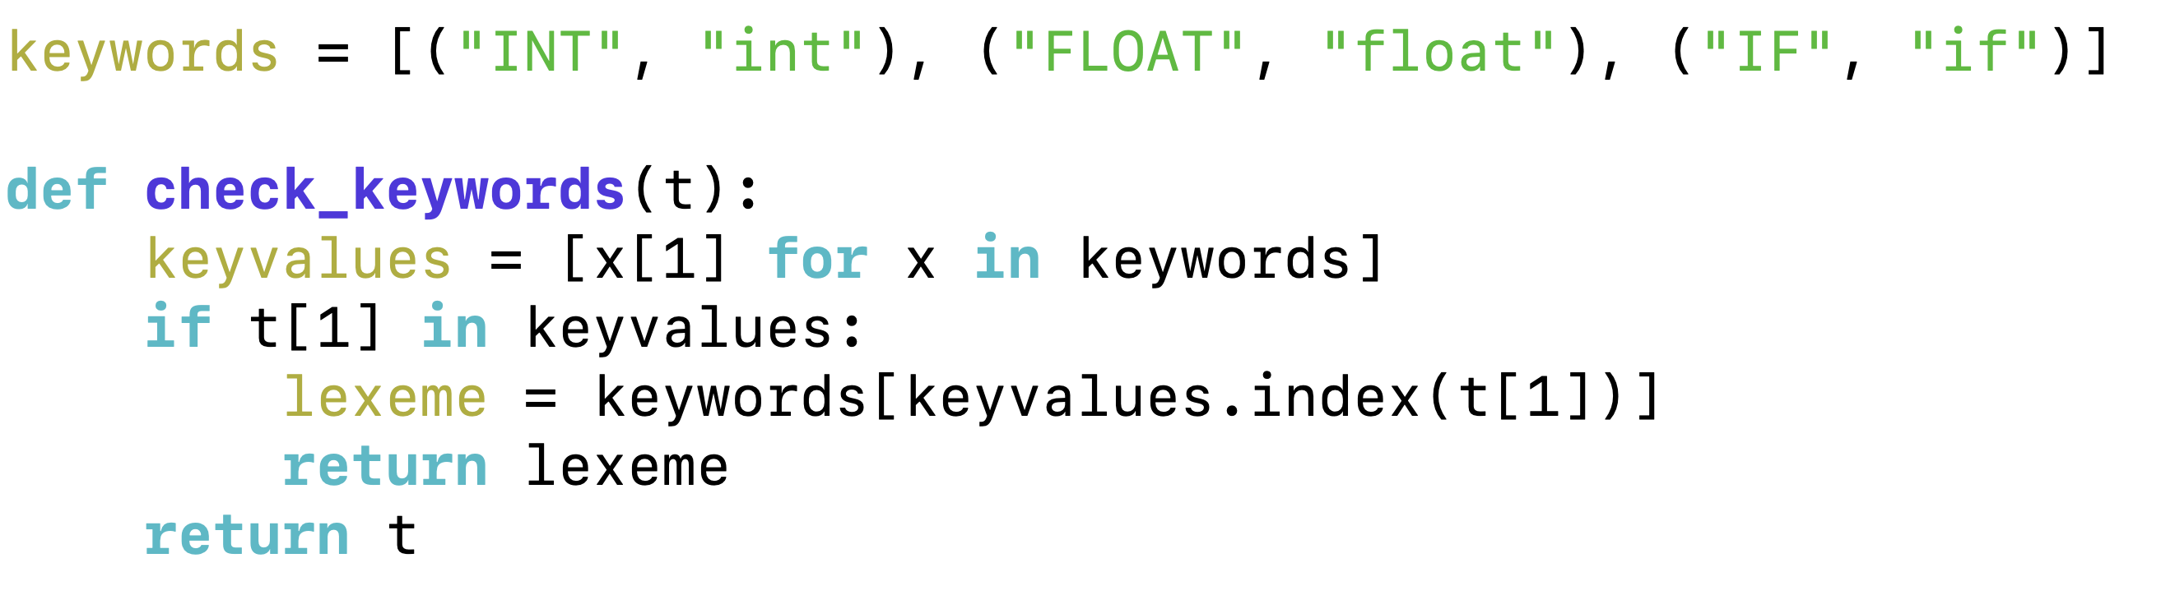
Examples
Modifying a value
def cat_dog(x):
if x[1] == "Cat":
return (x[0], "Dog")
return x
Modifying a token type

Slide 11
Examples
Keeping track of statistics
def count_lines(x):
if x[1] == "\n":
s.lineno += 1
return x
What other statistics might you want?

Slide 12
Quiz
This is really difficult to do with token actions:
token actions take a single lexeme and return a single lexeme

Slide 13
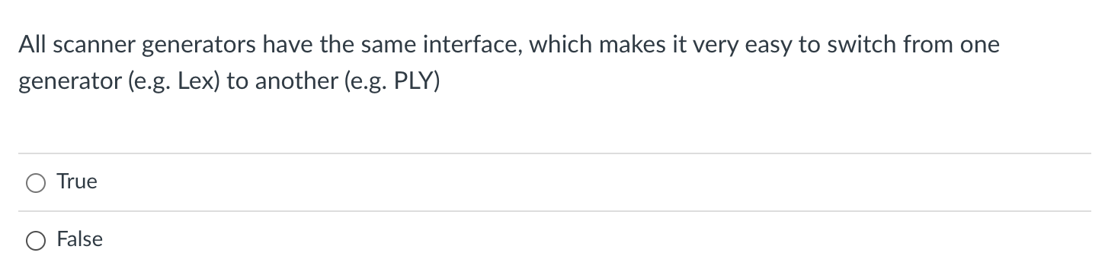
Quiz

Slide 14
Scanner generators
You can assume that all take in Regular expressions
Most of the time they have nice optional operators, e.g. [0-9], +, ?
You can assume that all of them support token actions, but they may be expressed differently.
You can assume that all of them have a function similar to token()
In lex it is called yylex()

Slide 15
PLY Example
Defining a token with no token action
t_PRONOUN = "her|his|their"
Defining a token with a token action
def t_PRONOUN(t):
"her|his|their"
if t.value in ["his", "her"]:
t.value = "their"
return t

Slide 16
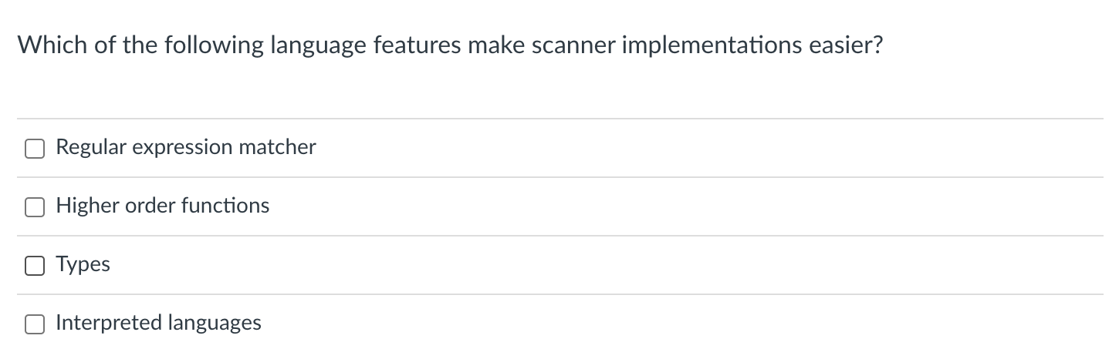
Quiz

Slide 17
Quiz
Required unless you want to write your own (take CSE211 for an example)

Slide 18
Quiz
Great for token actions, custom error functions, etc.

Slide 19
Quiz
Great for making sure your token actions are consistent. This is a shortcoming of Python

Slide 20
Quiz
Doesn’t really matter.
Ocaml is great for compilers (compiled)
Scheme is great for compilers (interpreted)

Slide 21
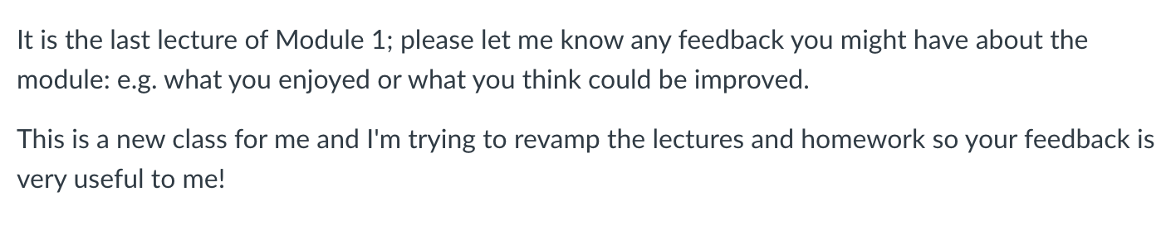
Quiz
Thanks for all your feedback! I have ideas for next time
It sounds like the pacing can be picked up a bit and spend more time on:
Python code
Corner cases (e.g. how to deal with regular expressions that share common prefixes)

Slide 22
Review
We covered token actions in the quiz.
Token actions are an optional part of a token definition
In our case, you can just send the idy function if you don’t need one
Token actions take in a lexeme and return a possibly refined lexeme
KEYWORDS refine IDs
Swap cat and dogs
Token actions can also modify state

Slide 23
Review
We also looked at using first class functions to implement our own error functions
We can throw an exception
Or try to recover at a ”synchronization” point (e.g. whitespace, or ;)
# Assume a scanner object s with the member istring
# to keep track of the string being scanned
def recover_err():
v = s.istring[0] # Get first character
s.istring = s.istring[1:] # Chop the first
return ("ERROR", v); # Return a special ERROR lexeme
# set the error function in the scanner
s.set_error(recover_err)

Slide 24
Review
You should know that Scanner generators exist
Lex
Classic C-based Scanner
PLY
Python implementation of Lex
Antlr
Modern scanner/parser generator
Similar interfaces, but not exactly the same
PLY lexemes contain line/column numbers
PLY using “token()”, lex uses “yylex()”

Slide 25
New module
Parsing:
Often times scanning is also included in parsing
Specifically this module is about “Syntactic Analysis”

Slide 26
Compiler Architecture
compiler
creates structure
produces executable code
Optimizations
Optimizations
Optimizations
machine code
input program
Front end
Optimizations
Back end
string
parsing
code gen
optimizations
build on each other
This module will finish up the front end

Slide 27
IR program
input program
Lexical Analysis
Syntactic Analyzer
Semantic Analyzer
Intermediate code gen
IR optimizations
loop!
optimized IR program
string
token stream
syntax tree
syntax tree
target code gen
ISA program
target code optimizations
loop!
optimized ISA program
machine code
More detailed view

Slide 28
IR program
input program
Lexical Analysis
Syntactic Analyzer
Semantic Analyzer
Intermediate code gen
IR optimizations
loop!
optimized IR program
string
token stream
syntax tree
syntax tree
target code gen
position = initial + rate * 60;
ISA program
target code optimizations
loop!
optimized ISA program
machine code
More detailed view

Slide 29
IR program
input program
Lexical Analysis
Syntactic Analyzer
Semantic Analyzer
Intermediate code gen
IR optimizations
loop!
optimized IR program
string
token stream
syntax tree
syntax tree
target code gen
position = initial + rate * 60;
Token stream
<id,1> <assign,=> <id,2> <bin_op,+> <id,3> <bin_op,*> <num,60> <semi,;>
target code optimizations
loop!
optimized ISA program
machine code

Slide 30
position = initial + rate * 60;
IR program
input program
Lexical Analysis
Syntactic Analyzer
Semantic Analyzer
Intermediate code gen
IR optimizations
loop!
optimized IR program
string
token stream
syntax tree
syntax tree
target code gen
Token stream
<id,1> <assign,=> <id,2> <bin_op,+> <id,3> <bin_op,*> <num,60> <semi,;>
parse tree
=
target code optimizations
+
loop!
<id,1>
<id,2>
*
<id,3>
60
machine code

Slide 31
Syntactic Analysis
Lexical Analysis turns a string into a stream of tokens
Syntactic Analysis determines if the tokens fit into the syntactic structure of the language
In our natural language example, it describes the structure of sentences

Slide 32
Syntactic Analysis
Natural language example
The dog ran across the park
ARTICLE
NOUN
VERB
PREPOSITION
ARTICLE
NOUN
What are valid sentences?
ARTICLE NOUN VERB PREPOSITION ARTICLE NOUN
ARTICLE ADJECTIVE NOUN VERB
Now we check if stream of lexemes fits
a sentence

Slide 33
How do we express a valid sentence?
List of tokens:
ARTICLE NOUN VERB PREPOSITION ARTICLE NOUN
Pros? Cons?

Slide 34
How do we express a valid sentence?
List of tokens:
ARTICLE NOUN VERB PREPOSITION ARTICLE NOUN
Pros? Cons?
Simple, but probably too simple

Slide 35
How do we express a valid sentence?
Several lists of tokens
ARTICLE NOUN VERB PREPOSITION ARTICLE NOUN
ARTICLE NOUN VERB
ARTICLE ADJECTIVE NOUN VERB
ARTICLE ADJECTIVE ADJECTIVE NOUN VERB
Pros? Cons?

Slide 36
How do we express a valid sentence?
Several lists of tokens
ARTICLE NOUN VERB PREPOSITION ARTICLE NOUN
ARTICLE NOUN VERB
ARTICLE ADJECTIVE NOUN VERB
ARTICLE ADJECTIVE ADJECTIVE NOUN VERB
Pros? Cons?
Potentially infinite choices

Slide 37
How do we express a valid sentence?
Regular expressions over tokens:
ARTICLE ADJECTIVE* NOUN VERB
Pros? Cons?

Slide 38
How do we express a valid sentence?
Regular expressions over tokens:
ARTICLE ADJECTIVE* NOUN VERB
Pros? Cons?
Regular expressions worked really well for tokens
Provides decent expressivity
But what might go wrong?

Slide 39
Mathematical expressions
tokens:
NUM = “[0-9]+”
PLUS = “\+”
MULT = “\*”
Can we describe expressions?

Slide 40
Mathematical expressions
NUM ((PLUS | MULT) NUM)*
5
5 + 6
5 + 6 * 3

Slide 41
Mathematical expressions
NUM ((PLUS | MULT) NUM)*
5
5 + 6
5 + 6 * 3
But what does this one mean? What if we want different precedence?

Slide 42
Mathematical expressions
NUM ((PLUS | MULT) NUM)*
5
5 + 6
5 + 6 * 3
But what does this one mean? What if we want different precedence?
(5 + 6) * 3
Can we do this one?

Slide 43
Mathematical expressions
tokens:
NUM = “[0-9]+”
PLUS = “\+”
MULT = “\*”
OPAR = “\(“
CPAR = “\)”

Slide 44
Mathematical expressions
OPAR? NUM ((PLUS | MULT) OPAR? NUM CPAR?)*
Add parenthesis tokens
5
5 + 6
5 + 6 * 3
But what does this one mean? What if we want different precedence?
(5 + 6) * 3
Can we do this one?

Slide 45
Mathematical expressions
OPAR? NUM ((PLUS | MULT) OPAR? NUM CPAR?)*
Seems like it works! But what is the issue?

Slide 46
Mathematical expressions
OPAR? NUM ((PLUS | MULT) OPAR? NUM CPAR?)*
Seems like it works! But what is the issue?
(5 + 6 * 3
What about this one?

Slide 47
Mathematical expressions
OPAR? NUM ((PLUS | MULT) OPAR? NUM CPAR?)*
Seems like it works! But what is the issue?
(5 + 6 * 3
What about this one?
()s are a key part of syntax. They are import for the structure we want to create and
we need to reliably detect strings that are not syntactically valid!

Slide 48
Context Free Grammars: A new class of languages
Regular expressions CANNOT match
(),
{},
HTML start/end tags
etc.
We will use context free grammars

Slide 49
Recall: Language theory
Some theory:
Given a language L, a string s is either part of that language or not
Integers are a language: “5”, “6”, “-7” is in the language. “abc” is not.
Languages are grouped into families depending on how “hard” it is to determine if a string is part of that language.

Slide 50
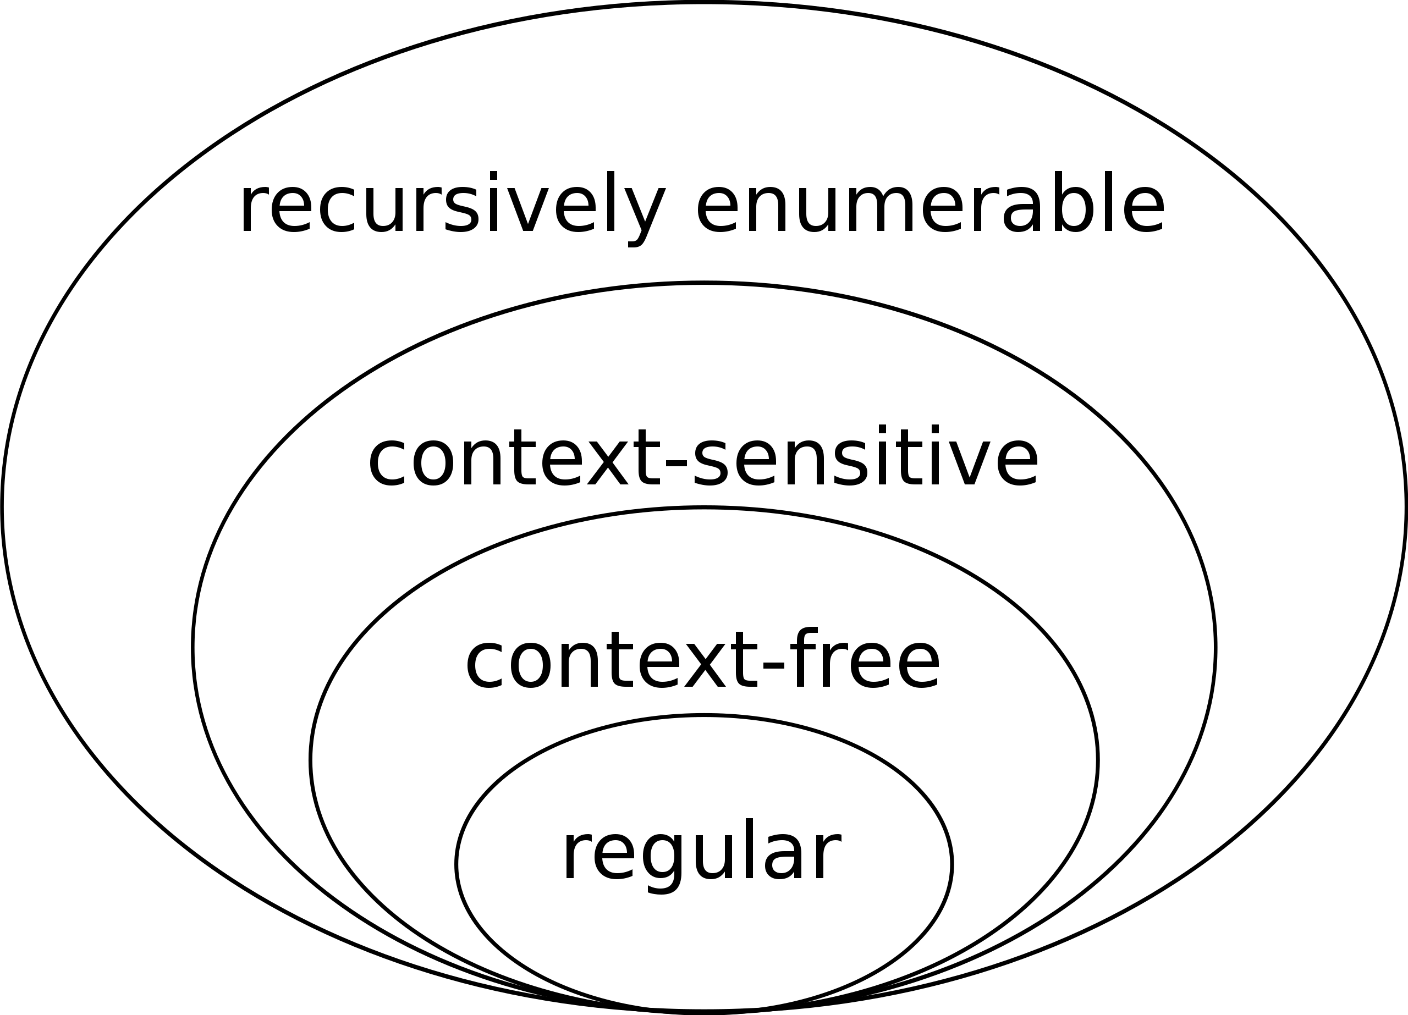
Recall: Language theory
The simplest languages are regular. We used
regular expressions for tokens.
They are fast, even in the general case
good level of abstraction for tokens
We will now use context-free languages for
Syntactic Analysis
Fast algorithms exist in many cases (not all)
Determining membership can be even inefficient
or even undecidable at higher levels (context-sensitive and recursively enumerable)
image source: wikipedia

Slide 51
Context-free languages
We will define similar to like regular languages
In this class a context-free language is a language that can be recognized by a context-free grammar

Slide 52
Context-free languages
We will define similar to like regular languages
In this class a context-free language is a language that can be recognized by a context-free grammar
....
What is a context-free grammar?

Slide 53
Context-free grammar
We will use Backus–Naur form (BNF) form
non-terminals are language ids. You can have as many as you need.
each non-terminal maps to one or more production rules.
one non-terminal is designated as the start or goal symbol
non-terminal-1 ::= production-rule-1
| production-rule-2
| ...
non-terminal-2 ::= production-rule-1
| production-rule-2
| ...
....

Slide 54
Context-free grammar
We will use Backus–Naur form (BNF) form
Production rules contain a sequence of either non-terminals or terminals
In our class, terminals will either be string constants or tokens
Examples:
add_expr ::= NUM ‘+’ NUM
mult_expr ::= NUM ‘*’ NUM
joint_expr ::= add_expr ‘*’ add_expr
simple_expr ::= NUM ‘+’ NUM
| NUM ‘*’ NUM

Slide 55
Deriving strings
A CFG G is said to derive a string s if s is in the language of G
We can show a string s belongs to G by providing a derivation
SheepNoise ::= ‘baa’ SheepNoise
| ‘baa’
Start with a sentinel string: a string containing terminals and non-terminals:
“SheepNoise”
Then pick one of the non-terminals and expand it

Slide 56
Deriving strings
Give each production rule a numeric id
1: SheepNoise ::= ‘baa’ SheepNoise
2: | ‘baa’
RULE | Sentential Form
start | SheepNoise
RULE | Sentential Form
start | SheepNoise

Slide 57
Deriving strings
Give each production rule a numeric id
1: SheepNoise ::= ‘baa’ SheepNoise
2: | ‘baa’
RULE | Sentential Form
start | SheepNoise
2 | baa
RULE | Sentential Form
start | SheepNoise
1 | baa SheepNoise
2 | baa baa

Slide 58
A more complicated example
1: Expr ::= ‘(’ Expr ‘)’
2: | Expr Op ID
3: | ID
4: Op ::= ‘+’
5: Op | ‘*’
Can we derive the string (a+b)*c
RULE | Sentential Form
start | Expr

Slide 59
A more complicated example
1: Expr ::= ‘(’ Expr ‘)’
2: | Expr Op ID
3: | ID
4: Op ::= ‘+’
5: Op | ‘*’
Can we derive the string (a+b)*c
RULE | Sentential Form
start | Expr
2 | Expr Op ID
5 | Expr * ID
1 | (Expr) * ID
2 | (Expr Op ID) * ID
4 | (Expr + ID) * ID
3 | (ID + ID) * ID

Slide 60
A more complicated example
1: Expr ::= ‘(’ Expr ‘)’
2: | Expr Op ID
3: | ID
4: Op ::= ‘+’
5: Op | ‘*’
Can we derive the string (a+b)*c
We can visualize this as a tree:
RULE | Sentential Form
start | Expr
2 | Expr Op ID
5 | Expr * ID
1 | (Expr) * ID
2 | (Expr Op ID) * ID
4 | (Expr + ID) * ID
3 | (ID + ID) * ID
Expr

Slide 61
A more complicated example
1: Expr ::= ‘(’ Expr ‘)’
2: | Expr Op ID
3: | ID
4: Op ::= ‘+’
5: Op | ‘*’
Can we derive the string (a+b)*c
We can visualize this as a tree:
RULE | Sentential Form
start | Expr
2 | Expr Op ID
5 | Expr * ID
1 | (Expr) * ID
2 | (Expr Op ID) * ID
4 | (Expr + ID) * ID
3 | (ID + ID) * ID
Expr
Expr
Op
(ID, c)

Slide 62
A more complicated example
1: Expr ::= ‘(’ Expr ‘)’
2: | Expr Op ID
3: | ID
4: Op ::= ‘+’
5: Op | ‘*’
Can we derive the string (a+b)*c
We can visualize this as a tree:
RULE | Sentential Form
start | Expr
2 | Expr Op ID
5 | Expr * ID
1 | (Expr) * ID
2 | (Expr Op ID) * ID
4 | (Expr + ID) * ID
3 | (ID + ID) * ID
Expr
Expr
Op
(ID, c)
*

Slide 63
A more complicated example
1: Expr ::= ‘(’ Expr ‘)’
2: | Expr Op ID
3: | ID
4: Op ::= ‘+’
5: Op | ‘*’
Can we derive the string (a+b)*c
We can visualize this as a tree:
RULE | Sentential Form
start | Expr
2 | Expr Op ID
5 | Expr * ID
1 | (Expr) * ID
2 | (Expr Op ID) * ID
4 | (Expr + ID) * ID
3 | (ID + ID) * ID
Expr
Expr
Op
(ID, c)
(
Expr
)
*

Slide 64
A more complicated example
1: Expr ::= ‘(’ Expr ‘)’
2: | Expr Op ID
3: | ID
4: Op ::= ‘+’
5: Op | ‘*’
Can we derive the string (a+b)*c
We can visualize this as a tree:
RULE | Sentential Form
start | Expr
2 | Expr Op ID
5 | Expr * ID
1 | (Expr) * ID
2 | (Expr Op ID) * ID
4 | (Expr + ID) * ID
3 | (ID + ID) * ID
Expr
Expr
Op
(ID, c)
(
Expr
)
*
Expr
Op
(ID, b)

Slide 65
A more complicated example
1: Expr ::= ‘(’ Expr ‘)’
2: | Expr Op ID
3: | ID
4: Op ::= ‘+’
5: Op | ‘*’
Can we derive the string (a+b)*c
We can visualize this as a tree:
RULE | Sentential Form
start | Expr
2 | Expr Op ID
5 | Expr * ID
1 | (Expr) * ID
2 | (Expr Op ID) * ID
4 | (Expr + ID) * ID
3 | (ID + ID) * ID
Expr
Expr
Op
(ID, c)
(
Expr
)
*
Expr
Op
(ID, b)
+

Slide 66
A more complicated example
1: Expr ::= ‘(’ Expr ‘)’
2: | Expr Op ID
3: | ID
4: Op ::= ‘+’
5: Op | ‘*’
Are there other ways to derive(a+b)*c?
We can visualize this as a tree:
RULE | Sentential Form
start | Expr
2 | Expr Op ID
5 | Expr * ID
1 | (Expr) * ID
2 | (Expr Op ID) * ID
4 | (Expr + ID) * ID
3 | (ID + ID) * ID
Expr
Expr
Op
(ID, c)
(
Expr
)
*
Expr
Op
(ID, b)
(ID, a)
+

Slide 67
A more complicated example
1: Expr ::= ‘(’ Expr ‘)’
2: | Expr Op ID
3: | ID
4: Op ::= ‘+’
5: Op | ‘*’
Are there other ways to derive(a+b)*c?
RULE | Sentential Form
start | Expr
2 | Expr Op ID
5 | Expr * ID
1 | (Expr) * ID
2 | (Expr Op ID) * ID
4 | (Expr + ID) * ID
3 | (ID + ID) * ID
RULE | Sentential Form
start | Expr

Slide 68
A more complicated example
1: Expr ::= ‘(’ Expr ‘)’
2: | Expr Op ID
3: | ID
4: Op ::= ‘+’
5: Op | ‘*’
Are there other ways to derive(a+b)*c?
RULE | Sentential Form
start | Expr
2 | Expr Op ID
5 | Expr * ID
1 | (Expr) * ID
2 | (Expr Op ID) * ID
4 | (Expr + ID) * ID
3 | (ID + ID) * ID
RULE | Sentential Form
start | Expr
2 | Expr Op ID
1 | (Expr) Op ID
2 | (Expr Op ID) Op ID
3 | (ID Op ID) Op ID
4 | (ID + ID) Op ID
5 | (ID + ID) + ID
right derivation
left derivation

Slide 69
A more complicated example
1: Expr ::= ‘(’ Expr ‘)’
2: | Expr Op ID
3: | ID
4: Op ::= ‘+’
5: Op | ‘*’
Are there other ways to derive(a+b)*c?
Expr
RULE | Sentential Form
start | Expr
2 | Expr Op ID
1 | (Expr) Op ID
2 | (Expr Op ID) Op ID
3 | (ID Op ID) Op ID
4 | (ID + ID) Op ID
5 | (ID + ID) + ID
Expr
Op
(ID, c)
(
Expr
)
*
Expr
Op
(ID, b)
same parse tree
(ID, a)
+
left derivation

Slide 70
Ambiguous grammars
What happens when different derivations have different parse trees?
1: Statement ::= ”if” Expr “then” Statement “else” Statement
2: | ”if” Expr “then” Statement
3: | Assignment
4: | ....
can we derive this string?
if Expr1 then if Expr2 then Assignment1 else Assignment2
Next few figures taken from the EAC book (Chapter 3.1)

Slide 71
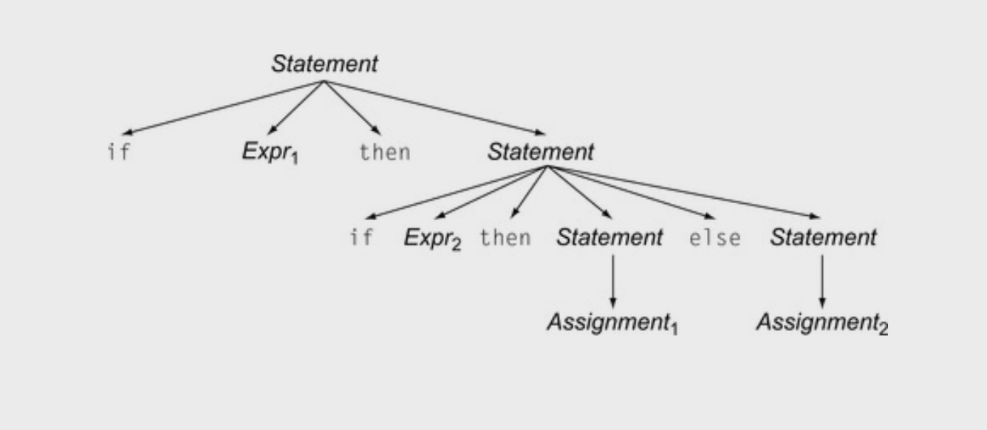
Ambiguous grammars
1: Statement ::= ”if” Expr “then” Statement “else” Statement
2: | ”if” Expr “then” Statement
3: | Assignment
4: | ....
if Expr₁ then if Expr₂ then Assignment₁ else Assignment₂

Slide 72
Ambiguous grammars
1: Statement ::= ”if” Expr “then” Statement “else” Statement
2: | ”if” Expr “then” Statement
3: | Assignment
4: | ....
if Expr₁ then if Expr₂ then Assignment₁ else Assignment₂
Valid derivation

Slide 73
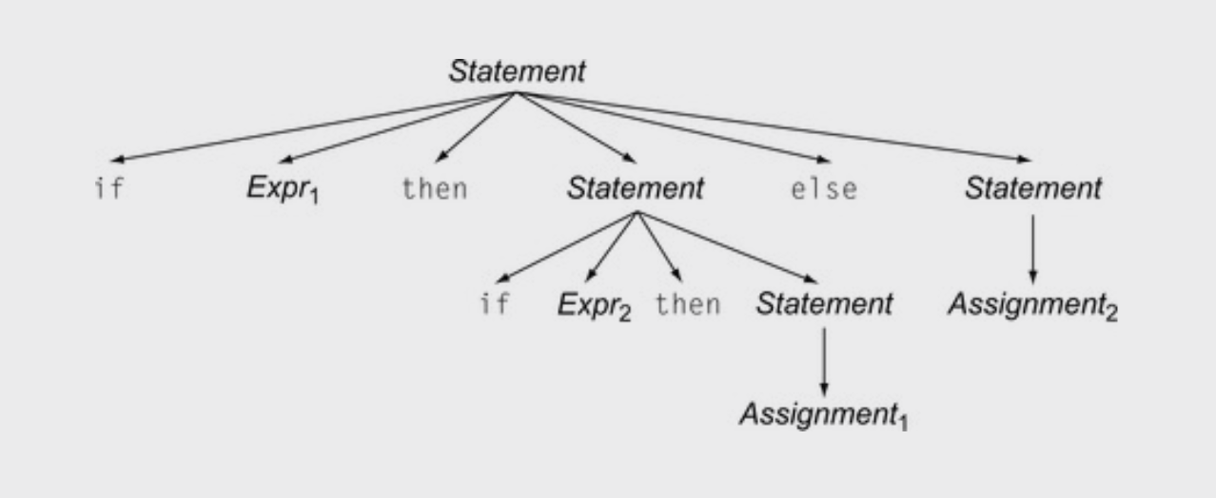
Ambiguous grammars
1: Statement ::= ”if” Expr “then” Statement “else” Statement
2: | ”if” Expr “then” Statement
3: | Assignment
4: | ....
if Expr₁ then if Expr₂ then Assignment₁ else Assignment₂
Valid derivation

Slide 74
Ambiguous grammars
1: Statement ::= ”if” Expr “then” Statement “else” Statement
2: | ”if” Expr “then” Statement
3: | Assignment
4: | ....
if Expr₁ then if Expr₂ then Assignment₁ else Assignment₂
Valid derivation
Also a valid derivation

Slide 75
Ambiguous grammars
Is this an issue? Don’t we only care if a grammar can derive a string?
Valid derivation
Also a valid derivation

Slide 76
Meaning into structure
We want to start encoding meaning into the parse structure. We will want as much structure as possible as we continue through the compiler
The structure is that we want evaluation of program to correspond to a post order traversal of the parse tree (also called the natural traversal)

Slide 77
Post order traversal
visiting for for different types
of traversals:
pre order?
in order?
post order

Slide 78
Post order traversal
4
visiting for for different types
of traversals:
post order
1
2
3

Slide 79
Ambiguous grammars
When we encode meaning into structure, these are very different programs
Valid derivation
Also a valid derivation

Slide 80
We will study how to eliminate ambiguity
But I want to close out today with an interesting case study

Slide 81
Case study
Using a CFG, you can derive random strings in a language
C-Smith
Generates random C programs
Used to test compiler correctness
clang -00
run
Random C program
Check outcome. Is it the same? if not, then there is a bug in one of the compilers
clang -03
run
gcc ...
run

Slide 82
Case study
400+ compiler bugs found
Demo
clang -00
run
Random C program
Check outcome. Is it the same? if not, then there is a bug in one of the compilers
clang -03
run
gcc ...
run

Slide 83
Case study
int main() {
int x;
printf("%d\n", x);
return 0;
}
Big challenge: Undefined behavior
Even though the program is syntactically valid, the behavior may be undefined
Uninitialized variables can return
anything!
Use advanced compiler analysis
to catch these issues
clang -00
run
Random C program
Check outcome. Is it the same? if not, then there is a bug in one of the compilers
clang -03
run
gcc ...
run

Slide 84
On Wednesday
How to remove ambiguity from grammars
Precedence
Associativity

