Slide 1
CSE110A: Compilers May 2, 2022
..
AST
..
..
..
..
Topics:
ASTs
type checking
CFG
...
...
...
...
3 address code
store i32 0, ptr %2
%3 = load i32, ptr %1
%4 = add nsw i32 %3, 1,
store i32 %4, ptr %1
%5 = load i32, ptr %2

Slide 2
Announcements
HW 1 grades are released
Let us know in 1 week if there are any issues
Please let us know through a private piazza post
Do not ask TAs or Tutors directly about changing your grade
Midterm is posted
I have updated the document once (as documented in the announcement)
I have started a piazza note with clarifications

Slide 3
Announcements
Midterm rules
Ask any questions as a private piazza post
Do not discuss any part of it with classmates (e.g. tests, concepts, or approaches)
Do not ask questions online or google for exact questions
And if you happen to stumble across answers online, please let me know!
Document your answers so we can give as much partial credit as possible!
No late midterms will be accepted, so please plan ahead!

Slide 4
Announcements
HW 2 is due today
Please try to get it in on time!
It is a difficult homework; as such I will provide a life preserve
If you submit by the deadline you get 10 extra points
that can count towards 100% (but not over 100%)
At midnight, we will release a solution to part 1:
A grammar along with a First+ set
You can use this grammar to help you with part 2 and part 3
Late penalties still apply. No extra points
The intent is this:
If you got a decent solution turned in, you can be done with this homework as planned
If you were completely stuck, you can use the grammar and first+ sets to submit something in the next few days
We will only grade one solution and we will grade the latest solution submitted

Slide 5
Homework 2 clarifications
What information for each variable does the symbol table hold?
For this assignment, nothing! It just keeps track of which variables have been declared and in which scope.
For the next homework we will add type information to the symbol table

Slide 6
Quiz

Slide 7
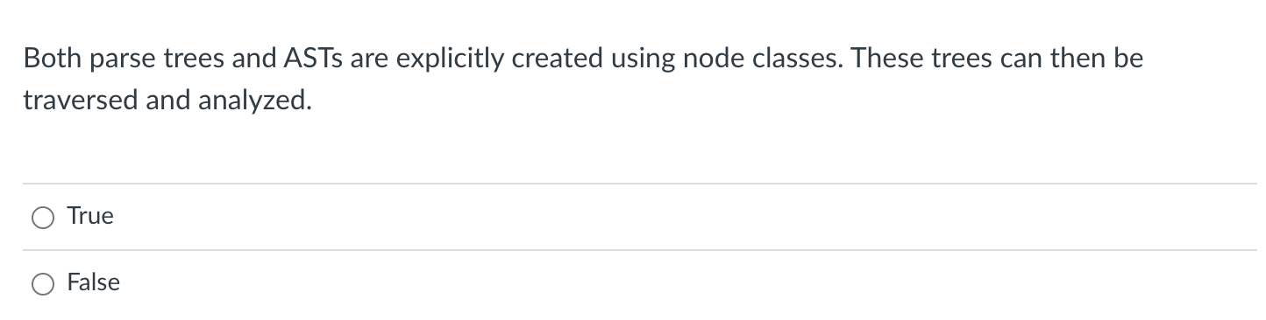
Quiz

Slide 8
Creating an AST from predictive grammar
5 - 4 - 3
Expr ::= NUM Expr2
Expr2 ::= MINUS NUM Expr2
| “”
Expr
5
Expr2
AST<->
-
4
Expr2
-
3
Expr2
AST<->
AST<3>
AST<5>
AST<4>
How do we get to the desired parse tree?

Slide 9
class ASTNode():
def __init__(self):
pass
class ASTLeafNode(ASTNode):
def __init__(self, value):
self.value = value
class ASTNumNode(ASTLeafNode):
def __init__(self, value):
super().__init__(value)
class ASTIDNode(ASTLeafNode):
def __init__(self, value):
super().__init__(value)
class ASTBinOpNode(ASTNode):
def __init__(self, l_child, r_child):
self.l_child = l_child
self.r_child = r_child
class ASTPlusNode(ASTBinOpNode):
def __init__(self, l_child, r_child):
super().__init__(l_child,r_child)
class ASTMultNode(ASTBinOpNode):
def __init__(self, l_child, r_child):
super().__init__(l_child,r_child)

Slide 10
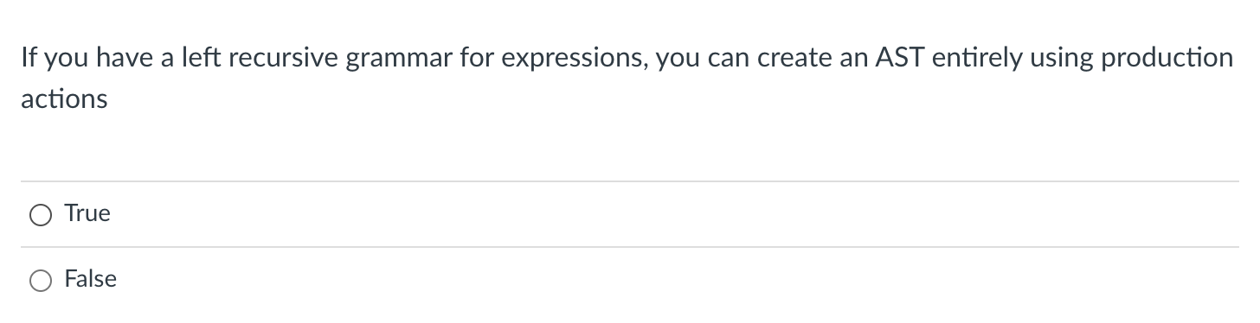
Quiz

Slide 11
input: (1+5)*6
Name | Productions | Production action
expr | : expr PLUS term | term | {return ASTAddNode($1,$3)} {return $1}
term | : term TIMES factor | factor | {return ASTMultNode($1,$3)} {return $1}
factor | : LPAR expr RPAR | NUM | ID | {return $2} {return ASTNumNode($1)} {return ASTIDNode($1)}
expr
term
term
<TIMES, “*”>
factor
factor
<NUM, “6”>
<LPAR, “(”>
expr
<RPAR, “)”>
expr
<PLUS,”+”>
term
factor
term
<NUM, “5”>
factor
<NUM, “1”>

Slide 12
input: (1+5)*6
Name | Productions | Production action
expr | : expr PLUS term | term | {return ASTAddNode($1,$3)} {return $1}
term | : term TIMES factor | factor | {return ASTMultNode($1,$3)} {return $1}
factor | : LPAR expr RPAR | NUM | ID | {return $2} {return ASTNumNode($1)} {return ASTIDNode($1)}
expr
term
term
<TIMES, “*”>
factor
factor
<NUM, “6”>
AST<*>
<LPAR, “(”>
expr
<RPAR, “)”>
expr
<PLUS,”+”>
term
AST<+>
AST<6>
factor
term
AST<1>
AST<5>
<NUM, “5”>
factor
<NUM, “1”>

Slide 13
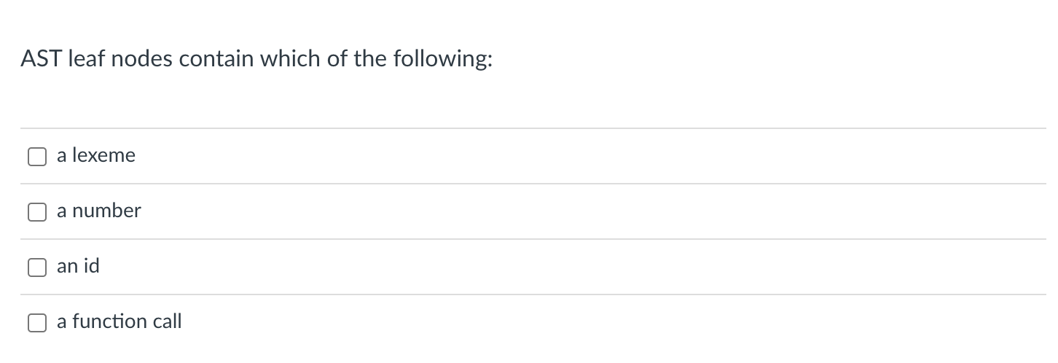
Quiz

Slide 14
input: (1+5)*6
Name | Productions | Production action
expr | : expr PLUS term | term | {return ASTAddNode($1,$3)} {return $1}
term | : term TIMES factor | factor | {return ASTMultNode($1,$3)} {return $1}
factor | : LPAR expr RPAR | NUM | ID | {return $2} {return ASTNumNode($1)} {return ASTIDNode($1)}
expr
term
term
<TIMES, “*”>
factor
factor
<NUM, “6”>
AST<*>
<LPAR, “(”>
expr
<RPAR, “)”>
expr
<PLUS,”+”>
term
AST<+>
AST<6>
factor
term
AST<1>
AST<5>
<NUM, “5”>
factor
<NUM, “1”>

Slide 15
Name | Productions | Production action
expr | : expr PLUS term | term | {return ASTAddNode($1,$3)} {return $1}
term | : term TIMES factor | factor | {return ASTMultNode($1,$3)} {return $1}
factor | : LPAR expr RPAR | NUM | ID | {return $2} {return ASTNumNode($1)} {return ASTIDNode($1)}
input: (1+x)*6
expr
term
term
<TIMES, “*”>
factor
factor
<NUM, “6”>
AST<*>
<LPAR, “(”>
expr
<RPAR, “)”>
expr
<PLUS,”+”>
term
AST<+>
AST<6>
factor
term
AST<1>
AST<x>
<ID, “x”>
factor
<NUM, “1”>

Slide 16
Quiz

Slide 17
(1+x)*sqrt(x)
Our language doesn’t have function calls,
but what do we think?
expr
term
term
<TIMES, “*”>
factor
factor
<?>
AST<*>
<LPAR, “(”>
expr
<RPAR, “)”>
expr
<PLUS,”+”>
term
AST<+>
AST<?>
factor
term
AST<1>
AST<x>
<ID, “x”>
factor
<NUM, “1”>

Slide 18
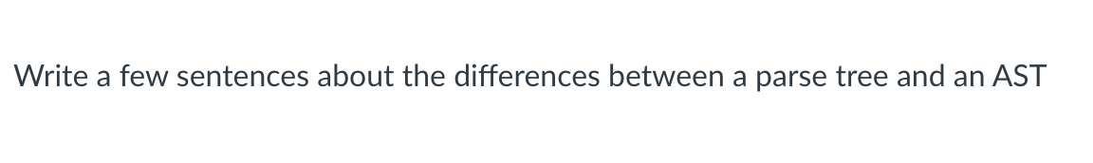
Quiz

Slide 19
Review
The quiz was a good review of the material

Slide 20
New material
Type systems
Evaluating an AST
Type systems
Type checking

Slide 21
Evaluate an AST by doing a post order traversal
5 + 4 + 3
Expr ::= NUM Expr2
Expr2 ::= PLUS NUM Expr2
| “”
Expr
parse tree
5
Expr2
AST<+>
AST
+
4
Expr2
+
3
Expr2
AST<+>
AST<3>
AST<5>
AST<5>
AST<4>
Parse trees cannot always be evaluated in post-order. An AST should always be

Slide 22
Evaluate an AST by doing a post order traversal
Expr ::= NUM Expr2
Expr2 ::= PLUS NUM Expr2
| “”
What if you cannot evaluate it? What else might you do?
x + y + z
AST<+>
AST<+>
AST<z>
AST<x>
AST<y>

Slide 23
Evaluate an AST by doing a post order traversal
Expr ::= NUM Expr2
Expr2 ::= PLUS NUM Expr2
| “”
What if you cannot evaluate it? What else might you do?
int x;
int y;
float z;
float w; w = x + y + z
AST<+>
AST<+>
AST<z>
AST<x>
AST<y>
How does this change things?

Slide 24
Evaluate an AST by doing a post order traversal
Expr ::= NUM Expr2
Expr2 ::= PLUS NUM Expr2
| “”
What if you cannot evaluate it? What else might you do?
adding together an int and a float
int x;
int y;
float z;
float w; w = x + y + z
adding together two ints
AST<+>
AST<+>
AST<z>
AST<x>
AST<y>
How does this change things?
in many languages this is fine, but we are working towards assembly language

Slide 25
Evaluate an AST by doing a post order traversal
Expr ::= NUM Expr2
Expr2 ::= PLUS NUM Expr2
| “”
add r0 r1 - interprets the bits in the registers as integers and adds them together
needs to be an x86 addss instruction
needs to be an x86 add instruction
AST<+>
addss r0 r1 - interprets the bits in the registers as floats and adds them together
AST<+>
AST<z>
AST<x>
AST<y>

Slide 26
Evaluate an AST by doing a post order traversal
int x;
int y;
float z;
float w; w = x + y + z
Expr ::= NUM Expr2
Expr2 ::= PLUS NUM Expr2
| “”
needs to be an x86 addss instruction
Lets do some experiments.
What should 5 + 5.0 be?
needs to be an x86 add instruction
AST<+>
AST<+>
AST<z>
AST<x>
AST<y>
Is this all?

Slide 27
Evaluate an AST by doing a post order traversal
int x;
int y;
float z;
float w; w = x + y + z
Expr ::= NUM Expr2
Expr2 ::= PLUS NUM Expr2
| “”
needs to be an x86 addss instruction
Lets do some experiments.
What should 5 + 5.0 be?
but
addss r1 r2
interprets both registers
as floats
needs to be an x86 add instruction
AST<+>
AST<+>
AST<z>
AST<x>
AST<y>
Is this all?

Slide 28
Evaluate an AST by doing a post order traversal
int x;
int y;
float z;
float w; w = x + y + z
Expr ::= NUM Expr2
Expr2 ::= PLUS NUM Expr2
| “”
needs to be an x86 addss instruction
needs to be an x86 add instruction
AST<+>
But the binary of 5 is 0b101 the float value of 0b101 is 7.00649232162e-45
We cannot just add them!
AST<+>
AST<z>
AST<x>
AST<y>
Is this all?

Slide 29
Evaluate an AST by doing a post order traversal
int x;
int y;
float z;
float w; w = x + y + z
Expr ::= NUM Expr2
Expr2 ::= PLUS NUM Expr2
| “”
converts the int
value to a float value
AST<+>
AST<int_to_float>
AST<z>
AST<+>
We need to make sure our operands are in the right format!
AST<x>
AST<y>

Slide 30
Type systems

Slide 31
Type systems
Given a language a type system defines:
The primitive (base) types in the language
How the types can be converted to other types
implicitly or explicitly
How the user can define new types

Slide 32
Type systems
Given a language a type system defines:
The primitive (base) types in the language
How the types can be converted to other types
implicitly or explicitly
How the user can define new types
Type checking
Check a program to ensure that it adheres to the type system
Especially interesting for compilers as a program given in the type system for the input language must be translated to a type system for lower-level program

Slide 33
Type systems
Different types of Type Systems for languages:
statically typed: types can be determined at compile time
dynamically typed: types are determined at runtime
untyped: the language has no types
What are examples of each?
What are pros and cons of each?

Slide 34
Type systems
Different types of Type Systems for languages:
statically typed: types can be determined at compile time
dynamically typed: types are determined at runtime
untyped: the language has no types
What are examples of each?
What are pros and cons of each?
do type conversion at compile time otherwise you have to check without static types, this would need to be translated to:
x + y
if type(x) == int and type(y) == int:
add(x,y) if type(x) == int and type(y) == float:
addss(int_to_float(x), y) if ...

Slide 35
Type systems
Different types of Type Systems for languages:
statically typed: types can be determined at compile time
dynamically typed: types are determined at runtime
untyped: the language has no types
What are examples of each?
What are pros and cons of each?
Can write more generic code
def add(x,y):
return x + y
You would need to write many different functions for each type

Slide 36
Type systems
Different types of Type Systems for languages:
statically typed: types can be determined at compile time
dynamically typed: types are determined at runtime
untyped: the language has no types
What are examples of each?
What are pros and cons of each?
Very close to assembly. You can write really optimized code. But very painful

Slide 37
Type systems
Different types of Type Systems for languages:
statically typed: types can be determined at compile time
dynamically typed: types are determined at runtime
untyped: the language has no types
What are examples of each?
What are pros and cons of each?
In this class, we will be:
Compiling a statically typed language (similar to C)
into an untyped language (similar to an ISA)
using a dynamically typed language (python)

Slide 38
Type systems
Considerations:

Slide 39
Type systems
Considerations:
Base types in the language:
ints
chars
strings
floats
bool
How to combine types in expressions:
int and float?
int and char?
int and bool?

Slide 40
Type systems
Considerations:
Base types:
ints
chars
strings
floats
bool
How to combine types in expressions:
int and float?
int and char?
int and bool?
size of ints? How does C do it? How does Python do it?
Pros and cons?

Slide 41
Type systems
Considerations:
Base types:
ints
chars
strings
floats
bool
How to combine types in expressions:
int and float?
int and char?
int and bool?
Are strings a base type? In C? In Python?

Slide 42
Type systems
Considerations:
Base types:
ints
chars
strings
floats
bool
How to combine types in expressions:
int and float?
int and char?
int and bool?
How are bools handled? in C? in Python

Slide 43
Type systems
Considerations:
Base types:
ints
chars
strings
floats
bool
How to combine types in expressions:
int and float?
int and char?
int and bool?

Slide 44
Type systems
Considerations:
Base types:
ints
chars
strings
floats
bool
How to combine types in expressions:
int and float?
int and char?
int and bool?
What do each of these do if they are +’ed together?

Slide 45
Type checking
Two components
Type inference
Determines a type for each AST node
Modifies the AST into a type-safe form
Catches type-related errors

Slide 46
Type checking on an AST
int x;
int y;
float z;
float w; w = x + y + z
each node additionally gets a type
AST<->
AST<->
AST<z>
AST<x>
AST<y>

Slide 47
Type checking on an AST
int x;
int y;
float z;
float w; w = x + y + z
each node additionally gets a type
we can get this from the symbol table for the leaves or based
on the input (e.g. 5 vs 5.0)
AST<+>
AST<+>
AST<z, float>
AST<x, int>
AST<y, int>

Slide 48
Type checking on an AST
int x;
int y;
float z;
float w; w = x + y + z
How do we get the type for this one?
AST<+>
AST<+,?>
AST<z, float>
AST<x, int>
AST<y, int>

Slide 49
Type checking on an AST
int x;
int y;
float z;
float w; w = x + y + z
How do we get the type for this one?
inference rules for addition:
AST<+>
first | second | result
int | int | int
int | float | float
float | int | float
float | float | float
AST<+,?>
AST<z, float>
AST<x, int>
AST<y, int>

Slide 50
Type checking on an AST
int x;
int y;
float z;
float w; w = x + y + z
How do we get the type for this one?
inference rules for addition:
AST<+>
first | second | result
int | int | int
int | float | float
float | int | float
float | float | float
AST<+,int>
AST<z, float>
AST<x, int>
AST<y, int>

Slide 51
Type checking on an AST
int x;
int y;
float z;
float w; w = x + y + z
How do we get the type for this one?
inference rules for addition:
AST<+,?>
first | second | result
int | int | int
int | float | float
float | int | float
float | float | float
AST<+,int>
AST<z, float>
AST<x, int>
AST<y, int>

Slide 52
Type checking on an AST
int x;
int y;
float z;
float w; w = x + y + z
How do we get the type for this one?
inference rules for addition:
AST<+,float>
first | second | result
int | int | int
int | float | float
float | int | float
float | float | float
AST<+,int>
AST<z, float>
AST<x, int>
AST<y, int>

Slide 53
Type checking on an AST
int x;
int y;
float z;
float w; w = x + y + z
How do we get the type for this one?
inference rules for addition:
AST<+,float>
first | second | result
int | int | int
int | float | float
float | int | float
float | float | float
AST<+,int>
AST<z, float>
AST<x, int>
AST<y, int>
what else?

Slide 54
Type checking on an AST
int x;
int y;
float z;
float w; w = x + y + z
How do we get the type for this one?
inference rules for addition:
AST<+,float>
first | second | result
int | int | int
int | float | float
float | int | float
float | float | float
AST<int_to_float,?>
AST<z, float>
AST<+,int>
AST<x, int>
AST<y, int>
what else? need to convert the int to a float

Slide 55
class ASTNode():
def __init__(self):
pass
class ASTLeafNode(ASTNode):
def __init__(self, value):
self.value = value
class ASTNumNode(ASTLeafNode):
def __init__(self, value):
super().__init__(value)
class ASTIDNode(ASTLeafNode):
def __init__(self, value):
super().__init__(value)
class ASTBinOpNode(ASTNode):
def __init__(self, l_child, r_child):
self.l_child = l_child
self.r_child = r_child
class ASTPlusNode(ASTBinOpNode):
def __init__(self, l_child, r_child):
super().__init__(l_child,r_child)
class ASTMultNode(ASTBinOpNode):
def __init__(self, l_child, r_child):
super().__init__(l_child,r_child)

Slide 56
Enum for types
Now we need to set the types for the leaf nodes
from enum import Enum
class Types(Enum):
INT = 1
FLOAT = 2
Our base AST Node needs a type
class ASTNode():
def __init__(self):
self.node_type = None
pass
def set_type(self, t):
self.node_type = t
def get_type(self):
return self.node_type

Slide 57
Enum for types
Now we need to set the types for the leaf nodes
from enum import Enum
class Types(Enum):
INT = 1
FLOAT = 2
class ASTNumNode(ASTLeafNode):
def __init__(self, value):
super().__init__(value)
if is_int(value):
self.set_type(Types.INT)
else:
self.set_type(Types.FLOAT)
Our base AST Node needs a type
class ASTNode():
def __init__(self):
self.node_type = None
pass
def set_type(self, t):
self.node_type = t
def get_type(self):
return self.node_type

Slide 58
Enum for types
Now we need to set the types for the leaf nodes
from enum import Enum
class Types(Enum):
INT = 1
FLOAT = 2
class ASTNumNode(ASTLeafNode):
def __init__(self, value):
super().__init__(value)
if is_int(value):
self.set_type(Types.INT)
else:
self.set_type(Types.FLOAT)
Our base AST Node needs a type
class ASTNode():
def __init__(self):
self.node_type = None
pass
def set_type(self, t):
self.node_type = t
def get_type(self):
return self.node_type
class ASTIDNode(ASTLeafNode):
def __init__(self, value, value_type):
super().__init__(value)
self.set_type(value_type)
Where can we get the value type for an ID?

Slide 59
Symbol Table
Say we are matched the statement: int x;
SymbolTable ST;
declare_statement ::= TYPE ID SEMI
{
eat(TYPE)
id_name = self.to_match[1]
eat(ID)
ST.insert(id_name, None)
eat(SEMI)
}
(TYPE, ‘int’)
(ID, ‘x’)
in homework 2 we didn’t
record any information in the symbol table

Slide 60
Symbol Table
Say we are matched the statement: int x;
SymbolTable ST;
declare_statement ::= TYPE ID SEMI
{
value_type = self.to_match[1]
eat(TYPE)
id_name = self.to_match[1]
eat(ID)
ST.insert(id_name, value_type)
eat(SEMI)
}
(TYPE, ‘int’)
(ID, ‘x’)
in homework 2 we didn’t
record any information in the symbol table
record the type in the symbol table

Slide 61
Enum for types
Now we need to set the types for the leaf nodes
from enum import Enum
class Types(Enum):
INT = 1
FLOAT = 2
class ASTNumNode(ASTLeafNode):
def __init__(self, value):
super().__init__(value)
if is_int(value):
self.set_type(Types.INT)
else:
self.set_type(Types.FLOAT)
Our base AST Node needs a type
class ASTNode():
def __init__(self):
self.node_type = None
pass
def set_type(self, t):
self.node_type = t
def get_type(self):
return self.node_type
class ASTIDNode(ASTLeafNode):
def __init__(self, value, value_type):
super().__init__(value)
self.set_type(value_type)
Where can we get the value type for an ID?
But that doesn’t get us here yet...

Slide 62
add the type at parse time
Unit ::= ID
| NUM
def parse_unit(self, lhs_node):
# ... for applying the first production rule (ID)
value = self.next_word[1]
# ... Check that value is in the symbol table
node = ASTIDNode(value, ST[value])
return node

Slide 63
Type inference
We now have the types for the leaf nodes
int x;
int y;
float w; w = x + y + 5.5
AST<+,?>
AST<+,?>
AST<5.5, float>
AST<x, int>
AST<y, int>

Slide 64
Type inference
We now have the types for the leaf nodes
Next steps:
we do a post order traversal
on the AST and do a type inference
AST<+,?>
AST<+,?>
AST<5.5, float>
AST<x, int>
AST<y, int>

Slide 65
Type inference
def type_inference(n):
Given a node n: find its type and the types of any of its children

Slide 66
Type inference
def type_inference(n):
Given a node n: find its type and the types of any of its children
case split on n:
if n is a leaf node:
return n.get_type()
base case

Slide 67
Type inference
def type_inference(n):
Given a node n: find its type and the types of any of its children
case split on n:
if n is a leaf node:
return n.get_type()
if n is a plus node:
...

Slide 68
Type inference
def type_inference(n):
Given a node n: find its type and the types of any of its children
case split on n:
if n is a leaf node:
return n.get_type()
if n is a plus node:
return lookup type from table
inference rules for plus
left | right | result
int | int | int
int | float | float
float | int | float
float | float | float
lookup the rule for plus

Slide 69
Type inference
def type_inference(n):
Given a node n: find its type and the types of any of its children
case split on n:
if n is a leaf node:
return n.get_type()
if n is a plus node:
return lookup type from table
inference rules for plus
left | right | result
int | int | int
int | float | float
float | int | float
float | float | float
lookup the rule for plus
but we’re missing a few things

Slide 70
Type inference
def type_inference(n):
Given a node n: find its type and the types of any of its children
case split on n:
if n is a leaf node:
return n.get_type()
if n is a plus node:
do type inference on children
return lookup type from table
inference rules for plus
we need to make sure the children have types!
left | right | result
int | int | int
int | float | float
float | int | float
float | float | float

Slide 71
Type inference
def type_inference(n):
Given a node n: find its type and the types of any of its children
case split on n:
if n is a leaf node:
return n.get_type()
if n is a plus node:
do type inference on children
t = lookup type from table
set n type to t
return t
inference rules for plus
we should record our type
left | right | result
int | int | int
int | float | float
float | int | float
float | float | float

Slide 72
Type inference
def type_inference(n):
Given a node n: find its type and the types of any of its children
case split on n:
if n is a leaf node:
return n.get_type()
if n is a plus node:
do type inference on children
t = lookup type from table
set n type to t
return t
is this just for plus?
left | right | result
int | int | int
int | float | float
float | int | float
float | float | float

Slide 73
Type inference
def type_inference(n):
Given a node n: find its type and the types of any of its children
case split on n:
if n is a leaf node:
return n.get_type()
if n is a plus node:
do type inference on children
t = lookup type from table
set n type to t
return t
most language promote
types, e.g. ints to float for
expression operators
is this just for plus?
left | right | result
int | int | int
int | float | float
float | int | float
float | float | float

Slide 74
Type inference
def type_inference(n):
Given a node n: find its type and the types of any of its children
case split on n:
if n is a leaf node:
return n.get_type()
if n is a bin op node:
do type inference on children
t = lookup type from table
set n type to t
return t
most language promote
types, e.g. ints to float for
expression operators
is this just for plus?
left | right | result
int | int | int
int | float | float
float | int | float
float | float | float

Slide 75
Type inference
What about for assignments?
def type_inference(n):
int x;
cout << (x = 5.5) << endl;
case split on n:
if n is a leaf node:
return n.get_type()
if n is a bin op node:
do type inference on children
t = lookup type from table
set n type to t
return t
What does this return?
left | right | result
int | int | int
int | float | float
float | int | float
float | float | float

Slide 76
Type inference
What about for assignments?
def type_inference(n):
int x;
cout << (x = 5.5) << endl;
case split on n:
if n is a leaf node:
return n.get_type()
if n is a bin op node:
do type inference on children
t = lookup type from table
set n type to t
return t
What does this return?
left | right | result
int | int | int
int | float | int
float | int | float
float | float | float
whatever the left is

Slide 77
Type inference
What about for assignments?
def type_inference(n):
int x;
cout << (x = 5.5) << endl;
case split on n:
if n is a leaf node:
return n.get_type()
if n is an assignment:
....
if n is a bin op node:
...
What does this return?
left | right | result
int | int | int
int | float | int
float | int | float
float | float | float
whatever the left is

Slide 78
Type checking
Checking for errors

Slide 79
Type inference
def type_inference(n):
Given a node n: find its type and the types of any of its children
case split on n:
if n is a leaf node:
return n.get_type()
if n is a plus node:
do type inference on children
t = lookup type from table
if t is None:
throw type exception
set n type to t
return t
inference rules for plus
we should record our type
left | right | result
int | int | int
int | float | float
float | int | float
float | float | float

Slide 80
Type inference
def type_inference(n):
Given a node n: find its type and the types of any of its children
case split on n:
if n is a leaf node:
return n.get_type()
if n is a plus node:
do type inference on children
t = lookup type from table
if t is None:
throw type exception
set n type to t
return t
inference rules for plus
we should record our type
left | right | result
int | int | int
int | float | float
float | int | float
float | float | float
string | int | None
like in Python

Slide 81
Type inference
def type_inference(n):
Given a node n: find its type and the types of any of its children
case split on n:
if n is a leaf node:
return n.get_type()
if n is a plus node:
do type inference on children
t = lookup type from table
if t is None:
throw type exception
set n type to t
return t
inference rules for plus
we should record our type
left | right | result
int | int | int
int | float | float
float | int | float
float | float | float
string | int | None
like in Python

Slide 82
See everyone on Wednesday
We will discuss linearizing code

