Slide 1
CSE110A: Compilers March 30, 2022
Topics:
Logistics
Location
Office hours
Piazza
Quiz
Compiler Overview
What is a compiler
What are the different stages of a compiler
Frontend
Intermediate
Backend

Slide 2
Announcements
New room!
Previous room only sat 64 students
Moving to Soc Sci 2 - 71 (Bigger room)
should help with social distancing as well
We let everyone on the wait list in (68 students)
Class is slightly more impacted
might effect grading time, office hours, etc. but we will do our best

Slide 3
Announcements
Piazza is up and going!
Private questions for homework help (especially if you are going to share code, or ask for clarification on a grade)
Public questions for framework, programming languages, content, etc.
Did anyone set up a discord?

Slide 4
Announcements
Office hours:
Yanwen:
??
Arrian:
??
Neal:
??

Slide 5
Quiz

Slide 6
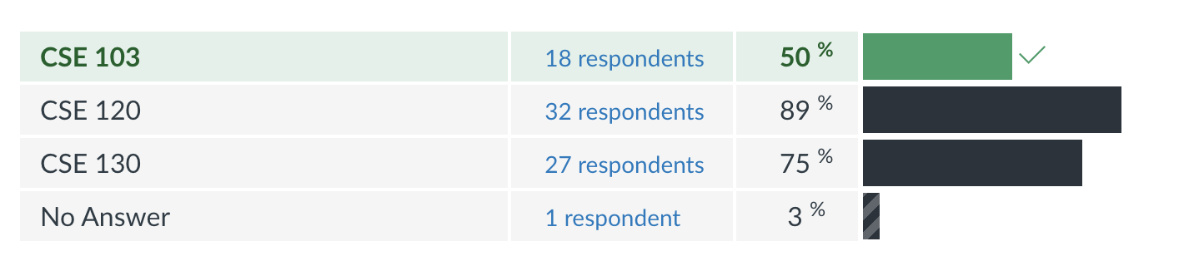
Background
What classes have you taken:

Slide 7
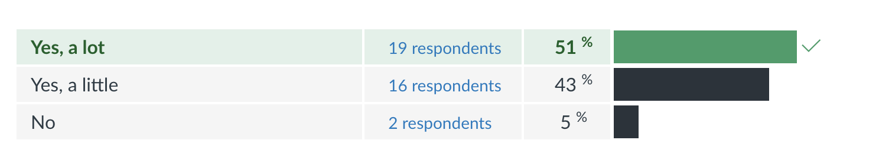
Background
Have you programmed in Python before?
It is worthwhile to learn!
https://www.tiobe.com/tiobe-index/

Slide 8
What do people hope to get out of this class?
A few answers that I liked:
“I don’t know too much about compilers and I want to learn!”
”learning about compilers will make me a better programmer”
”Increase knowledge about computer science”
“Want to make my own programming language”
“Why programming languages are the way they are”

Slide 9
Quiz
Thank you for all your thoughtful answers!
We will decide on what to do about masks later

Slide 10
Review
Normally we would do a review here, but nothing too much to review

Slide 11
Schedule
Introduction to compilers
Compiler architecture

Slide 12
Schedule
Introduction to compilers
Compiler architecture

Slide 13
What is a compiler?
Let’s discuss

Slide 14
What is a compiler?
Let’s discuss

Slide 15
What are some of your favorite compilers
Let’s discuss

Slide 16
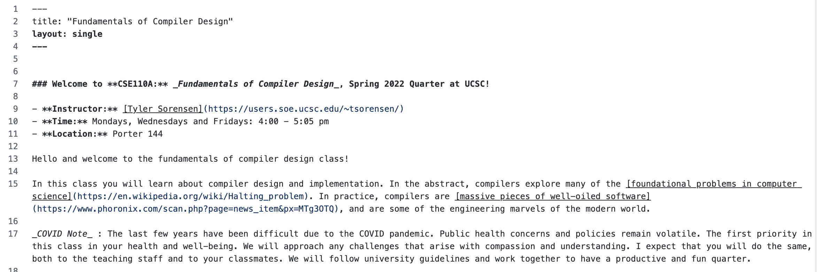
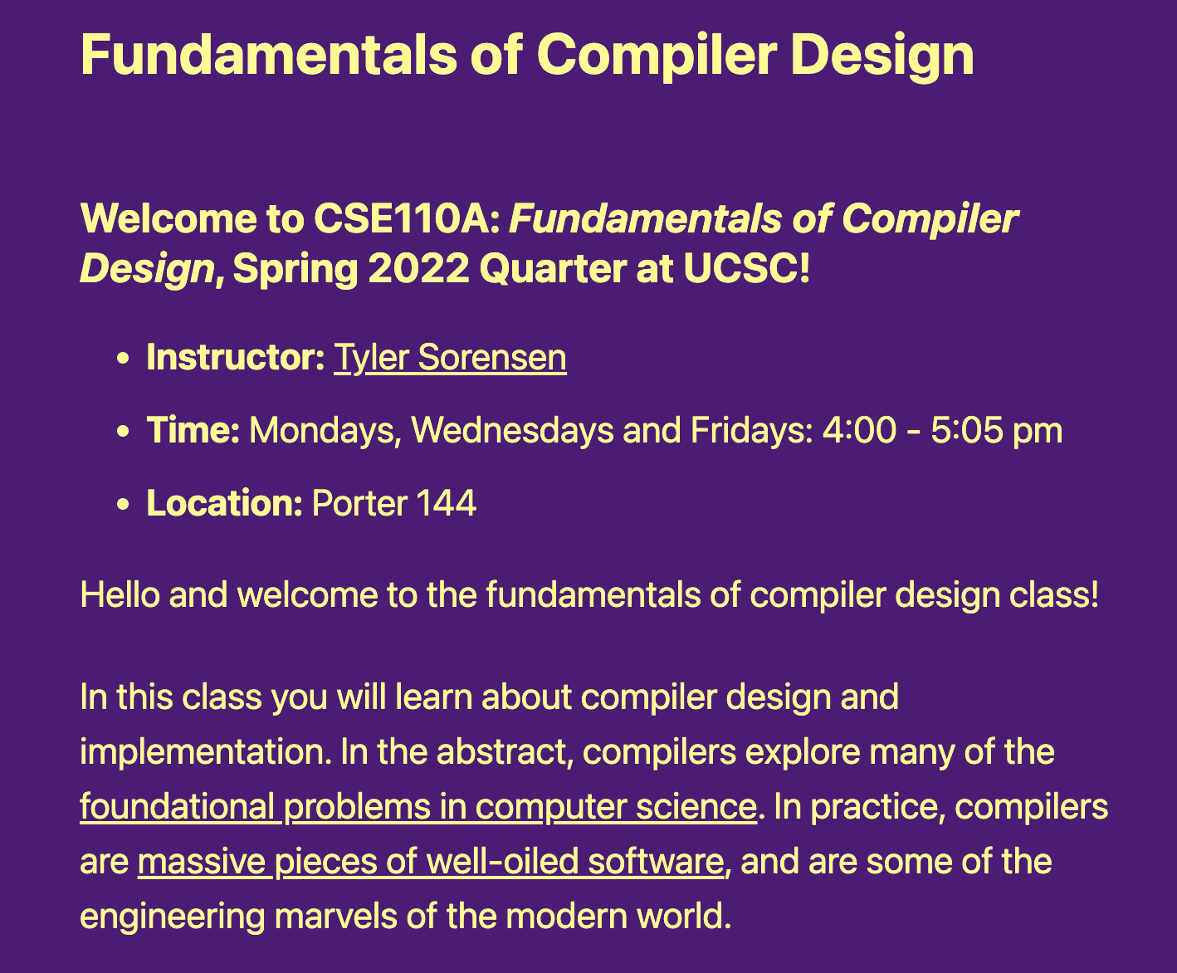
Building this website started with:
Markdown to describe the page
compiled with Jekyll to a static webpage
static webpage is in HTML and javascript

Slide 17

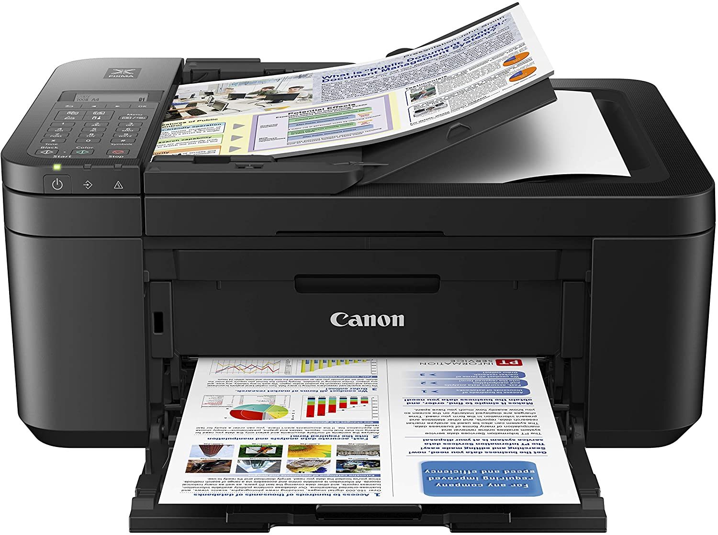

Slide 18
What is a compiler?
Input
Compiler
Output

Slide 19
What is a compiler?
Input
Compiler
Output
This is way too general to be useful Any program fits this description.

Slide 20
What is a compiler?
Input
Compiler
Output
Strings belonging to language L
Strings belonging to language L’
A theoretical answer

Slide 21
Building this website started with:
Markdown to describe the page
compiled with Jekyll to a static webpage
static webpage is in HTML and javascript
This would be a compiler

Slide 22
What is a compiler?
A more traditional description What are some examples here?
Input
Compiler
Output
Strings belonging to language L
Strings belonging to language L’
A series of statements in
programming language L
An executable binary file in an ISA language

Slide 23
What is a compiler?
A classic example
Input
Compiler
Output
Strings belonging to language L
Strings belonging to language L’
A series of statements in
programming language L
An executable binary file in an ISA language
A program written in C
gcc/clang
An x86 Binary executable

Slide 24
What is a compiler?
int main() {
printf("hello world\n");
}
gcc main.c
Input
Compiler
Output
Strings belonging to language L
Strings belonging to language L’
A series of statements in
programming language L
An executable binary file in an ISA language
A program written in C
gcc/clang
An x86 Binary executable

Slide 25
What is a compiler?
What is wrong with this picture?
int main() {
printf("hello world\n");
}
$ ./a.out
hello CSE 110A
gcc main.c
Input
Compiler
Output
Strings belonging to language L
Strings belonging to language L’
A series of statements in
programming language L
An executable binary file in an ISA language
A program written in C
gcc/clang
An x86 Binary executable

Slide 26
What is a compiler?
A valid input must have a equivalent valid output. Semantic equivalence
Input
Compiler
Output
Strings belonging to language L
Strings belonging to language L’
A series of statements in
programming language L
An executable binary file in an ISA language
A program written in C
gcc/clang
An x86 Binary executable

Slide 27
What is a compiler?
What is wrong with this picture?
int main() {
printf("hello world\n");
}
$ ./a.out
hello CSE 110A
gcc main.c
Input
Compiler
Output
Strings belonging to language L
Strings belonging to language L’
A series of statements in
programming language L
An executable binary file in an ISA language
A program written in C
gcc/clang
An x86 Binary executable

Slide 28
What is a compiler?
int main() {
printf("hello world\n");
}
$ ./a.out
hello world
gcc main.c
Input
Compiler
Output
Strings belonging to language L
Strings belonging to language L’
A series of statements in
programming language L
An executable binary file in an ISA language
A program written in C
gcc/clang
An x86 Binary executable

Slide 29
What is a compiler?
What else does a compiler give you?
Input
Compiler
Output
Strings belonging to language L
Strings belonging to language L’
A series of statements in
programming language L
An executable binary file in an ISA language
A program written in C
gcc/clang
An x86 Binary executable

Slide 30
What is a compiler?
What are some examples here?
Analysis
Input
Compiler
Output
Strings belonging to language L
Strings belonging to language L’
A series of statements in
programming language L
An executable binary file in an ISA language
A program written in C
gcc/clang
An x86 Binary executable

Slide 31
What is a compiler?
What are some examples here?
Analysis
Warnings
Errors Performance logs
Input
Compiler
Output
Strings belonging to language L
Strings belonging to language L’
A series of statements in
programming language L
An executable binary file in an ISA language
A program written in C
gcc/clang
An x86 Binary executable

Slide 32
What is a compiler?
What are some examples here?
Analysis
Warnings
Errors Performance logs
Input
Compiler
Output
Strings belonging to language L
Strings belonging to language L’
A series of statements in
programming language L
An executable binary file in an ISA language
A program written in C
gcc/clang
An x86 Binary executable

Slide 33
Demo
What are some examples of code that might give a warning?

Slide 34
What can happen when the Input isn’t valid?
int foo() {
int x;
int y = x;
return y;
}
Try running this through the compiler

Slide 35
What can happen when the Input isn’t valid?
int foo() {
int x;
int y = x;
return y;
}
int foo(int condition) {
int x;
if (condition) {
x = 5;
}
int y = x;
return y;
}
What about this one?
Try running this through the compiler

Slide 36
What is a compiler?
A valid input must have a equivalent valid output. Semantic equivalence
Input
Compiler
Output
Strings belonging to language L
Strings belonging to language L’
A series of statements in
programming language L
An executable binary file in an ISA language
A program written in C
gcc/clang
An x86 Binary executable

Slide 37
What is a compiler?
What are some examples here?
Analysis
Warnings
Errors Performance logs
Input
Compiler
Output
Strings belonging to language L
Strings belonging to language L’
A series of statements in
programming language L
An executable binary file in an ISA language
A program written in C
gcc/clang
An x86 Binary executable

Slide 38
What can happen when the Input isn’t valid?
int foo() {
int my_var = 5;
my_var = my_car + 5;
return my_var
}
Try running this through a compiler

Slide 39
What can happen when the Input isn’t valid?
int foo() {
int my_var = 5;
my_var = my_car + 5;
return my_var
}
Try running this through a compiler
You get an error and a suggestion these days

Slide 40
What can happen when the Input isn’t valid?
int foo() {
int *x = malloc(100*sizeof(int));
return x[100];
}
What about this one? No error...
What sort of errors are compilers good at catching? What ones are they not?

Slide 41
What is a compiler?
What are some examples here?
Analysis
Warnings
Errors Performance logs
Input
Compiler
Output
Strings belonging to language L
Strings belonging to language L’
A series of statements in
programming language L
An executable binary file in an ISA language
A program written in C
gcc/clang
An x86 Binary executable

Slide 42
How can we know what the compiler is doing?
#define SIZE (1024*1024)
int add(int * a, int * b, int * c) {
for (int i = 0; i < SIZE; i++) {
a[i] = b[i] + c[i];
}
return 0;
}
Use the compiler flags -Rpass-missed=loop-vectorize -Rpass=loop-vectorize

Slide 43
Does the compiler need to perform every step?
int foo() {
int my_var = 0;
for (int i = 0; i < 128; i++) {
my_var++;
}
return my_var;
}

Slide 44
Does the compiler need to perform every step?
int foo() {
int my_var = 0;
for (int i = 0; i < 128; i++) {
my_var++;
}
return my_var;
}
Mentally we probably step through the for loop:

Slide 45
Does the compiler need to perform every step?
int foo() {
int my_var = 0;
for (int i = 0; i < 128; i++) {
my_var++;
}
return my_var;
}
Mentally we probably step through the for loop:
What does the compiler do?

Slide 46
What is a compiler?
A valid input must have a equivalent valid output. Semantic equivalence
Input
Compiler
Output
Strings belonging to language L
Strings belonging to language L’
A series of statements in
programming language L
An executable binary file in an ISA language
A program written in C
gcc/clang
An x86 Binary executable

Slide 47
Does the compiler need to perform every step?
int foo() {
int my_var = 0;
for (int i = 0; i < 128; i++) {
my_var++;
}
return my_var;
}
int foo() {
return 128;
}
are these the same?

Slide 48
Does the compiler need to perform every step?
int foo() {
int my_var = 0;
for (int i = 0; i < 128; i++) {
my_var++;
}
return my_var;
}
int foo() {
return 128;
}
are these the same?
Functionally - they are the same Non-functionally - they are not
Most compilers are concerned only with functional equivalence

Slide 49
Schedule
Introduction to compilers
Compiler architecture

Slide 50
Compiler Architecture

Slide 51
Compiler Architecture
input program
Compiler
machine code
Compilers are complicated and this image is too simple

Slide 52
Compiler Architecture
compiler
input program
Front end
Optimizations
Back end
machine code
Medium detailed view

Slide 53
Compiler Architecture
compiler
creates structure
produces executable code
Optimizations
Optimizations
Optimizations
machine code
input program
Front end
Optimizations
Back end
string
parsing
code gen
optimizations
build on each other
Medium detailed view
more about optimizations: https://stackoverflow.com/questions/15548023/clang-optimization-levels

Slide 54
Compiler Architecture
What are some of the benefits of this design? What are some of the drawbacks of this design?
compiler
creates structure
produces executable code
Optimizations
Optimizations
Optimizations
machine code
input program
Front end
Optimizations
Back end
string
parsing
code gen
optimizations
build on each other
Medium detailed view
more about optimizations: https://stackoverflow.com/questions/15548023/clang-optimization-levels

Slide 55
input program
Lexical Analysis
Syntactic Analyzer
Semantic Analyzer
Intermediate code gen
IR optimizations
loop!
target code gen
target code gen
loop!
machine code
More detailed view

Slide 56
IR program
input program
Lexical Analysis
Syntactic Analyzer
Semantic Analyzer
Intermediate code gen
IR optimizations
loop!
optimized IR program
string
token stream
syntax tree
syntax tree
target code gen
ISA program
target code gen
loop!
optimized ISA program
machine code
More detailed view

Slide 57
IR program
input program
Lexical Analysis
Syntactic Analyzer
Semantic Analyzer
Intermediate code gen
IR optimizations
loop!
optimized IR program
string
token stream
syntax tree
syntax tree
target code gen
position = initial + rate * 60;
ISA program
target code gen
loop!
optimized ISA program
machine code
More detailed view

Slide 58
IR program
input program
Lexical Analysis
Syntactic Analyzer
Semantic Analyzer
Intermediate code gen
IR optimizations
loop!
optimized IR program
string
token stream
syntax tree
syntax tree
target code gen
position = initial + rate * 60;
Token stream
<id,1> <assign,=> <id,2> <bin_op,+> <id,3> <bin_op,*> <num,60> <semi,;>
target code gen
id | name | info
1 | position | float
2 | initial | float
3 | rate | float
loop!
optimized ISA program
machine code
Symbol table

Slide 59
position = initial + rate * 60;
IR program
input program
Lexical Analysis
Syntactic Analyzer
Semantic Analyzer
Intermediate code gen
IR optimizations
loop!
optimized IR program
string
token stream
syntax tree
syntax tree
target code gen
Token stream
<id,1> <assign,=> <id,2> <bin_op,+> <id,3> <bin_op,*> <num,60> <semi,;>
Syntax tree
=
target code gen
+
loop!
<id,1>
<id,2>
*
<id,3>
60
machine code

Slide 60
position = initial + rate * 60;
IR program
input program
Lexical Analysis
Syntactic Analyzer
Semantic Analyzer
Intermediate code gen
IR optimizations
loop!
optimized IR program
string
token stream
syntax tree
syntax tree
target code gen
Token stream
<id,1> <assign,=> <id,2> <bin_op,+> <id,3> <bin_op,*> <num,60> <semi,;>
Syntax tree
=
target code gen
+
loop!
<id,1>
Can we multiply a float by an integer?
<id,2>
*
<id,3>
60
machine code

Slide 61
position = initial + rate * 60;
IR program
input program
Lexical Analysis
Syntactic Analyzer
Semantic Analyzer
Intermediate code gen
IR optimizations
loop!
optimized IR program
string
token stream
syntax tree
syntax tree
target code gen
Token stream
<id,1> <assign,=> <id,2> <bin_op,+> <id,3> <bin_op,*> <num,60> <semi,;>
Syntax tree
=
target code gen
+
loop!
<id,1>
<id,2>
*
int_to_float
machine code
<id,3>
60

Slide 62
position = initial + rate * 60;
IR program
input program
Lexical Analysis
Syntactic Analyzer
Semantic Analyzer
Intermediate code gen
IR optimizations
loop!
optimized IR program
token stream
syntax tree
syntax tree
Syntax tree
target code gen
=
<id,1>
+
<id,2>
*
int_to_float
target code gen
<id,3>
loop!
60
IR program
%r0 = int_to_float(60); %r1 = %r0 * id3; %r2 = %r1 + id2;
%id1 = %r2;
machine code

Slide 63
position = initial + rate * 60;
IR program
input program
Lexical Analysis
Syntactic Analyzer
Semantic Analyzer
Intermediate code gen
IR optimizations
loop!
optimized IR program
token stream
syntax tree
syntax tree
IR program
target code gen
%r0 = int_to_float(60); %r1 = %r0 * id3; %r2 = %r1 + id2;
%id1 = %r2;
ISA program
target code gen
Optimized IR program
loop!
%r1 = 60.0 * id3; id1 = %r1 + id2;
machine code

Slide 64
position = initial + rate * 60;
IR program
input program
Lexical Analysis
Syntactic Analyzer
Semantic Analyzer
Intermediate code gen
IR optimizations
loop!
optimized IR program
token stream
syntax tree
syntax tree
Optimized IR program
target code gen
%r1 = 60.0 * id3; id1 = %r1 + id2;
ISA program
target code gen
ISA program
loop!
mul.s $f0, 60.0, $id3
add.s $f1, $f0, $id2
(some pseudo code)
machine code

Slide 65
position = initial + rate * 60;
IR program
input program
Lexical Analysis
Syntactic Analyzer
Semantic Analyzer
Intermediate code gen
IR optimizations
loop!
optimized IR program
token stream
syntax tree
syntax tree
target code gen
ISA program
mul.s $f0, 60.0, $id3
add.s $f1, $f0, $id2
(some pseudo code)
ISA program
target code gen
ISA program
loop!
madd.s $f1, 60.0, $id3, $id2
some architectures have fused multiply and add instructions
optimized ISA program
machine code

Slide 66
position = initial + rate * 60;
IR program
input program
Lexical Analysis
Syntactic Analyzer
Semantic Analyzer
Intermediate code gen
IR optimizations
loop!
optimized IR program
token stream
syntax tree
syntax tree
target code gen
ISA program
target code gen
loop!
optimized ISA program
machine code

Slide 67
Compiler Architecture
input program
Compiler
machine code
Now you’ve seen a journey through a compiler!

Slide 68
First module
IR program
input program
Lexical Analysis
Syntactic Analyzer
Semantic Analyzer
Intermediate code gen
IR optimizations
loop!
optimized IR program
string
token stream
syntax tree
syntax tree
target code gen
position = initial + rate * 60;
Token stream
<id,1> <assign,=> <id,2> <bin_op,+> <id,3> <bin_op,*> <num,60> <semi,;>
target code gen
id | name | info
1 | position | float
2 | initial | float
3 | rate | float
loop!
optimized ISA program
machine code
Symbol table

Slide 69
Next Class
Lexical Analysis

