Slide 1
CSE110A: Compilers May 27, 2022
Topics:
Homework overview
More loop transforms
Control flow graphs

Slide 2
Announcements
New grades:
Midterm grades are out
Let us know within a week if there are issues.
You should be able to see comments for each subsection if you missed points
If not let us know
Double check the comments. If we messed up let us know
Average was ~76%
HW 3 is due
It was due yesterday
get it in ASAP if you have not
Homework 4 is released
my opinion:
conceptually it is not as hard as HW2 or HW3.
Practically it is difficult to deal with all the corner cases.
start early!

Slide 3
Quiz

Slide 4
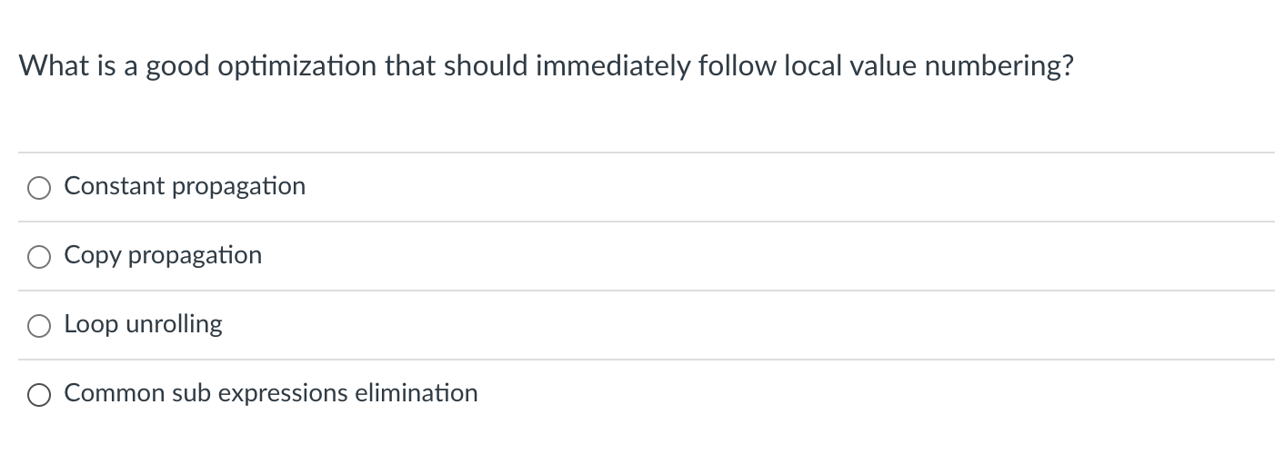
Quiz

Slide 5
Discussion
b0 = b;
c1 = c;
e3 = e;
f4 = f; a2 = b0 + c1;
d5 = e3 + f4;
g6 = a2;
a = a2;
d = d5;
g = g6;
label_0:
g0 = g;
a1 = a;
h2 = g0 + a1;
k3 = h2;
h = h2;
k = k3;
There lots of copies here
a2 = b0 + c1;
d5 = e3 + f4;
g6 = a2;
Whole example:
label_0:
h2 = g0 + a1;
k3 = h2;
new variables: {b0, c1, e3, f4, a2, d5, g6}
{g0, a1, h2, k3}

Slide 6
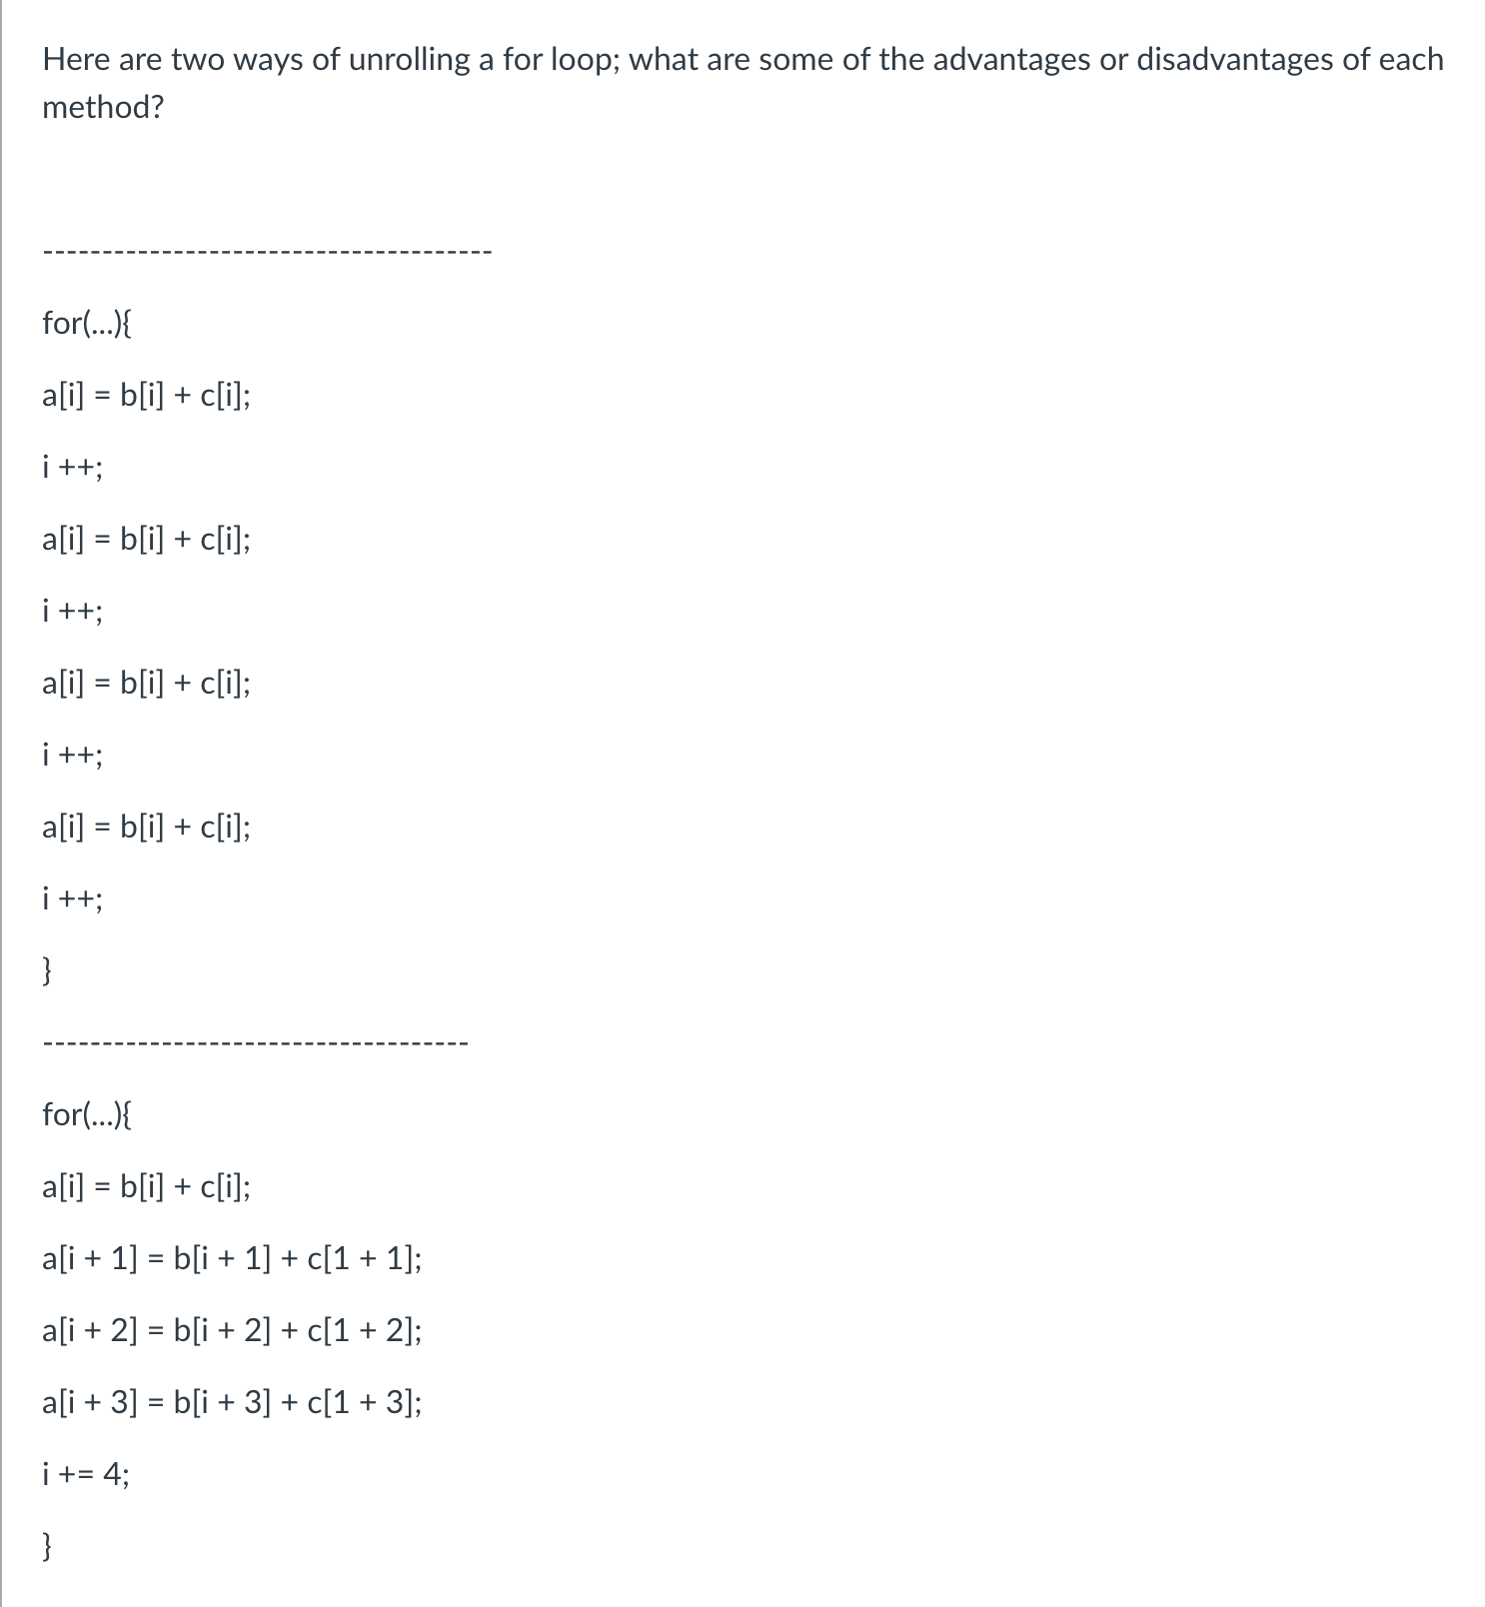
Quiz

Slide 7
Quiz
how many times i gets
updated?
memory access optimizations loop jamming (we will see next slide)

Slide 8
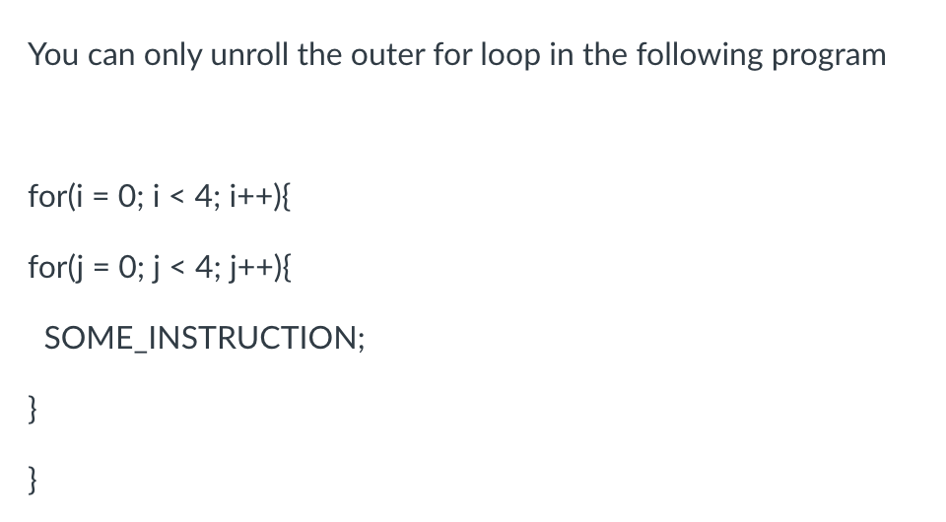
Quiz

Slide 9
Discussion
Lets think about how unrolling
this loop would look...
for (i = 0; i < 4; i++){
for (j = 0; j < 4; j++){
SOME_INSTRUCTION;
}
}

Slide 10
Discussion
Lets think about how unrolling
this loop would look...
for (i = 0; i < 4; i++){
for (j = 0; j < 4; j++){
SOME_INSTRUCTION;
}
}

Slide 11
Discussion
Lets think about how unrolling
this loop would look...
for (i = 0; i < 4; i++){
for (j = 0; j < 4; j++){
a[i] += b[j];
}
i++;
for (j = 0; j < 4; j++){
a[i] += b[j];
}
}

Slide 12
Discussion
Lets think about how unrolling
this loop would look...
for (i = 0; i < 4; i+=2){
for (j = 0; j < 4; j++){
a[i] += b[j];
a[i+1] += b[j];
}
}
This is an optimization called unroll and jam:
unroll the outer loop and fuse the inner loop.

Slide 13
Review
Quiz was a good review and we’ve spent enough time on local value numbering (on the slides at least)

Slide 14
Homework overview
discussion and demo
code structure (command line args)
loop unrolling:
test 4 is the right place to start
local value numbering
basic blocks
parsing classier
speedup demos

Slide 15
More loop transforms
Loop nesting order
Loop tiling
General area is called polyhedral compilation
https://en.wikipedia.org/wiki/Polytope_model

Slide 16
New constraints:
Typically requires that loop iterations are independent
You can do the loop iterations in any order and get the same result
are these independent?
for (int i = 0; i < 2; i++) {
counter += 1;
}
vs
for (int i = 0; i < 1024; i++) {
counter = i;
}

Slide 17
adds two arrays
for (int i = 0; i < SIZE; i++) {
a[i] = b[i] + c[i];
}
adds elements with neighbors
for (int i = 0; i < SIZE; i++) {
a[i] += a[i+1]
}

Slide 18
are they the same if you traverse them backwards?
adds two arrays
for (int i = 0; i < SIZE; i++) {
a[i] = b[i] + c[i];
}
for (int i = SIZE-1; i >= 0; i--) {
a[i] = b[i] + c[i];
}
adds elements with neighbors
for (int i = SIZE-1; i >= 0; i--) {
a[i] += a[i+1]
}
for (int i = 0; i < SIZE; i++) {
a[i] += a[i+1]
}

Slide 19
are they the same if you traverse them backwards?
adds two arrays
for (int i = 0; i < SIZE; i++) {
a[i] = b[i] + c[i];
}
for (int i = SIZE-1; i >= 0; i--) {
a[i] = b[i] + c[i];
}
adds elements with neighbors
for (int i = SIZE-1; i >= 0; i--) {
a[i] += a[i+1]
}
for (int i = 0; i < SIZE; i++) {
a[i] += a[i+1]
}
No!

Slide 20
what about a random order?
adds two arrays
for (int i = 0; i < SIZE; i++) {
a[i] = b[i] + c[i];
}
for (pick i randomly) {
a[i] = b[i] + c[i];
}
adds elements with neighbors
for (pick i randomly) {
a[i] += a[i+1]
}
for (int i = 0; i < SIZE; i++) {
a[i] += a[i+1]
}

Slide 21
what about a random order?
adds two arrays
for (int i = 0; i < SIZE; i++) {
a[i] = b[i] + c[i];
}
for (pick i randomly) {
a[i] = b[i] + c[i];
}
adds elements with neighbors
for (pick i randomly) {
a[i] += a[i+1]
}
for (int i = 0; i < SIZE; i++) {
a[i] += a[i+1]
}
No!

Slide 22
for (int i = 0; i < SIZE; i++) {
a[i] = b[i] + c[i];
}
These are DOALL loops:
Loop iterations are independent
You can do them in ANY order and get the same results
If a compiler can find a DOALL loop then there are lots of optimizations to apply!

Slide 23
Safety Criteria: independent iterations
How do we check this?
If the property doesn’t hold then there exists 2 iterations, such that if they are re-ordered, it causes different outcomes for the loop.
Write-Write conflicts: two distinct iterations write different values to the same location
Read-Write conflicts: two distinct iterations where one iteration reads from the location written to by another iteration.

Slide 24
Safety Criteria: independent iterations
Criteria: every iteration of the outer-most loop must be independent
the loop must produce the same result for any order of the iterations
for (i = 0; i < size; i++) {
a[index(i)] = loop(i);
}

Slide 25
Safety Criteria: independent iterations
Criteria: every iteration of the outer-most loop must be independent
the loop must produce the same result for any order of the iterations
for (i = 0; i < size; i++) {
a[index(i)] = loop(i);
}
index calculation based on the loop variable

Slide 26
Safety Criteria: independent iterations
Criteria: every iteration of the outer-most loop must be independent
the loop must produce the same result for any order of the iterations
for (i = 0; i < size; i++) {
a[index(i)] = loop(i);
}
index calculation based on the loop variable Computation to store in the memory location

Slide 27
Safety Criteria: independent iterations
Criteria: every iteration of the outer-most loop must be independent
the loop must produce the same result for any order of the iterations
for (i = 0; i < size; i++) {
a[index(i)] = loop(i);
}
Write-write conflicts: for two distinct iteration variables:
i_{x} != i_{y} Check:
index(i_{x}) != index(i_{y})

Slide 28
Safety Criteria: independent iterations
Criteria: every iteration of the outer-most loop must be independent
the loop must produce the same result for any order of the iterations
for (i = 0; i < size; i++) {
a[index(i)] = loop(i);
}
Write-write conflicts: for two distinct iteration variables:
i_{x} != i_{y} Check:
index(i_{x}) != index(i_{y})
Why? Because if index(i_{x}) == index(i_{y})
then:
a[index(i_{x})] will equal either loop(i_{x}) or loop(i_{y}) depending on the order

Slide 29
Safety Criteria: independent iterations
Criteria: every iteration of the outer-most loop must be independent
for (i = 0; i < size; i++) {
a[write_index(i)] = a[read_index(i)] + loop(i);
}
Read-write conflicts: for two distinct iteration variables:
i_{x} != i_{y} Check:
write_index(i_{x}) != read_index(i_{y})

Slide 30
Safety Criteria: independent iterations
Criteria: every iteration of the outer-most loop must be independent
for (i = 0; i < size; i++) {
a[write_index(i)] = a[read_index(i)] + loop(i);
}
Why? if i_{x} iteration happens first, then iteration i_{y} reads an updated value. if i_{y} happens first, then it reads the original value
Read-write conflicts: for two distinct iteration variables:
i_{x} != i_{y} Check:
write_index(i_{x}) != read_index(i_{y})

Slide 31
Examples:
for (i = 0; i < 128; i++) {
a[i]= a[i]*2;
}

Slide 32
Examples:
for (i = 0; i < 128; i++) {
a[i]= a[i]*2;
}
for (i = 0; i < 128; i++) {
a[i]= a[0]*2;
}

Slide 33
Examples:
for (i = 0; i < 128; i++) {
a[i]= a[i]*2;
}
for (i = 0; i < 128; i++) {
a[i]= a[0]*2;
}
for (i = 1; i < 128; i++) {
a[i]= a[0]*2;
}

Slide 34
Examples:
for (i = 0; i < 128; i++) {
a[i]= a[i]*2;
}
for (i = 0; i < 128; i++) {
a[i]= a[0]*2;
}
for (i = 1; i < 128; i++) {
a[i]= a[0]*2;
}
for (i = 0; i < 128; i++) {
a[i%64]= a[i]*2;
}

Slide 35
Examples:
for (i = 0; i < 128; i++) {
a[i]= a[i]*2;
}
for (i = 0; i < 128; i++) {
a[i]= a[0]*2;
}
for (i = 1; i < 128; i++) {
a[i]= a[0]*2;
}
for (i = 0; i < 128; i++) {
a[i%64]= a[i]*2;
}
for (i = 0; i < 128; i++) {
a[i%64]= a[i+64]*2;
}

Slide 36




Motivation:
pretty straight forward computation
for brightening (1 pass over all pixels)
Image processing
Taken from Halide:
A project out of MIT
This computation is known as the “Local Laplacian Filter”. Requires visiting all pixels 99 times
We want to be able to do this
fast and efficiently!
Main results in from an image DSL show
a 1.7x speedup with 1/5 the LoC
over hand optimized versions at Adobe
from: https://people.csail.mit.edu/sparis/publi/2011/siggraph/

Slide 37
for (int y = 0; y < 4; y++) {
for (int x = 0; x < 4; x++) {
output[y,x] = x + y;
}
}
you can compute the pixels in any order you want, you just have to compute all of them!
from: https://halide-lang.org/tutorials/tutorial_lesson_05_scheduling_1.html

Slide 38
for (int y = 0; y < 4; y++) {
for (int x = 0; x < 4; x++) {
output[y,x] = x + y;
}
}
you can compute the pixels in any order you want, you just have to compute all of them!
for (int x = 0; x < 4; x++) {
for (int y = 0; y < 4; y++) {
output[y,x] = x + y;
}
}
What is the difference here? What will the difference be?
from: https://halide-lang.org/tutorials/tutorial_lesson_05_scheduling_1.html

Slide 39
Demo
Why do we see the performance difference?

Slide 40




Adding 2D arrays together
Demo
Memory accesses
$$A=B+C$$
$$A$$
$$B$$
$$C$$

Slide 41
But sometimes there isn’t a good ordering

Slide 42

transposed arrays
In some cases, there might not be a good nesting order for all accesses:
$$A=B+C^{T}$$
$$A$$
$$B$$
$$C$$

Slide 43
transposed arrays
In some cases, there might not be a good nesting order for all accesses:
$$A=B+C^{T}$$
$$A$$
$$B$$
$$C$$
cold miss for all of them

Slide 44
transposed arrays
In some cases, there might not be a good nesting order for all accesses:
$$A=B+C^{T}$$
$$A$$
$$B$$
$$C$$
Hit on A and B. Miss on C

Slide 45
transposed arrays
In some cases, there might not be a good nesting order for all accesses:
$$A=B+C^{T}$$
$$A$$
$$B$$
$$C$$
Hit on A and B. Miss on C

Slide 46
What happens here?
Demo

Slide 47
How can we fix it?
Can we use the compiler?
Does loop order matter?

Slide 48
for (int y = 0; y < 4; y++) {
for (int x = 0; x < 4; x++) {
output[y,x] = x + y;
}
}
Loop splitting:
for (int y = 0; y < 4; y++) {
for (int x_outer = 0; x_outer < 4; x_outer+=2) {
for (int x = x_outer; x < x_outer+2; x++) {
output[y,x] = x + y;
}
}
}
What is the difference here?
from: https://halide-lang.org/tutorials/tutorial_lesson_05_scheduling_1.html

Slide 49
Does loop splitting by itself work?
Lets try it
demo

Slide 50
We can chain optimizations
Lets try chaining loop splitting and reorder
Demo

Slide 51
We can chain optimizations
Lets try chaining loop splitting and reorder
Demo
What happened?!

Slide 52
Our new schedule looks like this:
Why is this beneficial?
from: https://halide-lang.org/tutorials/tutorial_lesson_05_scheduling_1.html

Slide 53
blocking

Slide 54




blocking
Blocking operates on smaller chunks to exploit locality in column increment accesses. Example 2x2
$$A=B+C^{T}$$
$$A$$
$$B$$
$$C$$

Slide 55
blocking
Blocking operates on smaller chunks to exploit locality in column increment accesses. Example 2x2
$$A=B+C^{T}$$
$$A$$
$$B$$
$$C$$

Slide 56
blocking
Blocking operates on smaller chunks to exploit locality in column increment accesses. Example 2x2
$$A=B+C^{T}$$
$$A$$
$$B$$
$$C$$
cold miss for all of them

Slide 57
blocking
Blocking operates on smaller chunks to exploit locality in column increment accesses. Example 2x2
$$A=B+C^{T}$$
$$A$$
$$B$$
$$C$$
Miss on C

Slide 58
blocking
Blocking operates on smaller chunks to exploit locality in column increment accesses. Example 2x2
$$A=B+C^{T}$$
$$A$$
$$B$$
$$C$$
Miss on A,B, hit on C

Slide 59
blocking
Blocking operates on smaller chunks to exploit locality in column increment accesses. Example 2x2
$$A=B+C^{T}$$
$$A$$
$$B$$
$$C$$
Hit on all!

Slide 60
Loop transformation summary
If the compiler can prove different properties about your loops, you can automatically make code go a lot faster
It is hard in languages like C/C++. But in constrained languages (often called domain specific languages (DSLs) it is easier!
Hot topic right now for Machine learning, graphics, graph analytics, etc!
Main results in from an image DSL show
a 1.7x speedup with 1/5 the LoC
over hand optimized versions at Adobe
from: https://people.csail.mit.edu/sparis/publi/2011/siggraph/

Slide 61
Global Optimization (analysis)
Loop transforms are a regional analysis
Compiler works hard to show that code fits a certain pattern
Global analysis must account for arbitrary patterns
Generality costs us! Lots of times these optimizations are not as effective or precise.
But they can still help...

Slide 62
To finish up the class: Live variable analysis
Not an analysis to make your code go faster
An analysis to help warn programmers about potential bugs
Optimizations that make code go faster are really fun but the reality i that programmers often spend ~70% of their time debugging and testing.
Compilers can help!!

Slide 63
Control flow graphs

Slide 64
Control flow graphs
start:
r0 = ...;
r1 = ...;
br r0, if, else;
A graph where:
nodes are basic blocks
edges mean that it is possible for one block to branch to another
if: r2 = ...;
br end_if;
else:
r3 = ...;
end_if:
r4 = ...;

Slide 65
Control flow graphs
start:
r0 = ...;
r1 = ...;
br r0, if, else;
A graph where:
nodes are basic blocks
edges mean that it is possible for one block to branch to another
if: r2 = ...;
br end_if;
else:
r3 = ...; br end_if;
end_if:
r4 = ...;

Slide 66
Control flow graphs
start:
r0 = ...;
r1 = ...;
br r0, if, else;
b0
A graph where:
nodes are basic blocks
edges mean that it is possible for one block to branch to another
b1
b2
if: r2 = ...;
br end_if;
else:
r3 = ...; br end_if;
end_if:
r4 = ...;
b3

Slide 67
Interesting CFGs

Slide 68
Interesting CFGs
Exceptions
Break in a loop
Switch statement (consider break, no break)
first class branches (or functions)

Slide 69
CFG demo
PyCFG

Slide 70
See everyone on Wednesday
Control flow graphs

