Slide 1
CSE110A: Compilers April 13, 2022
..
Topics:
Syntactic Analysis continued
Precedence and associativity part 2
Top down parsing
Oracle parser
Rewriting to avoid left recursion
int main() { printf(““);
return 0; }
..
..
..
..

Slide 2
Announcements
HW 1 is due on Monday at midnight
For help
Ask on Piazza: No guaranteed help over the weekend or off business hours
Yanwen has office hours on Monday 1-2, but I hope you will not save it that late!
Test case post on Piazza
It is best to share the test cases there so that teaching staff can look over them.
Plan on HW2 assigned on Monday (due 2 weeks later)

Slide 3
Announcements
For part 4:
You must use the same tokens that you created in part 2 and used in part 3
You must build the RE programmatically
Keep track of the token actions in a separate data structure

Slide 4
Quiz

Slide 5
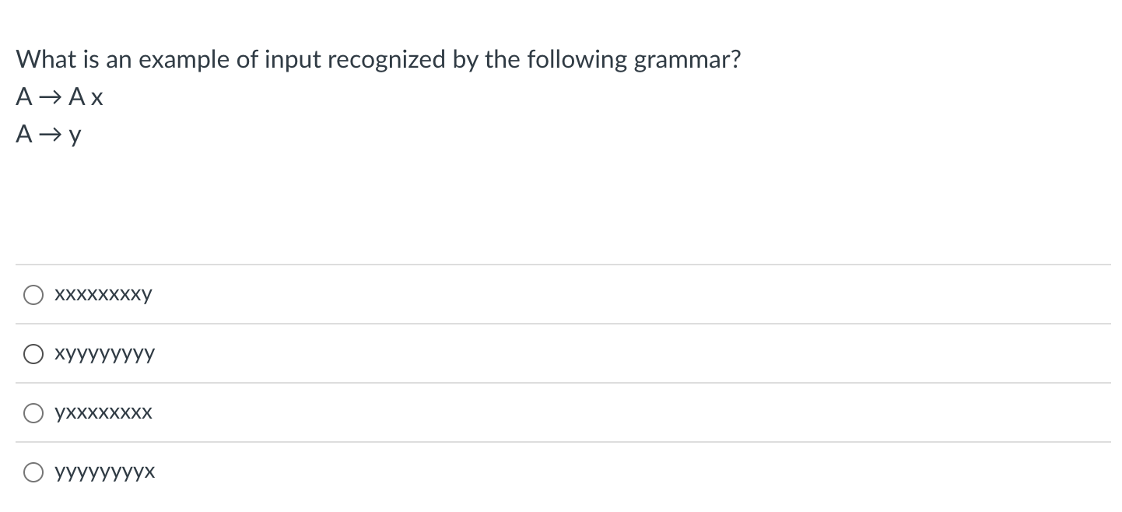
Quiz

Slide 6
Quiz
1 2
How about this one?
xxxxxxxxy
RULE | Sentential Form
start | A

Slide 7
Quiz
1 2
How about this one?
xxxxxxxxy
Applying either rule gives us a sentential form that won’t create the string
RULE | Sentential Form
start | A

Slide 8
Quiz
1 2
How about this one?
xyyyyyyyy
RULE | Sentential Form
start | A

Slide 9
Quiz
1 2
How about this one?
xyyyyyyyy
Similar reason: strings that are longer than 1 character cannot end in y
RULE | Sentential Form
start | A

Slide 10
Quiz
1 2
How about this one?
yxxxxxxxx
RULE | Sentential Form
start | A

Slide 11
Quiz
1 2
How about this one?
yxxxxxxxx
RULE | Sentential Form
start | A
1 | A x
1 | A x x
2 | y xxxxxxxx
9 more rows, then eventually

Slide 12
Quiz
1 2
How about this one?
yyyyyyyyx
RULE | Sentential Form
start | A

Slide 13
Quiz
1 2
How about this one?
yyyyyyyyx
We can only produce
1 y, so we cannot
derive this string
RULE | Sentential Form
start | A

Slide 14
Quiz
1 2
A
What if we changed the rules?? Does this work?
How about this one?
yyyyyyyyx
RULE | Sentential Form
start | A

Slide 15
Quiz
1 2
A
What if we changed the rules?? Does this work?
We need a terminating string: A -> “”
How about this one?
yyyyyyyyx
RULE | Sentential Form
start | A

Slide 16
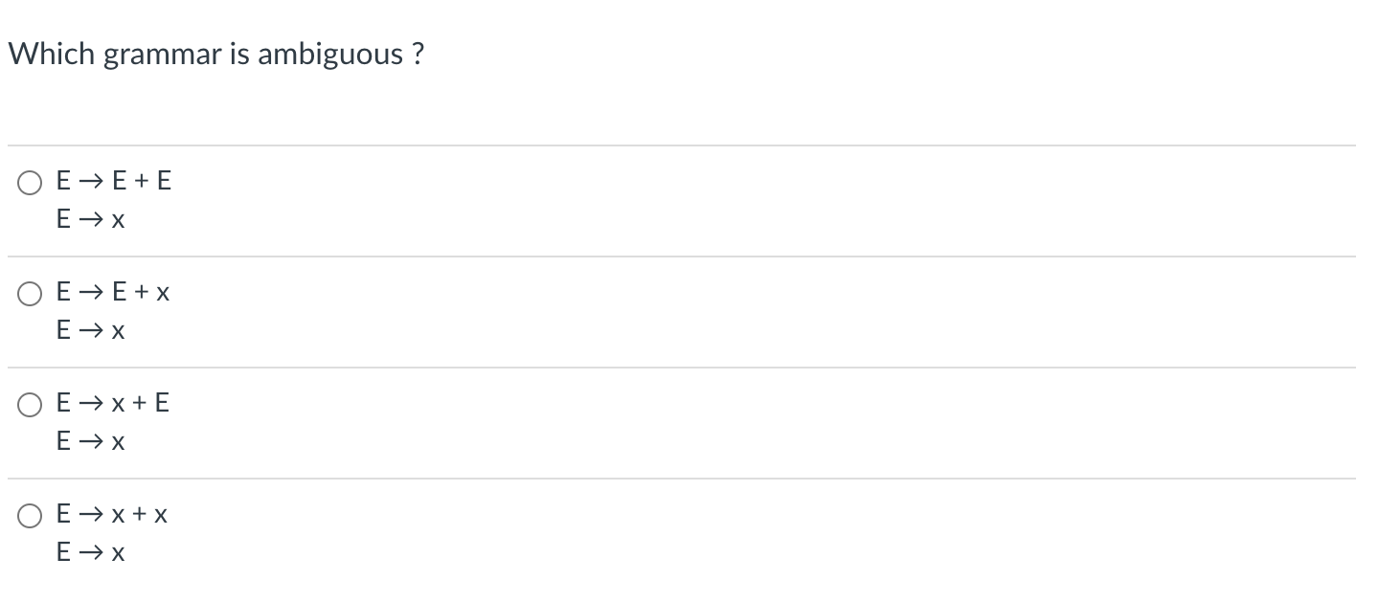
Quiz

Slide 17
Quiz
Let’s look at some examples. Let’s assume that E is an ”expr”
and x is a number

Slide 18
input: 2+3+4
Both parse trees are valid, this grammar is ambiguous
expr
expr
expr
<PLUS>
expr
expr
<PLUS>
expr
expr
<PLUS>
expr
term
term
expr
<PLUS>
expr
term
term
factor
term
term
factor
factor
factor
<NUM, 4>
factor
factor
<NUM, 2>
<NUM, 2>
<NUM, 3>
<NUM, 3>
<NUM, 4>

Slide 19
input: 2+3+4
What about this one?
expr
expr
expr
<PLUS>
expr
expr
<PLUS>
expr
expr
<PLUS>
expr
term
term
expr
<PLUS>
expr
term
term
factor
term
term
factor
factor
factor
<NUM, 4>
factor
factor
<NUM, 2>
<NUM, 2>
<NUM, 3>
<NUM, 3>
<NUM, 4>

Slide 20
input: 2+3+4
Doesn’t allow an expression on the RHS. This parse tree is not allowed
What about this one?
expr
expr
expr
<PLUS>
expr
expr
<PLUS>
expr
expr
<PLUS>
expr
term
term
expr
<PLUS>
expr
term
term
factor
term
term
factor
factor
factor
<NUM, 4>
factor
factor
<NUM, 2>
<NUM, 2>
<NUM, 3>
<NUM, 3>
<NUM, 4>

Slide 21
input: 2+3+4
What about this one?
expr
expr
expr
<PLUS>
expr
expr
<PLUS>
expr
expr
<PLUS>
expr
term
term
expr
<PLUS>
expr
term
term
factor
term
term
factor
factor
factor
<NUM, 4>
factor
factor
<NUM, 2>
<NUM, 2>
<NUM, 3>
<NUM, 3>
<NUM, 4>

Slide 22
input: 2+3+4
Doesn’t allow an expression on the LHS. This parse tree is not allowed
What about this one?
expr
expr
expr
<PLUS>
expr
expr
<PLUS>
expr
expr
<PLUS>
expr
term
term
expr
<PLUS>
expr
term
term
factor
term
term
factor
factor
factor
<NUM, 4>
factor
factor
<NUM, 2>
<NUM, 2>
<NUM, 3>
<NUM, 3>
<NUM, 4>

Slide 23
input: 2+3+4
What about this one?
expr
expr
expr
<PLUS>
expr
expr
<PLUS>
expr
expr
<PLUS>
expr
term
term
expr
<PLUS>
expr
term
term
factor
term
term
factor
factor
factor
<NUM, 4>
factor
factor
<NUM, 2>
<NUM, 2>
<NUM, 3>
<NUM, 3>
<NUM, 4>

Slide 24
input: 2+3+4
What about this one?
Cannot produce either
parse tree!
expr
expr
expr
<PLUS>
expr
expr
<PLUS>
expr
expr
<PLUS>
expr
term
term
expr
<PLUS>
expr
term
term
factor
term
term
factor
factor
factor
<NUM, 4>
factor
factor
<NUM, 2>
<NUM, 2>
<NUM, 3>
<NUM, 3>
<NUM, 4>

Slide 25
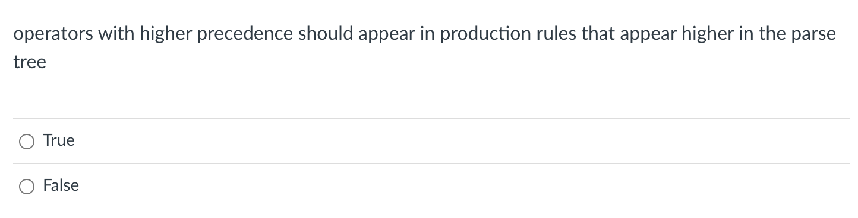
Quiz

Slide 26
Post order traversal
What is the post order traversal
of this tree?

Slide 27
Post order traversal
5
What is the post order traversal
of this tree?
3
4
1
2

Slide 28
Post order traversal
operators that are higher
in the parse tree get evaluated later
5
What is the post order traversal
of this tree?
3
4
1
2
operators that are lower
in the parse tree get evaluated earlier

Slide 29
Evaluating a parse tree
input: 1+5*6
expr
Operator | Name | Productions
+ | expr | : expr PLUS expr | term
* | term | : term TIMES term | factor
() | factor | : LPAREN expr RPAREN | NUM
expr
<PLUS>
expr
term
term
term
<TIMES>
term
factor
factor
factor
<NUM, 1>
<NUM, 5>
<NUM, 6>

Slide 30
Evaluating a parse tree
input: 1+5*6
expr: 31
Operator | Name | Productions
+ | expr | : expr PLUS expr | term
* | term | : term TIMES term | factor
() | factor | : LPAREN expr RPAREN | NUM
expr: 1
<PLUS>
expr
term: 30
term: 1
term: 5
<TIMES>
term: 6
factor: 1
factor:5
factor: 6
<NUM, 1>
<NUM, 5>
<NUM, 6>

Slide 31
Evaluating a parse tree
input: 1+5*6
expr: 31
Operator | Name | Productions
+ | expr | : expr PLUS expr | term
* | term | : term TIMES term | factor
() | factor | : LPAREN expr RPAREN | NUM
expr: 1
<PLUS>
expr
lower in the parse tree
term: 30
term: 1
term: 5
<TIMES>
term: 6
factor: 1
factor:5
factor: 6
<NUM, 1>
<NUM, 5>
<NUM, 6>

Slide 32
Avoiding Ambiguity
Precedence
increases going down
new production rules
One non-terminal for each level of precedence
lowest precedence at the top
highest precedence at the bottom
How would we add power? ^
Operator | Name | Productions
+ | expr | : expr PLUS expr | term
* | term | : term TIMES term | factor
() | factor | : LPAREN expr RPAREN | NUM

Slide 33

Quiz

Slide 34
Ambiguous grammars
expr ::= NUM
| expr PLUS expr
| expr TIMES expr
| LPAREN expr RPAREN
input: 1 + 5 * 6
expr
expr
expr
expr
expr
<PLUS>
expr
<TIMES>
expr
expr
<NUM, 1>
expr
<TIMES>
expr
<PLUS>
<NUM, 6>
<NUM, 1>
<NUM, 5>
<NUM, 5>
<NUM, 6>

Slide 35
Ambiguous grammars
expr ::= NUM
| expr PLUS expr
| expr TIMES expr
| LPAREN expr RPAREN
input: 1 + 5 * 6
Evaluations are different!
expr
expr
expr
expr
expr
<PLUS>
expr
<TIMES>
expr
expr
<NUM, 1>
expr
<TIMES>
expr
<PLUS>
<NUM, 6>
<NUM, 1>
<NUM, 5>
<NUM, 5>
<NUM, 6>

Slide 36
Review
I think the quiz did a good job covering last lectures material

Slide 37
New material
Continue our discussion on associativity

Slide 38
Let’s make some more parse trees
input: 2+3+4
Operator | Name | Productions
+ | expr | : expr PLUS expr | term
* | term | : term TIMES term | factor
() | factor | : LP expr RP | NUM

Slide 39
Let’s make some more parse trees
input: 2+3+4
expr
Operator | Name | Productions
+ | expr | : expr PLUS expr | term
* | term | : term TIMES term | factor
() | factor | : LP expr RP | NUM
expr
<PLUS>
expr
term
expr
<PLUS>
expr
term
term
factor
factor
factor
<NUM, 2>
<NUM, 3>
<NUM, 4>

Slide 40
This is ambiguous, is it an issue?
input: 2+3+4
expr
expr
expr
<PLUS>
expr
expr
<PLUS>
expr
expr
<PLUS>
expr
term
term
expr
<PLUS>
expr
term
term
factor
term
term
factor
factor
factor
<NUM, 4>
factor
factor
<NUM, 2>
<NUM, 2>
<NUM, 3>
<NUM, 3>
<NUM, 4>

Slide 41
What about for a different operator?
input: 2-3-4

Slide 42
What about for a different operator?
input: 2-3-4
expr
expr
expr
<MINUS>
expr
expr
<MINUS>
expr
expr
<MINUS>
expr
term
term
expr
<MINUS>
expr
term
term
factor
term
term
factor
factor
factor
<NUM, 4>
factor
factor
<NUM, 2>
<NUM, 2>
<NUM, 3>
<NUM, 3>
<NUM, 4>
Which one is right?

Slide 43
What about for a different operator?
input: 2-3-4
Evaluates (2-3) - 4
expr
Evaluates 2 - (3 - 4)
expr
expr
<MINUS>
expr
expr
<MINUS>
expr
expr
<MINUS>
expr
term
term
expr
<MINUS>
expr
term
term
factor
term
term
factor
factor
factor
<NUM, 4>
factor
factor
<NUM, 2>
<NUM, 2>
<NUM, 3>
<NUM, 3>
<NUM, 4>
Which one is right?

Slide 44
Associativity
If an operator is not associative then we define
left to right (left-associative)
2-3-4 is evaluated as ((2-3) - 4)
What other operators are left-associative
right-to-left (right-associative)
Any operators you can think of?

Slide 45
Associativity
If an operator is not associative then we define
left to right (left-associative)
2-3-4 is evaluated as ((2-3) - 4)
What other operators are left-associative
right-to-left (right-associative)
Assignment, power operator

Slide 46
How to encode associativity?
Like precedence, some tools (e.g. YACC) allow associativity specification through keywords:
“+”: left, “^”: right
Also like precedence, we can also encode it into the production rules

Slide 47
Associativity for a single operator
input: 2-3-4
expr
expr
<MINUS>
expr
Operator | Name | Productions
- | expr | : expr MINUS expr | NUM
<NUM, 2>
expr
<MINUS>
expr
<NUM, 3>
<NUM, 4>
We want to disallow this parse tree

Slide 48
Associativity for a single operator
input: 2-3-4
expr
expr
<MINUS>
expr
Operator | Name | Productions
- | expr | : expr MINUS NUM | NUM
<NUM, 2>
expr
<MINUS>
expr
<NUM, 3>
<NUM, 4>
No longer allowed

Slide 49
Associativity for a single operator
input: 2-3-4
expr
expr
<MINUS>
<NUM,?>
Operator | Name | Productions
- | expr | : expr MINUS NUM | NUM
Lets start over

Slide 50
Associativity for a single operator
input: 2-3-4
expr
expr
<MINUS>
<NUM,4>
Operator | Name | Productions
- | expr | : expr MINUS NUM | NUM

Slide 51
Associativity for a single operator
input: 2-3-4
expr
expr
<MINUS>
<NUM,4>
Operator | Name | Productions
- | expr | : expr MINUS NUM | NUM
expr
<MINUS>
<NUM,3>

Slide 52
Associativity for a single operator
input: 2-3-4
expr
expr
<MINUS>
<NUM,4>
Operator | Name | Productions
- | expr | : expr MINUS NUM | NUM
expr
<MINUS>
<NUM, 3>
<NUM, 2>

Slide 53
Should you have associativity when its not required?
input: 2+3+4
Benefits?
Drawbacks?
expr
expr
<PLUS>
<NUM,4>
Operator | Name | Productions
+ | expr | : expr PLUS expr | NUM
expr
<PLUS>
<NUM, 3>
<NUM, 2>

Slide 54
Should you have associativity when its not required?
input: 2+3+4
Benefits?
Drawbacks?
expr
expr
<PLUS>
<NUM,4>
Operator | Name | Productions
+ | expr | : expr PLUS NUM | NUM
expr
<PLUS>
<NUM, 3>
<NUM, 2>
Good design principle to avoid ambiguous grammars,
even when strictly not required too.
Helps with debugging, etc. etc.
Many tools will warn if it detects ambiguity

Slide 55
Let’s make a richer expression grammar
Let’s do operators [+,*,-,/,^] and()
Operator | Name | Productions
Tokens:
NUM = “[0-9]+”
PLUS = ‘\+’
TIMES = ’\*’
LP = ‘\(’
RP = \)’ MINUS = ‘-’
DIV = ‘/’
CARROT =’ \^’

Slide 56
Let’s make a richer expression grammar
Let’s do operators [+,*,-,/,^] and()
Operator | Name | Productions
+,- | expr | : expr PLUS term | expr MINUS term | term
*,/ | term | : term TIMES pow | term DIV pow | pow
^ | pow | : factor CARROT pow | factor
() | factor | : LPAR expr RPAR | NUM
Tokens:
NUM = “[0-9]+”
PLUS = ‘\+’
TIMES = ’\*’
LP = ‘\(’
RP = \)’ MINUS = ‘-’
DIV = ‘/’
CARROT =’ \^’

Slide 57
What associativity do operators in C have?
https://en.cppreference.com/w/c/language/operator_precedence

Slide 58
New topic: Algorithms for parsing

Slide 59
New topic: Algorithms for parsing
One goal:
Given a string s and a CFG G, determine if G can derive s
We will do that be implicitly attempting to derive a parse tree for s
Two different approaches, each with different trade-offs:
Top down
Bottom up

Slide 60
Top-down parsing
input: 2+3+4
expr
Operator | Name | Productions
+ | expr | : expr PLUS NUM | NUM

Slide 61
Top-down parsing
input: 2+3+4
expr
Operator | Name | Productions
+ | expr | : expr PLUS NUM | NUM
expr
<PLUS>
<NUM,4>

Slide 62
Top-down parsing
input: 2+3+4
expr
Operator | Name | Productions
+ | expr | : expr PLUS NUM | NUM
expr
<PLUS>
<NUM,4>
expr
<PLUS>
<NUM, 3>

Slide 63
Top-down parsing
input: 2+3+4
expr
Operator | Name | Productions
+ | expr | : expr PLUS NUM | NUM
expr
<PLUS>
<NUM,4>
expr
<PLUS>
<NUM, 3>
<NUM, 2>

Slide 64
Top-down parsing
Pros:
Algorithm is simpler
Faster than bottom-up
Easier recovery
Cons:
Not efficient on arbitrary grammars
Most grammars need to be re-written

Slide 65
Bottom-up parsing
input: 2+3+4
Operator | Name | Productions
+ | expr | : expr PLUS NUM | NUM
<NUM, 2>
<PLUS>
<NUM, 3>
<PLUS>
<NUM,4>

Slide 66
Bottom-up parsing
input: 2+3+4
Operator | Name | Productions
+ | expr | : expr PLUS NUM | NUM
expr
<NUM, 2>
<PLUS>
<NUM, 3>
<PLUS>
<NUM,4>

Slide 67
Bottom-up parsing
input: 2+3+4
Operator | Name | Productions
+ | expr | : expr PLUS NUM | NUM
expr
expr
<NUM, 2>
<PLUS>
<NUM, 3>
<PLUS>
<NUM,4>

Slide 68
Bottom-up parsing
input: 2+3+4
expr
Operator | Name | Productions
+ | expr | : expr PLUS NUM | NUM
expr
expr
<NUM, 2>
<PLUS>
<NUM, 3>
<PLUS>
<NUM,4>

Slide 69
Bottom up
Pros:
can handle grammars expressed more naturally
can encode precedence and associativity even if grammar is ambiguous
Cons:
algorithm is complicated
in many cases slower than top down

Slide 70
Let’s start with top down

Slide 71
root = start symbol; focus = root;
push(None);
to_match = s.token();
while (true):
if (focus is a nonterminal)
pick next rule (A ::= B1,B2,B3...BN);
push(BN... B3, B2);
focus = B1
else if (focus == to_match)
to_match = s.token()
focus = pop()
else if (to_match == None and focus == None)
Accept
1: Expr ::= Expr Op Unit
2: | Unit 3: Unit ::= ‘(‘ Expr ‘)’
4: | ID
5: Op ::= ‘+’
6: | ‘*’
Can we derive the string (a+b)*c
Expanded Rule | Sentential Form
start | Expr
Variable | Value
focus
to_match
s.istring
stack

Slide 72
root = start symbol; focus = root;
push(None);
to_match = s.token();
while (true):
if (focus is a nonterminal)
pick next rule (A ::= B1,B2,B3...BN);
push(BN... B3, B2);
focus = B1
else if (focus == to_match)
to_match = s.token()
focus = pop()
else if (to_match == None and focus == None)
Accept
1: Expr ::= Expr Op Unit
2: | Unit 3: Unit ::= ‘(‘ Expr ‘)’
4: | ID
5: Op ::= ‘+’
6: | ‘*’
Currently we assume this is magic and picks
the right rule every time
Can we derive the string (a+b)*c
Expanded Rule | Sentential Form
start | Expr
Variable | Value
focus
to_match
s.istring
stack

Slide 73
root = start symbol; focus = root;
push(None);
to_match = s.token();
while (true):
if (focus is a nonterminal)
pick next rule (A ::= B1,B2,B3...BN);
push(BN... B3, B2);
focus = B1
else if (focus == to_match)
to_match = s.token()
focus = pop()
else if (to_match == None and focus == None)
Accept
1: Expr ::= Expr Op Unit
2: | Unit 3: Unit ::= ‘(‘ Expr ‘)’
4: | ID
5: Op ::= ‘+’
6: | ‘*’
Currently we assume this is magic and picks
the right rule every time
Can we derive the string (a+b)*c
Expanded Rule | Sentential Form
start | Expr
1 | Expr Op Unit
2 | Unit Op Unit
3 | '(’ Expr ‘)’ Op Unit
1 | ‘(‘ Expr Op Unit ‘)’ Op Unit
2 | ‘(‘ Unit Op Unit ‘)’ Op Unit
4 | ‘(‘ ID Op Unit ‘)’ Op Unit
Variable | Value
focus | Op
to_match | ‘+’
s.istring | b)*c
stack | Unit ‘)’ Op, Expr, None
And so on...

Slide 74
root = start symbol; focus = root;
push(None);
to_match = s.token();
while (true):
if (focus is a nonterminal)
pick next rule (A ::= B1,B2,B3...BN);
push(BN... B3, B2);
focus = B1
else if (focus == to_match)
to_match = s.token()
focus = pop()
else if (to_match == None and focus == None)
Accept
1: Expr ::= Expr Op Unit
2: | Unit 3: Unit ::= ‘(‘ Expr ‘)’
4: | ID
5: Op ::= ‘+’
6: | ‘*’
What can go wrong if we don’t have a magic
choice
Can we derive the string (a+b)*c
Expanded Rule | Sentential Form
start | Expr
Variable | Value
focus
to_match
s.istring
stack

Slide 75
root = start symbol; focus = root;
push(None);
to_match = s.token();
while (true):
if (focus is a nonterminal)
pick next rule (A ::= B1,B2,B3...BN);
push(BN... B3, B2);
focus = B1
else if (focus == to_match)
to_match = s.token()
focus = pop()
else if (to_match == None and focus == None)
Accept
1: Expr ::= Expr Op Unit
2: | Unit 3: Unit ::= ‘(‘ Expr ‘)’
4: | ID
5: Op ::= ‘+’
6: | ‘*’
What can go wrong
Can we derive the string (a+b)*c
Expanded Rule | Sentential Form
start | Expr
2 | Expr Op Unit
2 | Expr Op Unit Op Unit
2 | Expr Op Unit Op Unit Op Unit
2 | Expr Op Unit ....
Variable | Value
focus
to_match
s.istring
stack
Infinite recursion!

Slide 76
Top down parsing does not handle left recursion
1: Expr ::= Expr Op Unit
2: | Unit 3: Unit ::= ‘(‘ Expr ‘)’
4: | ID
5: Op ::= ‘+’
6: | ‘*’
1: Expr_base ::= Unit
2: | Expr_op
3: Expr_op ::= Expr_base Op Unit 4: Unit ::= ‘(‘ Expr_base ‘)’
5: | ID
6: Op ::= ‘+’
7: | ‘*’
direct left recursion
indirect left recursion
Top down parsing cannot handle either

Slide 77
Top down parsing does not handle left recursion
In general, any CFG can be re-written without left recursion

Slide 78
Eliminating direct left recursion
Fee ::= Fee “a”
| “b”
What does this grammar describe?

Slide 79
Eliminating direct left recursion
The grammar can be rewritten as
Fee ::= Fee “a”
| “b”
Fee ::= “b” Fee2
Fee2 ::= “a” Fee2
| “”

Slide 80
Eliminating direct left recursion
In general, A and B can be any sequence of non-terminals and terminals
Fee ::= Fee A
| B
Fee ::= B Fee2
Fee2 ::= A Fee2
| “”

Slide 81
Eliminating direct left recursion
1: Expr ::= Expr Op Unit
2: | Unit 3: Unit ::= ‘(‘ Expr ‘)’
4: | ID
5: Op ::= ‘+’
6: | ‘*’
Lets do this one as an example:
Fee ::= B Fee2
Fee2 ::= A Fee2
| “”
Fee ::= Fee A
| B

Slide 82
Eliminating direct left recursion
A = Op Unit
B = Unit
1: Expr ::= Expr Op Unit
2: | Unit 3: Unit ::= ‘(‘ Expr ‘)’
4: | ID
5: Op ::= ‘+’
6: | ‘*’
1: Expr ::= Unit Expr2
2: Expr2 ::= Op Unit Expr2
3: | “” 4: Unit ::= ‘(‘ Expr ‘)’
5: | ID
6: Op ::= ‘+’
7: | ‘*’
Lets do this one as an example:
Fee ::= B Fee2
Fee2 ::= A Fee2
| “”
Fee ::= Fee A
| B

Slide 83
root = start symbol; focus = root;
push(None);
to_match = s.token();
while (true):
if (focus is a nonterminal)
pick next rule (A ::= B1,B2,B3...BN);
push(BN... B3, B2);
focus = B1
else if (focus == to_match)
to_match = s.token()
focus = pop()
else if (to_match == None and focus == None)
Accept
1: Expr ::= Unit Expr2
2: Expr2 ::= Op Unit Expr2
3: | “” 4: Unit ::= ‘(‘ Expr ‘)’
5: | ID
6: Op ::= ‘+’
7: | ‘*’
Expanded Rule | Sentential Form
start | Expr
Variable | Value
focus
to_match
s.istring
stack

Slide 84
root = start symbol; focus = root;
push(None);
to_match = s.token();
while (true):
if (focus is a nonterminal)
pick next rule (A ::= B1,B2,B3...BN);
push(BN... B3, B2);
focus = B1
else if (focus == to_match)
to_match = s.token()
focus = pop()
else if (to_match == None and focus == None)
Accept
1: Expr ::= Unit Expr2
2: Expr2 ::= Op Unit Expr2
3: | “” 4: Unit ::= ‘(‘ Expr ‘)’
5: | ID
6: Op ::= ‘+’
7: | ‘*’
How to handle this case?
Expanded Rule | Sentential Form
start | Expr
Variable | Value
focus
to_match
s.istring
stack

Slide 85
root = start symbol; focus = root;
push(None);
to_match = s.token();
while (true):
if (focus is a nonterminal)
pick next rule (A ::= B1,B2,B3...BN);
if A == “”: focus=pop(); continue;
push(BN... B3, B2);
focus = B1
else if (focus == to_match)
to_match = s.token()
focus = pop()
else if (to_match == None and focus == None)
Accept
1: Expr ::= Unit Expr2
2: Expr2 ::= Op Unit Expr2
3: | “” 4: Unit ::= ‘(‘ Expr ‘)’
5: | ID
6: Op ::= ‘+’
7: | ‘*’
How to handle this case?
Expanded Rule | Sentential Form
start | Expr
Variable | Value
focus
to_match
s.istring
stack

Slide 86
How about indirect left recursion?
1: Expr ::= Expr Op Unit
2: | Unit 3: Unit ::= ‘(‘ Expr ‘)’
4: | ID
5: Op ::= ‘+’
6: | ‘*’
1: Expr_base ::= Unit
2: | Expr_op
3: Expr_op ::= Expr_base Op Unit 4: Unit ::= ‘(‘ Expr_base ‘)’
5: | ID
6: Op ::= ‘+’
7: | ‘*’
direct left recursion
indirect left recursion
Top down parsing cannot handle either

Slide 87
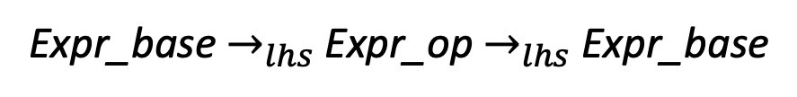
How about indirect left recursion?
1: Expr_base ::= Unit
2: | Expr_op
3: Expr_op ::= Expr_base Op Unit 4: Unit ::= ‘(‘ Expr_base ‘)’
5: | ID
6: Op ::= ‘+’
7: | ‘*’
Identify indirect left left recursion
Expr_base $→_{lhs}$ Expr_op $→_{lhs}$Expr_base

Slide 88
How about indirect left recursion?
1: Expr_base ::= Unit
2: | Expr_op
3: Expr_op ::= Expr_base Op Unit 4: Unit ::= ‘(‘ Expr_base ‘)’
5: | ID
6: Op ::= ‘+’
7: | ‘*’
Identify indirect left left recursion
Expr_base $→_{lhs}$ Expr_op $→_{lhs}$Expr_base
Substitute indirect non-terminal closer to initial non-terminal

Slide 89
How about indirect left recursion?
1: Expr_base ::= Unit
2: | Expr_op
3: Expr_op ::= Expr_base Op Unit 4: Unit ::= ‘(‘ Expr_base ‘)’
5: | ID
6: Op ::= ‘+’
7: | ‘*’
1: Expr_base ::= Unit
2: | Expr_base Op Unit
3: Expr_op ::= Expr_base Op Unit 4: Unit ::= ‘(‘ Expr_base ‘)’
5: | ID
6: Op ::= ‘+’
7: | ‘*’
What to do with production rule 3?
Identify indirect left left recursion
Expr_base $→_{lhs}$ Expr_op $→_{lhs}$Expr_base
Substitute indirect non-terminal closer to initial non-terminal

Slide 90
How about indirect left recursion?
1: Expr_base ::= Unit
2: | Expr_op
3: Expr_op ::= Expr_base Op Unit 4: Unit ::= ‘(‘ Expr_base ‘)’
5: | ID
6: Op ::= ‘+’
7: | ‘*’
1: Expr_base ::= Unit
2: | Expr_base Op Unit
3: Expr_op ::= Expr_base Op Unit 4: Unit ::= ‘(‘ Expr_base ‘)’
5: | ID
6: Op ::= ‘+’
7: | ‘*’
What to do with production rule 3? It may need to stay if another production rule references it!
Identify indirect left left recursion
Expr_base $→_{lhs}$ Expr_op $→_{lhs}$Expr_base
Substitute indirect non-terminal closer to initial non-terminal

Slide 91
Next time: algorithms for syntactic analysis
Continue with our top down parser.
Backtracking
Lookahead sets

