Slide 1
CSE110A: Compilers April 29, 2022
..
AST
..
..
..
..
Topics:
ASTs
parse trees into ASTs
type checking
CFG
...
...
...
...
3 address code
store i32 0, ptr %2
%3 = load i32, ptr %1
%4 = add nsw i32 %3, 1,
store i32 %4, ptr %1
%5 = load i32, ptr %2

Slide 2
Announcements
HW 2
Due on Monday by midnight
There is no guarantee of help on piazza off business hours and weekends
Neal wrote a recursive descent document you should read for extra help
HW 3 will be assigned a week from Monday (May 9) so that you only have the midterm to do next week.

Slide 3
Announcements
HW2 clarification:
You do not need to return anything from your parser!
If the input program satisfies the grammar then you return without issue
If it does not, then you throw an exception
Scanner exception if you cannot create a token
Parser exception if the input violations the grammar
Symbol table exception if a variable is used outside of a scope it is declared
HW 3 will be creating an IR inside your parser.

Slide 4
Announcements
Midterm will be given on May 2 (Monday)
Take home midterm.
Assigned on Monday morning and due on Friday by midnight
No late midterms are accepted - start early so that you can absorb any issues
No help off of business hours. Do not discuss the midterm at all with classmates, including conceptual, programming, or framework questions.
Open
book
notes
slides
lectures
You can use the internet for concepts. You cannot use it to ask questions or google answers to questions.

Slide 5
Quiz

Slide 6
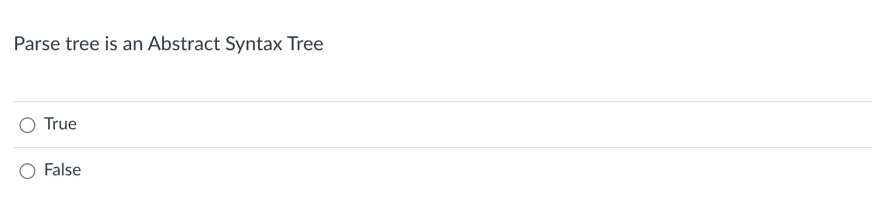
Quiz

Slide 7
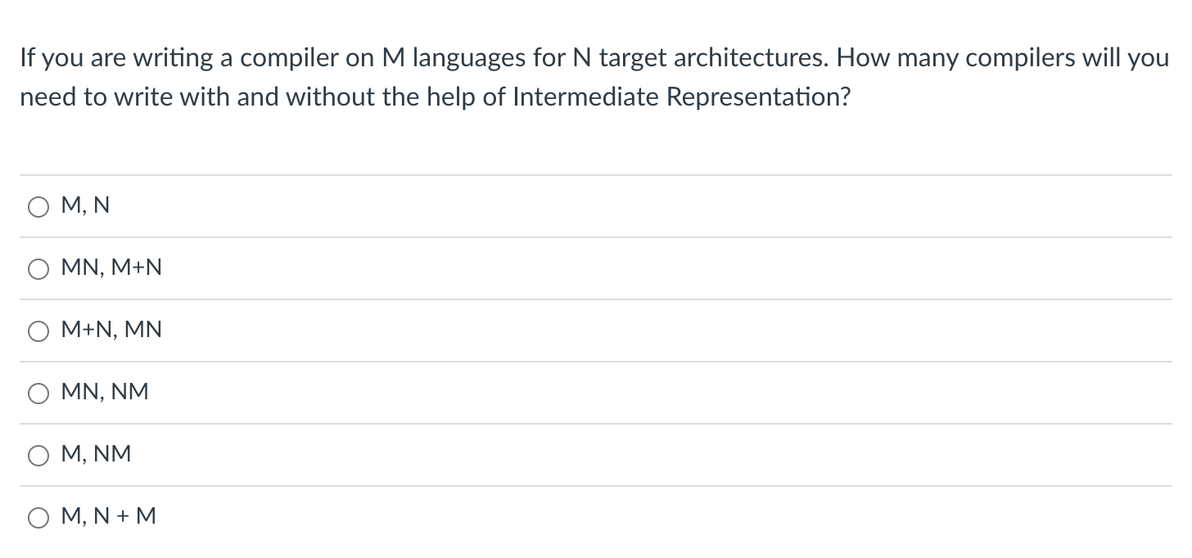
Quiz

Slide 8
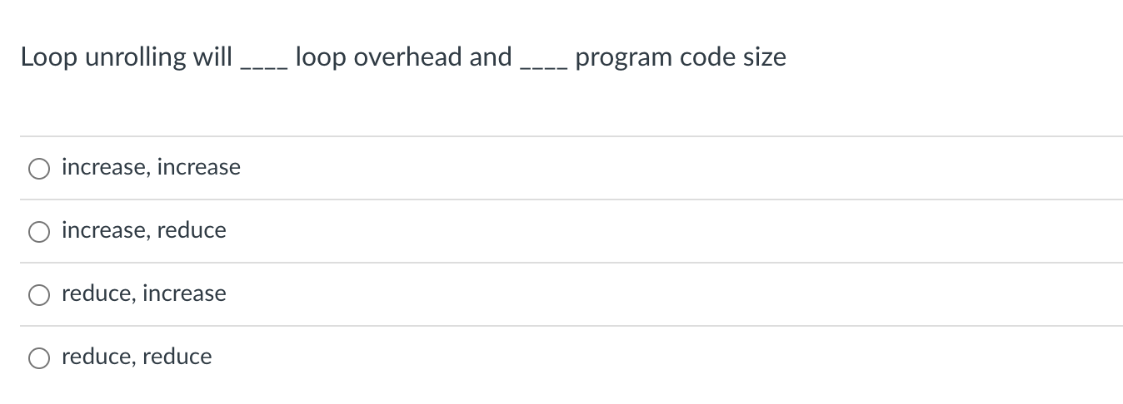
Quiz

Slide 9
Example: loop unrolling
Check:
1. Find iteration variable by
examining assignment, comparison and update.
2. found i
3. check that statement doesn’t change i.
4. check that comparison goes around an even number of times.
Perform optimization
copy statement and put an update before it
for_statement
assignment
comparison
update
statement update statement
for (i = 0; i < 100; i = i + 1) {
x = x + 1;
}

Slide 10
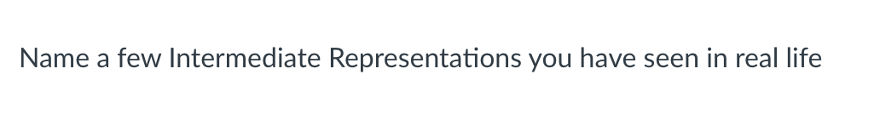
Quiz

Slide 11
Review

Slide 12
Compiler Architecture
compiler
creates structure
produces executable code
Optimizations
Optimizations
Optimizations
machine code
input program
Front end
Optimizations
Back end
string
parsing
code gen
optimizations
build on each other
Medium detailed view
more about optimizations: https://stackoverflow.com/questions/15548023/clang-optimization-levels

Slide 13
More detailed view

Slide 14
input program
Lexical Analysis
Syntactic Analyzer
Semantic Analyzer
Intermediate code gen
IR optimizations
loop!
target code gen
target code gen
loop!
machine code
More detailed view

Slide 15
input program
Lexical Analysis
Syntactic Analyzer
Intermediate code gen
IR Analysis/ Optimization
loop!
We’re going to move semantic analysis
into IR optimizations and analysis
target code gen
target code gen
loop!
machine code
More detailed view

Slide 16
IR programs
input program
Lexical Analysis
Syntactic Analyzer
Intermediate code gen
IR Analysis/ Optimization
loop!
optimized IR program
string
token stream
syntax tree
target code gen
ISA program
target code optimizations
loop!
optimized ISA program
machine code
More detailed view

Slide 17
IR programs
input program
Lexical Analysis
Syntactic Analyzer
Intermediate code gen
IR Analysis/ Optimization
loop!
optimized IR program
string
token stream
syntax tree
target code gen
position = initial + rate * 60;
ISA program
target code gen
loop!
optimized ISA program
machine code
More detailed view

Slide 18
IR programs
input program
Lexical Analysis
Syntactic Analyzer
Intermediate code gen
IR Analysis/ Optimization
loop!
optimized IR program
string
token stream
syntax tree
target code gen
position = initial + rate * 60;
Token stream
<id,> <assign,=> <id,> <bin_op,+> <id,> <bin_op,*> <num,60> <semi,;>
target code gen
loop!
optimized ISA program
machine code

Slide 19
position = initial + rate * 60;
IR programs
input program
Lexical Analysis
Syntactic Analyzer
Intermediate code gen
IR Analysis/ Optimization
loop!
optimized IR program
string
token stream
syntax tree
target code gen
Token stream
<id,> <assign,=> <id,> <bin_op,+> <id,> <bin_op,*> <num,60> <semi,;>
Syntax tree
assign
target code gen
expr
loop!
<id,1>
=
<id,2>
term
+
<id,3>
60
machine code
*

Slide 20
position = initial + rate * 60;
IR programs
input program
Lexical Analysis
Syntactic Analyzer
Intermediate code gen
IR Analysis/ Optimization
loop!
optimized IR program
string
token stream
syntax tree
target code gen
Syntax tree
assign
<id,1>
=
expr
<id,2>
term
+
target code gen
<id,3>
60
AST
*
loop!
=
<id,1>
+
<id,2>
*
machine code
<id,3>
60

Slide 21
position = initial + rate * 60;
IR programs
input program
Lexical Analysis
Syntactic Analyzer
Intermediate code gen
IR Analysis/ Optimization
loop!
optimized IR program
string
token stream
syntax tree
target code gen
AST
=
<id,1>
+
target code gen
<id,2>
*
loop!
int_to_float
<id,3>
60
machine code

Slide 22
position = initial + rate * 60;
IR programs
input program
Lexical Analysis
Syntactic Analyzer
Intermediate code gen
IR Analysis/ Optimization
loop!
optimized IR program
token stream
syntax tree
syntax tree
AST
target code gen
=
<id,1>
+
<id,2>
*
int_to_float
target code gen
<id,3>
loop!
60
3-address code program
%r0 = int_to_float(60); %r1 = %r0 * id3; %r2 = %r1 + id2;
%id1 = %r2;
machine code

Slide 23
Intermediate representations
Several forms:
tree - abstract syntax tree
graphs - control flow graph
linear program - 3 address code
Often times the program is represented as a hybrid
graphs where nodes are a linear program
linear program where expressions are ASTs
Progression:
start close to a parse tree
move closer to an ISA

Slide 24
Intermediate representations
Several forms:
tree - abstract syntax tree
graphs - control flow graph
linear program - 3 address code
Different optimizations and analysis are more suitable for IRs in different forms.

Slide 25
Our first IR: abstract syntax tree
One step away from parse trees
Great representation for expressions
Natural representation to apply type checking

Slide 26
What is an AST?
input: 1+5*6
We’ll start by looking at a parse tree:
Operator | Name | Productions
+ | expr | : expr PLUS term | term
* | term | : term TIMES factor | factor
() | factor | : LPAR expr RPAR | NUM
expr
expr
<PLUS,”+”>
term
term
term
<TIMES, “*”>
factor
factor
<NUM, “6”>
tokens = [
(NUM, “[0-9]+”),
(TIMES, “\*”),
(PLUS, “\+”),
(LPAR, “\(“,
(RPAR, ”\)”
]
factor
<NUM, “5”>
<NUM, “1”>

Slide 27
What is an AST?
input: 1+5*6
We’ll start by looking at a parse tree:
Operator | Name | Productions
+ | expr | : expr PLUS term | term
* | term | : term TIMES factor | factor
() | factor | : LPAR expr RPAR | NUM
expr
expr
<PLUS,”+”>
term
term
term
<TIMES, “*”>
factor
factor
<NUM, “6”>
tokens = [
(NUM, “[0-9]+”),
(TIMES, “\*”),
(PLUS, “\+”),
(LPAR, “\(“,
(RPAR, ”\)”
]
factor
<NUM, “5”>
<NUM, “1”>
What are leaves?

Slide 28
What is an AST?
input: 1+5*6
We’ll start by looking at a parse tree:
Operator | Name | Productions
+ | expr | : expr PLUS term | term
* | term | : term TIMES factor | factor
() | factor | : LPAR expr RPAR | NUM
expr
expr
<PLUS,”+”>
term
term
term
<TIMES, “*”>
factor
factor
<NUM, “6”>
tokens = [
(NUM, “[0-9]+”),
(TIMES, “\*”),
(PLUS, “\+”),
(LPAR, “\(“,
(RPAR, ”\)”
]
factor
<NUM, “5”>
<NUM, “1”>
What are leaves? lexemes

Slide 29
What is an AST?
input: 1+5*6
We’ll start by looking at a parse tree:
Operator | Name | Productions
+ | expr | : expr PLUS term | term
* | term | : term TIMES factor | factor
() | factor | : LPAR expr RPAR | NUM
expr
expr
<PLUS,”+”>
term
term
term
<TIMES, “*”>
factor
factor
<NUM, “6”>
tokens = [
(NUM, “[0-9]+”),
(TIMES, “\*”),
(PLUS, “\+”),
(LPAR, “\(“,
(RPAR, ”\)”
]
factor
<NUM, “5”>
<NUM, “1”>
What are nodes?

Slide 30
What is an AST?
input: 1+5*6
We’ll start by looking at a parse tree:
Operator | Name | Productions
+ | expr | : expr PLUS term | term
* | term | : term TIMES factor | factor
() | factor | : LPAR expr RPAR | NUM
expr
expr
<PLUS,”+”>
term
term
term
<TIMES, “*”>
factor
factor
<NUM, “6”>
tokens = [
(NUM, “[0-9]+”),
(TIMES, “\*”),
(PLUS, “\+”),
(LPAR, “\(“,
(RPAR, ”\)”
]
factor
<NUM, “5”>
<NUM, “1”>
What are nodes? non-terminals

Slide 31
What is an AST?
input: 1+5*6
Parse trees are defined entirely by the grammar
Tokens
Production rules
Parse trees are often not explicitly constructed. We use them to visualize the parsing computation
expr
expr
<PLUS,”+”>
term
term
term
<TIMES, “*”>
factor
factor
<NUM, “6”>
factor
<NUM, “5”>
<NUM, “1”>

Slide 32
in your homework, do you actually make a parse tree?
5 - 4 - 3
Expr
Expr ::= NUM Expr2
Expr2 ::= MINUS NUM Expr2
| “”
(NUM,5)
Expr2
(MINUS,-)
(NUM,4)
Expr2
(MINUS,-)
(NUM,3)
Expr2

Slide 33
What is an AST?
input: 1+5*6
Parse trees are defined entirely by the grammar
Tokens
Production rules
Parse trees are often not explicitly constructed. We use them to visualize the parsing computation
expr
expr
<PLUS,”+”>
term
term
term
<TIMES, “*”>
factor
factor
<NUM, “6”>
factor
<NUM, “5”>
<NUM, “1”>

Slide 34
What is an AST?
input: 1+5*6
What are some differences?
+
expr
1
*
expr
<PLUS,”+”>
term
5
6
term
factor
term
<TIMES, “*”>
factor
<NUM, “6”>
AST
factor
<NUM, “5”>
<NUM, “1”>
Parse Tree

Slide 35
What is an AST?
input: 1+5*6
What are some differences?
+
expr
1
*
expr
<PLUS,”+”>
term
5
6
term
factor
term
<TIMES, “*”>
factor
<NUM, “6”>
AST
factor
<NUM, “5”>
<NUM, “1”>
decoupled from the grammar
leaves are data, not lexemes
nodes are operators, not non-terminals
Parse Tree

Slide 36
Example
input: (1+5)*6
expr
what happens to ()s in an AST?
Operator | Name | Productions
+ | expr | : expr PLUS term | term
* | term | : term TIMES factor | factor
() | factor | : LPAR expr RPAR | NUM

Slide 37
Example
input: (1+5)*6
expr
term
what happens to ()s in an AST?
<TIMES, “*”>
term
factor
factor
<NUM, “6”>
Operator | Name | Productions
+ | expr | : expr PLUS term | term
* | term | : term TIMES factor | factor
() | factor | : LPAR expr RPAR | NUM
<LPAR, “(”>
expr
<RPAR, “)”>
expr
<PLUS,”+”>
term
factor
term
<NUM, “5”>
factor
<NUM, “1”>

Slide 38
Example
input: (1+5)*6
expr
term
what happens to ()s in an AST?
<TIMES, “*”>
term
factor
*
factor
<NUM, “6”>
+
6
expr
<RPAR, “)”>
<LPAR, “(”>
1
5
<PLUS,”+”>
term
expr
factor
term
No need for (), they simply capture precedence. And now we have precedence in the AST tree structure
<NUM, “5”>
factor
<NUM, “1”>

Slide 39
formalizing an AST
A tree based data structure, used to represent expressions
Main building block: Node
Leaf node: ID or Number
Node with one child: Unary operator (-) or type conversion (int_to_float)
Node with two children: Binary operator (+,*)

Slide 40
class ASTNode():
def __init__(self):
pass
class ASTLeafNode(ASTNode):
def __init__(self, value):
self.value = value
class ASTNumNode(ASTLeafNode):
def __init__(self, value):
super().__init__(value)
class ASTIDNode(ASTLeafNode):
def __init__(self, value):
super().__init__(value)
class ASTBinOpNode(ASTNode):
def __init__(self, l_child, r_child):
self.l_child = l_child
self.r_child = r_child
class ASTPlusNode(ASTBinOpNode):
def __init__(self, l_child, r_child):
super().__init__(l_child,r_child)
class ASTMultNode(ASTBinOpNode):
def __init__(self, l_child, r_child):
super().__init__(l_child,r_child)

Slide 41
Creating an AST from production rules
Operator | Name | Productions | Production action
+ | expr | : expr PLUS term | term | {} {}
* | term | : term TIMES factor | factor | {} {}
() | factor | : LPAR expr RPAR | NUM | ID | {} {} {}

Slide 42
Creating an AST from production rules
Operator | Name | Productions | Production action
+ | expr | : expr PLUS term | term | {return ASTAddNode($1,$3)} {return $1}
* | term | : term TIMES factor | factor | {return ASTMultNode($1,$3)} {return $1}
() | factor | : LPAR expr RPAR | NUM | ID | {return $2} {return ASTNumNode($1)} {return ASTIDNode($1)}

Slide 43
input: (1+5)*6
Name | Productions | Production action
expr | : expr PLUS term | term | {return ASTAddNode($1,$3)} {return $1}
term | : term TIMES factor | factor | {return ASTMultNode($1,$3)} {return $1}
factor | : LPAR expr RPAR | NUM | ID | {return $2} {return ASTNumNode($1)} {return ASTIDNode($1)}
expr
term
term
<TIMES, “*”>
factor
factor
<NUM, “6”>
Lets build the AST
<LPAR, “(”>
expr
<RPAR, “)”>
expr
<PLUS,”+”>
term
factor
term
<NUM, “5”>
factor
<NUM, “1”>

Slide 44
input: (1+5)*6
Name | Productions | Production action
expr | : expr PLUS term | term | {return ASTAddNode($1,$3)} {return $1}
term | : term TIMES factor | factor | {return ASTMultNode($1,$3)} {return $1}
factor | : LPAR expr RPAR | NUM | ID | {return $2} {return ASTNumNode($1)} {return ASTIDNode($1)}
expr
term
term
<TIMES, “*”>
factor
factor
<NUM, “6”>
Lets build the AST
<LPAR, “(”>
expr
<RPAR, “)”>
expr
<PLUS,”+”>
term
factor
term
<NUM, “5”>
factor
AST<1>
<NUM, “1”>

Slide 45
input: (1+5)*6
Name | Productions | Production action
expr | : expr PLUS term | term | {return ASTAddNode($1,$3)} {return $1}
term | : term TIMES factor | factor | {return ASTMultNode($1,$3)} {return $1}
factor | : LPAR expr RPAR | NUM | ID | {return $2} {return ASTNumNode($1)} {return ASTIDNode($1)}
expr
term
term
<TIMES, “*”>
factor
factor
<NUM, “6”>
AST<*>
<LPAR, “(”>
expr
<RPAR, “)”>
expr
<PLUS,”+”>
term
AST<+>
AST<6>
factor
term
AST<1>
AST<5>
<NUM, “5”>
factor
<NUM, “1”>

Slide 46
Creating an AST from predictive grammar
5 - 4 - 3
Expr ::= NUM Expr2
Expr2 ::= MINUS NUM Expr2
| “”
Expr
5
Expr2
-
4
Expr2
-
3
Expr2

Slide 47
Creating an AST from predictive grammar
5 - 4 - 3
Expr ::= NUM Expr2
Expr2 ::= MINUS NUM Expr2
| “”
Expr
5
Expr2
AST<->
-
4
Expr2
-
3
Expr2
AST<->
AST<3>
AST<5>
AST<4>
How do we get to the desired parse tree?

Slide 48
Creating an AST from predictive grammar
5 - 4 - 3
Expr ::= NUM Expr2
Expr2 ::= MINUS NUM Expr2
| “”
Expr
5
Expr2
Keep in mind that because we wrote our own parser,
we can inject code at any point during the parse.
-
4
Expr2
-
3
Expr2

Slide 49
Creating an AST from predictive grammar
5 - 4 - 3
Expr ::= NUM Expr2
Expr2 ::= MINUS NUM Expr2
| “”
Expr
5
Expr2
Get number node after we see a number
-
4
Expr2
-
3
Expr2
AST<5>

Slide 50
Creating an AST from predictive grammar
5 - 4 - 3
Expr ::= NUM Expr2
Expr2 ::= MINUS NUM Expr2
| “”
Expr
5
Expr2
Pass the node down
-
4
Expr2
-
3
Expr2
AST<5>

Slide 51
Creating an AST from predictive grammar
5 - 4 - 3
Expr ::= NUM Expr2
Expr2 ::= MINUS NUM Expr2
| “”
Expr
AST<5>
5
Expr2
Pass the node down
-
4
Expr2
-
3
Expr2
AST<5>

Slide 52
Creating an AST from predictive grammar
5 - 4 - 3
Expr ::= NUM Expr2
Expr2 ::= MINUS NUM Expr2
| “”
Expr
AST<5>
5
Expr2
-
4
Expr2
In Expr2, after 4 is parsed, create a number node and a minus node
-
3
Expr2
AST<->
AST<5>
AST<5>
AST<4>

Slide 53
Creating an AST from predictive grammar
5 - 4 - 3
Expr ::= NUM Expr2
Expr2 ::= MINUS NUM Expr2
| “”
Expr
5
Expr2
AST<->
-
4
Expr2
pass the new node down
-
3
Expr2
AST<->
AST<5>
AST<5>
AST<4>

Slide 54
Creating an AST from predictive grammar
5 - 4 - 3
Expr ::= NUM Expr2
Expr2 ::= MINUS NUM Expr2
| “”
Expr
5
Expr2
AST<->
AST<->
-
4
Expr2
-
3
Expr2
AST<->
AST<3>
In Expr2, after 3 is parsed, create a number node and a minus node
AST<5>
AST<5>
AST<4>

Slide 55
Creating an AST from predictive grammar
5 - 4 - 3
Expr ::= NUM Expr2
Expr2 ::= MINUS NUM Expr2
| “”
Expr
5
Expr2
AST<->
-
4
Expr2
AST<->
-
3
Expr2
AST<->
AST<3>
pass down the new node
AST<5>
AST<5>
AST<4>

Slide 56
Creating an AST from predictive grammar
5 - 4 - 3
Expr ::= NUM Expr2
Expr2 ::= MINUS NUM Expr2
| “”
AST<->
Expr
5
Expr2
AST<->
-
4
Expr2
-
3
Expr2
AST<->
AST<3>
return the node when there is nothing left to parse
AST<5>
AST<5>
AST<4>

Slide 57
Creating an AST from predictive grammar
Expr ::= NUM Expr2
Expr2 ::= MINUS NUM Expr2
| “”
def parse_expr(self):
#lexemes second field is the value
value = self.next_word[1]
node = ASTNumNode(value)
self.eat("NUM")
return self.parse_expr2(node)

Slide 58
Creating an AST from predictive grammar
Expr ::= NUM Expr2
Expr2 ::= MINUS NUM Expr2
| “”
def parse_expr(self):
#lexemes second field is the value
value = self.next_word[1]
node = ASTNumNode(value)
self.eat("NUM")
return self.parse_expr2(node)
def parse_expr2(self, lhs_node):
# ... for applying the first production rule
self.eat("MINUS")
value = self.next_word[1]
rhs_node = ASTNumNode(value)
self.eat("NUM")
node = ASTMinusNode(lhs_node, rhs_node)
return self.parse_expr2(node)

Slide 59
Creating an AST from predictive grammar
Expr ::= NUM Expr2
Expr2 ::= MINUS NUM Expr2
| “”
def parse_expr(self):
#lexemes second field is the value
value = self.next_word[1]
node = ASTNumNode(value)
self.eat("NUM")
return self.parse_expr2(node)
def parse_expr2(self, lhs_node):
# ... for applying the second production rule
return lhs_node

Slide 60
Creating an AST from predictive grammar
Expr ::= Term Expr2
Expr2 ::= MINUS Term Expr2
| “”
def parse_expr(self):
#lexemes second field is the value
value = self.next_word[1]
node = ASTNumNode(value)
self.eat("NUM")
return self.parse_expr2(node)
In a more realistic grammar, you might have more layers: e.g. a Term how to adapt?
def parse_expr2(self, lhs_node):
# ... for applying the first production rule
self.eat("MINUS")
value = self.next_word[1]
rhs_node = ASTNumNode(value)
self.eat("NUM")
node = ASTMinusNode(lhs_node, rhs_node)
return self.expr2(node)

Slide 61
Creating an AST from predictive grammar
Expr ::= Term Expr2
Expr2 ::= MINUS Term Expr2
| “”
def parse_expr(self):
node = self.parse_term()
return self.parse_expr2(node)
In a more realistic grammar, you might have more layers: e.g. a Term how to adapt?
def parse_expr2(self, lhs_node):
# ... for applying the first production rule
self.eat("MINUS")
rhs_node = self.parse_term()
node = ASTMinusNode(lhs_node, rhs_node)
return self.parse_expr2(node)
The parse_term will figure out how
to get you an AST node
for that term.

Slide 62
Example
Python AST
import ast
print(ast.dump(ast.parse('5-4-2')))

Slide 63
Example
Python AST
import ast
print(ast.dump(ast.parse('5-4-2')))
Expr(value=BinOp(left=BinOp(left=Num(n=5), op=Sub(), right=Num(n=4)), op=Sub(), right=Num(n=2)))

Slide 64
Evaluate an AST by doing a post order traversal
5 - 4 - 3
Expr ::= NUM Expr2
Expr2 ::= MINUS NUM Expr2
| “”
Expr
parse tree
5
Expr2
AST<->
AST
-
4
Expr2
-
3
Expr2
AST<->
AST<3>
AST<5>
AST<5>
AST<4>
Parse trees cannot always be evaluated in post-order. An AST should always be

Slide 65
Evaluate an AST by doing a post order traversal
Expr ::= NUM Expr2
Expr2 ::= MINUS NUM Expr2
| “”
What if you cannot evaluate it? What else might you do?
x - y - z
AST<->
AST<->
AST<z>
AST<x>
AST<y>

Slide 66
Evaluate an AST by doing a post order traversal
Expr ::= NUM Expr2
Expr2 ::= MINUS NUM Expr2
| “”
What if you cannot evaluate it? What else might you do?
int x;
int y;
float z;
float w; w = x - y - z
AST<->
AST<->
AST<z>
AST<x>
AST<y>
How does this change things?

Slide 67
Evaluate an AST by doing a post order traversal
Expr ::= NUM Expr2
Expr2 ::= MINUS NUM Expr2
| “”
What if you cannot evaluate it? What else might you do?
needs to be an x86 addss instruction
int x;
int y;
float z;
float w; w = x - y - z
needs to be an x86 add instruction
AST<->
AST<->
AST<z>
AST<x>
AST<y>
How does this change things?
Is this all?

Slide 68
Evaluate an AST by doing a post order traversal
int x;
int y;
float z;
float w; w = x - y - z
Expr ::= NUM Expr2
Expr2 ::= MINUS NUM Expr2
| “”
needs to be an x86 addss instruction
Lets do some experiments.
What should 5 + 5.0 be?
needs to be an x86 add instruction
AST<->
AST<->
AST<z>
AST<x>
AST<y>
Is this all?

Slide 69
Evaluate an AST by doing a post order traversal
int x;
int y;
float z;
float w; w = x - y - z
Expr ::= NUM Expr2
Expr2 ::= MINUS NUM Expr2
| “”
needs to be an x86 addss instruction
Lets do some experiments.
What should 5 + 5.0 be?
but
addss r1 r2
interprets both registers
as floats
needs to be an x86 add instruction
AST<->
AST<->
AST<z>
AST<x>
AST<y>
Is this all?

Slide 70
Evaluate an AST by doing a post order traversal
int x;
int y;
float z;
float w; w = x - y - z
Expr ::= NUM Expr2
Expr2 ::= MINUS NUM Expr2
| “”
needs to be an x86 addss instruction
needs to be an x86 add instruction
AST<->
But the binary of 5 is 0b101 the float value of 0b101 is 7.00649232162e-45
We cannot just add them!
AST<->
AST<z>
AST<x>
AST<y>
Is this all?

Slide 71
Evaluate an AST by doing a post order traversal
int x;
int y;
float z;
float w; w = x - y - z
Expr ::= NUM Expr2
Expr2 ::= MINUS NUM Expr2
| “”
needs to be an x86 addss instruction
needs to be an x86 add instruction
AST<->
AST<int_to_float>
AST<z>
AST<->
We need to make sure our operands are in the right format!
AST<x>
AST<y>

Slide 72
Type systems
Given a language a type system defines:
The primitive (base) types in the language
How the types can be converted to other types
implicitly or explicitly
How the user can define new types
Type checking
Check a program to ensure that it adheres to the type system
Especially interesting for compilers as a program given in the type system for the input language must be translated to a type system for lower-level program

Slide 73
Type systems
Different types of Type Systems for languages:
statically typed: types can be determined at compile time
dynamically typed: types are determined at runtime
untyped: the language has no types
What are examples of each?
What are pros and cons of each?

Slide 74
Type systems
Different types of Type Systems for languages:
statically typed: types can be determined at compile time
dynamically typed: types are determined at runtime
untyped: the language has no types
What are examples of each?
What are pros and cons of each?
In this class, we will be:
Compiling a statically typed language (similar to C)
into an untyped language (similar to an ISA)
using a dynamically typed language (python)

Slide 75
Type systems
Considerations:
Base types in the language:
ints
chars
strings
floats
bool
How to combine types in expressions:
int and float?
int and char?
int and bool?

Slide 76
Type systems
Considerations:
Base types:
ints
chars
strings
floats
bool
How to combine types in expressions:
int and float?
int and char?
int and bool?
size of ints? How does C do it? How does Python do it?
Pros and cons?

Slide 77
Type systems
Considerations:
Base types:
ints
chars
strings
floats
bool
How to combine types in expressions:
int and float?
int and char?
int and bool?
Are strings a base type? In C? In Python?

Slide 78
Type systems
Considerations:
Base types:
ints
chars
strings
floats
bool
How to combine types in expressions:
int and float?
int and char?
int and bool?
How are bools handled? in C? in Python

Slide 79
Type systems
Considerations:
Base types:
ints
chars
strings
floats
bool
How to combine types in expressions:
int and float?
int and char?
int and bool?

Slide 80
Type systems
Considerations:
Base types:
ints
chars
strings
floats
bool
How to combine types in expressions:
int and float?
int and char?
int and bool?
What do each of these do if they are +’ed together?

Slide 81
Type checking on an AST
int x;
int y;
float z;
float w; w = x - y - z
each node additionally gets a type
AST<->
AST<->
AST<z>
AST<x>
AST<y>

Slide 82
Type checking on an AST
int x;
int y;
float z;
float w; w = x - y - z
each node additionally gets a type
we can get this from the symbol table for the leaves
AST<->
AST<->
AST<z, float>
AST<x, int>
AST<y, int>

Slide 83
Type checking on an AST
int x;
int y;
float z;
float w; w = x - y - z
How do we get the type for this one?
AST<->
AST<-,?>
AST<z, float>
AST<x, int>
AST<y, int>

Slide 84
Type checking on an AST
int x;
int y;
float z;
float w; w = x - y - z
How do we get the type for this one?
combination rules for subtraction:
AST<->
first | second | result
int | int | int
int | float | float
float | int | float
float | float | float
AST<-,?>
AST<z, float>
AST<x, int>
AST<y, int>

Slide 85
Type checking on an AST
int x;
int y;
float z;
float w; w = x - y - z
How do we get the type for this one?
inference rules for subtraction:
AST<->
first | second | result
int | int | int
int | float | float
float | int | float
float | float | float
AST<-,int>
AST<z, float>
AST<x, int>
AST<y, int>

Slide 86
Type checking on an AST
int x;
int y;
float z;
float w; w = x - y - z
How do we get the type for this one?
inference rules for subtraction:
AST<-,?>
first | second | result
int | int | int
int | float | float
float | int | float
float | float | float
AST<-,int>
AST<z, float>
AST<x, int>
AST<y, int>

Slide 87
Type checking on an AST
int x;
int y;
float z;
float w; w = x - y - z
How do we get the type for this one?
inference rules for subtraction:
AST<-,float>
first | second | result
int | int | int
int | float | float
float | int | float
float | float | float
AST<-,int>
AST<z, float>
AST<x, int>
AST<y, int>

Slide 88
Type checking on an AST
int x;
int y;
float z;
float w; w = x - y - z
How do we get the type for this one?
inference rules for subtraction:
AST<-,float>
first | second | result
int | int | int
int | float | float
float | int | float
float | float | float
AST<-,int>
AST<z, float>
AST<x, int>
AST<y, int>
what else?

Slide 89
Type checking on an AST
int x;
int y;
float z;
float w; w = x - y - z
How do we get the type for this one?
inference rules for subtraction:
AST<-,float>
first | second | result
int | int | int
int | float | float
float | int | float
float | float | float
AST<int_to_float,?>
AST<z, float>
AST<-,int>
AST<x, int>
AST<y, int>
what else? need to convert the int to a float

Slide 90
See everyone on Monday
We will discuss implementing type inference on Monday

