Slide 1
TESTNET — NO REAL VALUE
Machine customers
An API that sells to software — built on x402, Cloudflare Workers and Base Sepolia
Akif Kadaraca
Machine-Payments Revenue Sprint · Demo Day · September 2026
github.com/Soresta/x402-iot-poc · v1.2.0 · MIT
Notes:
Open on the demo page in a second window. Pre-flight: deploy current, buyer ledger moved aside, explorer tab open on a known-good transaction, fallback video queued.

Slide 2
THE USE-CASE
2 / 15
Most of the traffic is machines. None of it can pay.
21,000
What was built
A seller agent (a simulated IoT device) that sells one sensor reading for $0.001 and one AI inference for $0.002
A buyer agent that finds it, pays and consumes the data — with no account, no API key and no prior relationship
Unpaid requests get HTTP 402 Payment Required with machine-readable terms; payment settles on-chain before anything is served
Simulated: the sensor. Real: discovery, authorization, settlement, receipts (testnet USDC)
bot visits — pragma.vision baseline sheet
1,400
real human visits per week — same sheet
Baseline figures are from the manager's metrics sheet, not an industry statistic.
Notes:
Do not rush this. Everything after is a consequence. Each of those machine visits reads something and costs something to serve; none can pay because there is no way for software to pay: no card, no account, no patience for a signup form.

Slide 3
LIVE POC RUN · 1 OF 4
LIVE
3 / 15
Discovery: the buyer has never seen this seller
1
2
3
4
Read the card
Verify the signature
Check its own mandate
Pick what it can afford
GET /.well-known/agent-card.json — two products, two prices
ES256 over the canonical card, checked against a pinned public key
Signed spending limit: max per call, rolling 24 h cap, expiry
Counter-offers below list price get a machine-readable "no"
On screen: node buyer/agent.mjs → no "Agent Card NOT verified" warning, because the key is pinned.
Notes:
Run the buyer in the terminal next to the demo page. If the live run fails at any point on slides 3–6: cut to the fallback video, do not debug on stage.

Slide 4
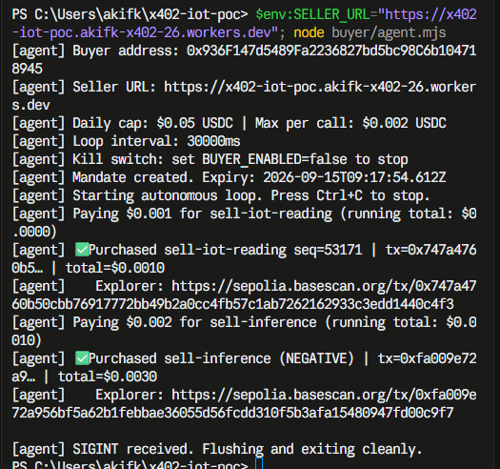
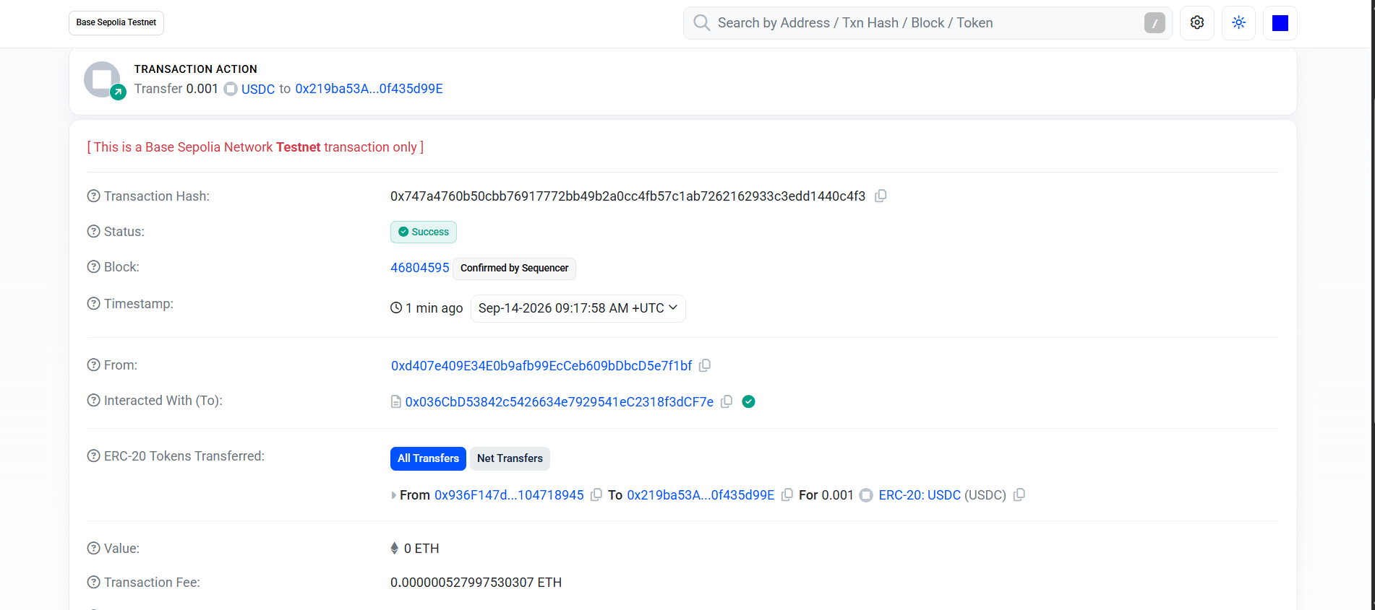
LIVE POC RUN · 2 OF 4
LIVE
4 / 15
Payment: 402, sign, retry, settled on-chain
No account. No API key. No human approved this.
Basescan: Success · 0.001 USDC buyer → seller. The transaction "From" is the facilitator's relayer, which pays the gas (EIP-3009).
Notes:
This is the slide the talk exists for. Hold the explorer page for a full two seconds on Status Success and the ERC-20 token transfer row. Expected question: why is From not the buyer? Because the buyer only signs; the facilitator submits and pays gas.

Slide 5
LIVE POC RUN · 3 OF 4
LIVE
5 / 15
A payment system is defined by what it refuses
Attempt | Status | Response
Replay the same payment proof | 402 | payment_already_used
Underpay | 402 | payment_amount_invalid
Expired mandate | 403 | mandate_expired
Someone else's mandate | 401 | identity_mismatch
30 requests at once, quota 10 | 429 | exactly 10 pass
Three layers, cheapest first
401
Who are you?
403
Are you allowed?
402
Show the money
The expensive check — the facilitator — runs last.
Notes:
Run the refusal scripts only if time allows; otherwise narrate the table. The burst row is the one that failed until 2026-09-11: the KV rate limiter let 30 of 30 through. It now counts in a Durable Object.

Slide 6
LIVE POC RUN · 4 OF 4
LIVE
6 / 15
An external agent pays — someone else's wallet
≈15 min
14 min
Who is paying — live demo page
0xc078…3b25
EXTERNAL
quickstart: no wallet → settled payment
README: their own seller, both products bought
0x936f…8945
OURS
Said plainly
The wallet belongs to a first-time tester I recruited, not a customer who found us. Organic external payers: 0.
It proves a stranger can pay from the docs alone. It does not prove anyone wants to.
They hit four documentation defects on the way (login, subdomain, a script ignoring SELLER_URL, wallet setup). All four were fixed the same day.
Notes:
Show the Who is paying panel on the live page. The external count is computed in code by excluding our own wallets, so /api/payers now reports external_payers: 1 — and the slide says who that one is.

Slide 7
FUNNEL NUMBERS · 1 OF 3
7 / 15
The funnel: built, instrumented, and almost empty
382
$0.405
1
0
purchases by our buyer agent
testnet USDC settled
external wallet — a recruited tester
organic external payers
0
0
0
$0
posts published — ten drafted
email subscribers
backlinks
infrastructure and acquisition cost
As of 2026-09-14. Purchases from the buyer ledger; payers from /api/payers, which excludes our own wallets in code.
Notes:
This will read as bad news. Say the numbers plainly and move to the next slide; defending them makes it worse. 382 purchases are the system buying from itself — they prove the machine runs, not demand.

Slide 8
FUNNEL NUMBERS · 2 OF 3
8 / 15
Why the top of the funnel is zero
W2
Book posts for channel #1 requested
never arrived — channel never went live
The part that is mine
I treated distribution as something that starts once the build is ready — and kept making the build readier.
"The REV lane survives first; say it Monday, not Friday." I reported the blocker weekly instead of escalating it once, hard, in Week 3.
W4
Publish decision requested
still open — nothing posted since
W4–W9
Ten assets written and ready
posts, threads, Show HN, tutorial, deck, outreach
Every GTM and REV metric is zero by construction, not by underperformance.
Notes:
Own the second box. It is the most credible thing on the slide.

Slide 9
FUNNEL NUMBERS · 3 OF 3
9 / 15
Activation: what first-time users actually hit
Where | What stopped them | Fixed the same day
Wallet setup | Adding Base Sepolia and finding the private key | Step-by-step MetaMask guide; keys accepted with or without 0x
Quickstart step 4 | Script ignored SELLER_URL → ECONNREFUSED | Falls back to SELLER_URL and says which setting is wrong
README step 5 | wrangler dev needs a Cloudflare login (AI runs remotely) | Login step documented; npm run dev:local for no account
README step 5 | New accounts need a workers.dev subdomain | Documented in step 5 and gotcha 11
30-second test, a person who had never seen the page: "We make a payment in exchange for data read from a sensor." Right transaction, wrong payer — they missed that no human pays. The page now opens with "No human is paying here."
Notes:
None of these would have been found by the people who built it. That is the argument for putting it in front of strangers early — the same argument as the publish decision.

Slide 10
REVENUE IMPACT MEMO · 1 OF 3
10 / 15
Zero revenue. Reusable assets. Both are real.
$0
Working PoC deployed, signed, tagged v1.2.0, MIT
Test suite 81 tests; 11 of 11 known defects caught when reintroduced
infrastructure — free tier throughout
Real-value readiness memo 12 questions for counsel — shortens a future legal review
Agentic-payments research board 11 technologies, 20 dated and sourced signals
$0
Ten publishable assets tutorial (clean-run tested), 3 posts, threads, Show HN, decks
attributable revenue
Handoff pack runbooks executed; the manager can run it without me
I would rather you see both numbers than have one dressed as the other.
Notes:
Cost: roughly nine weeks of my time, $0 infrastructure, $0 paid acquisition, faucet tokens. No row is classified as assisted revenue on a hunch.

Slide 11
REVENUE IMPACT MEMO · 2 OF 3
11 / 15
In this stack, wrong looks like working
20
The worst one
For a week the seller read the payment proof from the wrong header. Payments settled perfectly — while replay protection and rate limiting never ran.
The replay test passed the whole time: the rejection came from the chain, not from the protection being tested. Right answer, wrong reason.
Later: a rate limiter that passed every sequential test let 30 of 30 concurrent requests through; failed settlements were counted as sales.
Almost none of the twenty raised an error. They were found by checking numbers against an independent source — the chain, a burst, a stranger.
defects found and documented, each with its failing output
11 / 11
known defects the suite catches when put back
The mutation script once crashed mid-run and left the header bug in the tree. The suite caught it in ninety seconds; manual testing had missed it for a week.
Notes:
This is the most useful slide for anyone building on x402. Full list with failing outputs: docs/VERIFICATION.md section 4.

Slide 12
REVENUE IMPACT MEMO · 3 OF 3
12 / 15
Real value next quarter? Not yet — security, not regulation
Three 2026 papers document replay, wallet-drain and prompt-injection attacks on x402 implementations.
A USENIX Security 2026 study tested 15 facilitators, Coinbase's included: every one violated at least one security rule.
GENIUS Act is law and MiCA is enforcing — regulation is no longer the blocker people assume.
Spending controls score lowest; all three findings behind that row came from this repo.
Readiness memo recommendation: obtain a counsel opinion; move no real value.
Notes:
Scores cite a source or our own experiment, or they go down. Board: docs/research-board/AGENTIC-PAYMENTS-BOARD.md.

Slide 13
MONTHS 3–6 PROPOSAL · 1 OF 2
13 / 15
Targets I would sign up for
Target | Number | Measured by
External paying wallets | 5 | /api/payers — excludes our wallets in code
Email list | 50 | /api/subscribers/count — consent-first
Quality backlinks | 10 | directory listings plus organic references
B2B readiness briefings held | 6 | 15 outreach messages at a ≥ 3-reply rate
Real-value pilot | counsel opinion | no value moved — deliberately not "mainnet live"
Conditional on the publish decision. Without it none of these are reachable, and I will not sign up for a number I cannot influence. No revenue target: I do not control pricing or checkout.
Notes:
Two of these are measured by infrastructure I built, in code that excludes our own wallets. I chose them because I cannot flatter them.

Slide 14
MONTHS 3–6 PROPOSAL · 2 OF 2
14 / 15
The role: own the agentic-payments research vertical
1
Maintain the board
2
Run the briefings
Re-score quarterly against dated, sourced signals; add technologies as they appear
A 20-minute readiness briefing per sector; "not yet for you" counts as a success
3
Keep the PoC current
4
Publish the findings
It is the evidence: a live reference implementation every claim can be checked against
Every defect becomes a board entry and a post — twenty so far
1. Publish
→
2. Sign-offs
→
3. Counsel review
→
4. Then a paid micro-test
Notes:
Picked over productizing the starter kit (easy to copy) and running the growth loop (its input is a decision I do not control). Written up in docs/week9/ROLE-PROPOSAL.md.

Slide 15
THE ASK
15 / 15
Three decisions
Publish Everything is written and review-ready. Days, not weeks.
1
Review what is waiting One-pager, posts, funnel map, the readiness walkthrough — and whether the 24 h run, which reached 8 h 50 m, is accepted as partial.
2
The role Own the agentic-payments research vertical, with the targets on slide 13.
3
The machine works, and a stranger can pay it in fifteen minutes.
Nobody has been shown the door yet.
Notes:
Stop talking after the last line. Expected question — "why not fund a second wallet?" It would settle from a different address and still not be adoption; the KPI is wallets we do not own, and the exclusion is in config so the line cannot blur.

