Slide 1
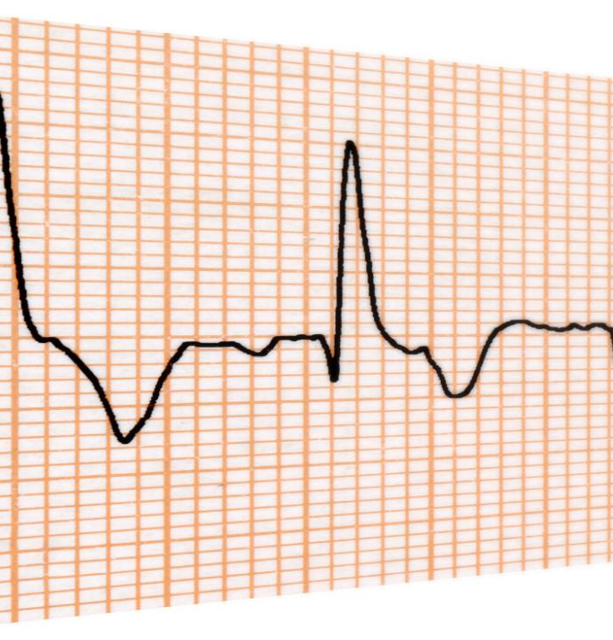
Literature Overview: EEG Noise and Artifact Removal
Key methods to improve EEG signal quality effectively
Soroush Gholizadeh jouryabi / 12454591
Notes:
AI-generated content may be incorrect. ---

Slide 2
Motivation and Context for EEG Artifact Removal
Notes:
Why EEG Recordings Require Careful Preprocessing, General Categories of EEG Noise and Artifacts

Slide 3

Why EEG Recordings Require Careful Preprocessing
Susceptibility to Noise
EEG signals are weak and easily contaminated by physiological and environmental noise sources.
Artifacts Distort Signal
Artifacts like eye blinks and muscle activity distort EEG waveforms and can mask true brain signals.
Importance of Preprocessing
Preprocessing removes artifacts to preserve genuine neural information for accurate analysis and interpretation.
Challenges in Validation
True clean EEG signals are unknown, making artifact removal evaluation reliant on indirect measures and expert review.
Notes:
Electroencephalography (EEG) measures very small electrical potentials generated by neural activity and recorded at the scalp, typically in the range of only a few microvolts. Because these signals are weak and measured non-invasively, EEG recordings are highly susceptible to contamination from non-neural sources. As a result, raw EEG data are almost never a pure representation of brain activity; instead, they are a mixture of neural signals, physiological artifacts, and environmental or instrumental noise. This makes preprocessing and artifact removal a fundamental step before any meaningful analysis can be performed. Without proper cleaning, artifacts can dominate the signal, distort its temporal waveform, alter its frequency spectrum, and create misleading spatial patterns across electrodes. For example, a large eye blink can appear as a slow, high-amplitude deflection in frontal channels, masking genuine neural responses, while muscle activity can introduce high-frequency components that resemble cognitive-related beta or gamma activity. These effects can severely bias downstream analyses such as brain–computer interface (BCI) classification, event-related potential (ERP) studies, frequency-tagging or steady-state visual evoked potential (SSVEP) analysis, and clinical interpretation. Another important challenge is that, in real EEG recordings, the true underlying “clean” brain signal is unknown. This lack of ground truth makes it difficult to objectively evaluate how well a given artifact-removal method performs. Researchers must therefore rely on indirect metrics, expert visual inspection, or controlled simulations. The literature consistently emphasizes that EEG preprocessing is not optional but a necessary prerequisite for reliable results. Across laboratory, clinical, and wearable EEG settings, artifact removal is best understood as a systematic effort to improve signal quality while preserving as much genuine neural information as possible, rather than as a single optional filtering step. This motivation underpins all the papers reviewed in this presentation.

Slide 4
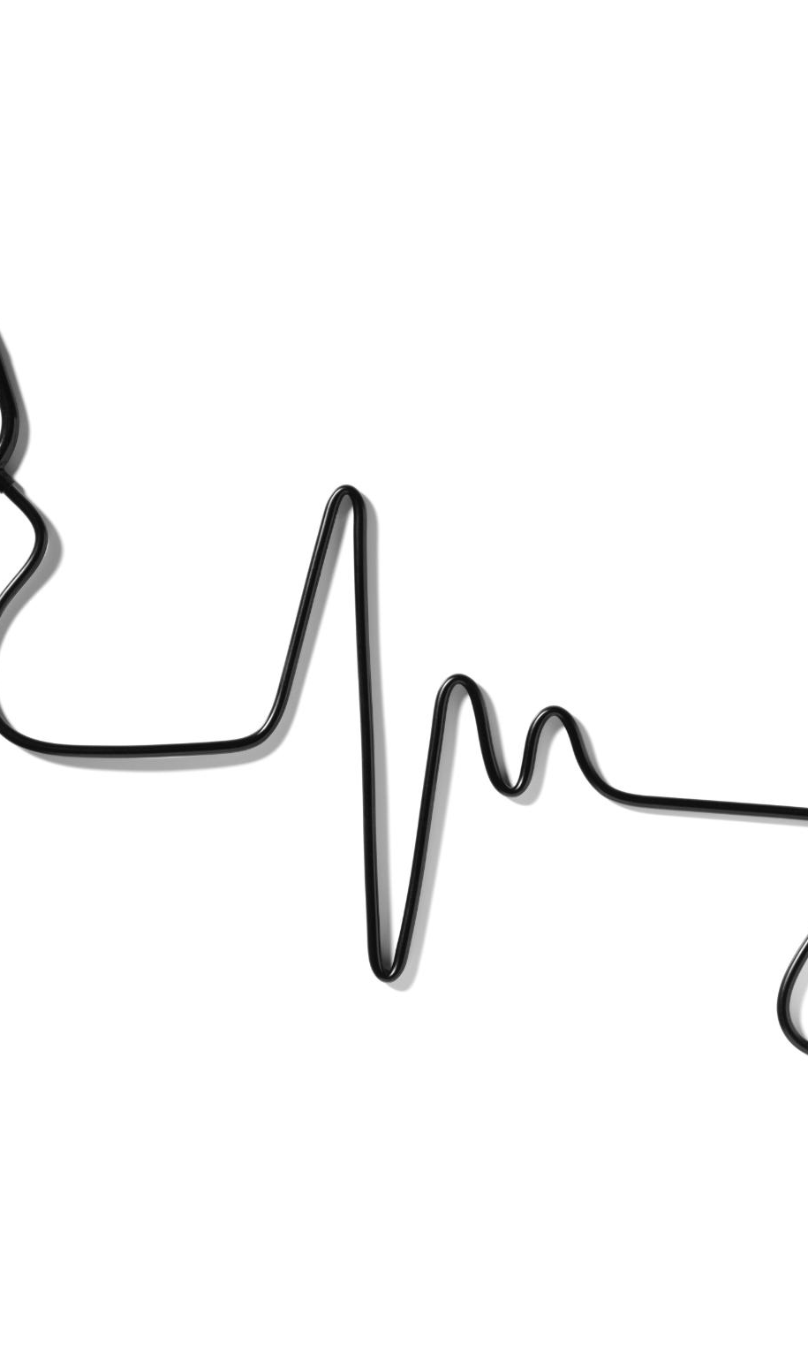
General Categories of EEG Noise and Artifacts
Physiological Artifacts
Physiological artifacts originate from non-brain biological activities like eye blinks, muscle movement, heartbeats, and body motion.
Non-Physiological Artifacts
Non-physiological artifacts arise from recording setup issues and environmental noise, such as electrode problems and electromagnetic interference.
Artifact Characteristics
Artifacts have unique temporal, spectral, and spatial properties that influence the choice of removal techniques in EEG analysis.
Artifact Removal Techniques
Understanding artifact types guides the use of methods like filtering, source separation, wavelet decomposition, and machine learning.
Notes:
EEG artifacts are commonly divided into physiological and non-physiological categories, a distinction that helps clarify their origins and appropriate removal strategies. Physiological artifacts arise from biological processes other than cortical brain activity. The most prominent examples are ocular artifacts, produced by eye blinks and eye movements, which generate large electrical potentials that spread across the scalp. Muscular or myogenic artifacts originate from facial, jaw, neck, or scalp muscles and often have a broad frequency spectrum, overlapping with neural EEG bands. Cardiac artifacts, related to the electrocardiogram (ECG), can appear as rhythmic components synchronized with the heartbeat. Movement-related artifacts, such as head or body motion, are also physiological in nature and can be particularly problematic in populations like infants or in mobile EEG recordings. Non-physiological artifacts stem from the recording setup or environment rather than the body. These include instrumental artifacts such as bad or flat channels caused by poor electrode contact, electrode displacement, cable movement, amplifier saturation, or impedance imbalance. Environmental noise, especially electromagnetic interference, is another major category; a classic example is power-line noise at 50 Hz in Europe or 60 Hz in other regions. Each artifact category has distinct temporal, spectral, and spatial characteristics, which is why no single removal method works optimally for all cases. The reviewed literature shows that understanding the type of artifact present is crucial, because it determines whether simple filtering is sufficient or whether more advanced techniques such as source separation, wavelet decomposition, or machine learning are required. This taxonomy provides the conceptual foundation for evaluating and comparing artifact-removal pipelines across different EEG applications.

Slide 5
Paper 1: Zhang et al. (2021) — EEGdenoiseNet
Notes:
EEGdenoiseNet: Motivation and Dataset Design, Artifact Types and Denoising Methods in EEGdenoiseNet

Slide 6
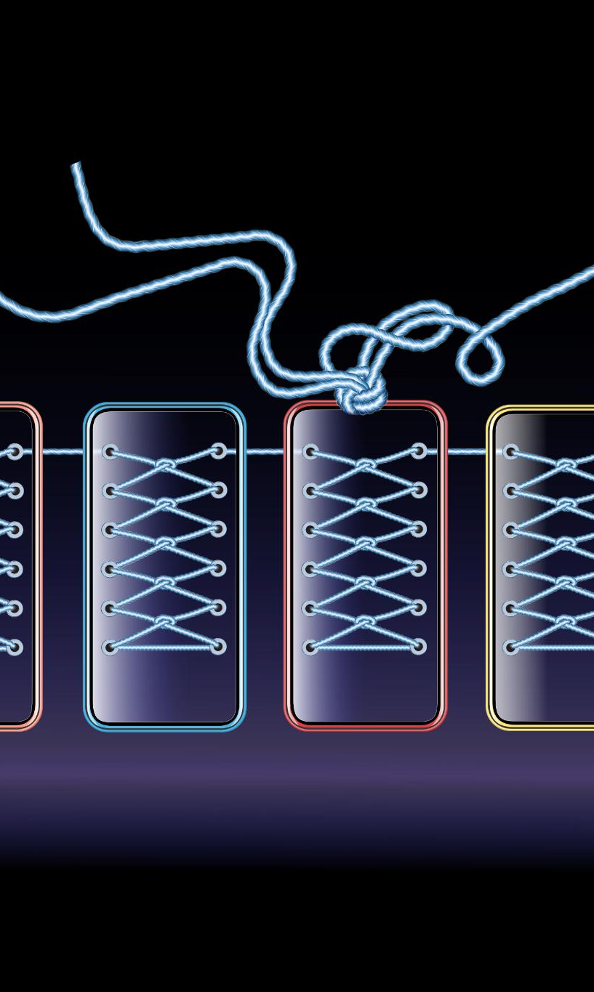
EEGdenoiseNet: Motivation and Dataset Design
Challenge in EEG Denoising
Real EEG signals mix brain activity and artifacts, making clean signal identification very difficult.
EEGdenoiseNet Dataset Components
Dataset includes clean EEG, ocular artifacts, and muscular artifacts for realistic signal synthesis.
Synthetic Mixing for Ground Truth
Clean EEG is synthetically mixed with artifact segments at controlled ratios for known ground truth.
Benchmark for Model Evaluation
Dataset enables objective evaluation and fair comparison of deep learning EEG denoising methods.
Notes:
Zhang et al. (2021) address a central problem in modern EEG denoising research: the lack of standardized benchmark datasets with known ground truth for evaluating artifact-removal methods, particularly deep learning models. In real EEG recordings, it is usually impossible to know the exact underlying clean brain signal, because artifacts and neural activity are inseparably mixed at the scalp. This makes supervised learning and objective performance comparison extremely challenging. To overcome this limitation, the authors introduce EEGdenoiseNet, a benchmark dataset specifically designed for training and evaluating deep-learning-based EEG denoising algorithms. The dataset consists of three main components: clean EEG segments, ocular artifact segments, and muscular artifact segments. Clean EEG signals are extracted from recordings with minimal contamination, while ocular artifacts capture eye blinks and eye movements, and muscular artifacts represent myogenic activity from facial or scalp muscles. By synthetically mixing clean EEG with artifact segments at controlled signal-to-noise ratios, the authors generate contaminated EEG signals for which the original clean EEG is known. This design enables direct quantitative evaluation of denoising performance by comparing the model output with the true clean signal. EEGdenoiseNet includes thousands of segments—on the order of several thousand clean EEG samples and several thousand artifact samples—providing sufficient data to train data-hungry deep learning models. Importantly, the dataset is not tied to a single algorithm; instead, it is intended as a common benchmark that allows fair comparison across different denoising approaches. In the context of the literature overview, this paper contributes a data-centric perspective, emphasizing that progress in EEG artifact removal depends not only on new algorithms but also on the availability of high-quality, standardized evaluation datasets.

Slide 7
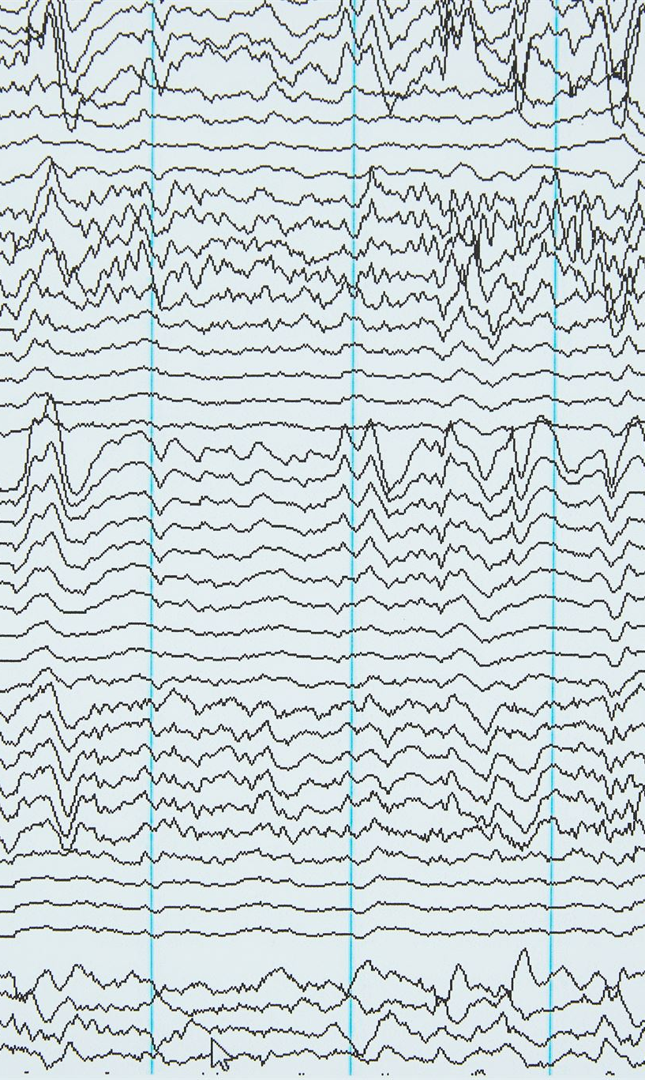
Artifact Types and Denoising Methods in EEGdenoiseNet
Physiological Artifact Types
Ocular artifacts arise from eye movements causing low-frequency EEG deflections. Muscular artifacts include high-frequency noise from facial and neck muscles.
Traditional Denoising Methods
Traditional methods involve regression-based correction, adaptive filtering, and blind source separation like ICA to remove EEG artifacts.
Deep Learning Approaches
Deep learning models such as CNNs and RNNs are trained to map contaminated EEG signals directly to clean signals with superior performance.
Performance and Limitations
Deep learning methods outperform traditional techniques given enough training data but require dataset quality and size matching model complexity.
Notes:
The EEGdenoiseNet paper focuses primarily on two major physiological artifact types: ocular artifacts and muscular, or myogenic, artifacts. Ocular artifacts are caused by eye blinks and eye movements, which generate strong electrical potentials due to the dipole formed by the cornea and retina. These artifacts typically appear as large-amplitude, low-frequency deflections, most prominently in frontal EEG channels such as Fp1 and Fp2. Muscular artifacts, on the other hand, originate from electrical activity in muscles of the face, jaw, neck, or scalp. They tend to have a broad frequency spectrum and often contribute high-frequency components that overlap with neural beta and gamma bands, making them particularly difficult to remove using simple frequency-based filters. Zhang et al. review several traditional artifact-removal approaches, including regression-based correction using reference channels, adaptive filtering techniques that adjust filter parameters over time, and blind source separation (BSS) methods such as independent component analysis (ICA). However, the main emphasis of the paper is on deep learning approaches. The authors benchmark multiple neural network architectures, including fully connected neural networks, convolutional neural networks, residual convolutional networks, and recurrent neural networks with long short-term memory units. These models learn a direct mapping from contaminated EEG to clean EEG in a supervised manner. The results demonstrate that deep learning methods can outperform traditional techniques under controlled conditions, particularly when sufficient training data are available. This paper therefore illustrates both the potential and the limitations of data-driven EEG denoising, highlighting the importance of matching algorithm complexity with dataset quality and size.

Slide 8
Paper 2: Kumaravel et al. (2022) — NEAR Pipeline
Notes:
Challenges of Artifact Removal in Newborn EEG, NEAR Pipeline: LOF-Based Channel Detection and ASR

Slide 9
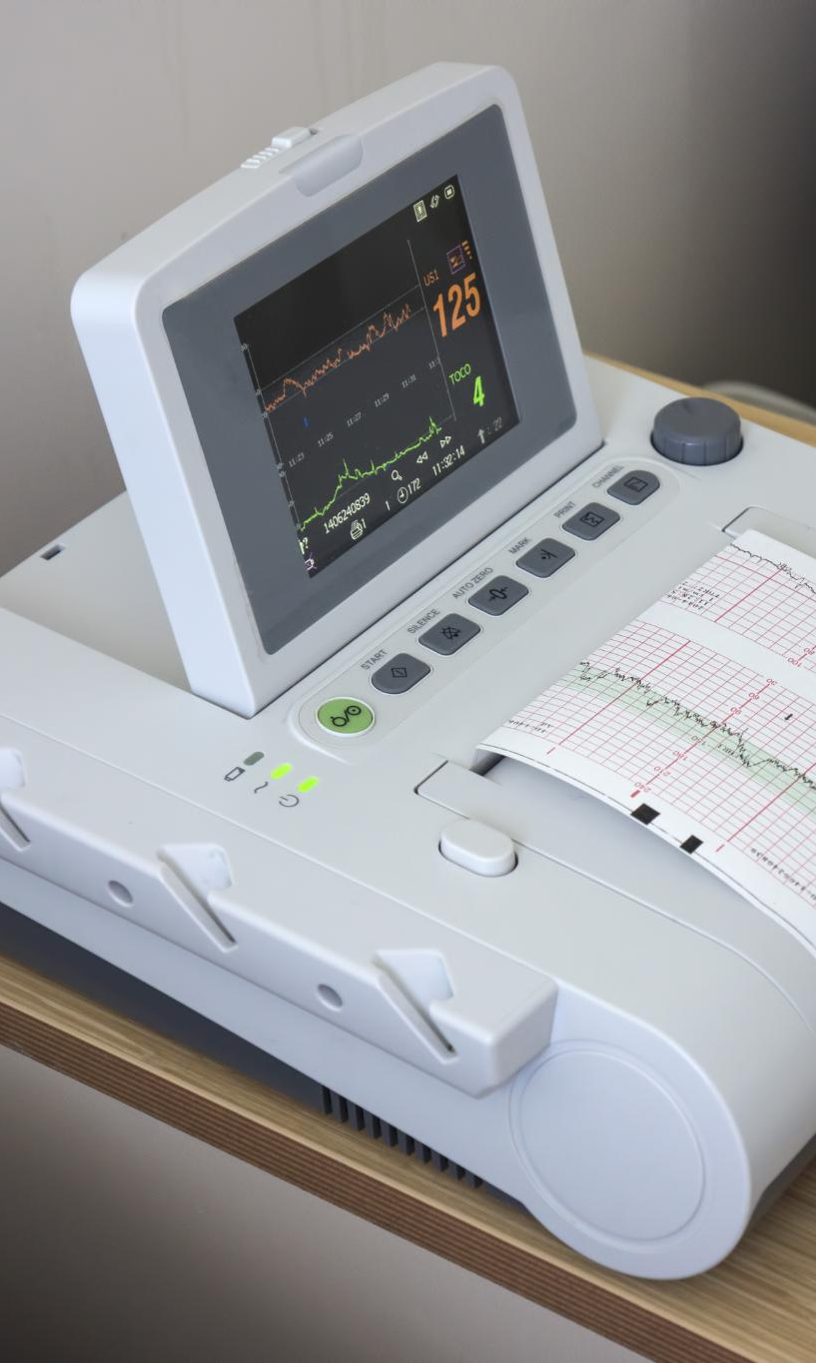
Challenges of Artifact Removal in Newborn EEG
Unique Newborn EEG Challenges
Newborn EEG recordings are short and affected by unpredictable infant movements causing diverse artifacts.
Limitations of Adult EEG Methods
Traditional adult EEG preprocessing methods often fail due to the variability and non-stereotyped nature of newborn artifacts.
Need for Adaptive Pipelines
Effective newborn EEG artifact removal requires robust, adaptive methods tailored to transient, high-amplitude disturbances.
Development of NEAR Pipeline
NEAR is a dedicated preprocessing pipeline designed specifically to address the unique characteristics of newborn EEG data.
Notes:
Kumaravel et al. (2022) focus on a particularly challenging EEG application: recordings from human newborns. Newborn EEG differs substantially from adult laboratory EEG in several important ways. First, recordings are typically short because infants cannot remain still or attentive for long periods. Second, newborns move unpredictably, producing frequent and often severe artifacts due to head movement, limb movement, frowning, sucking, or changes in posture. Third, electrode contact is often unstable, leading to bad or flat channels and sudden amplitude jumps. A key concept emphasized in this paper is that many newborn artifacts are non-stereotyped. Unlike eye blinks in adults, which tend to have a consistent shape and spatial distribution, newborn movement artifacts can vary widely from event to event. This variability reduces the effectiveness of traditional ICA-based methods, which rely on repeated, statistically independent sources. As a result, standard adult EEG preprocessing pipelines often perform poorly on newborn data. The authors argue that artifact removal in this context must be robust, adaptive, and capable of handling transient, high-amplitude disturbances without relying heavily on assumptions about artifact structure. This motivation leads to the development of NEAR, a dedicated preprocessing pipeline tailored specifically to the characteristics of newborn EEG. In the broader literature overview, this paper highlights the importance of adapting artifact-removal strategies to the population and recording conditions, rather than assuming that a single adult-oriented pipeline will generalize to all EEG scenarios.

Slide 10
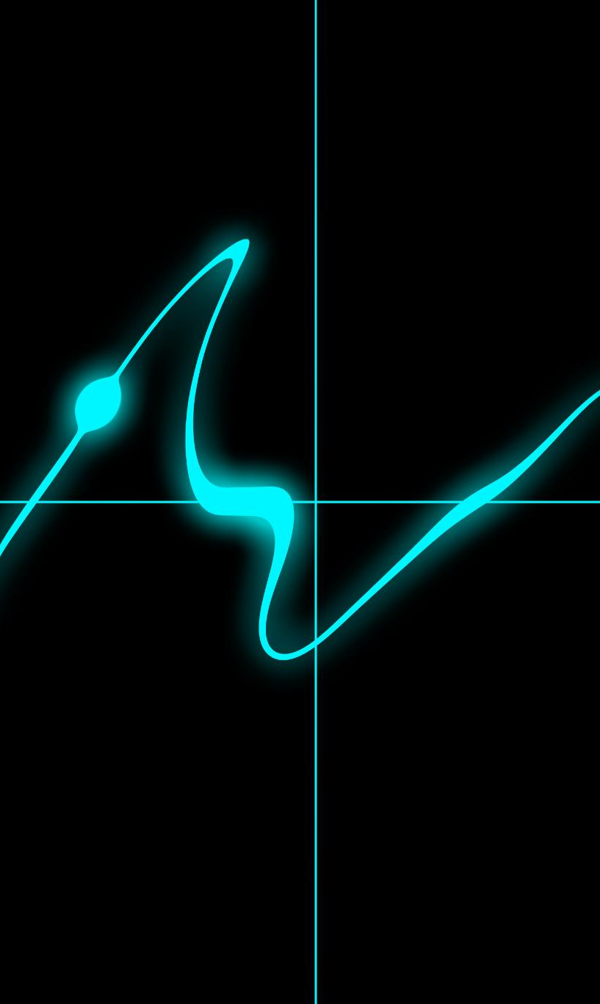
NEAR Pipeline: LOF-Based Channel Detection and ASR
LOF-Based Channel Detection
LOF algorithm identifies abnormal EEG channels by detecting outliers with unusual amplitude and noise patterns.
Artifact Subspace Reconstruction
ASR identifies and corrects transient high-amplitude EEG artifacts by comparing to clean data statistics.
Parameter Calibration
Calibration of ASR cutoff parameter is crucial for newborn EEG to balance artifact removal and signal preservation.
Signal Interpolation and Re-Referencing
After artifact removal, bad channels are interpolated and EEG data are re-referenced to improve signal quality.
Notes:
The NEAR pipeline, which stands for Newborn EEG Artifact Removal, is designed as a complete, multi-step preprocessing workflow rather than a single algorithm. A central component of NEAR is automatic bad-channel detection using the Local Outlier Factor (LOF) algorithm. LOF is an unsupervised, density-based outlier detection method that identifies data points—or, in this case, EEG channels—that behave very differently from their neighbors. Channels with abnormal amplitude distributions, excessive noise, or flat signals are flagged as outliers and marked as bad. This approach is more adaptive than simple global thresholding, which can be too strict or too lenient in noisy newborn recordings. After bad channels are identified, NEAR applies Artifact Subspace Reconstruction (ASR) to address transient, high-amplitude artifacts. ASR works by learning the statistical properties of relatively clean EEG data and then identifying time windows or subspaces that deviate strongly from this reference. These contaminated segments can be corrected or removed, depending on parameter settings. A critical parameter in ASR is the cutoff value, often denoted as k, which controls how aggressively artifacts are removed. Kumaravel et al. emphasize that this parameter must be calibrated for the specific dataset and population, as default values may not be appropriate for newborn EEG. Following ASR, bad channels are interpolated using neighboring electrodes, and the data are re-referenced. The NEAR pipeline demonstrates that effective artifact removal requires coordinated handling of channel quality, transient artifacts, and signal reconstruction.

Slide 11
Paper 3: Arpaia et al. (2025) — Wearable EEG Review
Notes:
Wearable EEG: Artifact Taxonomy and Challenges, Methods and Evaluation Metrics in Wearable EEG Studies

Slide 12
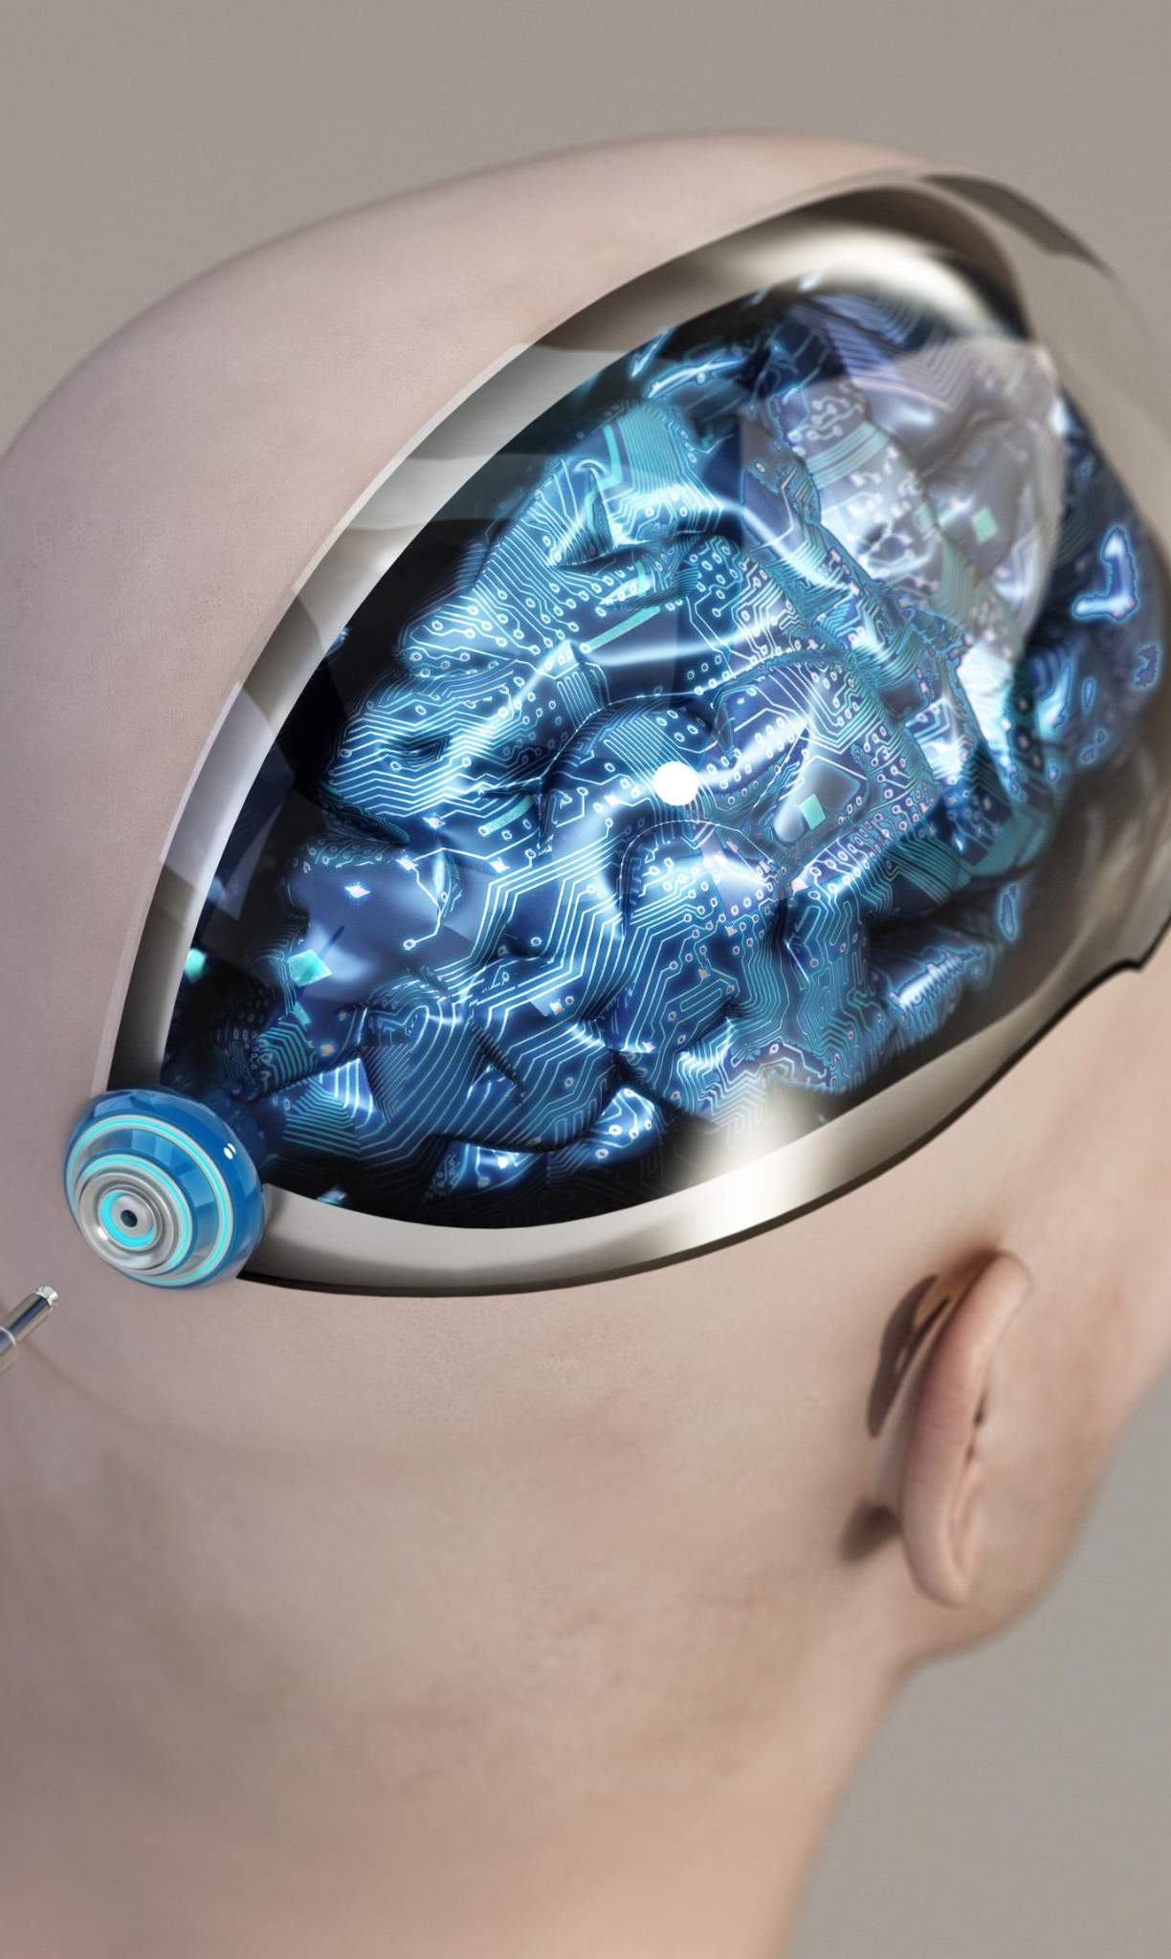
Wearable EEG: Artifact Taxonomy and Challenges
Wearable EEG Characteristics
Wearable EEG uses fewer channels, dry or semi-wet electrodes, and operates in mobile environments, increasing artifact susceptibility.
Artifact Taxonomy
Artifacts include ocular, muscular, movement, instrumental, cardiac, and electromagnetic interference affecting data quality in wearable EEG.
Artifact Detection Challenges
Most methods detect contamination but few identify specific artifact categories, which are essential for targeted removal methods.
Algorithmic Constraints
Low channel count and mobile use limit traditional source separation, requiring adaptive, lightweight artifact removal algorithms.
Notes:
Arpaia et al. (2025) present a systematic review of artifact detection and artifact category identification in wearable EEG systems. Wearable EEG differs from traditional laboratory EEG in several fundamental ways. It often relies on dry or semi-wet electrodes, uses fewer channels, and is designed for mobile or real-world environments rather than controlled laboratory settings. These characteristics make wearable EEG more susceptible to artifacts and noise. The review provides a comprehensive taxonomy of artifact types encountered in wearable EEG, including ocular artifacts, muscular artifacts, movement artifacts, instrumental artifacts, cardiac artifacts, and electromagnetic interference such as power-line noise. Ocular artifacts are reported as the most frequently studied category, followed by muscular and movement-related artifacts. Instrumental artifacts, such as electrode displacement or cable movement, are also common in wearable systems due to user motion and less stable electrode attachment. A key insight from the review is that many methods focus on detecting whether data are contaminated, but relatively few attempt to identify the specific artifact category. This distinction is important because knowing the artifact type can inform the choice of removal method. For example, power-line noise can be addressed with a notch filter, while movement artifacts may require ASR or sensor-assisted approaches. The paper emphasizes that wearable EEG introduces constraints—such as low channel count—that limit the applicability of traditional source separation techniques, motivating the need for adaptive and lightweight algorithms.

Slide 13
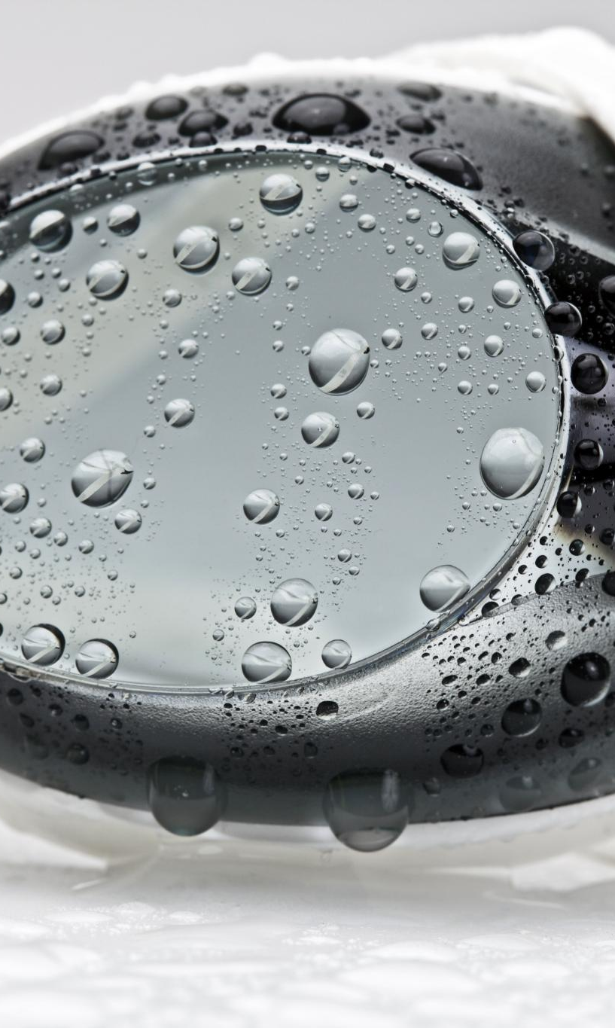
Methods and Evaluation Metrics in Wearable EEG Studies
Algorithmic Methods Overview
Wearable EEG artifact removal methods include filtering, blind source separation, signal decomposition, ASR, and machine learning models.
Popular Artifact Handling Techniques
ASR and wavelet-based methods are favored for managing movement and non-stationary artifacts in wearable EEG recordings.
Evaluation Metrics Variability
Studies use diverse accuracy, selectivity, classification, and operational metrics, lacking standardization for comparison.
Need for Standard Benchmarks
Inconsistent evaluation practices highlight the need for clear benchmarks and reporting standards in wearable EEG research.
Notes:
In addition to artifact taxonomy, Arpaia et al. systematically categorize the algorithmic approaches and evaluation metrics used in wearable EEG artifact studies. Method families include traditional filtering techniques, such as band-pass and notch filtering, blind source separation methods like ICA and canonical correlation analysis, signal decomposition approaches including discrete and stationary wavelet transforms and empirical mode decomposition, ASR-based methods and their variants, and machine learning or deep learning models. The review highlights that ASR and wavelet-based techniques are particularly popular for handling movement and non-stationary artifacts in wearable EEG. On the evaluation side, the authors note a lack of standardization across studies. Common accuracy metrics include root-mean-square error, relative RMS error, mean absolute error, and signal-to-noise ratio. Selectivity metrics such as correlation coefficients, coherence, and mutual information are also used to assess how well neural information is preserved. Classification-based metrics, including accuracy, F1-score, true positive rate, and area under the curve, are employed when artifact detection is framed as a classification problem. Operational metrics, such as computational latency and power consumption, are especially relevant for wearable and real-time applications. The review concludes that inconsistent evaluation practices make it difficult to directly compare methods across studies, underscoring the need for clearer benchmarks and reporting standards in the field.

Slide 14
Paper 4: Zangeneh Soroush et al. (2022) — Hybrid Artifact Removal
Notes:
Hybrid Pipeline Using SOBI, Nonlinear Dynamics, and Machine Learning, Stationary Wavelet Transform and Key Lessons

Slide 15

Hybrid Pipeline Using SOBI, Nonlinear Dynamics, and Machine Learning
Source Separation with SOBI
SOBI efficiently decomposes multi-channel EEG into source components using second-order statistics and time-lagged covariances.
Nonlinear Dynamics Analysis
Phase space reconstruction and angle-space representation capture nonlinear dynamical behavior of EEG components for feature extraction.
Machine Learning Classification
Extracted features are input into machine learning classifiers to distinguish neural from artifactual EEG components with high accuracy.
Classification Performance
Binary classification outperforms multi-class, reliably separating neural and artifact components in real and simulated EEG data.
Notes:
Zangeneh Soroush et al. (2022) propose a technically sophisticated hybrid method for EEG artifact removal that combines signal processing, nonlinear dynamics, and machine learning. The method begins with source separation using Second-Order Blind Identification (SOBI), a blind source separation technique that exploits second-order statistics and time-lagged covariance matrices to decompose multi-channel EEG into source components. SOBI is chosen for its computational efficiency and suitability for EEG data. After source separation, the authors focus on automatically identifying which components are artifactual. To do this, they reconstruct the phase space of each component, capturing its nonlinear dynamical behavior, and derive an angle-space representation that encodes geometric relationships between points in the phase space. From this representation, a variety of features are extracted, including statistical measures and counts of intersections with predefined Poincaré planes. These features are then fed into several machine learning classifiers, such as multi-layer perceptrons, k-nearest neighbors, naïve Bayes classifiers, support vector machines, and ensemble models. The authors evaluate both multi-class classification, which attempts to distinguish specific artifact types, and binary classification, which simply separates neural from artifactual components. The results show that binary classification is more reliable, achieving high accuracy across simulated and real datasets.

Slide 16

Stationary Wavelet Transform and Key Lessons
Use of Stationary Wavelet Transform
SWT decomposes signals without downsampling, preserving temporal alignment for effective artifact suppression.
Artifact Suppression Technique
Soft thresholding with Haar wavelets attenuates artifact subbands while retaining neural details in EEG data.
Evaluation and Reconstruction
Method reconstructs EEG after denoising and is evaluated on diverse data sets using multiple performance metrics.
Key Lessons and Limitations
Artifact removal should preserve neural info; method suits stereotyped artifacts and requires many channels.
Notes:
A distinctive aspect of the method by Zangeneh Soroush et al. is the use of the Stationary Wavelet Transform (SWT) to suppress artifacts in identified artifactual components. Instead of completely removing these components—which risks discarding leaked neural information—the authors apply SWT-based denoising. SWT decomposes a signal into multiple scales without downsampling, preserving temporal alignment. Using a Haar wavelet, multiple decomposition levels, and soft thresholding, the method attenuates artifact-related subbands while retaining finer neural details. After denoising the artifactual components, the EEG is reconstructed using the inverse mixing process. The authors evaluate their approach on simulated, semi-simulated, and real EEG data, employing a wide range of metrics including classification accuracy, relative RMS error, spectral measures, correlation coefficients, mutual information, and visual inspection of power spectral density and topographic maps. The key lesson from this paper is that artifact removal should not automatically equate to component deletion. Instead, careful suppression and reconstruction can better preserve neural information. However, the authors also acknowledge limitations: the method requires sufficient channel count for source separation and is best suited for stereotyped biological artifacts rather than highly irregular movement artifacts. This paper provides an advanced example of how multiple techniques can be integrated into a single automated pipeline.

Slide 17
Implementation
Simple Python/MNE EEG Noise-Removal Pipeline
Focus of this section
1. General preprocessing pipeline stages
2. Input EEG recording and metadata
3. Generated output files and example results
LP Praktikum Informatik 1 | Implementation | 17

Slide 18
Implementation: General Pipeline Stages
Python/MNE baseline pipeline inspired by the reviewed literature
Load EEG
Inspect metadata
Raw time plot
Raw PSD
Band-pass 1–40 Hz
Notch 50 Hz
Optional ICA
Save outputs
Purpose
Implemented operations
Implement a simple and explainable EEG preprocessing workflow.
Use time-domain and frequency-domain plots to inspect the effect of cleaning.
Keep the pipeline reproducible using saved figures and JSON reports.
Band-pass filter: 1–40 Hz
Notch filter: 50 Hz
Optional ICA inspection/removal
PSD comparison: raw vs cleaned EEG
This is a baseline implementation, not a full reproduction of NEAR, EEGdenoiseNet, or the SOBI–SWT method.
LP Praktikum Informatik 1 | Implementation | 18

Slide 19
Input EEG Data: S001R01.edf
Recording metadata
Spatial channel coverage
Input file: data/S001R01.edf
Number of channels: 64
Channel type: EEG for all channels
Sampling frequency: 160.0 Hz
Duration: 60.99 seconds
Reference: 0 (FIFFV_MNE_CUSTOM_REF_OFF)
Frontal/frontopolar: Fp, AF, F
Frontocentral/central: FC, C
Centro-parietal/parietal: CP, P
Temporal: FT, T, TP
Parieto-occipital/occipital: PO, O, Iz
Full channel list stored in metadata_report.json
The recording provides a short 64-channel EEG example suitable for demonstrating a basic preprocessing pipeline.
LP Praktikum Informatik 1 | Implementation | 19

Slide 20
Generated Output Files
Visualization outputs
Report and data outputs
01_raw_time_domain.png
02_raw_psd.png
03_cleaned_time_domain.png
04_cleaned_psd.png
05_psd_raw_vs_cleaned.png
metadata_report.json
pipeline_report.json
cleaned_eeg_raw.fif
Pipeline report summary
Input: data\S001R01.edf
Band-pass: 1.0–40.0 Hz
Notch: 50.0 Hz
ICA was not applied automatically: no EOG/ECG components detected
LP Praktikum Informatik 1 | Implementation | 20

Slide 21
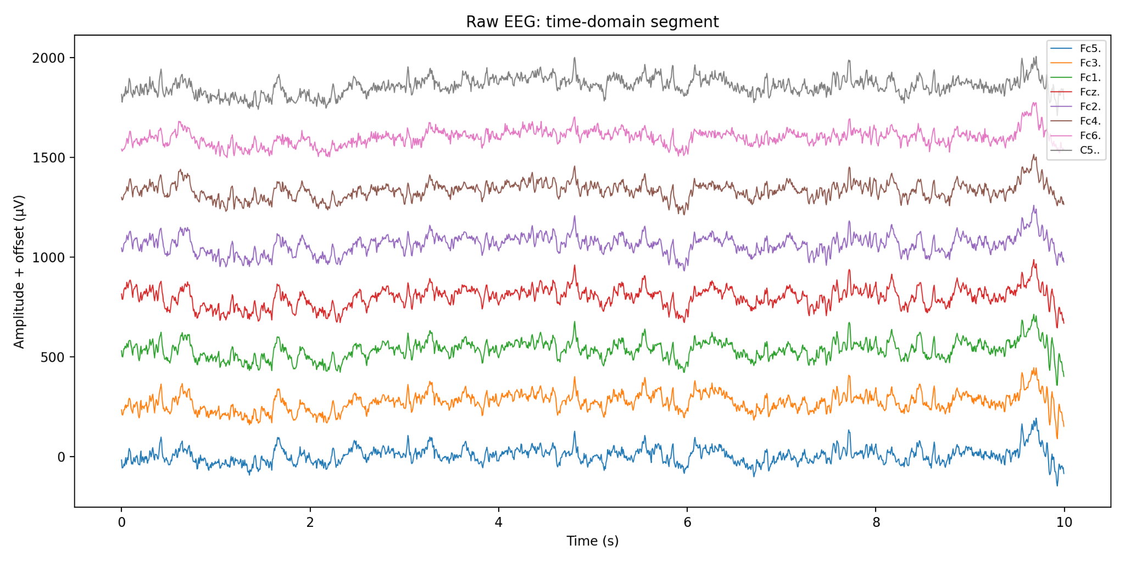
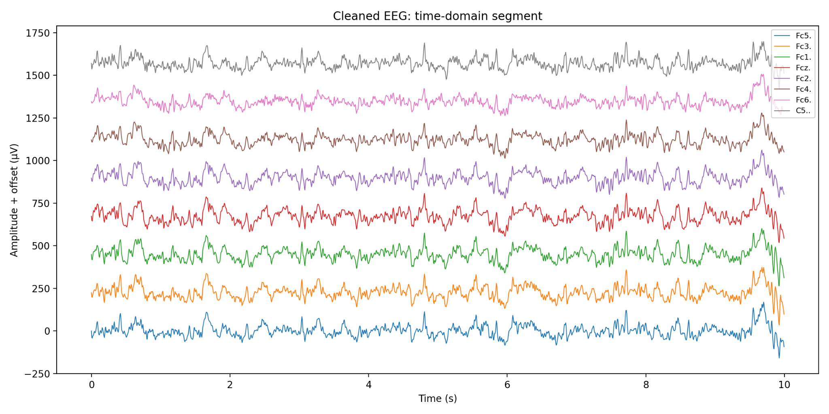
Time-Domain Results: Raw vs Cleaned EEG
Raw EEG segment
Cleaned EEG segment
First 10 seconds of selected EEG channels
Used for visual inspection of waveform-level artifacts
Same style of visualization after filtering
Used to check whether waveform behavior remains plausible
Time-domain plots are useful for visually checking large fluctuations, sudden jumps, noisy channels, and whether preprocessing changes the waveform structure.
LP Praktikum Informatik 1 | Implementation | 21

Slide 22
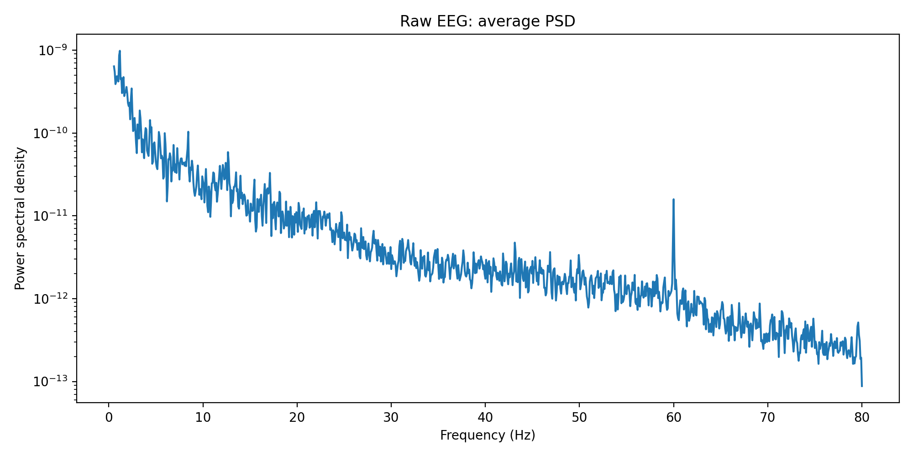
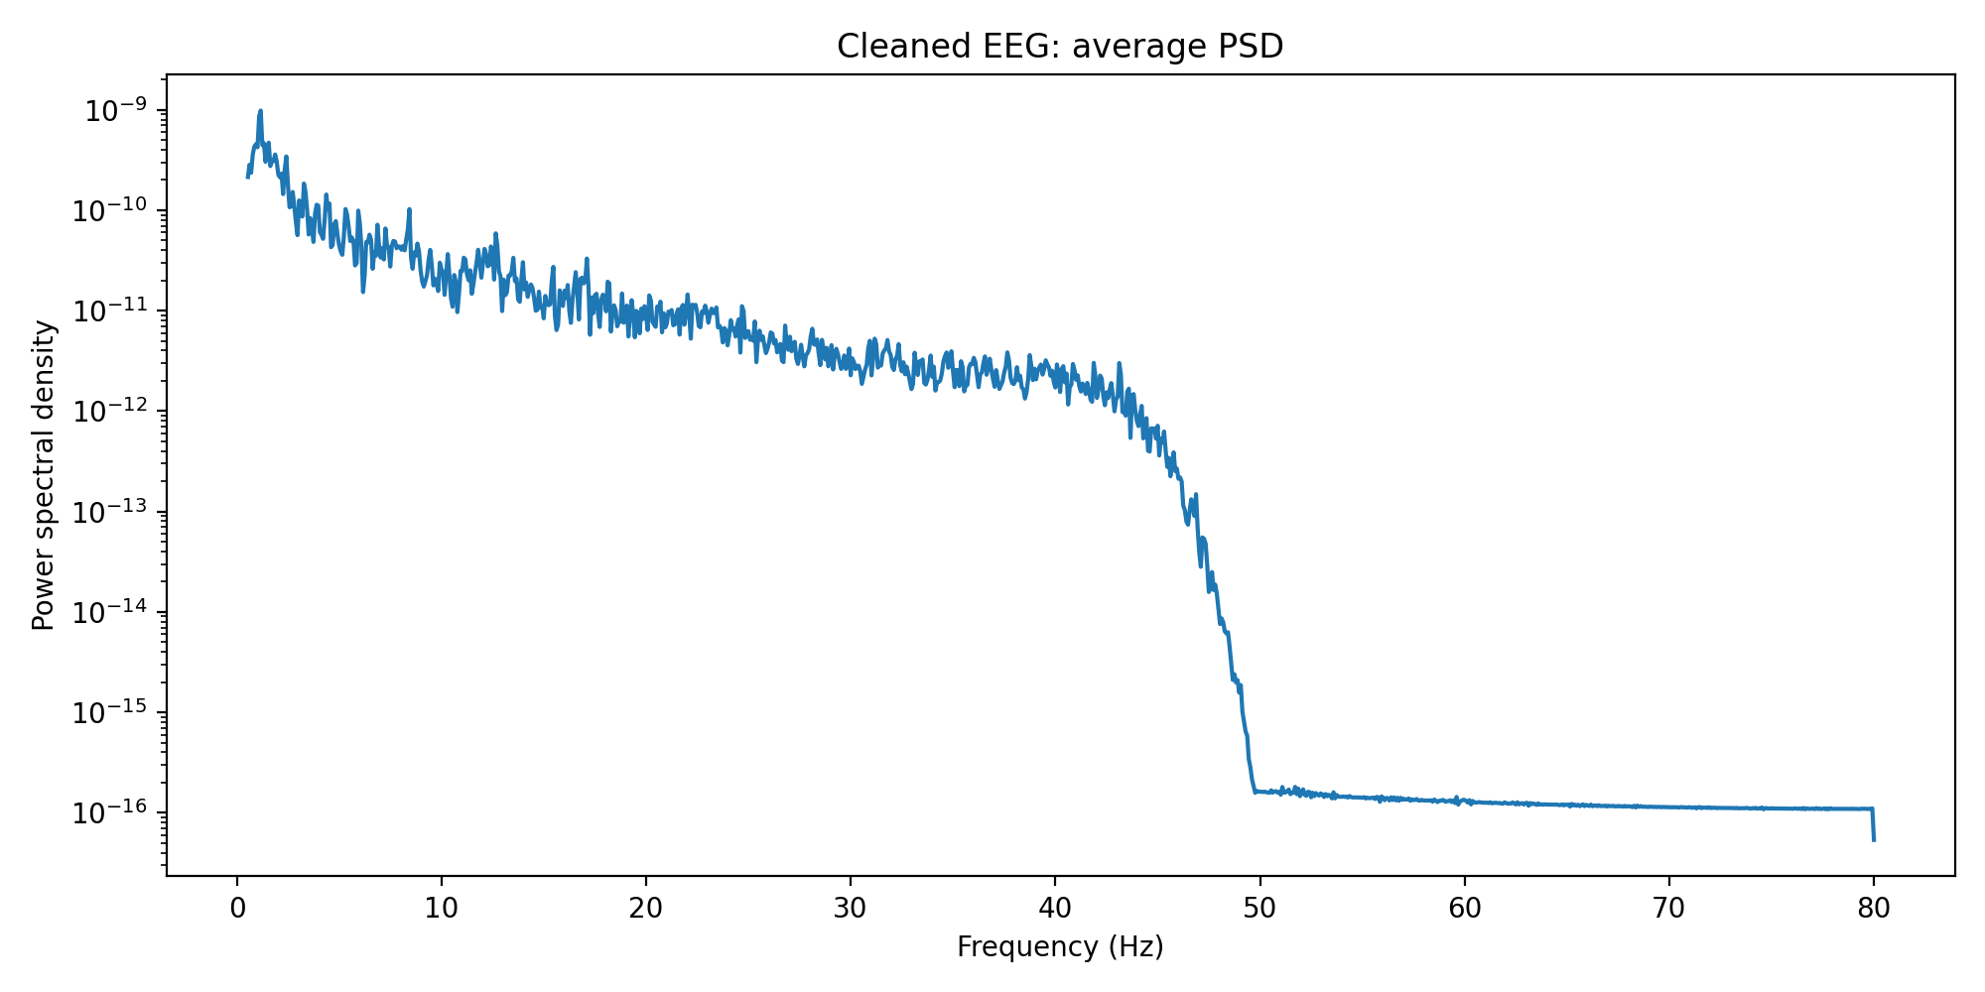
Frequency-Domain Results: PSD Before and After Cleaning
Interpretation
PSD shows signal power across frequencies.
After filtering, power drops strongly above the selected pass band.
The PSD comparison is the clearest evidence of the frequency-domain effect of preprocessing.
LP Praktikum Informatik 1 | Implementation | 22

Slide 23
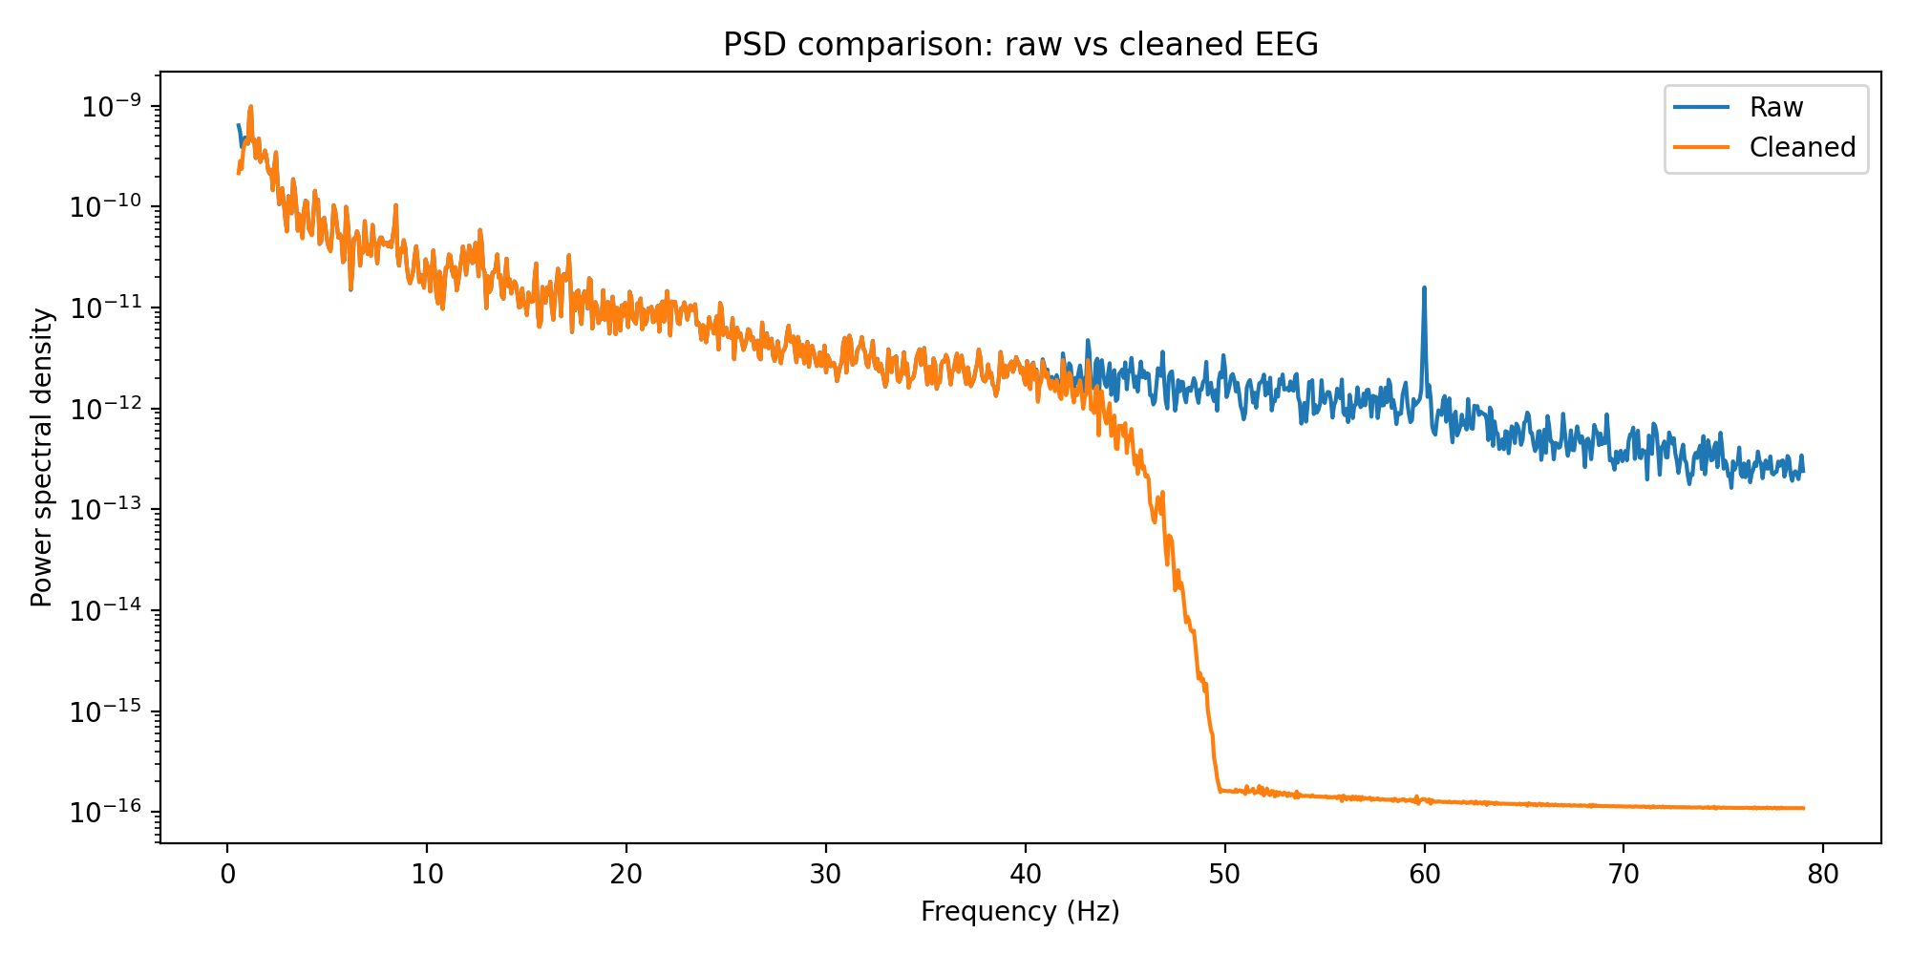
Raw vs Cleaned PSD Comparison
The cleaned spectrum shows the expected attenuation after filtering, especially around and above the high-frequency cutoff region.
LP Praktikum Informatik 1 | Implementation | 23

Slide 24
Implementation Takeaway
What was implemented
How it connects to the literature
A reusable Python/MNE preprocessing pipeline
Input handling for EEG recordings
Time-domain inspection
PSD/frequency-domain inspection
Band-pass and notch filtering
Result export for presentation and reporting
Uses filtering and PSD validation discussed across the reviewed papers
Follows the pipeline-based idea emphasized by NEAR
Keeps advanced methods such as ASR, deep learning, and SOBI–SWT as future extensions
Main conclusion: the implementation is a simple, transparent baseline pipeline for EEG noise reduction and visualization.
LP Praktikum Informatik 1 | Implementation | 24

